Slide 1
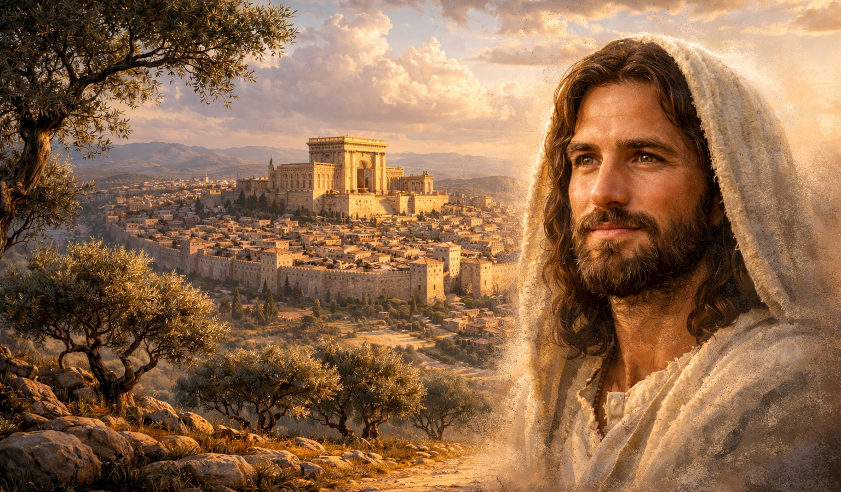
The Gospel of
Luke
Luke 2:21-38
Recognizing God’s Work
Preached by Dan Bridges Amman International Church, Jordan (AmmanChurch.org) Uploaded by Dr. Rick Griffith • Jordan Evangelical Theological Seminary Files in many languages for free download at BibleStudyDownloads.org

Slide 2
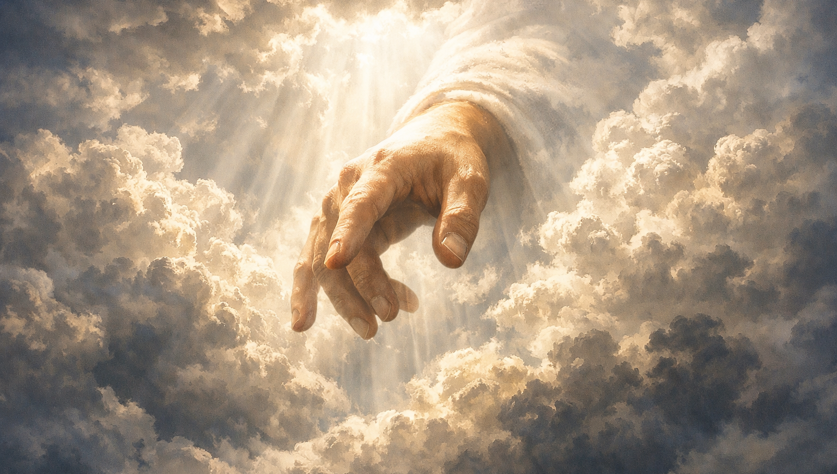
Do you believe God is working in the world today?
Is he working personally in your life?

Slide 3

Ever feel like God’s plan is not working out the way you had expected?

Slide 4
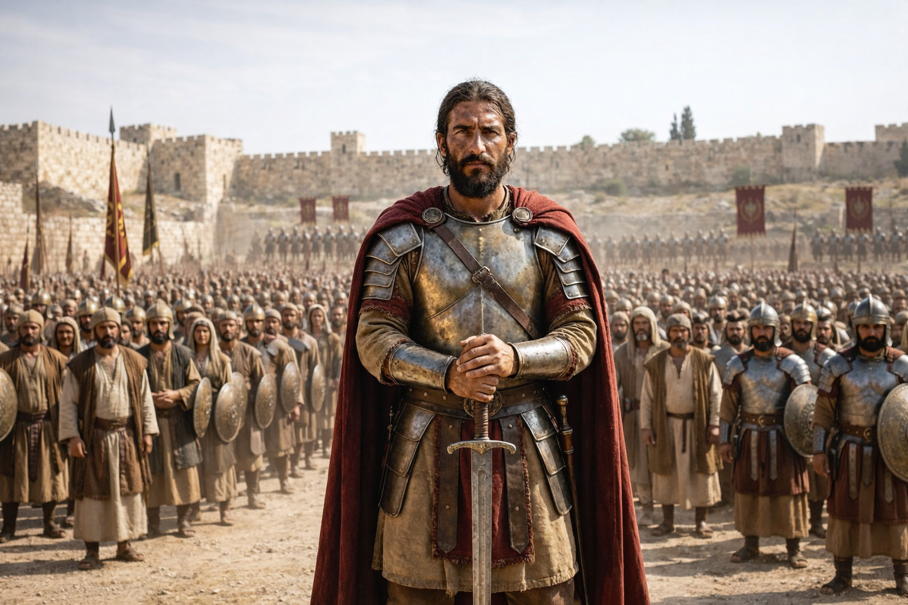
The first-century Jews were expecting a kingly Messiah to free them from Rome.

Slide 5
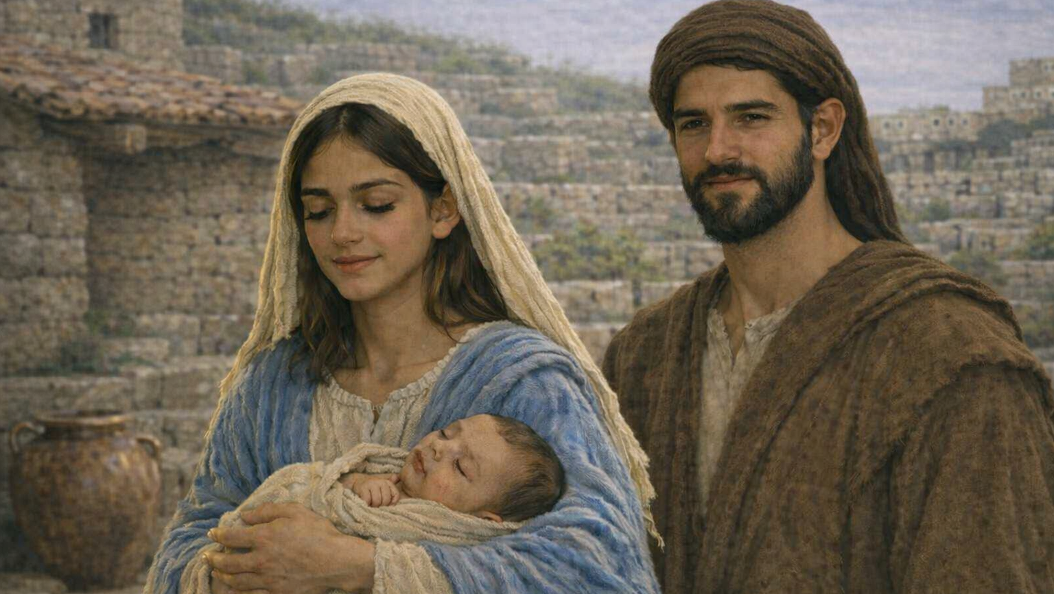
Instead, they got a baby born to a poor peasant family from Nazareth…
But some still recognized him as the Messiah!

Slide 6
How can we recognize what God is doing in our lives and around us?

Slide 7
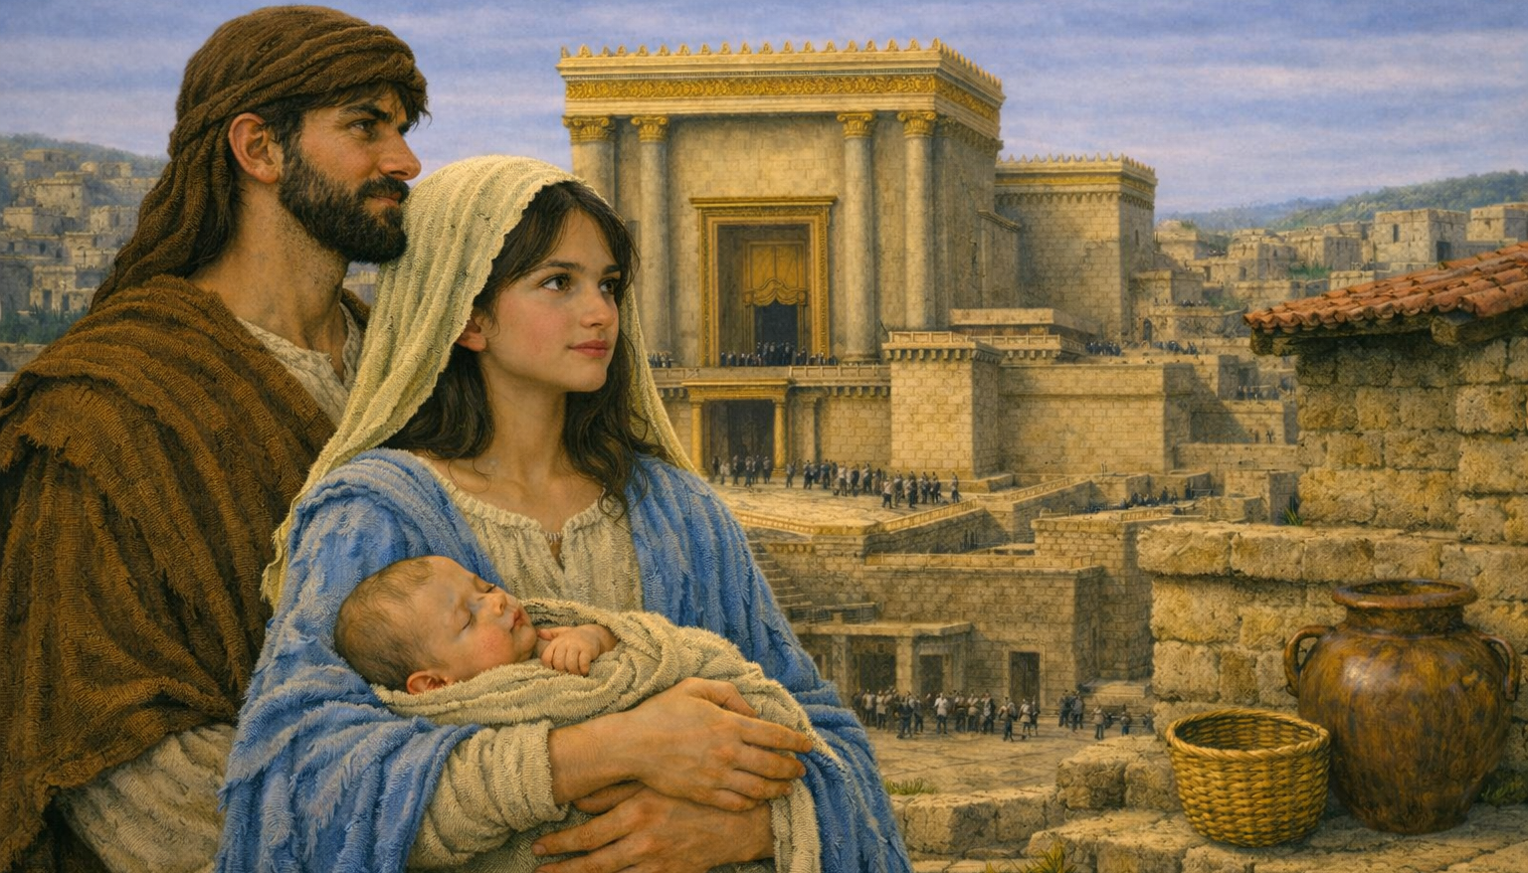
Recognizing God's Work
Understand How God Works (vss. 21-24)
Live in Informed, Expectant Faith (vss. 25-35)
Maintain a Close Relationship with God (vss. 36-38)

Slide 8
“And at the end of eight days, when he was circumcised, he was called Jesus, the name given by the angel before he was conceived in the womb.”
Luke 2:21

Slide 9
“And when the time came for their purification according to the Law of Moses, they brought him up to Jerusalem to present him to the Lord”
Luke 2:22

Slide 10
“(as it is written in the Law of the Lord, ‘Every male who first opens the womb shall be called holy to the LORD’).”
Luke 2:23

Slide 11
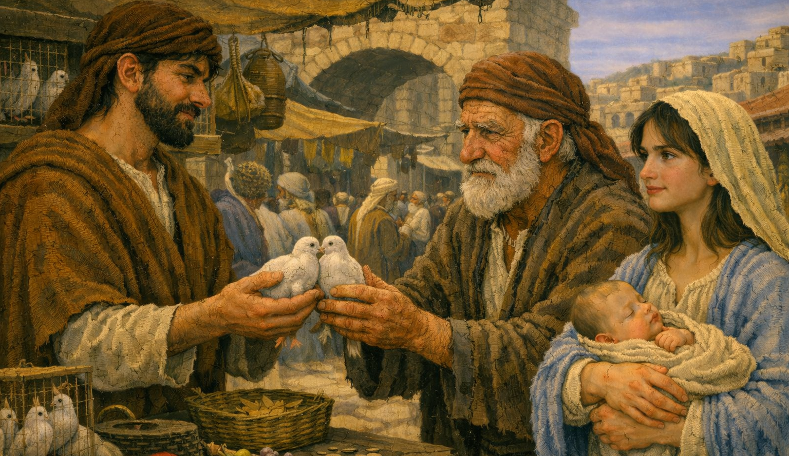
“and to offer a sacrifice according to what is said in the Law of the Lord, ‘a pair of turtledoves, or two young pigeons.’” Luke 2:24

Slide 12
Verses 21-24 describe three separate activities done to fulfill the Mosaic Law:
Circumcision
Purification
Presentation

Slide 13
“And at the end of eight days, when he was circumcised, he was called Jesus, the name given by the angel before he was conceived in the womb.”
Luke 2:21
“He who is eight days old among you shall be circumcised.”
Genesis 17:12

Slide 14
Leviticus 12 – Purification after childbirth
“And when the time came for their purification according to the Law of Moses, they brought him up to Jerusalem to present him to the Lord “(as it is written in the Law of the Lord, ‘Every male who first opens the womb shall be called holy to the LORD’) and to offer a sacrifice according to what is said in the Law of the Lord, ‘a pair of turtledoves, or two young pigeons.” Luke 2:22-24

Slide 15
Turtledove or pigeon as a sin offering
Lamb as a burnt offering or…
Turtledove or Pigeon for the poor
“And when the time came for their purification according to the Law of Moses, they brought him up to Jerusalem to present him to the Lord “(as it is written in the Law of the Lord, ‘Every male who first opens the womb shall be called holy to the LORD’) and to offer a sacrifice according to what is said in the Law of the Lord, ‘a pair of turtledoves, or two young pigeons.” Luke 2:22-24

Slide 16
Exodus 13 – Consecration of the firstborn
“And when the time came for their purification according to the Law of Moses, they brought him up to Jerusalem to present him to the Lord “(as it is written in the Law of the Lord, ‘Every male who first opens the womb shall be called holy to the LORD’) and to offer a sacrifice according to what is said in the Law of the Lord, ‘a pair of turtledoves, or two young pigeons.” Luke 2:22-24

Slide 17
Why did Luke include all these details?
“And when the time came for their purification according to the Law of Moses, they brought him up to Jerusalem to present him to the Lord “(as it is written in the Law of the Lord, ‘Every male who first opens the womb shall be called holy to the LORD’) and to offer a sacrifice according to what is said in the Law of the Lord, ‘a pair of turtledoves, or two young pigeons.” Luke 2:22-24

Slide 18
“But when the fullness of time had come, God sent forth his Son, born of woman, born under the law…”
Galatians 4:4
“And when the time came for their purification according to the Law of Moses, they brought him up to Jerusalem to present him to the Lord “(as it is written in the Law of the Lord, ‘Every male who first opens the womb shall be called holy to the LORD’) and to offer a sacrifice according to what is said in the Law of the Lord, ‘a pair of turtledoves, or two young pigeons.” Luke 2:22-24

Slide 19
Recognizing God’s Work
Jesus – the lawgiver and conquering Messiah – was coming in total humility and submission to God’s Law!
“And when the time came for their purification according to the Law of Moses, they brought him up to Jerusalem to present him to the Lord “(as it is written in the Law of the Lord, ‘Every male who first opens the womb shall be called holy to the LORD’) and to offer a sacrifice according to what is said in the Law of the Lord, ‘a pair of turtledoves, or two young pigeons.” Luke 2:22-24

Slide 20
Recognizing God’s Work
Understand How God Works:
God usually works within the systems he created.
God works through our obedience!
Notes:
Examples of how God’s works reflect his character:
God usually changes lives in small ways – not “headline news”!
God usually works through ordinary means, like other people.
God’s works promote his purposes like brokenness, righteousness and Christlike character.
Examples of basic obedience:
Commitment to regular (ideally daily) time with God
Showing up faithfully to opportunities for growth or ministry

Slide 21
Examples of how God’s works through the system he created:
God usually works through ordinary means – using people rather than miracles.
God usually uses his Word and circumstances to accomplish his work in and through us.
God’s work often seems ordinary – not flashy!
Examples of basic obedience:
Commitment to obeying the Bible
Commitment to regular (ideally daily) time with God
Showing up faithfully to opportunities for growth or ministry

Slide 22
Recognizing God's Work
Understand How God Works (vss. 21-24)
Live in Informed, Expectant Faith (vss. 25-35)
Maintain a Close Relationship with God (vss. 36-38)

Slide 23
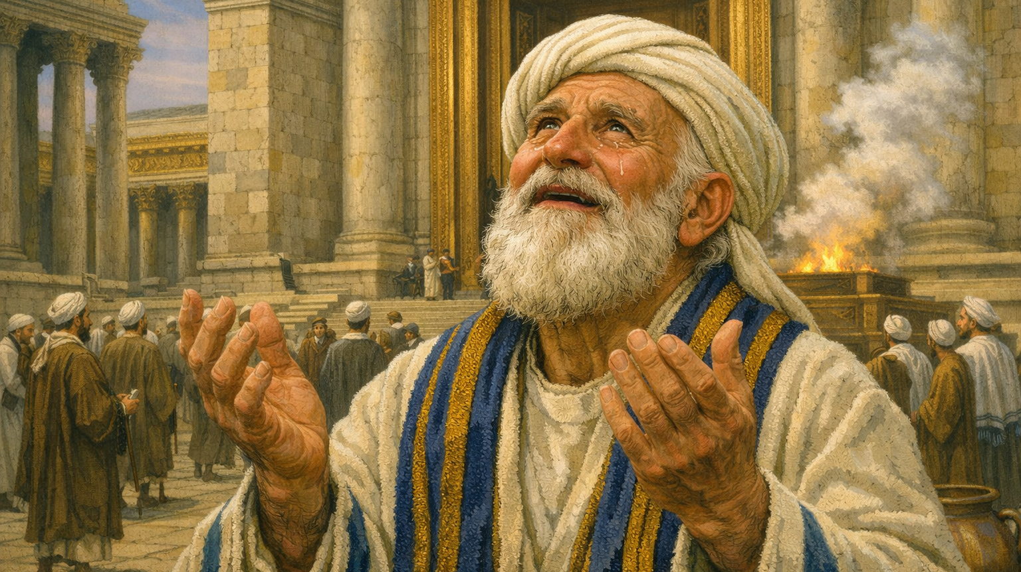
“Now there was a man in Jerusalem, whose name was Simeon, and this man was righteous and devout, waiting for the consolation of Israel, and the Holy Spirit was upon him.”
Luke 2:25

Slide 24
“And it had been revealed to him by the Holy Spirit that he would not see death before he had seen the Lord's Christ.”
Luke 2:26

Slide 25
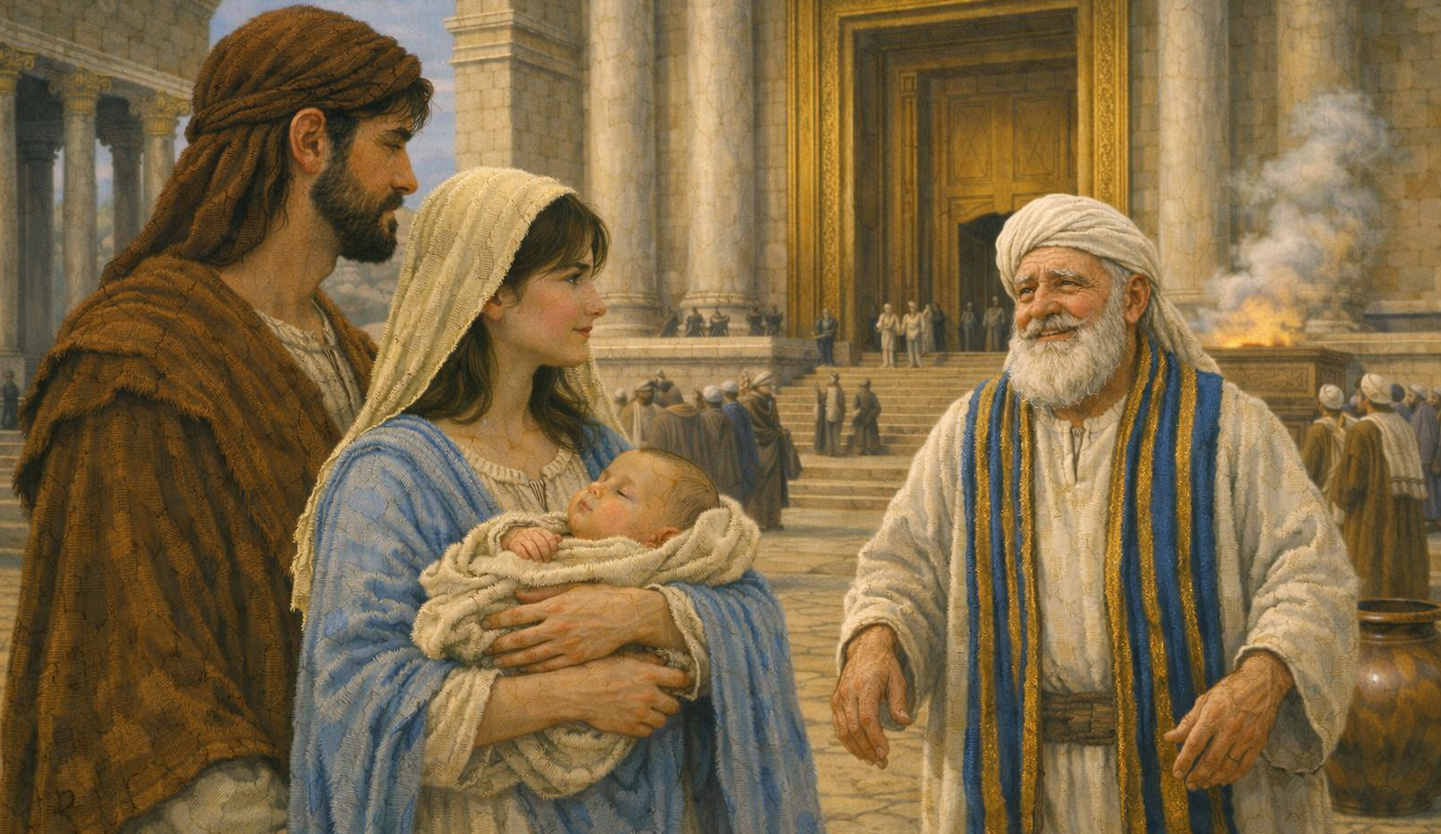
“And he came in the Spirit into the temple, and when the parents brought in the child Jesus, to do for him according to the custom of the Law,” Luke 2:27

Slide 26
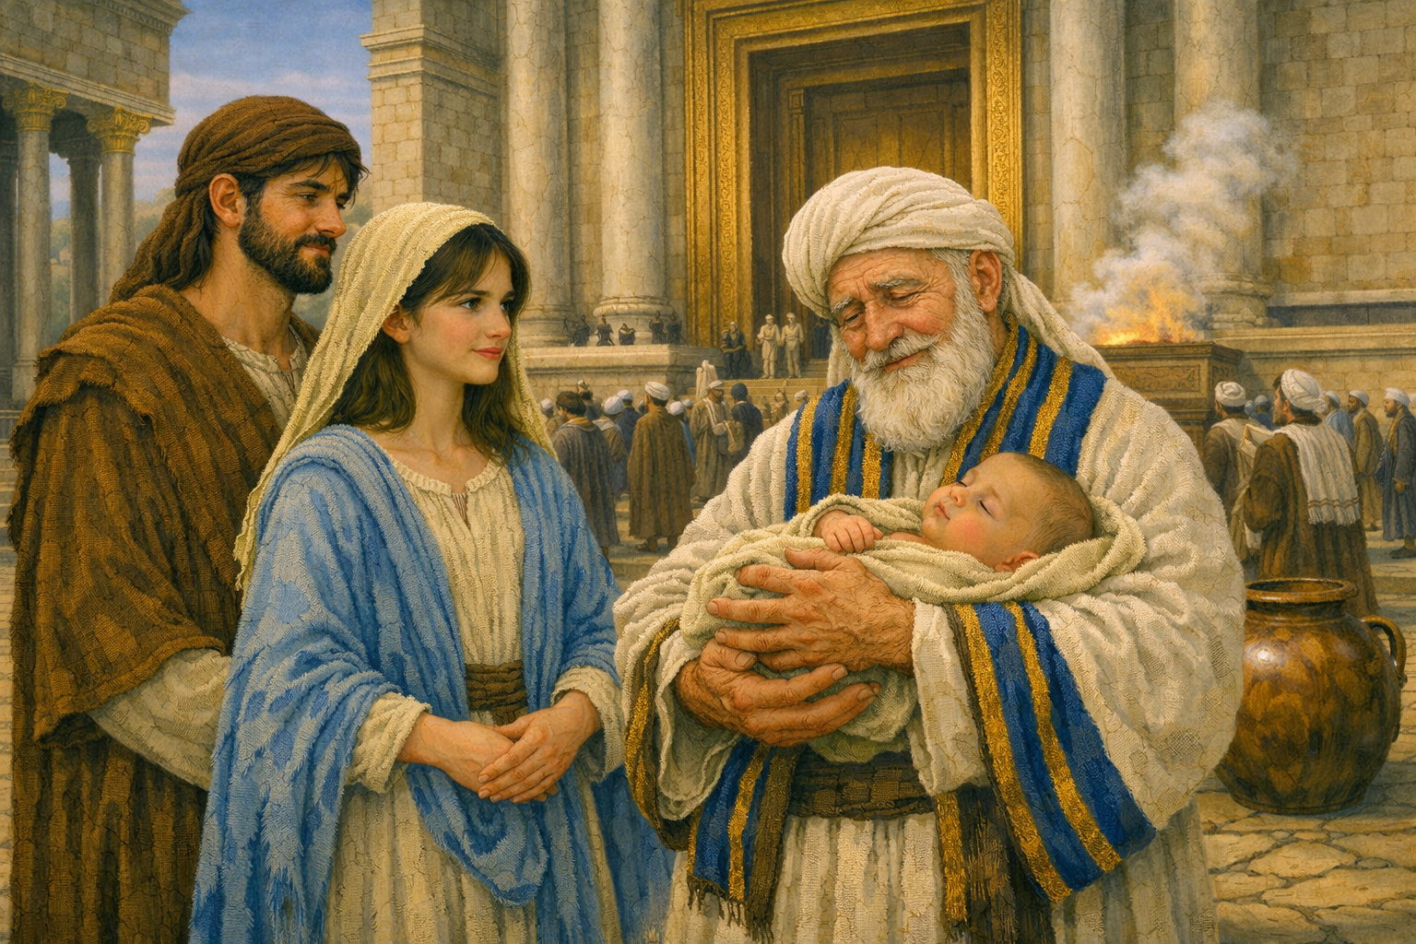
“he took him up in his arms and blessed God and said,
‘Lord, now you are letting your servant depart in peace,
according to your word;’” Luke 2:28-29

Slide 27
“‘for my eyes have seen your salvation
that you have prepared in the presence of all peoples,
a light for revelation to the Gentiles,
and for glory to your people Israel.’” Luke 2:30-32

Slide 28
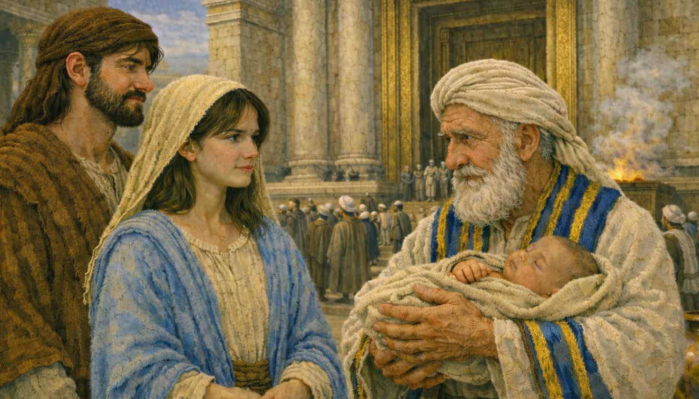
“And his father and his mother marveled at what was said about him. And Simeon blessed them and said to Mary his mother” Luke 2:33-34a

Slide 29
“‘Behold, this child is appointed for the fall and rising of many in Israel, and for a sign that is opposed (and a sword will pierce through your own soul also), so that thoughts from many hearts may be revealed.’” Luke 2:34b-35

Slide 30
Why does Luke focus on Simeon’s character?
To help us see why Simeon recognized the Messiah
To establish Simeon as a reliable witness to Jesus’ role and identity!
“Now there was a man in Jerusalem, whose name was Simeon, and this man was righteous and devout, waiting for the consolation of Israel, and the Holy Spirit was upon him. And it had been revealed to him by the Holy Spirit that he would not see death before he had seen the Lord's Christ.”
Luke 2:25-26

Slide 31
“And he came in the Spirit into the temple, and when the parents brought in the child Jesus, to do for him according to the custom of the Law,” Luke 2:27

Slide 32
The waiting was over!
Simeon looked at a 40 day-old baby,
born to a poor family from Nazareth,
and through the eyes of faith saw God’s Messiah!
“he took him up in his arms and blessed God and said,
‘Lord, now you are letting your servant depart in peace,
according to your word; for my eyes have seen your salvation that you have prepared in the presence of all peoples, a light for revelation to the Gentiles, and for glory to your people Israel.’” Luke 2:28-32

Slide 33
Why was Simeon able to recognize the Messiah?
Simeon was very familiar with the Old Testament.
Simeon’s words reflect much from Isaiah 40-66!
“he took him up in his arms and blessed God and said,
‘Lord, now you are letting your servant depart in peace,
according to your word; for my eyes have seen your salvation that you have prepared in the presence of all peoples, a light for revelation to the Gentiles, and for glory to your people Israel.’” Luke 2:28-32

Slide 34
“I will make you as a light for the nations,
that my salvation may reach to the end of the earth.”
Isaiah 49:6
“he took him up in his arms and blessed God and said,
‘Lord, now you are letting your servant depart in peace,
according to your word; for my eyes have seen your salvation that you have prepared in the presence of all peoples, a light for revelation to the Gentiles, and for glory to your people Israel.’” Luke 2:28-32

Slide 35
“The Lord has bared his holy arm
before the eyes of all the nations,
and all the ends of the earth shall see
the salvation of our God.”
Isaiah 52:10
“he took him up in his arms and blessed God and said,
‘Lord, now you are letting your servant depart in peace,
according to your word; for my eyes have seen your salvation that you have prepared in the presence of all peoples, a light for revelation to the Gentiles, and for glory to your people Israel.’” Luke 2:28-32

Slide 36
“And Simeon blessed them and said to Mary his mother, ‘Behold, this child is appointed for the fall and rising of many in Israel, and for a sign that is opposed (and a sword will pierce through your own soul also), so that thoughts from many hearts may be revealed.’” Luke 2:33-35

Slide 37
Jesus was coming to be a savior – why would he be opposed?
Behold, this child is appointed for
the fall and rising of many in Israel
and a sign that is opposed
so that thoughts from many hearts may be revealed.

Slide 38
What picture of a Messiah does this give?
Visible, public event
Dramatic political victory!
This is the Messiah people expected!
“The Lord has bared his holy arm
before the eyes of all the nations,
and all the ends of the earth shall see
the salvation of our God.”
Isaiah 52:10

Slide 39
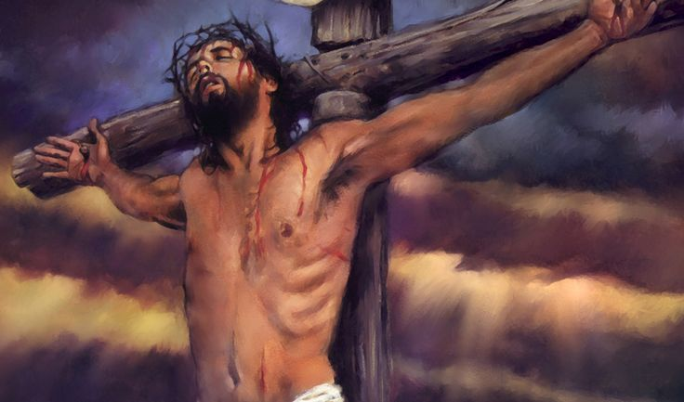
But then Isaiah goes right into Isaiah 53!
“He was despised and rejected by men,
a man of sorrows and acquainted with grief;
and as one from whom men hide their faces
he was despised, and we esteemed him not.”
Isaiah 53:3

Slide 40
But then Isaiah goes right into Isaiah 53!
“But he was pierced for our transgressions;
he was crushed for our iniquities;
upon him was the chastisement that brought us peace,
and with his wounds we are healed.”
Isaiah 53:5

Slide 41
Simeon was informed – he knew the nature of the coming Messiah!
The coming salvation was from sin – not from political enemies like the Romans.
The nature of this salvation was to be through suffering and death – not through military victory.
Not everyone would want this type of salvation.

Slide 42
Recognizing God’s Work
Simeon recognized Jesus as the Messiah because he
Was informed – he knew what God had promised. He understood what sort of Messiah they should expect.
Lived in expectant faith – waiting for the Messiah.
Behold, this child is appointed for
the fall and rising of many in Israel
and a sign that is opposed
so that thoughts from many hearts may be revealed.

Slide 43
How can we too live in informed, expectant faith?
Understand God’s promises of what he is going to do.
He has promised to develop our character.
He has promised us discipline and suffering.
He has promised to bring people from all nations to faith.
He has promised to come again.
Expect God to do what he has promised.
See suffering as God’s discipline and path to growth.
Expect God to use us in the lives of others.
Live in expectation of the second coming.

Slide 44
Recognizing God's Work
Understand How God Works (vss. 21-24)
Live in Informed, Expectant Faith (vss. 25-35)
Maintain a Close Relationship with God (vss. 36-38)

Slide 45
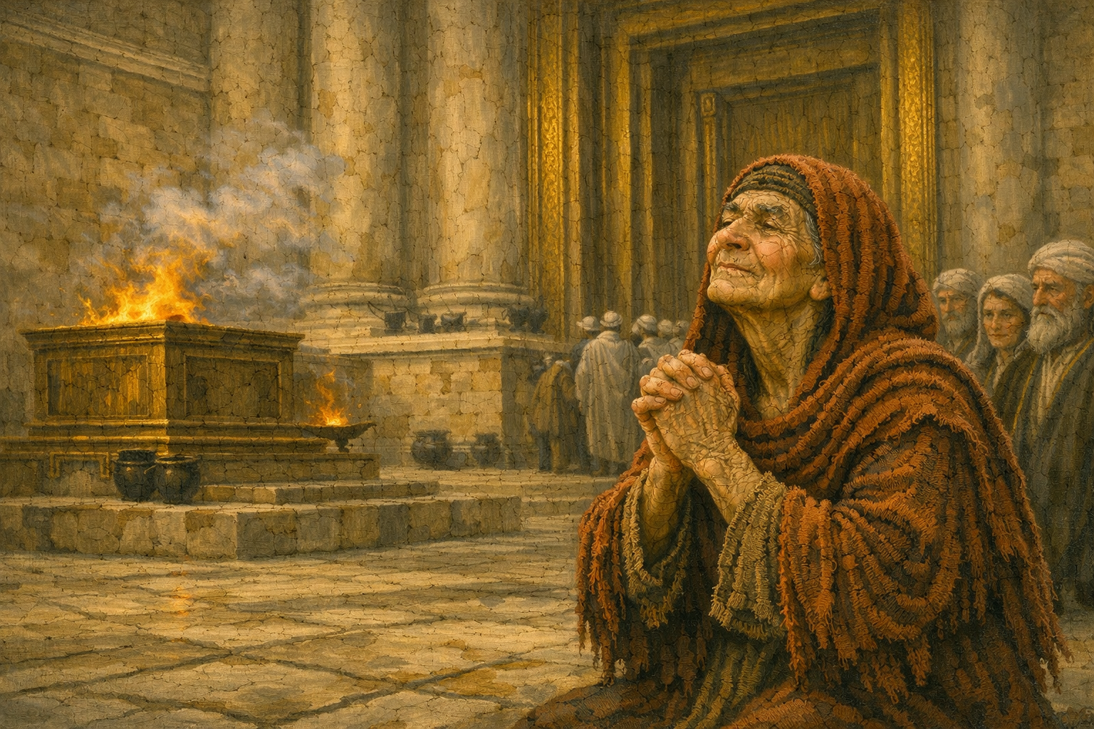
“And there was a prophetess, Anna, the daughter of Phanuel, of the tribe of Asher. She was advanced in years, having lived with her husband seven years from when she was a virgin, and then as a widow until she was eighty-four. She did not depart from the temple, worshiping with fasting and prayer night and day.” Luke 2:36-37

Slide 46
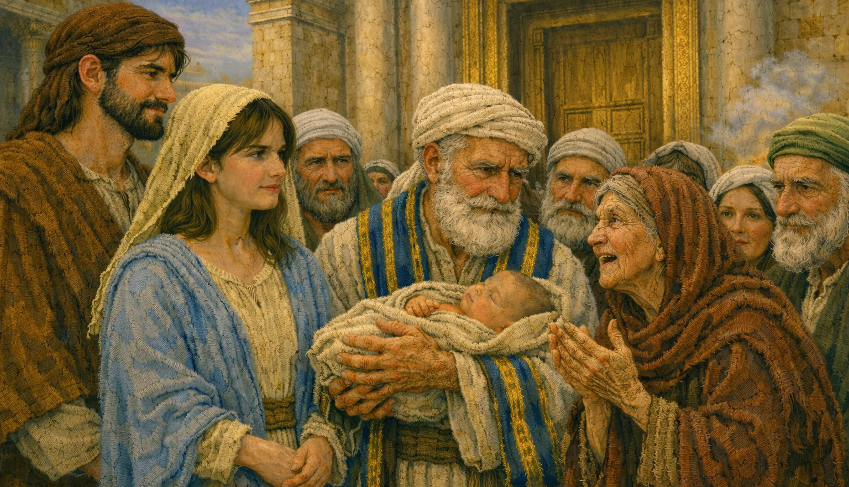
“‘And coming up at that very hour she began to give thanks to God and to speak of him to all who were waiting for the redemption of Jerusalem.’” Luke 2:38

Slide 47
“And there was a prophetess, Anna, the daughter of Phanuel, of the tribe of Asher. She was advanced in years, having lived with her husband seven years from when she was a virgin, and then as a widow until she was eighty-four. She did not depart from the temple, worshiping with fasting and prayer night and day.” Luke 2:36-37
Again, why does Luke focus on Anna’s character?
To help us see why Anna recognized the Messiah
To establish Anna as a reliable witness to Jesus’ role and identity!

Slide 48
She began to speak of Jesus – how he was the redeemer of Israel!
“‘And coming up at that very hour she began to give thanks to God and to speak of him to all who were waiting for the redemption of Jerusalem.’” Luke 2:38

Slide 49
Recognizing God’s Work
The redeemer of Jerusalem – born as a nobody in a poor family!
“‘And coming up at that very hour she began to give thanks to God and to speak of him to all who were waiting for the redemption of Jerusalem.’” Luke 2:38

Slide 50
Recognizing God’s Work
Why was Anna able to recognize the Messiah?
Anna maintained a life of worship.
Anna focused on things (like prayer and fasting) that were on God’s heart.
“‘And coming up at that very hour she began to give thanks to God and to speak of him to all who were waiting for the redemption of Jerusalem.’” Luke 2:38

Slide 51
Recognizing God's Work
Understand How God Works (vss. 21-24)
Live in Informed, Expectant Faith (vss. 25-35)
Maintain a Close Relationship with God (vss. 36-38)

Slide 52
Why were Simeon and Anna not surprised by the way God was working out his plan?

Slide 53
They were committed to the “little things”:
Familiarity with God’s Word
Obedience to God’s Word
Lifestyle of worship
Commitment to what God values
Led by the Spirit
Expecting God to do what he has promised

Slide 54
Sermon by Dan Bridges
Amman International Church (AIC)
Amman, Jordan
This and most other AIC sermons can be found on the church website:
ammanchurch.org

Slide 55
Black

Slide 56


NT Preaching link at BibleStudyDownloads.org
Get this presentation and script for free!
Notes:
NT Preaching (np)

