Slide 1
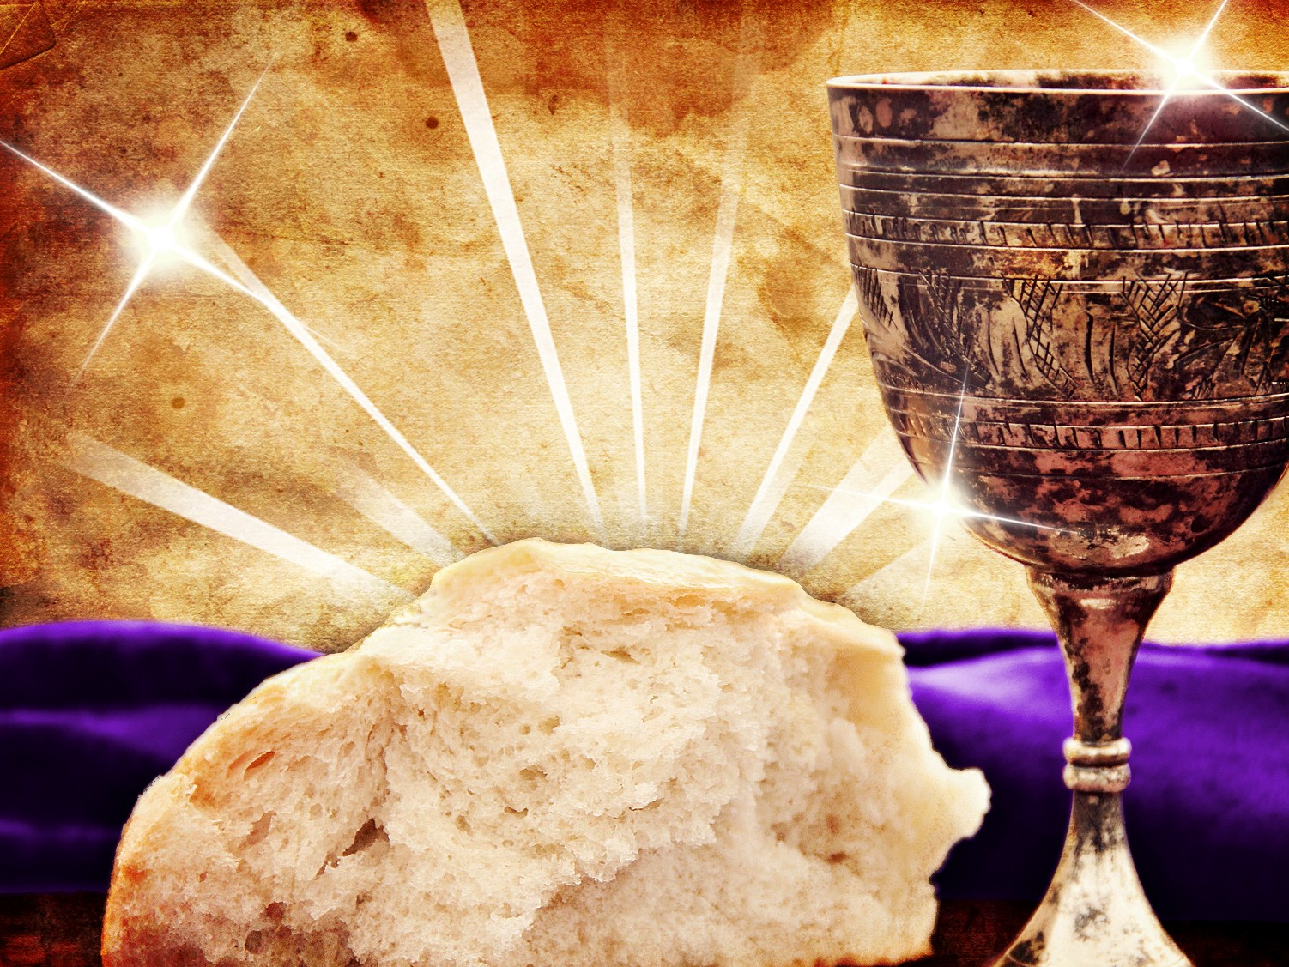
The Passover Meal
Luke 22:7-20
Dr. Rick Griffith • Crossroads International Church Singapore
CICFamily.com & BibleStudyDownloads.org
Notes:
1

Slide 2
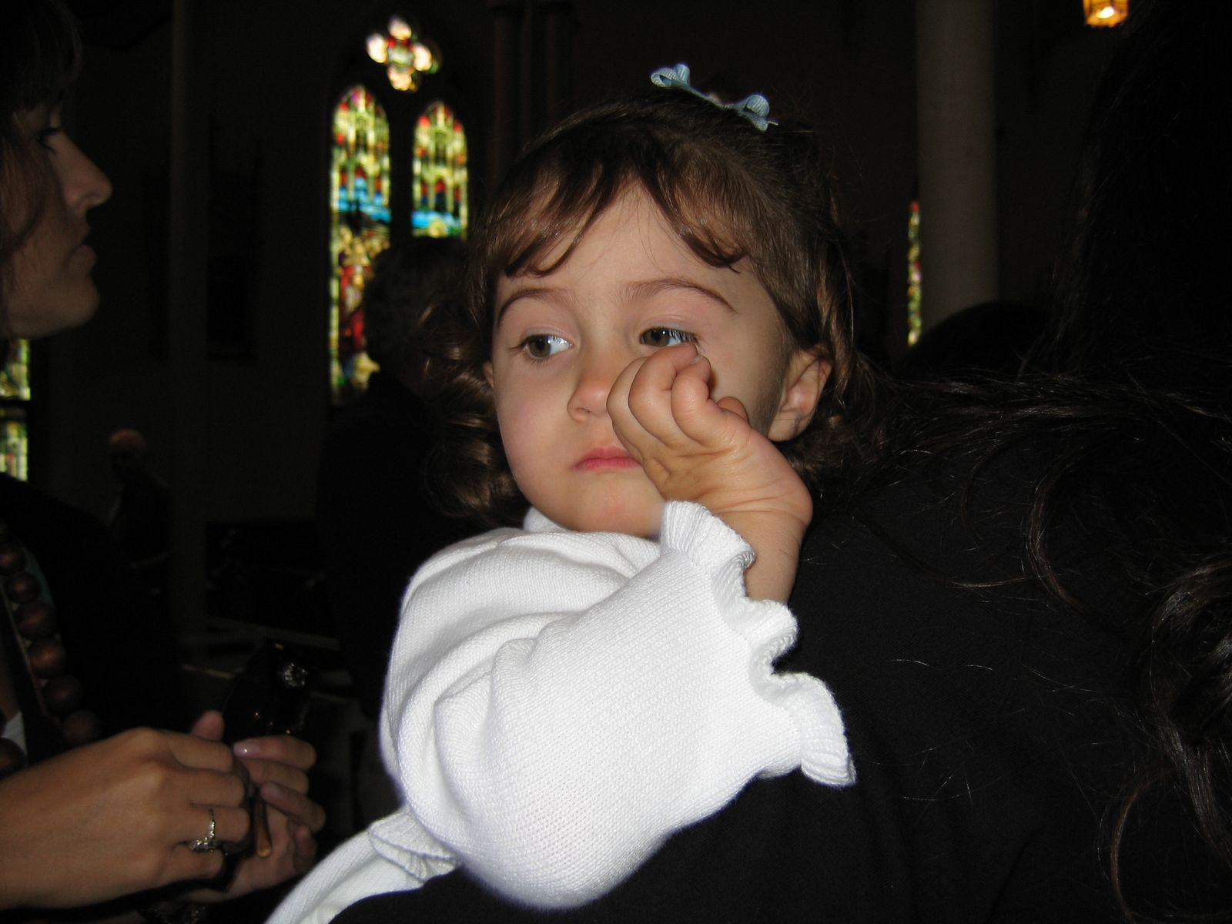
Sarah went to Big Church…

Slide 3
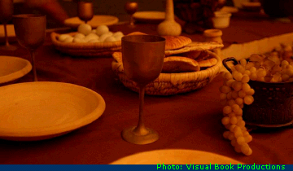
“Do this to remember me”
????
Notes:
3

Slide 4
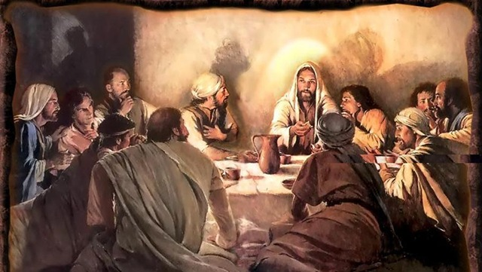
Luke 22:7-13
The Passover Setting
Notes:
4

Slide 5
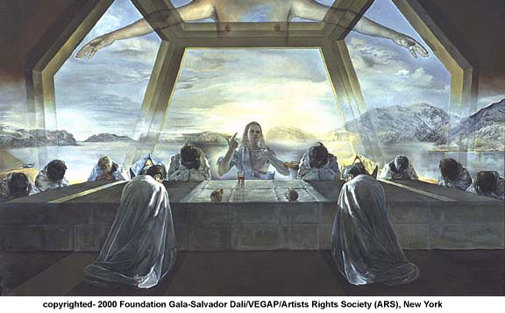
Why did Jesus give us the Lord's Supper?
Notes:
5

Slide 6
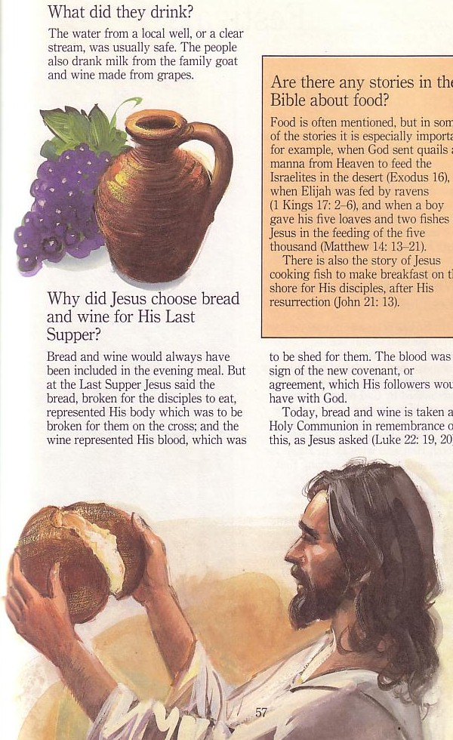
Passover & the Lord's Supper
Four Comparisons

Slide 7
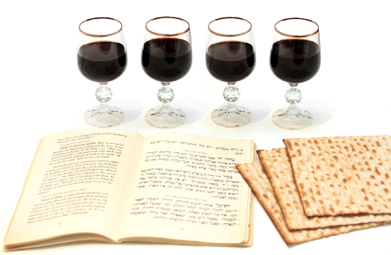
4 cups and matzoth
Notes:
7

Slide 8

I. Look forward to Christ's return (14-16).
The Four Directions
forward

Slide 9
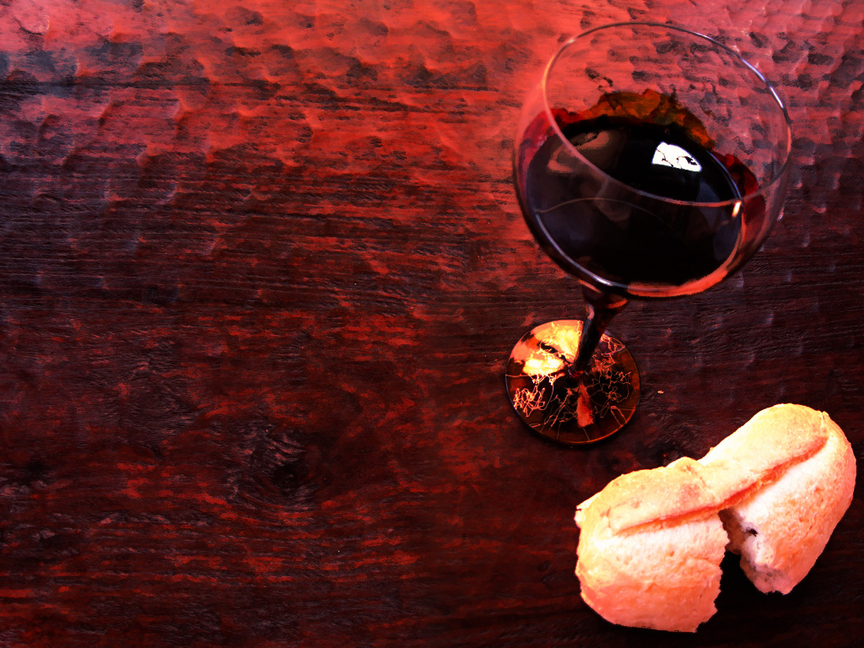
1 Corinthians 11:26 (NLT)
²⁶For whenever you eat this bread and drink this cup, you proclaim the Lord's death until he comes.
Notes:
9

Slide 10
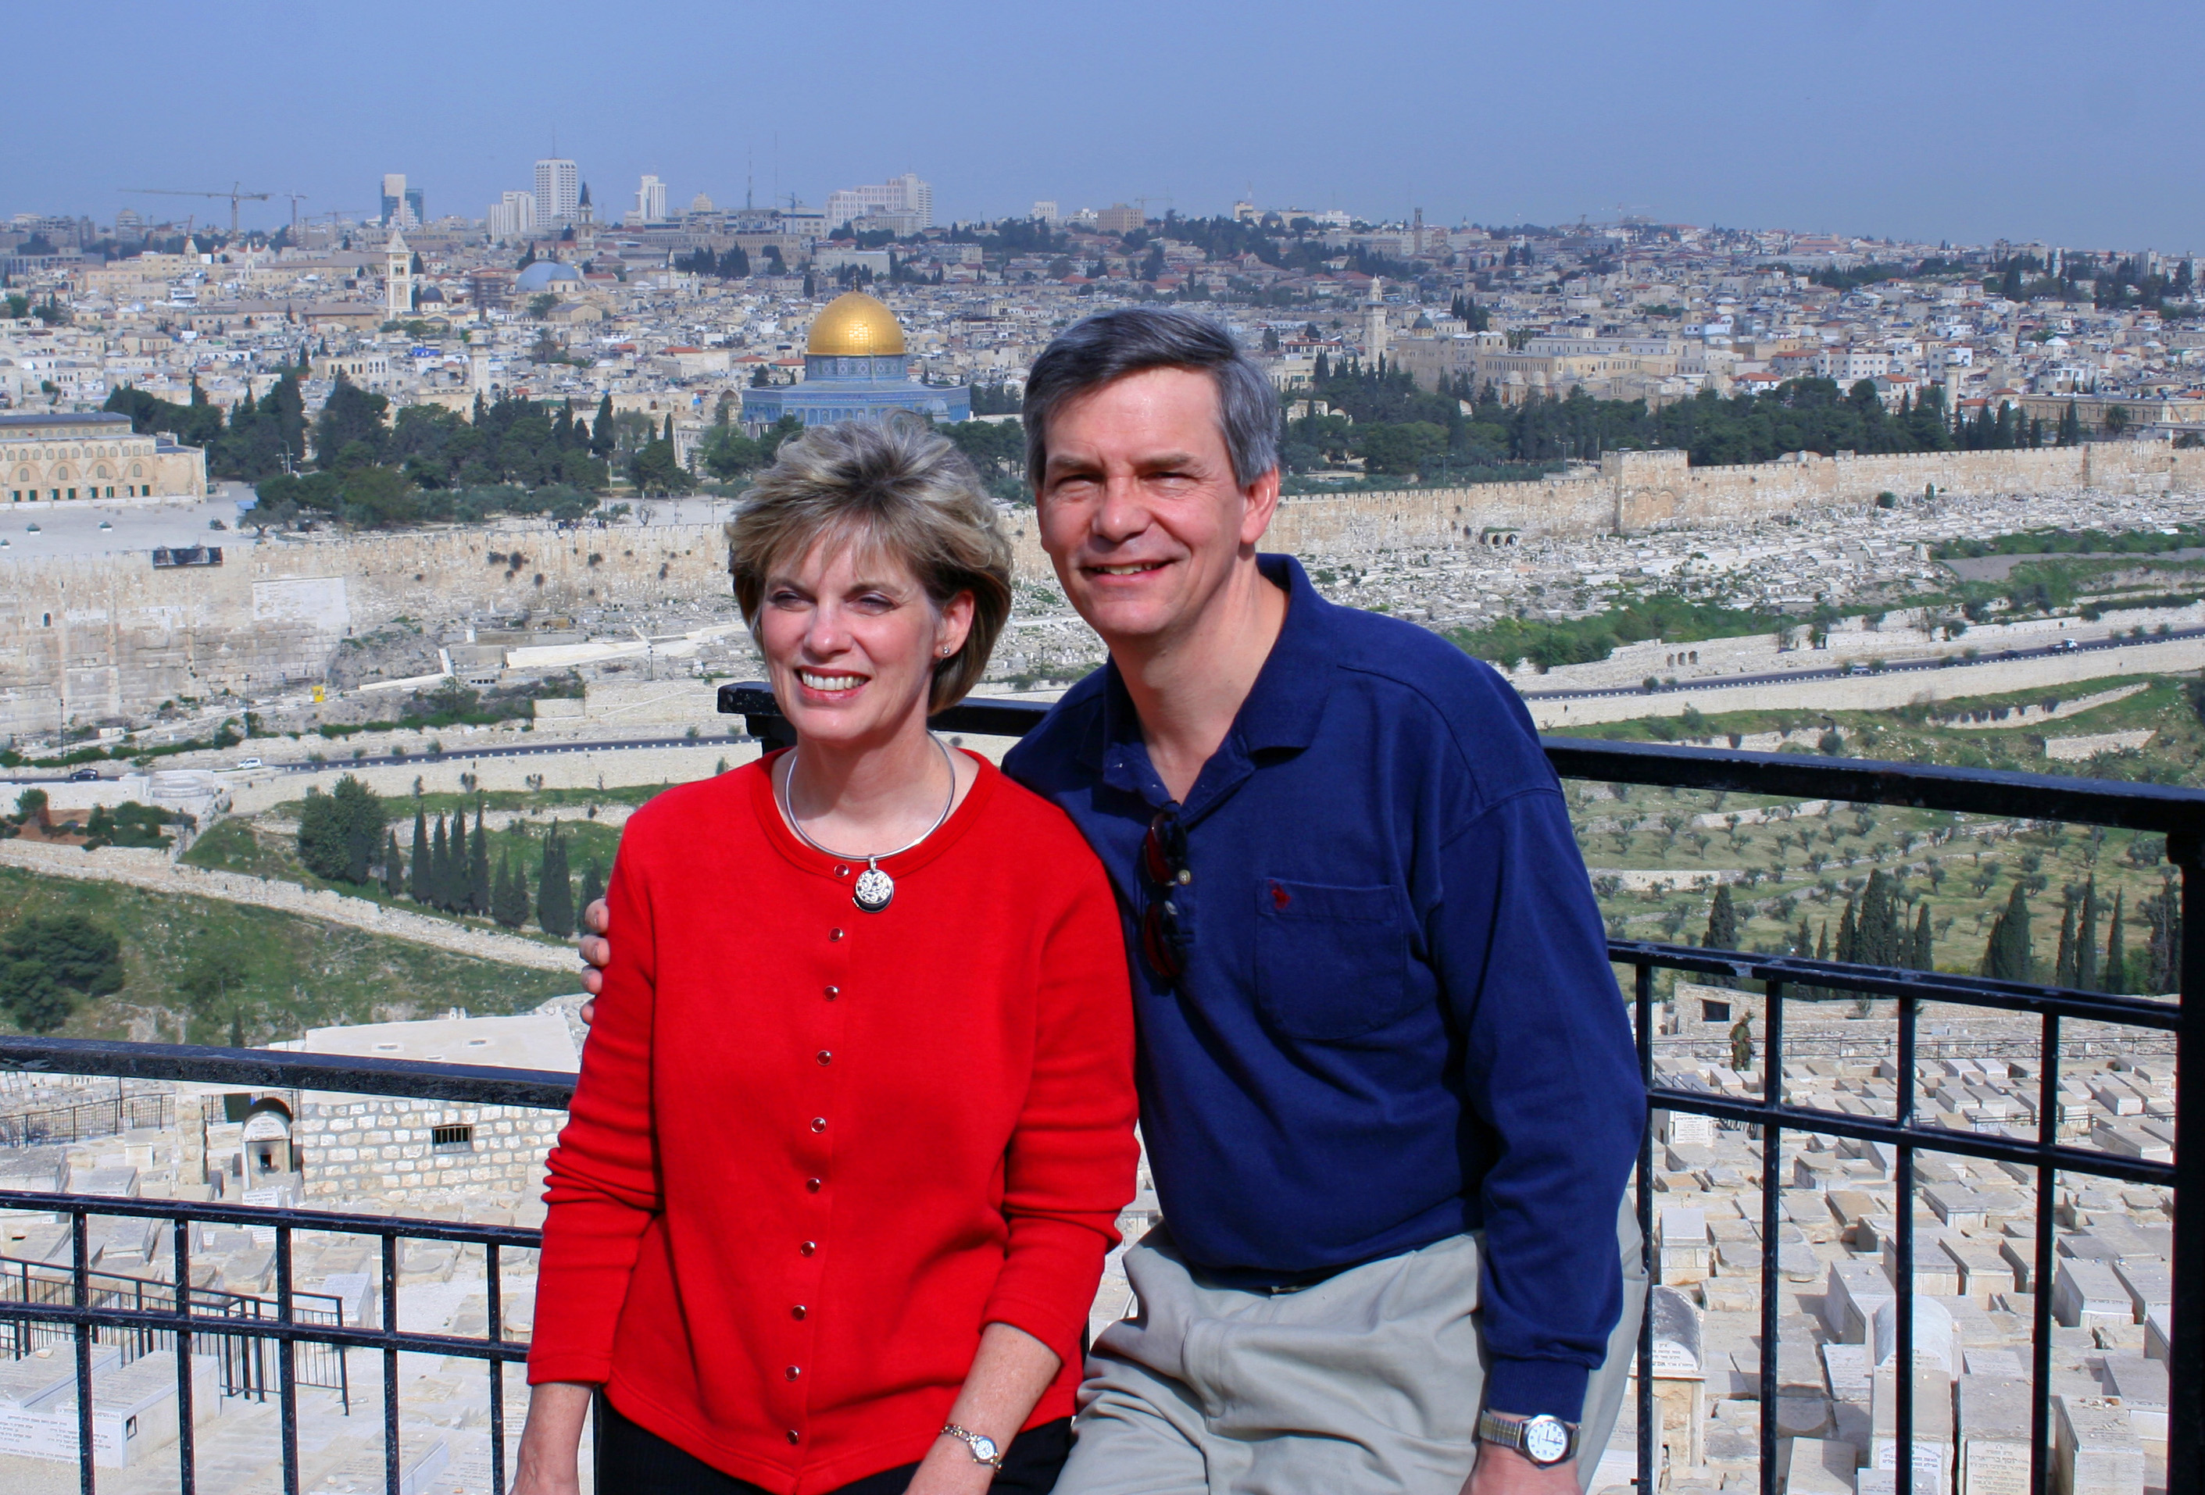
“This year we are here.
Next year in Jerusalem!”

Slide 11
I. Look forward to Christ's return (14-16).
The Four Directions
forward

Slide 12
II. Look outward at your relationships with other believers (17-18).
The Four Directions
outward
forward

Slide 13
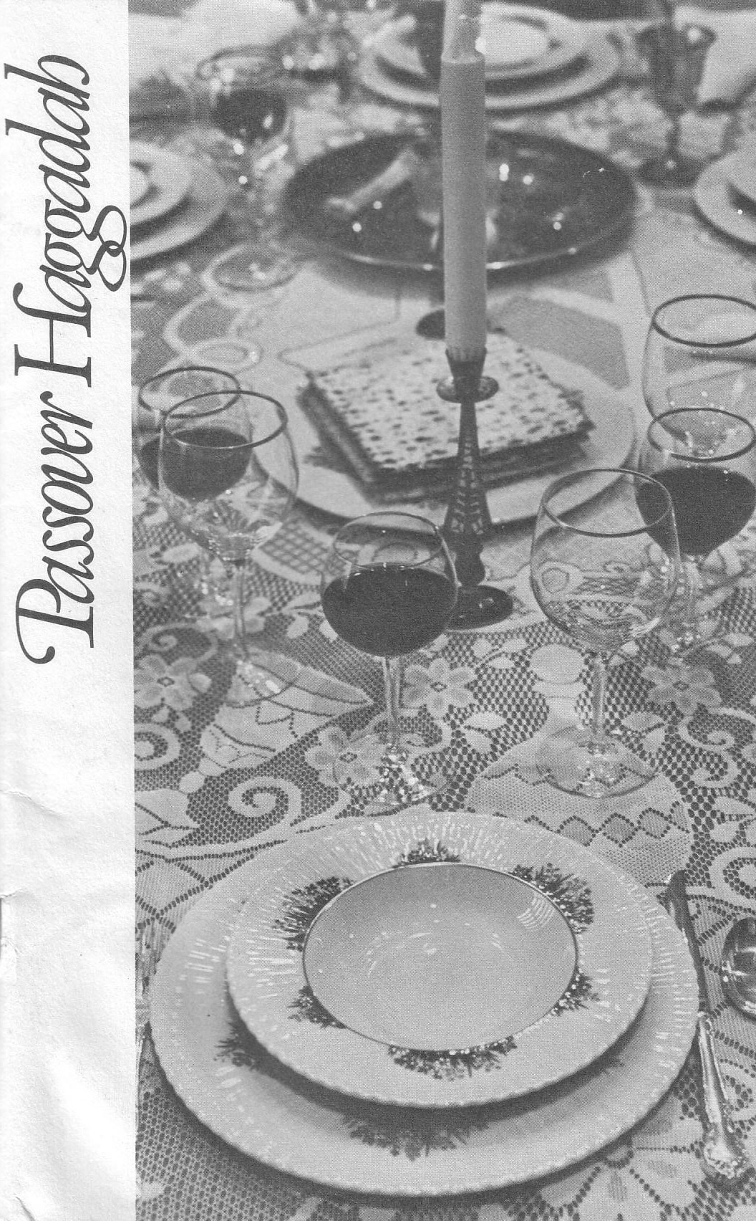
The Four Cups (Exod. 6:6-7)
Blessing
Plagues
Redemption
Praise

Slide 14
1 Corinthians 11:17-19 (NLT)
But in the following instructions, I cannot praise you. For it sounds as if more harm than good is done when you meet together. ¹⁸First, I hear that there are divisions among you when you meet as a church, and to some extent I believe it. ¹⁹But, of course, there must be divisions among you so that you who have God’s approval will be recognized!
Notes:
14

Slide 15
1 Corinthians 11:20-22 (NLT)
When you meet together, you are not really interested in the Lord’s Supper. ²¹For some of you hurry to eat your own meal without sharing with others. As a result, some go hungry while others get drunk. ²²What? Don’t you have your own homes for eating and drinking? Or do you really want to disgrace God’s church and shame the poor? What am I supposed to say? Do you want me to praise you? Well, I certainly will not praise you for this!
Notes:
15

Slide 16
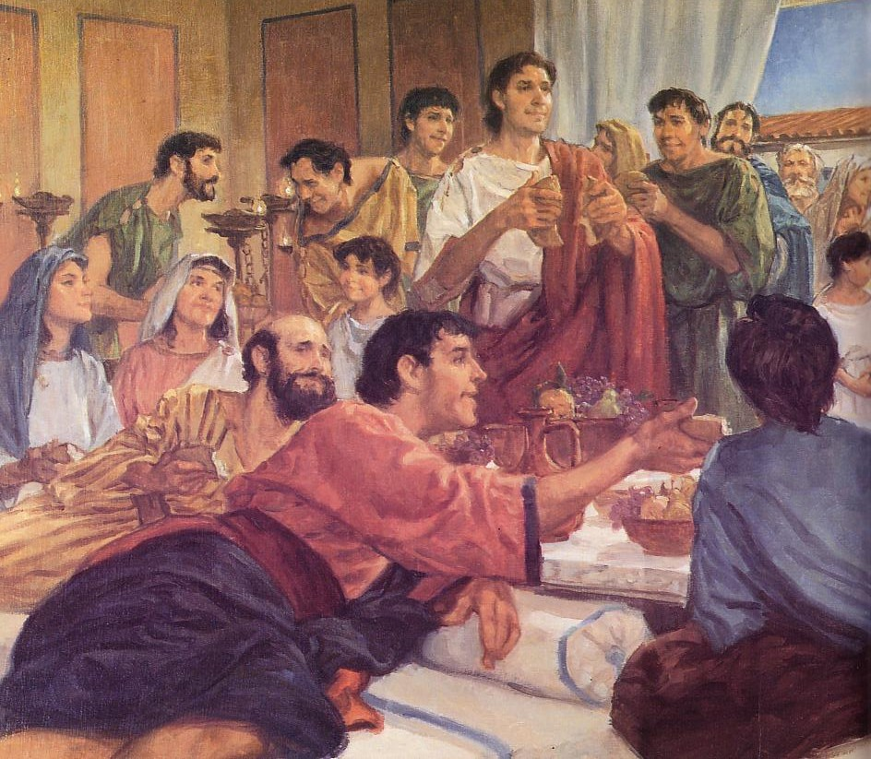
The Agape (Love) Feast

Slide 17
Black

Slide 18
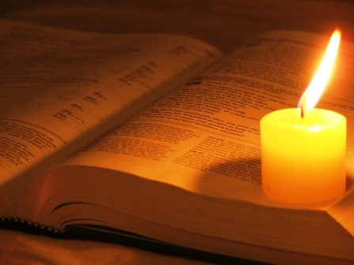
1 Cor. 10:15-18 (NLT)
¹⁵You are reasonable people. Decide for yourselves if what I am saying is true. ¹⁶When we bless the cup at the Lord's Table, aren't we sharing in the blood of Christ? And when we break the bread, aren't we sharing in the body of Christ? ¹⁷And though we are many, we all eat from one loaf of bread, showing that we are one body. ¹⁸Think about the people of Israel. Weren't they united by eating the sacrifices at the altar?

Slide 19
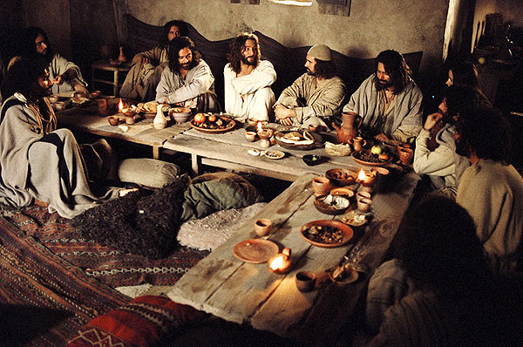
The Passover "Family"
Notes:
19

Slide 20
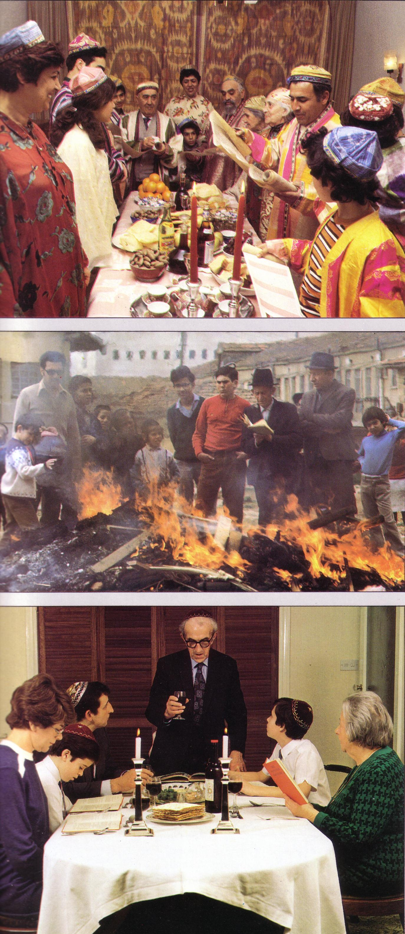
Modern Passover

Slide 21
Black

Slide 22
Matthew 5:23-24
?
"Therefore if you are presenting your offering at the altar, and there remember that your brother has something against you, leave your offering there before the altar and go; first be reconciled to your brother, and then come and present your offering.”

Slide 23
Black

Slide 24
I. Look forward to Christ's return (14-16).
The Four Directions
forward

Slide 25
II. Look outward at your relationships with other believers (17-18).
The Four Directions
outward
forward

Slide 26
III. Look inward to confess all sin (19)
The Four Directions
outward
forward
inward

Slide 27
1 Corinthians 11:27-29 (NLT)
²⁷Therefore, whoever eats the bread or drinks the cup of the Lord in an unworthy manner will be guilty of sinning against the body and blood of the Lord. ²⁸A man ought to examine himself before he eats of the bread and drinks of the cup. ²⁹For anyone who eats and drinks without recognizing the body of the Lord eats and drinks judgment on himself.
Notes:
27

Slide 28
1 Corinthians 11:30-32 (NLT)
³⁰ That is why many among you are weak and sick, and a number of you have fallen asleep. ³¹But if we judged ourselves, we would not come under judgment. ³²When we are judged by the Lord, we are being disciplined so that we will not be condemned with the world.
Notes:
28

Slide 29
1 Corinthians 11:33-34 (NLT)
³³So then, my brothers, when you come together to eat, wait for each other. ³⁴If anyone is hungry, he should eat at home, so that when you meet together it may not result in judgment. And when I come I will give further directions.
Notes:
29

Slide 30
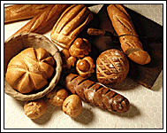

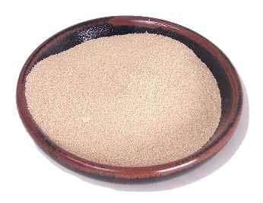

Feast of Unleavened Bread
Notes:
www.stephenwilliamson.com/ Hobbies/bakin.htm (Yeast bloom)

Slide 31
“Burn All the Yeast!”

Slide 32
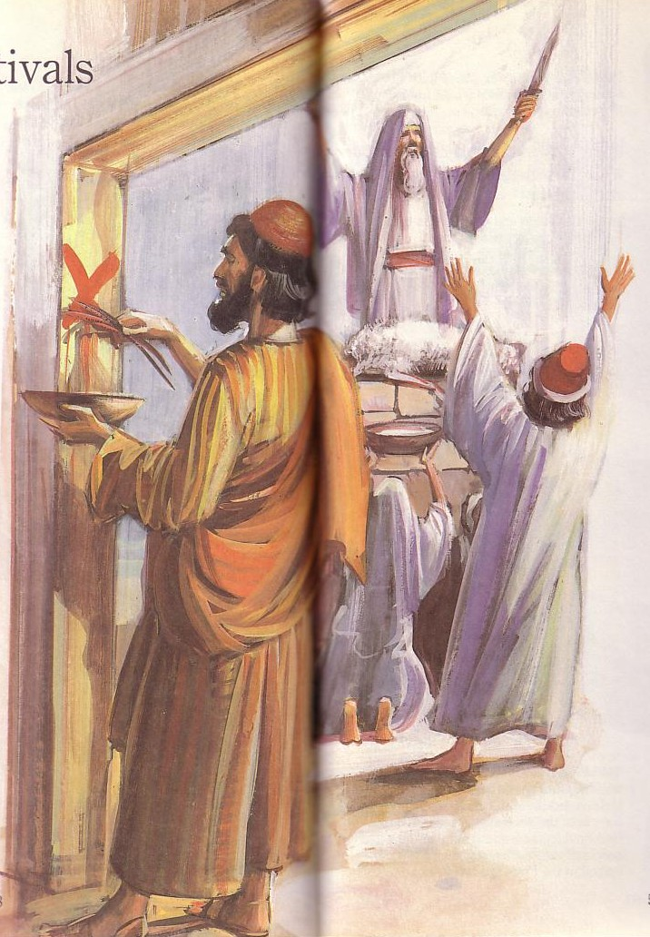
Passover's Past Significance

Slide 33
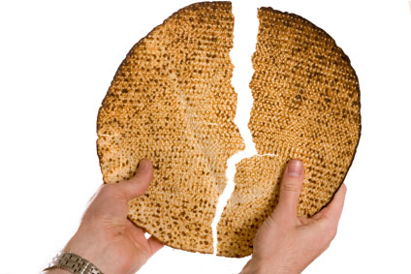
"This is the bread of affliction…"
Notes:
33

Slide 34
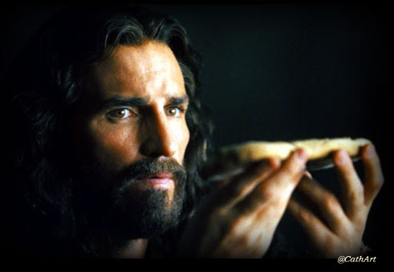
"This is my body…"
Notes:
34

Slide 35
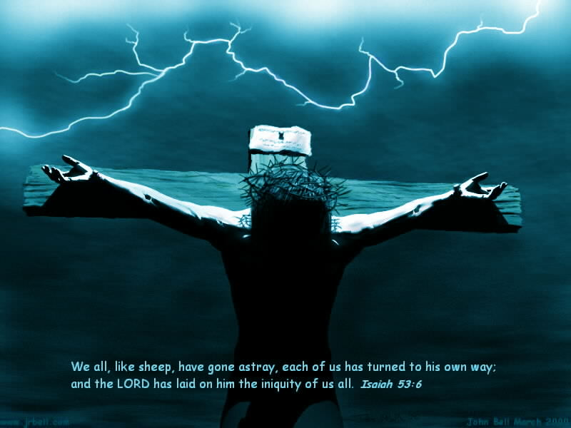
“This is my body, which is for you…”
Notes:
35

Slide 36
Black

Slide 37

Think!
inward

Slide 38
IV. Look back at Christ's death for you (20).
The Four Directions
outward
back
forward
inward

Slide 39
1 Corinthians 11:23-25
²³For I received from the Lord what I also passed on to you: The Lord Jesus, on the night he was betrayed, took bread, ²⁴and when he had given thanks, he broke it and said, "This is my body, which is for you; do this in remembrance of me." ²⁵In the same way, after supper he took the cup, saying, "This cup is the new covenant in my blood; do this, whenever you drink it, in remembrance of me."
Notes:
39

Slide 40
The Four Cups (Exod. 6:6-7)
Blessing
Plagues
Redemption
Praise

Slide 41
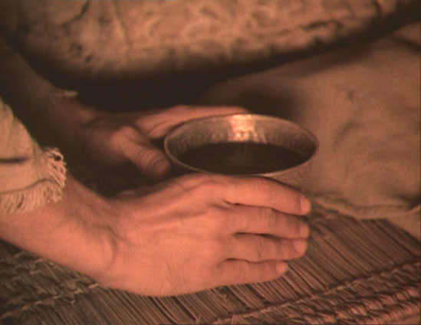
“I will redeem you with an outstretched arm…”
Notes:
41

Slide 42
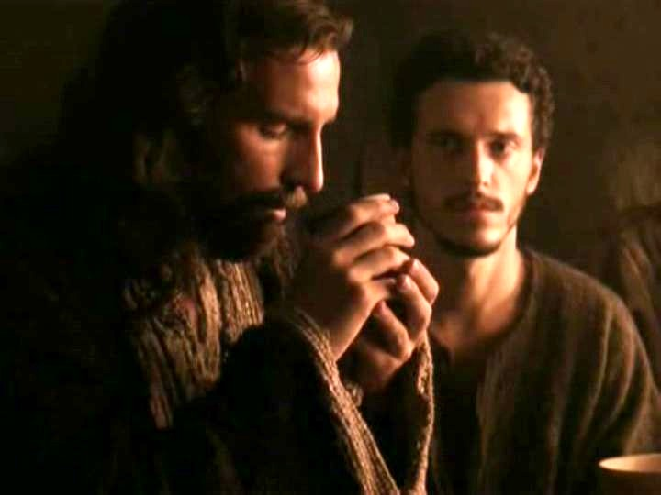
“This cup is the new covenant in my blood” (Jer. 31:31-34)
Israel and Judah reunited (31:31-32)
Spirit indwelling (31:33)
No need for evangelism (31:34a)
Israel forgiven (31:34b)
Notes:
42

Slide 43
Black

Slide 44
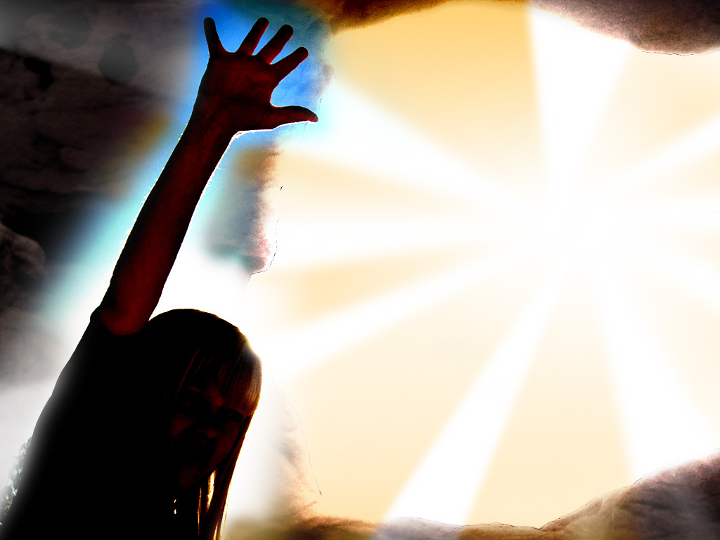
Song
“I'm not what
I wanna be,
I'm not what
I'm gonna be,
But thank God
I'm not what I was!”
Notes:
44

Slide 45
Look in all four directions!
The Four Directions & Four Cups
Blessing
outward
Praise
Plagues
back
forward
inward
Redemption

Slide 46
Why did Jesus give us the Lord's Supper?
Notes:
46

Slide 47
The Four Directions
(Adapted from David Watson, I Believe in the Holy Spirit)
143
Look... | Passover (Jewish) | Lord's Supper (Christian)
Forward | Wait for messianic age (Ezek. 45:21) | Anticipate return of Christ (1 Cor. 11:26; Mark 14:25; Luke 22:14-16)
Outward | Whole family involved (Exod. 12:3-4, 16) | Fellowship and unity (1 Cor. 11:17-22; 10:16-17; Luke 22:17-18)
Inward | Purify house of leaven or evil (Exod. 12:8, 15) | Examine sin in yourself (1 Cor. 11:27-32; cf. 5:6-8; Luke 22:19)
Back | Deliverance from Egypt (Exod. 12:31-42) | Deliverance from sin (1 Cor. 11:23-25; Luke 22:20)
Blessing
Plagues
Praise
Redemption

Slide 48
To properly look back on His death and look forward to His return, look outward for others and look inward at your own life.
The Main Idea
outward
back
forward
inward

Slide 49
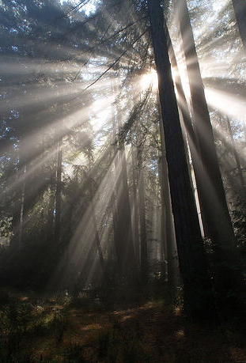
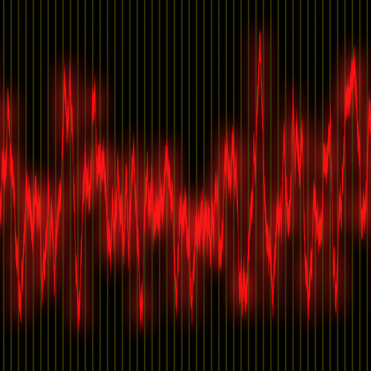
Life or Death
“For God so loved the world that he gave his one and only Son, that whoever believes in him
shall not perish
but have eternal life.
¹⁷For God did not send his Son into the world to condemn the world,
but to save the world through him. ¹⁸Whoever believes in him is not condemned,
but whoever does not believe stands condemned already because he has not believed in the name of God's one and only Son”
(John 3:16-18 NLT)

Slide 50
What outward or inward issues do you need to address right NOW?
Two Directions
outward
inward

Slide 51
Black

Slide 52


NT Preaching link at BibleStudyDownloads.org
Get this presentation and script for free!
Notes:
NT Preaching (np)

