Slide 1
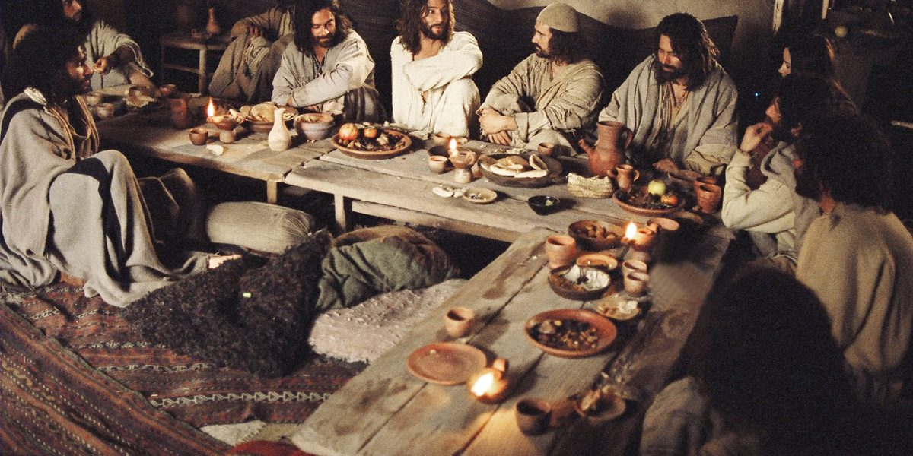
Becoming Upper Room Believers

Slide 2
Becoming Upper Room Believers

Slide 3
Welcome to the Room of Consecration (Luke 22:1-38)
How do you enter? (vs. 1-6)
Why do you enter? (vs. 7-13)
Who do you focus on? (vs. 14-30)
Who do you pray for? (vs. 31-38)

Slide 4
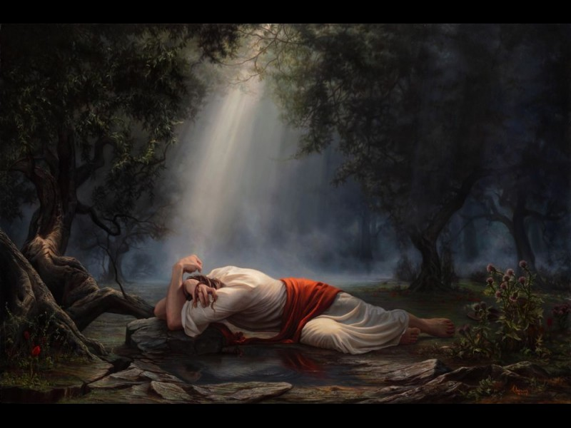
Head to the Place of Testing
(Luke 22:39-71)
Pray fervently to resist temptation to sin (vs. 39-46)
Face the foe (vs. 47-71)

Slide 5
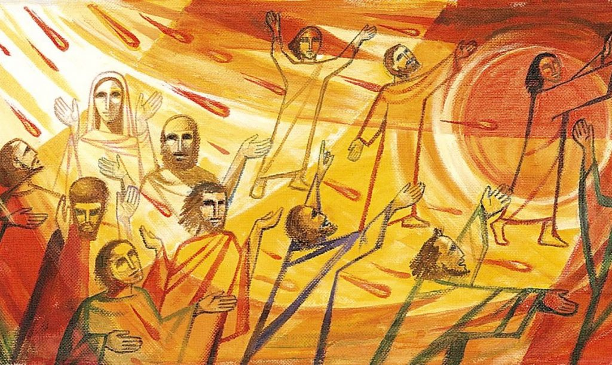
Go to the Room of Intercession and Transformation (Acts 1)
Unified in spirit (Acts 1:12-14a)
Devoted to prayer (Acts 1:14b)
Proclaiming Scripture (Acts 1:15-22)

