Slide 1

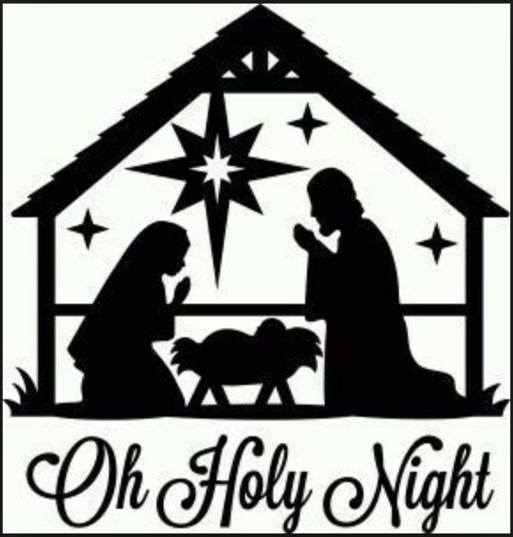
Preparing the Ways for the Lord: Lessons from John
Preached by Andrew B. Spurgeon
at Crossroads International Church Singapore • cicfamily.com

Slide 2

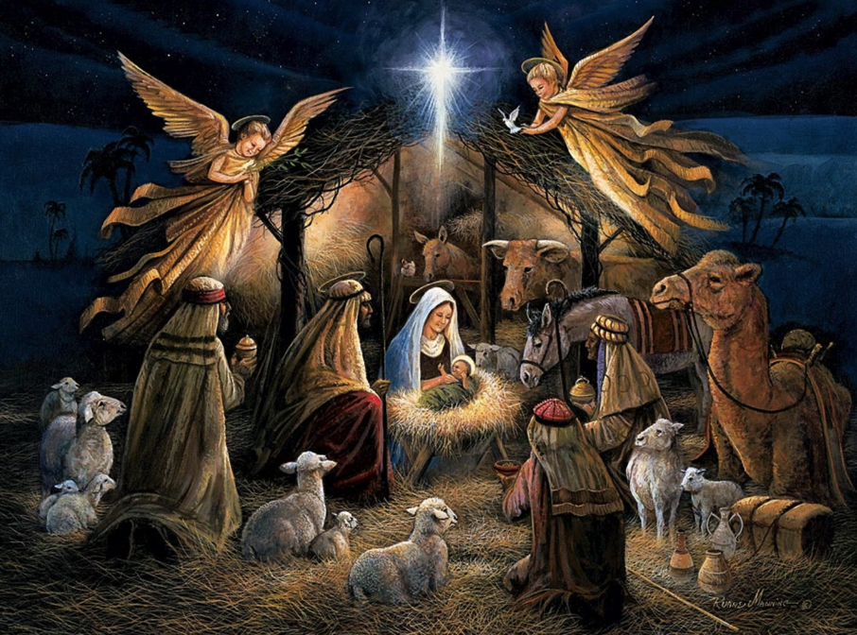
Preparing the Ways
Look, who is missing!

Slide 3


Preparing the Ways
Look, who is missing!
Jesus’ cousin John

Slide 4
Preparing the Ways
Look, who is missing!
Luke 1:5–80

Slide 5
Preparing the Ways
The Parents
Zechariah & Elizabeth
Luke 1:5–7

Slide 6
Preparing the Ways
In the time of Herod king of Judea there was a priest named Zechariah, who belonged to the priestly division of Abijah; his wife Elizabeth was also a descendant of Aaron. Both of them were righteous in the sight of God, observing all the Lord’s commands and decrees blamelessly. But they were childless because Elizabeth was not able to conceive, and they were both very old.

Slide 7
Preparing the Ways
The Vision
Luke 1:8–12

Slide 8
Preparing the Ways
Once when Zechariah’s division was on duty and he was serving as priest before God, he was chosen by lot, according to the custom of the priesthood, to go into the temple of the Lord and burn incense. And when the time for the burning of incense came, all the assembled worshipers were praying outside. An angel of the Lord appeared to him, standing at the right side of the altar of incense. When Zechariah saw him, he was startled and was gripped with fear.

Slide 9
Preparing the Ways
The Message
Luke 1:13–17

Slide 10
Preparing the Ways
The angel said to him: “Do not be afraid, Zechariah; your prayer has been heard. Your wife Elizabeth will bear you a son, and you are to call him John. He will be a joy and delight to you, and many will rejoice because of his birth, for he will be great in the sight of the Lord. He is never to take wine or other fermented drink, and he will be filled with the Holy Spirit even before he is born. He will bring back many of the people of Israel to the Lord their God.

Slide 11
Preparing the Ways
And he will go on before the Lord, in the spirit and power of Elijah, to turn the hearts of the parents to their children and the disobedient to the wisdom of the righteous—to make ready a people prepared for the Lord.”
(Yah = Yahweh; LORD; chanan = is gracious; Yahchanan = Ioannes = John = “LORD is gracious”)

Slide 12
Preparing the Ways
Doubt & Punishment
Luke 1:18–20

Slide 13
Preparing the Ways
Zechariah asked the angel, “How can I be sure of this? I am an old man and my wife is well along in years.” The angel said to him, “I am Gabriel. I stand in the presence of God, and I have been sent to speak to you and to tell you this good news. And now you will be silent and not able to speak until the day this happens, because you did not believe my words, which will come true at their appointed time.”

Slide 14
Preparing the Ways
The Aftermath
Luke 1:21–23

Slide 15
Preparing the Ways
Meanwhile, the people were waiting for Zechariah and wondering why he stayed so long in the temple. When he came out, he could not speak to them. They realized he had seen a vision in the temple, for he kept making signs to them but remained unable to speak. When his time of service was completed, he returned home.

Slide 16
Preparing the Ways
God’s Faithfulness
Luke 1:24–25

Slide 17
Preparing the Ways
After this his wife Elizabeth became pregnant and for five months remained in seclusion. “The Lord has done this for me,” she said. “In these days he has shown his favor and taken away my disgrace among the people.”

Slide 18
Preparing the Ways
A Parallel Story
Luke 1:26–38

Slide 19
Preparing the Ways
In the sixth month of Elizabeth’s pregnancy, God sent the angel Gabriel to Nazareth, a town in Galilee, to a virgin pledged to be married to a man named Joseph, a descendant of David. The virgin’s name was Mary. The angel went to her and said, “Greetings, you who are highly favored! The Lord is with you.” Mary was greatly troubled at his words and wondered what kind of greeting this might be.
But the angel said to her, “Do not be afraid, Mary; you have found favor with God. You will conceive

Slide 20
Preparing the Ways
and give birth to a son, and you are to call him Jesus. He will be great and will be called the Son of the Most High. The Lord God will give him the throne of his father David, and he will reign over Jacob’s descendants forever; his kingdom will never end.” “How will this be,” Mary asked the angel, “since I am a virgin?” The angel answered, “The Holy Spirit will come on you, and the power of the Most High will overshadow you. So the holy one to be born will be called the Son of God. Even Elizabeth your

Slide 21
Preparing the Ways
relative is going to have a child in her old age, and she who was said to be unable to conceive is in her sixth month. For no word from God will ever fail.” “I am the Lord’s servant,” Mary answered. “May your word to me be fulfilled.” Then the angel left her.

Slide 22
Preparing the Ways
John & Jesus — First Encounter
Luke 1:39–45

Slide 23
Preparing the Ways
At that time Mary got ready and hurried to a town in the hill country of Judea, where she entered Zechariah’s home and greeted Elizabeth. When Elizabeth heard Mary’s greeting, the baby leaped in her womb, and Elizabeth was filled with the Holy Spirit. In a loud voice she exclaimed: “Blessed are you among women, and blessed is the child you will bear! But why am I so favored, that the mother of my Lord should come to me?”

Slide 24
Preparing the Ways
Mary’s Song
Luke 1:46–55

Slide 25
Preparing the Ways
Mary Returns Home
Luke 1:56

Slide 26
Preparing the Ways
Birth of John
Luke 1:56–67

Slide 27
Preparing the Ways
Mary stayed with Elizabeth for about three months and then returned home. When it was time for Elizabeth to have her baby, she gave birth to a son. Her neighbors and relatives heard that the Lord had shown her great mercy, and they shared her joy. On the eighth day they came to circumcise the child, and they were going to name him after his father Zechariah, but his mother spoke up and said, “No! He is to be called John.” They said to her, “There is no one among your relatives who has that

Slide 28
Preparing the Ways
name.” Then they made signs to his father, to find out what he would like to name the child. He asked for a writing tablet, and to everyone’s astonishment he wrote, “His name is John.” Immediately his mouth was opened and his tongue set free, and he began to speak, praising God. All the neighbors were filled with awe, and throughout the hill country of Judea people were talking about all these things. Everyone who heard this wondered about it, asking, “What then is this child going to be?”

Slide 29
Preparing the Ways
The Prophecy
Luke 1:68–79

Slide 30
Preparing the Ways
His father Zechariah was filled with the Holy Spirit and prophesied. “Praise be to the Lord, the God of Israel, because he has come to his people and redeemed them. He has raised up a horn of salvation for us in the house of his servant David (as he said through his holy prophets of long ago), salvation from our enemies and from the hand of all who hate us—to show mercy to our ancestors and to remember his holy covenant, the oath he swore to our father Abraham: to rescue us from the hand of our enemies,

Slide 31
Preparing the Ways
and to enable us to serve him without fear in holiness and righteousness before him all our days. And you, my child, will be called a prophet of the Most High;
for you will go on before the Lord to prepare the ways for him, to give his people the knowledge of salvation through the forgiveness of their sins, because of the tender mercy of our God, by which rising sun will come to us from heaven to shine on those living in darkness and in the shadow of
death, to guide our feet into the path of peace.”

Slide 32
Preparing the Ways
Childhood
Luke 1:80

Slide 33
Preparing the Ways
And the child grew and became strong in spirit; and he lived in the wilderness until he appeared publicly to Israel.

Slide 34
Preparing the Ways
30 Years Later
Luke 3:1–3

Slide 35
Preparing the Ways
In the fifteenth year of the reign of Tiberius Caesar—when Pontius Pilate was governor of Judea, Herod tetrarch of Galilee, his brother Philip tetrarch of Iturea and Traconitis, and Lysanias tetrarch of Abilene—during the high-priesthood of Annas and Caiaphas, the word of God came to John son of Zechariah in the wilderness. He went into all the country around the Jordan, preaching a baptism of repentance for the forgiveness of sins.

Slide 36
Preparing the Ways
His Preaching
Luke 3:4–14

Slide 37
Preparing the Ways
His Self-Understanding
Luke 3:15–18

Slide 38
Preparing the Ways
The people were waiting expectantly and were all wondering in their hearts if John might possibly be the Messiah. John answered them all, “I baptize you with water. But one who is more powerful than I will come, the straps of whose sandals I am not worthy to untie. He will baptize you with the Holy Spirit and fire.”

Slide 39
Preparing the Ways
John & Jesus — Second Encounter
Matthew 3:13–15

Slide 40
Preparing the Ways
Then Jesus came from Galilee to the Jordan to be baptized by John. But John tried to deter him, saying, “I need to be baptized by you, and do you come to me?” Jesus replied, “Let it be so now; it is proper for us to do this to fulfill all righteousness.” Then John consented.

Slide 41
Preparing the Ways
John & Jesus — Third Encounter
Matthew 11:2–14

Slide 42
Preparing the Ways
When John, who was in prison, heard about the deeds of the Messiah, he sent his disciples to ask him, “Are you the one who is to come, or should we expect someone else?” Jesus replied, “Go back and report to John what you hear and see: The blind receive sight, the lame walk, those who have leprosy are cleansed, the deaf hear, the dead are raised, and the good news is proclaimed to the poor. Blessed is anyone who does not stumble on account of me.”

Slide 43
Preparing the Ways
As John’s disciples were leaving, Jesus began to speak to the crowd about John: “What did you go out into the wilderness to see? A reed swayed by the wind? If not, what did you go out to see? A man dressed in fine clothes? No, those who wear fine clothes are in kings’ palaces. Then what did you go out to see? A prophet? Yes, I tell you, and more than a prophet. This is the one about whom it is written: “‘I will send my messenger ahead of you, who will prepare your way before you.’ Truly I tell you, among

Slide 44
Preparing the Ways
those born of women there has not risen anyone greater than John the Baptist; yet whoever is least in the kingdom of heaven is greater than he. From the days of John the Baptist until now, the kingdom of heaven has been subjected to violence, and violent people have been raiding it. For all the Prophets and the Law prophesied until John. And if you are willing to accept it, he is the Elijah who was to come. Whoever has ears to listen, let them hear.

Slide 45
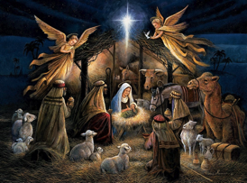
Preparing the Ways
John versus Jesus
John — a priestly son (Aaron’s lineage)
Jesus — a kingly son (King David’s lineage)

Slide 46
Preparing the Ways
John versus Jesus
John — ate honey and locusts (Matt 3:4)
Jesus — ate with the sinners and tax collectors (Mark 2:16); those who opposed him said he was a drunkard and a glutton (Luke 7:34)

Slide 47
Preparing the Ways
“For John the Baptist came neither eating bread nor drinking wine, and you say, ‘He has a demon.’ The Son of Man came eating and drinking, and you say, ‘Here is a glutton and a drunkard, a friend of tax collectors and sinners.’”

Slide 48
Preparing the Ways
John versus Jesus
John — a forerunner (one who prepares the ways for the Lord)
Jesus — the Way (John 14:6 – I am the way, the truth, and the life. No one comes to the Father except through me.)

Slide 49

Preparing the Ways
John versus Jesus

Slide 50
Preparing the Ways
John versus Jesus
John lived to prepare the ways for the Lord so others might come to him; he didn’t prepare his way or be the way.
John 3:25–30

Slide 51
Preparing the Ways
An argument developed between some of John’s disciples and a certain Jew over the matter of ceremonial washing. They came to John and said to him, “Rabbi, that man who was with you on the other side of the Jordan—the one you testified about—well, he is baptizing, and everyone is going to him.” To this John replied, “A man can receive only what is given him from heaven. You yourselves can testify that I said, ‘I am not the Christ but am sent ahead of him.’ The bride belongs to the bridegroom.

Slide 52
Preparing the Ways
The friend who attends the bridegroom waits and listens for him, and is full of joy when he hears the bridegroom’s voice. That joy is mine, and it is now complete. He must become greater; I must become less.

Slide 53
Preparing the Ways
Lessons from John
1. We must always prepare the ways for the Lord, not for us; or be the way.
2. In all that we do, the Lord must become greater and we lesser.
3. The Lord is always gracious.

Slide 54

Preparing the Ways
Merry Christmas!

Slide 56


NT Preaching link at BibleStudyDownloads.org
Get this presentation for free!

