Slide 1
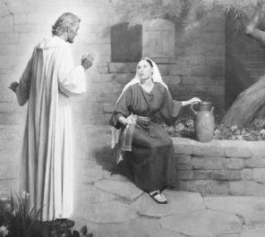
There’s Something About Mary
Luke 1:26-38
Preached by Dr. Lewis Winkler at Crossroads International Church Singapore • CICFamily.com Uploaded by Dr. Rick Griffith • Jordan Evangelical Theological Seminary Files in many languages for free download at BibleStudyDownloads.org

Slide 2
Possible Christmas Theme Songs:
Evening Well Diggers Unlimited
“O Holey Night”
Bethlehem Inn Owners Association
“Have You Any Room for Jesus?”
Christian Bathroom Cleaners United
“Who Is He in Yonder Stall?”
Mute Christians Christmas Conference
“Silent Night”

Slide 3
Possible Christmas Theme Songs:
Salvation Army Christmas Convention
“Come On, Ring Those Bells!”
Community of Christian Amnesiacs
“I Wonder as I Wander”
Christian Climbers Association
“Go Tell It on the Mountain!”
Christian Tax-collectors United
“What Can I Give Him?”
A Seminar for Parents of Teenagers
“What Child Is This?”

Slide 4
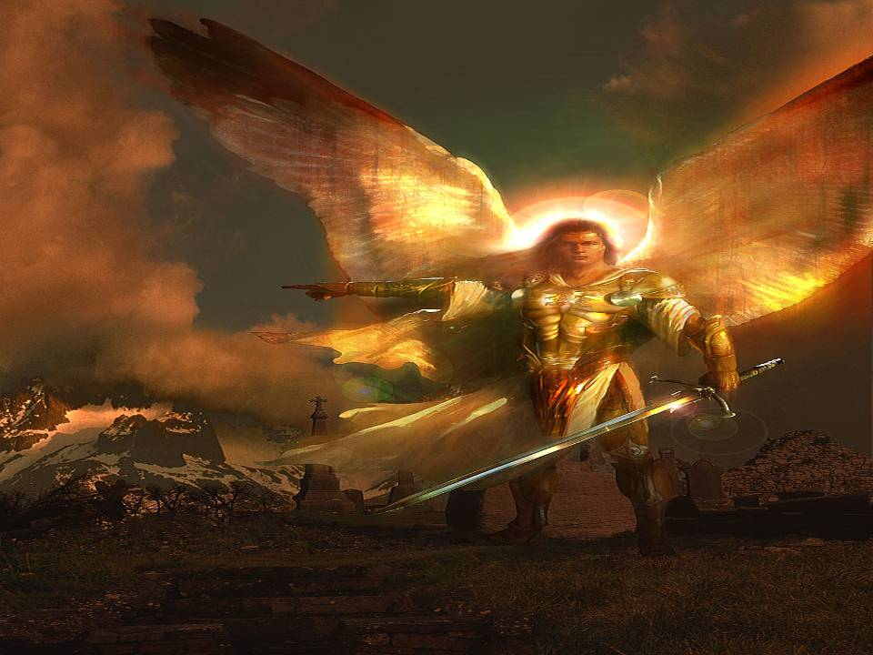
What is it about Mary? Luke 1:26-30
The Angel came from God.

Slide 5
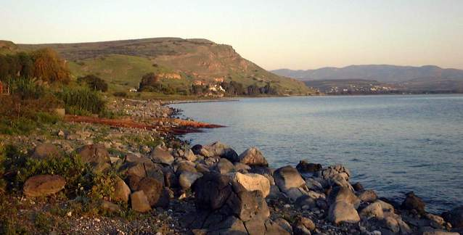
What is it about Mary? Luke 1:26-30
He was sent to Nazareth in Galilee.

Slide 6
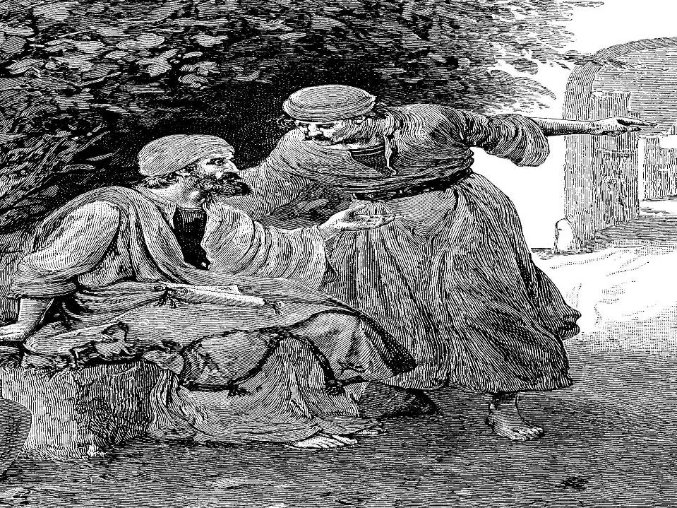
John 1:45-46
Philip found Nathanael and told him, “We have found the one Moses wrote about in the Law, and about whom the prophets also wrote—Jesus of Nazareth, the son of Joseph.”
“Nazareth! Can anything good come from there?” Nathanael asked.

Slide 7
John 7:52
The Jewish leaders, talking contemptuous to Nicodemus about Jesus, say the following:
“Look into it, and you will find that a prophet does not come out of Galilee.”

Slide 8
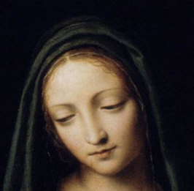
What is it about Mary? Luke 1:26-30
She is Galilean.
She is unmarried.
She is favored by God.

Slide 9
What is it about Mary? Luke 1:26-30
It was not her age.
It was not her social status.
It was not her location.
It was not her economic situation.
It was not her beauty, education or intelligence.

Slide 10
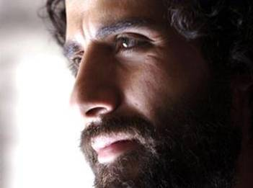
God’s Favor on Mary?
She nearly loses her husband.
“Mary was pledged to be married to Joseph, but before they came together, she was found to be with child through the Holy Spirit. Because Joseph her husband was a righteous man and did not want to expose her to public disgrace, he had in mind to divorce her quietly.”
Matthew 1:18-19

Slide 11
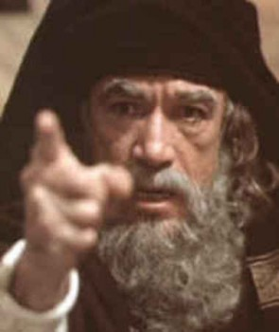
God’s Favor on Mary?
She will live under the cloud of sexual scandal.
In John 8:41, the Pharisees say the following to Jesus: “We are not illegitimate children!”

Slide 12
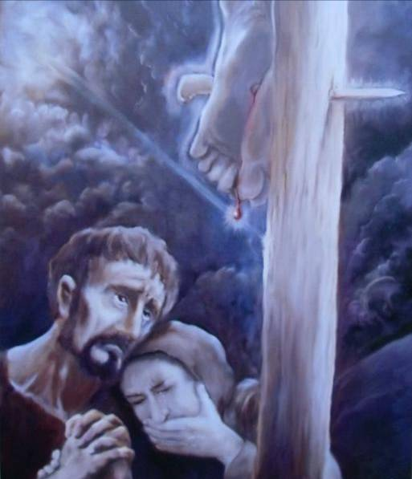
God’s Favor on Mary?
She will have to watch her son die for the sins of the world.
“Near the cross of Jesus stood his mother . . . .”
—John 19:25

Slide 13
God’s Favor on Mary?
YES!

Slide 14
God’s Favor on Mary?
She will bear the savior of the world!
She will bear the king of the universe!

Slide 15
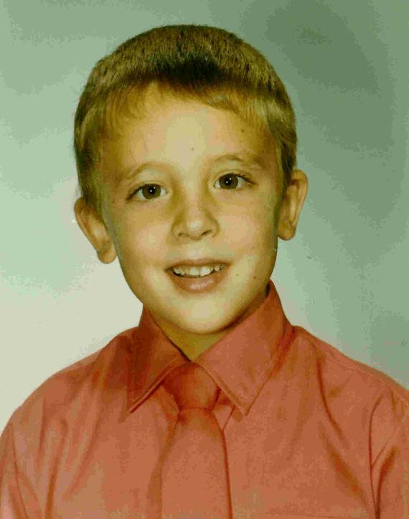
What am I doing here?
An unlikely move when
the funds ran out
An unlikely church
because that’s not
the way we were raised
An unlikely evangelist
whose name I cannot recall

Slide 16
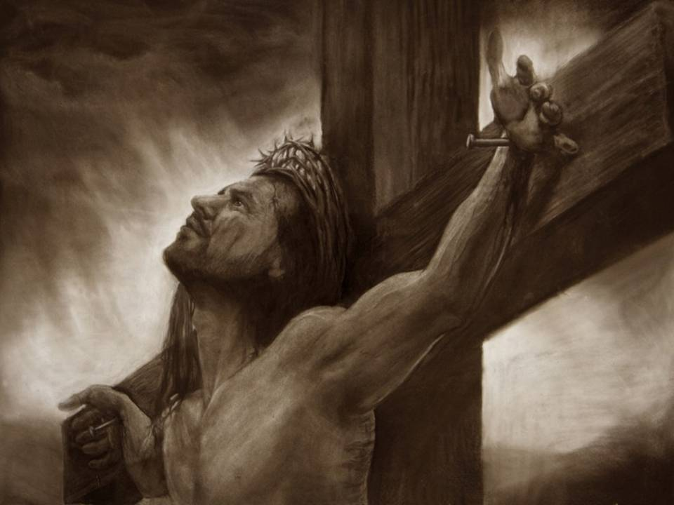
What kind of Messiah is Jesus? Luke 1:31-33
He is the Savior.

Slide 17
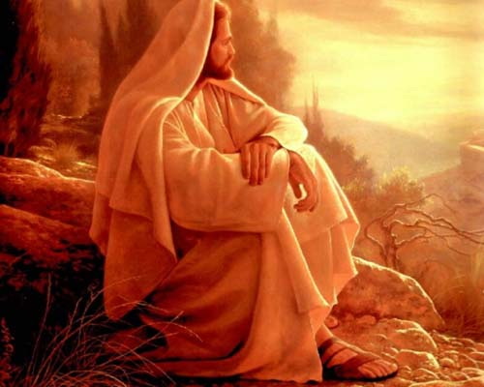
What kind of Messiah is Jesus? Luke 1:31-33
He is the Son.

Slide 18
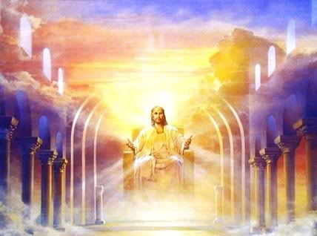
What kind of Messiah is Jesus? Luke 1:31-33
He is the Sovereign.

Slide 19
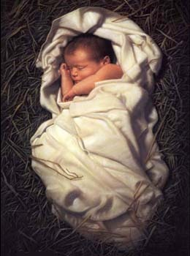
What kind of Messiah is Jesus? Luke 1:31-33
He is a human baby!

Slide 20
How can this be? Luke 1:34-37
She is a virgin.

Slide 21
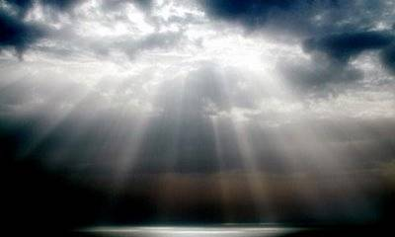
How can this be? Luke 1:34-37
God is the Father.

Slide 22
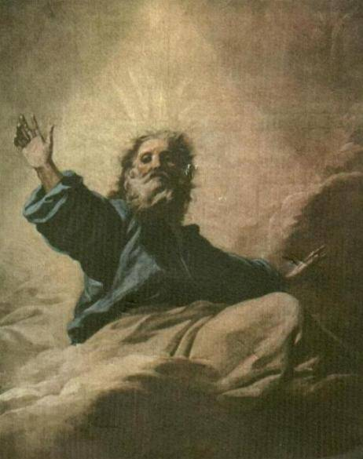
How can this be? Luke 1:34-37
Nothing is impossible with God!

Slide 23
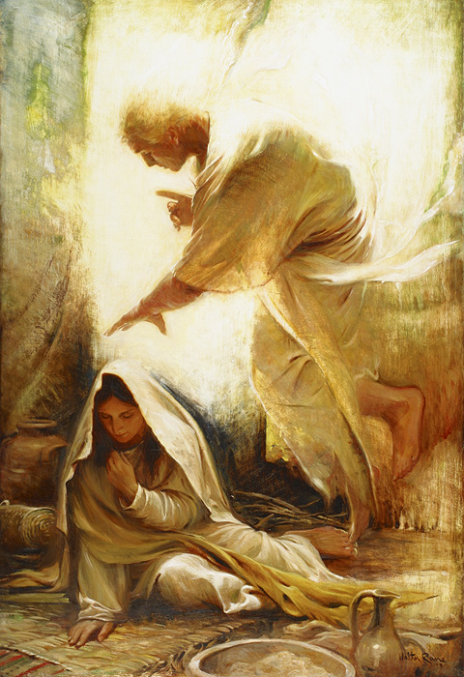
How does Mary respond? Luke 1:38
She submits.
She is willing.

Slide 24
What is it about Mary?
She is willing to be God’s servant.
She is willing to submit to God’s plan.

Slide 25

Called to Speak for God?
I was scared to death.

Slide 26
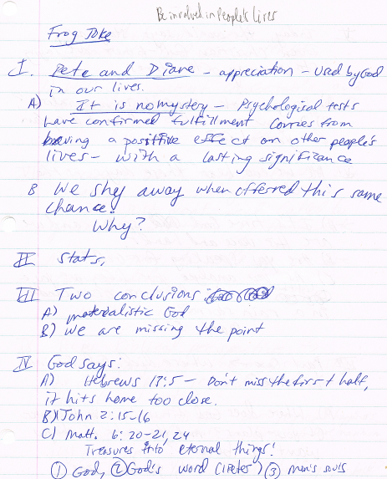
Called to Speak for God?
I was ill-prepared.

Slide 27
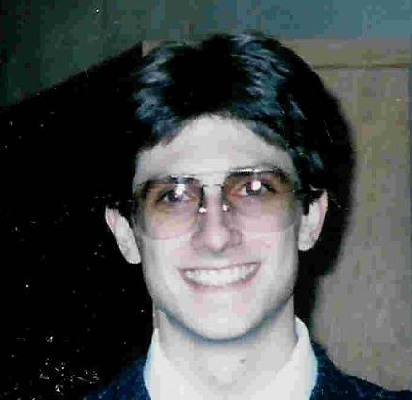
Called to Speak for God?
I was called to speak for God.

Slide 28
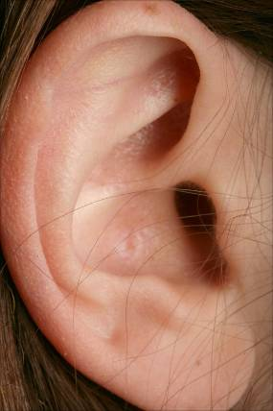
Called to Speak for God?
I was reluctant to listen to God’s call.
Praise God, I eventually did!

Slide 29
Conclusion and Application
Are you willing to fully submit to God’s plan, however unexpected, inconvenient or crazy it might seem?
Is there something about you that would prompt God to call on you to help fulfill His purposes and plans?

Slide 30
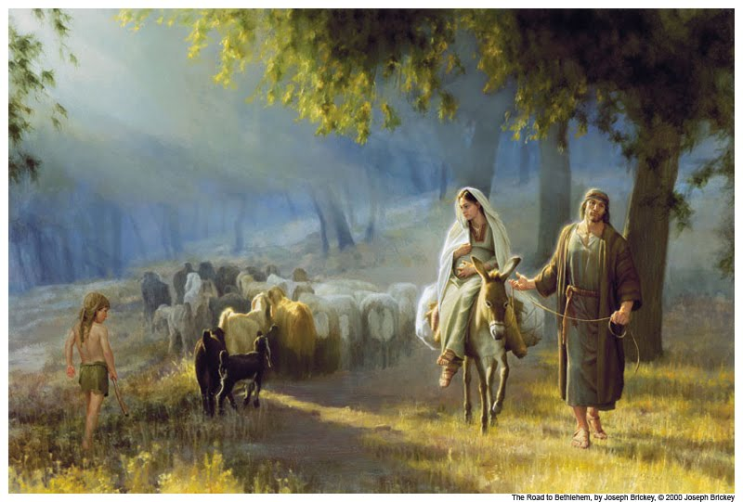
“Breath of Heaven (Mary’s Song)” by Amy Grant
I have traveled
Many moonless nights
Cold and Weary
With a babe inside
And I wonder
What I've done
Holy Father,
You have come
Chosen me now
To carry your Son

Slide 31
“Breath of Heaven (Mary’s Song)” by Amy Grant
I am waiting
In a silent prayer
I am frightened
By the load I bear
In a world as cold as stone
Must I walk this path alone?
Be with me now
Be with me now

Slide 32
“Breath of Heaven (Mary’s Song)” by Amy Grant
Breath of Heaven
Hold me together
Be forever near me
Breath of Heaven
Breath of Heaven
Lighten my darkness
Pour over me your holiness
For you are holy, Breath of Heaven

Slide 33
“Breath of Heaven (Mary’s Song)” by Amy Grant
Do you wonder
As you watch my face
If a wiser one
Should of had my place?
But I offer all I am
For the mercy of your plan
Help me be strong
Help me be . . . . Help me

Slide 34
Black

Slide 35


NT Preaching link at BibleStudyDownloads.org
Get this presentation and script for free!
Notes:
NT Preaching (np)

