Slide 1

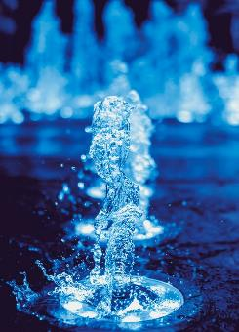
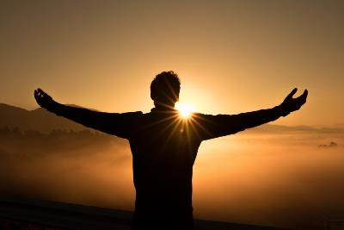
Favor with God
Luke 1:26-38
The Miracles of Jesus
Preached by Matt Lyle • 19 December 2021
at Crossroads International Church Singapore • CICFamily.com
Uploaded by Dr. Rick Griffith • Jordan Evangelical Theological Seminary
Files in many languages for free download at BibleStudyDownloads.org

Slide 2
Notes:
Photo by Guneet Jassal on Unsplash
https://unsplash.com/photos/6gMrc3eeWUw
What comes to mind when you think about the month of December?

Slide 3
December 2021
MON | TUE | WED | THU | FRI | SAT | SUN
 |  | 1 | 2 | 3 | 4 | 5
6 | 7 | 8 | 9 | 10 | 11 | 12
13 | 14 | 15 | 16 | 17 | 18 | 19
20 | 21 | 22 | 23 | 24 | 25 | 26
27 | 28 | 29 | 30 | 31
Notes:
Because you are sitting in Church or if you are listening to this sermon online: Christmas
Kids: no school
Adults: clearing leave
Travelling, visiting family, meals,
Starbucks: Peppermint Mocha
December is also known for Blockbuster movies.

Slide 4

West Side Story Dec 10th
Notes:
A remake of a classic
West Side Story picture courtesy of:
https://www.cnet.com/news/new-movies-coming-out-in-2021-netflix-marvel-postponed-blockbusters/

Slide 5

The Kings Man Dec 22nd
Notes:
A prequel to the series of Kings Men movies
The Kings Man movie poster courtesy of:
https://www.20thcenturystudios.com/movies/the-kings-man

Slide 6

Spider-Man: No Way Home Dec 17th
Notes:
A sequel to a 2019 version of Spiderman, itself a remake or reboot of another version.
Spider man movie poster courtesy of
https://www.flickeringmyth.com/2021/11/new-posters-and-tv-spots-for-spider-man-no-way-home/

Slide 7
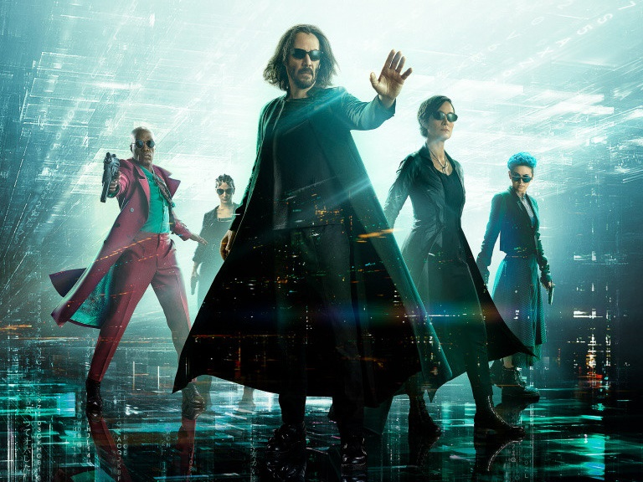
The Matrix Resurrections Dec 22nd
Notes:
No one is really sure what to call the Matrix
Matrix Resurrections movie poster courtesy of:
https://www.diraxe.com/2021/11/17/matrix-resurrections-neo-trinity-and-morpheus-re-emerge-in-a-new-official-poster/

Slide 8
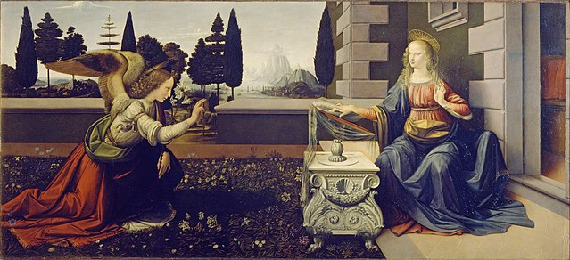
Annunciation
Earliest known work of Leonardo da Vinci
Luke 1:26-38
Notes:
By Leonardo da Vinci - http://www.marysrosaries.com/collaboration/index.php?title=File:Annunciation_-_Leonardo_Da_Vinci_-_Annunciazione.jpeg, Public Domain, https://commons.wikimedia.org/w/index.php?curid=13126265

Slide 9
The Miracles of Jesus

Slide 10
Feeding of the 5000 John 6:1-15
Water to Wine John 2:1-11
A Miraculous Catch Luke 5:1-11
The Virgin Birth Luke 1:26-38

Slide 11
A Miracle
about Jesus

Slide 12
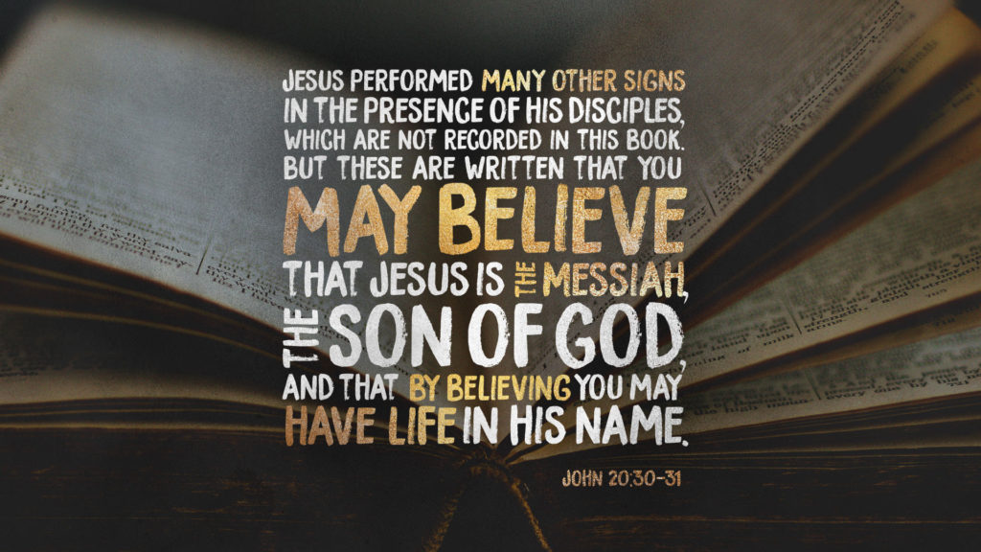

Slide 13
Luke 1:1-4 Introduction
¹ Many people have set out to write accounts about the events that have been fulfilled among us. ² They used the eyewitness reports circulating among us from the early disciples. ³ Having carefully investigated everything from the beginning, I also have decided to write an accurate account for you, most honorable Theophilus,
⁴ so you can be certain of the truth of everything you were taught.

Slide 14
GOD DOES THE IMPOSSIBLE

Slide 15
God did the impossible:
by bringing the son of God to earth in a virgin womb to become the Son of David who rules an eternal kingdom.
Luke 1:26-38

Slide 16
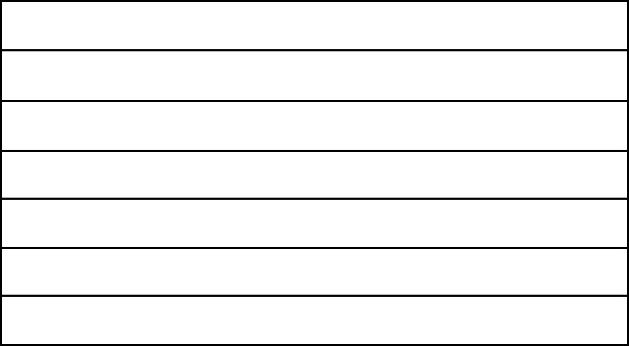
7 Great Periods of History
PERIOD
Nations
Israel
YEARS
2000+
2000
SCRIPTURE
Gen 1-11
Gen 12 – Mal 4
BACKGROUND
The tragic fall
of a perfect creation
followed by judgment
and the promise of final redemption
Terry Hall, Bible Panorama, 157

Slide 17
7 Great Periods of History
PERIOD
Nations
Israel
Silent Years
Christ on Earth
Church on Earth
Tribulation
Christ's Kingdom
YEARS
2000+
2000
400
~33
~1990 + ??
7
1000
SCRIPTURE
Gen 1-11
Gen 12 – Mal 4
None
Matt 1 – Acts 1
Acts 2 – Rev 3
Rev 4 – 19
Rev 20 – 22
BACKGROUND
Terry Hall, Bible Panorama, 157

Slide 18
7 Great Periods of History
PERIOD
Nations
Israel
Silent Years
Christ on Earth
Church on Earth
Tribulation
Christ's Kingdom
YEARS
2000+
2000
400
~33
~1990 + ??
7
1000
SCRIPTURE
Gen 1-11
Gen 12 – Mal 4
None
Matt 1 – Acts 1
Acts 2 – Rev 3
Rev 4 – 19
Rev 20 – 22
BACKGROUND
Terry Hall, Bible Panorama, 157

Slide 19
Luke 1:5-25 Birth Announcement
Zechariah and Elizabeth

Slide 20
Luke 1:26-38
/ Matt 1:18-24
Birth Announcement
Joseph and Mary

Slide 21
Luke 1:5-25 Birth Announcement
Zechariah and Elizabeth
Both descended from Aaron (Priest)

Slide 22
Luke 1:26-38
/ Matt 1:18-24
Joseph and Mary
Both descended from King David

Slide 23
Luke 1:5-25 Birth Announcement
Zechariah and Elizabeth
Both descended from Aaron (Priest)
Had no children
Both were old and Elizabeth was barren

Slide 24
Luke 1:26-38
/ Matt 1:18-24
Joseph and Mary
Both descended from King David
Had no children
Betrothed (not yet married)

Slide 25
Luke 1:5-25 Birth Announcement
Zechariah and Elizabeth
Both descended from Aaron (Priest)
Had no children
Both were old and Elizabeth was barren
“Were righteous in God’s eyes, careful to obey all of the Lord’s commandments” (Luke 1:6)

Slide 26
Luke 1:26-38
/ Matt 1:18-24
Joseph and Mary
Both descended from King David
Had no children
Betrothed (not yet married)
“Joseph . . . was a righteous man” (Matt 1:19)
Mary “found favor with God” (Luke 1:30)

Slide 27
Luke 1:5-25 Birth Announcement
Zechariah and Elizabeth
Both descended from Aaron (Priest)
Had no children
Both were old and Elizabeth was barren
“Were righteous in God’s eyes, careful to obey all of the Lord’s commandments” (Luke 1:6)
Zechariah was visited by an angel

Slide 28
Luke 1:26-38
/ Matt 1:18-24
Joseph and Mary
Both descended from King David
Had no children
Betrothed (not yet married)
“Joseph . . . was a righteous man” (Matt 1:19)
Mary “found favor with God” (Luke 1:30)
Mary and Joseph were both visited by an angel

Slide 29
Luke 1:5-25 Birth Announcement
Zechariah and Elizabeth
Both descended from Aaron (Priest)
Had no children
Both were old and Elizabeth was barren
“Were righteous in God’s eyes, careful to obey all of the Lord’s commandments” (Luke 1:6)
Zechariah was visited by an angel
Retelling of an old Story

Slide 30
Barren Women in the Old Testament
Sarah
Rebekah
Rachel
Hannah
Mother of Samson
the Shunammite,
(an acolyte of the prophet Elisha )
Notes:
Photo by Ignacio Campo on Unsplash
https://unsplash.com/photos/tC9boyqy_40

Slide 31
Luke 1:5-25 Birth Announcement
Zechariah was visited by an angel
Was troubled
Angel explained
Asked for a sign (i.e. didn’t believe)
Made mute
Elizabeth became pregnant

Slide 32
²⁶ In the sixth month of Elizabeth’s pregnancy, God sent the angel Gabriel to Nazareth, a village in Galilee, ²⁷ to a virgin named Mary. She was engaged to be married to a man named Joseph, a descendant of King David.
Luke 1:26-38

Slide 33
When was Jesus Born?
Gabriel Visits Mary
Gabriel Visits Zechariah
Jesus is Born
Elizabeth
Mary
6 months
9 months

Slide 34
Zechariah’s Duty
⁸ Now while he was serving as priest before God when his division was on duty, ⁹ according to the custom of the priesthood, he was chosen by lot to enter the temple of the Lord and burn incense.
²¹ And the people were waiting for Zechariah, and they were wondering at his delay in the temple.

Slide 35
Leviticus
Lev 16:39 (NLT)
“On the tenth day of the appointed month in early autumn"*
16
Day of Atonement
Purity
Footnote
11-15
17-20
*This Day of Atonement in the ancient Hebrew lunar calendar occurred in September or October.
Priesthood
8-10
21-22
Ritual
1-7
23-27

Slide 36
When was Jesus Born?
Gabriel Visits Mary
Gabriel Visits Zechariah
Jesus is Born
Elizabeth
Mary
6 months
9 months
Sep / Oct
Nov / Dec
Mar / Apr

Slide 37
²⁸ Gabriel appeared to her and said, “Greetings, favored woman! The Lord is with you!”
²⁹ Confused and disturbed, Mary tried to think what the angel could mean.
Luke 1:26-38

Slide 38






The Old Testament
GENESIS
EXODUS
JUDGES
ESTHER
1 SAMUEL
1 CHRON
NEHEMIAH
2 SAMUEL
2 KINGS
LEVITICUS
JOSHUA
1 KINGS
2 CHRON
RUTH
EZRA
NUMBERS
DEUTERONOMY
LAW
HISTORY
JOB
PSALMS
ISAIAH
JEREMIAH
LAMENTATIONS
EZEKIEL
DANIEL
PROVERBS
POETRY
MAJOR PROPHETS
Song of
Solomon
HOSEA
JONAH
NAHUM
MALACHI
MICAH
HABAKKUK
JOEL
OBADIAH
ZEPHANIAH
ZECHARIAH
AMOS
HAGGAI
Ecclesiastes
POETRY
MINOR PROPHETS
followed by judgment
promise of final redemption

Slide 39
The Old Testament
Ch 2: ³ But this is what the Lord says:
“I will reward your evil with evil;
you won’t be able to pull your neck out of the noose.
You will no longer walk around proudly,
for it will be a terrible time.”
HOSEA
JONAH
NAHUM
MALACHI
MICAH
HABAKKUK
JOEL
OBADIAH
ZEPHANIAH
ZECHARIAH
AMOS
HAGGAI
MINOR PROPHETS
followed by judgment
promise of final redemption

Slide 40
The Old Testament
Ch 2: ¹¹ Suppose a prophet full of lies would say to you,
“I’ll preach to you the joys of wine and alcohol!”
That’s just the kind of prophet you would like!
HOSEA
JONAH
NAHUM
MALACHI
MICAH
HABAKKUK
JOEL
OBADIAH
ZEPHANIAH
ZECHARIAH
AMOS
HAGGAI
MINOR PROPHETS
Warnings about False Prophets

Slide 41
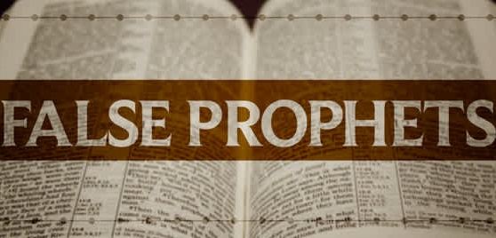
Who are the False Prophets Today?

Slide 42

Singapore slips from ‘obstructed’ to ‘repressed’ in global civic freedoms report
Notes:
https://coconuts.co/singapore/news/singapore-slips-from-obstructed-to-repressed-in-global-civic-freedoms-report/

Slide 43

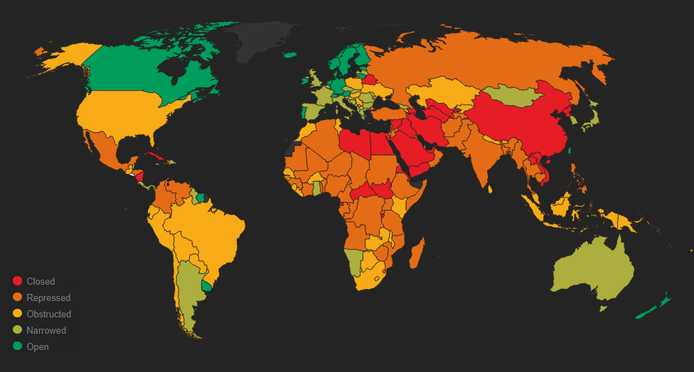
Finland
In Case With Global Implications, Finland Puts Christians On Trial For Their Faith
Notes:
https://monitor.civicus.org/

Slide 44
Who are the False Prophets Today?

Slide 45
²⁸ Gabriel appeared to her and said, “Greetings, favored woman! The Lord is with you!”
²⁹ Confused and disturbed, Mary tried to think what the angel could mean.
Luke 1:26-38

Slide 46
Zechariah
Mary
Luke 1:12 (ESV)
Luke 1:29 (ESV)
Zechariah was troubled
she was greatly troubled at the saying
Which part troubled Mary?
a. "Greetings, favored woman!"
b. "The Lord is with you!"

Slide 47
³⁰ “Don’t be afraid, Mary,” the angel told her, "for you have found favor with God!"
Luke 1:26-38
What is the result of finding favor with God?

Slide 48
³⁰ “Don’t be afraid, Mary,” the angel told her, “for you have found favor with God! ³¹ You will conceive and give birth to a son, and you will name him Jesus. ³² He will be very great and will be called the Son of the Most High. The Lord God will give him the throne of his ancestor David. ³³ And he will reign over Israel forever; his Kingdom will never end!”
Luke 1:26-38

Slide 49
Mary
What is the result of finding favor with God?
the privilege of
giving birth to Jesus
Christians
What is the result of finding favor with God?

Slide 50
Apostle Paul
Romans 10:15 (NLT)
And how will anyone go and tell them without being sent? That is why the Scriptures say, “How beautiful are the feet of messengers who bring good news!"
Prophet Isaiah
Isaiah 52:7 (NLT)
How beautiful on the mountains
are the feet of the messenger who brings good news,
the good news of peace and salvation,
the news that the God of Israel reigns!

Slide 51
Mary
What is the result of finding favor with God?
the privilege of
giving birth to Jesus
Christians
What is the result of finding favor with God?
the privilege of
sharing the gospel

Slide 52
Religion
Good Works
Morality
Sinful
Humanity
Holy
God
Philosophy

Slide 53

CHRIST
Religion
Good Works
Morality
Sinful
Humanity
Holy
God
Philosophy

Slide 54
Mary
How does Mary find favor with God?

Slide 55
³⁴ Mary asked the angel, “But how can this happen? I am a virgin.”
Luke 1:26-38

Slide 56
Zechariah
Mary
Luke 1:18 (NLT)
Luke 1:34 (NLT)
Zechariah said to the angel, “How can I be sure this will happen? I’m an old man now, and my wife is also well along in years.”
Mary asked the angel, “But how can this happen? I am a virgin."
Asked in belief
wanted to be a part of Gods plan,
will be given a sign
asked in disbelief
needed a sign

Slide 57
³⁴ Mary asked the angel, “But how can this happen? I am a virgin.”
³⁵ The angel replied, “The Holy Spirit will come upon you, and the power of the Most High will overshadow you. So the baby to be born will be holy, and he will be called the Son of God. ³⁶ What’s more, your relative Elizabeth has become pregnant in her old age! People used to say she was barren, but she has conceived a son and is now in her sixth month."
Luke 1:26-38

Slide 58
³⁷ "For the word of God will never fail.”
Luke 1:26-38

Slide 59
NLT: ³⁷ "For the word of God will never fail.”
ESV: ³⁷ "For nothing will be impossible with God.”
NIV: ³⁷ "For no word from God will ever fail.”
KJV: ³⁷ "For with God nothing shall be impossible.”
ὅτι | οὐκ | ἀδυνατήσει | παρὰ | τοῦ | θεοῦ | ⸃ πᾶν | ῥῆμα
for | not | it is impossible | with | the | God | every | word

Slide 60
³⁷ For the word of God will never fail.”
³⁸ Mary responded, “I am the Lord’s servant. May everything you have said about me come true.” And then the angel left her.
Luke 1:26-38

Slide 61
³⁷ For the word of God will never fail.”
³⁸ Mary responded, “I am the Lord’s servant. May everything you have said about me come true.” And then the angel left her.
Luke 1:26-38

Slide 62
NLT: ³⁸ May everything you have said about me come true.”
ESV: ³⁸ let it be to me according to your word.”
NIV: ³⁸ May your word to me be fulfilled.”
KJV: ³⁷ be it unto me according to thy word.”
γένοιτό | μοι | κατὰ | τὸ | ῥῆμά | σου.
May it | to me | according to | the | word | your | be done

Slide 63
³⁷ "For the word of God will never fail.”
³⁸ Mary responded, “I am the Lord’s servant. May everything you have said about me come true.” And then the angel left her.
Luke 1:26-38
ESV: ³⁸ let it be to me according to your word.”
NIV: ³⁸ May your word to me be fulfilled.”
KJV: ³⁷ be it unto me according to thy word.”

Slide 64
Mary
How does Mary find favor with God?
She is obedient to
every word
Christians
How can we find
favor with God?
By being obedient to
every word

Slide 65
Finding Favor Follows From
Obedience

Slide 66
Black

Slide 67


NT Preaching link at BibleStudyDownloads.org
Get this presentation and script for free!
Notes:
NT Preaching (np)

