Slide 1
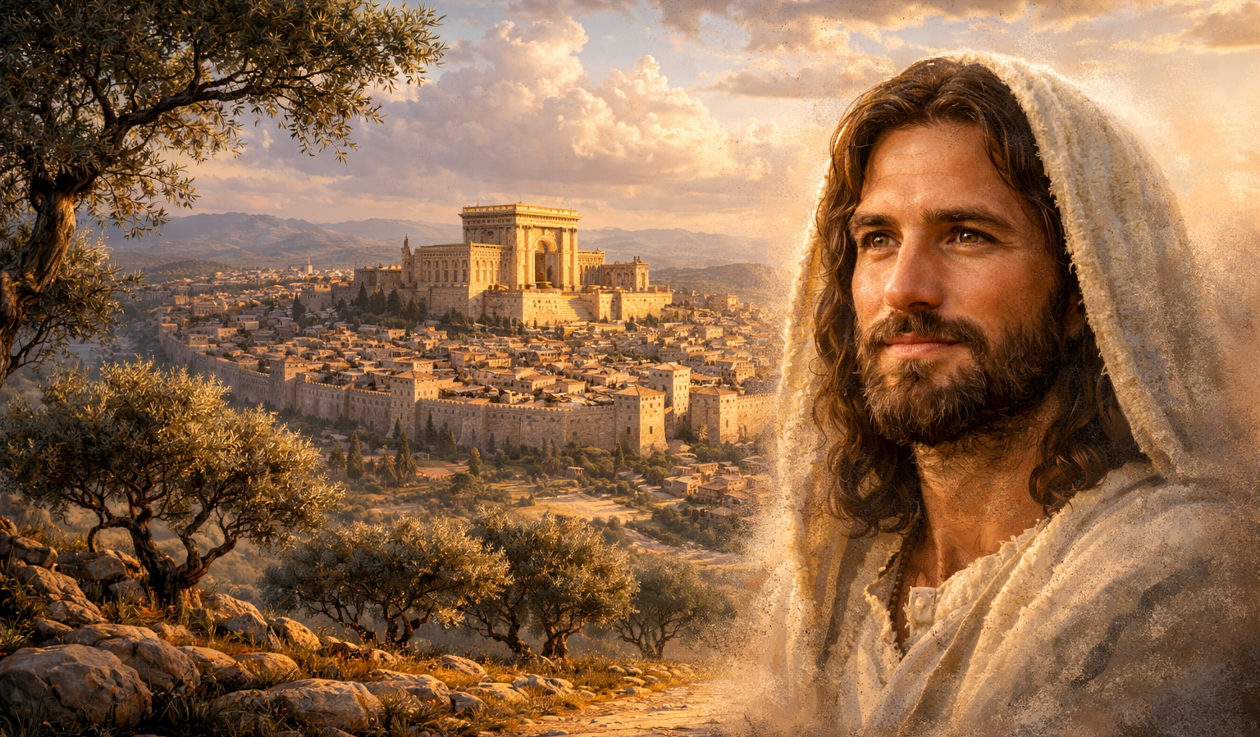
The Gospel of
Luke
Luke 1:26-38
Meekness and Majesty!
Preached by Dan Bridges
Amman International Church, Jordan (AmmanChurch.org)
Uploaded by Dr. Rick Griffith • Jordan Evangelical Theological Seminary
Files in many languages for free download at BibleStudyDownloads.org

Slide 2
Luke 1:26-38 presents a clear contrast…
Jesus is announced as the Eternal King
Jesus was to be born into a humble, no-name family

Slide 3
“Though he was God,
he did not think of equality with God
as something to cling to.
Instead, he gave up his divine privileges;
he took the humble position of a slave
and was born as a human being.
When he appeared in human form,
he humbled himself in obedience to God
and died a criminal’s death on a cross.”
Philippians 2:6-8
As God, why did Jesus not come in obvious power?

Slide 4
Jesus came to bring salvation – not to rule as a king.
Our sin problem is solved not by power, but by a sacrificial death.
Jesus identified with all human weakness and suffering.
Jesus revealed God’s character – his sacrificial, self-giving love!
As God, why did Jesus not come in obvious power?

Slide 5
Luke 1:5 – 4:13 – An Orderly Account!
 | John’s Story | Jesus’ Story
1:5-25
1:26-38
1:39-56
1:57-80
2:1-52
3:1-20
3:21-4:13
John’s Birth Foretold
Jesus’ Birth Foretold
Mary and Elizabeth Together
John’s Birth
Jesus’ Birth & Boyhood
John Prepares the Way
Jesus is Prepared

Slide 6
Luke 1:5 – 4:13 – An Orderly Account!
 | John’s Story | Jesus’ Story
1:5-25
1:26-38
1:39-56
1:57-80
2:1-52
3:1-20
3:21-4:13
John’s Birth Foretold
Jesus’ Birth Foretold
Mary and Elizabeth Together
John’s Birth
Jesus’ Birth & Boyhood
John Prepares the Way
Jesus is Prepared

Slide 7
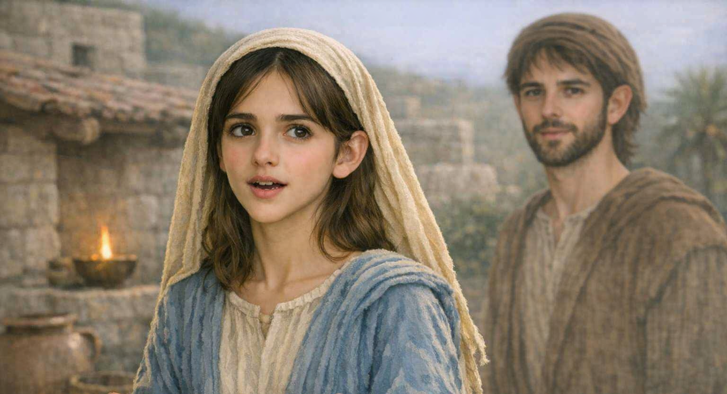
“In the sixth month the angel Gabriel was sent from God to a city of Galilee named Nazareth, to a virgin betrothed to a man whose name was Joseph, of the house of David. And the virgin's name was Mary.” Luke 1:26-27

Slide 8
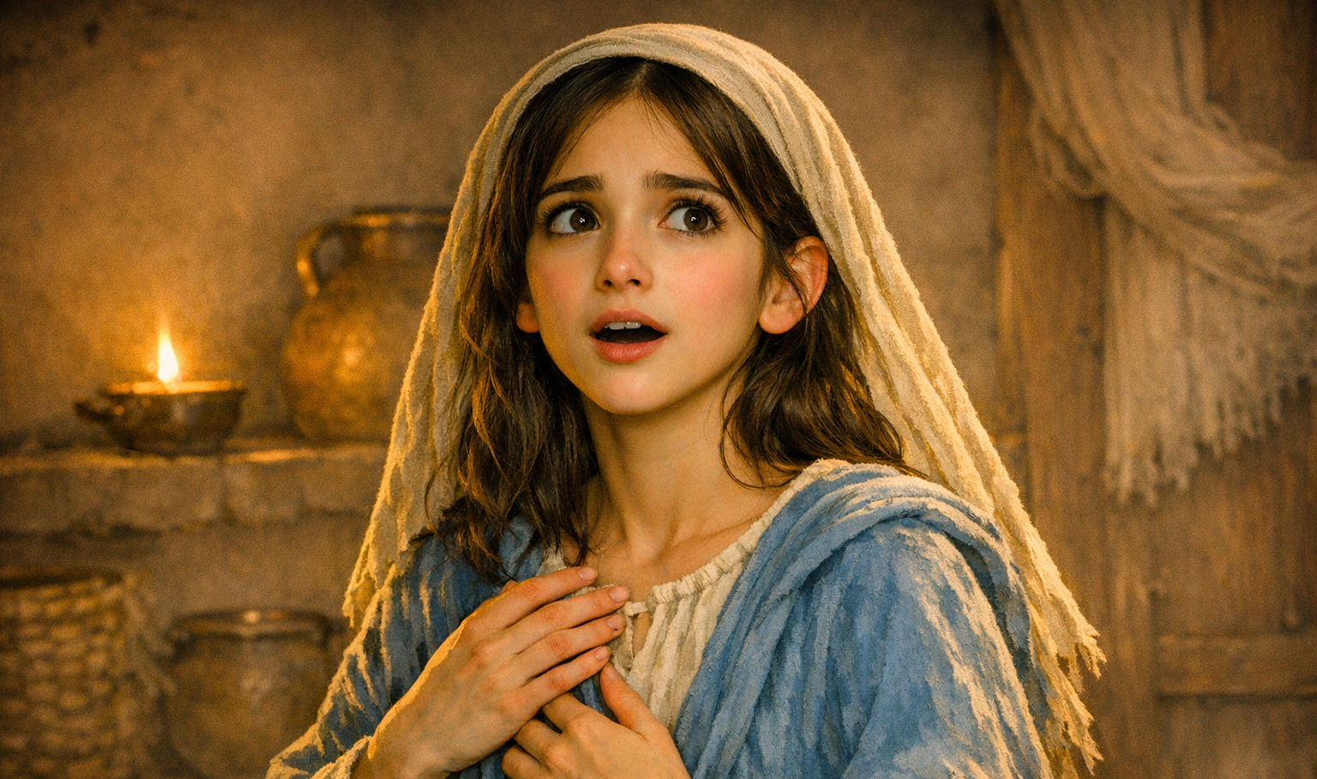
“And he came to her and said, ‘Greetings, O favored one, the Lord is with you!’ But she was greatly troubled at the saying, and tried to discern what sort of greeting this might be.”
Luke 1:28-29

Slide 9
“And the angel said to her, ‘Do not be afraid, Mary, for you have found favor with God.’” Luke 1:30

Slide 10
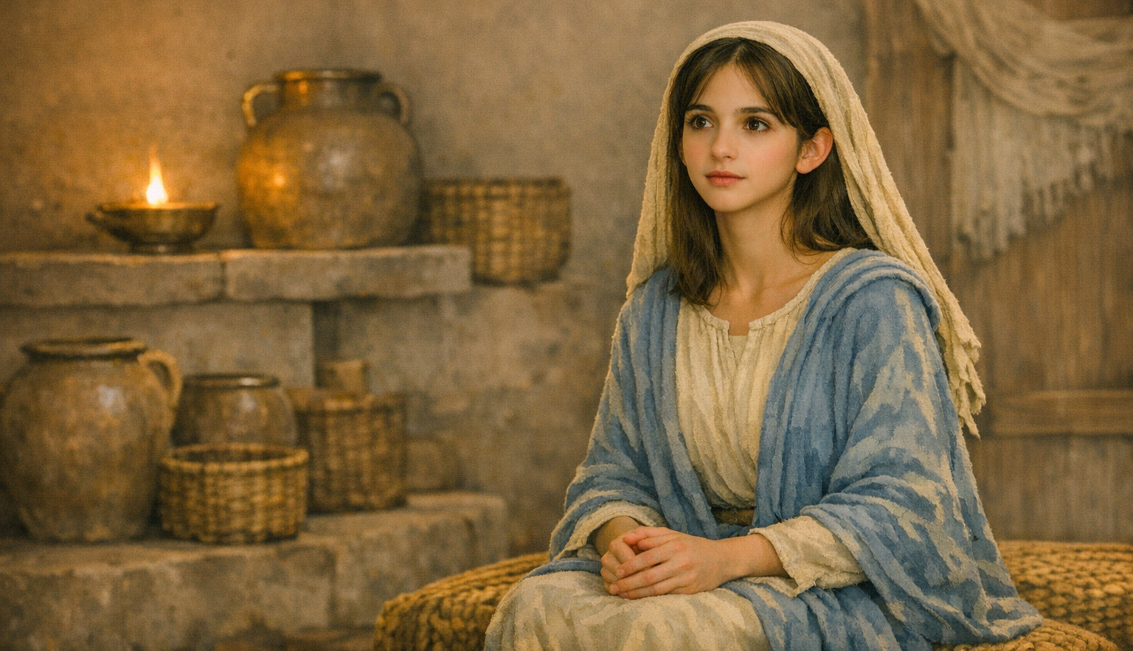
“‘And behold, you will conceive in your womb and bear a son, and you shall call his name Jesus. He will be great and will be called the Son of the Most High. And the Lord God will give to him the throne of his father David, and he will reign over the house of Jacob forever, and of his kingdom there will be no end.’” Luke 1:31-33

Slide 11
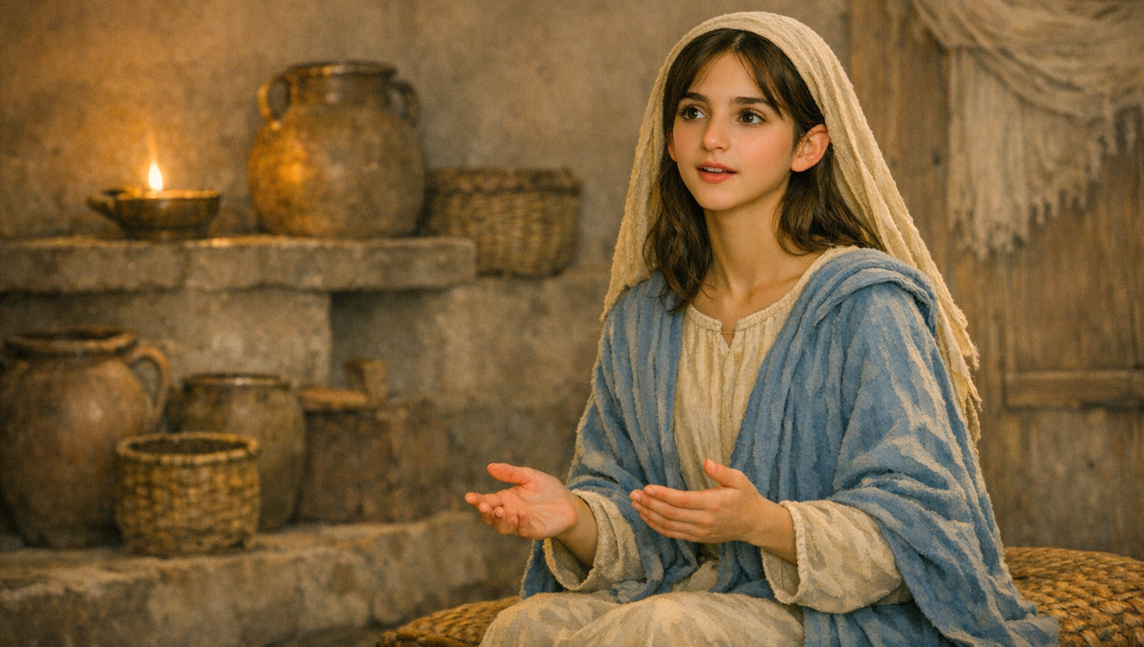
“And Mary said to the angel, ‘How will this be, since I am a virgin?’” Luke 1:34

Slide 12
“And the angel answered her, ‘The Holy Spirit will come upon you, and the power of the Most High will overshadow you; therefore the child to be born will be called holy—the Son of God.’”
Luke 1:35

Slide 13
“’And behold, your relative Elizabeth in her old age has also conceived a son, and this is the sixth month with her who was called barren. For nothing will be impossible with God.’” Luke 1:36-37

Slide 14
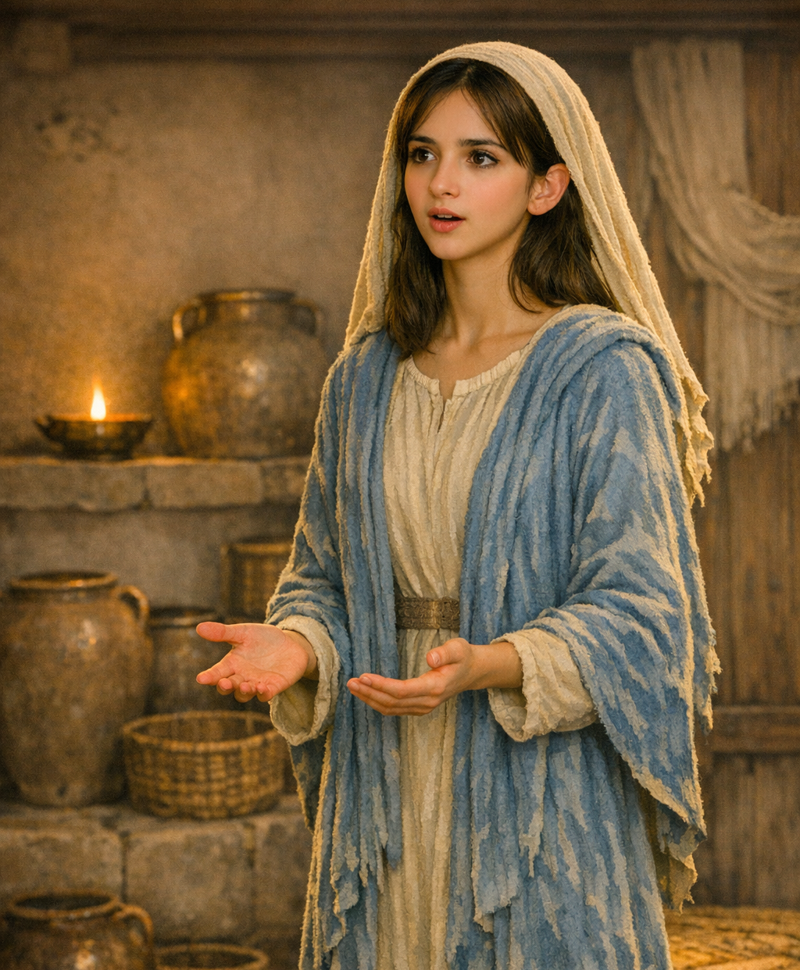
“And Mary said, ‘Behold, I am the servant of the Lord; let it be to me according to your word.’ And the angel departed from her.”
Luke 1:38

Slide 15
Meekness and Majesty!
Lowliness Revealed (vss. 26-27)
Grace Extended (vss. 28-30)
Majesty Predicted (vss. 31-35)
Power Promised (vss. 36-38)

Slide 16
The sixth month of Elizabeth’s pregnancy – not an event the world was counting!
“In the sixth month the angel Gabriel was sent from God to a city of Galilee named Nazareth, to a virgin betrothed to a man whose name was Joseph, of the house of David. And the virgin's name was Mary.” Luke 1:26-27

Slide 17
A little-known country village…
“Can anything good come from Nazareth?”
“In the sixth month the angel Gabriel was sent from God to a city of Galilee named Nazareth, to a virgin betrothed to a man whose name was Joseph, of the house of David. And the virgin's name was Mary.” Luke 1:26-27

Slide 18
Mary was insignificant…
Poor
Likely uneducated
Young (probably 13ish!)
Female (male dominated culture)
“In the sixth month the angel Gabriel was sent from God to a city of Galilee named Nazareth, to a virgin betrothed to a man whose name was Joseph, of the house of David. And the virgin's name was Mary.” Luke 1:26-27

Slide 19
Why did God select a “nobody” from a “no-name” town?
Reflects who Jesus came to be
Reflects how God usually works!
“In the sixth month the angel Gabriel was sent from God to a city of Galilee named Nazareth, to a virgin betrothed to a man whose name was Joseph, of the house of David. And the virgin's name was Mary.” Luke 1:26-27

Slide 20
Critical detail – tying the story to Old Testament prophecy!
“In the sixth month the angel Gabriel was sent from God to a city of Galilee named Nazareth, to a virgin betrothed to a man whose name was Joseph, of the house of David. And the virgin's name was Mary.” Luke 1:26-27

Slide 21
Meekness and Majesty!
Lowliness Revealed (vss. 26-27)
Grace Extended (vss. 28-30)
Majesty Predicted (vss. 31-35)
Power Promised (vss. 36-38)

Slide 22
Favor – from “charis”
(to be treated with undeserved kindness)
“And he came to her and said, ‘Greetings, O favored one, the Lord is with you!’ But she was greatly troubled at the saying, and tried to discern what sort of greeting this might be. And the angel said to her, ‘Do not be afraid, Mary, for you have found favor with God.’” Luke 1:28-30

Slide 23
Note on “Hail Mary, full of grace…” :
Mistakenly looks to Mary as sinless and a source of grace
Here we see Mary as the recipient of grace – not the source of it!
“And he came to her and said, ‘Greetings, O favored one, the Lord is with you!’ But she was greatly troubled at the saying, and tried to discern what sort of greeting this might be. And the angel said to her, ‘Do not be afraid, Mary, for you have found favor with God.’” Luke 1:28-30

Slide 24
This greeting and assurance is common to those with special roles in salvation history!
“And he came to her and said, ‘Greetings, O favored one, the Lord is with you!’ But she was greatly troubled at the saying, and tried to discern what sort of greeting this might be. And the angel said to her, ‘Do not be afraid, Mary, for you have found favor with God.’” Luke 1:28-30

Slide 25
God’s words to Abraham:
“I will make of you a great nation, and I will bless you and make your name great, so that you will be a blessing. I will bless those who bless you…”
Genesis 12:2-3
“And he came to her and said, ‘Greetings, O favored one, the Lord is with you!’ But she was greatly troubled at the saying, and tried to discern what sort of greeting this might be. And the angel said to her, ‘Do not be afraid, Mary, for you have found favor with God.’” Luke 1:28-30

Slide 26
God’s words to Isaac:
“Do not be afraid, for I am with you and will bless you. I will multiply your descendants, and they will become a great nation.” Genesis 26:24
“And he came to her and said, ‘Greetings, O favored one, the Lord is with you!’ But she was greatly troubled at the saying, and tried to discern what sort of greeting this might be. And the angel said to her, ‘Do not be afraid, Mary, for you have found favor with God.’” Luke 1:28-30

Slide 27
God’s words to Jacob:
“I am with you, and I will protect you wherever you go. One day I will bring you back to this land. I will not leave you until I have finished giving you everything I have promised you.” Genesis 28:15
“And he came to her and said, ‘Greetings, O favored one, the Lord is with you!’ But she was greatly troubled at the saying, and tried to discern what sort of greeting this might be. And the angel said to her, ‘Do not be afraid, Mary, for you have found favor with God.’” Luke 1:28-30

Slide 28
God’s words to Moses:
“I will be with you. And this is your sign that I am the one who has sent you: When you have brought the people out of Egypt, you will worship God at this very mountain.” Exodus 3:12
“And he came to her and said, ‘Greetings, O favored one, the Lord is with you!’ But she was greatly troubled at the saying, and tried to discern what sort of greeting this might be. And the angel said to her, ‘Do not be afraid, Mary, for you have found favor with God.’” Luke 1:28-30

Slide 29
God’s words to Gideon:
“The angel of the Lord appeared to him and said, ‘Mighty hero, the LORD is with you!’”
Judges 6:12
“And he came to her and said, ‘Greetings, O favored one, the Lord is with you!’ But she was greatly troubled at the saying, and tried to discern what sort of greeting this might be. And the angel said to her, ‘Do not be afraid, Mary, for you have found favor with God.’” Luke 1:28-30

Slide 30
Meekness and Majesty!
Lowliness Revealed (vss. 26-27)
Grace Extended (vss. 28-30)
Majesty Predicted (vss. 31-35)
Power Promised (vss. 36-38)

Slide 31
Jesus – The Lord Saves!
“And behold, you will conceive in your womb and bear a son, and you shall call his name Jesus. He will be great and will be called the Son of the Most High. And the Lord God will give to him the throne of his father David, and he will reign over the house of Jacob forever, and of his kingdom there will be no end.” Luke 1:31-33

Slide 32
Unqualified greatness!
Used in Old Testament to describe God, his character and his majesty!
“And behold, you will conceive in your womb and bear a son, and you shall call his name Jesus. He will be great and will be called the Son of the Most High. And the Lord God will give to him the throne of his father David, and he will reign over the house of Jacob forever, and of his kingdom there will be no end.” Luke 1:31-33

Slide 33
The Son of God!
What does this mean?
Role of messianic king (how Jews used the term “son of God”)
Not yet expression of divinity
“And behold, you will conceive in your womb and bear a son, and you shall call his name Jesus. He will be great and will be called the Son of the Most High. And the Lord God will give to him the throne of his father David, and he will reign over the house of Jacob forever, and of his kingdom there will be no end.” Luke 1:31-33

Slide 34
Promised an eternal kingdom!
“And behold, you will conceive in your womb and bear a son, and you shall call his name Jesus. He will be great and will be called the Son of the Most High. And the Lord God will give to him the throne of his father David, and he will reign over the house of Jacob forever, and of his kingdom there will be no end.” Luke 1:31-33

Slide 35
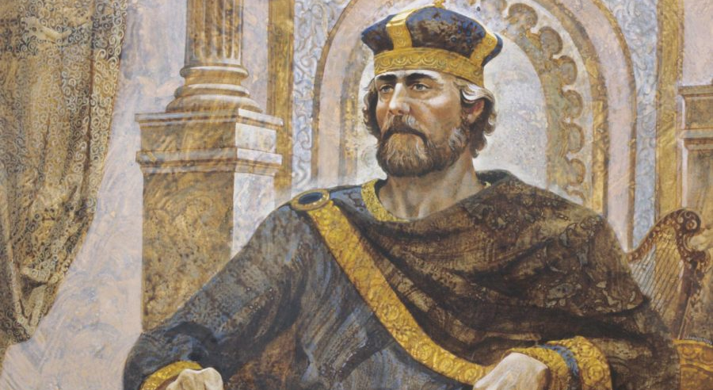
“Your house and your kingdom will continue before me for all time, and your throne will be secure forever.”
2 Samuel 7:16

Slide 36
“His government and its peace will never end. He will rule with fairness and justice from the throne of his ancestor David for all eternity.” Isaiah 9:7

Slide 37
“And Mary said to the angel, ‘How will this be, since I am a virgin?’” Luke 1:34

Slide 38
“And the angel answered her, ‘The Holy Spirit will come upon you, and the power of the Most High will overshadow you; therefore the child to be born will be called holy—the Son of God.’”
Luke 1:35
Holy:
Set apart, consecrated
Sharing in God’s purity
Free from human defilement

Slide 39
“And the angel answered her, ‘The Holy Spirit will come upon you, and the power of the Most High will overshadow you; therefore the child to be born will be called holy—the Son of God.’”
Luke 1:35
Son of God
What does it mean?
Beyond traditional Jewish meaning
Divine origin (his conception)
Set apart from sin
Uniquely related to God

Slide 40
Meekness and Majesty!
Lowliness Revealed (vss. 26-27)
Grace Extended (vss. 28-30)
Majesty Predicted (vss. 31-35)
Power Promised (vss. 36-38)

Slide 41
“And behold, your relative Elizabeth in her old age has also conceived a son, and this is the sixth month with her who was called barren. For nothing will be impossible with God.” Luke 1:36-37
Nothing is impossible!
A baby for a barren woman
A virgin birth
Impossible situations in our lives!

Slide 42
“And Mary said, ‘Behold, I am the servant of the Lord; let it be to me according to your word.’ And the angel departed from her.”
Luke 1:38
Amazing submission!
What about…
The impossibility of the promise?
Her marriage?
Her reputation?

Slide 43
Meekness and Majesty!
Lowliness Revealed (vss. 26-27)
Grace Extended (vss. 28-30)
Majesty Predicted (vss. 31-35)
Power Promised (vss. 36-38)

Slide 44
How Does “Meekness and Majesty” Apply to Us Today?
The need for Meekness!
God’s value of the weak and lowly
Our need of God’s grace and favor
The importance of surrendering to whatever role God has for us in life and ministry

Slide 45
How Does “Meekness and Majesty” Apply to Us Today?
The hope of Majesty!
The reality of our eternal king
The hope of God’s power in any situation

Slide 46
Sermon by Dan Bridges
Amman International Church (AIC)
Amman, Jordan
This and most other AIC sermons can be found on the church website:
ammanchurch.org

Slide 47
Black

Slide 48


NT Preaching link at BibleStudyDownloads.org
Get this presentation and script for free!
Notes:
NT Preaching (np)

