Slide 1
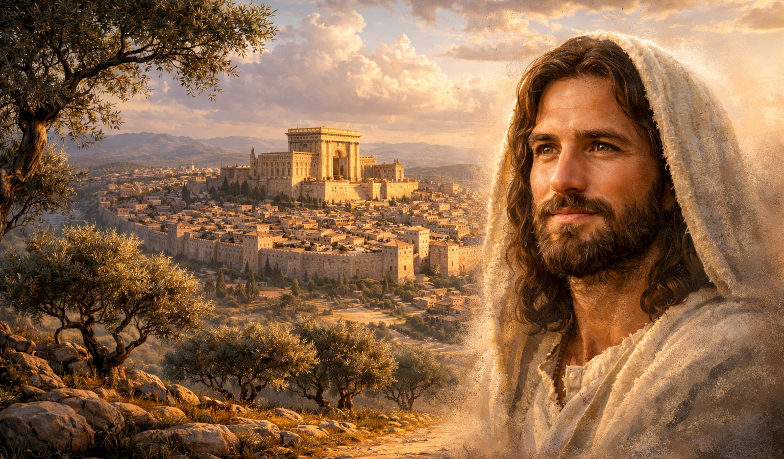
The Gospel of
Luke
Luke 1:1-4
A Dependable Faith
Preached by Dan Bridges Amman International Church, Jordan (AmmanChurch.org) Uploaded by Dr. Rick Griffith • Jordan Evangelical Theological Seminary Files in many languages for free download at BibleStudyDownloads.org

Slide 2
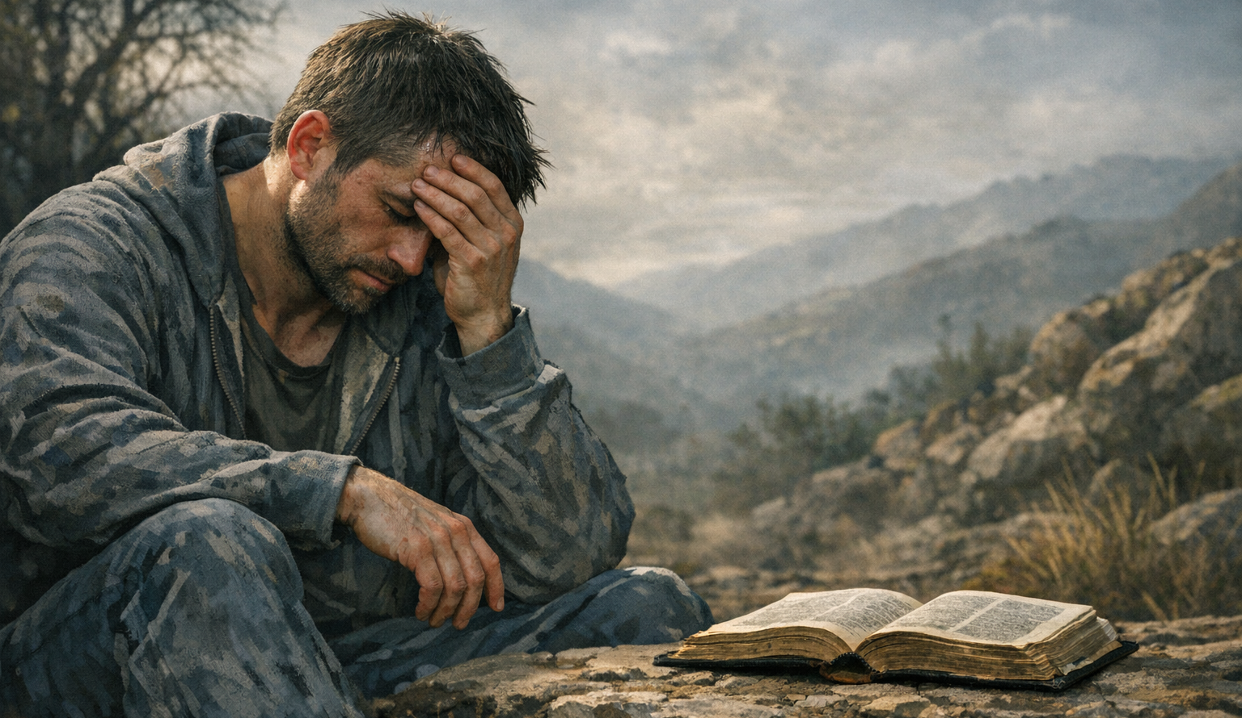
Have you ever struggled with doubt about your faith in Jesus?

Slide 3
Are there people around you who are confused about who Jesus is?

Slide 4
Have you become so familiar with the stories about Jesus that you have lost the wonder of who he is?

Slide 5
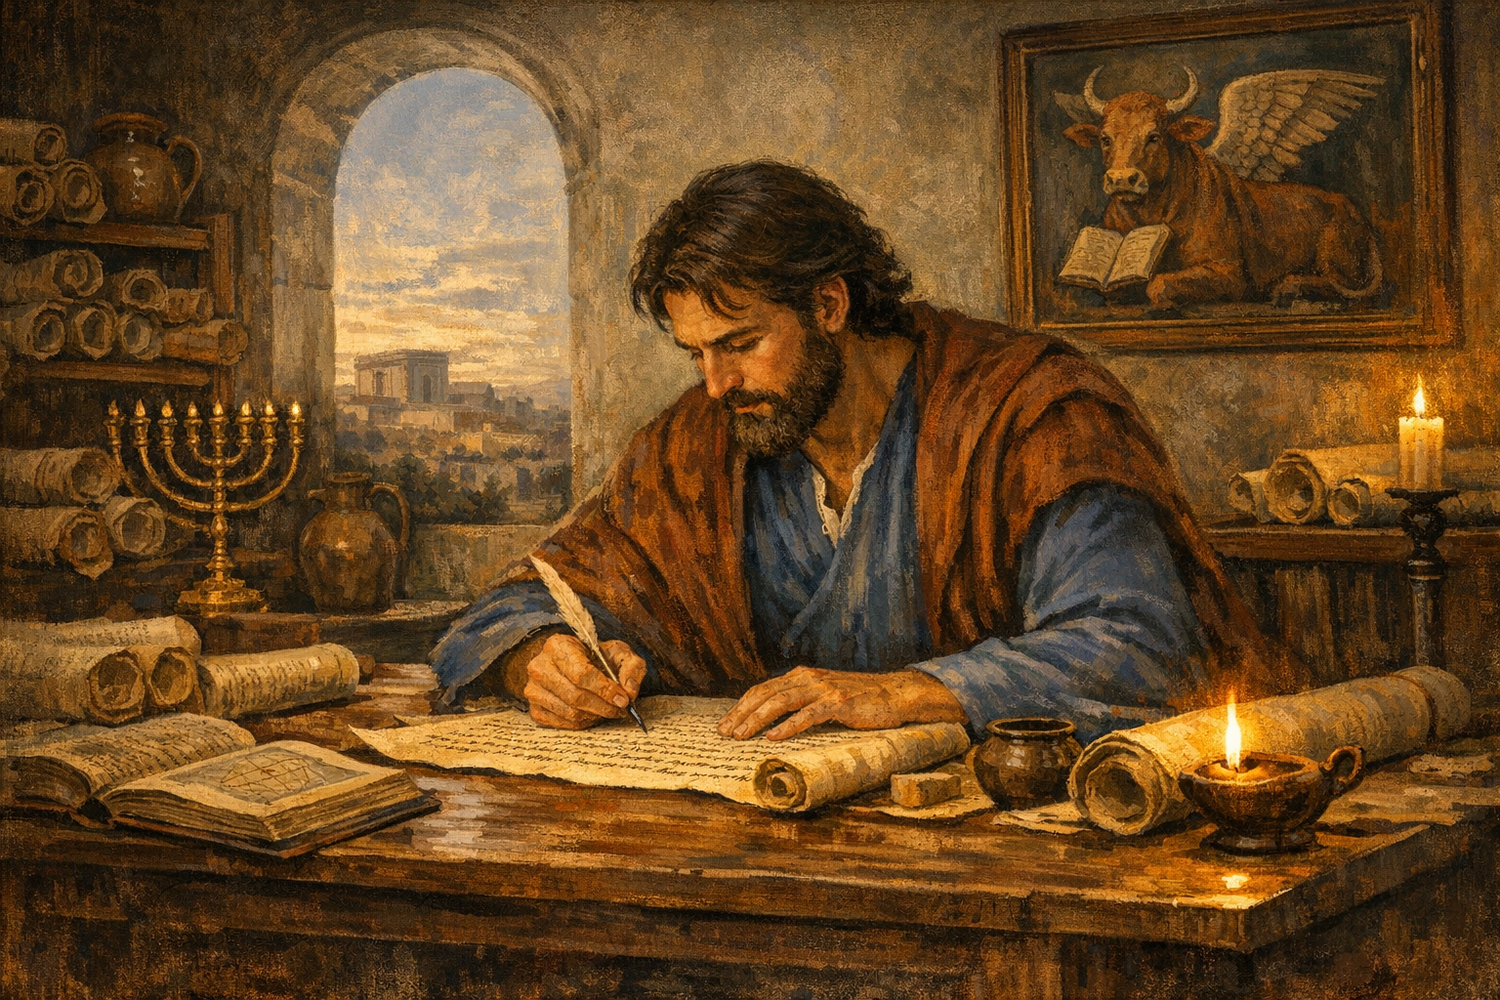
A Dependable Faith
Intro to Luke – the Man and the Book
Luke’s Purpose in Writing
Luke’s Method in Writing
Our Purposes in Studying

Slide 6
Intro to Luke
Who was Luke?
Identified by early church leaders as
Author of the Gospel of Luke
Author of the Book of Acts

Slide 7
Intro to Luke
Who was Luke?
“it seemed good to me… to write an orderly account for you, most excellent Theophilus…”
Luke 1:3
“In the first book, O Theophilus, I have dealt with all that Jesus began to do and teach…”
Acts 1:1
Luke wrote over 1/4 of the New Testament!

Slide 8
Intro to Luke
Who was Luke?
“Aristarchus… and Mark the cousin of Barnabas… and Jesus who is called Justus. These are the only men of the circumcision among my fellow workers for the kingdom of God…
Luke the beloved physician greets you…”
Colossians 4:10-14
Luke was a Gentile
Luke was a physician

Slide 9
Intro to Luke
Who was Luke?
Identified by early church leaders as
Author of the Gospel of Luke
Author of the Book of Acts
Eusebius: “Luke of Antioch”

Slide 10
Intro to Luke
Who was Luke?
“Now those who were scattered because of the persecution that arose over Stephen traveled as far as Phoenicia and Cyprus and Antioch, speaking the word to no one except Jews. But there were some of them, men of Cyprus and Cyrene, who on coming to Antioch spoke to the Hellenists also, preaching the Lord Jesus. And the hand of the Lord was with them, and a great number who believed turned to the Lord.” Acts 11:19-21

Slide 11
Intro to Luke
Who was Luke?
Let’s imagine Luke’s story for a moment…
Notes:
Luke’s Background Story Imagined…
Luke worked as a young doctor in the cosmopolitan city of Antioch – the third largest city in the Roman empire after Rome and Alexandria. The city teemed with merchants, soldiers, slaves and ordinary citizens.
Luke was aware of the Jewish population in the city, but he had little interaction with them. They had their synagogues and religious systems and separated themselves from Gentiles like Luke.
One day, however, Luke noticed a small crowd gathered around a group of foreigners—Jews, but not like the ones he was used to. Their accents were different. Cypriot. North African. They looked like refugees, not rabbis.
Drawing near, Luke heard them speaking of a man named Jesus—how He touched lepers, restored the broken, forgave sins, and rose from the dead. They spoke as if they knew Him personally.
Luke had heard many stories in Antioch—myths, legends, rumors—but this felt different. These men weren’t trying to impress anyone. They weren’t performing. They were remembering.
Luke found himself walking with them, listening for hours. They spoke of a God who saw every person—Greek or Jew, slave or free—as beloved. A God who stepped into human suffering, not from a distance but from within it.
As a physician, Luke had devoted his life to trying to mend broken people. But these men spoke of a healer who could reach places no medicine could touch.
Day after day, Luke sought out these men. Finally, one day, the message they carried—the message they lived—took hold of him. As a result of the faithful testimony of these refugees, Luke now had a relationship with Jesus!

Slide 12
Intro to Luke
Who was Luke?
“And when Paul had seen the vision, immediately we sought to go on into Macedonia…” Acts 16:11
“And when we came into Rome, Paul was allowed to stay by himself…” Acts 28:16
Luke became a traveling companion of Paul (likely starting with Paul’s 2nd journey)

Slide 13
Intro to Luke
Who was Luke?
“Demas, in love with this present world, has deserted me and gone to Thessalonica. Crescens has gone to Galatia, Titus to Dalmatia. Luke alone is with me.” 2 Timothy 4:10-11
Luke remained a faithful companion of Paul (right up until Paul’s death in Rome)

Slide 14
Intro to Luke
When was Luke Written?
Luke and Acts were written at about the same time. Given that Acts ends around AD62, these were probably written around AD 60-62.
(Within the lifetime of many of the apostles)

Slide 15
Intro to Luke
Who was Theophilus?
Name means “Lover of God” or “Beloved of God”
“Most excellent Theophilus” in Luke 1:3 probably refers to a well-known Gentile dignitary

Slide 16
A Dependable Faith
Intro to Luke – the Man and the Book
Luke’s Purpose in Writing
Luke’s Method in Writing
Our Purposes in Studying

Slide 17
Luke’s Purpose in Writing
“Inasmuch as many have undertaken to compile a narrative of the things that have been accomplished among us, just as those who from the beginning were eyewitnesses and ministers of the word have delivered them to us, it seemed good to me also, having followed all things closely for some time past, to write an orderly account for you, most excellent Theophilus, that you may have certainty concerning the things you have been taught.” Luke 1:1-4

Slide 18
Luke’s Purpose in Writing
“Inasmuch as many have undertaken to compile a narrative of the things that have been accomplished among us, just as those who from the beginning were eyewitnesses and ministers of the word have delivered them to us, it seemed good to me also, having followed all things closely for some time past, to write an orderly account for you, most excellent Theophilus, that you may have certainty concerning the things you have been taught.” Luke 1:1-4
Luke’s perspective:
Not a narrative about “what had happened”
A narrative about “the things that have been accomplished”

Slide 19
Luke’s Purpose in Writing
“Inasmuch as many have undertaken to compile a narrative of the things that have been accomplished among us, just as those who from the beginning were eyewitnesses and ministers of the word have delivered them to us, it seemed good to me also, having followed all things closely for some time past, to write an orderly account for you, most excellent Theophilus, that you may have certainty concerning the things you have been taught.” Luke 1:1-4
Luke was writing
To give an orderly account of Jesus’ life and ministry
In order to give Theophilus certainty – to convince him that what he had been taught was accurate and true!

Slide 20
A Dependable Faith
Intro to Luke – the Man and the Book
Luke’s Purpose in Writing
Luke’s Method in Writing
Our Purposes in Studying

Slide 21
Luke’s Method in Writing
“Inasmuch as many have undertaken to compile a narrative of the things that have been accomplished among us, just as those who from the beginning were eyewitnesses and ministers of the word have delivered them to us, it seemed good to me also, having followed all things closely for some time past, to write an orderly account for you, most excellent Theophilus, that you may have certainty concerning the things you have been taught.” Luke 1:1-4
Starting with his conversion in Antioch, Luke had devoted himself for quite some time to learning about the work and ministry of Jesus.

Slide 22
Luke’s Method in Writing
“Inasmuch as many have undertaken to compile a narrative of the things that have been accomplished among us, just as those who from the beginning were eyewitnesses and ministers of the word have delivered them to us, it seemed good to me also, having followed all things closely for some time past, to write an orderly account for you, most excellent Theophilus, that you may have certainty concerning the things you have been taught.” Luke 1:1-4
Luke had spoken to many eyewitnesses of these accounts – people like the apostles, Mary the mother of Jesus, and others…

Slide 23
Luke’s Method in Writing
How accurate was the “oral tradition” of these eyewitnesses?
Memory of illiterate people far exceeds that of literate!
First-century Jewish culture was a “memory culture”
Most Jewish boys (and some girls) memorized
Large portions of the Torah
Key Psalms
The Shema (Deut 6:4–9)
Festival passages
Portions of the Prophets

Slide 24
Luke’s Method in Writing
Given that Luke was from Antioch, when would he have spoken to these eyewitnesses – most of whom would have been in Jerusalem or the surrounding areas?
Luke most likely was with Paul when he traveled to Jerusalem and was then imprisoned in Caesarea in AD57-59.

Slide 25
Luke’s Method in Writing
“Inasmuch as many have undertaken to compile a narrative of the things that have been accomplished among us, just as those who from the beginning were eyewitnesses and ministers of the word have delivered them to us, it seemed good to me also, having followed all things closely for some time past, to write an orderly account for you, most excellent Theophilus, that you may have certainty concerning the things you have been taught.” Luke 1:1-4
Luke used the narratives that others had already written about the life of Jesus – probably including the Gospel of Mark.

Slide 26
Luke’s Method in Writing
“Inasmuch as many have undertaken to compile a narrative of the things that have been accomplished among us, just as those who from the beginning were eyewitnesses and ministers of the word have delivered them to us, it seemed good to me also, having followed all things closely for some time past, to write an orderly account for you, most excellent Theophilus, that you may have certainty concerning the things you have been taught.” Luke 1:1-4
After all this research, Luke wrote his own orderly account – specifically for an audience like Theophilus.

Slide 27
A Dependable Faith
Intro to Luke – the Man and the Book
Luke’s Purpose in Writing
Luke’s Method in Writing
Our Purposes in Studying

Slide 28
Have you ever struggled with doubt about your faith in Jesus?
Are there people around you who are confused about who Jesus is?

Slide 29
Luke’s Purpose in Writing
“Inasmuch as many have undertaken to compile a narrative of the things that have been accomplished among us, just as those who from the beginning were eyewitnesses and ministers of the word have delivered them to us, it seemed good to me also, having followed all things closely for some time past, to write an orderly account for you, most excellent Theophilus, that you may have certainty concerning the things you have been taught.” Luke 1:1-4

Slide 30
A Dependable Faith
How does Luke help us with doubt or confusion about Jesus?
Luke was a hard-working historian – he was very concerned about historical accuracy!

Slide 31
A Dependable Faith
“But as to the facts of the occurrences of the war, I have thought it my duty to give them, not as ascertained from any chance informant, nor as seemed to me probable, but only after investigating with the greatest possible accuracy each detail, in the case of both the events in which I myself participated and of those regarding which I got my information from others. And the endeavor to discover these facts was a laborious task.”
Thucydides – History of the Peloponnesian War

Slide 32
A Dependable Faith
“Wherever modern scholarship has been able to check up on the accuracy of Luke’s work the judgment has been unanimous: he is one of the finest and ablest historians in the ancient world.”
Otto Piper – Theologian, Princeton Theological Seminary
“Luke is a historian of the first rank... This author should be placed along with the very greatest of historians.” William Ramsay – Archaeologist

Slide 33
A Dependable Faith
“Through the testimony of Luke and others, the things that Jesus accomplished are as well established as any fact of ancient history, and this provides a rational basis for our faith.” Dr. Philip Ryken

Slide 34
A Dependable Faith
How does Luke help us with doubt or confusion about Jesus?
Luke was a hard-working historian – he was very concerned about historical accuracy!
Luke was more than a historian – his purpose was theological – “what has been accomplished among us…”

Slide 35
A Dependable Faith
How does Luke help us with doubt or confusion about Jesus?
Luke was a hard-working historian – he was very concerned about historical accuracy!
Luke was more than a historian – his purpose was theological – “what has been accomplished among us…”
Every story or group of stories was selected for a purpose – to make the identity and message of Jesus clear!

Slide 36
Have you become so familiar with the stories about Jesus that you have lost the wonder of who he is?

Slide 37
How can we regain the wonder of Jesus – as if we are learning about him for the first time?
Read and study Luke for yourself!
Work to put ourselves into the stories
Constantly ask the questions, “Why is this story here?” And “What does it teach me about Jesus?”
Constantly ask God to teach us!

Slide 38
A Dependable Faith
Are you ready to be like Luke?
To devote yourself to the study of Jesus?
To be willing to work hard to understand?
To be willing to obey what you learn?

Slide 39
Sermon by Dan Bridges
Amman International Church (AIC)
Amman, Jordan
This and most other AIC sermons can be found on the church website:
ammanchurch.org

Slide 40
Black

Slide 41


NT Preaching link at BibleStudyDownloads.org
Get this presentation and script for free!
Notes:
NT Preaching (np)

