Slide 1
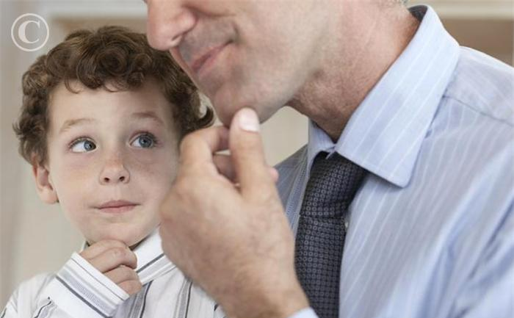
Will the Real Father Stand Up?
Luke 15:11-32
Dr. Rick Griffith, Crossroads International Church cicfamily.com & biblestudydownloads.com

Slide 2
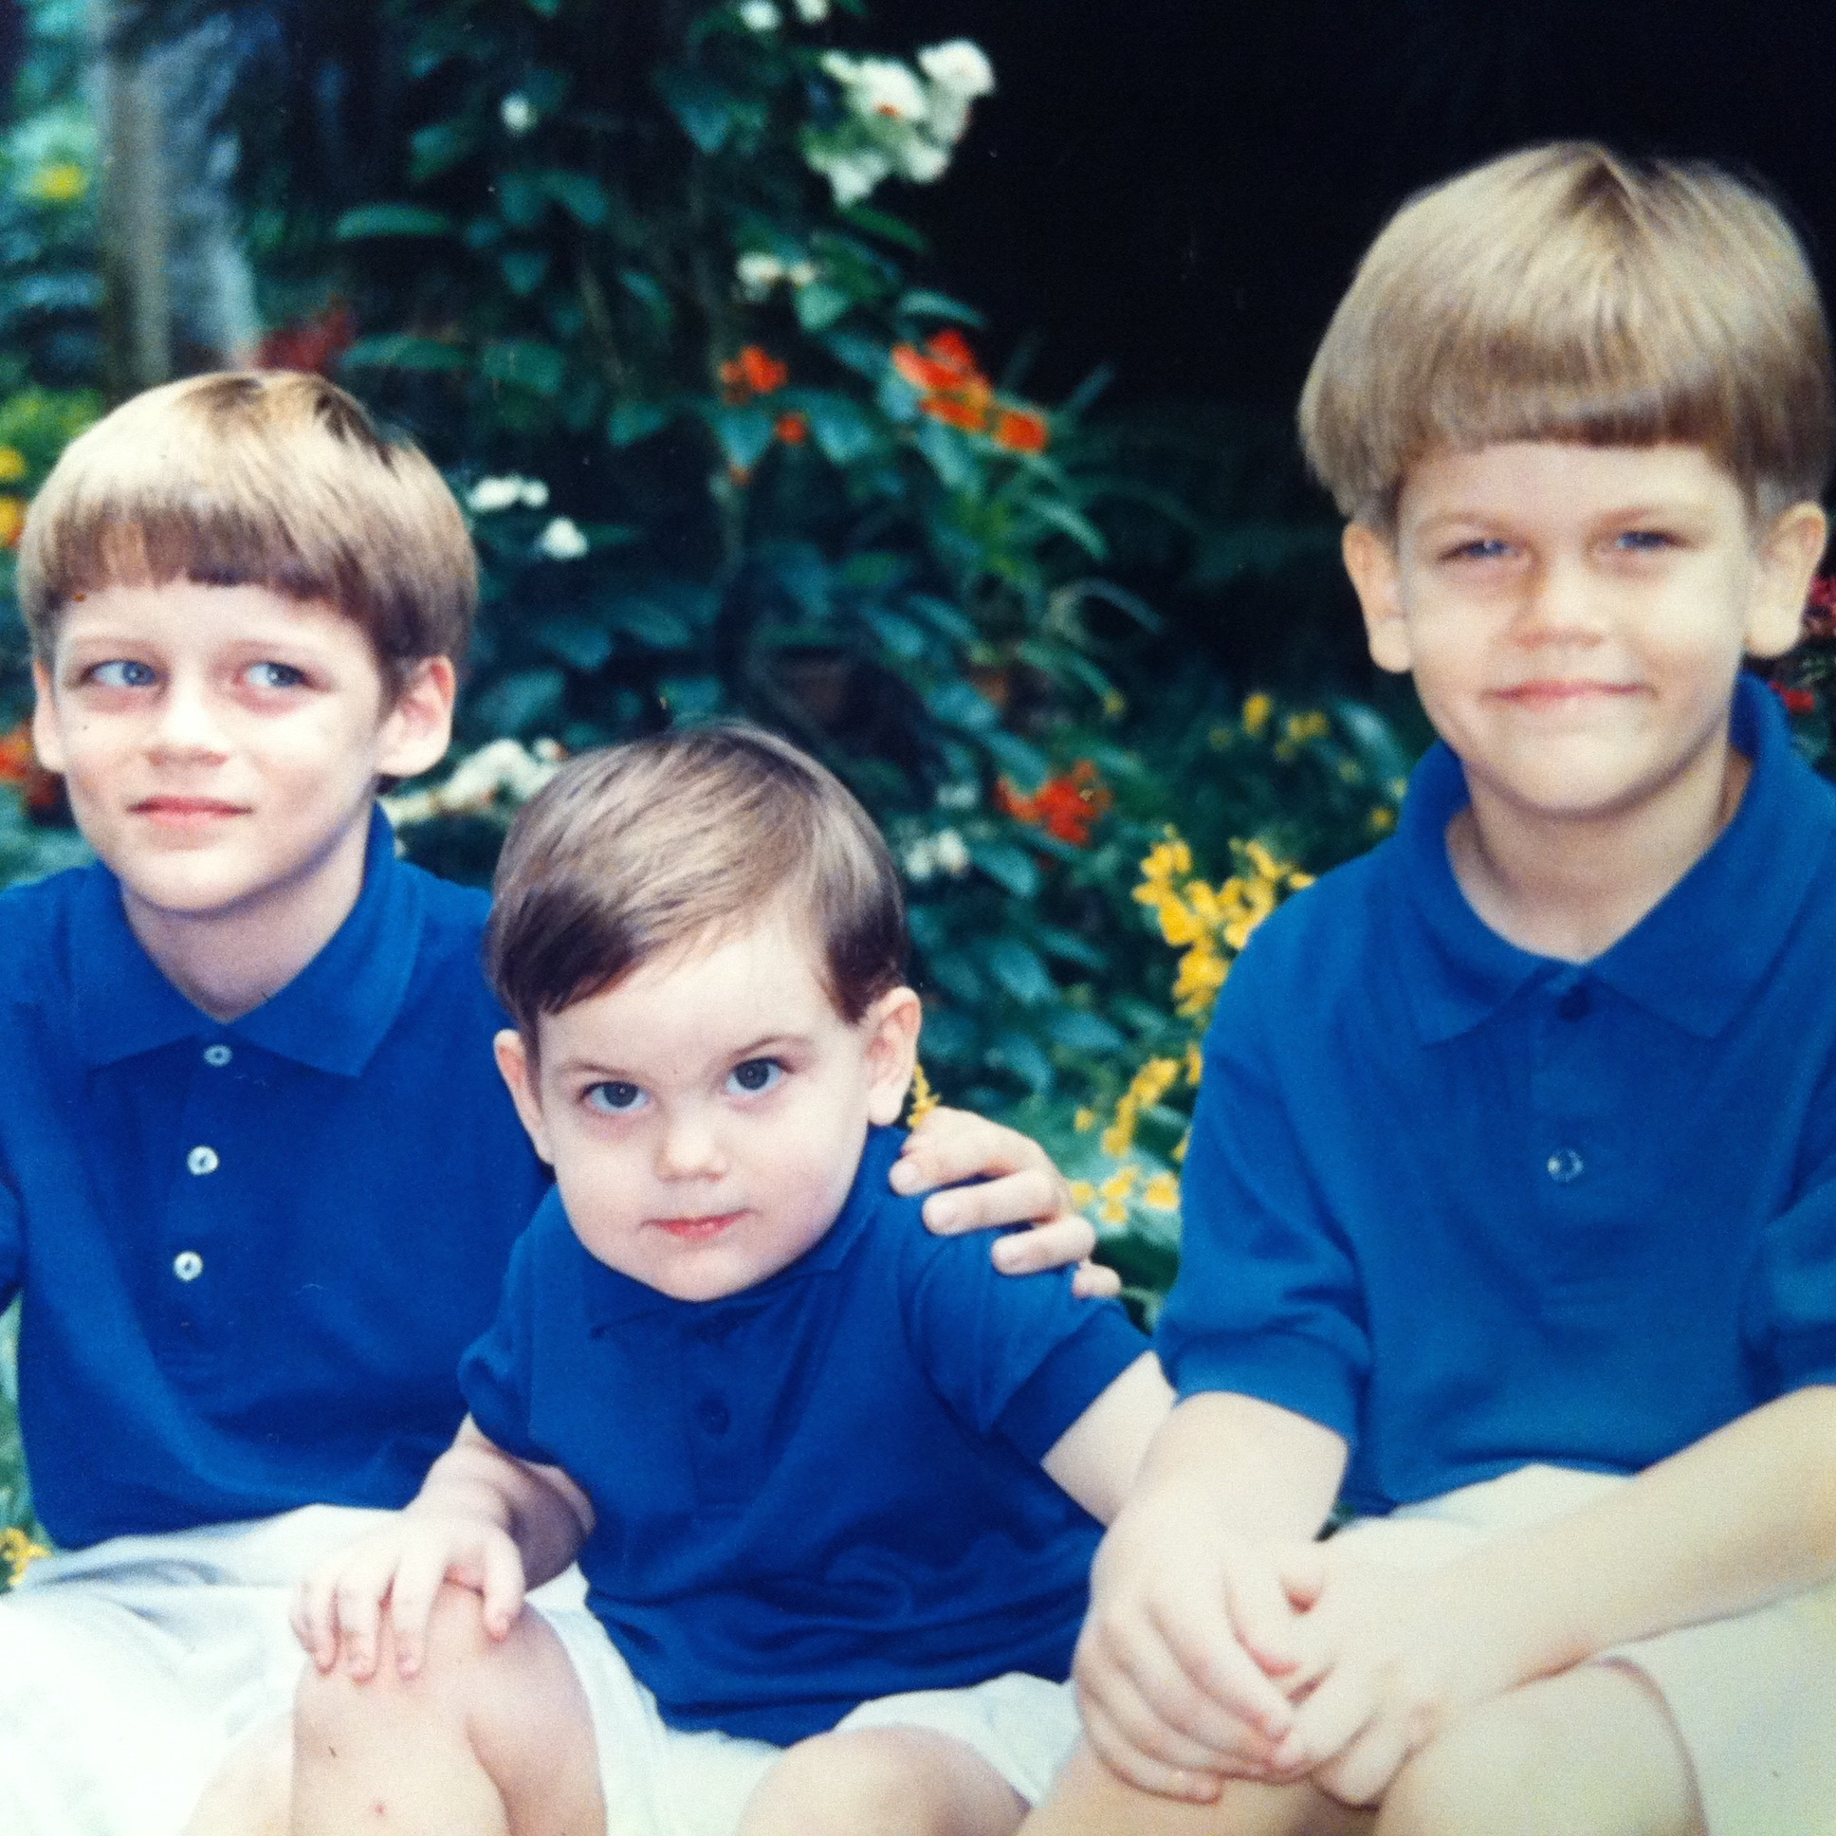
Our Three Sons
Notes:
One of the greatest joys of my life is to father three special sons.

Slide 3
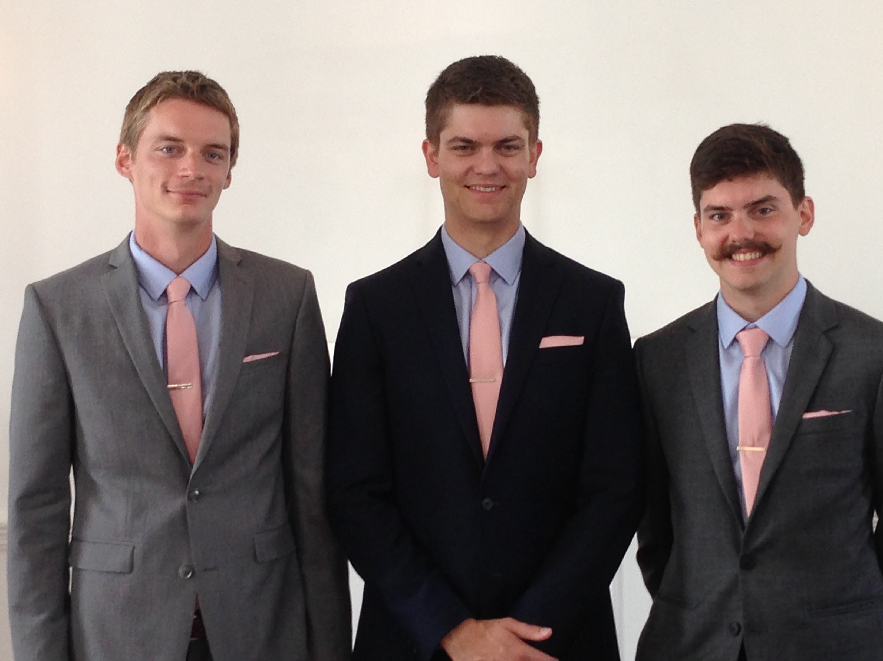
Our Three Sons
Notes:
These three are now in their 20s and are a great source of joy for Susan and me.

Slide 4



Kurt works in IT
9g
Notes:
Our oldest, Kurt, invested ages 20-27 in IT to help Central American farmers get out of poverty.
• At this NGO he met his future wife, Cara.

Slide 5
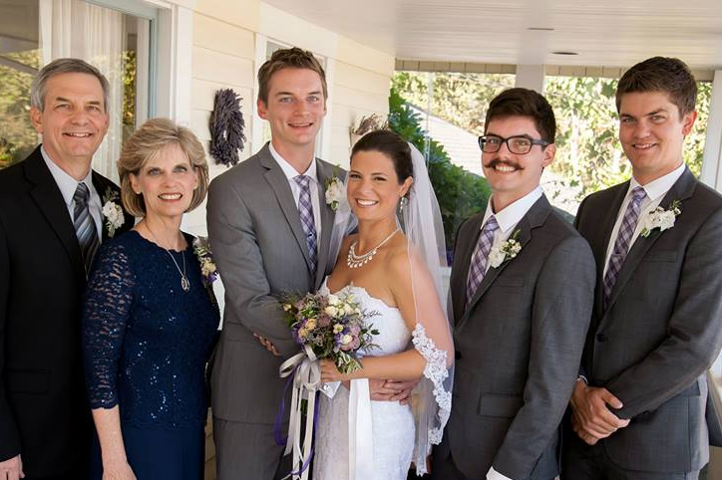
The Griffith Family Sept 2014
2014
Rick
Stephen 25
Susan
John 22
Kurt & Cara 28
Notes:
They married in 2014.

Slide 6
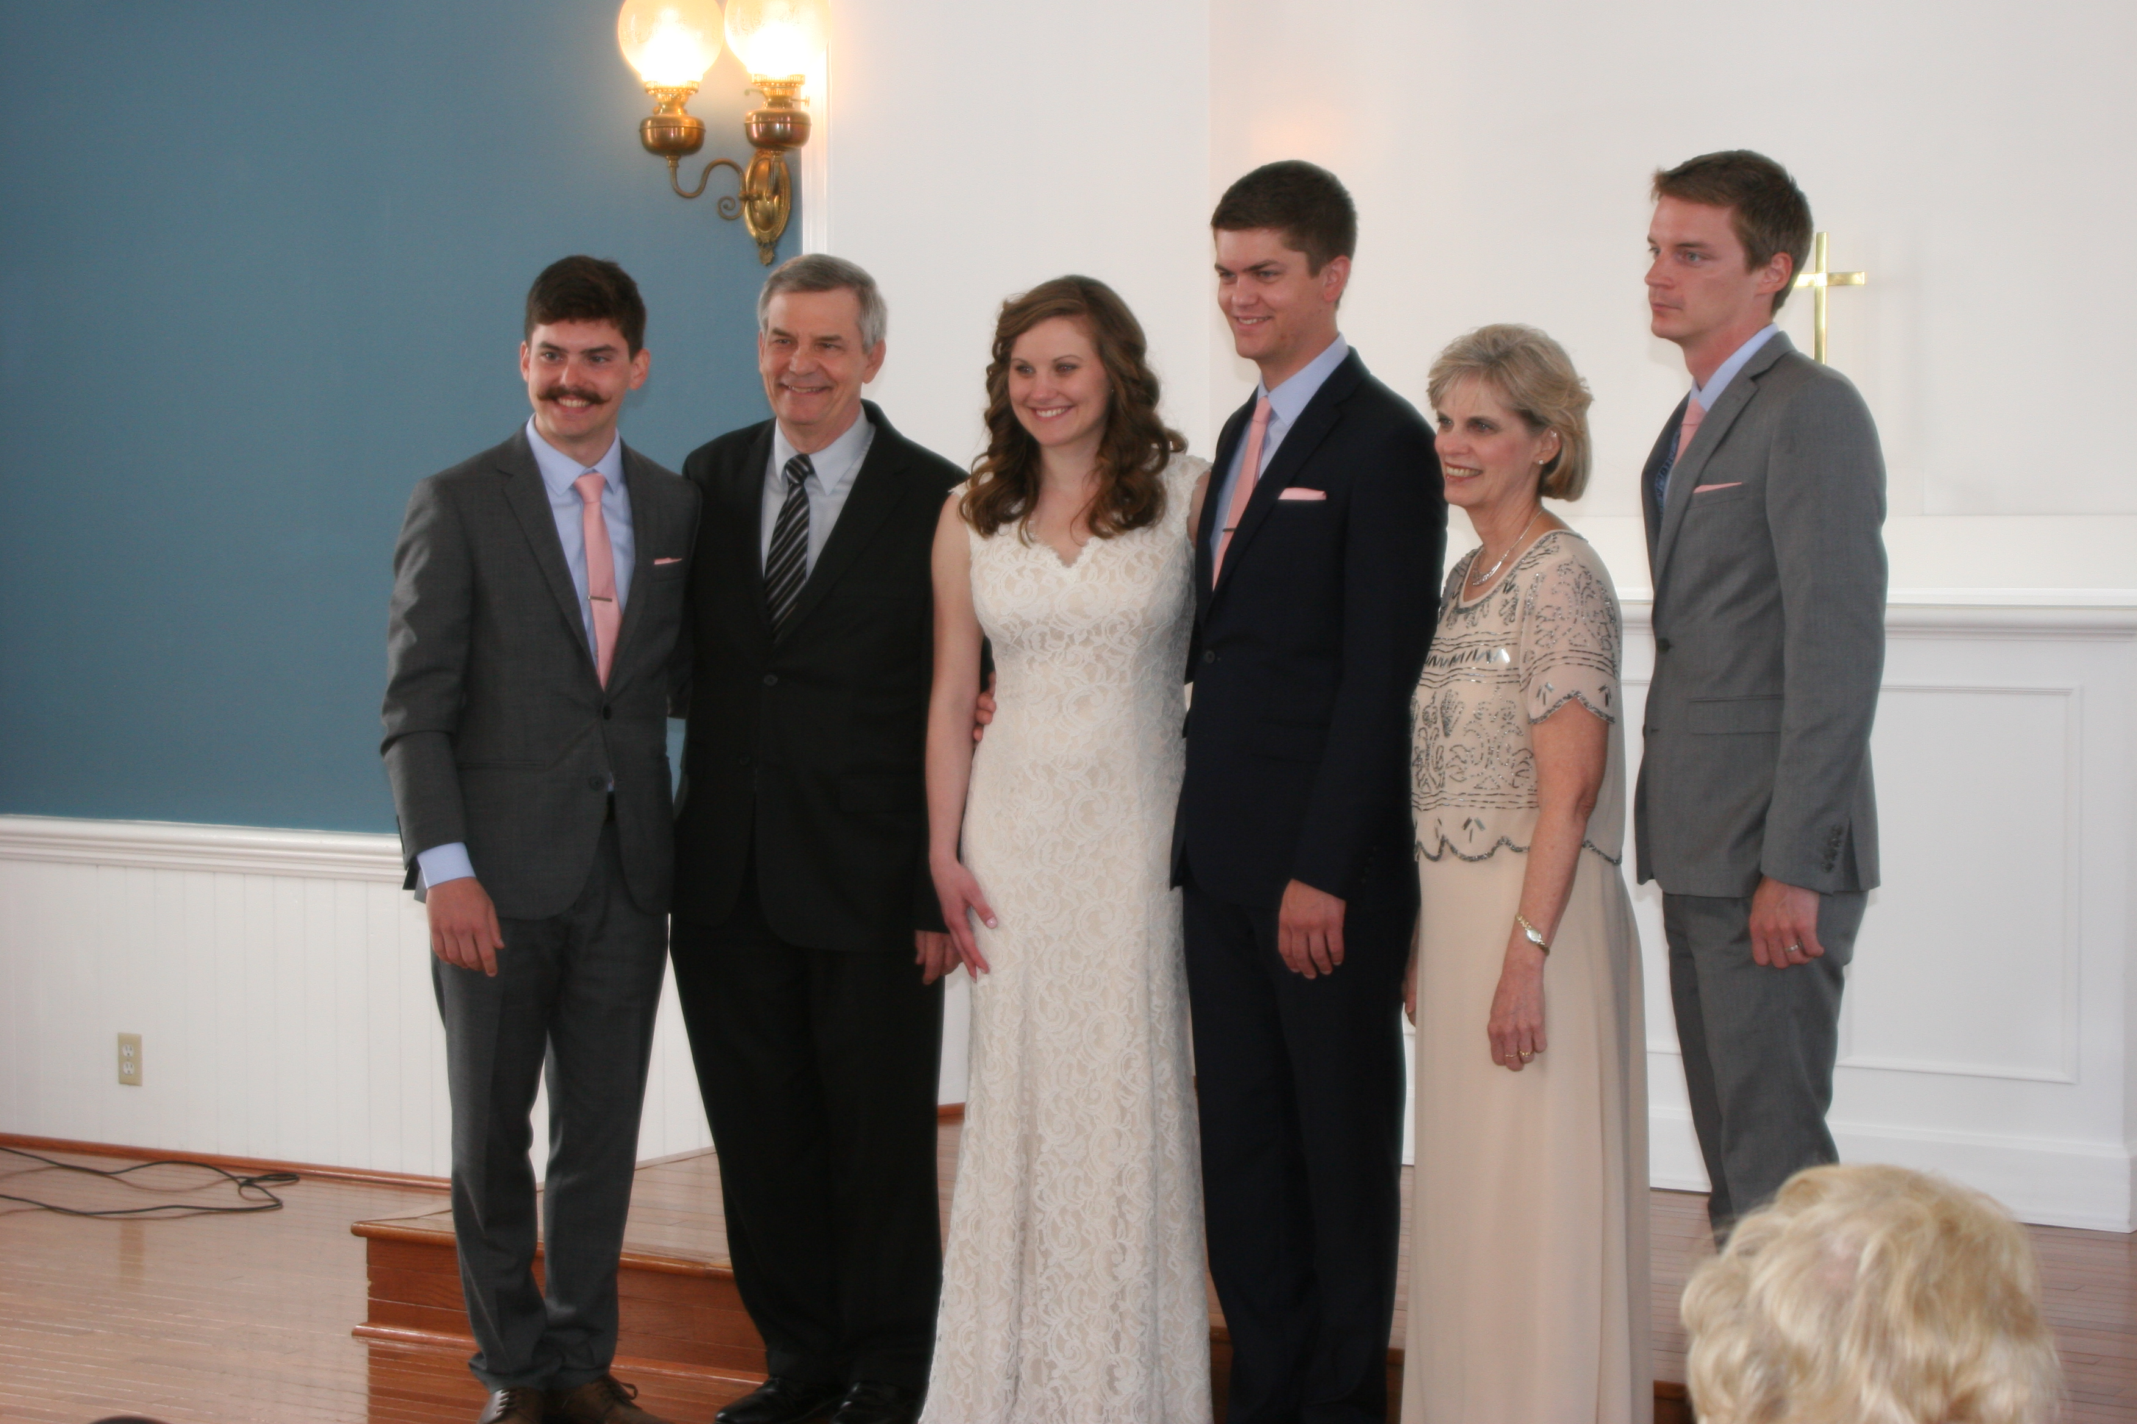
The Griffith Family May 2015
2015
John 22
Kurt 28
Rick
Susan
Stephen & Katie 25
Notes:
Then our second son, Stephen, married in 2015.

Slide 7
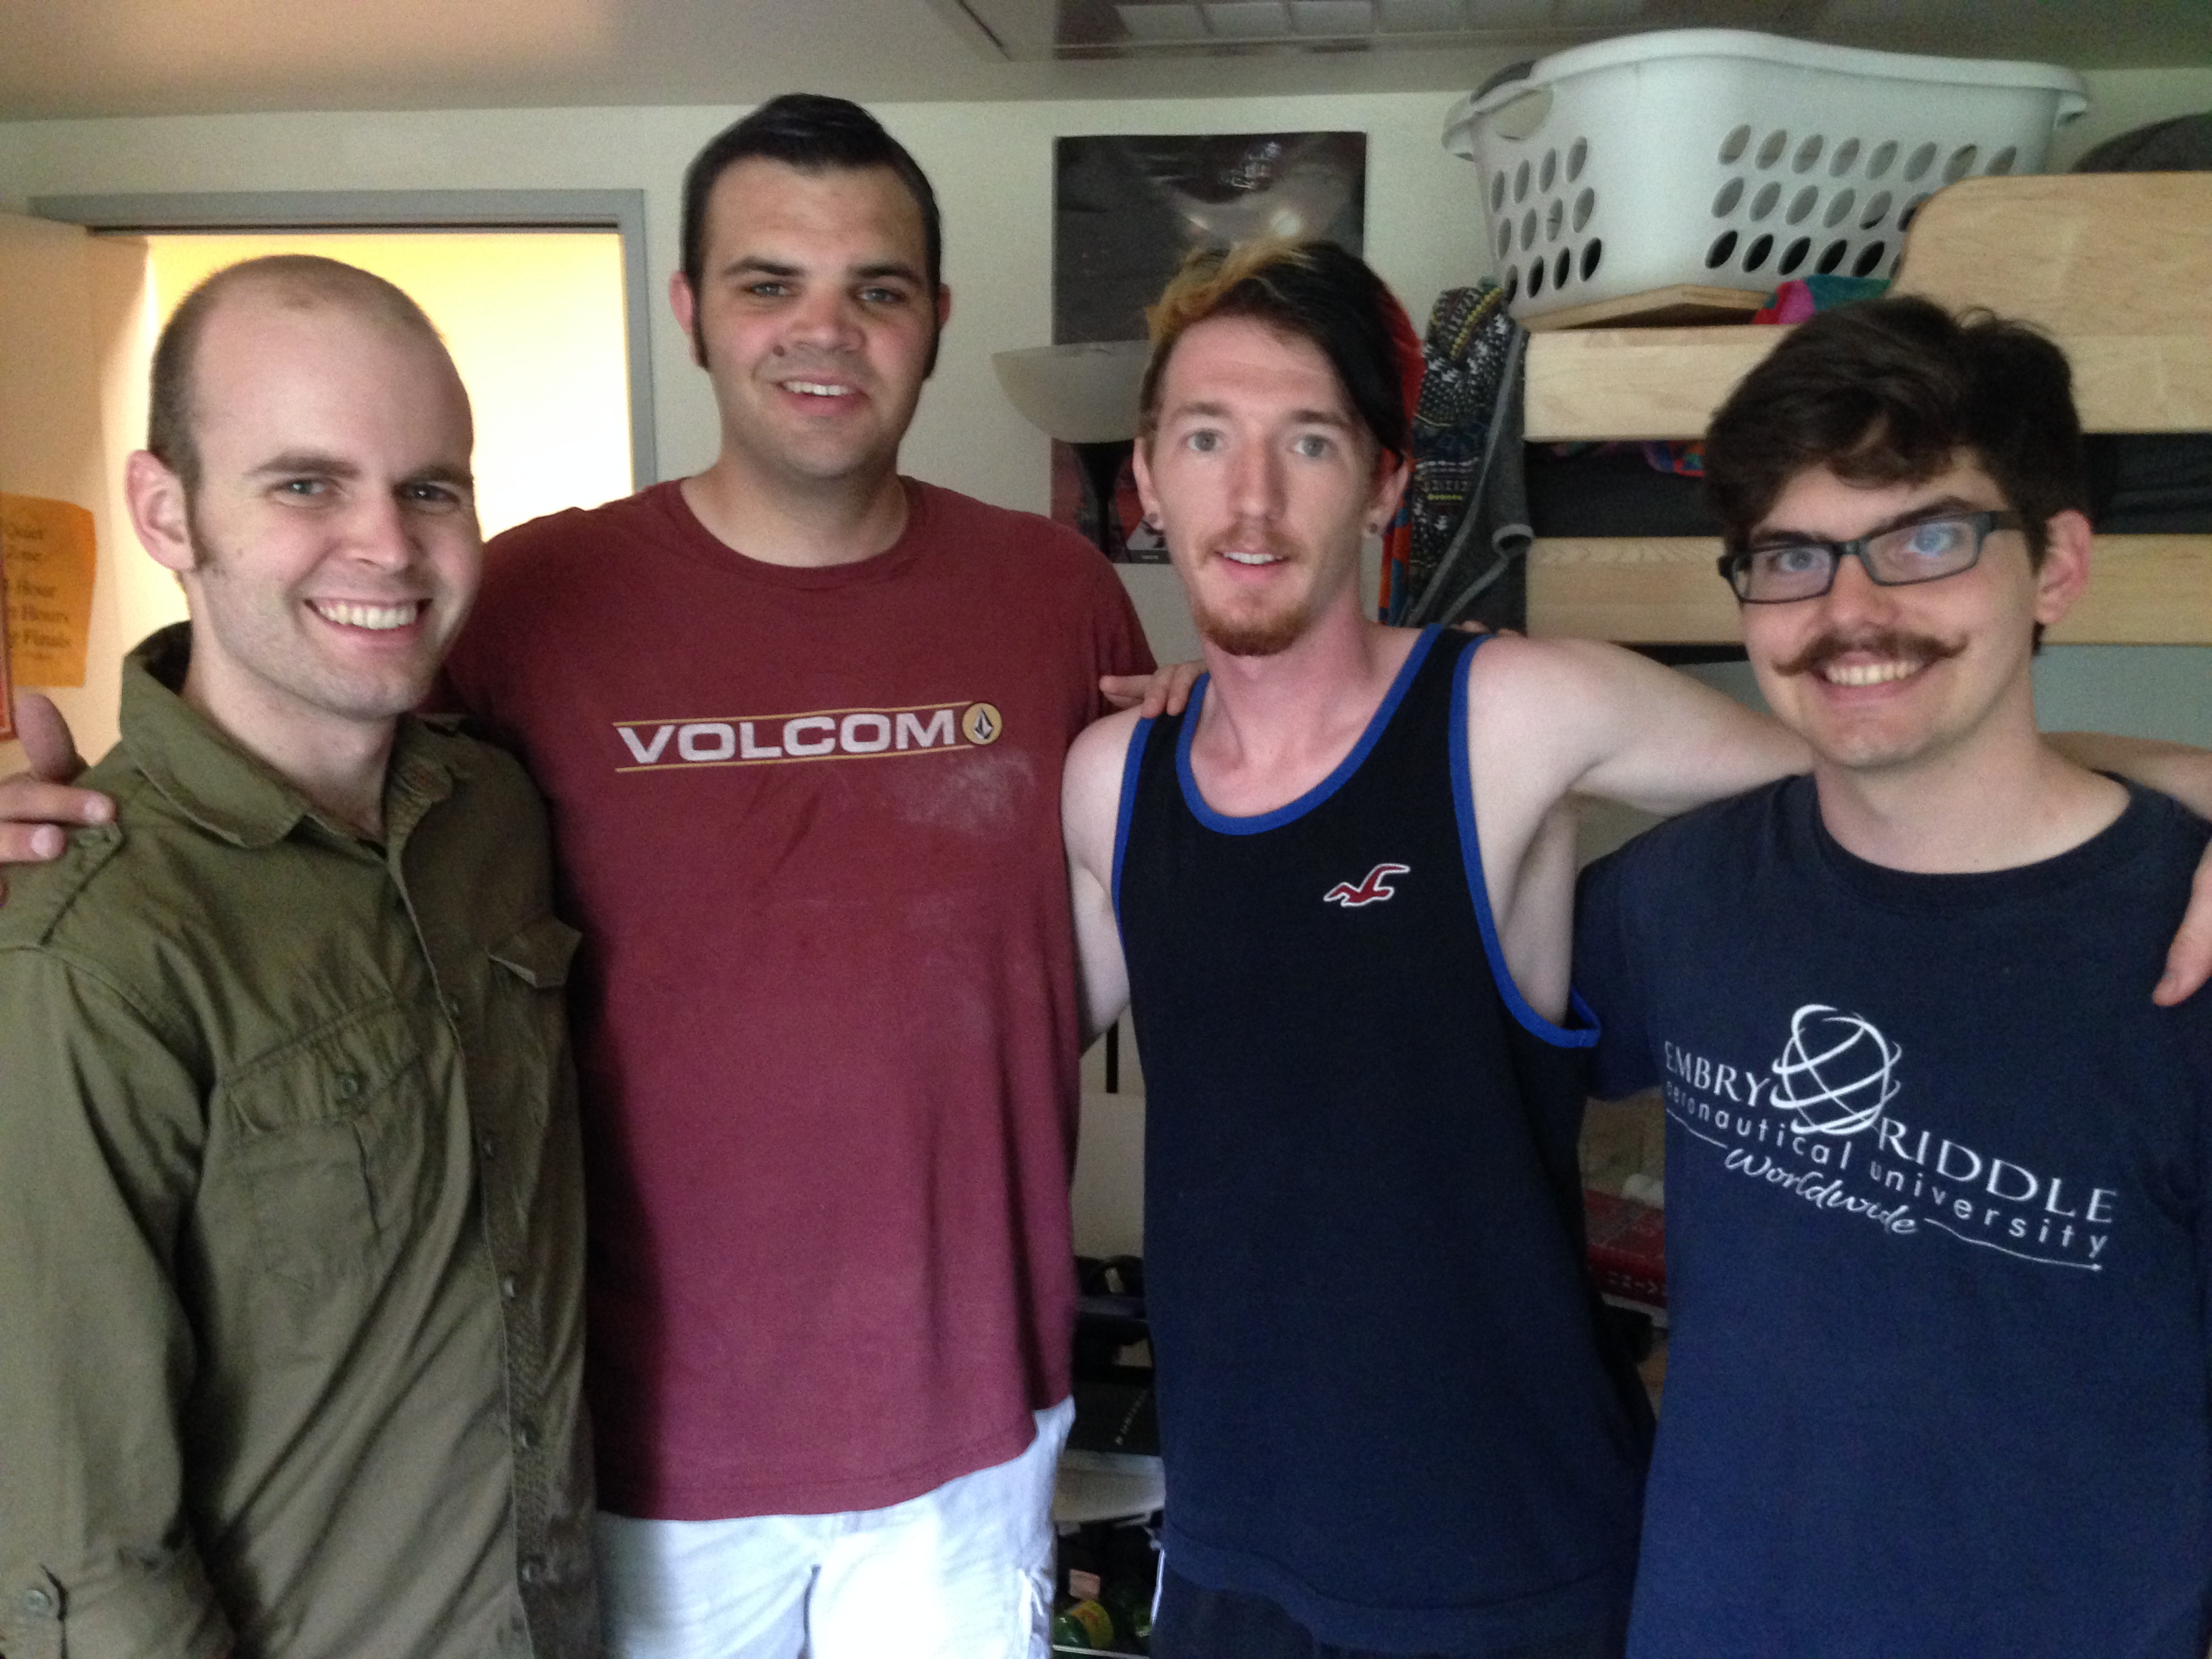
John at Biola University
Notes:
Thankfully, our youngest, John (22), is NOT married! He presses on to graduate from Biola.

Slide 8


John at World Vision
Notes:
He is investing his summer as a graphic design intern at World Vision in Seattle.

Slide 9

America is in
E
T
O
B
L
R
U
Notes:
Despite the good news, I am not optimistic about America—as this country is in big trouble. Why? Men have neglected their God-given roles.

Slide 10


Missing From Action
Notes:
Author Weldon Hardenbrook speaks this truth in his book Missing From Action: Vanishing Manhood in America.

Slide 11
Four Fabrications of American Manhood
Weldon M. Hardenbrook, Vanishing From Action
Notes:
Hardenbrook identifies "four fabrications of American manhood:"

Slide 12
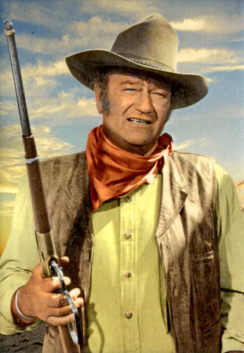

Macho Maniac
John Wayne
Marion Michael Morrison
Sylvester Stallone ("Rambo")
Weldon M. Hardenbrook, Vanishing From Action
Notes:
First is The Macho-Maniac
• This is the Marion Michael Morrison image. What? You never heard of Marion Michael Morrison? • Maybe you know him by his stage name: John Wayne, the Duke—the large, muscular body and the deep, low voice—the one who overcame obstacles while suppressing his feelings of fear and pain.
• More recently this image has been typified in Sylvester Stallone—the Rambo "macho superhero… perfectly capable of single-handedly destroying half of North Vietnam, along with a contingent of Russian reserves, while at the same time intimidating his own government" (p. 17).
(The second fabrication of American manhood is called…)

Slide 13
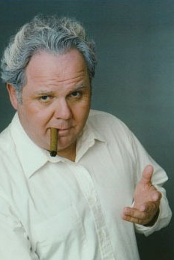
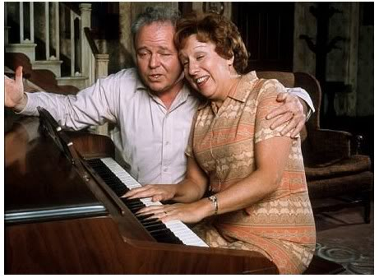
Great Pretender
Archie Bunker
Weldon M. Hardenbrook, Vanishing From Action
Notes:
The Great Pretender
Perhaps no man better embodies this phony than Archie Bunker, whom the author refers to as "the proud, urban, blue-collar, big-mouthed bigot…who gains his personal worth by constantly belittling his family."
• Writes Hardenbrook (p. 18), "Perfectly on cue, this man could be polite and gracious to any woman except his own wife. In fact, it was more important to Archie to 'lovingly correct' his wife with a constant stream of contempt. He wanted all who observed them to have no doubt who was in charge…
EDITH: Oh, Archie, I had the most wonderful idea!
ARCHIE: Never mind ideas. When did you ever have an idea? I don't need ideas, I need a beer."
Hardenbrook says, "These great pretenders probably think they are lovable creatures. In reality they are frightened little boys who’ve crawled into their dream world as a protection against imagined enemies of their masculinity" (p. 19)…”
(There's a third type of man in America who distorts what real masculinity is about…)

Slide 14
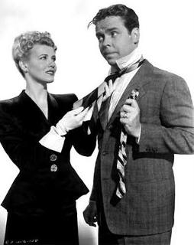
World Class Wimp
Dagwood Bumstead
Weldon M. Hardenbrook, Vanishing From Action
Notes:
The World-Class Wimp
• Who portrays the wimp better than Dagwood Bumstead? This overly submissive male constantly gets rescued by his charming, levelheaded, Blondie—his devoted wife and affectionate companion.
One professor describes Dagwood as "a well-meaning idiot who is constantly outwitted by his children, his wife and even his dog" (p. 20).
"Somewhere he's found a modern beatitude: 'Blessed are the passive, for they shall avoid conflict'" (p. 22)
(Finally, we encounter the last distortion of real manhood…)

Slide 15
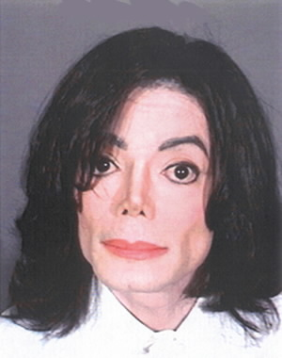
Gender Blender
Michael Jackson
Weldon M. Hardenbrook, Vanishing From Action
Notes:
The Gender Blender
• Enter center stage Michael Jackson and Boy George and Bruce Gender—I mean “Jenner.”
"According to People magazine back in the 1980s, 'A psychologist… asked his 7-year-old nephew, "Is Michael Jackson a boy or a girl?" The boy thought for a moment before replying, "Both."'" (p. 23)

Slide 16
Four Fabrications of American Manhood
Macho Maniac
Great Pretender
World Class Wimp
Gender Blender
Weldon M. Hardenbrook, Vanishing From Action
Notes:
So there you have it, summarized by the author as… (Back cover)
• “The Macho Maniac who reaches for unobtainable heights of courage while stripping away human sensitivity: a warrior without a cause,
• The Great Pretender who masks his ignorance with a façade of macho lingo…
• The Wimp who surrenders and avoids conflict: a coward, and finally…
• Hardenbrook summarizes the Gender Blender with these words: "He trades his masculinity for the nonidentity of unisex: he commits masculine suicide."

Slide 17
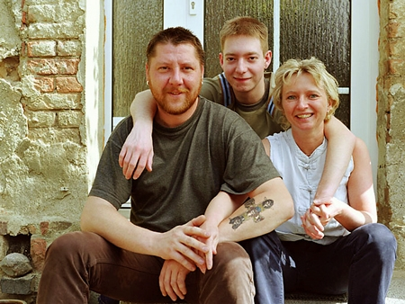
Will the real father stand up?
Notes:
In the midst of all these distortions of masculinity and fatherhood we cry out, "Will the real father stand up?" Of course, none of them are it. You need to go to the Bible to find out what a real man should be.

Slide 18

Biblical Instructions to Fathers?
Biblical Examples of Fathers?
Notes:
When you do turn to Scripture you find good instruction to fathers in various places, but as for a good, real, example of a father we come up with few or no good examples. Most of even the best men were failures as fathers: Abraham, Isaac, Jacob, David, Solomon, Samuel, Eli, Hezekiah…

Slide 19

Luke 15
Lost people (1-2)
Lost sheep (3-8)
Lost coin (9-10)
Lost son (11-32)
Caring Savior
Caring shepherd
Caring woman
Caring father
Notes:
However, while searching through the Scripture I noticed one example of an excellent father—the father of the Prodigal Son in Luke 15. Let’s turn there together.
In verses 1-2 the Pharisees oppose Jesus reaching out to sinners [“Tax collectors and other notorious sinners often came to listen to Jesus teach. ² This made the Pharisees and teachers of religious law complain that he was associating with such sinful people—even eating with them!” NLT]. • The focus is a caring Savior. In response, Christ told three stories to show how God accepts sinners.
• Verses 3-8 aren’t really about lost sheep as much as • how God rejoices over people who repent like a caring shepherd rejoices over a lost sheep.
• Then in verses 9-10 a person who strays away from God is depicted as a lost coin. • But God, depicted as a caring woman, searches relentlessly to find that coin—a reason for joy.
• Finally, the prodigal son parable in verses 11-32 teaches the same—• not about a lost son as much as a Heavenly Father who cares enough to help us return to Him.

Slide 20

7 ways to imitate this father...
Notes:
So the message of this parable is not fatherhood, but how God the Father is the perfect example of love reaching out to repentant sinners. But I still think we can learn some principles about good fathering from this man's example.
• So let’s look at seven ways we can imitate this father who depicts God the Father [subject]. The first way is to…

Slide 21
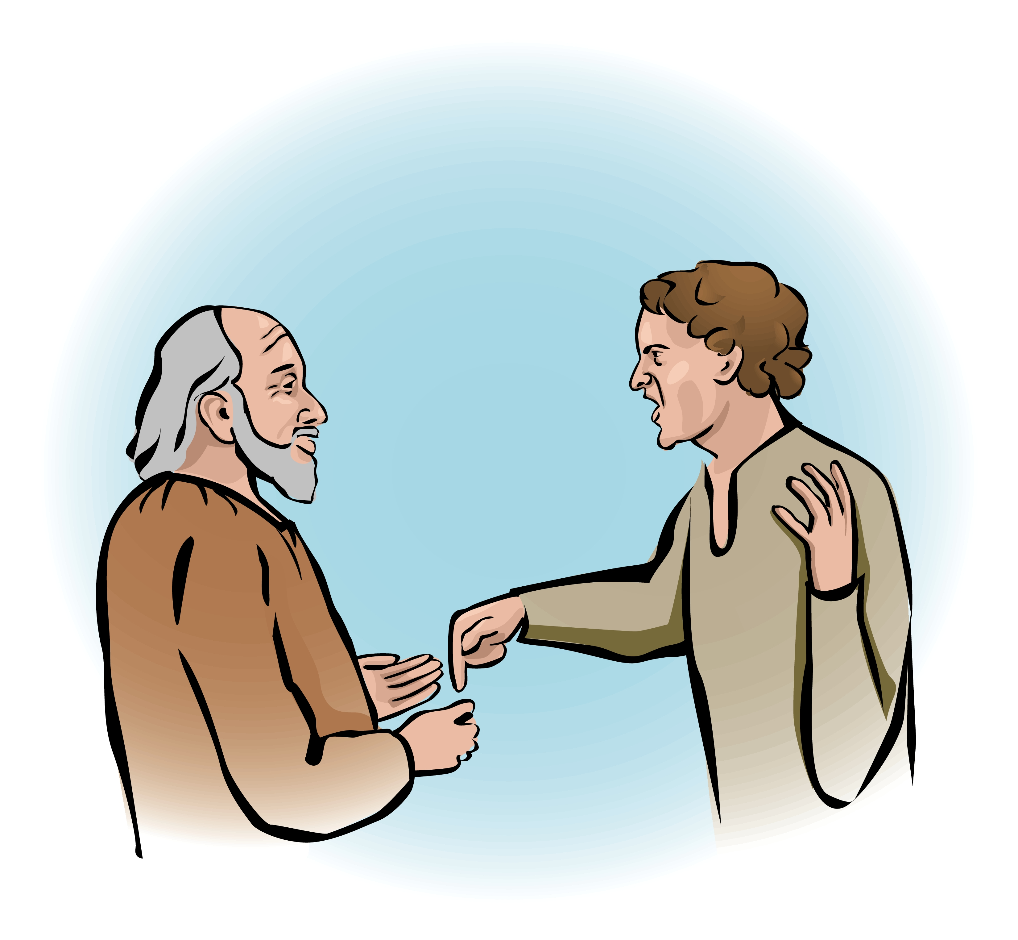
1. Take a loss to help your kids gain (15:11-12).
¹¹Jesus continued: "There was a man who had two sons. ¹²The younger one said to his father, 'Father, give me my share of the estate.' So he divided his property between them.
Notes:
[The father allowed a potential financial crisis to meet his fatherly obligation.]
The normal practice during the first century was for a father to divide his estate among his sons when he could no longer manage it well on his own.
But in this passage we see something unusual. Although the father was still managing his estate, the younger demands his share right then and there. He was entitled to one third, while the older son got the double portion—or two thirds of the estate.
Imagine the hassles caused by giving a third of his entire estate to a son all at once! Imagine emptying 33% of your entire bank account and assets and giving them away to your least responsible child! You’d be asking for a lot of financial strain!
But this father knew that this son needed to learn an important lesson.
Maybe the son would misuse the money, but the father reasoned that his son would learn more if he got the whole inheritance then. You know how some kids just need to learn the hard way?
But the point is that this father was willing to undergo even great personal loss to instruct his son and fulfill his promise to give him his share of the inheritance.

Slide 22
Black
Notes:
There are many times a father will sacrifice for his kids if he really loves them:
I know American missionary Dads in Singapore who left a thriving ministry there to return to the USA to save their son or daughter’s emotional or spiritual lives.
Another took on an evening job he doesn't care for to help his son go to college.
There's our first positive quality we'll see in the father: the willingness to undergo personal loss to fulfill his promise to his son. Here's the second…

Slide 23
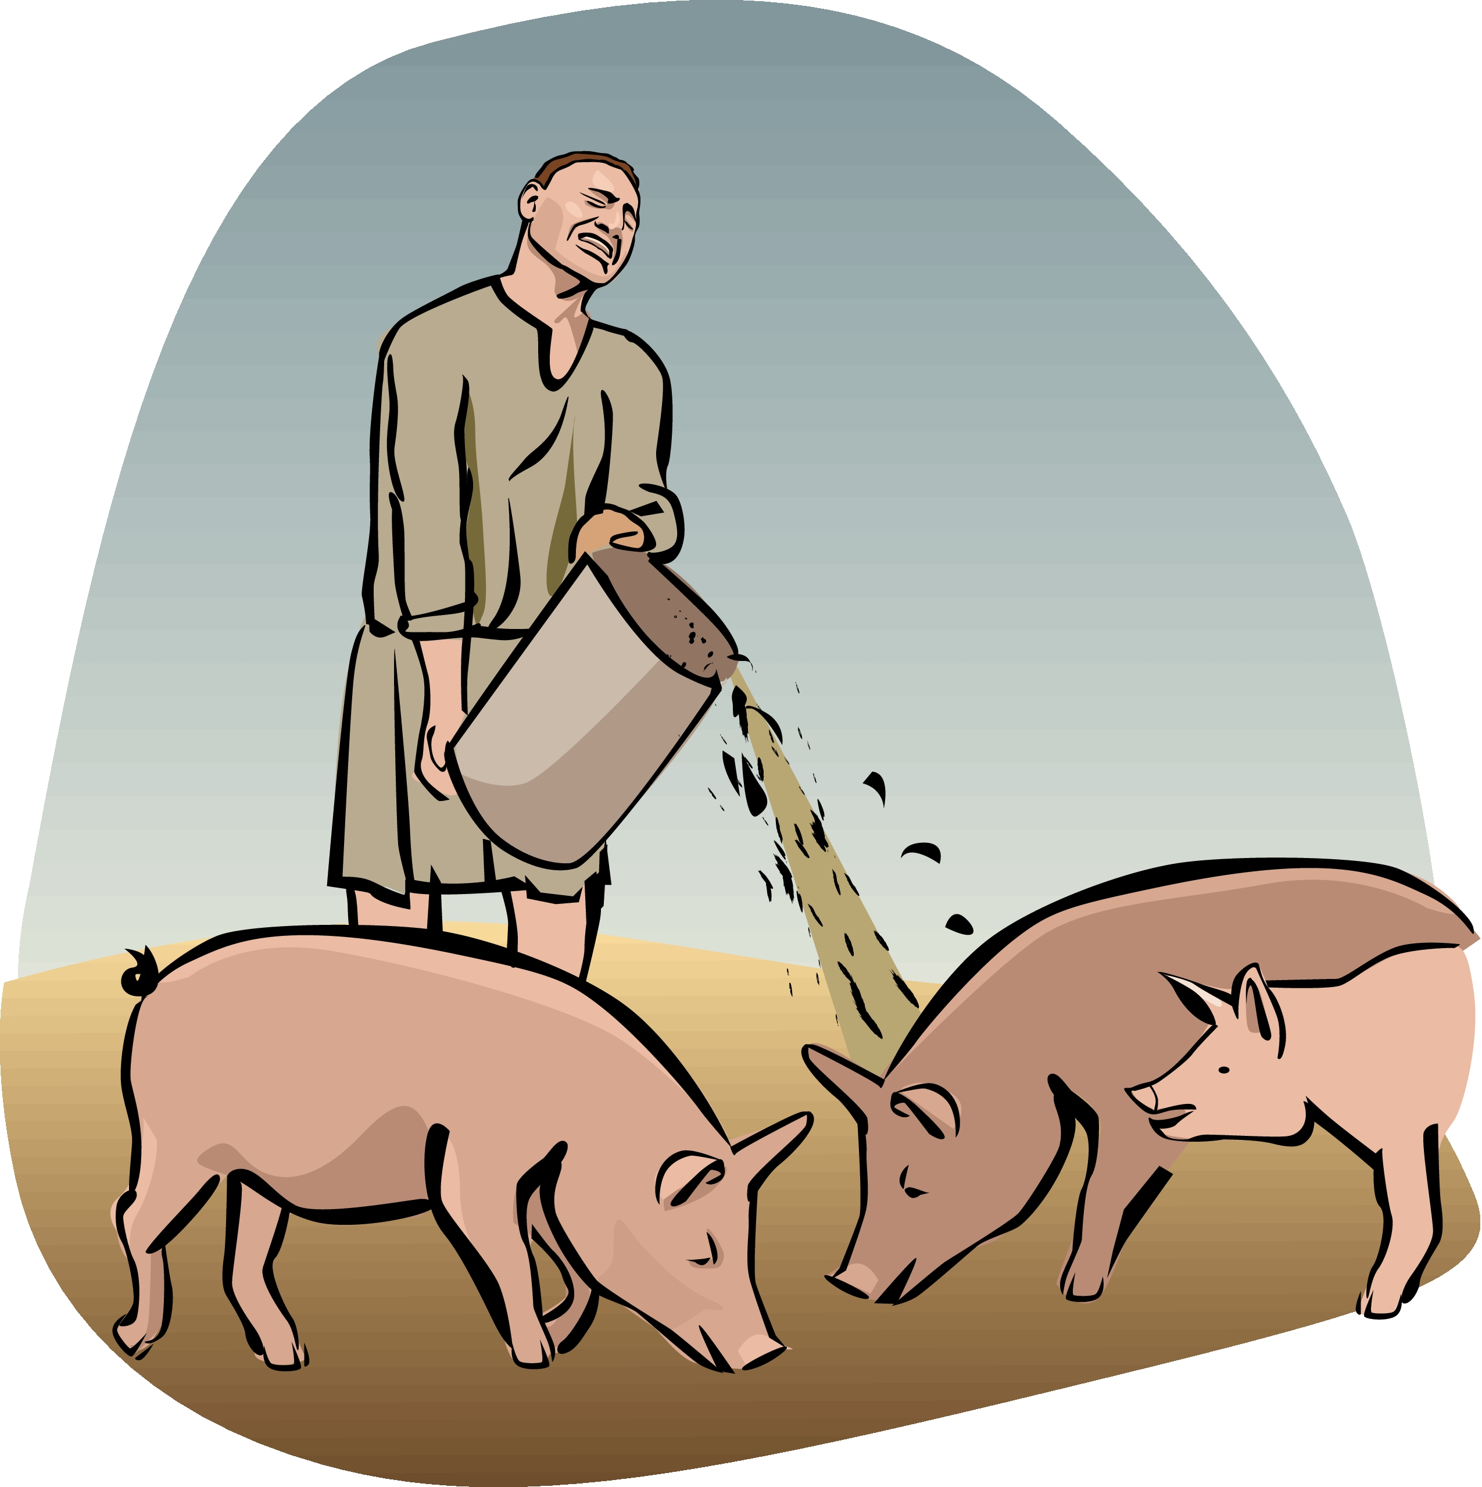
2. Allow your son to experience results of his sin (15:13-16).
¹³Not long after that, the younger son got together all he had, set off for a distant country and there squandered his wealth in wild living. ¹⁴After he had spent everything, there was a severe famine in that whole country, and he began to be in need.
Notes:
The father didn’t protect his son from the pain of poor choices.

Slide 24
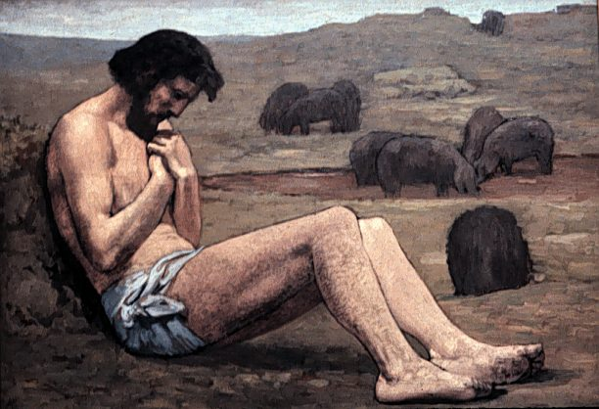
2. Allow your son to experience results of his sin (15:13-16).
¹⁵So he went and hired himself out to a citizen of that country, who sent him to his fields to feed pigs. ¹⁶He longed to fill his stomach with the pods that the pigs were eating, but no one gave him anything.
Notes:
The father didn’t protect his son from the pain of poor choices.

Slide 25
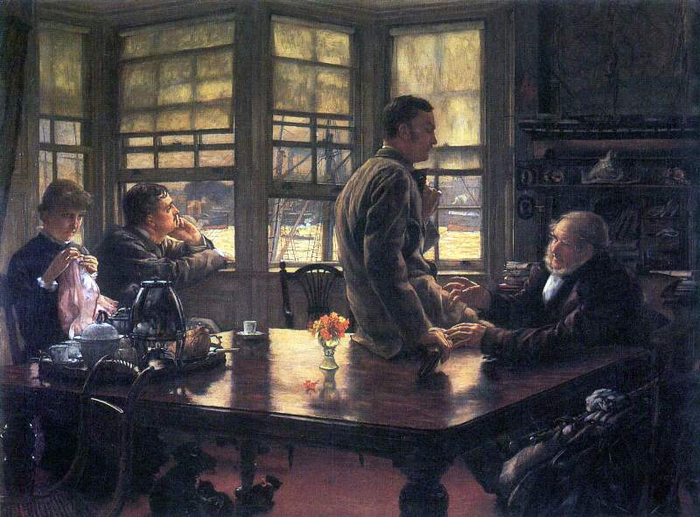
The Farewell
Artist: Tissot
Notes:
Notice what the Dad did not do—depicted well in this modern painting of a longing Dad:
He didn't run after his son and beg him to return.
He didn't send his servants to rescue his son from mistakes that he would regret.

Slide 26
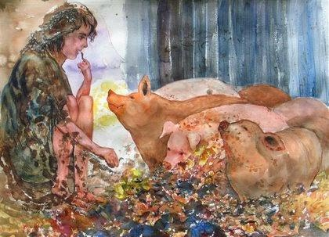
Pig Pod Pleasure?
Notes:
He allowed the son to stoop to the lowest position any Jew could get—feeding pigs for a living—unclean animals which every Jew despised.

Slide 27
Black
Notes:
Why? A good father will allow his children to make mistakes and learn from them. He won't bail them out every time their mistakes get them into trouble.
My high school friend Stuart seemed to always have a new stereo system and all kinds of money. Why? His dad never let him bear the consequences of poor choices. The last I heard, Stuart had financial troubles, dropped out of school, bought so much music he couldn’t afford food, you name it…
Larry Burkett tells the story of when his son needed to borrow $10.
"OK," he told his son, "But you need something for collateral."
"What's that?" his son asked.
"Well, it's an item that's worth more than $10 which I keep if you don't pay me back on time. How soon can you pay me back and do you have an item for collateral?"
"I have my skateboard—it's worth $70-$80. I can pay you back next Monday."
"OK," the father said, "Now realize that if you don't pay me back I can sell the skateboard for whatever I want to in order to get back my money." He agreed.
The next week came and no $10 repayment. So Mr. Burkett promptly sold the skateboard. When his son found out he was furious, "Why did you sell my skateboard?" he demanded.
"I didn't sell your skateboard," his father said, "Remember our agreement? If you didn't pay me back within a week it was to become my skateboard. So I sold it for $10 to get my money back."
"You sold it my $80 skateboard for $10?" His father nodded.
It was a hard-nosed line for dad to take, but he had to show his son that there are consequences for negligence. Better to have a skateboard repossessed than a home years later. Speaking of years later, after he got married the son thanked Mr. Burkett for that valuable lesson in finances.
(The prodigal's father had the guts to allow his son to bear the consequences of poor choices. However, although he held his ground, notice in verses 17-20 another trait…)

Slide 28
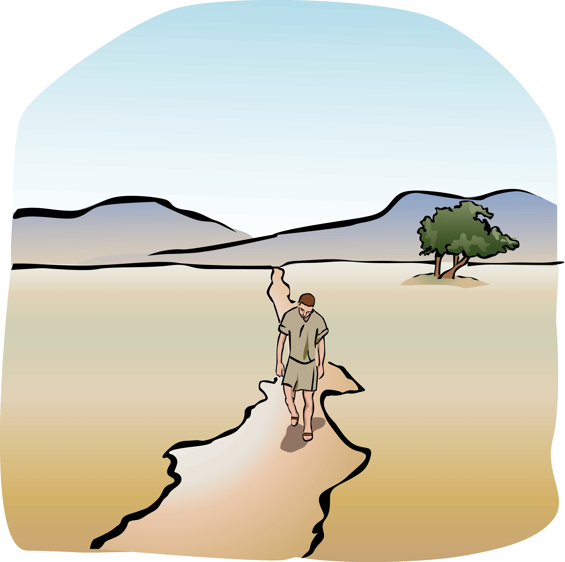
3. Preserve the opportunity to fellowship with your child (15:17-20a).
¹⁷When he came to his senses, he said, 'How many of my father's hired men have food to spare, and here I am starving to death! ¹⁸I will set out and go back to my father and say to him: “Father, I have sinned against heaven and against you. ¹⁹I am no longer worthy to be called your son; make me like one of your hired men.”' ^{20a}So he got up and went to his father.
Notes:
The father kept the door open for a restored relationship.
Sure he allowed his son to hit rock bottom, but the prodigal knew that his father was still there. The father balanced toughness with compassion and forgiveness.

Slide 29
Black
Notes:
How a parent can close the door to fellowship with a child I don't understand. I’m so glad my in-laws accepted my wife’s sister despite her marrying a non-Christian. The relationship was never severed.
If you're a father with a child away from the Lord, don't slam the door to a relationship with you. If your child can't be restored to fellowship with you because of your rejection, I wonder whether your child will believe that God will not accept him or her either.
(The father shows a fourth characteristic of a godly father…)

Slide 30
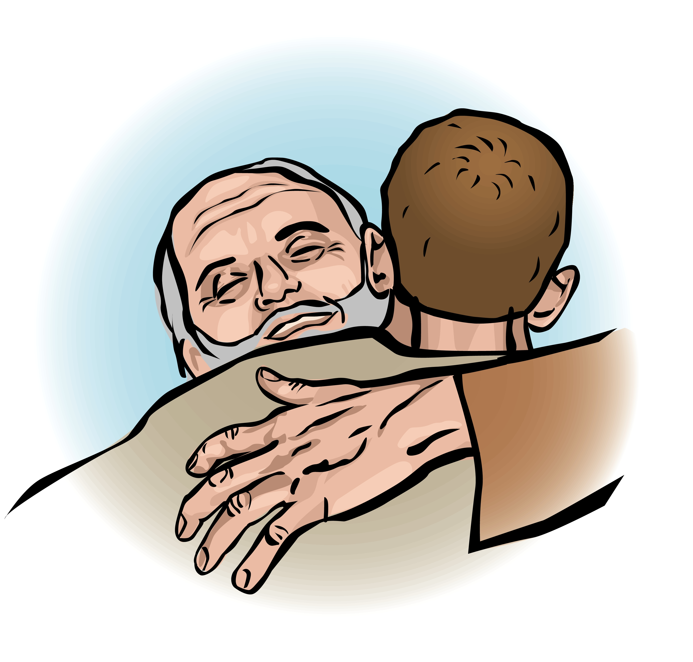
4. Compassionately accept your son even in his disobedience (15:20b).
^{20b} But while he was still a long way off, his father saw him and was filled with compassion for him; he ran to his son, threw his arms around him and kissed him.
Notes:
He didn’t let personal bitterness over his son’s failures steal his compassion.
You know what many fathers would do here? "So you finally run out of money with wild living, huh? Well, get out of here! You're a disgrace to me and the family!"

Slide 31
Black
Notes:
Not this father. No doubt his compassion for his son kept the door open for ministry to him again. He was just glad to finally see his son again.
Notice that he ran to accept him before he even knew whether the son had repented or not—at this point the son hadn’t said a word!
(How could the father have this compassionate response? Because of a fifth characteristic…)

Slide 32
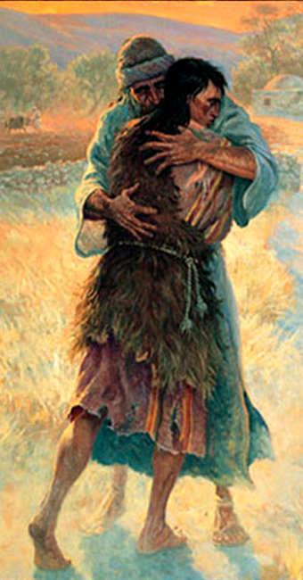
5. Consider your child's wellbeing more than your reputation (15:21-24).
²¹The son said… 'Father, I have sinned against heaven and against you. I am no longer worthy to be called your son.'
²²But the father said to his servants, 'Quick! Bring the best robe and put it on him. Put a ring on his finger and sandals on his feet. ²³Bring the fattened calf and kill it. Let's have a feast and celebrate. ²⁴For this son of mine was dead and is alive again; he was lost and is found.' So they began to celebrate.
Notes:
What others thought of the father was less important to him than his son’s safety.
The son's concern was his father's reputation—he feared that his own behavior so disgraced his dad that he should never be referred to as a son again.
But the father’s concern was for his son. He didn’t even listen to his son's well-rehearsed speech. He was so elated that his son returned safely that it was time to celebrate.

Slide 33
Black
Notes:
I think genuine acceptance is more difficult for fathers than for mothers. We're too concerned about ourselves, our image before others that our kids help or hinder…
(Now notice the sixth quality the father in our story portrays…)

Slide 34
6. Ask others to accept your wayward son (15:25-30).
²⁵Meanwhile, the older son was in the field. When he came near the house, he heard music and dancing. ²⁶So he called one of the servants and asked him what was going on. ²⁷'Your brother has come,' he replied, 'and your father has killed the fattened calf because he has him back safe and sound.'
Notes:
This dad didn’t belittle his son before others but instead urged them to accept him.

Slide 35
6. Ask others to accept your wayward son (15:25-30).
²⁸The older brother became angry and refused to go in. So his father went out and pleaded with him. ²⁹But he answered his father, 'Look! All these years I've been slaving for you and never disobeyed your orders. Yet you never gave me even a young goat so I could celebrate with my friends. ³⁰But when this son of yours who has squandered your property with prostitutes comes home, you kill the fattened calf for him!'
Notes:
This Dad was thrilled over his son's repentance and tried to convince his older son to accept him too. Why?

Slide 36
Black
Notes:
A good father will protect what others think about his children.
Some fathers say such negative things about their kids that it really scares me. I wonder what they must communicate to the children at home.
Some fathers say 10 negative comments for every one word of praise they say with respect to their children. These things ought not to be so.
The prodigal's father had all kinds of reason to badmouth his son before others, but instead we find him encouraging others to rejoice over his return.
(Verse 31 adds one final truth about this father, though, which balances the picture…)

Slide 37

7. Fulfill your promises to your other children (15:31-32).
³¹'My son,' the father said, 'you are always with me, and everything I have is yours. ³²But we had to celebrate and be glad, because this brother of yours was dead and is alive again; he was lost and is found.' "
Notes:
What was his promise? To give each son his own inheritance. He fulfilled this for the younger son, and this made all the rest of his property his older son's.

Slide 38
Black
Notes:
God expects us fathers not to show favoritism towards certain children.
Here's where Jacob missed the boat by treating his son Joseph with special favor (remember the multi-colored coat?). This led to rivalry between the brothers.
An impartial father can help curb jealousy among his children.

Slide 39
Four Fabrications of American Manhood
Macho Maniac
Great Pretender
World Class Wimp
Gender Blender
Weldon M. Hardenbrook, Vanishing From Action
Notes:
So what have we learned from this father of the prodigal? He is certainly not one of the four fabrications of manhood I noted earlier!

Slide 40
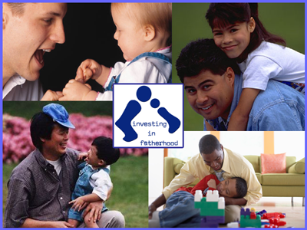
Investing in Fatherhood
Notes:
Instead, he invested himself in genuine fatherhood. Because he was a godly man, his son felt free to return to him for forgiveness. So what is this parable saying to us today?

Slide 41


The Main Idea:
Real fathers show godly qualities that often cause their children to return to the Lord
Notes:
Our Heavenly Father shows every attribute that would cause us to want to come back to him. If we don’t return to him, it is not due to any lack in God the Father but to a lack in us.

Slide 42
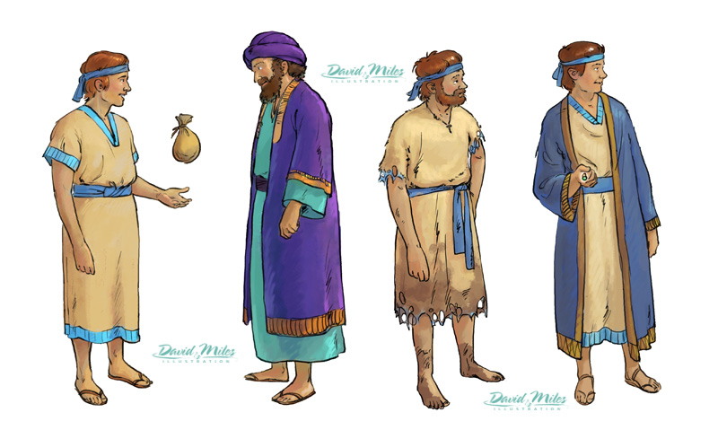
How can we help them return?
Notes:
For us fathers here, how can we best facilitate the return of our kids who stray away?

Slide 43
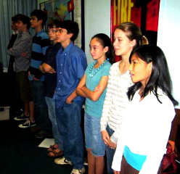
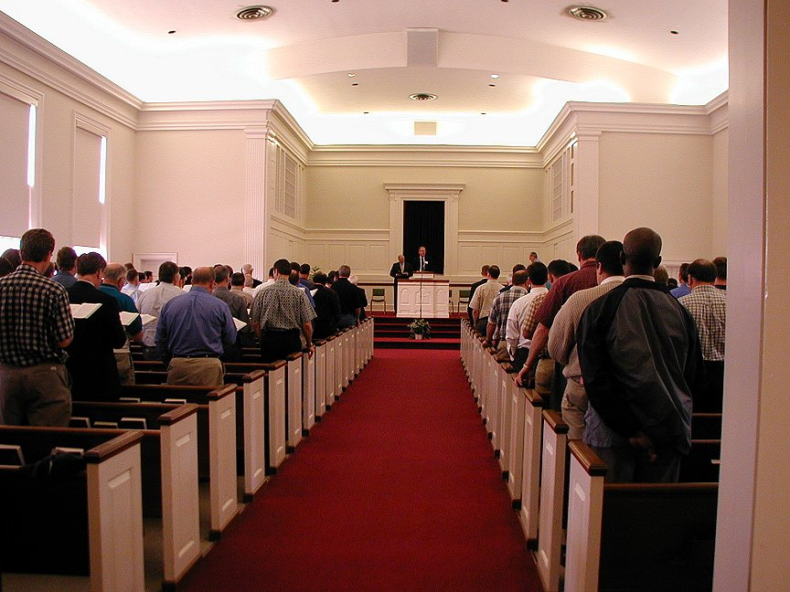
Already Gone: Why Your Kids Will Quit Church And What You Can Do To Stop It (Master Books, 2009).
Notes:
I want to urge to you buy and read Ken Ham’s 2009 book, which he co-authored with Britt Beemer, president of America’s Research Group. It is called Already Gone: Why your kids will quit church and what you can do to stop it (Master Books, 2009). Respected pollster George Barna first put numbers to this epidemic, finding in 2000 that six out of ten 20-somethings who were involved in a church during their teen years are already gone. That means the prodigal is not the exception but the norm.

Slide 44
Seven Qualities
1. Are you willing to endure personal loss to fulfill promises to your children?
2. Do you allow your child to experience the results of sin?
3. Have you kept in fellowship with a child of yours gone astray?
4. Can you accept your disobedient child—while rejecting his or her lifestyle?
5. Do you consider your child’s wellbeing more than your own reputation?
6. Do you talk to others positively about an erring child of yours?
7. Do you fulfill promises to your children?
Notes:
Please look at our list of seven qualities of a good father. How are you doing? In which area do you need a tune-up to raise kids who won’t become prodigals?
1. Are you willing to endure personal loss to fulfill promises to your children?
2. Do you allow your child to experience the consequences of sin?
3. Have you preserved the opportunity to fellowship with your child gone astray?
4. Can you accept your disobedient child—while rejecting his or her lifestyle?
5. Do you consider your child’s wellbeing more than your own reputation?
6. Do you encourage others to accept an erring child of yours?
7. Do you fulfill promises—or show favoritism—to your children?

Slide 45
Happy Father's Day Video Loop
Notes:
Prayer

Slide 46


NT Preaching link at BibleStudyDownloads.org
Get this presentation and script for free!
Notes:
NT Preaching (np)

