Slide 1
The ODM Syndrome
Luke 12:13-21
––––
Dr Rick Griffith
Singapore Bible College

Slide 2
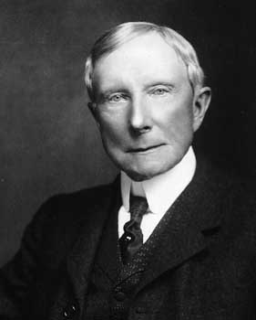
John D. Rockefeller
(1839-1937)
Founder of Standard Oil World’s First Billionaire

Slide 3
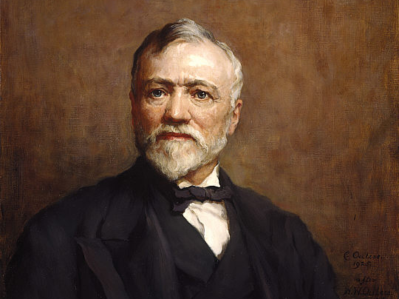
Andrew Carnegie
“Millionaries seldom smile”

Slide 4
“How much money do you need to be happy?”
“One dollar more”

Slide 5

The ODM Syndrome
One
Dollar
More

Slide 6
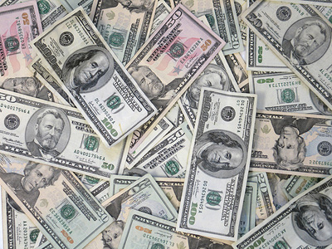
Do you have ODM?

Slide 7
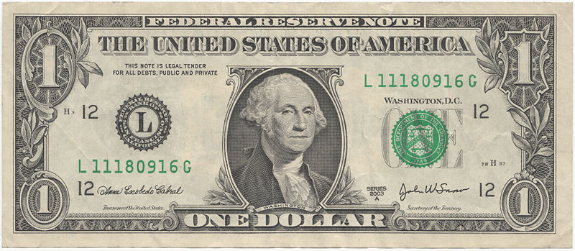
“How much money do you need to be happy?”
“One dollar more”

Slide 8
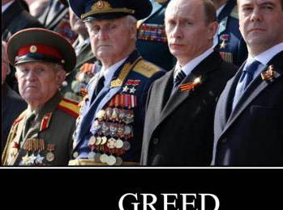
50 medals on your chest doesn’t mean you shouldn’t snatch the one on Putin’s chest too.

Slide 9
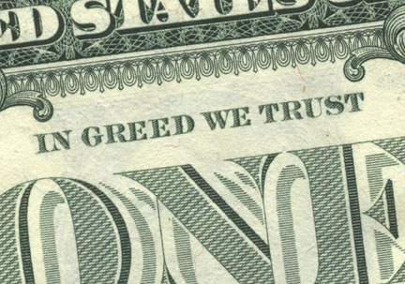
How does God cure us of ODM?

Slide 10
Black
Notes:
ODM in Jesus’ time
Rich = Righteous

Slide 11
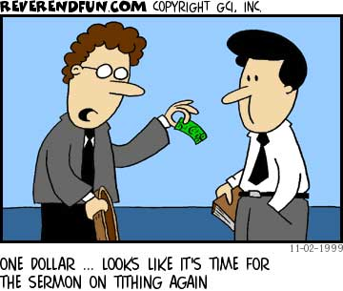
ODM isn’t one more dollar for God!

Slide 12
How does God cure us of ODM?
Let’s see 2 ways...
Luke 12:13-21

Slide 13
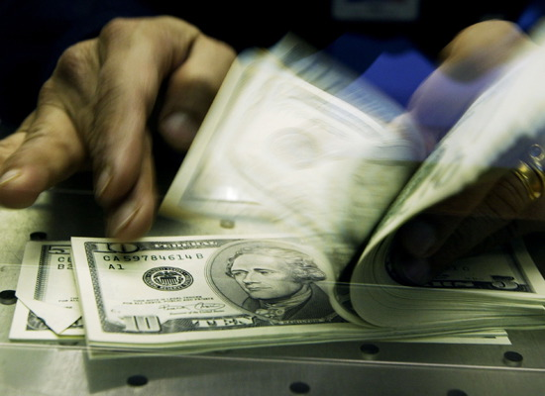
I. God keeps us from money that we want (13-15)

Slide 14
Luke 12:13
Someone in the crowd said to him,
“Teacher, tell my brother to divide the inheritance with me.”

Slide 15
Luke 12:14
Jesus replied, “Man, who appointed me a judge or an arbiter between you?”

Slide 16
Luke 12:15
Then he said to them, “Watch out! Be on your guard against all kinds of greed; a man’s life does not consist in the abundance of his possessions.”

Slide 17
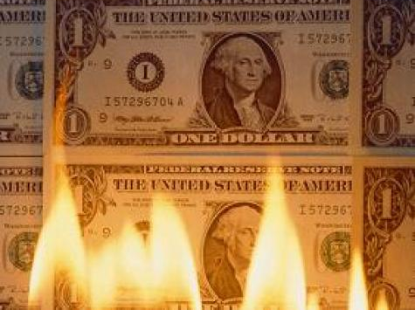
God sometimes reveals our ODM tendencies by taking money away.
God sometimes reveals our ODM tendencies by taking money away.

Slide 18
Black
Notes:
Grandpa dies – siblings never talk to one another again
Sales job but no sales after 3 months
Business partner or taxes cheat you

Slide 19
I. God keeps us from money that we want (13-15)

Slide 20

II. God gives us money to give to others (16-21)

Slide 21
Luke 12:16-17
And he told them this parable: “The ground of a certain rich man produced a good crop. ¹⁷He thought to himself, ‘What shall I do? I have no place to store my crops.’

Slide 22
Luke 12:18-19
¹⁸“Then he said, ‘This is what I’ll do. I will tear down my barns and build bigger ones, and there I will store all my grain and my goods. ¹⁹And I’ll say to myself, “You have plenty of good things laid up for many years. Take life easy; eat, drink and be merry.” ’

Slide 23
Luke 12:20
“But God said to him, ‘You fool! This very night your life will be demanded from you. Then who will get what you have prepared for yourself?’

Slide 24
Luke 12:21
“This is how it will be with anyone who...
stores up things for himself
but is not rich toward God.”

Slide 25
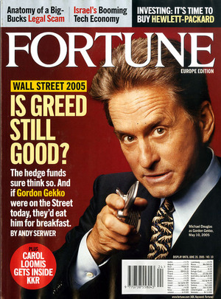
What’s the Problem?

Slide 26
Luke 12:16-17
And he told them this parable: “The ground of a certain rich man produced a good crop. ¹⁷He thought to himself, ‘What shall I do? I have no place to store my crops.’

Slide 27
Luke 12:18-19
¹⁸“Then he said, ‘This is what I’ll do. I will tear down my barns and build bigger ones, and there I will store all my grain and my goods. ¹⁹And I’ll say to myself, “You have plenty of good things laid up for many years. Take life easy; eat, drink and be merry.” ’
Notes:
14 times in 3 verses: I, my, myself
Both of them failed to see that financial blessing came from God
Both also only saw money for them—not as a means to help others

Slide 28
Luke 12:20
“But God said to him, ‘You fool! This very night your life will be demanded from you. Then who will get what you have prepared for yourself?’

Slide 29
Luke 12:21
“This is how it will be with anyone who...
stores up things for himself
but is not rich toward God.”

Slide 30
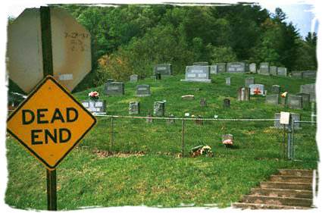
All ODM people will give their money to others after they die (20b-21).
All ODM people will give their money to others after they die (20b-1).

Slide 31
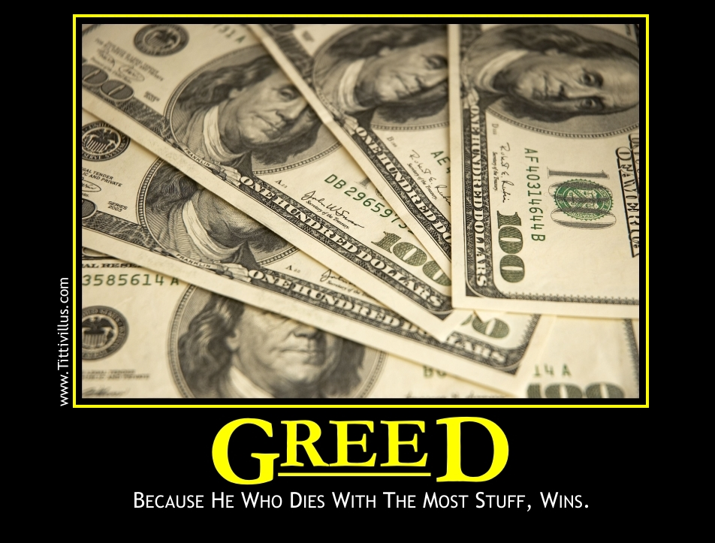
“He who dies with the most stuff, wins”

Slide 32
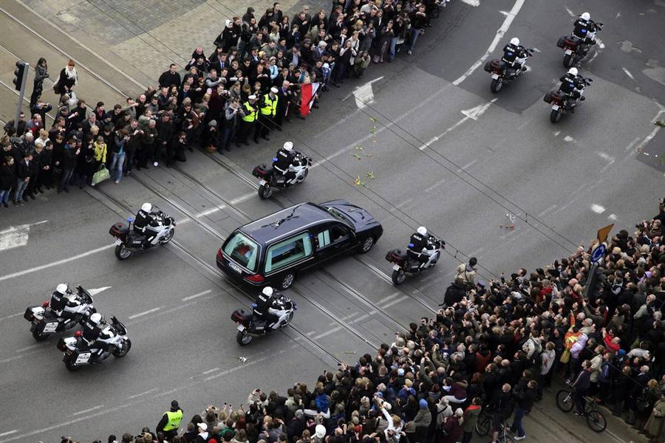
Hearse

Slide 33
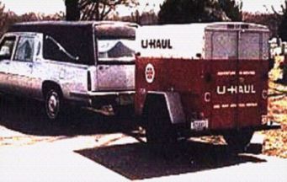
Hearse with U-Haul

Slide 34

The ODM Solution?

Slide 35
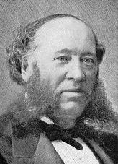
Railroad Tycoon
"The care of $200 million is enough to kill anyone. There is no pleasure in it."
W. H. Vanderbilt

Slide 36
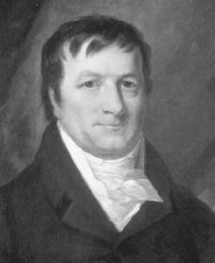
First US multi-millionaire
"I am the most miserable man on earth."
John Jacob Astor

Slide 37
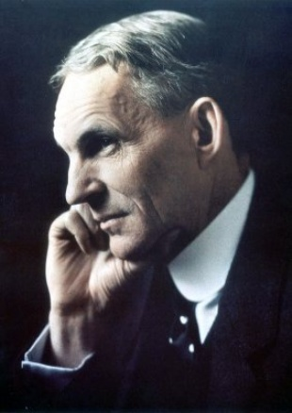
Henry Ford
"I was happier when doing a mechanic's job."

Slide 38

What does it look like?
Notes:
God doesn’t need any money, but investing our resources in others is evidence of being rich towards God

Slide 39

“How tragic when people are rich in this world but poor in the next!”
––Warren Wiersbe

Slide 40
How does God cure us of ODM?
Sometimes he keeps us from money we want while other times he gives us money to give to others.

Slide 41
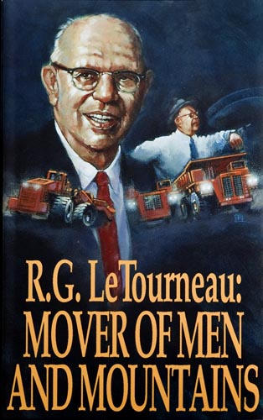
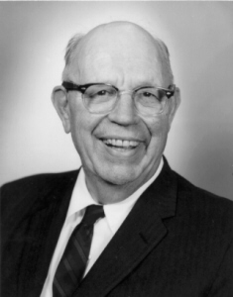
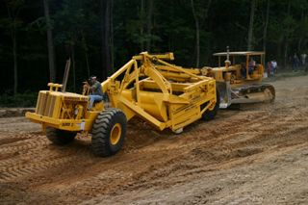
R. G. LeTourneau
Lived on 10%
Gave away 90%

Slide 42
Ed Sheffield
K-Mart tennis shoes
Modest house
Drove used cars
Gave away $150,000 monthly

Slide 43
Giving Patterns of Christians
Upper Class
Middle Class
Give away 1%
Give away 3%
Moody Monthly, 1987

Slide 44
One Man’s Journey
• As income rose…
Gifts
INCOME
$30k
• higher expenses followed
EXPENSES

Slide 45
“The RICH Family in Our Church”
By Eddie Ogan (a woman looks back)

Slide 46
Black

Slide 47


NT Preaching link at BibleStudyDownloads.org
Get this presentation and script for free!
Notes:
NT Preaching (np)

