Slide 1
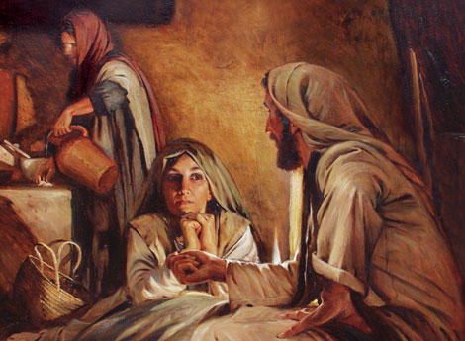
The One Thing Necessary
Luke 10:38-42
Preached by Manik Corea at Crossroads International Church Singapore • CICFamily.com Uploaded by Dr. Rick Griffith • Jordan Evangelical Theological Seminary Files in many languages for free download at BibleStudyDownloads.org

Slide 2
1) God Owns It All
2) God Invests in Us
3) Work Hard
4) Plan What You Get
5) Plan for the Future
6) Avoid High-Risk Investments
7) Guard Against Sinful Attitudes
8) Give God Firstfruits
9) Prayerfully Determine Where Giving Goes and How Much to Give
10) Trust the Lord to Provide Personal Living Expenses
PRINCIPLES

Slide 5
Dear Pastor,
People in the Church = 566
Frail and elderly - 100
At school or university - 80
Busy businesspeople - 150
Looking after family - 150
Live too far away - 15
Already did their bit - 69
======
Left = 2
Good luck to you!

Slide 6
The One Thing Necessary - Luke 10:38-42
Luke’s Gospel – Jesus’ concern for the lost & marginalized
For women, who were treated as second-class in those days (Luke 7:36-50, 8:1-3)
For the Samaritans (9:51-56, 10:30-37, 17:11-19)
For Gentiles (Luke 7:1-9, even though Jesus ministered exclusively in Israel).

Slide 7
The One Thing Necessary - Luke 10:38-42
Today’s passage is in the middle of 3 passages dealing with how we truly love God and our neighbour:
Through caring for the ‘other’, the stranger (10:25-37)
2) By listening to God as a priority (10:38-42) and
3) By praying with persistent faith (11:1-13).

Slide 8
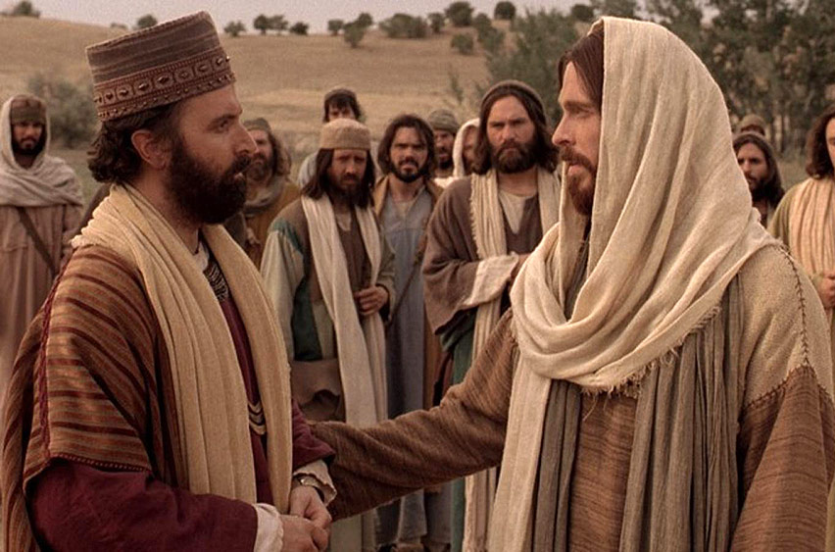
“What must I do to inherit eternal life?”

Slide 9
”You shall love the Lord your God with all your heart and with all your soul and with all your strength and with all your mind, and your neighbor as yourself.”

Slide 10
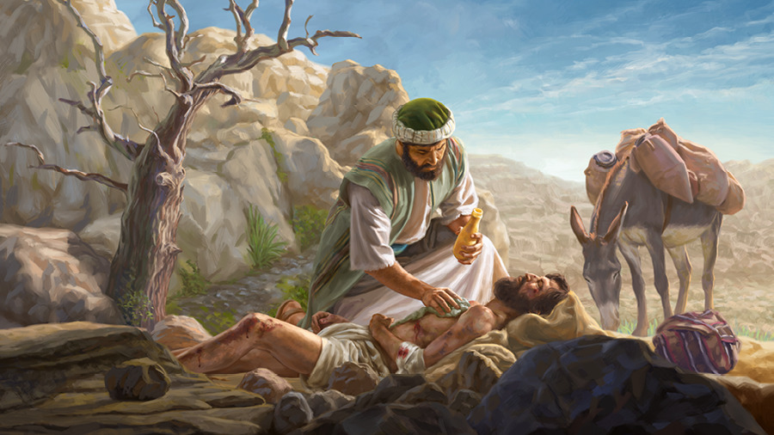

Slide 11
"Theological propriety kept them from acting in love. Martha's social proprieties kept her from focusing her attention on Jesus and his agenda for her life.”
Bruce Larson, Luke, The Preacher’s Commentary, vol. 26 (Nelson, 1983).

Slide 12
The One Thing Necessary - Luke 10:38-42
MAIN POINT:
Anything that stops or prevents you from giving your full attention to Jesus, is dangerous.

Slide 13
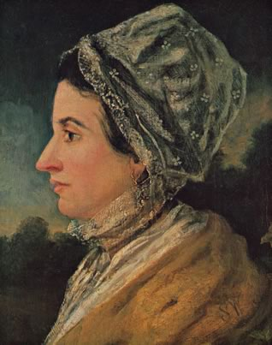
“Whatever weakens your reason, impairs the tenderness of your conscience, obscures your sense of God, or takes away your relish for spiritual things, in short, whatever increases the authority of the flesh over the spirit, that thing is sin to you, however innocent it may seem in itself.”
Susanna Wesley

Slide 14
The One Thing Necessary - Luke 10:38-42
Vs 38 – Jesus entered a village (Bethany). Martha, Mary and Lazarus were supporters of Jesus (John 11:1-2, 12:3).
Vs 39 – Mary ”sat at the Lord’s feet and listened to his teaching.”
→ “Sat at His feet” – the position of a student before his
rabbi (Luke 8:5; Acts 22:3). Typically reserved for men.

Slide 15
Jesus’ ministry breaks molds. Those who are sensitive to him recognize that he invites them to come to him. They sense that he will receive them, that he is ready to teach all types of people. In the early church, women are noted for their service: Phoebe (Rom. 16:1–2), Priscilla (Rom. 16:3), Lydia (Acts 16:14–15), and the four daughters of Philip (Acts 21:9).
Darrell Bock, Luke, Baker Exegetical Commentary on the New Testament, 2 vols. (Grand Rapids: Baker Academic, 1984), 1:551.

Slide 16
The One Thing Necessary - Luke 10:38-42
Vs 40 – Martha was distracted, and complaining. “Don’t you care…tell her to help me.”
Vs 41 - Jesus answered her tenderly:
“You are anxious and troubled about many things…”
Vs 42 - “But one thing is necessary. Mary chose the better portion…”
She was feeding on His Word (Luke 4:4, Deut. 8:3, John 6:35).

Slide 18
The One Thing Necessary - Luke 10:38-42
APPLICATION
Being Vs Doing – A balance between silence and service, of reflection and action.
Retreats and rest (sabbath) – but how do you make space in a busy life?
Get up early – or find 10-30 minutes in your schedule daily.
Make sure you are still in God’s presence, read His word systematically (follow a plan) and pray for yourself and for others.

Slide 20
The One Thing Necessary - Luke 10:38-42
Be A Mary Before You Do Like Martha
Let your Being-With-Christ Feed your Doing-Through-Christ
Romans 12:1-2 – ”Offer yourselves…be renewed.”
“Take your everyday, ordinary life—your sleeping, eating, going-to-work, and walking-around life—and place it before God as an offering.”
(Romans 12:2 - The Message paraphrase)

Slide 21
Black

Slide 22
NT Preaching link at BibleStudyDownloads.org
Get this presentation and script for free!
Notes:
NT Preaching (np)

