Slide 1

The Light of the World
John 8:12-59
Rick Griffith • Crossroads International Church • BibleStudyDownloads.org

Slide 2

Can people tell the difference
between
and light?
darkness

Slide 3
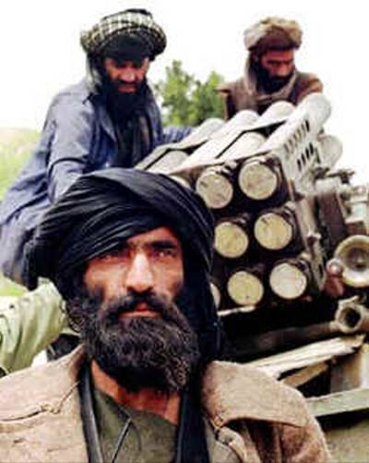


Edwin Paul
28 Sep 2010

Slide 4

Jesus (logos) was God (1:1c)
"In the beginning
was the Word,
and the Word was with God,
and the Word was God"
(John 1:1)
Notes:
Scripture is very clear that Jesus is God. Christians have always believed this key doctrine called the deity of Christ.

Slide 5

The Great Transfer
For he has rescued us from the kingdom of darkness
and transferred us into the Kingdom of his dear Son
¹⁴ who purchased our freedom and forgave our sins (Col 1:13-14)

Slide 6

How should we expect people to respond to Christ's claim to be eternal God?

Slide 7



John 6–8
Bread
6
Water
7
Light
8

Slide 8
How should we expect people to respond to Christ's claim to be eternal God?
3 responses...

Slide 9
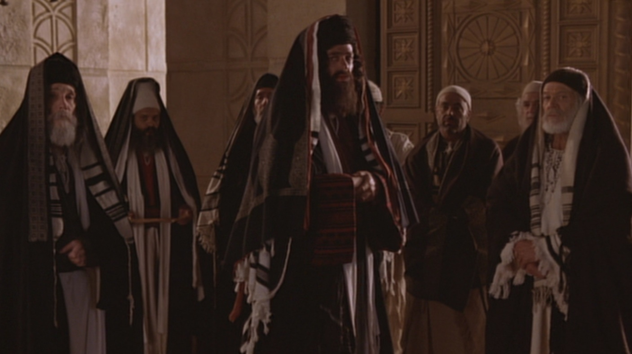
I. Some are hostile to Christ as the way of salvation (12-20).

Slide 10

"I am the light of the world"
John 8:12

Slide 11
"The claim is exclusive, one only God could make. Note that Jesus claimed to the light of the world, not a light. Although the claim is exclusive, the offer is inclusive—an offer any and all could respond to."
Charles Swindoll, Following Christ… The Man of God, 33, emphasis his

Slide 12

Two Witnesses (Deut 17:6)
"But never put a person to death on the testimony of only one witness. There must always be two or three witnesses."

Slide 13
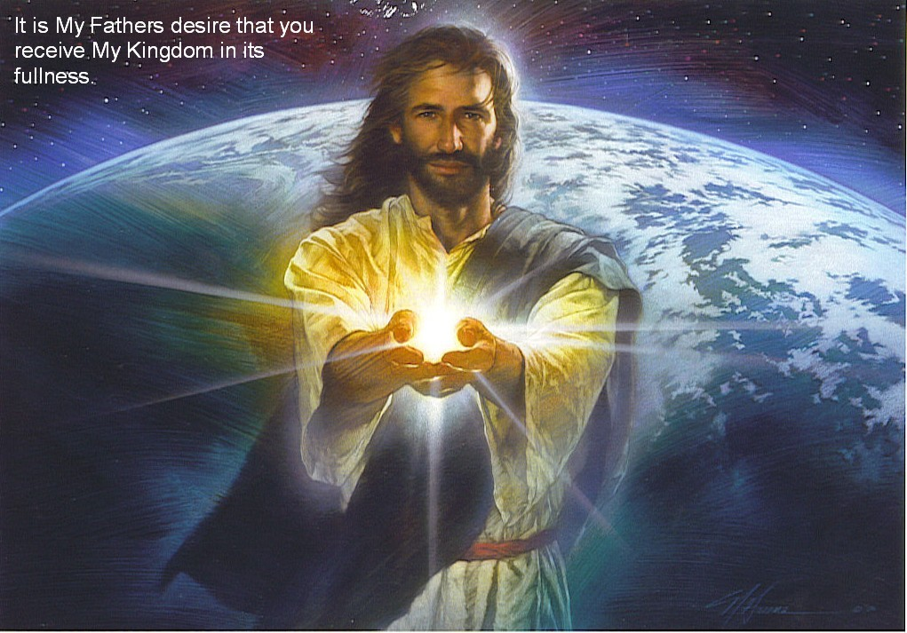
Jesus is the light of life (12-20)
Light
Life
Darkness
Death
Hostility!

Slide 14

Oprah Winfrey
"Does God care about your heart... Or does God care that you call his son 'Jesus'?"
Notes:
http://www.youtube.com/watch?v=ETeI6i5oqh4&feature=related

Slide 15
I. Some are hostile to Christ as the way of salvation (12-20).

Slide 16
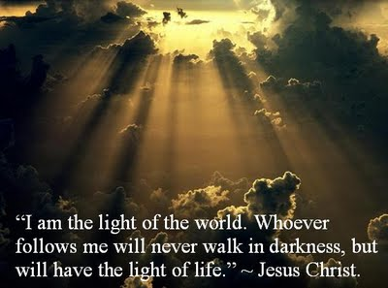
II. Many believe that the Father sent Jesus from heaven (21-30).

Slide 17

Who are you?!
John 8:25

Slide 18
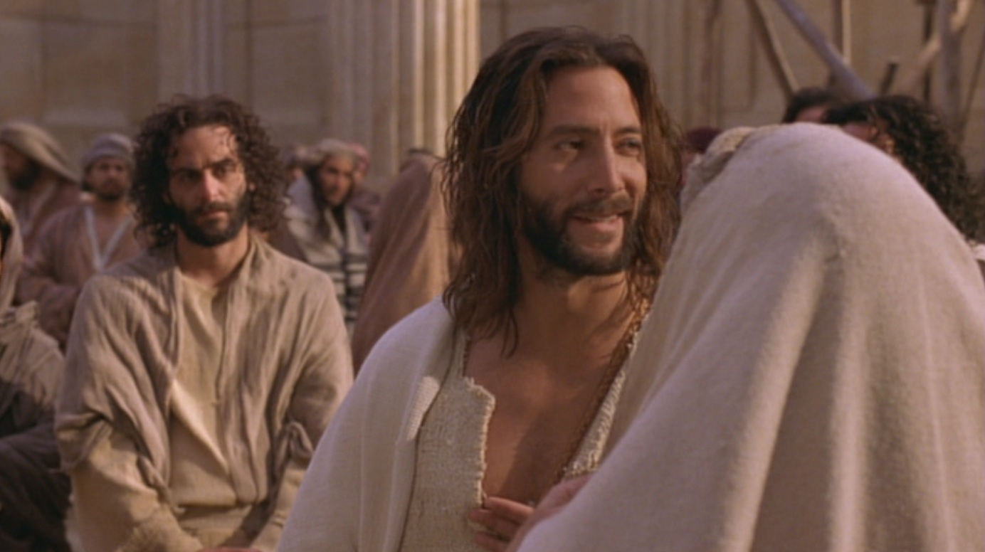
"My identity? I am God!" (John 8:25-30)
Above
Eternal life
Below
Die in sins
Jesus continued, "You are from below; I am from above. You belong to this world; I do not. ²⁴ That is why I said that you will die in your sins; for unless you believe that I Am who I claim to be, you will die in your sins" (John 8:23-24).

Slide 19
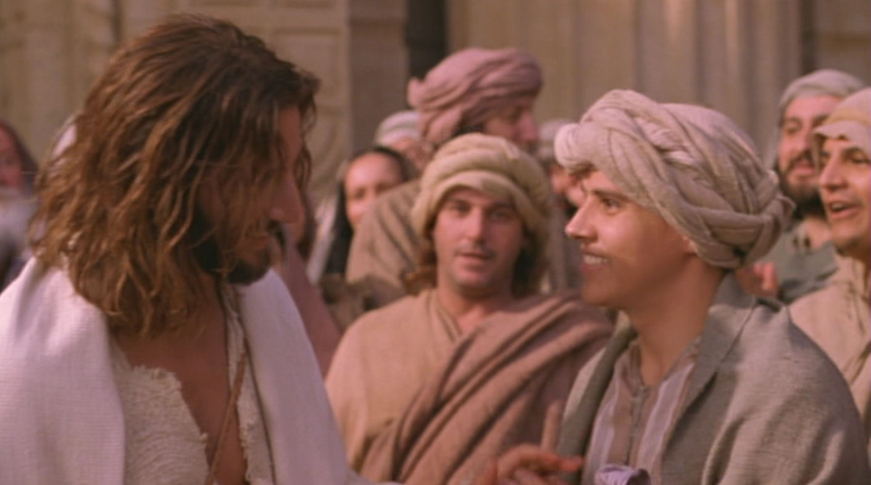
Many people there placed their faith in him (30).

Slide 20
I. Some are hostile to Christ as the way of salvation (12-20).

Slide 21
II. Many believe that the Father sent Jesus from heaven (21-30).

Slide 22

III. All are revealed as of God or Satan (31-59).

Slide 23

A. Believers in Jesus are freed from slavery to be the spiritual descendants of Abraham (31-38).
Child of God

Slide 24

"Believe" in John's Gospel
"Then many who heard him say these things believed in him.
³¹ Jesus said to the people who believed in him, 'You are truly my disciples if you remain faithful to my teachings. ³² And you will know the truth, and the truth will set you free'" (John 8:30-32).

Slide 25
They answered Him, “We are Abraham’s descendants and have never yet been enslaved to anyone; how is it that You say, ‘You will become free’?”
John 8:33 NAU
Notes:
Who is "They"? Are they the new believers in verses 30-32, or are they the unbelievers to whom Jesus is speaking throughout the chapter?
“They” answered him. While some argue that “they” refers back to verse 30 (i.e., to those who have believed in Him), the portrayal of those addressed in 8:33-59 renders this impression highly unlikely. Jesus says that they are slaves to sin; they are murderers; they have no belief in His word (v. 37); they want to kill Jesus; their father is Satan (v. 44); they are unable to hear what Jesus has to say (v. 43); they do not believe in Christ (v. 45); and they do not belong to God (v. 47). They in turn say that Jesus is demon-possessed (v. 48), and they picked up stones to stone him (v. 48). This hardly sounds like the same group in verse 30, who, after hearing him speak, “put their faith in him” (v. 30). Charles Bing is correct, “The abrupt change of tone from verses 30-31 resumes this motif, making it unnecessary to identify the speakers; the Jews had raised objections from the start of the dialogue (v. 13, 19, 22, 25).”1240 These critics, having heard Jesus’ aside to the new Christians, respond in anger.
Bing continues, “The objection of v 33 is totally out of character with the inclination of those mentioned in verses 30–32, as is also the declaration that those opposing Christ are children of the devil (v 44).”1241 The true believers of verses 31-32 are clearly not “children of the devil.” It is therefore perplexing why Schreiner and Caneday call our interpretation “remarkable.”1242 It is not “remarkable” at all. It makes very good sense of the context and the general usage of the phrase “believe in” found in the rest of John’s gospel. 1243
"In an extensive analysis, John Niemalä has shown that in John’s Gospel there are 353 speaking verbs which introduce new speakers or reintroduce previously introduced ones. He determined that there are 78 such verbs which do not have an explicit subject word like “Jesus said” or “the Pharisees replied,” etc. In all 78 instances, the use of such verbs without a named subject (“they said,” “they replied,” etc.), these verbs always indicated the reintroduction of a speaker who had spoken earlier in the context. This proves that the “they” of v. 33 cannot refer to the believers in v. 31 who have never spoken in the preceding context and must refer to the Pharisees who have (see vv. 13, 14, 19, 22, 25, 33).1244
"Long ago Augustine argued that “those who believed in him” are true, not spurious believers, and that the “they” of verse 33 refers to Christ’s critics, not the true believers of verses 31-32.1245 As Bernard and McNeile have noted, “Those who made the answer which follows were not the Jews who ‘believed Him’ (v. 31), but the Jewish objectors, with whom throughout the rest of this chapter Jesus is engaged in controversy. He could not have charged ‘the Jews who believed Him’ with seeking His life (vv. 37, 39).”1246
____________
1240 See Charles C. Bing, "The Condition for Salvation in John's Gospel," JOTGES 9, no. 1 (Spring 1996): 36.
1241 Ibid.
1242 Schreiner and Caneday, The Race Set Before Us, 118.
1243 Does this violate the principle of the near antecedent? Should the “they” of verse 33 refer to those in verse 31 and not the Pharisees of verses 27-29? Not necessarily. The principle of the near antecedent is only suggestive and not absolute. What might be the nearest antecedent contextually might not be the nearest antecedent in the author’s mind. For example in Acts 4:11 “He” refers to Christ in v. 10, but the near antecedent is “this man” in v. 10.
1244 John Niemalä, "Free at Last! Liberty in Jesus' Footsteps (John 8:30-32),"(2013). Niemalä’s paper can be downloaded from http://www.mol316.com/pdfs/GES2013FreeAtLast.pdf.
1245 Augustine, "Tractates on John," in Nicene and Post-Nicene Fathers ed. Philip Schaff (Oak Harbor, WA: Logos Research Systems, 1997), 7:230.
1246 J. H. Bernard and A. H. McNeile, A Critical and Exegetical Commentary on the Gospel According to St. John, 2 vols. (Edinburgh: T. & T. Clark, 1928), 2:306.
Joseph C. Dillow, Final Destiny, 4th ed. (Monument, CO; Paniym Group, Inc., 2019), 359-360

Slide 26
“'They' answered him. While some argue that 'they' refers back to verse 30 (i.e., to those who have believed in Him), the portrayal of those addressed in 8:33-59 renders this impression highly unlikely. Jesus says that they are slaves to sin; they are murderers; they have no belief in His word (v. 37); they want to kill Jesus; their father is Satan (v. 44); they are unable to hear what Jesus has to say (v. 43); they do not believe in Christ (v. 45); and they do not belong to God (v. 47). They in turn say that Jesus is demon-possessed (v. 48), and they picked up stones to stone him. (v. 48)."
Dillow, Final Destiny, 359
Notes:
Who is "They"? Are they the new believers in verses 30-32, or are they the unbelievers to whom Jesus is speaking throughout the chapter?
“They” answered him. While some argue that “they” refers back to verse 30 (i.e., to those who have believed in Him), the portrayal of those addressed in 8:33-59 renders this impression highly unlikely. Jesus says that they are slaves to sin; they are murderers; they have no belief in His word (v. 37); they want to kill Jesus; their father is Satan (v. 44); they are unable to hear what Jesus has to say (v. 43); they do not believe in Christ (v. 45); and they do not belong to God (v. 47). They in turn say that Jesus is demon-possessed (v. 48), and they picked up stones to stone him (v. 48). This hardly sounds like the same group in verse 30, who, after hearing him speak, “put their faith in him” (v. 30). Charles Bing is correct, “The abrupt change of tone from verses 30-31 resumes this motif, making it unnecessary to identify the speakers; the Jews had raised objections from the start of the dialogue (v. 13, 19, 22, 25).”1240 These critics, having heard Jesus’ aside to the new Christians, respond in anger.
Bing continues, “The objection of v 33 is totally out of character with the inclination of those mentioned in verses 30–32, as is also the declaration that those opposing Christ are children of the devil (v 44).”1241 The true believers of verses 31-32 are clearly not “children of the devil.” It is therefore perplexing why Schreiner and Caneday call our interpretation “remarkable.”1242 It is not “remarkable” at all. It makes very good sense of the context and the general usage of the phrase “believe in” found in the rest of John’s gospel. 1243
"In an extensive analysis, John Niemalä has shown that in John’s Gospel there are 353 speaking verbs which introduce new speakers or reintroduce previously introduced ones. He determined that there are 78 such verbs which do not have an explicit subject word like “Jesus said” or “the Pharisees replied,” etc. In all 78 instances, the use of such verbs without a named subject (“they said,” “they replied,” etc.), these verbs always indicated the reintroduction of a speaker who had spoken earlier in the context. This proves that the “they” of v. 33 cannot refer to the believers in v. 31 who have never spoken in the preceding context and must refer to the Pharisees who have (see vv. 13, 14, 19, 22, 25, 33).1244
"Long ago Augustine argued that “those who believed in him” are true, not spurious believers, and that the “they” of verse 33 refers to Christ’s critics, not the true believers of verses 31-32.1245 As Bernard and McNeile have noted, “Those who made the answer which follows were not the Jews who ‘believed Him’ (v. 31), but the Jewish objectors, with whom throughout the rest of this chapter Jesus is engaged in controversy. He could not have charged ‘the Jews who believed Him’ with seeking His life (vv. 37, 39).”1246
____________
1240 See Charles C. Bing, "The Condition for Salvation in John's Gospel," JOTGES 9, no. 1 (Spring 1996): 36.
1241 Ibid.
1242 Schreiner and Caneday, The Race Set Before Us, 118.
1243 Does this violate the principle of the near antecedent? Should the “they” of verse 33 refer to those in verse 31 and not the Pharisees of verses 27-29? Not necessarily. The principle of the near antecedent is only suggestive and not absolute. What might be the nearest antecedent contextually might not be the nearest antecedent in the author’s mind. For example in Acts 4:11 “He” refers to Christ in v. 10, but the near antecedent is “this man” in v. 10.
1244 John Niemalä, "Free at Last! Liberty in Jesus' Footsteps (John 8:30-32),"(2013). Niemalä’s paper can be downloaded from http://www.mol316.com/pdfs/GES2013FreeAtLast.pdf.
1245 Augustine, "Tractates on John," in Nicene and Post-Nicene Fathers ed. Philip Schaff (Oak Harbor, WA: Logos Research Systems, 1997), 7:230.
1246 J. H. Bernard and A. H. McNeile, A Critical and Exegetical Commentary on the Gospel According to St. John, 2 vols. (Edinburgh: T. & T. Clark, 1928), 2:306.
Joseph C. Dillow, Final Destiny, 4th ed. (Monument, CO; Paniym Group, Inc., 2019), 359-360

Slide 27
"This hardly sounds like the same group in verse 30, who, after hearing him speak, 'put their faith in him' (v. 30). Charles Bing is correct, 'The abrupt change of tone from verses 30-31 resumes this motif, making it unnecessary to identify the speakers; the Jews had raised objections from the start of the dialogue (v. 13, 19, 22, 25).^{'1240} These critics, having heard Jesus’ aside to the new Christians, respond in anger."
Dillow, Final Destiny, 359
Notes:
Who is "They"? Are they the new believers in verses 30-32, or are they the unbelievers to whom Jesus is speaking throughout the chapter?
“They” answered him. While some argue that “they” refers back to verse 30 (i.e., to those who have believed in Him), the portrayal of those addressed in 8:33-59 renders this impression highly unlikely. Jesus says that they are slaves to sin; they are murderers; they have no belief in His word (v. 37); they want to kill Jesus; their father is Satan (v. 44); they are unable to hear what Jesus has to say (v. 43); they do not believe in Christ (v. 45); and they do not belong to God (v. 47). They in turn say that Jesus is demon-possessed (v. 48), and they picked up stones to stone him (v. 48). This hardly sounds like the same group in verse 30, who, after hearing him speak, “put their faith in him” (v. 30). Charles Bing is correct, “The abrupt change of tone from verses 30-31 resumes this motif, making it unnecessary to identify the speakers; the Jews had raised objections from the start of the dialogue (v. 13, 19, 22, 25).”1240 These critics, having heard Jesus’ aside to the new Christians, respond in anger.
Bing continues, “The objection of v 33 is totally out of character with the inclination of those mentioned in verses 30–32, as is also the declaration that those opposing Christ are children of the devil (v 44).”1241 The true believers of verses 31-32 are clearly not “children of the devil.” It is therefore perplexing why Schreiner and Caneday call our interpretation “remarkable.”1242 It is not “remarkable” at all. It makes very good sense of the context and the general usage of the phrase “believe in” found in the rest of John’s gospel. 1243
"In an extensive analysis, John Niemalä has shown that in John’s Gospel there are 353 speaking verbs which introduce new speakers or reintroduce previously introduced ones. He determined that there are 78 such verbs which do not have an explicit subject word like “Jesus said” or “the Pharisees replied,” etc. In all 78 instances, the use of such verbs without a named subject (“they said,” “they replied,” etc.), these verbs always indicated the reintroduction of a speaker who had spoken earlier in the context. This proves that the “they” of v. 33 cannot refer to the believers in v. 31 who have never spoken in the preceding context and must refer to the Pharisees who have (see vv. 13, 14, 19, 22, 25, 33).1244
"Long ago Augustine argued that “those who believed in him” are true, not spurious believers, and that the “they” of verse 33 refers to Christ’s critics, not the true believers of verses 31-32.1245 As Bernard and McNeile have noted, “Those who made the answer which follows were not the Jews who ‘believed Him’ (v. 31), but the Jewish objectors, with whom throughout the rest of this chapter Jesus is engaged in controversy. He could not have charged ‘the Jews who believed Him’ with seeking His life (vv. 37, 39).”1246
____________
1240 See Charles C. Bing, "The Condition for Salvation in John's Gospel," JOTGES 9, no. 1 (Spring 1996): 36.
1241 Ibid.
1242 Schreiner and Caneday, The Race Set Before Us, 118.
1243 Does this violate the principle of the near antecedent? Should the “they” of verse 33 refer to those in verse 31 and not the Pharisees of verses 27-29? Not necessarily. The principle of the near antecedent is only suggestive and not absolute. What might be the nearest antecedent contextually might not be the nearest antecedent in the author’s mind. For example in Acts 4:11 “He” refers to Christ in v. 10, but the near antecedent is “this man” in v. 10.
1244 John Niemalä, "Free at Last! Liberty in Jesus' Footsteps (John 8:30-32),"(2013). Niemalä’s paper can be downloaded from http://www.mol316.com/pdfs/GES2013FreeAtLast.pdf.
1245 Augustine, "Tractates on John," in Nicene and Post-Nicene Fathers ed. Philip Schaff (Oak Harbor, WA: Logos Research Systems, 1997), 7:230.
1246 J. H. Bernard and A. H. McNeile, A Critical and Exegetical Commentary on the Gospel According to St. John, 2 vols. (Edinburgh: T. & T. Clark, 1928), 2:306.
Joseph C. Dillow, Final Destiny, 4th ed. (Monument, CO; Paniym Group, Inc., 2019), 359-360

Slide 28
"Bing continues, 'The objection of v 33 is totally out of character with the inclination of those mentioned in verses 30–32, as is also the declaration that those opposing Christ are children of the devil (v 44).'¹²⁴¹ The true believers of verses 31-32 are clearly not 'children of the devil.' It is therefore perplexing why Schreiner and Caneday call our interpretation 'remarkable.'¹²⁴² It is not 'remarkable' at all. It makes very good sense of the context and the general usage of the phrase 'believe in' found in the rest of John’s gospel." ¹²⁴³
Dillow, Final Destiny, 359
Notes:
Who is "They"? Are they the new believers in verses 30-32, or are they the unbelievers to whom Jesus is speaking throughout the chapter?
“They” answered him. While some argue that “they” refers back to verse 30 (i.e., to those who have believed in Him), the portrayal of those addressed in 8:33-59 renders this impression highly unlikely. Jesus says that they are slaves to sin; they are murderers; they have no belief in His word (v. 37); they want to kill Jesus; their father is Satan (v. 44); they are unable to hear what Jesus has to say (v. 43); they do not believe in Christ (v. 45); and they do not belong to God (v. 47). They in turn say that Jesus is demon-possessed (v. 48), and they picked up stones to stone him (v. 48). This hardly sounds like the same group in verse 30, who, after hearing him speak, “put their faith in him” (v. 30). Charles Bing is correct, “The abrupt change of tone from verses 30-31 resumes this motif, making it unnecessary to identify the speakers; the Jews had raised objections from the start of the dialogue (v. 13, 19, 22, 25).”1240 These critics, having heard Jesus’ aside to the new Christians, respond in anger.
Bing continues, “The objection of v 33 is totally out of character with the inclination of those mentioned in verses 30–32, as is also the declaration that those opposing Christ are children of the devil (v 44).”1241 The true believers of verses 31-32 are clearly not “children of the devil.” It is therefore perplexing why Schreiner and Caneday call our interpretation “remarkable.”1242 It is not “remarkable” at all. It makes very good sense of the context and the general usage of the phrase “believe in” found in the rest of John’s gospel. 1243
"In an extensive analysis, John Niemalä has shown that in John’s Gospel there are 353 speaking verbs which introduce new speakers or reintroduce previously introduced ones. He determined that there are 78 such verbs which do not have an explicit subject word like “Jesus said” or “the Pharisees replied,” etc. In all 78 instances, the use of such verbs without a named subject (“they said,” “they replied,” etc.), these verbs always indicated the reintroduction of a speaker who had spoken earlier in the context. This proves that the “they” of v. 33 cannot refer to the believers in v. 31 who have never spoken in the preceding context and must refer to the Pharisees who have (see vv. 13, 14, 19, 22, 25, 33).1244
"Long ago Augustine argued that “those who believed in him” are true, not spurious believers, and that the “they” of verse 33 refers to Christ’s critics, not the true believers of verses 31-32.1245 As Bernard and McNeile have noted, “Those who made the answer which follows were not the Jews who ‘believed Him’ (v. 31), but the Jewish objectors, with whom throughout the rest of this chapter Jesus is engaged in controversy. He could not have charged ‘the Jews who believed Him’ with seeking His life (vv. 37, 39).”1246
____________
1240 See Charles C. Bing, "The Condition for Salvation in John's Gospel," JOTGES 9, no. 1 (Spring 1996): 36.
1241 Ibid.
1242 Schreiner and Caneday, The Race Set Before Us, 118.
1243 Does this violate the principle of the near antecedent? Should the “they” of verse 33 refer to those in verse 31 and not the Pharisees of verses 27-29? Not necessarily. The principle of the near antecedent is only suggestive and not absolute. What might be the nearest antecedent contextually might not be the nearest antecedent in the author’s mind. For example in Acts 4:11 “He” refers to Christ in v. 10, but the near antecedent is “this man” in v. 10.
1244 John Niemalä, "Free at Last! Liberty in Jesus' Footsteps (John 8:30-32),"(2013). Niemalä’s paper can be downloaded from http://www.mol316.com/pdfs/GES2013FreeAtLast.pdf.
1245 Augustine, "Tractates on John," in Nicene and Post-Nicene Fathers ed. Philip Schaff (Oak Harbor, WA: Logos Research Systems, 1997), 7:230.
1246 J. H. Bernard and A. H. McNeile, A Critical and Exegetical Commentary on the Gospel According to St. John, 2 vols. (Edinburgh: T. & T. Clark, 1928), 2:306.
Joseph C. Dillow, Final Destiny, 4th ed. (Monument, CO; Paniym Group, Inc., 2019), 359-360

Slide 29
"In an extensive analysis, John Niemalä has shown that in John’s Gospel there are 353 speaking verbs which introduce new speakers or reintroduce previously introduced ones. He determined that there are 78 such verbs which do not have an explicit subject word like 'Jesus said' or 'the Pharisees replied,' etc. In all 78 instances, the use of such verbs without a named subject ('they said,' 'they replied,' etc.), these verbs always indicated the reintroduction of a speaker who had spoken earlier in the context."
Dillow, Final Destiny, 359
Notes:
Who is "They"? Are they the new believers in verses 30-32, or are they the unbelievers to whom Jesus is speaking throughout the chapter?
“They” answered him. While some argue that “they” refers back to verse 30 (i.e., to those who have believed in Him), the portrayal of those addressed in 8:33-59 renders this impression highly unlikely. Jesus says that they are slaves to sin; they are murderers; they have no belief in His word (v. 37); they want to kill Jesus; their father is Satan (v. 44); they are unable to hear what Jesus has to say (v. 43); they do not believe in Christ (v. 45); and they do not belong to God (v. 47). They in turn say that Jesus is demon-possessed (v. 48), and they picked up stones to stone him (v. 48). This hardly sounds like the same group in verse 30, who, after hearing him speak, “put their faith in him” (v. 30). Charles Bing is correct, “The abrupt change of tone from verses 30-31 resumes this motif, making it unnecessary to identify the speakers; the Jews had raised objections from the start of the dialogue (v. 13, 19, 22, 25).”1240 These critics, having heard Jesus’ aside to the new Christians, respond in anger.
Bing continues, “The objection of v 33 is totally out of character with the inclination of those mentioned in verses 30–32, as is also the declaration that those opposing Christ are children of the devil (v 44).”1241 The true believers of verses 31-32 are clearly not “children of the devil.” It is therefore perplexing why Schreiner and Caneday call our interpretation “remarkable.”1242 It is not “remarkable” at all. It makes very good sense of the context and the general usage of the phrase “believe in” found in the rest of John’s gospel. 1243
"In an extensive analysis, John Niemalä has shown that in John’s Gospel there are 353 speaking verbs which introduce new speakers or reintroduce previously introduced ones. He determined that there are 78 such verbs which do not have an explicit subject word like “Jesus said” or “the Pharisees replied,” etc. In all 78 instances, the use of such verbs without a named subject (“they said,” “they replied,” etc.), these verbs always indicated the reintroduction of a speaker who had spoken earlier in the context. This proves that the “they” of v. 33 cannot refer to the believers in v. 31 who have never spoken in the preceding context and must refer to the Pharisees who have (see vv. 13, 14, 19, 22, 25, 33).1244
"Long ago Augustine argued that “those who believed in him” are true, not spurious believers, and that the “they” of verse 33 refers to Christ’s critics, not the true believers of verses 31-32.1245 As Bernard and McNeile have noted, “Those who made the answer which follows were not the Jews who ‘believed Him’ (v. 31), but the Jewish objectors, with whom throughout the rest of this chapter Jesus is engaged in controversy. He could not have charged ‘the Jews who believed Him’ with seeking His life (vv. 37, 39).”1246
____________
1240 See Charles C. Bing, "The Condition for Salvation in John's Gospel," JOTGES 9, no. 1 (Spring 1996): 36.
1241 Ibid.
1242 Schreiner and Caneday, The Race Set Before Us, 118.
1243 Does this violate the principle of the near antecedent? Should the “they” of verse 33 refer to those in verse 31 and not the Pharisees of verses 27-29? Not necessarily. The principle of the near antecedent is only suggestive and not absolute. What might be the nearest antecedent contextually might not be the nearest antecedent in the author’s mind. For example in Acts 4:11 “He” refers to Christ in v. 10, but the near antecedent is “this man” in v. 10.
1244 John Niemalä, "Free at Last! Liberty in Jesus' Footsteps (John 8:30-32),"(2013). Niemalä’s paper can be downloaded from http://www.mol316.com/pdfs/GES2013FreeAtLast.pdf.
1245 Augustine, "Tractates on John," in Nicene and Post-Nicene Fathers ed. Philip Schaff (Oak Harbor, WA: Logos Research Systems, 1997), 7:230.
1246 J. H. Bernard and A. H. McNeile, A Critical and Exegetical Commentary on the Gospel According to St. John, 2 vols. (Edinburgh: T. & T. Clark, 1928), 2:306.
Joseph C. Dillow, Final Destiny, 4th ed. (Monument, CO; Paniym Group, Inc., 2019), 359-360

Slide 30
"This proves that the 'they' of v. 33 cannot refer to the believers in v. 31 who have never spoken in the preceding context and must refer to the Pharisees who have (see vv. 13, 14, 19, 22, 25, 33)."¹²⁴⁴
Dillow, Final Destiny, 359
Notes:
Who is "They"? Are they the new believers in verses 30-32, or are they the unbelievers to whom Jesus is speaking throughout the chapter?
“They” answered him. While some argue that “they” refers back to verse 30 (i.e., to those who have believed in Him), the portrayal of those addressed in 8:33-59 renders this impression highly unlikely. Jesus says that they are slaves to sin; they are murderers; they have no belief in His word (v. 37); they want to kill Jesus; their father is Satan (v. 44); they are unable to hear what Jesus has to say (v. 43); they do not believe in Christ (v. 45); and they do not belong to God (v. 47). They in turn say that Jesus is demon-possessed (v. 48), and they picked up stones to stone him (v. 48). This hardly sounds like the same group in verse 30, who, after hearing him speak, “put their faith in him” (v. 30). Charles Bing is correct, “The abrupt change of tone from verses 30-31 resumes this motif, making it unnecessary to identify the speakers; the Jews had raised objections from the start of the dialogue (v. 13, 19, 22, 25).”1240 These critics, having heard Jesus’ aside to the new Christians, respond in anger.
Bing continues, “The objection of v 33 is totally out of character with the inclination of those mentioned in verses 30–32, as is also the declaration that those opposing Christ are children of the devil (v 44).”1241 The true believers of verses 31-32 are clearly not “children of the devil.” It is therefore perplexing why Schreiner and Caneday call our interpretation “remarkable.”1242 It is not “remarkable” at all. It makes very good sense of the context and the general usage of the phrase “believe in” found in the rest of John’s gospel. 1243
"In an extensive analysis, John Niemalä has shown that in John’s Gospel there are 353 speaking verbs which introduce new speakers or reintroduce previously introduced ones. He determined that there are 78 such verbs which do not have an explicit subject word like “Jesus said” or “the Pharisees replied,” etc. In all 78 instances, the use of such verbs without a named subject (“they said,” “they replied,” etc.), these verbs always indicated the reintroduction of a speaker who had spoken earlier in the context. This proves that the “they” of v. 33 cannot refer to the believers in v. 31 who have never spoken in the preceding context and must refer to the Pharisees who have (see vv. 13, 14, 19, 22, 25, 33).1244
"Long ago Augustine argued that “those who believed in him” are true, not spurious believers, and that the “they” of verse 33 refers to Christ’s critics, not the true believers of verses 31-32.1245 As Bernard and McNeile have noted, “Those who made the answer which follows were not the Jews who ‘believed Him’ (v. 31), but the Jewish objectors, with whom throughout the rest of this chapter Jesus is engaged in controversy. He could not have charged ‘the Jews who believed Him’ with seeking His life (vv. 37, 39).”1246
____________
1240 See Charles C. Bing, "The Condition for Salvation in John's Gospel," JOTGES 9, no. 1 (Spring 1996): 36.
1241 Ibid.
1242 Schreiner and Caneday, The Race Set Before Us, 118.
1243 Does this violate the principle of the near antecedent? Should the “they” of verse 33 refer to those in verse 31 and not the Pharisees of verses 27-29? Not necessarily. The principle of the near antecedent is only suggestive and not absolute. What might be the nearest antecedent contextually might not be the nearest antecedent in the author’s mind. For example in Acts 4:11 “He” refers to Christ in v. 10, but the near antecedent is “this man” in v. 10.
1244 John Niemalä, "Free at Last! Liberty in Jesus' Footsteps (John 8:30-32),"(2013). Niemalä’s paper can be downloaded from http://www.mol316.com/pdfs/GES2013FreeAtLast.pdf.
1245 Augustine, "Tractates on John," in Nicene and Post-Nicene Fathers ed. Philip Schaff (Oak Harbor, WA: Logos Research Systems, 1997), 7:230.
1246 J. H. Bernard and A. H. McNeile, A Critical and Exegetical Commentary on the Gospel According to St. John, 2 vols. (Edinburgh: T. & T. Clark, 1928), 2:306.
Joseph C. Dillow, Final Destiny, 4th ed. (Monument, CO; Paniym Group, Inc., 2019), 359-360

Slide 31
"Long ago Augustine argued that 'those who believed in him' are true, not spurious believers, and that the 'they' of verse 33 refers to Christ’s critics, not the true believers of verses 31-32.¹²⁴⁵ As Bernard and McNeile have noted, 'Those who made the answer which follows were not the Jews who "believed Him" (v. 31), but the Jewish objectors, with whom throughout the rest of this chapter Jesus is engaged in controversy. He could not have charged "the Jews who believed Him" with seeking His life (vv. 37, 39).'”¹²⁴⁶
Dillow, Final Destiny, 359-60
Notes:
Who is "They"? Are they the new believers in verses 30-32, or are they the unbelievers to whom Jesus is speaking throughout the chapter?
“They” answered him. While some argue that “they” refers back to verse 30 (i.e., to those who have believed in Him), the portrayal of those addressed in 8:33-59 renders this impression highly unlikely. Jesus says that they are slaves to sin; they are murderers; they have no belief in His word (v. 37); they want to kill Jesus; their father is Satan (v. 44); they are unable to hear what Jesus has to say (v. 43); they do not believe in Christ (v. 45); and they do not belong to God (v. 47). They in turn say that Jesus is demon-possessed (v. 48), and they picked up stones to stone him (v. 48). This hardly sounds like the same group in verse 30, who, after hearing him speak, “put their faith in him” (v. 30). Charles Bing is correct, “The abrupt change of tone from verses 30-31 resumes this motif, making it unnecessary to identify the speakers; the Jews had raised objections from the start of the dialogue (v. 13, 19, 22, 25).”1240 These critics, having heard Jesus’ aside to the new Christians, respond in anger.
Bing continues, “The objection of v 33 is totally out of character with the inclination of those mentioned in verses 30–32, as is also the declaration that those opposing Christ are children of the devil (v 44).”1241 The true believers of verses 31-32 are clearly not “children of the devil.” It is therefore perplexing why Schreiner and Caneday call our interpretation “remarkable.”1242 It is not “remarkable” at all. It makes very good sense of the context and the general usage of the phrase “believe in” found in the rest of John’s gospel. 1243
"In an extensive analysis, John Niemalä has shown that in John’s Gospel there are 353 speaking verbs which introduce new speakers or reintroduce previously introduced ones. He determined that there are 78 such verbs which do not have an explicit subject word like “Jesus said” or “the Pharisees replied,” etc. In all 78 instances, the use of such verbs without a named subject (“they said,” “they replied,” etc.), these verbs always indicated the reintroduction of a speaker who had spoken earlier in the context. This proves that the “they” of v. 33 cannot refer to the believers in v. 31 who have never spoken in the preceding context and must refer to the Pharisees who have (see vv. 13, 14, 19, 22, 25, 33).1244
"Long ago Augustine argued that “those who believed in him” are true, not spurious believers, and that the “they” of verse 33 refers to Christ’s critics, not the true believers of verses 31-32.1245 As Bernard and McNeile have noted, “Those who made the answer which follows were not the Jews who ‘believed Him’ (v. 31), but the Jewish objectors, with whom throughout the rest of this chapter Jesus is engaged in controversy. He could not have charged ‘the Jews who believed Him’ with seeking His life (vv. 37, 39).”1246
____________
1240 See Charles C. Bing, "The Condition for Salvation in John's Gospel," JOTGES 9, no. 1 (Spring 1996): 36.
1241 Ibid.
1242 Schreiner and Caneday, The Race Set Before Us, 118.
1243 Does this violate the principle of the near antecedent? Should the “they” of verse 33 refer to those in verse 31 and not the Pharisees of verses 27-29? Not necessarily. The principle of the near antecedent is only suggestive and not absolute. What might be the nearest antecedent contextually might not be the nearest antecedent in the author’s mind. For example in Acts 4:11 “He” refers to Christ in v. 10, but the near antecedent is “this man” in v. 10.
1244 John Niemalä, "Free at Last! Liberty in Jesus' Footsteps (John 8:30-32),"(2013). Niemalä’s paper can be downloaded from http://www.mol316.com/pdfs/GES2013FreeAtLast.pdf.
1245 Augustine, "Tractates on John," in Nicene and Post-Nicene Fathers ed. Philip Schaff (Oak Harbor, WA: Logos Research Systems, 1997), 7:230.
1246 J. H. Bernard and A. H. McNeile, A Critical and Exegetical Commentary on the Gospel According to St. John, 2 vols. (Edinburgh: T. & T. Clark, 1928), 2:306.
Joseph C. Dillow, Final Destiny, 4th ed. (Monument, CO; Paniym Group, Inc., 2019), 359-360

Slide 32
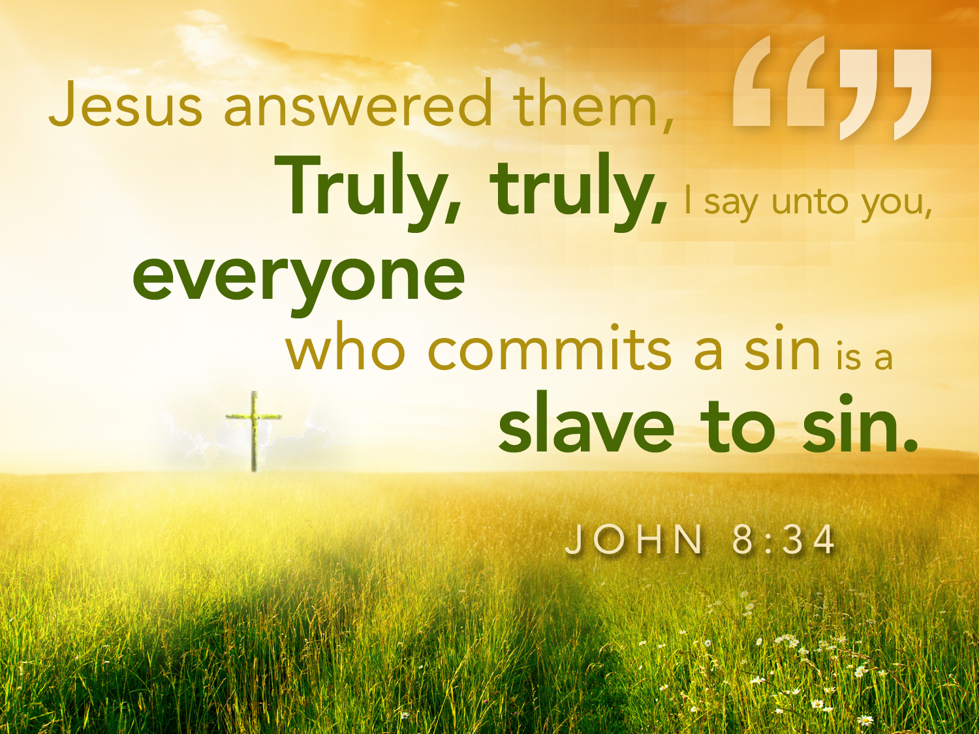
John 8:34 text

Slide 33

Life's Journey

Slide 34

Freedom (John 8:34)

Slide 35
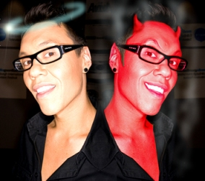
B. Those who reject Jesus identify the devil as their father, even to the point of trying to kill the messenger (John 8:39-59).

Slide 36
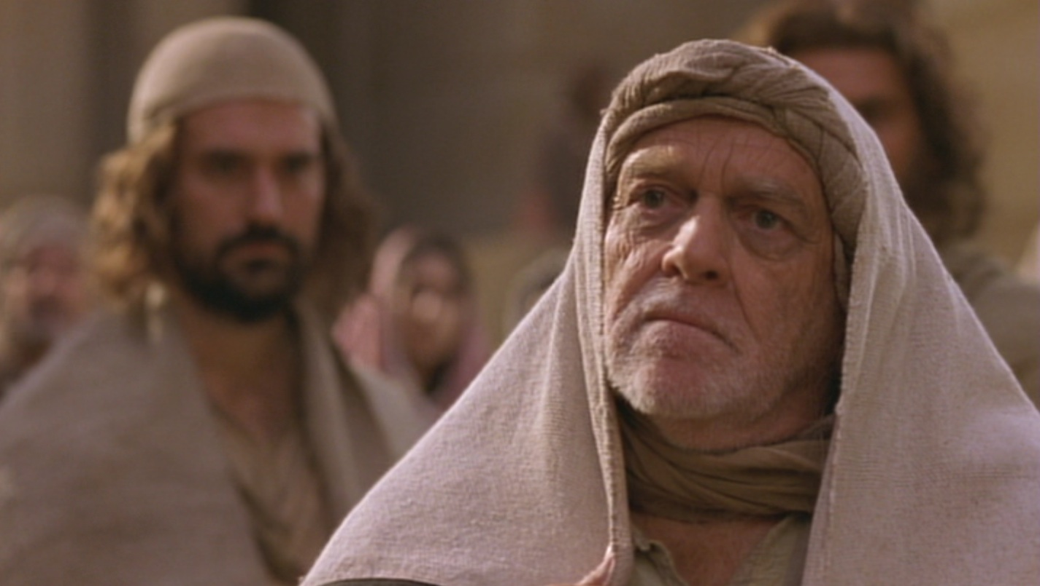
1. Those who reject Jesus identify the devil as their father (John 8:39-47).

Slide 37
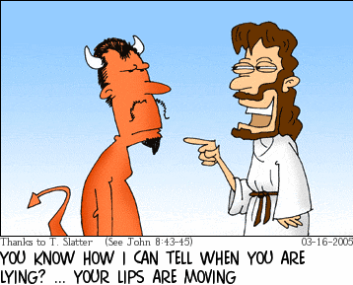
“You belong to your father, the devil... He was a murderer from the beginning... When he lies, he speaks his native language...” (John 8:44)
YOU KNOW HOW I CAN TELL WHEN YOU LYING? … YOUR LIPS ARE MOVING

Slide 38

2. Some reject God to the point that they even try to kill the messenger (John 8:48-59).
Somali Christian Beheaded for his Faith

Slide 39
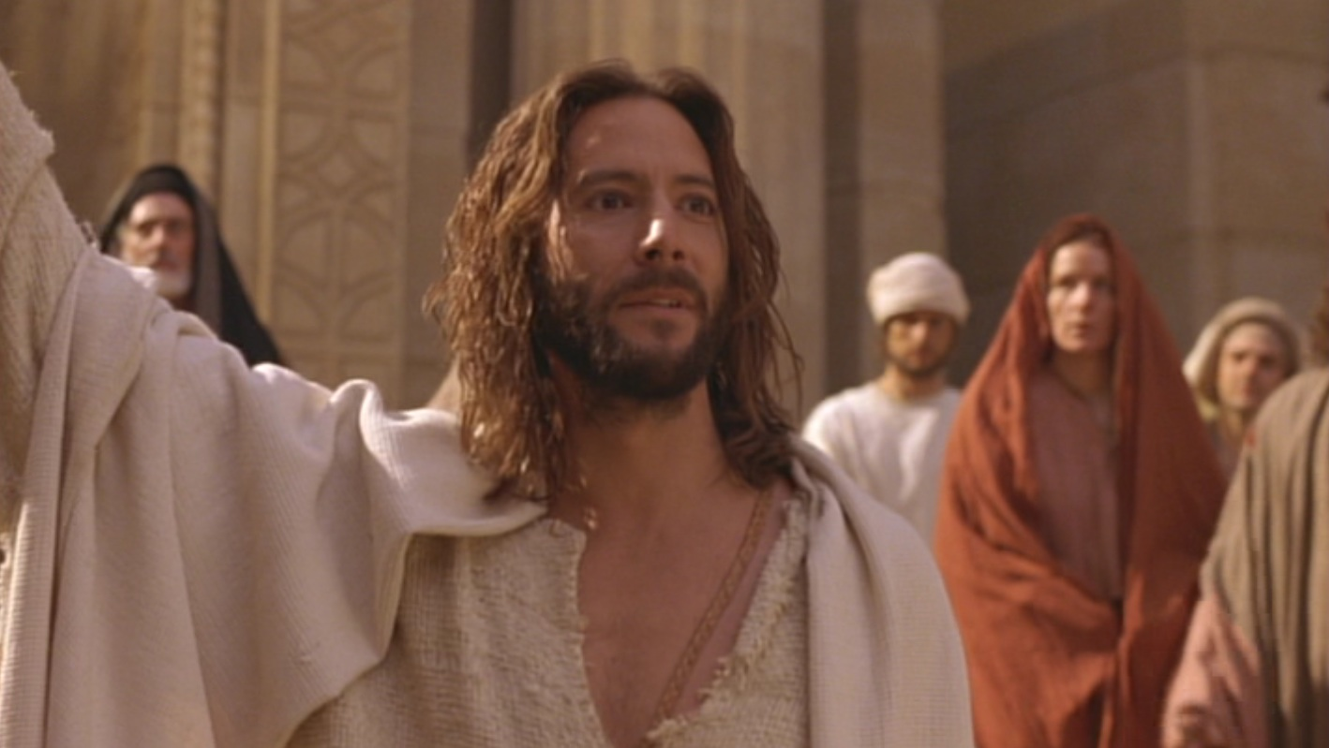
“Before Abraham was born, I Am!”
John 8:58
Notes:
John 8:58 Jesus answered, “I tell you the truth, before Abraham was even born, I AM!"
He is referring to Exodus 3:14.

Slide 40
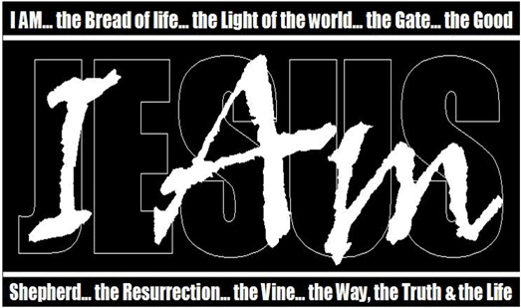
Christ’s “I Am…” Claims in John’s Gospel

Slide 41
Christ’s “I Am…” Claims in John’s Gospel
“Light of the World”
“Before Abraham”
“Good Shepherd”
“Door”
“I & Father are one”
“Resurrection & Life”
“Way, Truth, & Life”
“True Vine”

Slide 42
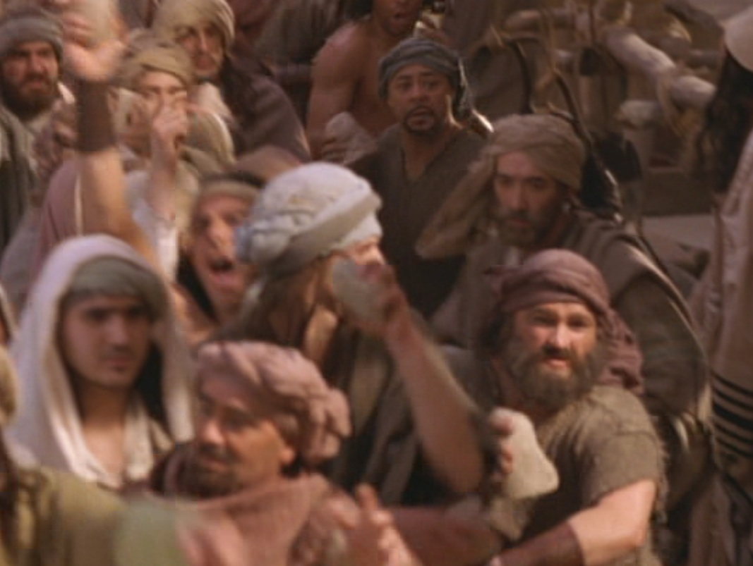
“They picked up stones to throw at him”
John 8:59

Slide 43
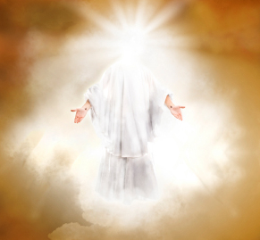
Main Idea
How should we expect people to respond to Christ’s claim to be eternal God who saves us from sin?
Christ’s claim to be God elicits the best & worst in us.

Slide 44
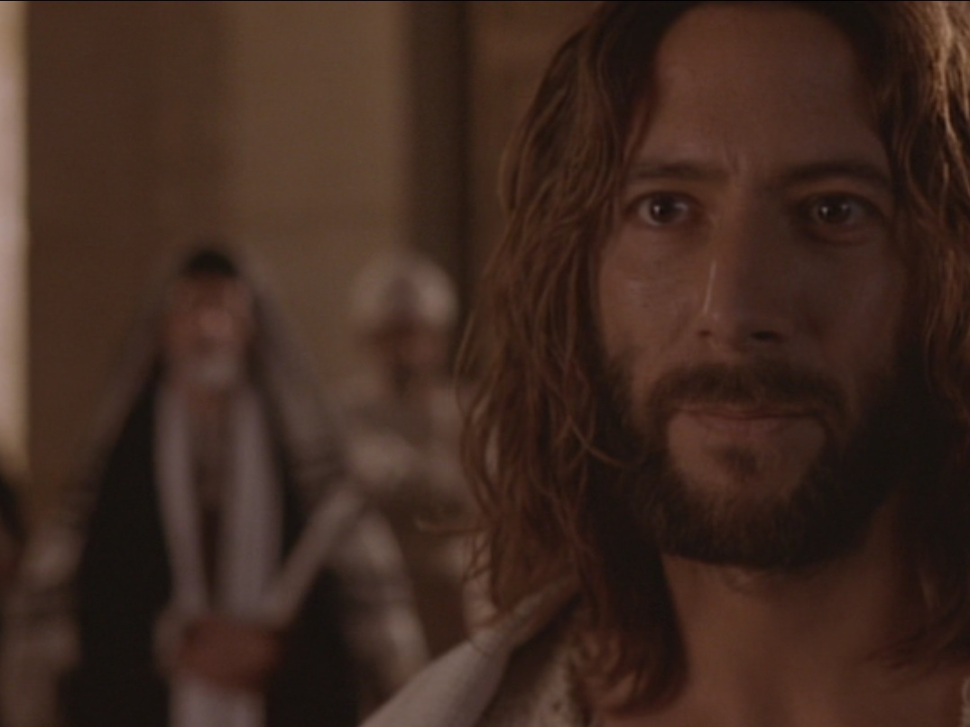
Who is Jesus?
Jesus is the Light of life (John 8:12-20)
Jesus is sent from heaven by God the Father (John 8:21-30)
Jesus can make you God’s child (31-38)
Jesus is God eternal (John 8:39-59)

Slide 45

3 responses:
• Some are hostile (12-20).
• Many believe (21-30).
• All are revealed as of God or Satan (31-59).

Slide 46

Walk to the light!

Slide 47
C. S. Lewis, Mere Christianity, 55-56
“I am here trying to prevent anyone saying the really foolish thing that people often say about Him: ‘I’m ready to accept Jesus as a great moral teacher, but I don’t accept His claim to be God.’ That is the one thing we must not say. A man who was merely a man and said the sort of things Jesus said would not be a great moral teacher. He would either be a lunatic—on a level with the man who says he is a poached egg—or else he would be the Devil of Hell. You must make your choice. Either this man was, and is, the Son of God: or else a madman or something worse. You can shut Him up for a fool, you can spit at Him and kill Him as a demon; or you can fall at His feet and call Him Lord and God. But let us not come with any patronising nonsense about His being a great human teacher. He has not left that open to us. He did not intend to.”

Slide 48
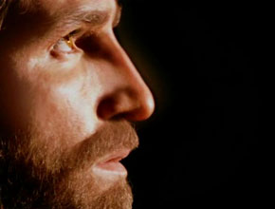
Liar–Lunatic–Lord
Jesus said
I AM GOD
If True
If False
If Insincere
If Sincere
Jesus is God
Jesus is a
Jesus is a
LORD
LIAR
LUNATIC
Notes:
C.S. Lewis, a popular British theologian, wrote, "I am trying here to prevent anyone saying the really foolish thing that people often say about Him: 'I'm ready to accept Jesus as a great moral teacher, but I don't accept His claim to be God.' That is the one thing we must not say. A man who was merely a man and said the sort of things Jesus said would not be a great moral teacher. He would either be a lunatic - on the level with the man who says he is a poached egg - or else he would be the Devil of Hell. You must make your choice. Either this man was, and is, the Son of God: or else a madman or something worse. You can shut Him up for a fool, you can spit at Him and kill Him as a demon; or you can fall at His feet and call Him Lord and God. But let us not come with any patronising nonsense about His being a great human teacher. He has not left that open to us. He did not intend to" (C.S. Lewis, Mere Christianity, The MacMillan Company, 1960, pp. 40-41.)

Slide 49
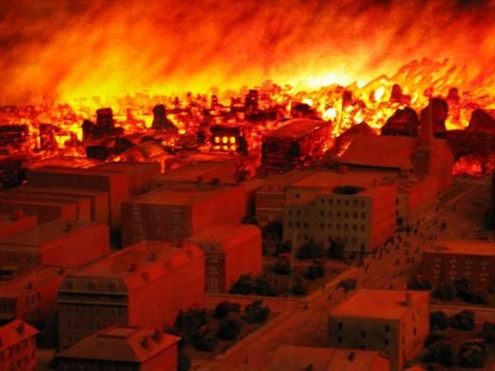
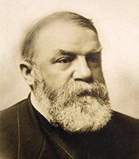
D.L. Moody
Notes:
[Moody’s mistake and the Great Chicago Fire by Swindoll, Following Christ…The Man of God, 32]
“Dwight L. Moody, by his own admission, made a mistake on the eighth of October 1871—a mistake he determined never to repeat. He had been preaching in Chicago. That particular night drew his largest audience yet. His message was, ‘What will you do then with Jesus who is called the Christ?’
By the end of the service, he was tired. He concluded his message with a presentation of the gospel and a concluding statement: ‘Now I give you a week to think that over. And when we come together again, you will have the opportunity to respond.’
A soloist began to sing. But before the final note, the music was drowned out by clanging bells and wailing sirens screaming through the streets. The great Chicago Fire was blazing. In the ashen aftermath, hundreds were dead, and over a hundred thousand were homeless.
Without a doubt, some who heard Moody’s message had died in the fire. He reflected remorsefully that he would have given this right arm before he would ever give another week to an audience to think over the message of the gospel.
If you were a victim of a fire like that, would you know with certainty whether you would spend eternity with Christ in heaven? Not hope or wish or pray that you would go there—but know?”
I can’t guarantee that this is your last chance to trust Christ—but I also can’t assure you that it isn’t. So why not trust Him today?

Slide 50
Black

Slide 51


NT Preaching link at BibleStudyDownloads.org
Get this presentation and script for free!
Notes:
NT Preaching (np)

