Slide 1
Deepening Trust in the Lord
Stronger Faith in Crisis
(John 6:16-21)
Preached by Dr. Jim Harmeling at Crossroads International Church Singapore • CICFamily.com Uploaded by Dr. Rick Griffith • Jordan Evangelical Theological Seminary Files in many languages for free download at BibleStudyDownloads.org

Slide 2
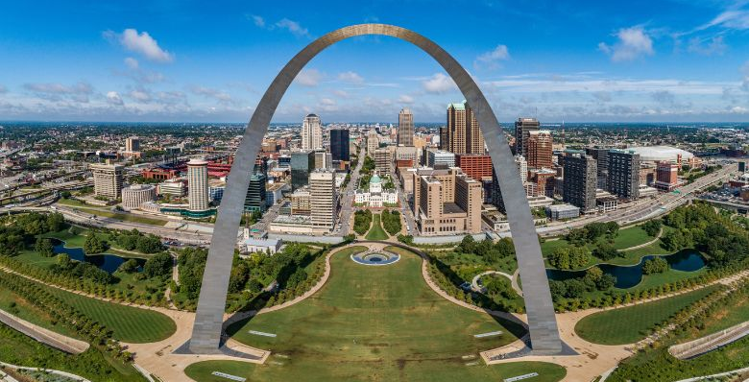

Slide 3
Deepening Trust in the Lord
Stronger Faith in Crisis
(John 6:16-21)

Slide 4
Believing
C H R I S T
Responding to John’s Gospel

Slide 5
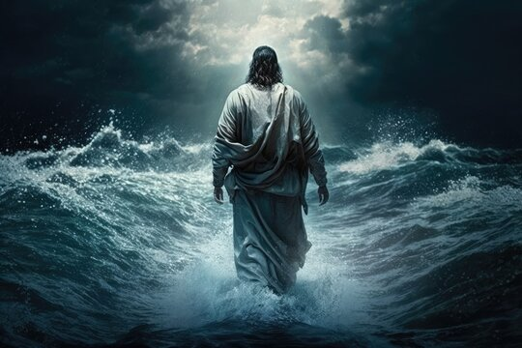
Deepened trust in the Lord involves great crisis (vs. 16-18a)
Deepened trust in the Lord may require isolation (v. 17b)
Deepened trust in the Lord can increase fear (v. 19)
“It is the fear that fills a person confronted with the revelation of God or the divine . . . or, in general, with the supernatural . . . , a fear that apparently also prevented the disciples from immediately recognizing Jesus in the approaching figure. For they had never learned to know him in that way and thus, in that place and horrendous situation, had not expected him at all.”
Herman Ridderbos

Slide 6
Deepened trust in the Lord involves great crisis (vs. 16-18a)
Deepened trust in the Lord may require isolation (v. 17b)
Deepened trust in the Lord can increase fear (v. 19)
Deepened trust in the Lord brings reassurance (vs. 20-21a)
“But by saying this Jesus also describes his coming and appearance as a divine epiphany; and this occurs in a context – and that is where the emphasis lies in this self-revelation – that should convince them that, in virtue of the glory given him by God, no darkness was too deep, waves too high, or sea too wide for him to find them and be with them in the midst of that tumult.”
Herman Ridderbos

Slide 7
Deepened trust in the Lord involves great crisis (vs. 16-18a)
Deepened trust in the Lord may require isolation (v. 17b)
Deepened trust in the Lord can increase fear (v. 19)
Deepened trust in the Lord brings reassurance (vs. 20-21a)
Deepened trust in the Lord leads to provision (v. 21b)

Slide 8
Black

Slide 9
NT Preaching link at BibleStudyDownloads.org
Get this presentation and notes for free!
Notes:
NT Preaching (np)

