Slide 1
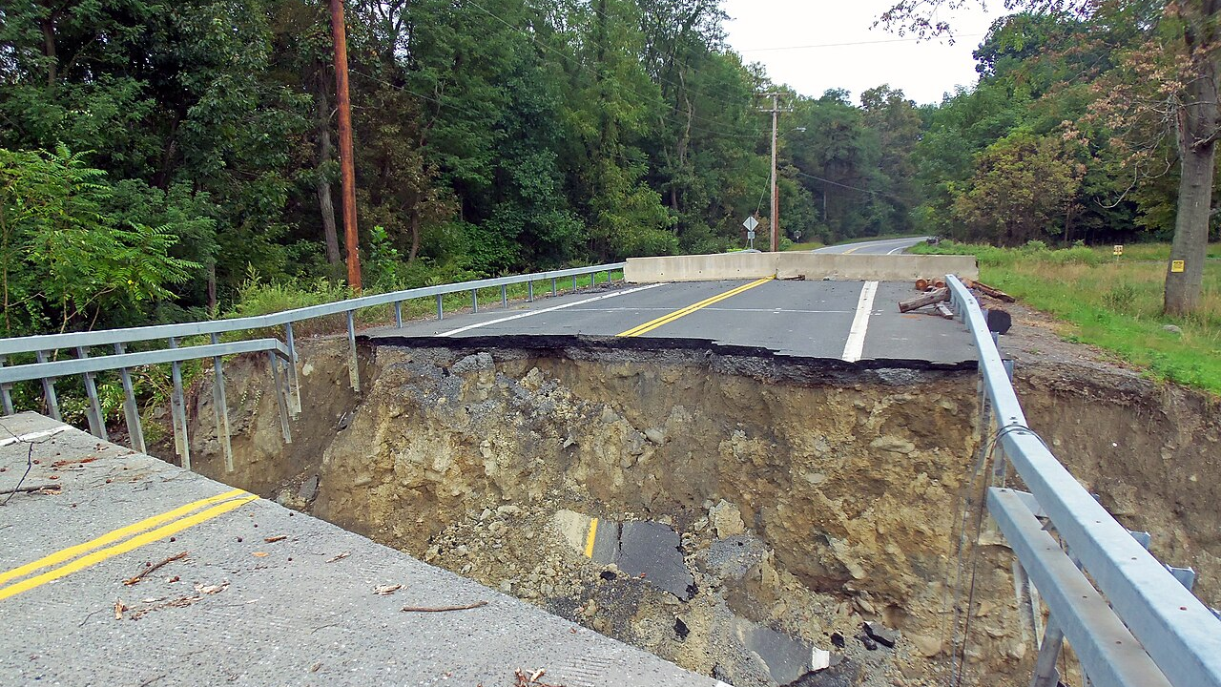
The Tests of Faith
How do you follow Jesus when facing problems?
(John 6:1-15)
Preached by Dr. Jim Harmeling at Crossroads International Church Singapore • CICFamily.com Uploaded by Dr. Rick Griffith • Jordan Evangelical Theological Seminary Files in many languages for free download at BibleStudyDownloads.org

Slide 3
The Tests of Faith
How do you follow Jesus when facing problems?
(John 6:1-15)

Slide 4
Believing
C H R I S T
Responding to John’s Gospel

Slide 5
Deuteronomy 18:18
I will raise up for them a prophet like you from among their brothers. And I will put my words in his mouth, and he shall speak to them all that I command him.

Slide 6
2 Kings 4:42-44
⁴² A man came from Baal-shalishah, bringing the man of God bread of the firstfruits, twenty loaves of barley and fresh ears of grain in his sack. And Elisha said, “Give to the men, that they may eat.” ⁴³ But his servant said, “How can I set this before a hundred men?” So he repeated, “Give them to the men, that they may eat, for thus says the Lord, ‘They shall eat and have some left.’” ⁴⁴ So he set it before them. And they ate and had some left, according to the word of the Lord.

Slide 7
The test for the committed: How do you follow Jesus? (vs. 1-13)
Test 1: Solve an impossible problem of provision (3-7)
Romans 4:19
He did not weaken in faith when he considered his own body, which was as good as dead (since he was about a hundred years old), or when he considered the barrenness of Sarah's womb.

Slide 8
The test for the committed: How do you follow Jesus? (vs. 1-13)
Test 1: Solve an impossible problem of provision (3-7)
Test 2: Move forward with a ridiculous solution to an impossible problem of provision (8-13)

Slide 9
Person Problem Solution
Abraham Have a baby while old Wait
Moses Egyptian army Repeat God’s words and hold up stick
Moses Food & water for millions Wake up to bread and talk to rocks
Joshua Jericho walls March in a circle, blow horns, and yell
Gideon Midianites Smash jars and yell
David Goliath Throw rocks
Naaman Incurable disease Jump in the river
Jehoshaphat Many armies Sing and play music
Hezekiah Assyrians Do nothing
Daniel Lions Spend the night in the den

Slide 10
The test for the committed: How do you follow Jesus? (vs. 1-13)
The test of the uncommitted: Why do you follow Jesus? (vs. 14-15)

Slide 11
Black

Slide 12
NT Preaching link at BibleStudyDownloads.org
Get this presentation and notes for free!
Notes:
NT Preaching (np)

