Slide 1
Like Father, Like Son
John 5: 19-29
Preached by Rev. Manik Corea at Crossroads International Church Singapore • CICFamily.com Uploaded by Dr. Rick Griffith • Jordan Evangelical Theological Seminary Files in many languages for free download at BibleStudyDownloads.org

Slide 2
Believing
C H R I S T
Responding to John’s Gospel
Notes:
Today’s sermon is the third in a series called Believing Christ, Responding to John’s Gospel account.
And here is a spoiler alert: everyone who hears the gospel, or good news, in our story today, in verses 35-51, responds by believing that Jesus is the Christ.
But, even though we know how they responded, we can still learn something by looking at the various circumstances leading up to,
as well as the differences in their actual reactions.

Slide 3
Signs
Then
Words

Slide 4
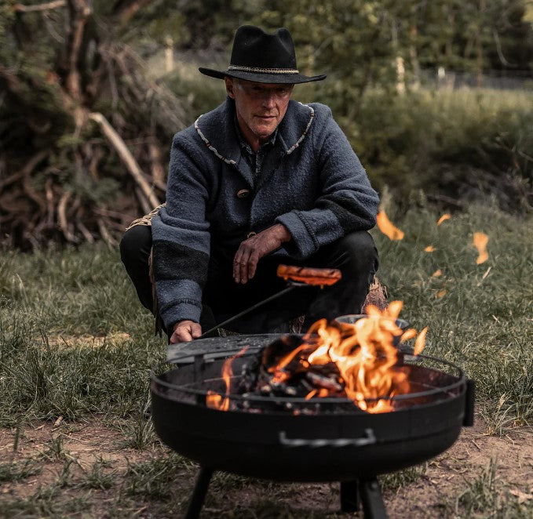

Slide 5
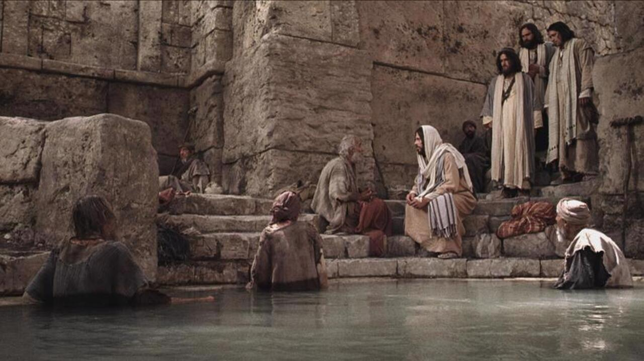
¹⁶ And this was why the Jews were persecuting Jesus, because he was doing these things on the Sabbath. ¹⁷ But Jesus answered them, “My Father is working until now, and I am working.”
¹⁸ This was why the Jews were seeking all the more to kill him, because not only was he breaking the Sabbath, but he was even calling God his own Father, making himself equal with God.

Slide 6
John 5:19-29
In 19, 24 and 25, Jesus says 'truly, truly I tell you.’ These are significant and truthful sayings.
Verses 19-24 – The motif is of a son learning/apprenticing with his father.

Slide 7
Father to Son
“The Father initiates, sends, commands, commissions, grants; the Son responds, obeys, performs his Father’s will, receives authority.”
Don Carson, The Gospel According to John (Eerdmans, 1991), page 251.

Slide 8
C. S. Lewis, Mere Christianity (London: Collins, 1952), pages 54–56

Slide 9
John 5:19-29
Vs 19 - The Son does what the Father does - unity in purpose.

Slide 10
John 5:19-29
Vs 19 - The Son does what the Father does - unity in purpose.
Vs 20 - The Father shows him everything - unity in essence and effect.

Slide 12
John 5:19-29
Vs 19 - The Son does what the Father does - unity in purpose.
Vs 20 - The Father shows him everything - unity in essence and effect.
Vs 21 - The Father and the Son BOTH have authority to give life and to raise the dead - unity in omnipotence.
In the Old Testament, this is only something that God can
do (Deuteronomy 32:39; 1 Samuel 2:6.)

Slide 13
John 5:19-29
Vs 19 - The Son does what the Father does - unity in purpose.
Vs 20 - The Father shows him everything - unity in essence and effect.
Vs 21 - The Father and the Son BOTH have authority to give life and to raise the dead - unity in omnipotence.
In the Old Testament, this is only something that God can do
(Deuteronomy 32:39; 1 Samuel 2:6)
Vs 22 - The Father, who alone judges all the earth (Genesis 18:25;
Psalm 98:9 and Isaiah 2:4) now gives this right to the Son - that all
may honour the Son as they do the Father – worship and honour.

Slide 14
As Father, As Son
"The Father bestows the authority and the Son exercises it; the Father sends, and the Son is sent. Yet so completely one are the Father and the Son, so perfectly does the Son manifest the Father, that no one can at the same time refuse the Son’s claims and pay honour to the Father."
F. F. Bruce, The Gospel & Epistles of John, Eerdmans: 1983, page 130.

Slide 15
www.morethandreams.org

Slide 16
²⁵ “Truly, truly, I say to you, an hour is coming, and is now here, when the dead will hear the voice of the Son of God, and those who hear will live. ²⁶ For as the Father has life in himself, so he has granted the Son also to have life in himself. ²⁷ And he has given him authority to execute judgment, because he is the Son of Man. ²⁸ Do not marvel at this, for an hour is coming when all who are in the tombs will hear his voice ²⁹ and come out, those who have done good to the resurrection of life, and those who have done evil to the resurrection of judgment."
—John 5:25-29

Slide 17
John 5:19-29
Jesus reinforces this by referring to himself here as "the Son of God" which is only one of three places that Jesus is called the Son of God in John’s Gospel (John 10:36, 11:4 cf 19:7).
Vs 25 begins with the final "truly, truly I say to you”.

Slide 18
John 5:19-29
Jesus reinforces this by referring to himself here as "the Son of God" which is only one of three places that Jesus is called the Son of God in John’s Gospel (John 10:36, 11:4 cf 19:7).
Vs 25 begins with the final "truly, truly I say to you”.
Vs 25-27: in the present, all who hear and receive Jesus have life in them now - "an hour is coming, and is now here.”
Vs 28-29: in the future, Jesus will bring all people back to life, the righteous to the "resurrection of life" and evil doers to a "resurrection of judgement."

Slide 20
Black

Slide 21
NT Preaching link at BibleStudyDownloads.org
Get this presentation and script for free!
Notes:
NT Preaching (np)

