Slide 1
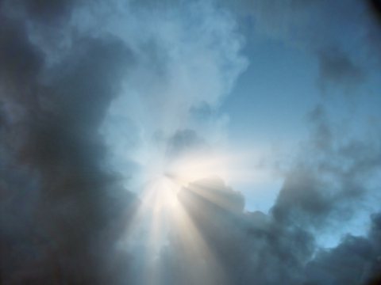
Receive the Light John 1:6-13
Rick Griffith • Crossroads International Church • biblestudydownloads.com

Slide 2
Black

Slide 3
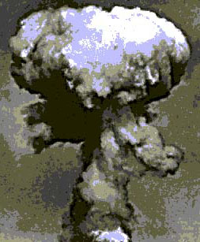
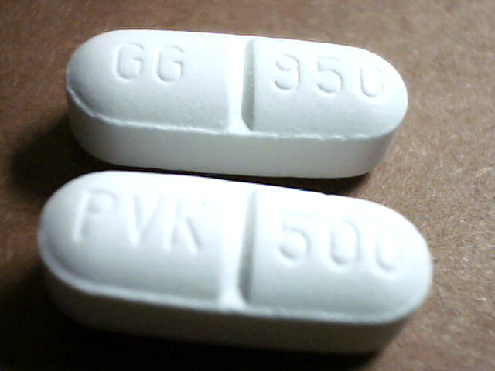
"What was the most important event of the 20th century?"
Men
Women
Hiroshima
Penicillin

Slide 4
Black

Slide 5
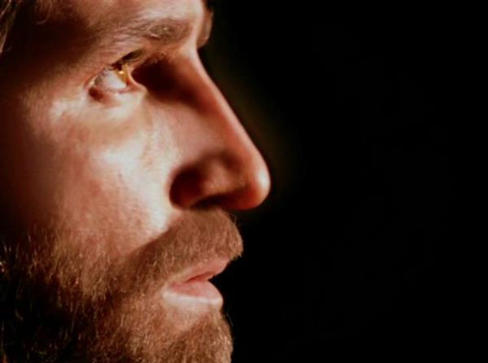
No person is debated more than Jesus Christ!
Two ways Jesus is unique…

Slide 6
John 1:6-13

Slide 7
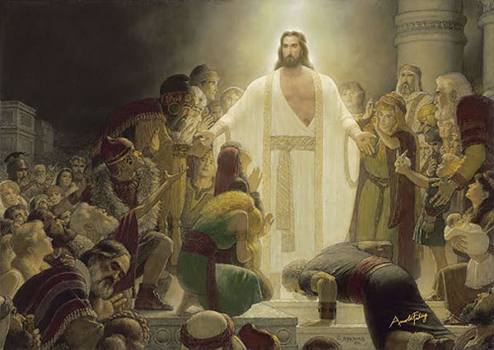
I. Christ is the only light (1:6-9)
Notes:
Jesus alone helps us in our dark state to find the way to God!

Slide 8
"There came a man who was sent from God; his name was John" (John 1:6)
﻿evge,neto
"No one born among women is as great as John" (Luke 7:28)

Slide 9
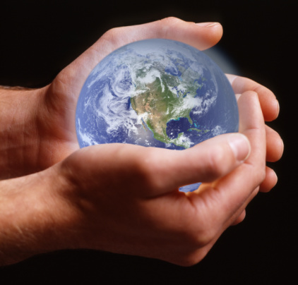
Jesus created all things (1:3).
﻿evge,neto
"Through [Christ] all things were made; without him nothing was made that has been made" (1:3 NIV)

Slide 10
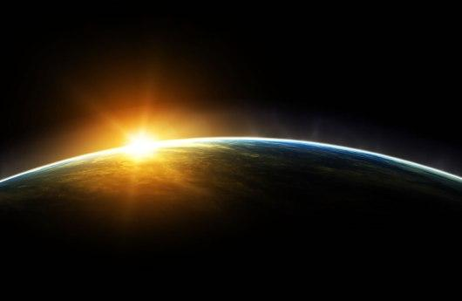
Jesus is God (1:1c)
"In the beginning
was the Word,
and the Word was with God,
and the Word was God"
(John 1:1 NIV)
Notes:
Scripture is very clear that Jesus is God. Christians have always believed this key doctrine called the deity of Christ.

Slide 11
Contrasting John with Jesus
John (1:6-9)
Came to the world (6)
Came into existence (6)
A Man (6)
Testified to the Light (7-8)
Jesus (1:1-5)
Made the world (3)
Was in the beginning (1a)
The Word, or God (1c)
Was the Light Himself (9)

Slide 12
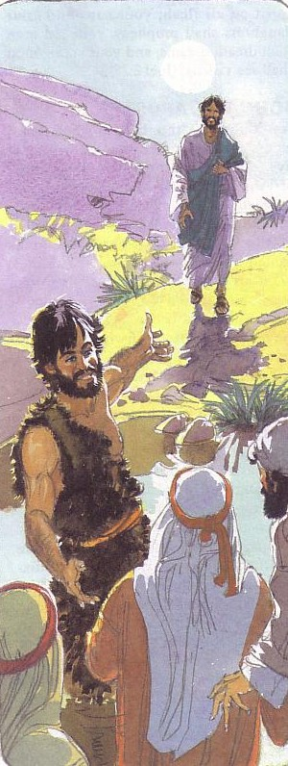
John the Baptist
John testified about Christ so people would believe in Jesus (7)
"God sent a man, John the Baptist, ⁷to tell about the light so that everyone might believe because of his testimony" (1:7 NLT)
Notes:
"He came as a witness to testify concerning that light, so that through him all men might believe" (1:7 NIV).

Slide 13
Our House
Notes:
But do we really live in that dark of a world?
Yes, darkness is the default mode.
I remember one of my boys saying when he was young after we tucked him into bed, headed out the door and reached for the switch, "Dad, don't turn on the darkness!"
The TV commercial on my boy's show caught my eye when it said, "The new superman, where the good guys always wear black!"

Slide 14
The Downpour
Notes:
Rained 6 inches in one hour!

Slide 15
License Plates
EK 6513 E
EK 8998 E

Slide 16
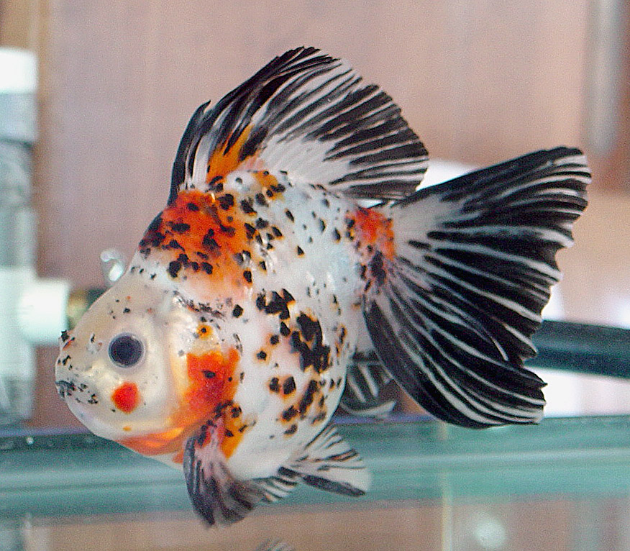
Goldfish
$25,000.00!

Slide 17
Evolution Garden
Notes:
One recent experience with darkness was my walk to the Botanic Gardens Evolution Garden

Slide 18
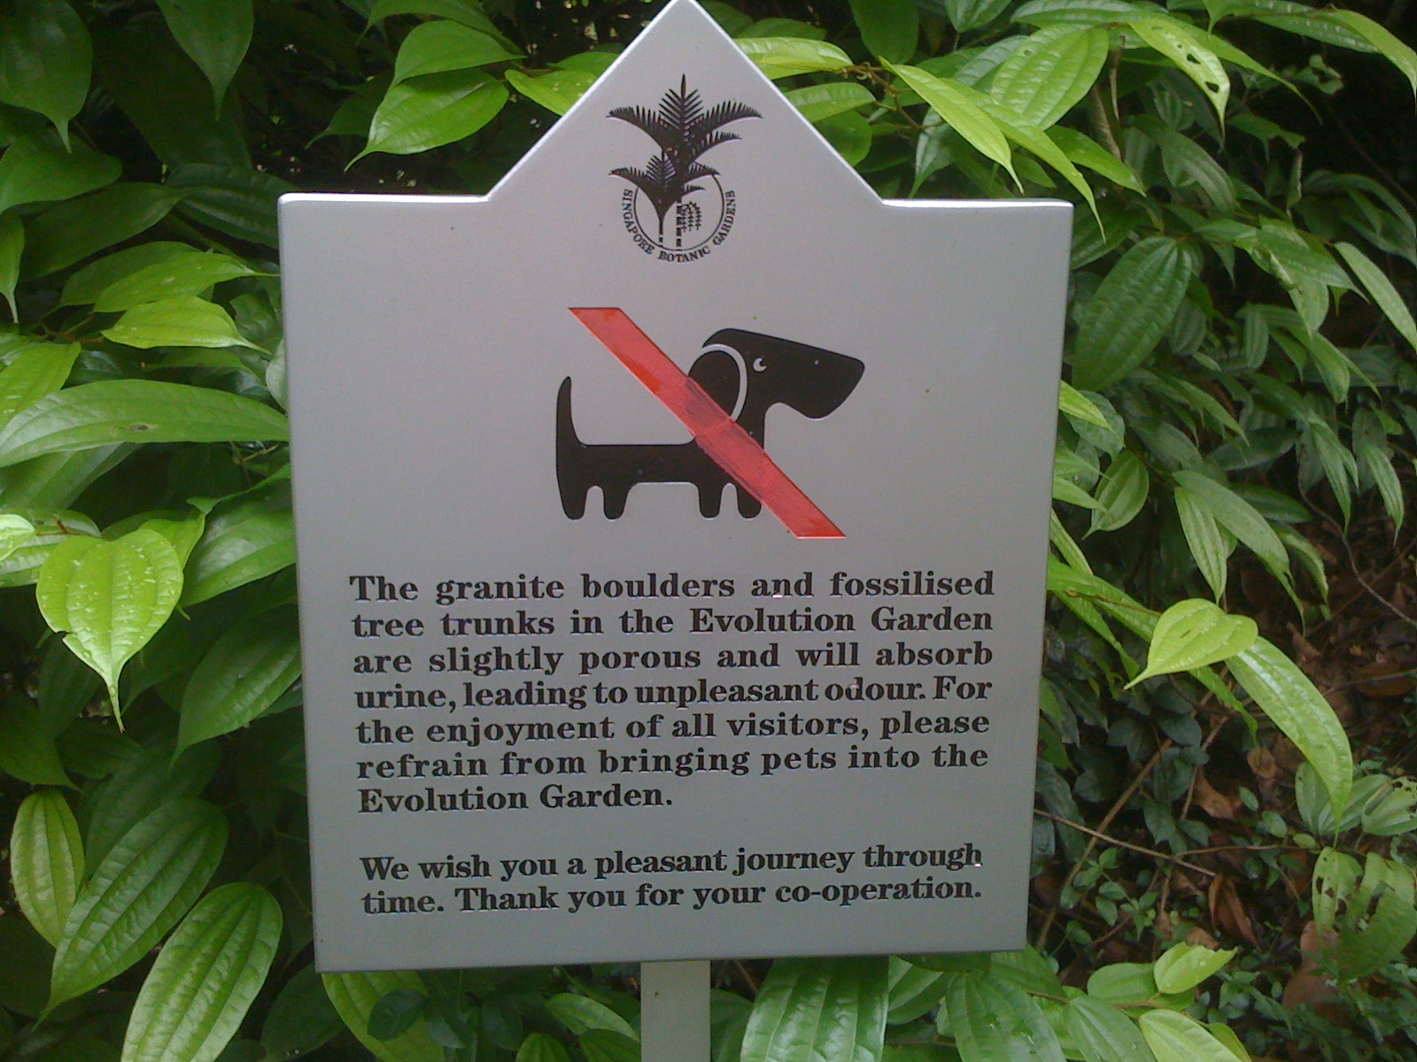
Evolution Garden
Notes:
Evidently the makers didn't believe in random chance after all, since pets were not allowed to disturb this eco-system

Slide 19
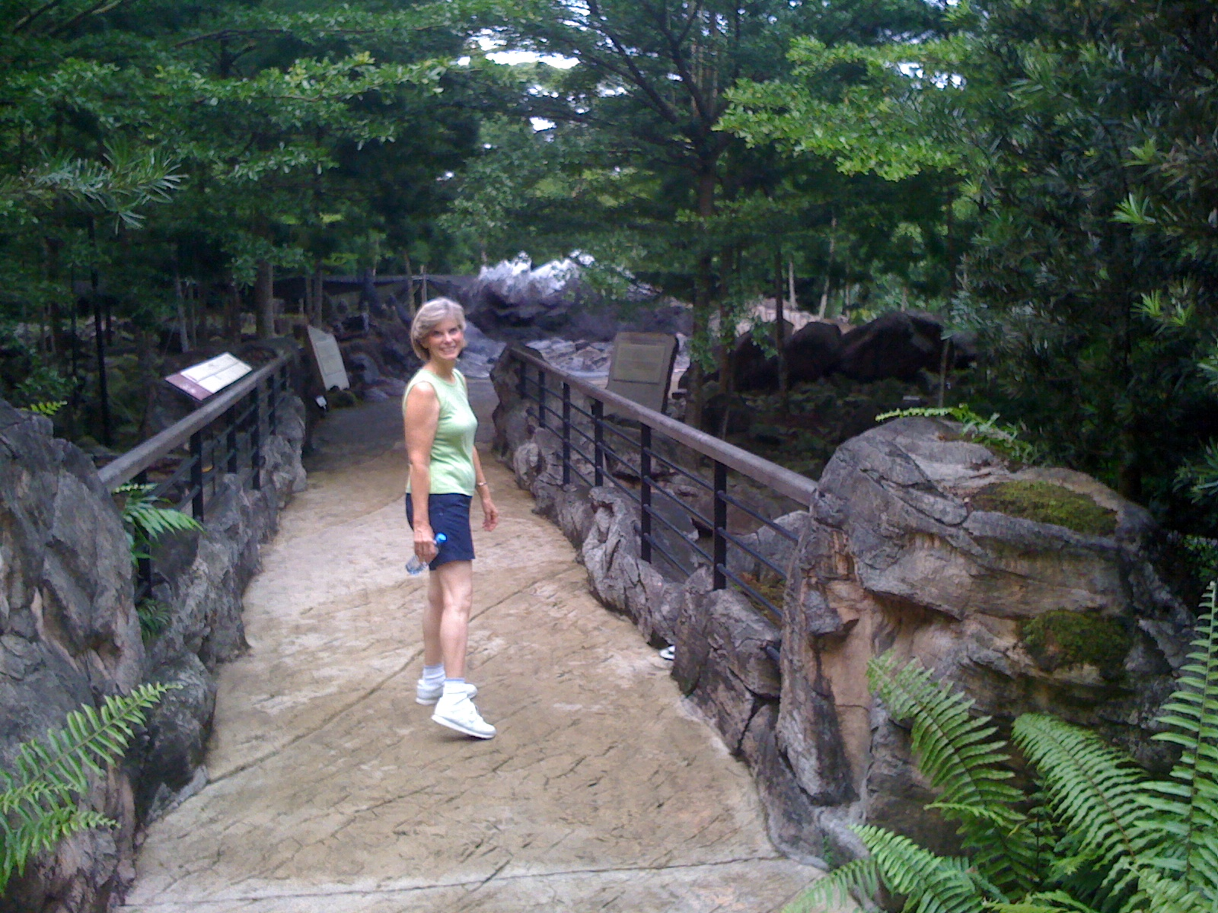
Evolution Garden
Notes:
The Evolution Garden is a beautifully manicured garden that depicts a walk through time

Slide 20
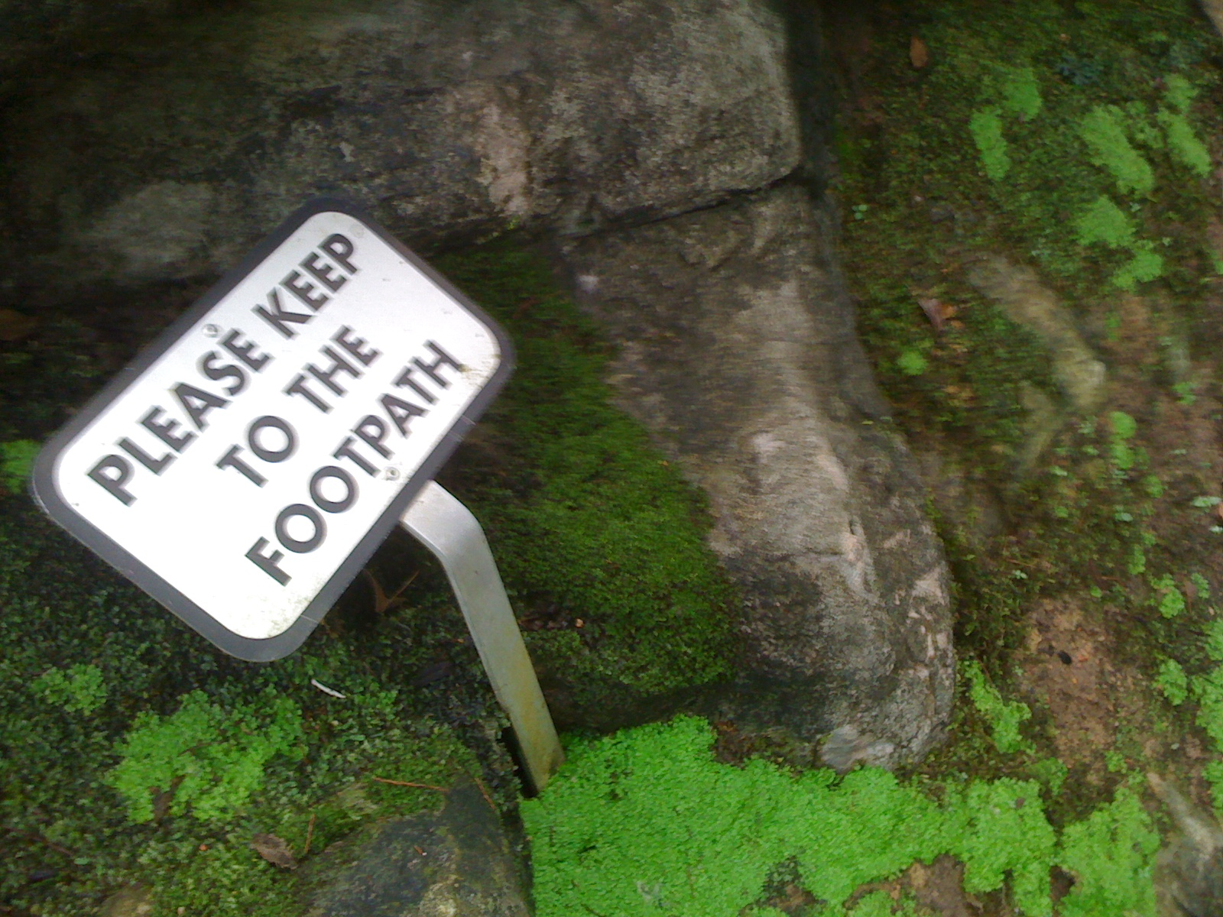
Evolution Garden
Notes:
Of course, like all of Singapore, in order to keep this beauty, the survival of the fittest is not allowed.

Slide 21
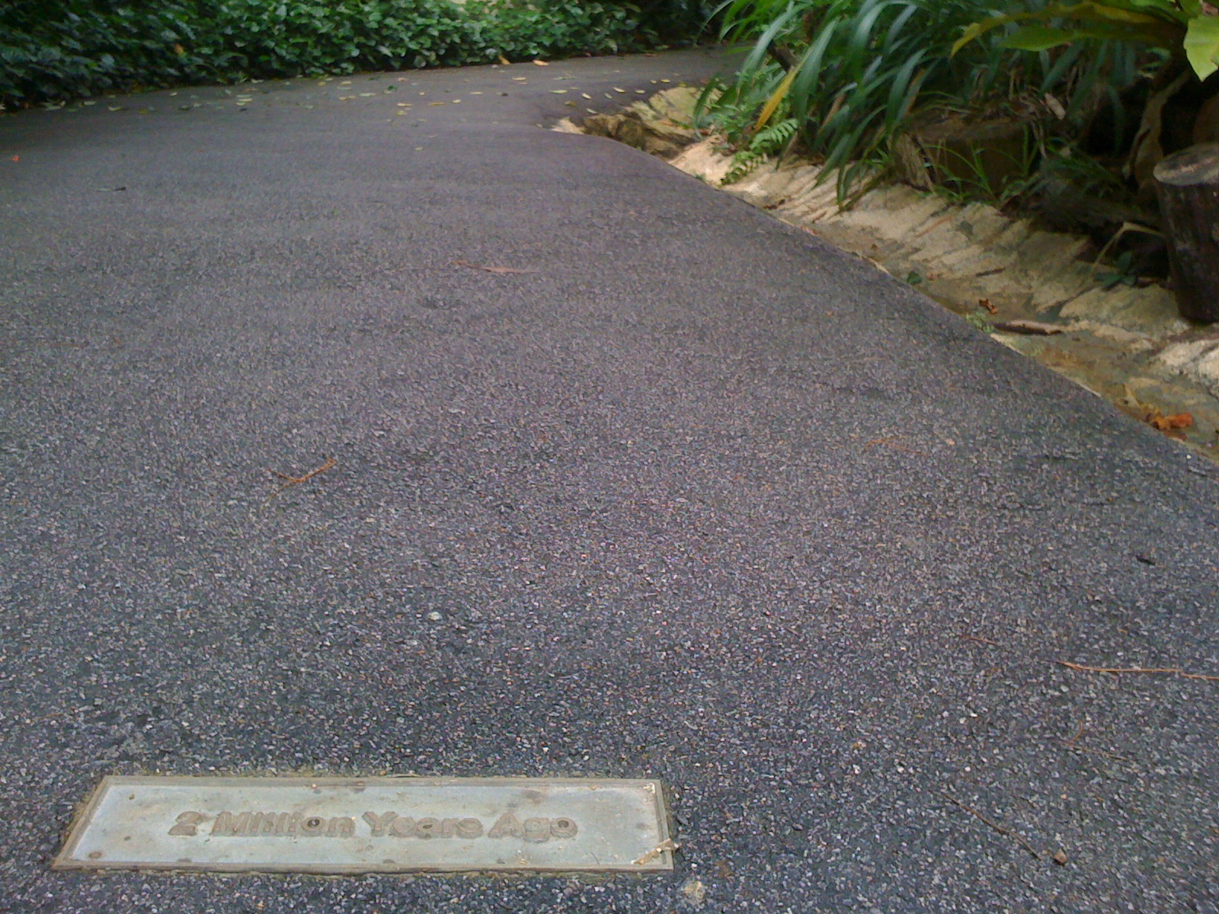
Evolution Garden
Notes:
This nice pathway depicts 2 million years ago

Slide 22
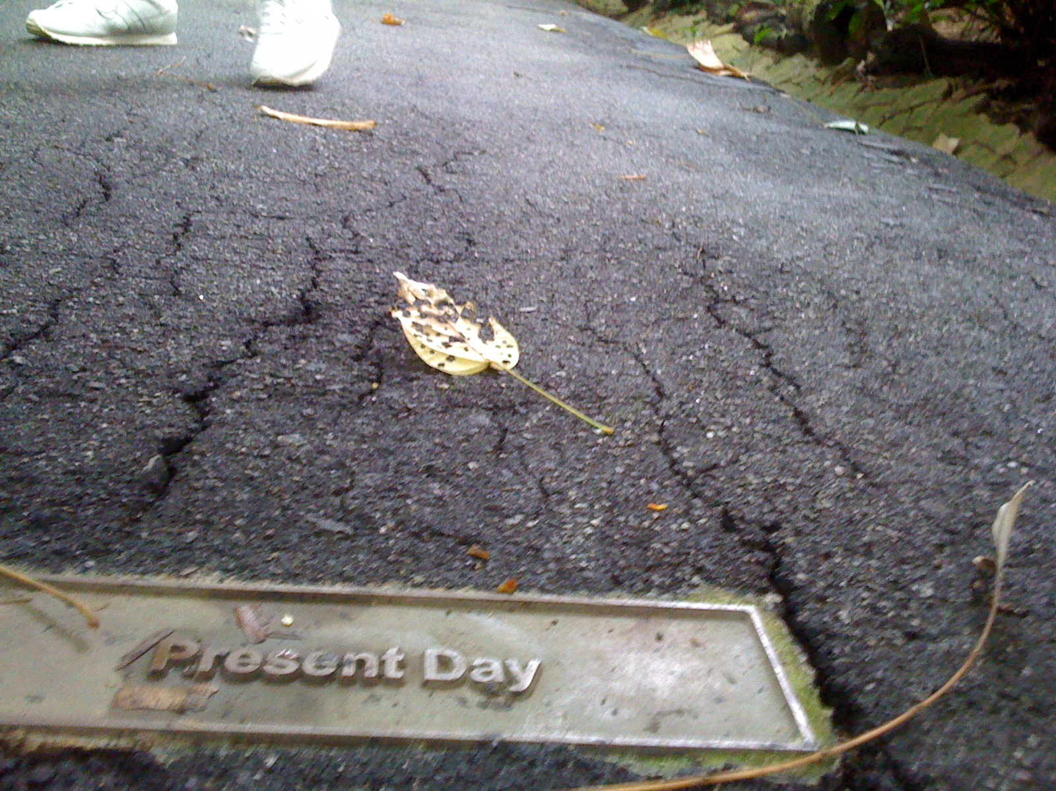
Evolution Garden
Notes:
But the present day has deteriorated somewhat!

Slide 23
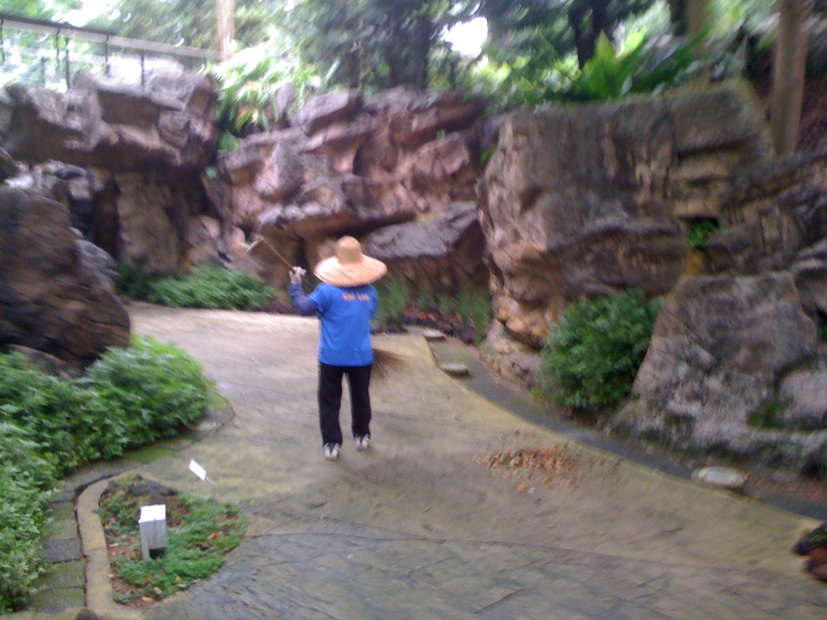
Evolution Garden
Notes:
What struck me most was how much upkeep it took to depict random processes!

Slide 24
Darkness
Notes:
What struck me most was how much upkeep it took to depict random processes!

Slide 25
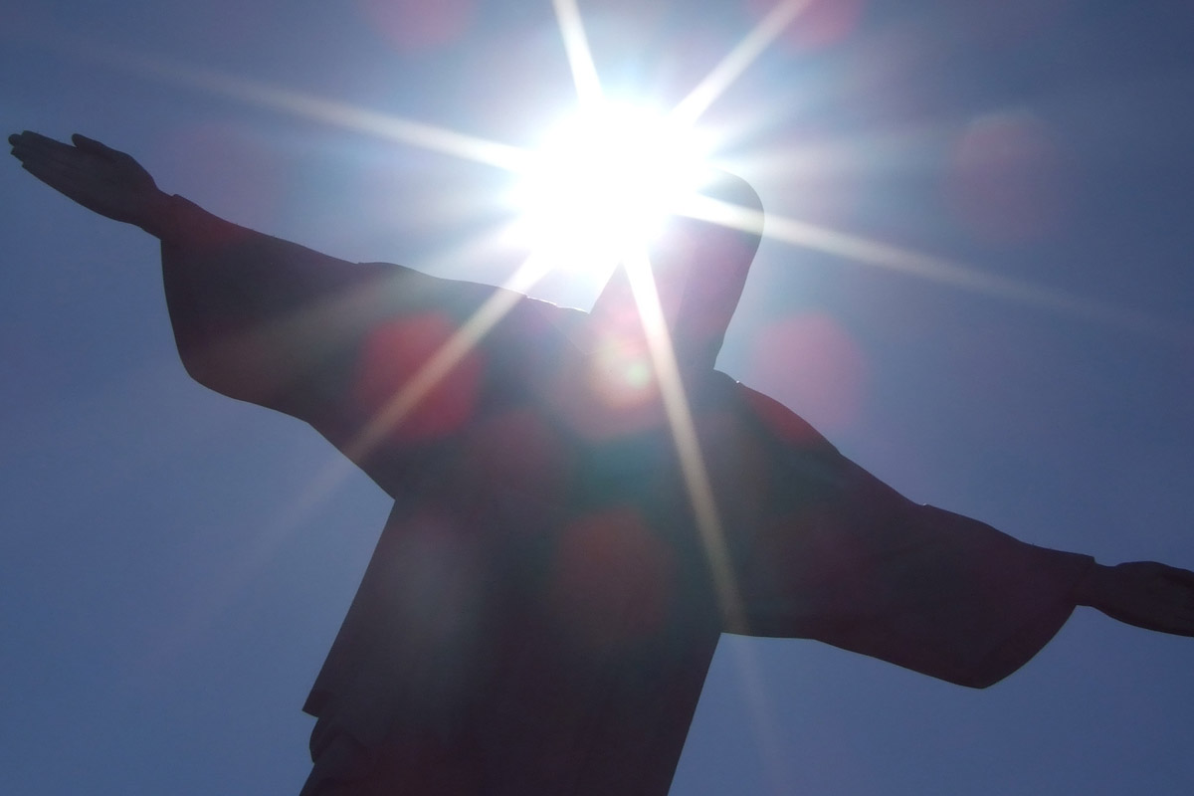
How is Jesus the "Light" (1:8)?
"John himself was not the light; he was simply a witness to tell about the light" (1:8 NLT)
Notes:
"He himself was not the light; he came only as a witness to the light" (1:8).

Slide 26
How is Jesus the "Light" (1:8)?
Reveals sin?
Shows true reality?
Incarnation?
Gospel of Christ?
Way to God
Reveals sin?
Shows true reality?
Incarnation?
Gospel of Christ?
Way to God
Notes:
"He himself was not the light; he came only as a witness to the light" (1:8).

Slide 27
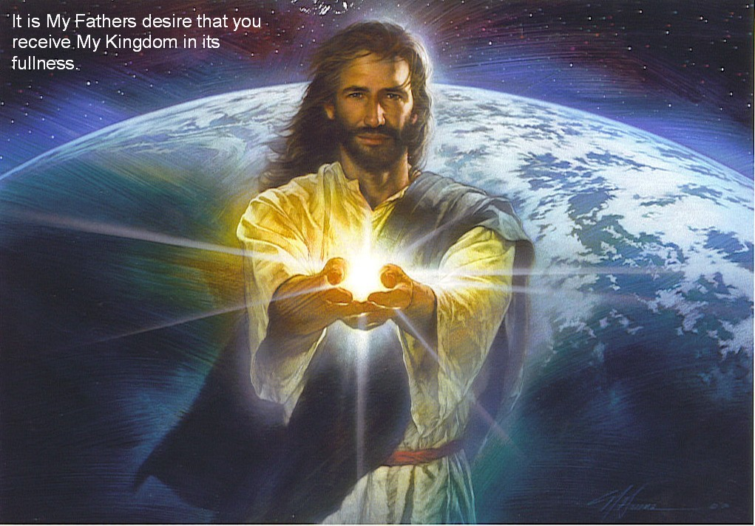
Jesus (not John) gives spiritual light
"The true light that gives light to every man was coming into the world" (1:9 NIV)
Notes:
Why this emphasis that John was a witness who testified (1:7a, 8b)?
Maybe during the apostle John's time some people believed that John the Baptist was the light (WBC, 12). In fact, Acts 19 records a group in John the Apostle's area of Ephesus who had heard of the baptism of John but not that of the Holy Spirit!
Here's a reminder for us too—when people compliment us, let's be quick to say that our light is not self-generated but from God.

Slide 28
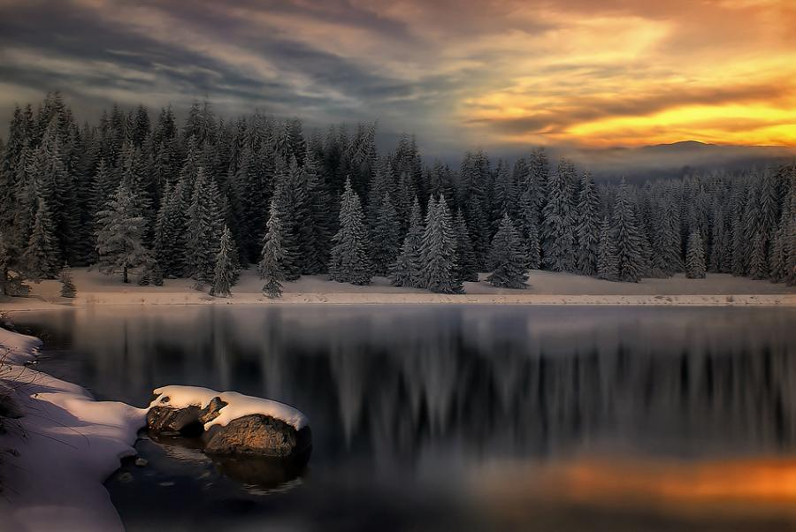
Romans 1:20
Person who is Limitless
Person who is Supernatural
For since the creation of the world God's invisible qualities — his eternal power and divine nature — have been clearly seen, being understood from what has been made, so that men are without excuse (NIV).

Slide 29
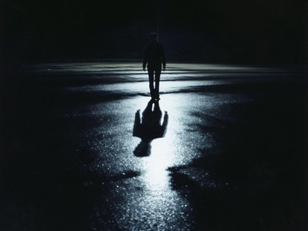
"The true light that gives light to every man was coming into the world" (1:9 NIV)

Slide 30
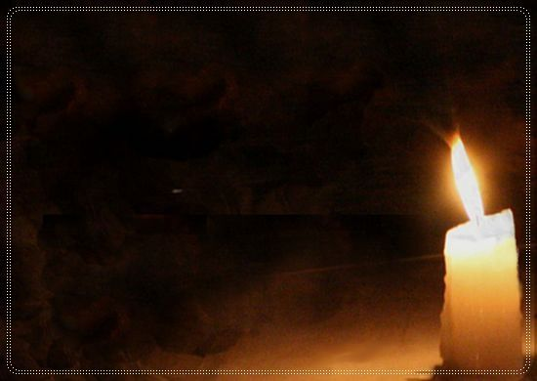
Point those in darkness to Christ as the Light
But how?

Slide 31
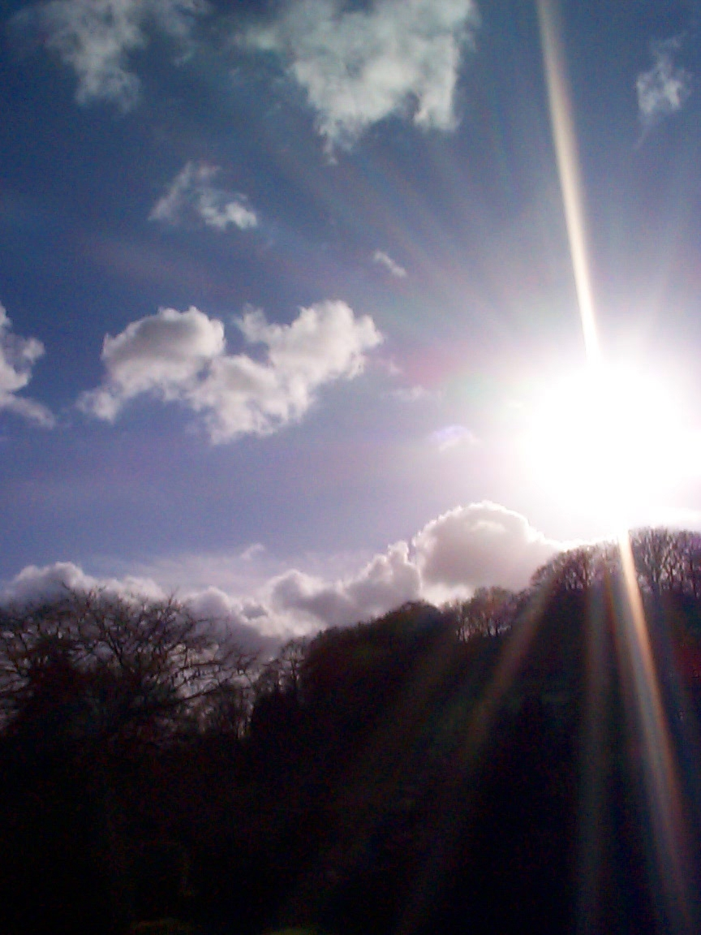
How can we point those in darkness to Christ as the Light?
1. Remember the light Christ shined on you

Slide 32
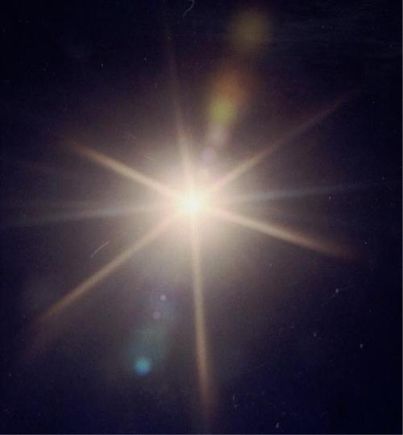
Colossians 1:13-14
"He has rescued us from the dominion of darkness…
…and brought us into the kingdom of the Son he loves, in whom we have forgiveness of sins"

Slide 33
How can we point those in darkness to Christ as the Light?
2. Tell others that Christ answers our sin problem

Slide 34
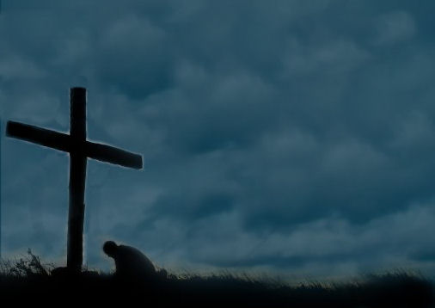
We need Christ!
If our greatest need had been information, God would have sent us an educator.
If our greatest need had been technology, God would have sent us a scientist.
If our greatest need had been money, God would have sent us an economist.
If our greatest need had been pleasure, God would have sent us an entertainer.
But our greatest need was forgiveness, so God sent us a Saviour.

Slide 35
How can we point those in darkness to Christ as the Light?
3. Live like a child of the light

Slide 36
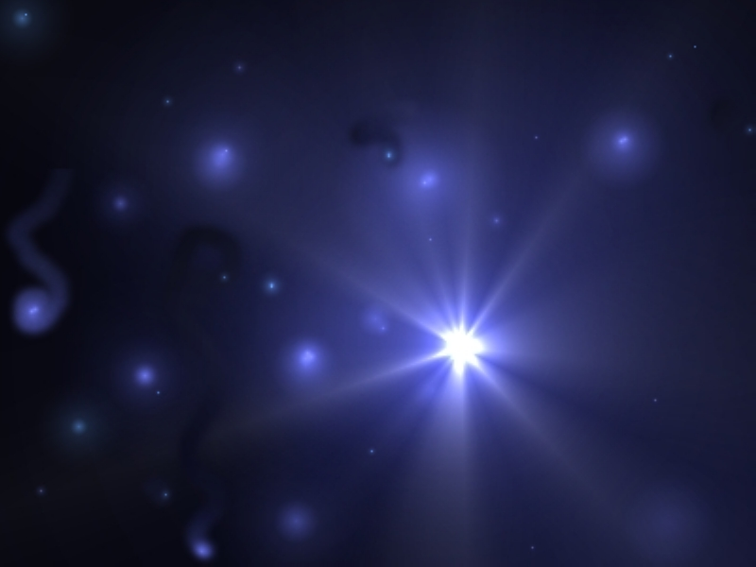
Philippians 2:15
"…become blameless and pure, children of God without fault in a crooked and depraved generation, in which you shine like stars (lights) in the universe as you hold out the word of life."

Slide 37
No person is debated more than Jesus Christ!
Two ways Jesus is unique…

Slide 38
I. Christ is the only light (1:6-9)
Notes:
Jesus alone helps us in our dark state to find the way to God!

Slide 39
II. Christ alone brings us into God's family (1:10-13)

Slide 40
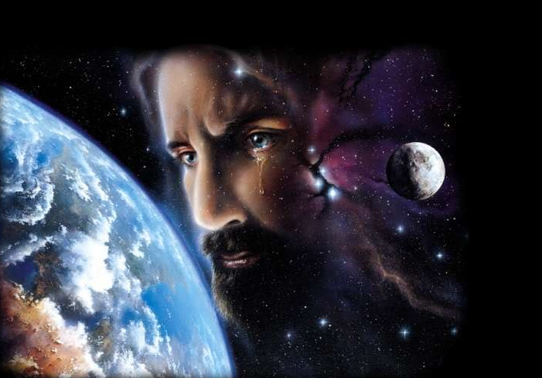
Jesus weeps over His creation
"He came into the very world he created, but the world didn't recognize him. ¹¹He came to his own people, and even they rejected him" (John 1:10-11 NLT)

Slide 41
Religious While Rejecting
87% belong to a religion
13% without a religion
100%
Gallup Millennium Survey of 60 nations

Slide 42
"God is very important for my personal life"
97% West Africa
88% Latin America
82% North America
49% Europe
47% Asia
= 4 billion people total !
Gallup Millennium Survey of 60 nations

Slide 43
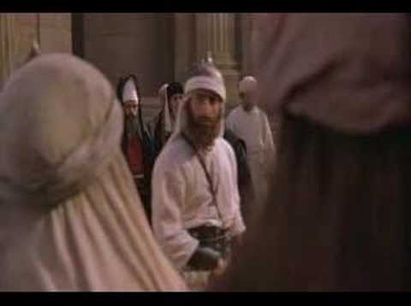
Jews rejected Christ even though he was Jewish (1:11)
"He came to that which was his own, but his own did not receive [Gr. "welcome alongside"] him" (NIV).

Slide 44
But all that accept him as God enter God's spiritual family (12-13).

Slide 45
You become a child of God by believing that Jesus is God:
"But to all who believed him and accepted him, he gave the right to become children of God" (1:12 NLT)

Slide 46
What is "Belief" in Christ?
119
Faith
+
Repentance
=
Conversion
Faith is being satisfied with Christ
MIND
Knowledge
Recognition
Agree
Conviction
Trust
Turning
EMOTIONS
WILL
Dr. Mahlon Friesen, First Baptist Church, Yucaipa, CA

Slide 47
How spiritual birth does not happen (13)…
• Parents (13a)
• Desire (13b)
• Planning (13c)
"children born not of natural descent, nor of human decision or a husband’s will" (1:13a NIV)

Slide 48
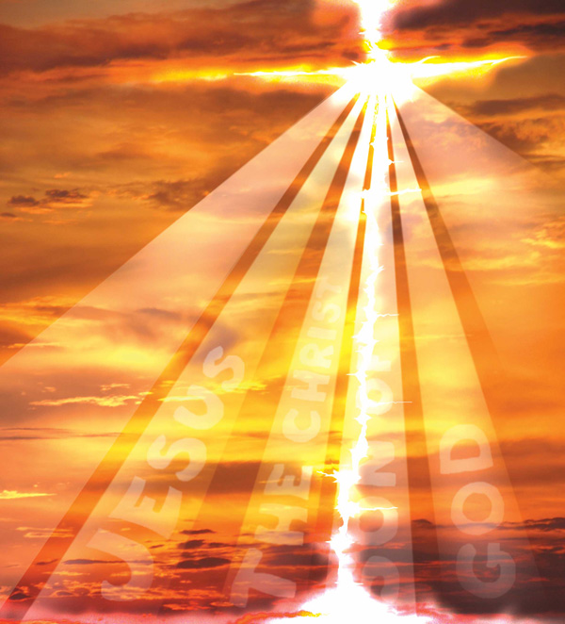
People enter God's family by God making them his children (13d).
"born of God"

Slide 49
No person is debated more than Jesus Christ!
Two ways Jesus is unique…

Slide 50
I. Christ is the only light (1:6-9)
Notes:
Jesus alone helps us in our dark state to find the way to God!

Slide 51
II. Christ alone brings us into God's family (1:10-13)

Slide 52
Main Idea
Receive the Light
and you'll enter God's family!

Slide 53
Black

Slide 54
Danger lies ahead in the darkness.
In 1967…
Darkness is only defeated with Light.
Light is found in Christ alone.

Slide 55
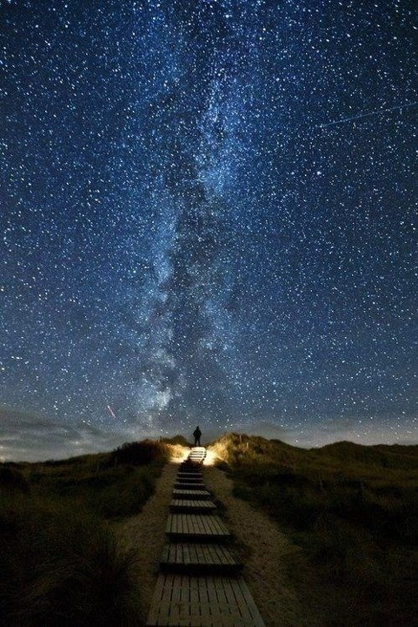
Ireland has its "Road to Heaven" where every two years the road aligns with the stars

Slide 56
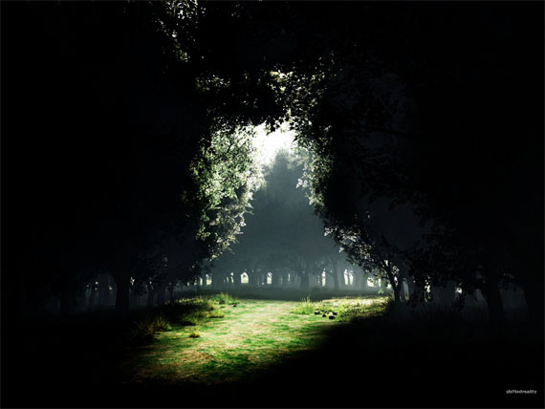
Step into the Light

Slide 57
Live as Shining Stars
Text

Slide 58
Black

Slide 59
NT Preaching link at BibleStudyDownloads.org
Get this presentation and script for free!
Notes:
NT Preaching (np)

