Slide 1
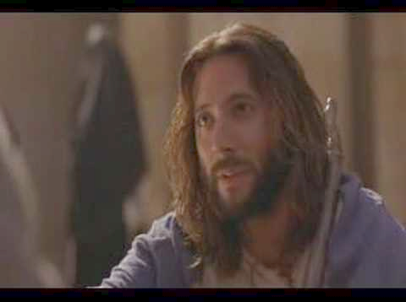
Who is Jesus?
John 1:35-51
Rick Griffith • Crossroads International Church Singapore • BibleStudyDownloads.org

Slide 2
Black

Slide 3
The Iranian Jesus

Slide 4
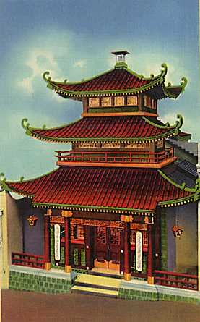
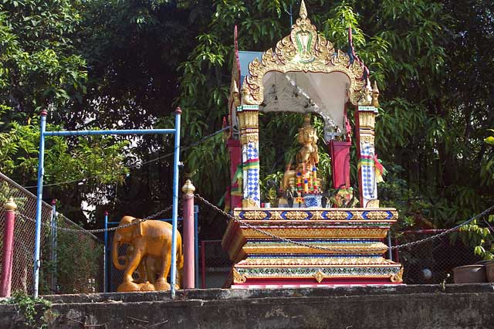
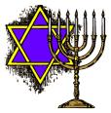
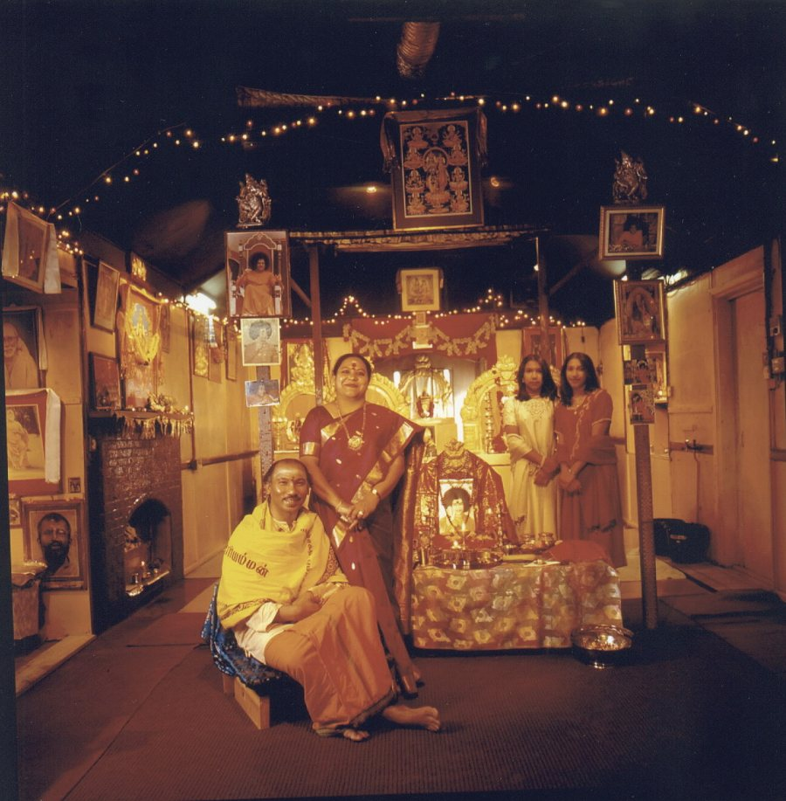
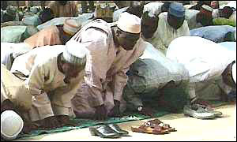
Religious Perspectives on Jesus

Slide 5
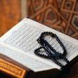
Religious Perspectives on Jesus
In Islam, Jesus is considered one of God's most important prophets.

Slide 6
Religious Perspectives on Jesus (cont.)
In Judaism, Jesus is considered a false prophet.

Slide 7
Religious Perspectives on Jesus (cont.)
In Buddhism, Jesus is considered an enlightened teacher.

Slide 8
Religious Perspectives on Jesus (cont.)
Different perspectives on Jesus in Hinduism:
A great guru
The son of Krishna
http://en.wikipedia.org/wiki/Religious_perspectives_on_Jesus

Slide 9
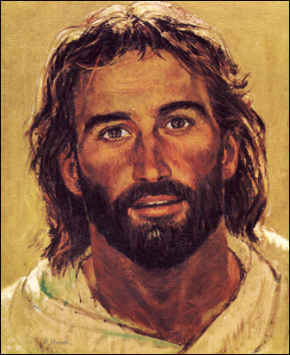
What about you?
Do you know who Jesus is?
What will you tell those who don’t know him?

Slide 10
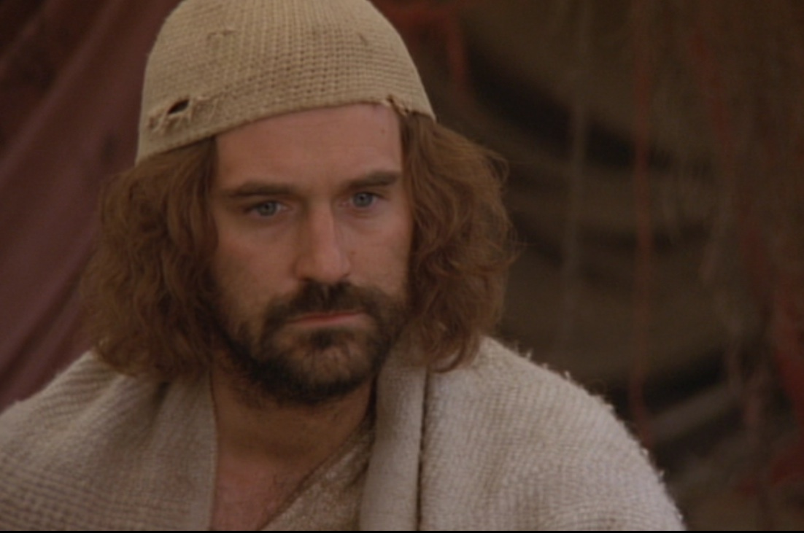
John the Apostle (Gospel Writer)

Slide 11
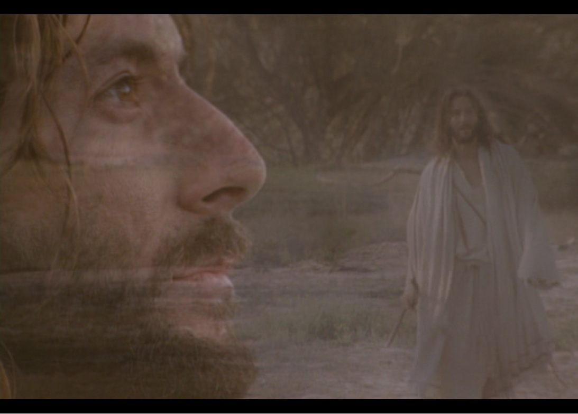
Why believe Jesus is God? John 1:19-51

Slide 12
A quick review…

Slide 13
Jesus is the Logos (Word)
“In the beginning
was the Word,
and the Word was with God,
and the Word was God”
(John 1:1)
Notes:
Scripture is very clear that Jesus is God. Christians have always believed this key doctrine called the deity of Christ.

Slide 14
Structure of the Book of John
Introductory Testimony (1:1-51)
Prologue (1:1-18)
Craig L. Blomberg, Jesus & The Gospels, 161

Slide 15
The Prologue (1:1-18)
Jesus is God
Introduces John the Baptist as the forerunner of Jesus
John the Baptist’s mission:
As a witness of Jesus
“Christ is the Light”

Slide 16
Structure of the Book of John
Introductory Testimony (1:1-51)
Prologue (1:1-18)
The Testimony of John and the First Disciples (1:19-51)
Craig L. Blomberg, Jesus & The Gospels, 161

Slide 17
Jesus’ First Disciples
John

Slide 18
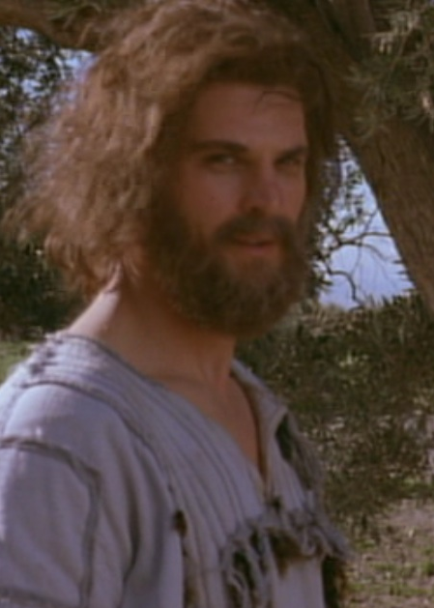
Jesus’ First Disciples
Andrew
Simon Peter

Slide 19
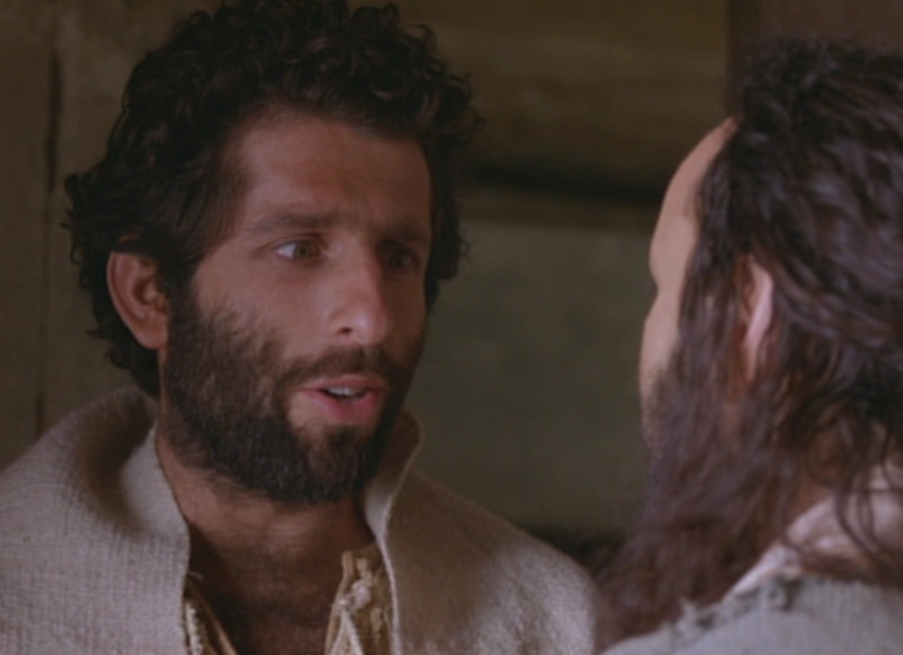
Jesus’ First Disciples
Philip
Nathanael or Bartholomew

Slide 20
The Word
GOD

Slide 21
Why believe Jesus is God? John 1:19-51
Jesus is the Savior

Slide 22
Three Reasons the Word is God
Saviour
Jesus
Lamb of God
WORD
Notes:
The identity of the Logos is threefold in John 1:19-51…

Slide 23
John the Baptist’s Testimony (1:19-39)
Three different audiences:
Jewish leaders (1:19-28)
People (1:29-34)
Two of his disciples (1:35-39)

Slide 24
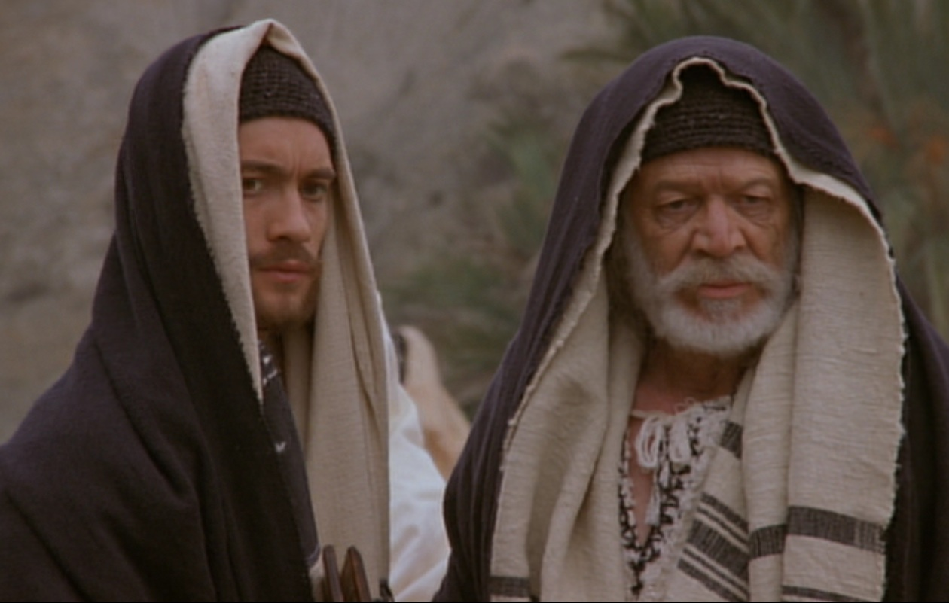
The Jewish Leaders

Slide 25
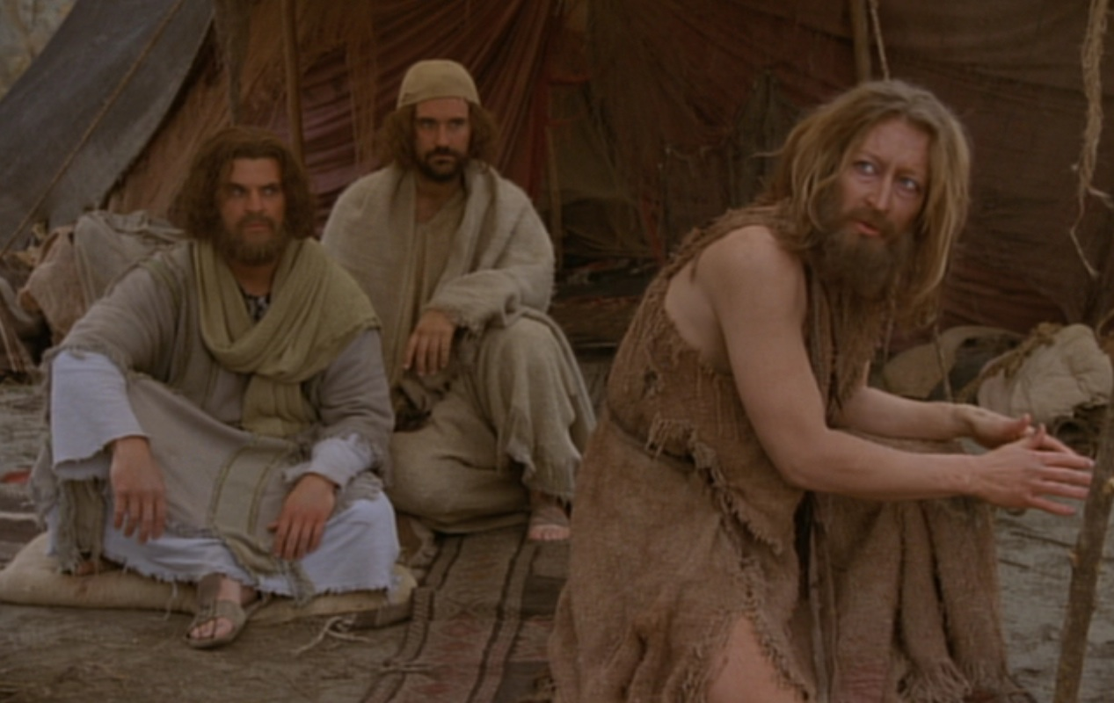
John to the Jewish Leaders
“I am not the Christ” (1:20)

Slide 26
“I am not the Christ”
Recalls the popular response to his ministry according to Luke’s Gospel:
“The people were waiting expectantly and were all wondering in their hearts if John might possibly be the Christ”
Luke 3:15
J. Ramsey Michaels, New International Biblical Commentary, 28

Slide 27
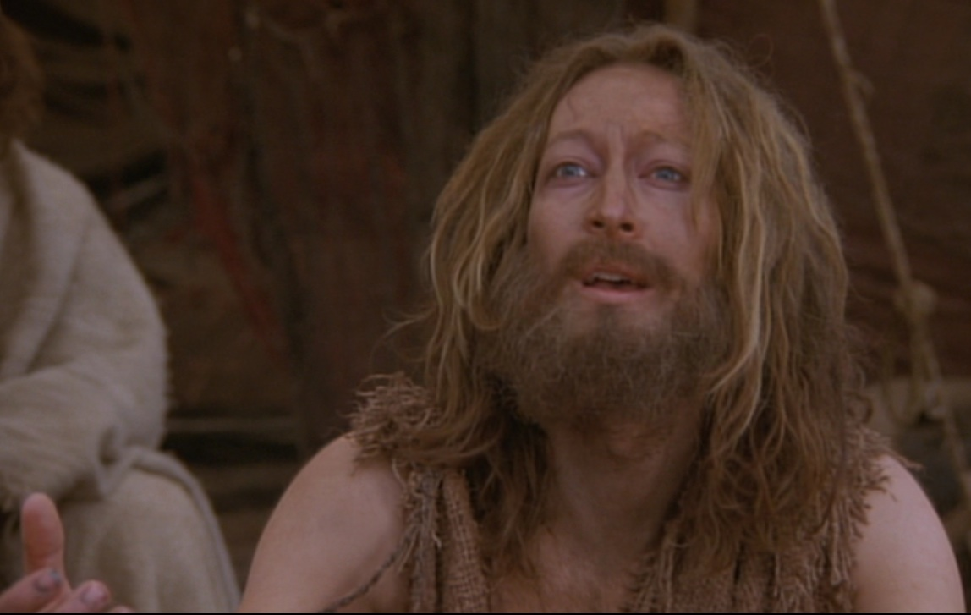
John to the Jewish Leaders:
“I am not the Christ” (1:20)
“I am not” (1:21a) – not Elijah

Slide 28
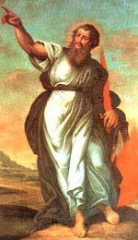
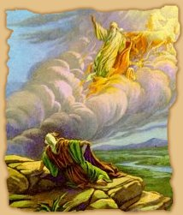
Elijah
“See, I will send you the prophet Elijah before that great and dreadful day of the LORD comes. He will turn the hearts of the fathers to their children, and the hearts of the children to their fathers; or else I will come and strike the land with a curse.”
Malachi 4:5-6

Slide 29
“The Prophet”
“The LORD your God will raise up for you a prophet like me from among your own brothers. You must listen to him.”
Deuteronomy 18:15

Slide 30
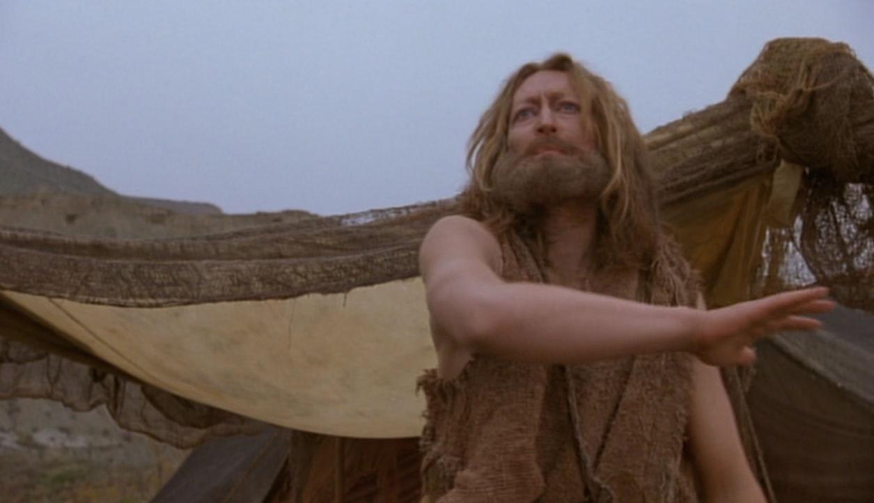
John focused on who Jesus was!
“I am the voice of one calling in the desert, ‘Make straight the way for the Lord.’“
John 1:23; cf. Isaiah 40:3

Slide 31
John to the Jewish Leaders:
“I am not the Christ” (1:20)
“I am not” (1:21a) – not Elijah
“No” (1:21b) – not the Prophet

Slide 32
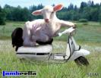
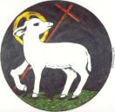
John’s Testimony to the people:
“Look, the Lamb of God, who takes away the sin of the world!“
John 1:29

Slide 33
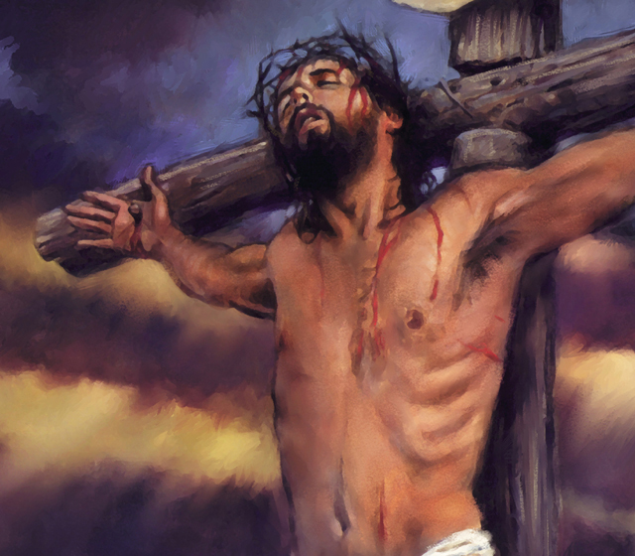
Sacrifice at theCross

Slide 34
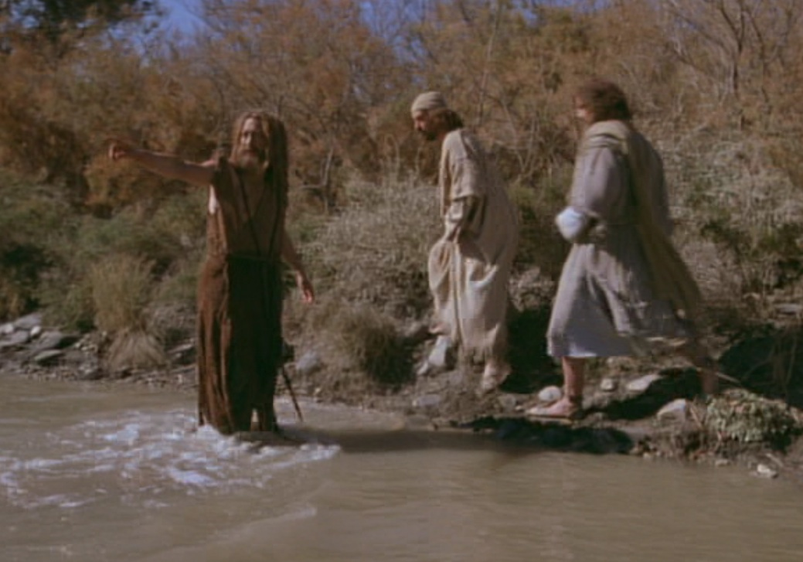
John’s Testimony to two of his disciples:
“Look, the Lamb of God, who takes away the sin of the world!“
John 1:36

Slide 35
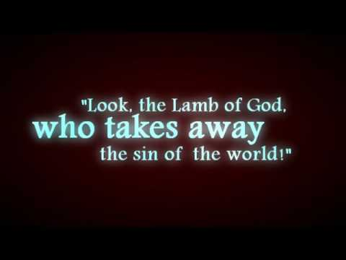
The Lamb of God (1:29, 36)
Jesus is the sacrificial lamb of the Jewish Passover!

Slide 36
996
Notes:
We must forget about ourselves and focus on the Savior
• How much do you care about what people think of you?
• Do we focus on US as a church? (500 outside, 200 guests, 200 gone, 100 here)
We aren’t in the business of becoming a mega church but only a voice in the desert
Bottom Line: It’s not about us!

Slide 37
Why believe Jesus is God? John 1:19-51
Jesus is the Savior
Jesus is the Messiah

Slide 38
Three Reasons the Word is God
Saviour
Jesus
Lamb of God
WORD
Messiah
Christ
Anointed One
Son of David
King of Israel
King of Kings
Son of Man
Notes:
The identity of the Logos is threefold in John 1:19-51…

Slide 39
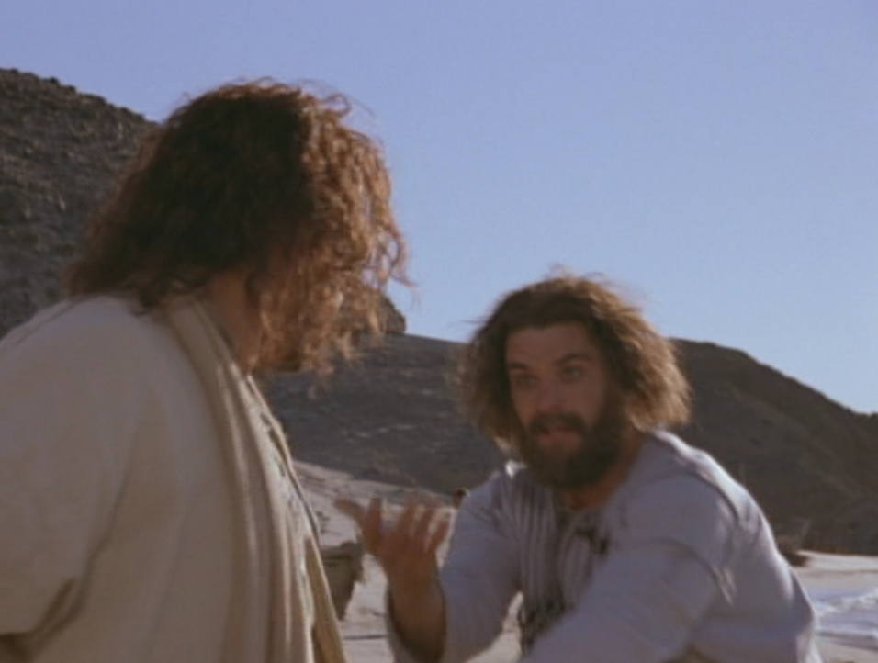
The story continues…
“Andrew, one of the two disciples, looked for his brother, Simon, and told him…
‘We have found the Messiah’ (which means ‘Christ’)” (John 1:41; cf. 6:4-9; 12:20-22)

Slide 40
John 1:42 NLT
Then Andrew brought Simon to meet Jesus. Looking intently at Simon, Jesus said, “Your name is Simon, son of John—but you will be called Cephas” (which means “Peter”*)
* The names Cephas (from Aramaic) and Peter (from Greek) both mean rock.

Slide 41
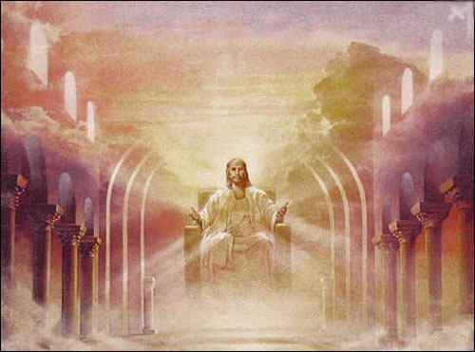
Christ = Messiah
A title, from the Greek Christos (ός Christós), which means “anointed one“
The Greek form is a literal translation of Messiah from Hebrew mashiyakh (משיח) or Aramaic m'shikha (משיחא)
Occurs often in the Old Testament and signifies "high priest" or “king“
Notes:
http://en.wikipedia.org/wiki/Names_and_titles_of_Jesus

Slide 42
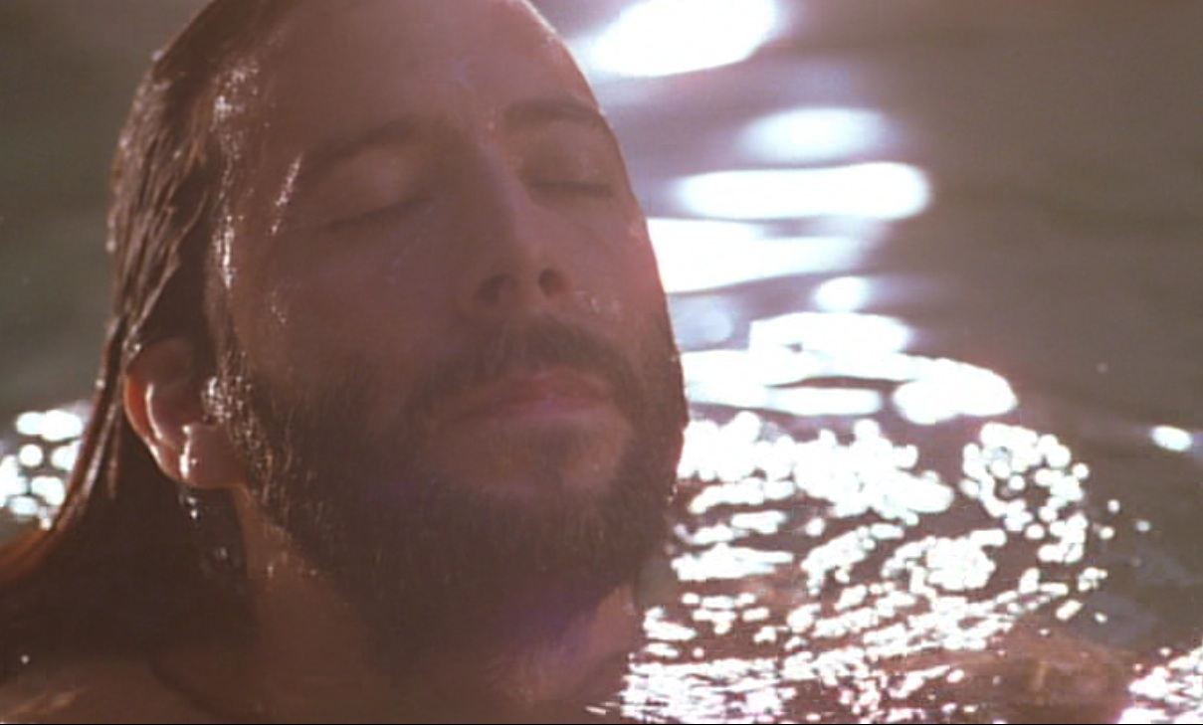
“Messiah”
Jewish eschatological term for the expected deliverer
Transliterates Aramaic as “anointed one”

Slide 43
Promises of the Davidic Covenant
2 Samuel 7:12-16 promises:
Sons: “house” never wiped out
Kingdom: political dynasty (each king in Jerusalem will be a direct descendant)
Throne: As an eternal covenant (v. 16), David’s family has the right to rule forever

Slide 44
Isaiah 61:1 Fulfilled in Jesus
The Spirit of the Sovereign LORD is on me,
because the LORD has anointed me
to preach good news to the poor.
He has sent me to bind up the brokenhearted,
to proclaim freedom for the captives
and release from darkness for the prisoners,
to proclaim the year of the LORD’S favor”
(NIV; cf. Luke 4:18-19)

Slide 45
The Kingdom in Matthew 1
Fall of the Kingdom
Establishing the Eternal Kingdom
ABRAHAM
Solomon
Shealtiel
Isaac
Rehoboam
Zerubbabel
Jacob
Abijah
Abiud
Judah
Asa
Eliakim
Perez
Jehoshaphat
Azor
Thus there were fourteen generations in all from Abraham to David, fourteen from David to the exile to Babylon, and fourteen from the exile to Christ.
Matthew 1:17
Hezron
Jehoram
Zadok
Ram
Uzziah
Akim
Amminadab
Jotham
Eliud
Nahshon
Ahaz
Eleazar
Salmon
Hezekiah
Matthan
Boaz
Manasseh
Jacob
Obed
Amon
Joseph +
Mary
Rise of the Kingdom
Jesse
Josiah
KING DAVID
JECONIAH (EXILE)
JESUS CHRIST

Slide 46
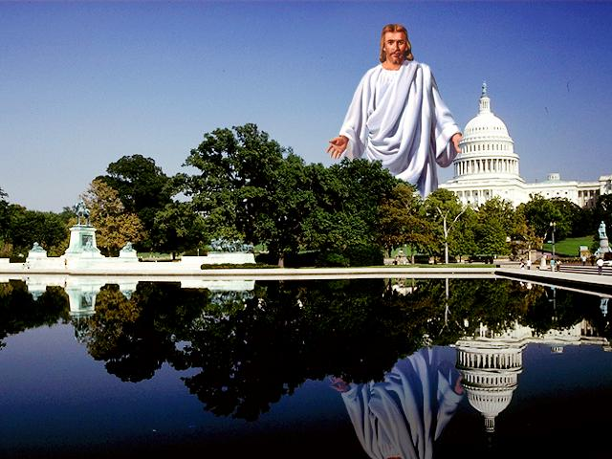
Christ is over all nations
“All authority in heaven and earth has been given to me.” (Matthew 28:19)

Slide 47
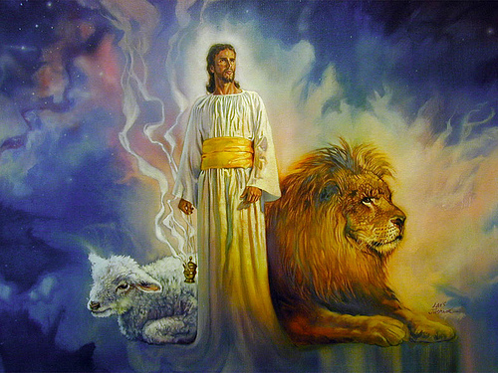
Do you submit to Christ’s authority over you?
Notes:
Admitting his rule over you gives true freedom!
You won’t have to wonder what to do when you do his will
Psalm 37:4, “Delight yourself in the Lord…”

Slide 48
Why believe Jesus is God? John 1:19-51
Jesus is the Savior
Jesus is the Messiah
Jesus is the Son of God

Slide 49
Three Reasons the Word is God
Saviour
Jesus
Lamb of God
Son of God
Lord
God
WORD
Messiah
Christ
Anointed One
Son of David
King of Israel
King of Kings
Son of Man
Lord Jesus Christ
Notes:
The identity of the Logos is threefold in John 1:19-51…

Slide 50
The story continues again…
The next day, Jesus found Philip and said, “Follow me…”
Philip came from the town of Bethsaida, like Andrew and Simon Peter.

Slide 51
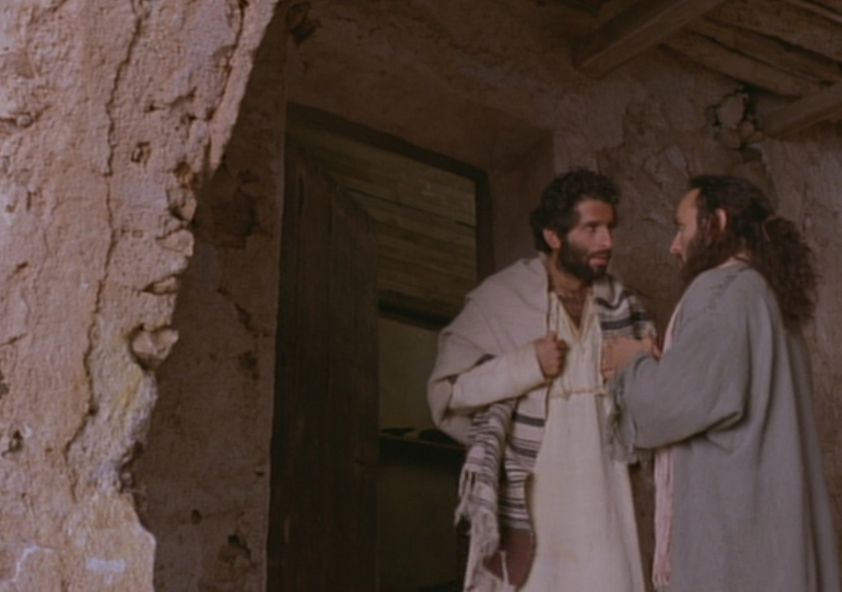
“Jesus fulfills prophecy!”
Philip went to look for Nathanael and told him, “We have found the very person Moses and the prophets wrote about! His name is Jesus, the son of Joseph from Nazareth” (1:45)

Slide 52
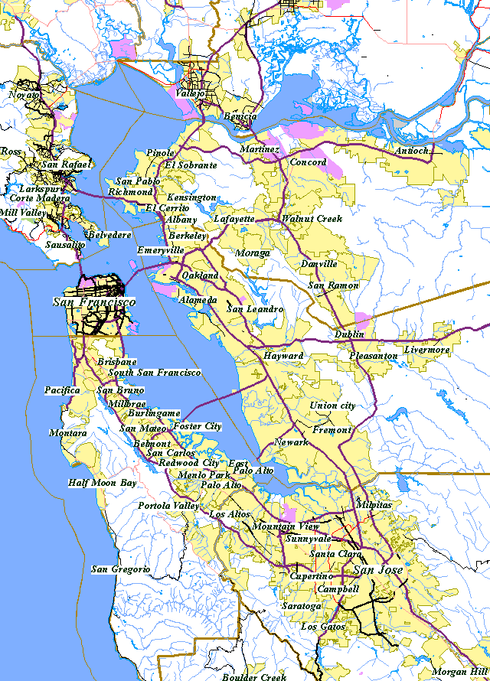
San Francisco Bay Area
Oakland
“Can anything good come from Nazareth?”
SF
Milpitas?”
Milpitas
Notes:
Someone scratched out “Nazareth” in my script and replaced it with “Milpitas”—the city where the sewage of 9 million people ran—the only city that you could smell before you got there!

Slide 53
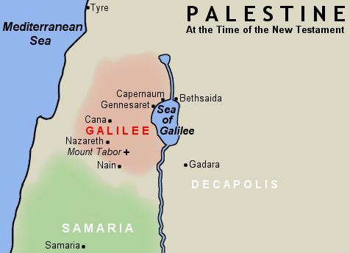
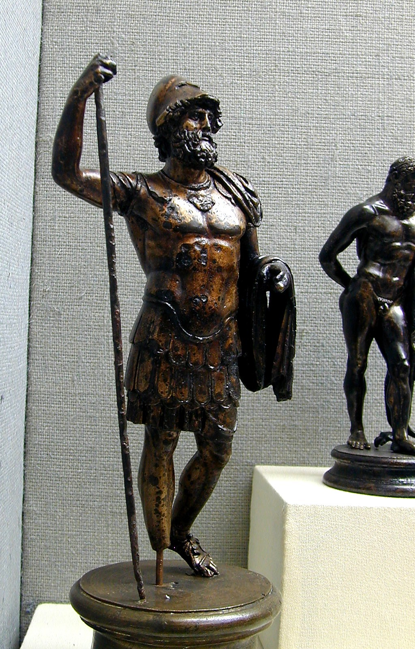
Galilee Sea Area
“Can anything good come from Nazareth?”
Nazareth
Notes:
Nazareth also had a horrible reputation as the headquarters of the Roman garrison of Galilee.

Slide 54
Who was Nathanael?
He is not included in the Twelve disciples of Jesus but is most likely Bartholomew.
Though prejudiced, he at least gave Jesus a chance...

Slide 55
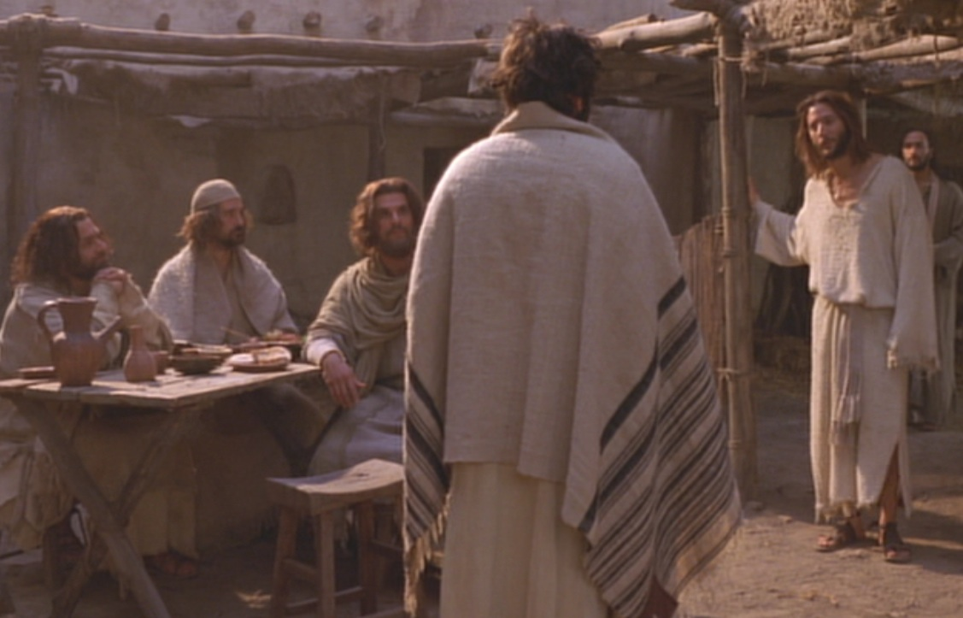
Jesus is no mere human…
After telling Nathanael about Jesus, Philip took him to Jesus, who compliments him!

Slide 56
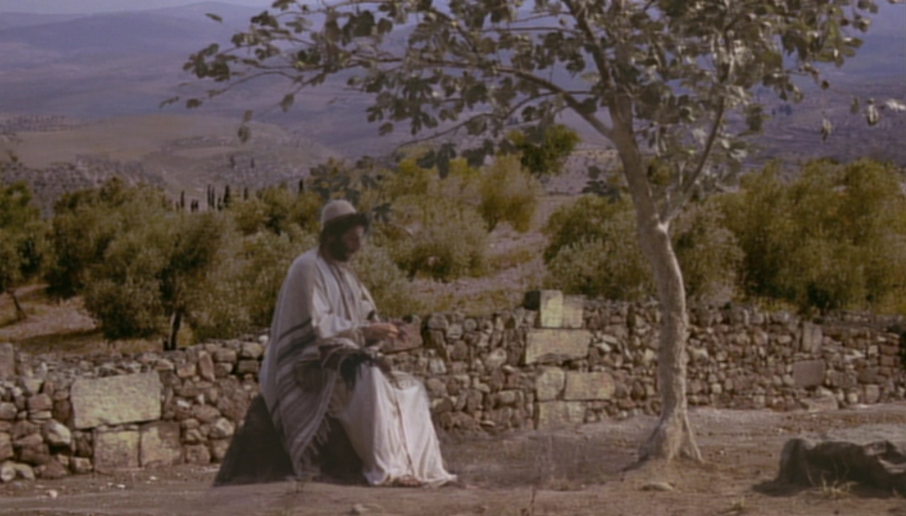
Christ Knew Nathanael
“How do you know about me?” Nathanael asked.
Jesus replied, “I could see you under the fig tree before Philip found you.”
(John 1:48 NLT)

Slide 57
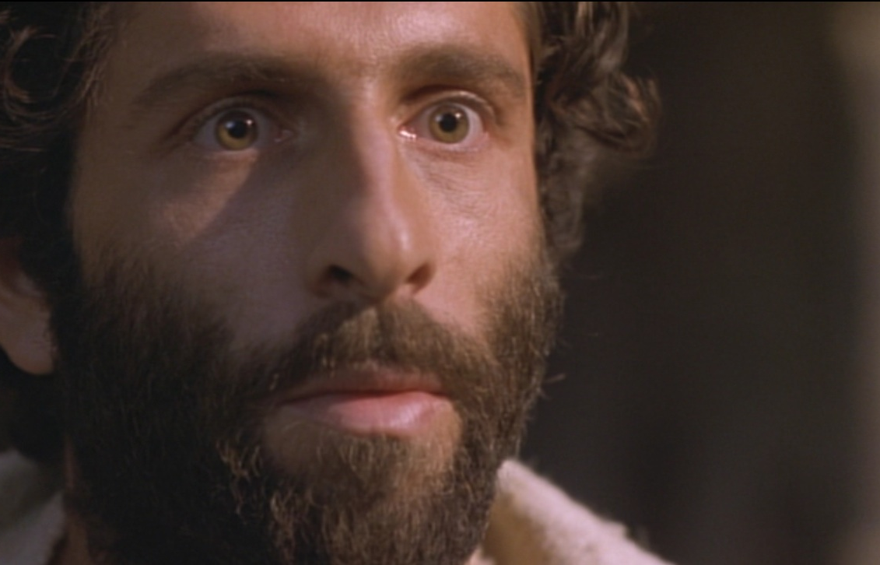
Nathanael’s Testimony
“Rabbi, you are the Son of God—the King of Israel!”
(John 1:49 NLT)

Slide 58
“Son of God”
Used first by John the Baptist (1:34).
The central teaching of John’s Gospel, since the purpose of this Gospel is to give evidences that:
“Jesus is the Christ, the Son of God” (John 20:31)
David R. Bauer, Dictionary of Jesus & the Gospels, 774

Slide 59
The Trinity

Slide 60
“Son of God”
In Psalm 2:6-7 God says, “I have installed my King on Zion, my holy hill. I will proclaim the decree of the Lord: He said to me, ‘You are my Son; today I have become your Father’” (NIV).
The significance of this title is in John 1:18, where Jesus is the final word from God, for nobody else has such a close relationship to deity.
Merrill C. Tenney, The Expositor’s Bible Commentary, 38

Slide 61
The Father, Son & Spirit

Slide 62
Who is Jesus?

Slide 63
Three Reasons the Word is God
Saviour
Jesus
Lamb of God
Son of God
Lord
God
WORD
Messiah
Christ
Anointed One
Son of David
King of Israel
Lord Jesus Christ
King of Kings
=
Son of Man
God Saviour King
Notes:
The identity of the Logos is threefold in John 1:19-51…

Slide 64
So what should we do?

Slide 65
So what should we do?
Don’t be afraid to tell others who Jesus really is.
Tell others that Jesus is the Savior, Messiah, and also Son of God.
He is the only One who is worthy of our worship and praise!
Main Idea

Slide 66
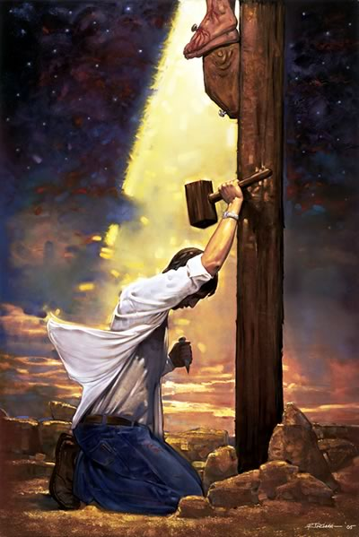
So what should we do?
Trust Him as Savior

Slide 67
Black

Slide 68
NT Preaching link at BibleStudyDownloads.org
Get this presentation and script for free!
Notes:
NT Preaching (np)

