Slide 1
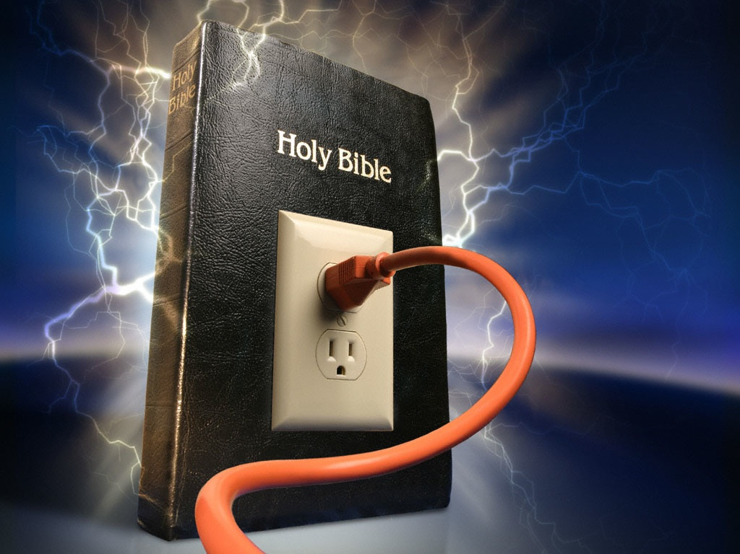
A Delicate Balance John 1:14-18

Slide 2
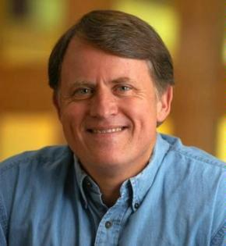
Randy Alcorn
Notes:
Read pages 9-15.

Slide 3
Black

Slide 4
Acts 4:33
“With great power the apostles continued to testify to the resurrection of the Lord Jesus, and much grace was upon them all”
Notes:
Any doubt as to who is meant by the “Word” is erased once we reached verse 14, which clearly shows the at “Word was God” means that Jews was God.
And ªthe Word ^{b}became flesh, and ^{1c}dwelt among us, and ^{d}we saw His glory, glory as of ²the only begotten from the Father, full of ^{e}grace and ^{f}truth.
aRev 19:13
bRom 1:3; Gal 4:4; Phil 2:7f; 1 Tim 3:16; Heb 2:14; 1 John 1:1f; 4:2; 2 John 7
1Or tabernacled; i.e. lived temporarily
cRev 21:3
dLuke 9:32; John 2:11; 17:22, 24; 2 Pet 1:16f; 1 John 1:1
2Or unique, only one of His kind
eJohn 1:17; Rom 5:21; 6:14
fJohn 8:32; 14:6; 18:37
New American Standard Bible : 1995 Update (LaHabra, CA: The Lockman Foundation, 1995), Jn 1:14.

Slide 5
Black

Slide 6
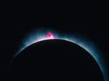
Jesus (logos) had no beginning (1a)
“In the beginning
was the Word,
and the Word was with God,
and the Word was God”
(John 1:1)
Notes:
Scripture is very clear that Jesus is God. Christians have always believed this key doctrine called the deity of Christ.

Slide 7
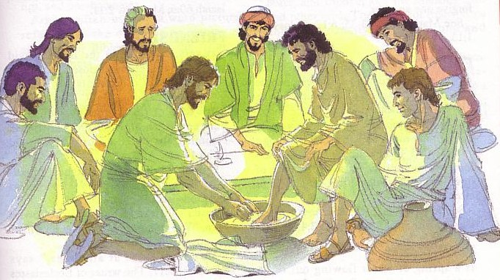
God became Man in Jesus
“The Word became flesh and made his dwelling among us. We have seen his glory, the glory of the One and Only, who came from the Father, full of grace and truth” (John 1:14 NIV)
Notes:
Any doubt as to who is meant by the “Word” is erased once we reached verse 14, which clearly shows the at “Word was God” means that Jews was God.
And ªthe Word ^{b}became flesh, and ^{1c}dwelt among us, and ^{d}we saw His glory, glory as of ²the only begotten from the Father, full of ^{e}grace and ^{f}truth.
aRev 19:13
bRom 1:3; Gal 4:4; Phil 2:7f; 1 Tim 3:16; Heb 2:14; 1 John 1:1f; 4:2; 2 John 7
1Or tabernacled; i.e. lived temporarily
cRev 21:3
dLuke 9:32; John 2:11; 17:22, 24; 2 Pet 1:16f; 1 John 1:1
2Or unique, only one of His kind
eJohn 1:17; Rom 5:21; 6:14
fJohn 8:32; 14:6; 18:37
New American Standard Bible : 1995 Update (LaHabra, CA: The Lockman Foundation, 1995), Jn 1:14.

Slide 8
Black

Slide 9
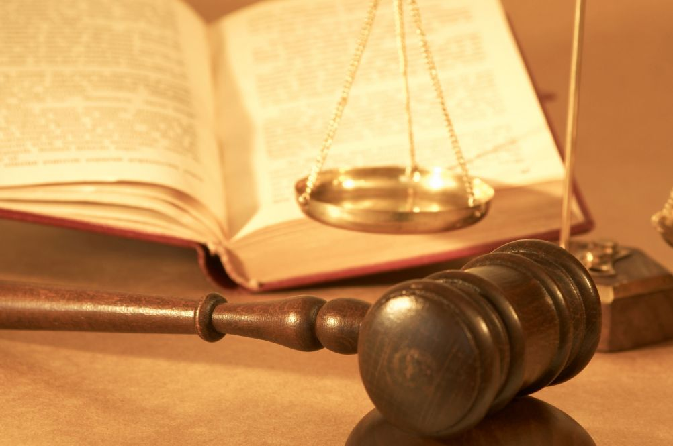
Need for Balance…
Grace
Truth

Slide 10
Need for Balance…
Grace
Truth

Slide 11
Need for Balance…
Grace
Truth

Slide 12
Need for Balance…
Grace
Truth

Slide 13
How we could best see God’s…
The best way was for God to become one of us!

Slide 14
Prologue Outline
Jesus is God because He is: (1) the Creator, (2) testified by John the Baptist, (3) the Saviour of the world, and (4) the best example of grace and truth.
I. Jesus was the Creator God (1:1-5)
II. John the Baptist testified that Jesus is God (1:6-8)
III. Jesus brought salvation to mankind (1:9-13)
IV. Jesus showed grace and truth (1:14-18)

Slide 15
John 1:1-18

Slide 16
I. Eyewitnesses saw God’s grace and truth when Jesus became human (1:14-15).

Slide 17
God became Man in Jesus
“The Word became flesh and made his dwelling among us. We have seen his glory, the glory of the One and Only, who came from the Father, full of grace and truth” (John 1:14 NIV)
Notes:
Any doubt as to who is meant by the “Word” is erased once we reached verse 14, which clearly shows the at “Word was God” means that Jews was God.
And ªthe Word ^{b}became flesh, and ^{1c}dwelt among us, and ^{d}we saw His glory, glory as of ²the only begotten from the Father, full of ^{e}grace and ^{f}truth.
aRev 19:13
bRom 1:3; Gal 4:4; Phil 2:7f; 1 Tim 3:16; Heb 2:14; 1 John 1:1f; 4:2; 2 John 7
1Or tabernacled; i.e. lived temporarily
cRev 21:3
dLuke 9:32; John 2:11; 17:22, 24; 2 Pet 1:16f; 1 John 1:1
2Or unique, only one of His kind
eJohn 1:17; Rom 5:21; 6:14
fJohn 8:32; 14:6; 18:37
New American Standard Bible : 1995 Update (LaHabra, CA: The Lockman Foundation, 1995), Jn 1:14.

Slide 18
Jesus (logos) had no beginning (1a)
“In the beginning
was the Word,
and the Word was with God,
and the Word was God”
(John 1:1)
Notes:
Scripture is very clear that Jesus is God. Christians have always believed this key doctrine called the deity of Christ.

Slide 19
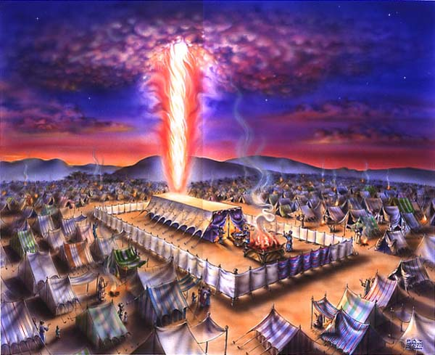
“The Word tabernacled among us…”
Exodus 40

Slide 20
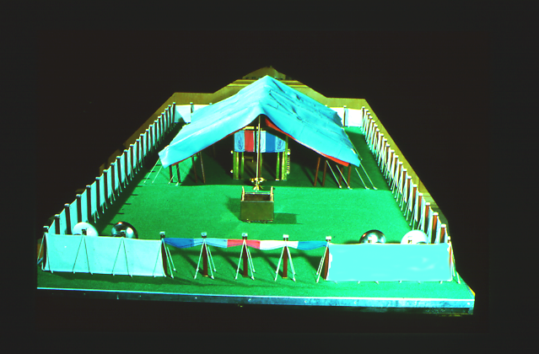
God set up a place for Him to dwell as King
7
The Tabernacle
MOSES
Exodus
Sinai
M - C - C
Kadesh Barnea
40
The Tabernacle in the Wilderness
Handbook pg. 26-29
2
16
Notes:
Both Jews and pagans viewed the temple not so much as the place where a deity was worshipped, but rather the place where the deity dwelt. These were in fact palaces of their divine king, although Solomon acknowledged that no “house” (beth) could contain God Himself (1 Kings 8:27). Interestingly, the Hebrew word hêcãl (lk'yhe) means either "temple" or "palace" (BDB 228a).
Infrequently it referred to the palace of Ahab (1 Kings 21:1) or of the king of Babylon (2 Kings 20:18 = Isa. 39:17; 2 Chron. 36:7; Dan. 1:4) or other pagan palaces such as those at Nineveh (Nahum 2:7).
The same word hêcãl is translated as the palace of God or "house of God," such as Solomon's temple (1 Kings 6:17)—which included the bet or holy place as distinguished from the inner sanctuary (1 Kings 6:1-2). Interestingly, though God's presence resided in the Holy of Holies, it was the holy place that was deemed the palace of the LORD. Jesus called the temple his "Father's house" (Luke 2:49; John 2:16).

Slide 21
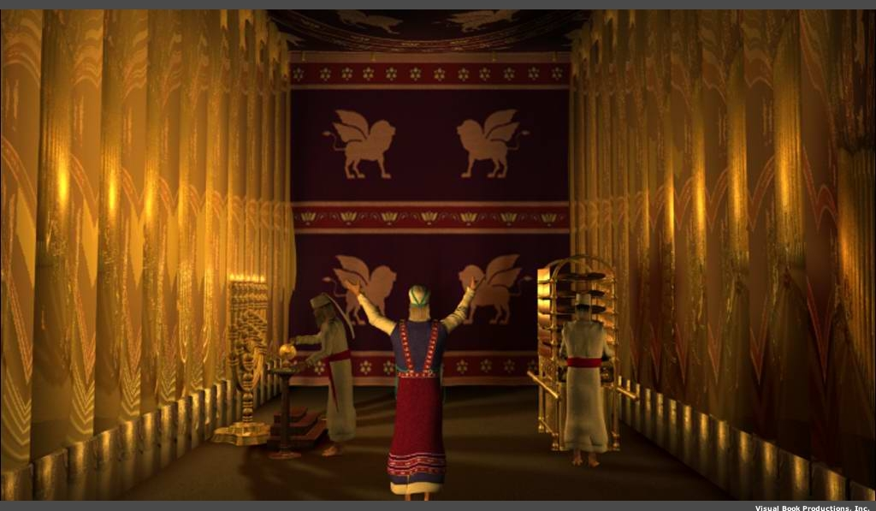
The Holy Place

Slide 22
God’s presence filled his new palace!
Then the cloud covered the tent of meeting, and the glory of the LORD filled the tabernacle.
Exodus 40:34 ESV

Slide 23
Black
Notes:
Jesus enjoyed uninterrupted fellowship with God for eternity past—who could show God’s grace and truth better than Jesus?

Slide 24
Randy Alcorn
Notes:
Read pages 19-21

Slide 25
Black

Slide 26
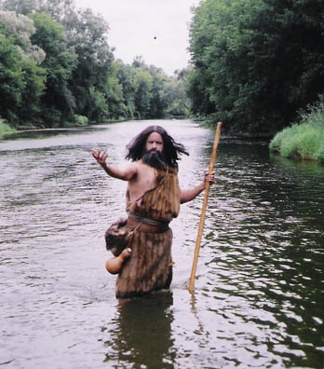
John the Baptist

Slide 27
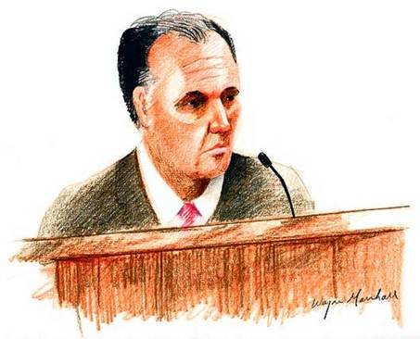
Black

Slide 28
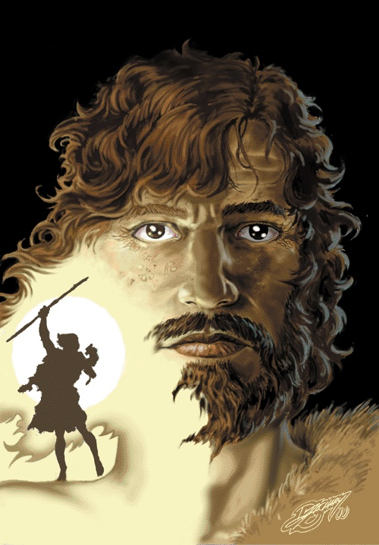
John & Jesus
Who was older?

Slide 29
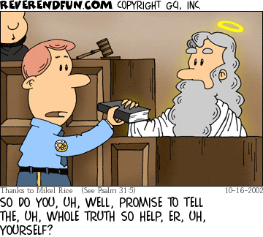
Black

Slide 30
II. We also see God’s grace and truth in Jesus (1:16-18).

Slide 31
Grace Upon Grace

Slide 32
Black

Slide 33
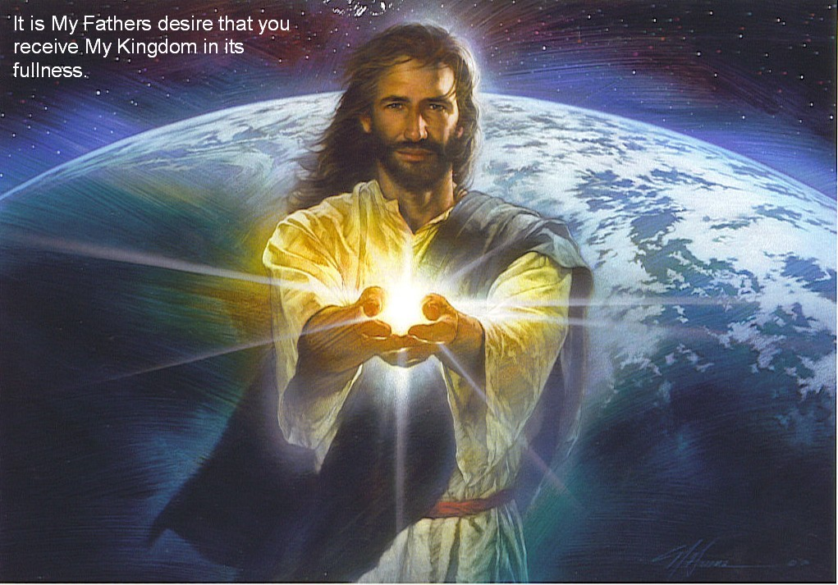
James 1:14
“Every good and perfect gift comes from the Father of lights…”

Slide 34
The law came through Moses…

Slide 35
Black

Slide 36
Where to Look for Truth?

Slide 37
Is truth relative?

Slide 38
The Truth Project

Slide 39
Truth Project Subjects

Slide 40
Black
Notes:
Verse 18 says we can’t see God—so God showed himself in Christ!
Jesus is “God the One and Only” (deity!)

Slide 41
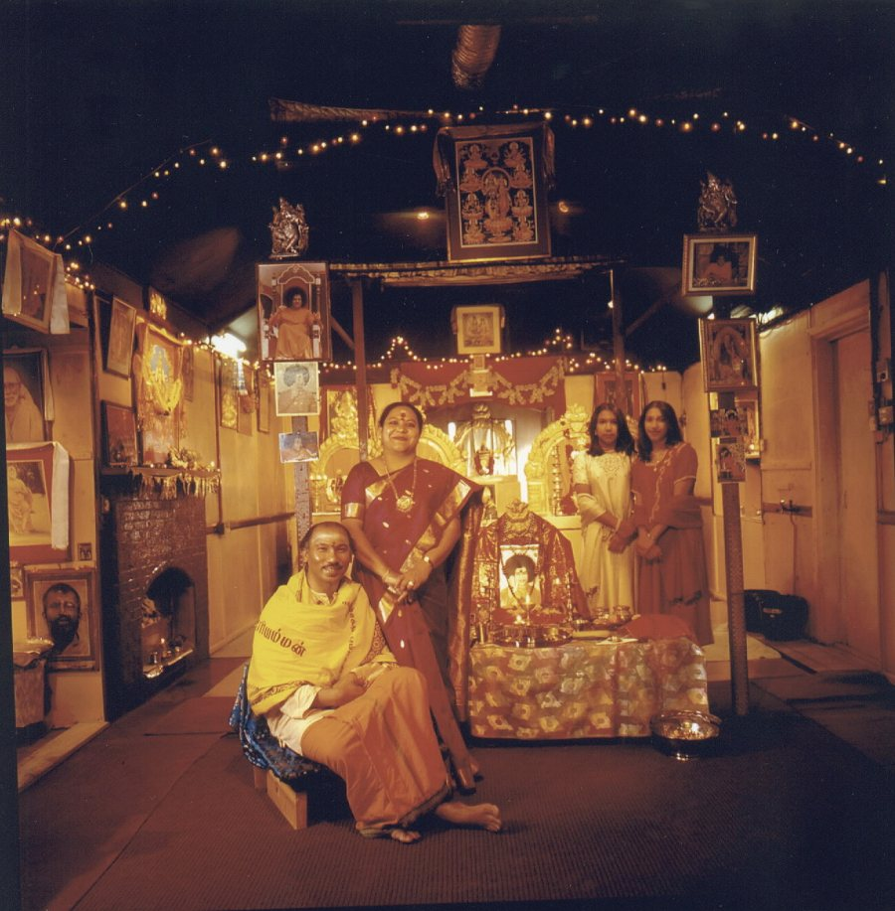
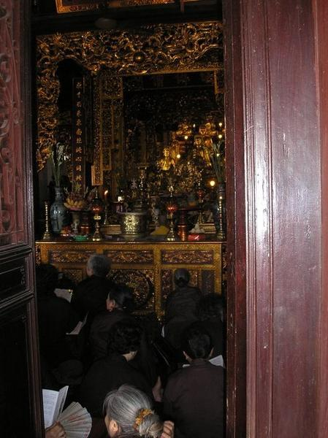
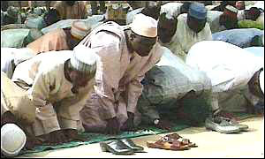
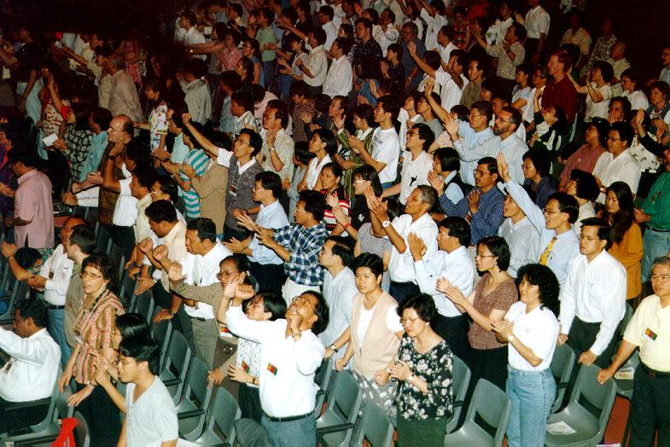
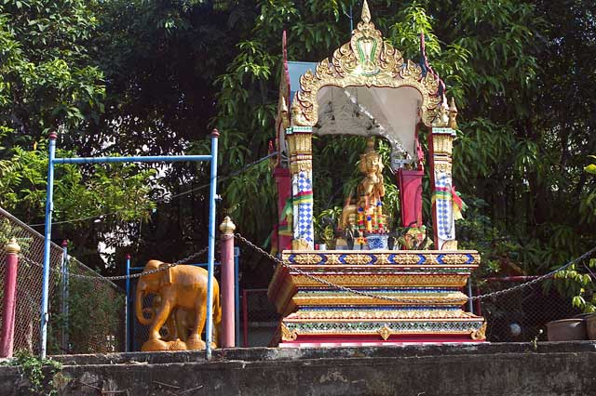
Which to believe?
Believe in God who revealed to us through the words and works of His Son

Slide 42
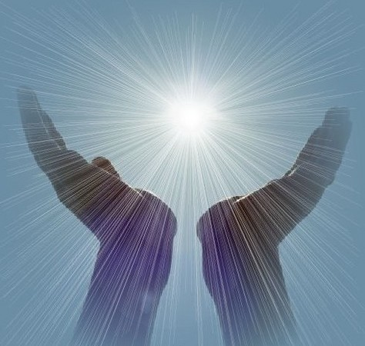
Jesus was eternal God made man to show the Father as full of grace and truth
–– The Main Idea of John 1:14-18 ––

Slide 43
Grace & Truth
A Delicate Balance

Slide 44
Out of Darkness into Light

Slide 45
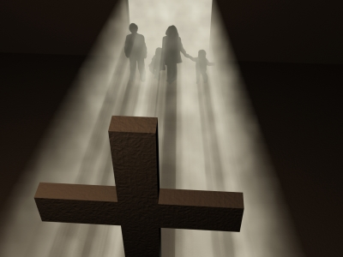
Grace at the Cross
Notes:
John 14:8 ªPhilip *said to Him, “Lord, show us the Father, and it is enough for us.”
John 14:9 Jesus *said to him, “Have I been so long with you, and yet you have not come to know Me, Philip? ªHe who has seen Me has seen the Father; how can you say, ‘Show us the Father’?

Slide 46
Black

