Slide 1
The Sovereign Plan: Pilate, Prophecy, and Obedience
John 19:17-42
Preached by Matthew Lyle
at Crossroads International Church Singapore • CICFamily.com
Uploaded by Dr. Rick Griffith • Jordan Evangelical Theological Seminary
Files in many languages for free download at BibleStudyDownloads.org

Slide 2











Notes:
By Original author: Pierre de Coubertin (1863-1937) - Own work using: https://olympics.com/images/static/b2p-images/logo_color.svg, Public Domain, https://commons.wikimedia.org/w/index.php?curid=12569757
Icons from Microsoft 365
Flags
China By Drawn by SKopp, Vectorization: Denelson83 and Zscout370Recode by -xfi- (code), Shizhao (colors) - Own work, National Flag Image for Online Usage, National People's Congress of PRC, per Article 9 of the National Flag Law of PRC., Public Domain, https://commons.wikimedia.org/w/index.php?curid=436175
Rusia Public Domain, https://en.wikipedia.org/w/index.php?curid=33285605
Kenya By User:Pumbaa80 - http://www.kenyarchives.go.ke/flag_specifications.htm, Public Domain, https://commons.wikimedia.org/w/index.php?curid=25314189
USA By U.S. Department of State - File:Flag of the United States.svg, this is a color modification based on standards published by the Department of State: ECA Design Guidelines (PDF) (Report). Bureau of Educational and Cultural Affairs Office of Public Affairs and Strategic Communications. January 2017. Retrieved 2023-01-21., Public Domain, https://commons.wikimedia.org/w/index.php?curid=127989664
Jamaica By This vector image was created with Inkscape by SKopp, and then manually edited by Zscout370, Madden and others - Own work. Geometry and Pantone colour codes from jis.gov.jm. Pantone "Black C" is intentionally replaced with plain black (#000)., Public Domain, https://commons.wikimedia.org/w/index.php?curid=23395023

Slide 3

Believing
C H R I S T
Responding to John’s Gospel

Slide 4
John 5:18 This was why the Jews were seeking all the more to kill him,. . .
John 7:1 . . .He would not go about in Judea, because the Jews were seeking to kill him.
John 7:19 Has not Moses given you the law? Yet none of you keeps the law. Why do you seek to kill me?”
John 7:25 Some of the people of Jerusalem therefore said, “Is not this the man whom they seek to kill?
John 8:37 yet you seek to kill me because my word finds no place in you.
John 8:40 but now you seek to kill me, a man who has told you the truth that I heard from God.

Slide 5
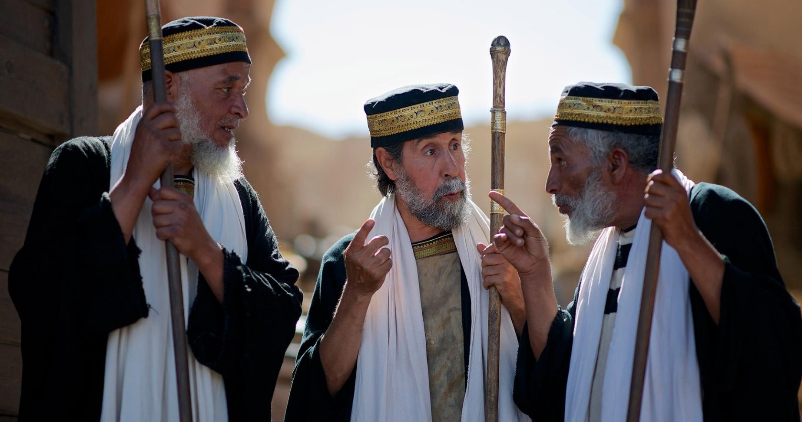
John 11:50 "It is better for you that one man should die for the people, not that the whole nation should perish.”
Notes:
Pharisees (image courtesy of www.freebibleimages.org)

Slide 6
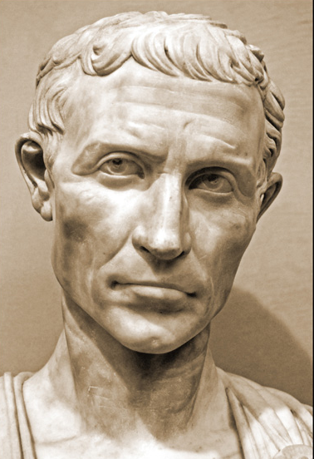
Take Me to the Pilate
-the trial of the indecisive-
Avoidance tactic 1: I get out of this, and no one gets hurt (38-40)
Avoidance tactic 2: I get out of this, and someone gets a little hurt (1-8)
Avoidance tactic 3: I get out of this by letting someone else make a decision (9-11)
John 18:28–19:16

Slide 7
The Sovereign Plan: Pilate, Prophecy, and Obedience
John 19:17-42

Slide 8
God’s sovereignty was demonstrated by Pilate’s Proclamation (17-22)
The Sovereign Plan: Pilate, Prophecy, and Obedience
John 19:17-42

Slide 9
So they took Jesus, ¹⁷ and he went out, bearing his own cross, to the place called The Place of a Skull, which in Aramaic is called Golgotha.
¹⁸ There they crucified him, and with him two others, one on either side, and Jesus between them.

Slide 10
¹⁹ Pilate also wrote an inscription and put it on the cross. It read, “Jesus of Nazareth, the King of the Jews.” ²⁰ Many of the Jews read this inscription, for the place where Jesus was crucified was near the city, and it was written in Aramaic, in Latin, and in Greek. ²¹ So the chief priests of the Jews said to Pilate, “Do not write, ‘The King of the Jews,’ but rather, ‘This man said, I am King of the Jews.’” ²² Pilate answered,
“What I have written I have written.”

Slide 11
So they took Jesus, ¹⁷ and he went out, bearing his own cross, to the place called The Place of a Skull, which in Aramaic is called Golgotha.
¹⁸ There they crucified him, and with him two others, one on either side, and Jesus between them.

Slide 12
Something Missing?
Simon’s Support
Notes:
Image by freepik
https://www.freepik.com/free-photo/missing-piece-puzzle-blue-textured-backdrop_5015057.htm#fromView=image_search_similar&page=1&position=0&uuid=7a22d0d3-6f4c-4a7b-bbde-b59999d437c0

Slide 13
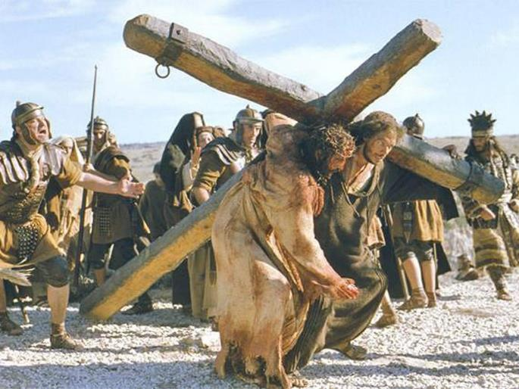
So they took Jesus, ¹⁷ and he went out, bearing his own cross, to the place called The Place of a Skull, which in Aramaic is called Golgotha.
Mark 15:21 And they compelled a passerby, Simon of Cyrene, who was coming in from the country, the father of Alexander and Rufus, to carry his cross.
Notes:
https://www.independent.co.uk/arts-entertainment/films/features/passion-of-the-christ-15-years-mel-gibson-jim-cavieziel-movie-reaction-christianity-a8788381.html

Slide 14
The film’s most immediate talking point, for many viewers, was the gratuitous brutality. . . .
audiences uniformly left The Passion in a state of shock.
Notes:
By The poster art can or could be obtained from Theatrical:Icon EntertainmentNewmarket FilmsEquinox Films20th Century FoxDVD:MGM Home EntertainmentWarner Home Video20th Century Fox Home Entertainment., Fair use, https://en.wikipedia.org/w/index.php?curid=63823001

Slide 15
What Gibson has provided for me, for the first time in my life, is a visceral idea of what the Passion consisted of. That his film is superficial in terms of the surrounding message—that we get only a few passing references to the teachings of Jesus—is, I suppose, not the point. This is not a sermon or a homily, but a visualization of the central event in the Christian religion. Take it or leave it.
Notes:
https://www.flickeringmyth.com/the-passion-of-the-christ-at-20-mel-gibsons-controversial-religious-tale-revisited/

Slide 16
So they took Jesus, ¹⁷ and he went out, bearing his own cross, to the place called The Place of a Skull, which in Aramaic is called Golgotha.
Notes:
https://www.independent.co.uk/arts-entertainment/films/features/passion-of-the-christ-15-years-mel-gibson-jim-cavieziel-movie-reaction-christianity-a8788381.html

Slide 17
So they took Jesus, ¹⁷ and he went out, bearing his own cross, to the place called The Place of a Skull, which in Aramaic is called Golgotha.
Notes:
https://www.independent.co.uk/arts-entertainment/films/features/passion-of-the-christ-15-years-mel-gibson-jim-cavieziel-movie-reaction-christianity-a8788381.html

Slide 18
So they took Jesus, ¹⁷ and he went out, bearing his own cross, to the place called The Place of a Skull, which in Aramaic is called Golgotha.
κρανίον
kranion
Γολγοθᾶ
golgotha
Greek
Aramaic
crānium
Latin
calvāria
Latin
Calvary
Notes:
https://www.independent.co.uk/arts-entertainment/films/features/passion-of-the-christ-15-years-mel-gibson-jim-cavieziel-movie-reaction-christianity-a8788381.html

Slide 19
So they took Jesus, ¹⁷ and he went out, bearing his own cross, to the place called The Place of a Skull, which in Aramaic is called Golgotha.
¹⁸ There they crucified him, and with him two others, one on either side, and Jesus between them.

Slide 20
Something Missing?
Simon’s Support
Criminals’ Conversation
Notes:
Image by freepik
https://www.freepik.com/free-photo/missing-piece-puzzle-blue-textured-backdrop_5015057.htm#fromView=image_search_similar&page=1&position=0&uuid=7a22d0d3-6f4c-4a7b-bbde-b59999d437c0

Slide 21
⁴⁰ But the other rebuked him, saying, “Do you not fear God, since you are under the same sentence of condemnation? ⁴¹ And we indeed justly, for we are receiving the due reward of our deeds; but this man has done nothing wrong.”
“Are you not the Christ?
Save yourself and us!”
Luke 23:39-43

Slide 22
⁴² And he said, “Jesus, remember me when you come into your kingdom.”
⁴³ And he said to him,
“Truly, I say to you,
Today you will be with me in paradise.”

Slide 23
God’s sovereignty was demonstrated by Pilate’s Proclamation (17-22)
The Sovereign Plan: Pilate, Prophecy, and Obedience
John 19:17-42

Slide 24
¹⁹ Pilate also wrote an inscription and put it on the cross. It read, “Jesus of Nazareth, the King of the Jews.” ²⁰ Many of the Jews read this inscription, for the place where Jesus was crucified was near the city, and it was written in Aramaic, in Latin, and in Greek. ²¹ So the chief priests of the Jews said to Pilate, “Do not write, ‘The King of the Jews,’ but rather, ‘This man said, I am King of the Jews.’” ²² Pilate answered,
“What I have written I have written.”

Slide 25
King Herod (Herod the Great)
Ordered Census
Met wise men
Killed Babies in Jerusalem

Slide 26
⁸ "Judah, your brothers will praise you.
You will grasp your enemies by the neck.
All your relatives will bow before you.
⁹ Judah, my son, is a young lion
that has finished eating its prey.
Like a lion he crouches and lies down;
like a lioness—who dares to rouse him?
¹⁰ The scepter will not depart from Judah,
nor the ruler’s staff from his descendants,
until the coming of the one to whom it belongs,
the one whom all nations will honor."
Gen 49:8-10

Slide 27
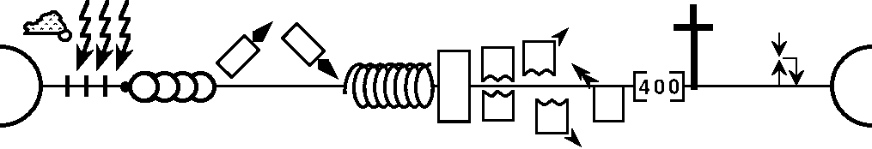
--------------------------------------------------------------------------1 & 2 Chronicles -----------------------------------------------------------------------------------
Deuteronomy
1 Samuel
Leviticus
2 Samuel
Nehemiah
Genesis 1-11
Genesis 12-50
Exodus
Numbers
Joshua
Judges
1 Kings
2 Kings
Ruth
Ezra
Esther
Moses
Cycles
S • D • S
1st Coming
Eternity
Creation
Joshua
J (R) & I (J)
Eternity
Fall
Babel
Flood
2nd Coming
Abraham
Joseph
Isaac
Jacob
1000
1990+
Exodus
Judges
until the coming of the one to whom it belongs,
the one whom all nations will honor.
Patriarchs
Conquests
Beginnings
United Kingdom
Captivity
Divided Kingdom
Max Anders, Dallas Theological Seminary
Notes:
By Genealogy_of_the_kings_of_Israel_and_Judah.png: User:Mr. Absurdderivative work: Jon C (talk) - Genealogy_of_the_kings_of_Israel_and_Judah.png, Public Domain, https://commons.wikimedia.org/w/index.php?curid=17802187

Slide 28



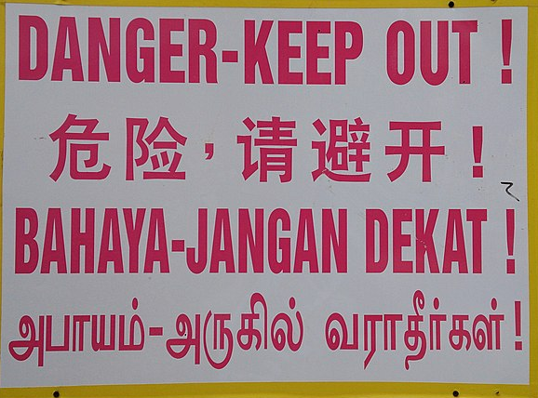
¹⁹ Pilate also wrote an inscription and put it on the cross. It read, “Jesus of Nazareth, the King of the Jews.” ²⁰ Many of the Jews read this inscription, for the place where Jesus was crucified was near the city, and it was written in Aramaic, in Latin, and in Greek. ²¹ So the chief priests of the Jews said to Pilate, “Do not write, ‘The King of the Jews,’ but rather, ‘This man said, I am King of the Jews.’” ²² Pilate answered,
“What I have written I have written.”
Notes:
By ProjectManhattan - Own work, CC0, https://commons.wikimedia.org/w/index.php?curid=29428176

Slide 29
¹⁹ Pilate also wrote an inscription and put it on the cross. It read, “Jesus of Nazareth, the King of the Jews.” ²⁰ Many of the Jews read this inscription, for the place where Jesus was crucified was near the city, and it was written in Aramaic, in Latin, and in Greek. ²¹ So the chief priests of the Jews said to Pilate, “Do not write, ‘The King of the Jews,’ but rather, ‘This man said, I am King of the Jews.’” ²² Pilate answered,
“What I have written I have written.”
P-O-F-M-A
Priests' Order for the Modification of the Accusation
Protection from Online Falsehoods and Manipulation Act
Notes:
By ProjectManhattan - Own work, CC0, https://commons.wikimedia.org/w/index.php?curid=29428176

Slide 30
¹⁹ Pilate also wrote an inscription and put it on the cross. It read, “Jesus of Nazareth, the King of the Jews.” ²⁰ Many of the Jews read this inscription, for the place where Jesus was crucified was near the city, and it was written in Aramaic, in Latin, and in Greek. ²¹ So the chief priests of the Jews said to Pilate, “Do not write, ‘The King of the Jews,’ but rather, ‘This man said, I am King of the Jews.’” ²² Pilate answered,
“What I have written I have written.”

Slide 31
Ch 11 ⁴⁹ But one of them, Caiaphas, who was high priest that year, said to them, “You know nothing at all. ⁵⁰ Nor do you understand that it is better for you that one man should die for the people, not that the whole nation should perish.”
Notes:
Pharisees (image courtesy of www.freebibleimages.org)

Slide 32
God’s sovereignty was demonstrated by Pilate’s Proclamation (17-22)
The Sovereign Plan: Pilate, Prophecy, and Obedience
John 19:17-42

Slide 33
God’s sovereignty was demonstrated by Pilate’s Proclamation (17-22)
God’s sovereignty was demonstrated by Fulfilled Prophecy (23-37)
The Sovereign Plan: Pilate, Prophecy, and Obedience
John 19:17-42

Slide 34
²³ When the soldiers had crucified Jesus, they took his garments and divided them into four parts, one part for each soldier; also his tunic. But the tunic was seamless, woven in one piece from top to bottom, ²⁴ so they said to one another, “Let us not tear it, but cast lots for it to see whose it shall be.” This was to fulfill the Scripture which says,
“They divided my garments among them,
and for my clothing they cast lots.”
So the soldiers did these things,
Prophecy: Psalm 22:18
"They divide my clothes among them and cast lots for my garment."

Slide 35
²⁵ but standing by the cross of Jesus were his mother and his mother's sister, Mary the wife of Clopas, and Mary Magdalene. ²⁶ When Jesus saw his mother and the disciple whom he loved standing nearby, he said to his mother, “Woman, behold, your son!” ²⁷ Then he said to the disciple, “Behold, your mother!” And from that hour the disciple took her to his own home.

Slide 36
²⁸ After this, Jesus, knowing that all was now finished, said (to fulfill the Scripture), “I thirst.” ²⁹ A jar full of sour wine stood there, so they put a sponge full of the sour wine on a hyssop branch and held it to his mouth. ³⁰ When Jesus had received the sour wine, he said, “It is finished,” and he bowed his head and gave up his spirit.
Prophecy: Psalm 69:21
"They put gall in my food and gave me vinegar for my thirst."

Slide 37
³¹ Since it was the day of Preparation, and so that the bodies would not remain on the cross on the Sabbath (for that Sabbath was a high day), the Jews asked Pilate that their legs might be broken and that they might be taken away. ³² So the soldiers came and broke the legs of the first, and of the other who had been crucified with him. ³³ But when they came to Jesus and saw that he was already dead, they did not break his legs.

Slide 38
³⁴ But one of the soldiers pierced his side with a spear, and at once there came out blood and water. ³⁵ He who saw it has borne witness—his testimony is true, and he knows that he is telling the truth—that you also may believe. ³⁶ For these things took place that the Scripture might be fulfilled: “Not one of his bones will be broken.” ³⁷ And again another Scripture says, “They will look on him whom they have pierced.”
Prophecy: Psalm 34:20
"He protects all his bones, not one of them will be broken."
Prophecy: Zechariah 12:10 "They will look on me, the one they have pierced, and they will mourn for him as one mourns for an only child, and grieve bitterly for him as one grieves for a firstborn son."

Slide 39
The Messiah
Foretold from the beginning
How do we know that Christ Jesus is who He claimed to be? Within just 24 hours, His crucifixion fulfilled 20 specific prophecies with exact precision—prophecies made hundreds of years in advance.

Slide 40

A clumsy panda becomes a kung fu master, fulfilling an ancient prophecy to save his valley from a villainous snow leopard.
Notes:
By May be found at the following website: http://www.movieposterdb.com/poster/35b70595, Fair use, https://en.wikipedia.org/w/index.php?curid=23581787

Slide 41
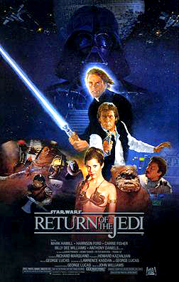
Anakin Skywalker, fulfills a prophecy to bring balance to the Force, by destroying the Sith, including Emperor Palpatine.
Notes:
By [1], Fair use, https://en.wikipedia.org/w/index.php?curid=1748174

Slide 42
Hon-Ming Chen (True Way) Mar 25, 1988
Harold Camping Sep 06, 1994
Sep 29, 1994
Oct 02, 1994
May 21, 2011
2012 Maya Apocalypse Dec 21, 2012

Slide 43
God’s sovereignty was demonstrated by Pilate’s Proclamation (17-22)
God’s sovereignty was demonstrated by Fulfilled Prophecy (23-37)
The Sovereign Plan: Pilate, Prophecy, and Obedience
John 19:17-42

Slide 44
²⁸ After this, Jesus, knowing that all was now finished, said (to fulfill the Scripture), “I thirst.” ²⁹ A jar full of sour wine stood there, so they put a sponge full of the sour wine on a hyssop branch and held it to his mouth. ³⁰ When Jesus had received the sour wine, he said, “It is finished,” and he bowed his head and gave up his spirit.
My debt is paid and the victory won

Slide 45
Romans 8 ¹ So now there is no condemnation for those who belong to Christ Jesus. ² And because you belong to him, the power of the life-giving Spirit has freed you from the power of sin that leads to death. ³ The law of Moses was unable to save us because of the weakness of our sinful nature. So God did what the law could not do. He sent his own Son in a body like the bodies we sinners have. And in that body God declared an end to sin’s control over us by giving his Son as a sacrifice for our sins.

Slide 46
God’s sovereignty was demonstrated by Pilate’s Proclamation (17-22)
God’s sovereignty was demonstrated by Fulfilled Prophecy (23-37)
The response to God’s sovereignty
is obedience (25-27, 38-42)
The Sovereign Plan: Pilate, Prophecy, and Obedience
John 19:17-42

Slide 47
²⁵ but standing by the cross of Jesus were his mother and his mother's sister, Mary the wife of Clopas, and Mary Magdalene. ²⁶ When Jesus saw his mother and the disciple whom he loved standing nearby, he said to his mother, “Woman, behold, your son!” ²⁷ Then he said to the disciple, “Behold, your mother!” And from that hour the disciple took her to his own home.

Slide 48
³⁸ After these things Joseph of Arimathea, who was a disciple of Jesus, but secretly for fear of the Jews, asked Pilate that he might take away the body of Jesus, and Pilate gave him permission. So he came and took away his body. ³⁹ Nicodemus also, who earlier had come to Jesus by night, came bringing a mixture of myrrh and aloes, about seventy-five pounds in weight.

Slide 49
³⁸ After these things Joseph of Arimathea, who was a disciple of Jesus, but secretly for fear of the Jews, asked Pilate that he might take away the body of Jesus, and Pilate gave him permission. So he came and took away his body. ³⁹ Nicodemus also, who earlier had come to Jesus by night, came bringing a mixture of myrrh and aloes, about seventy-five pounds in weight.

Slide 50
⁴⁰ So they took the body of Jesus and bound it in linen cloths with the spices, as is the burial custom of the Jews. ⁴¹ Now in the place where he was crucified there was a garden, and in the garden a new tomb in which no one had yet been laid. ⁴² So because of the Jewish day of Preparation, since the tomb was close at hand, they laid Jesus there.

Slide 51
God’s sovereignty was demonstrated by Pilate’s Proclamation (17-22)
God’s sovereignty was demonstrated by Fulfilled Prophecy (23-37)
The response to God’s sovereignty
is obedience (25-27, 38-42)
The Sovereign Plan: Pilate, Prophecy, and Obedience
John 19:17-42

Slide 52
⁴⁰ So they took the body of Jesus and bound it in linen cloths with the spices, as is the burial custom of the Jews. ⁴¹ Now in the place where he was crucified there was a garden, and in the garden a new tomb in which no one had yet been laid. ⁴² So because of the Jewish day of Preparation, since the tomb was close at hand, they laid Jesus there.

Slide 53

Thursday – Passover proper. The lamb is killed, and Jesus and His disciples eat the Passover meal in the upper room.
Friday – the Day of Preparation. Jesus is tried and executed (although never convicted). The Jews continue their “Passover” celebrations with the chagigah, offerings made during the Feast of Unleavened Bread.
Saturday – the weekly Sabbath.
Sunday – Resurrection Day.
www.gotquestions.org

Slide 54
⁴⁰ So they took the body of Jesus and bound it in linen cloths with the spices, as is the burial custom of the Jews. ⁴¹ Now in the place where he was crucified there was a garden, and in the garden a new tomb in which no one had yet been laid. ⁴² So because of the Jewish day of Preparation, since the tomb was close at hand, they laid Jesus there.

Slide 55

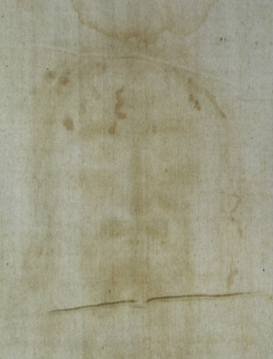
Shroud of Turin
Documented back to 1354
4th century iconography
Radiocarbon Dating
Contaminated Sample
Notes:
By Dianelos Georgoudis - Own work, CC BY-SA 3.0, https://commons.wikimedia.org/w/index.php?curid=33117743

Slide 56
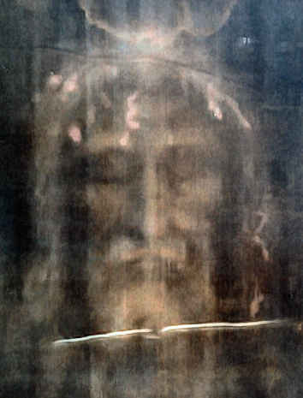
Photographic negative centuries before photography
Photographic negative centuries before photography
Notes:
By Dianelos Georgoudis - Own work, CC BY-SA 3.0, https://commons.wikimedia.org/w/index.php?curid=33117743

Slide 57

History of Negative Photography
Negative photography has its beginnings all the way back in 33 AD. The first-ever possibly negative image is considered to be the Turin Shroud, an image of a deceased man’s body imprinted into linen cloth.
Notes:
By Work-Order Studio - http://www.kodak.com/ Transferred from en.wikipedia to Commons., Public Domain, https://commons.wikimedia.org/w/index.php?curid=52387539
https://kodakdigitizing.com/blogs/news/history-of-negative-photography

Slide 58
History of Negative Photography
After the Turin Shroud, there is almost no evidence of negative photography until the 19th century
Notes:
By Work-Order Studio - http://www.kodak.com/ Transferred from en.wikipedia to Commons., Public Domain, https://commons.wikimedia.org/w/index.php?curid=52387539
https://kodakdigitizing.com/blogs/news/history-of-negative-photography

Slide 59

Fulfilled prophecy
indicates God’s sovereignty
Old & New Testament was changed
to have Jesus fulfill prophecies
Oldest available biblical text
almost 1,000 years after Christ
Monks made good copies
Monks made good copies
Dead Sea Scrolls Found

Slide 60
God’s sovereignty was demonstrated by Pilate’s Proclamation (17-22)
God’s sovereignty was demonstrated by Fulfilled Prophecy (23-37)
The response to God’s sovereignty
is obedience (25-27, 38-42)
The Sovereign Plan: Pilate, Prophecy, and Obedience
John 19:17-42

Slide 61
John 11:50 "It is better for you that one man should die for the people, not that the whole nation should perish."
John 3:16 "For God so loved the world, that he gave his only Son, that whoever believes in him should not perish but have eternal life."

Slide 62
Obedience
Believe
Read God’s Word
Pray to God
Fellowship with believers
Notes:
Image by rawpixel.com on Freepik
https://www.freepik.com/free-photo/jigsaw-teamwork-concept-macro-shot_19133634.htm#fromView=image_search_similar&page=2&position=32&uuid=b0c55f7d-cb8b-404a-a177-dd43ba6f5dbd

Slide 63
Black

Slide 64


NT Preaching link at BibleStudyDownloads.org
Get this presentation and notes for free!
Notes:
NT Preaching (np)

