Slide 1
Preached by Matt Hall at Crossroads International Church Singapore • cicfamily.com Uploaded by Dr. Rick Griffith • Singapore Bible College Files in many languages for free download at BibleStudyDownloads.org

Slide 2
Unity with the Father foundational
5:19;
8:26;
10:38;
14:10;
10:30.

Slide 3
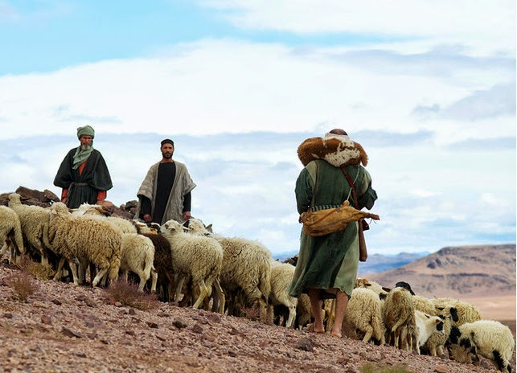
One flock belonging to one Shepherd
10:7; gate
10:14-16; good shepherd
15:1; remain close
17:11-12. protection

Slide 4
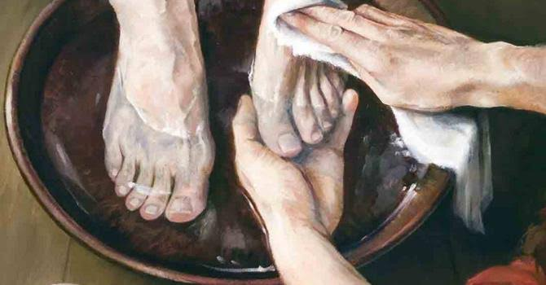

Slide 5
Continuation of mission and example of Jesus
John 13:15, 35;
John 4:38;
John 9:4;
John 15:16;
1 John 2:19, 23, 24;
2 John 8

Slide 6
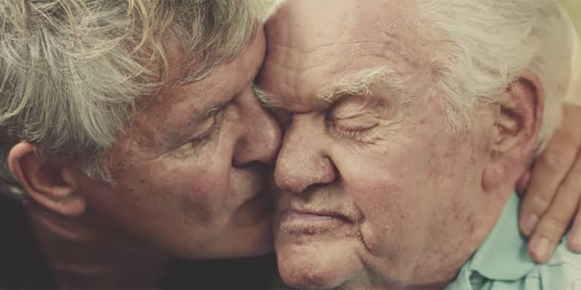

Slide 7
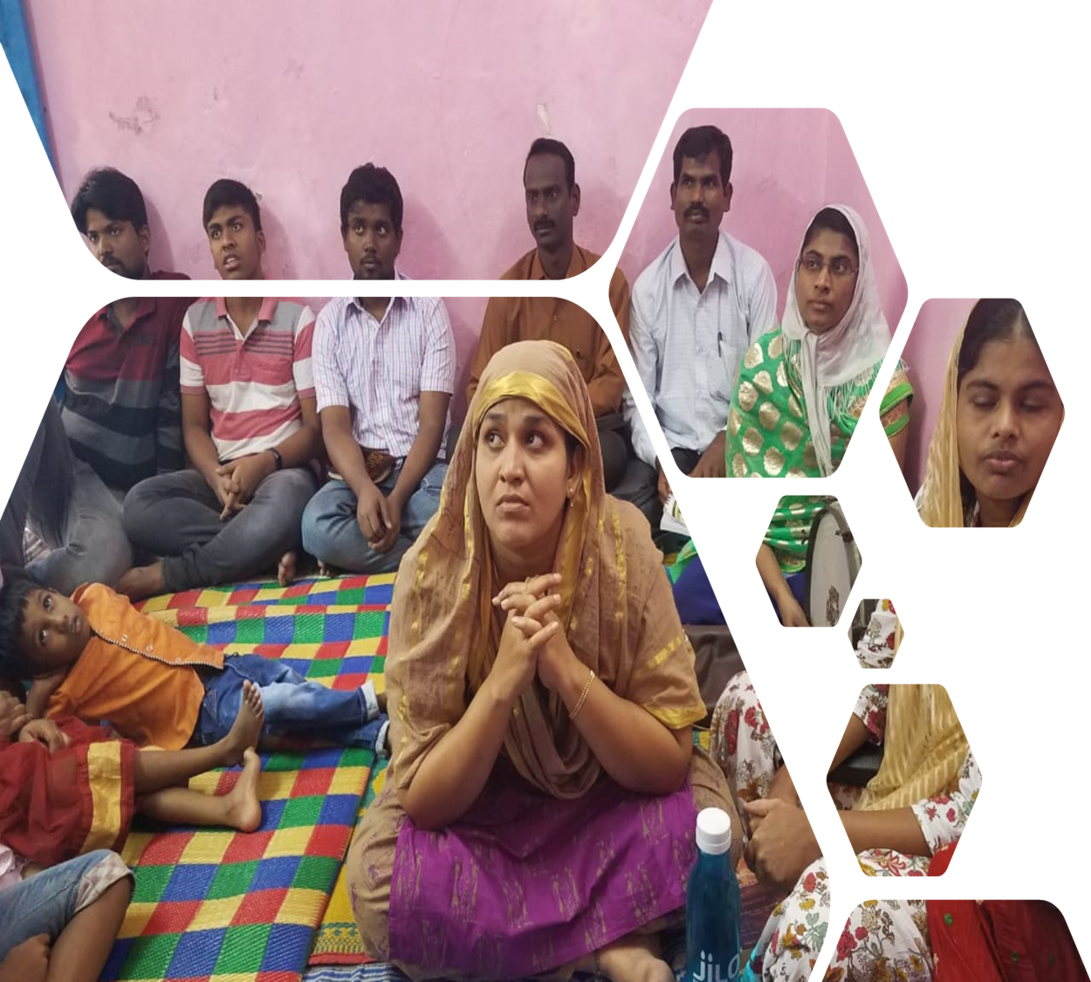

Slide 8
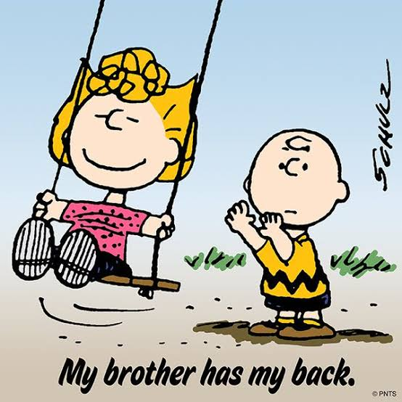

Slide 9
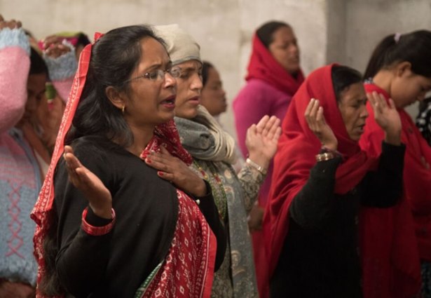
Fellowship we share—not merely common experience

Slide 10
Our primary identity as coparticipants in the fellowship of the triune God – ministry of the church in the world

Slide 12
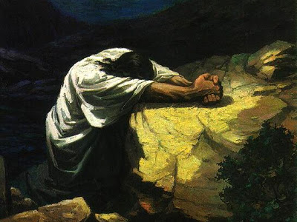

Slide 13
Black

Slide 14
NT Preaching link at BibleStudyDownloads.org
Get this presentation and script for free!
Notes:
NT Preaching (np)

