Slide 1
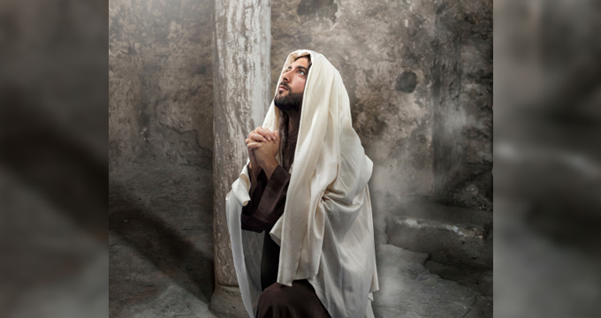
Just As We Are One
John 17:20-23: Philippians 2:2-4
“That they may be one as we are one…”
Preached by Dan Bridges on 20 August 2022 Amman International Church, Jordan (AmmanChurch.org) Uploaded by Dr. Rick Griffith • Jordan Evangelical Theological Seminary Files in many languages for free download at BibleStudyDownloads.org

Slide 2
BE ALL THAT YOU CAN BE!
A Series on
Realizing God’s Purpose for Your Life

Slide 3
Our Topic: Christian Unity
What do you think…
Can true Christians have serious conflict?

Slide 4
Examples:
#1 Reason why cross-cultural Christian workers leave
Registering an NGO
Listening to local advice

Slide 5
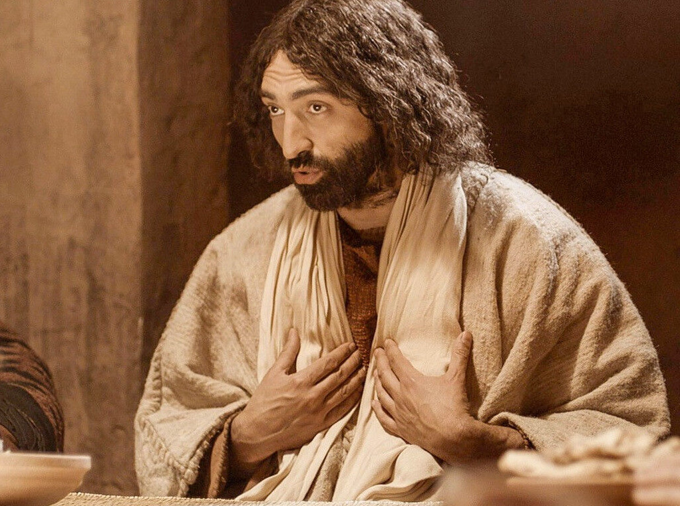
John 13-17
Upper Room Discourse
“In that day you will know that I am in my Father, and you in me, and I in you.”
John 14:20

Slide 6
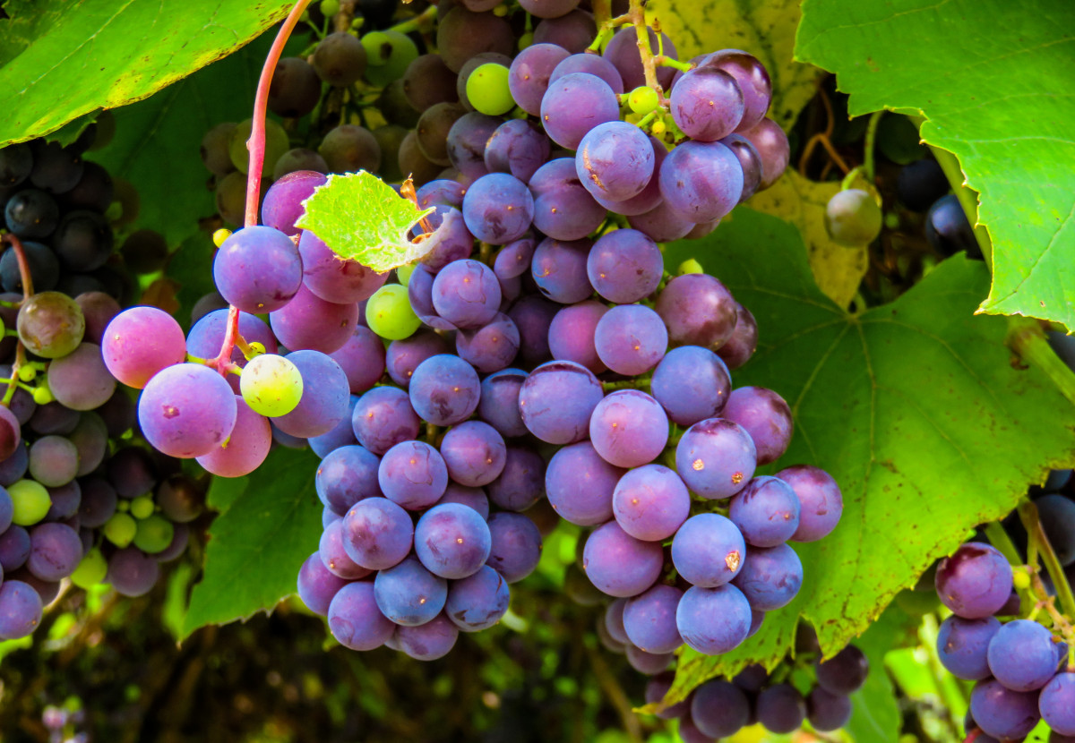
You in Me, and I in You
Like the organic relationship of a vine and its branches!

Slide 7
Week 1:
God’s Vision for Our Lives
FRUIT!!!

Slide 8
So what Fruit is God Working to Produce?
The Fruit of John 15:
Christ-like character
Spiritual Impact on Others

Slide 9
Week 2:
How do we bear fruit?
ABIDING!!!

Slide 10
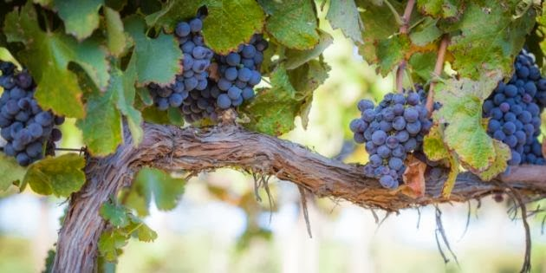
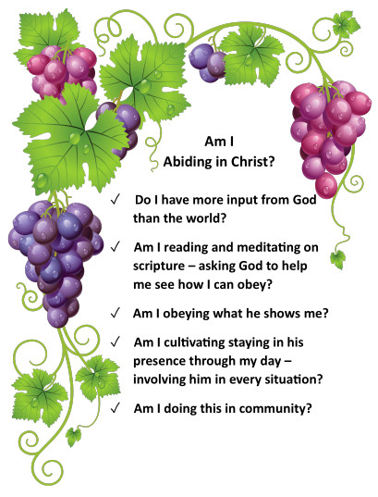
Abiding
Checklist!

Slide 11
Colossians 3
Ways to Abide
Hearts & Minds (1-4)
In Obedience (5-9)
In Community (10-17)

Slide 12
The Result of Abiding
“…that all of them may be one Father, just as you are in me and I am in you. May they also be in us so that the world may believe that you have sent me.”
John 17:21

Slide 13
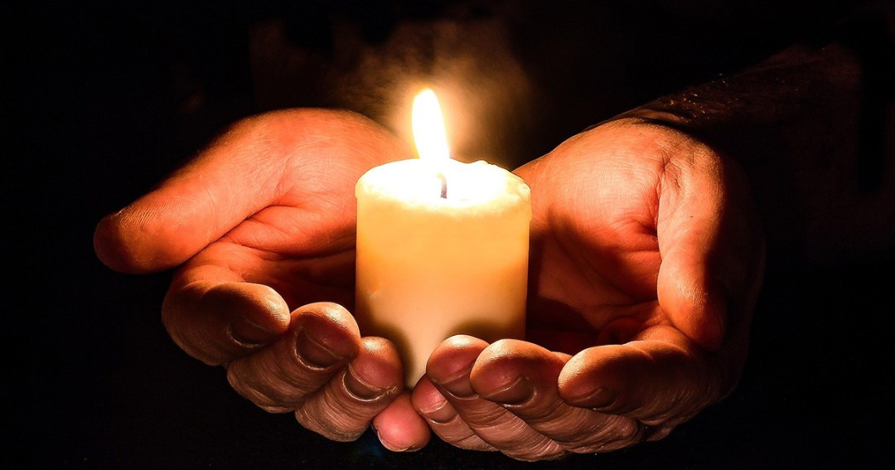
The Fruit of Unity
As believers, God intends for us to participate in his divine unity as we relate to him and to each other.

Slide 14
John 17:20-23 - Context
¹ “After Jesus said this, he looked to heaven and prayed…”
1-5 Jesus prays for himself
6-19 Jesus prays for his disciples
20-26 Jesus prays for us!

Slide 15
John 17:20-23
²⁰ “My prayer is not for them alone. I pray also for those who will believe in me through their message, ²¹ that all of them may be one, Father, just as you are in me and I am in you. May they also be in us so that the world may believe that you have sent me. ”

Slide 16
John 17:20-23
²² “I have given them the glory that you gave me, that they may be one as we are one – ²³ I in them and you in me – so that they may be brought to complete unity. Then the world will know that you sent me and have loved them even as you have loved me.”

Slide 17
John 17:20-23
Why was unity such a big deal to Jesus?
²² “I have given them the glory that you gave me, that they may be one as we are one – ²³ I in them and you in me – so that they may be brought to complete unity. Then the world will know that you sent me and have loved them even as you have loved me.”

Slide 18
God – in his essence – is unity
The end result of God’s plan of redemption is complete unity.
“ ⁹ he made known to us the mystery of his will according to his good pleasure, which he purposed in Christ, ¹⁰ to be put into effect when the times reach their fulfillment—to bring unity to all things in heaven and on earth under Christ.”
Ephesians 1:9-10

Slide 19
Unity
Five Characteristics of Unity
Philippians - A Picture of Unity

Slide 20
Characteristics of Unity
Biblical unity is based on truth
Sometimes we are tempted to sacrifice truth in order to find common ground with others.

Slide 21
John 17:20-23
²⁰ “My prayer is not for them alone. I pray also for those who will believe in me through their message, ²¹ that all of them may be one, Father, just as you are in me and I am in you. May they also be in us so that the world may believe that you have sent me. ”
“Sanctify them by the truth; your word is truth. As you sent me into the world, I have sent them into the world.” John 17:17-18

Slide 22
Ephesians 4:13-15
“¹³ …until we all reach unity in the faith … and become mature, attaining to the whole measure of the fullness of Christ. ¹⁴ Then we will no longer be infants, tossed back and forth by the waves, and blown here and there by every wind of teaching and by the cunning and craftiness of people in their deceitful scheming. ¹⁵ Instead, speaking the truth in love, we will grow to become in every respect the mature body of him who is the head, that is, Christ.

Slide 23
Characteristics of Unity
Biblical unity is based on truth
Biblical unity has its foundation in God’s unity
Sometimes we try to achieve unity by focusing primarily on the issue or the people.

Slide 24
John 17:20-23
²⁰ “My prayer is not for them alone. I pray also for those who will believe in me through their message, ²¹ that all of them may be one, Father, just as you are in me and I am in you. May they also be in us so that the world may believe that you have sent me. ”

Slide 25
John 17:20-23
²² “I have given them the glory that you gave me, that they may be one as we are one – ²³ I in them and you in me – so that they may be brought to complete unity. Then the world will know that you sent me and have loved them even as you have loved me.”

Slide 26
Implications of Basing Unity on God’s Unity
We can reach God’s solution rather than just compromising
It enables us to take the first step… “When we were yet sinners, Christ died for us…” Romans 5:8
It can continue even when we sin against each other
It applies to all relationships – not just ones where we are trying to improve unity
It grows deeper as we grow deeper in God

Slide 27
Characteristics of Unity
Biblical unity is based on truth
Biblical unity has its foundation in God’s unity
Biblical unity is supernatural

Slide 28
John 17:20-23
²² “I have given them the glory that you gave me, that they may be one as we are one – ²³ I in them and you in me – so that they may be brought to complete unity. Then the world will know that you sent me and have loved them even as you have loved me.”

Slide 29
Characteristics of Unity
Biblical unity is based on truth
Biblical unity has its foundation in God’s unity
Biblical unity is supernatural
Biblical unity is observable to the world

Slide 30
John 17:20-23
²⁰ “My prayer is not for them alone. I pray also for those who will believe in me through their message, ²¹ that all of them may be one, Father, just as you are in me and I am in you. May they also be in us so that the world may believe that you have sent me. ”

Slide 31
John 17:20-23
²² “I have given them the glory that you gave me, that they may be one as we are one – ²³ I in them and you in me – so that they may be brought to complete unity. Then the world will know that you sent me and have loved them even as you have loved me.”

Slide 32
Unity that is noticeable happens in response to conflicts and disagreements.
It is not the presence of conflict that discredits Christianity…
But when conflict fails to provide resolution, Christianity becomes irrelevant.

Slide 33
Unity that is noticeable to the world happens in situations where conflict is expected.
Male / Female
Politics:
Liberal / Conservative
Palestine / Israel
Ethnicity or Race
Master / Slave (Boss / employee)
Adult / Youth

Slide 34
Characteristics of Unity
Biblical unity is based on truth
Biblical unity has its foundation in God’s unity
Biblical unity is supernatural
Biblical unity is observable to the world
Biblical unity points to the gospel

Slide 35
John 17:20-23
The message of the Gospel is a message of restored relationship between God and man. Our restored human relationships are visible pictures of that!
²² “I have given them the glory that you gave me, that they may be one as we are one – ²³ I in them and you in me – so that they may be brought to complete unity. Then the world will know that you sent me and have loved them even as you have loved me.”

Slide 36
Ephesians 1:9-10
Our conflicts show our brokenness – our need for salvation…
Our unity shows the holistic salvation that God is bringing!
“⁹ he made known to us the mystery of his will according to his good pleasure, which he purposed in Christ, ¹⁰ to be put into effect when the times reach their fulfillment—to bring unity to all things in heaven and on earth under Christ.”

Slide 37
Characteristics of Unity
Biblical unity is based on truth
Biblical unity has its foundation in God’s unity
Biblical unity is supernatural
Biblical unity is observable to the world
Biblical unity points to the gospel

Slide 38
Unity
Five Characteristics of Unity
Philippians - A Picture of Unity

Slide 39
Philippians 1:27, 2:2-4
“ ²⁷ Whatever happens, conduct yourselves in a manner worthy of the gospel of Christ… stand firm in one spirit, contending as one man for the faith of the gospel…”

Slide 40
Philippians 1:27, 2:2-4
“ ² … make my joy complete by being like-minded, having the same love, being one in spirit and purpose. ³ Do nothing out of selfish ambition or vain conceit, but in humility consider others better than yourselves. ⁴ Each of you should look not only to your own interests but also to the interests of others.”

Slide 41
Philippians 1:27, 2:2-4
“ ²⁷ Whatever happens, conduct yourselves in a manner worthy of the gospel of Christ… stand firm in one spirit, contending as one man for the faith of the gospel…”
In the midst of persecution…
Wrestling together as one man…
For a goal that is bigger than any individual…

Slide 42
Philippians 1:27, 2:2-4
“ ² … make my joy complete by being like-minded, having the same love, being one in spirit and purpose. ³ Do nothing out of selfish ambition or vain conceit, but in humility consider others better than yourselves. ⁴ Each of you should look not only to your own interests but also to the interests of others.”
Desiring, pursuing, consumed by same thing
Committed to loving each other sacrificially
As a team, pursuing the same goals

Slide 43
Philippians 1:27, 2:2-4
How do we get there?
The path to unity is through humility!
“ ² … make my joy complete by being like-minded, having the same love, being one in spirit and purpose. ³ Do nothing out of selfish ambition or vain conceit, but in humility consider others better than yourselves. ⁴ Each of you should look not only to your own interests but also to the interests of others.”

Slide 44
Barriers to Unity in Ministry Contexts
Comparing ourselves – culturally, organizationally, personally
Competing with each other – who is the most “successful”; who is the most recognized
Breaking trust – How we talk about each other
Insisting on particular methods and criticizing others

Slide 45
Are we ready to pay the cost?
Do we really want to be all who Jesus wants us to be?
It will cost us all the non-God-given ambitions we have for our lives…
It will call us to die to ourselves in ways we never thought possible…
It will launch us into more joy and intimacy with God and each other than we ever thought possible!

Slide 46
Next Steps to Being all That We Can Be:
Take time this week to be with God:
How am I doing at abiding?
How’s my spiritual appetite?
Am I putting known sin to death?
How are my relationships with other believers?
Are there ways I need to humble myself to promote unity?

Slide 47
Black

Slide 48
NT Preaching link at BibleStudyDownloads.org
Get this presentation for free!
Notes:
NT Preaching (np)

