Slide 1
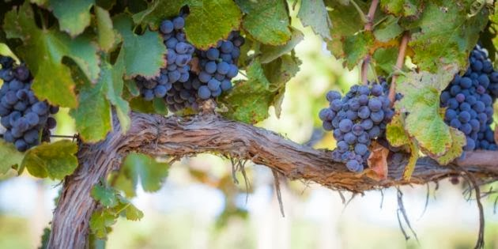
Abiding: The Key to Everything!
John 15:4-8
Preached by Dan Bridges on 23 July 2022 Amman International Church, Jordan (AmmanChurch.org) Uploaded by Dr. Rick Griffith • Jordan Evangelical Theological Seminary Files in many languages for free download at BibleStudyDownloads.org

Slide 2
BE ALL THAT YOU CAN BE!
A Series on
Realizing God’s Purpose for Your Life

Slide 3
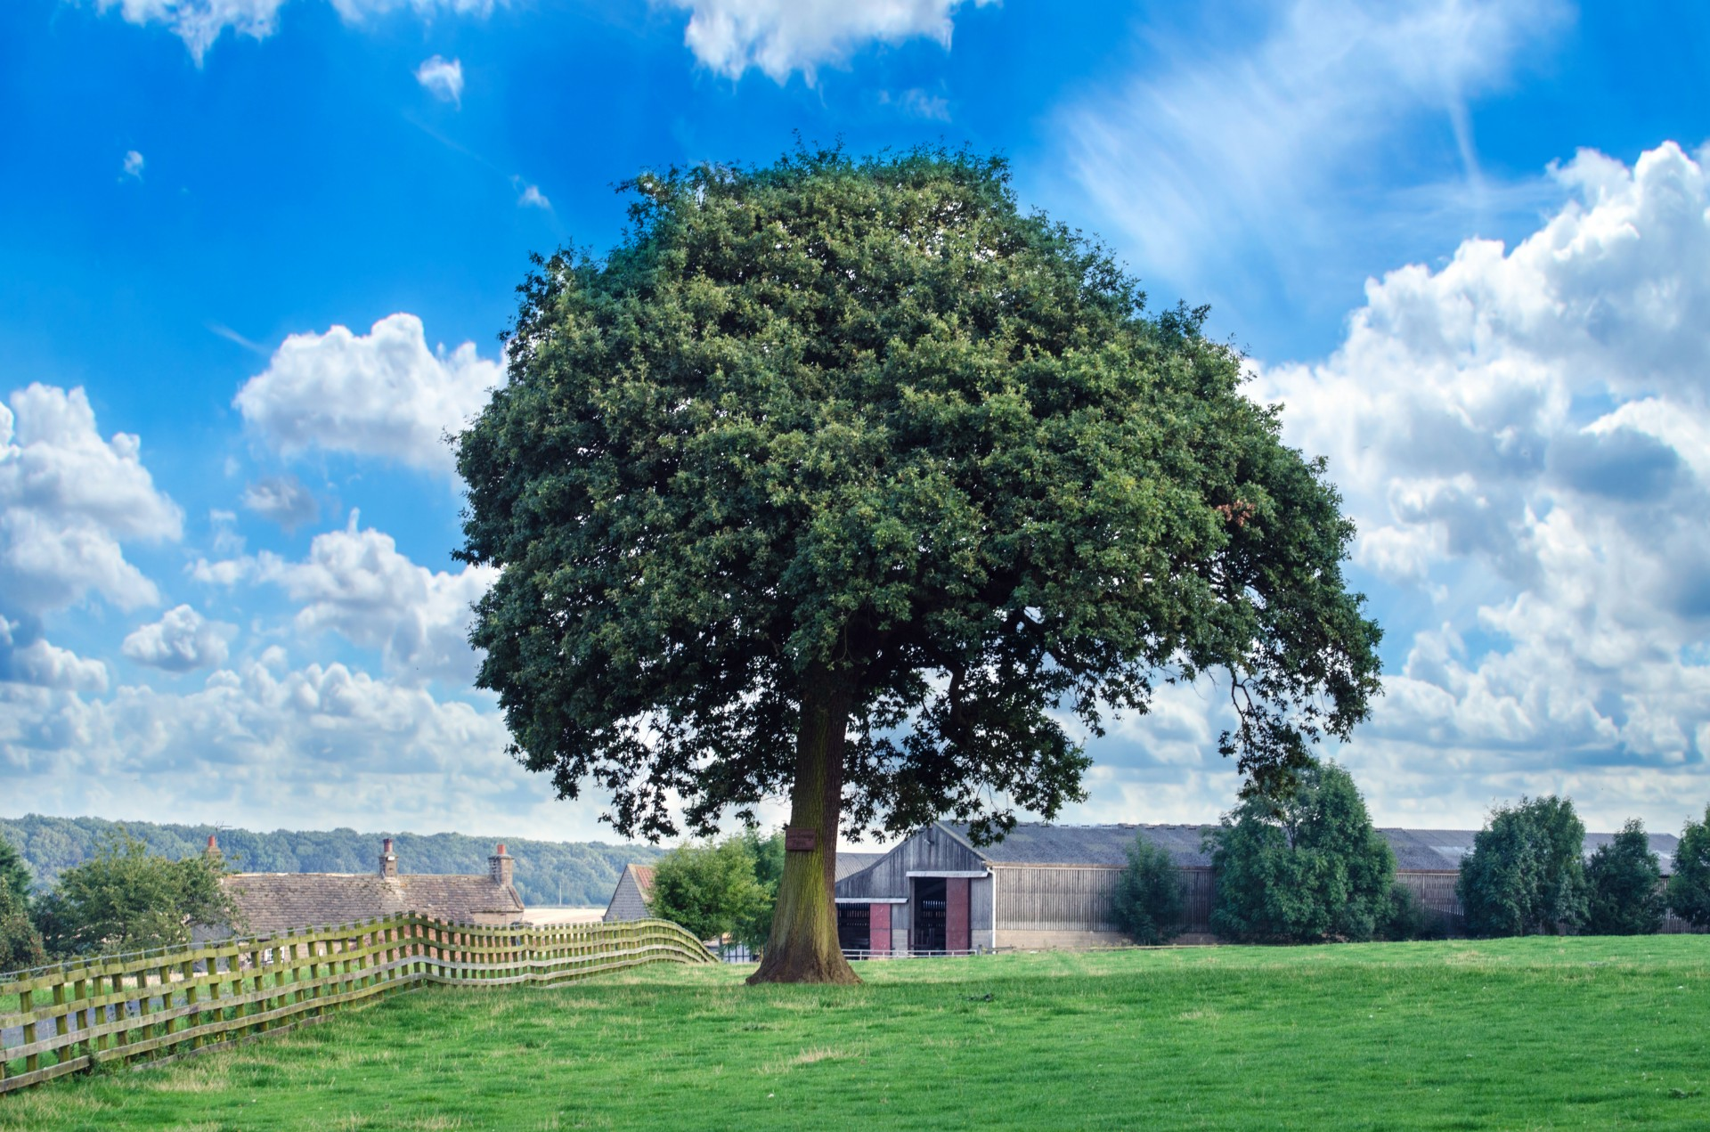
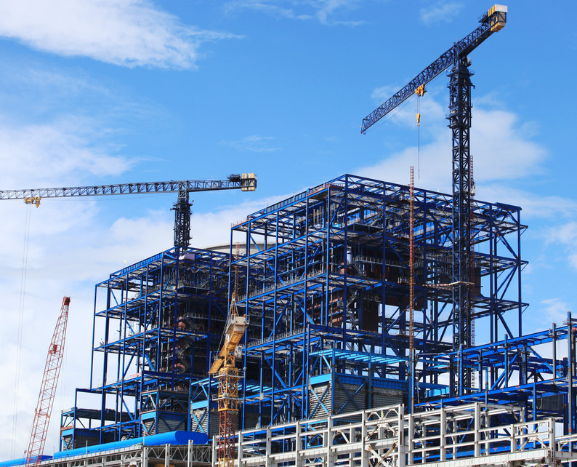
Organic Growth Mechanical Growth
These are both growing… What’s the difference?

Slide 4
Organic Growth Mechanical Growth
True spiritual transformation is not just changing behavior – we become who God wants us to be through the inter-penetration of our lives and God’s life.

Slide 5
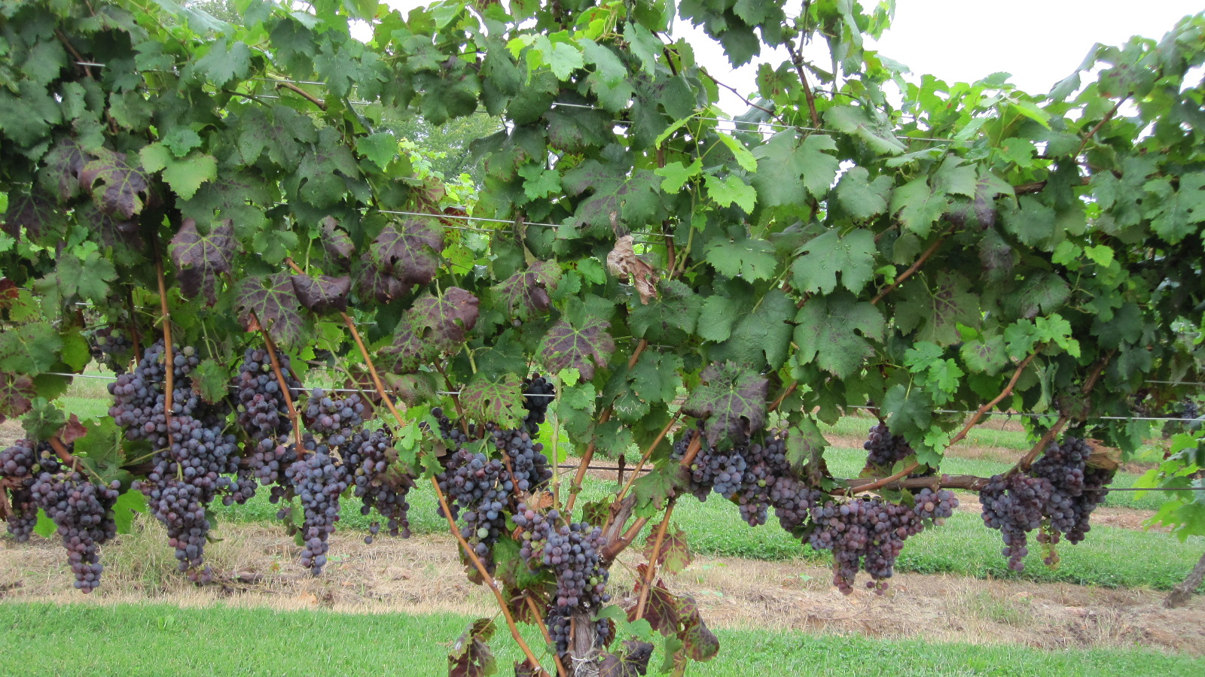
Last Week – John 15:1-3
¹ “I am the true vine, and my Father is the gardener. ² He cuts off every branch in me that bears no fruit, while every branch that does bear fruit he prunes so that it will be even more fruitful. ³ You are already clean because of the word I have spoken to you.”
What is God’s vision for our lives?
What does he do to bring that about?

Slide 6
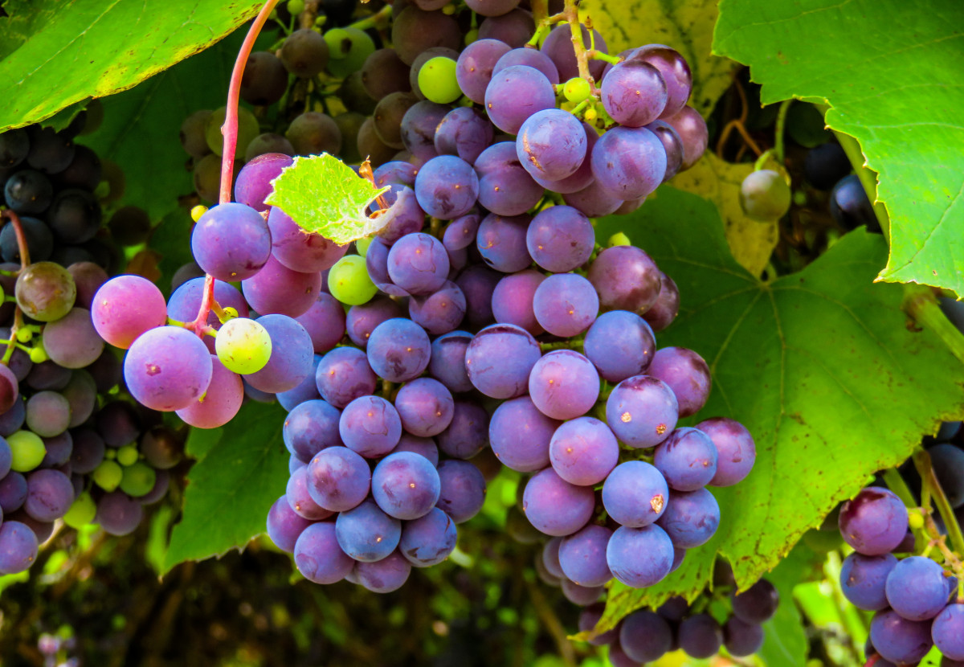
God’s Vision for Our Lives
FRUIT!!!

Slide 7
So what Fruit is God Working to Produce?
The Fruit of John 15:
Christ-like character and spiritual impact on others that are results of an intimate union with Jesus.

Slide 8
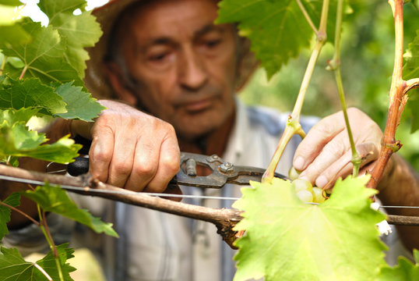
The Father is the Gardener –
He is in Charge of our Growth
God – The master gardener – skillfully and lovingly cares for us – in order that we might bear fruit!

Slide 9
God
God
Me
Me
Which of these pictures most accurately represents your picture of spiritual growth?

Slide 10
The Father is the Gardener –
He is in Charge of our Growth
God’s one goal: To make us completely like himself!
What sins are we willing to live with?
What have we given up on changing?
Are we expectant and ready to be used by God to spiritually impact others around us?

Slide 11
The Father is the Gardener –
He is in Charge of our Growth
To reach this goal, God wants to:
Bring about lasting, internal transformation.
Make us unrecognizable!
Our Response:
Let’s give up on our small ambitions!

Slide 12
Question for this Week:
If God, as the gardener, is in charge of our growth, why do some people grow and produce more fruit than others?
Because he still leaves it up to us to respond!

Slide 13
John 15:4-8
To have a Christ-like character and the ability to impact others spiritually, there is nothing more important than remaining (or abiding) in Jesus!

Slide 14
John 15:1-8
¹ “I am the true vine, and my Father is the gardener. ² He cuts off every branch in me that bears no fruit, while every branch that does bear fruit he prunes so that it will be even more fruitful. ³ You are already clean because of the word I have spoken to you.
⁴ Remain in me, and I will remain in you. No branch can bear fruit by itself; it must remain in the vine. Neither can you bear fruit unless you remain in me.”

Slide 15
John 15:1-8
⁵ “I am the vine; you are the branches. If a man remains in me and I in him, he will bear much fruit; apart from me you can do nothing. ⁶ If anyone does not remain in me, he is are like a branch that is thrown away and withers; such branches are picked up, thrown into the fire and burned. ⁷ If you remain in me and my words remain in you, ask whatever you wish, and it will be given you. ⁸ This is to my Father’s glory, that you bear much fruit, showing yourselves to be my disciples.”

Slide 16
6 Truths about Remaining in Christ…
⁴ “Remain in me, and I will remain in you. No branch can bear fruit by itself; it must remain in the vine. Neither can you bear fruit unless you remain in me.”
It’s the only path to Christ-likeness and spiritual impact on others.
“You” here is plural – not singular. Remaining is not just individual – it also happens in community.

Slide 17
6 Truths about Remaining in Christ…
⁵ “I am the vine; you are the branches. If a man remains in me and I in him, he will bear much fruit; apart from me you can do nothing.”
It will produce Christ-likeness and enable us to spiritually impact others.

Slide 18
6 Truths about Remaining in Christ…
⁶ “If anyone does not remain in me, he is like a branch that is thrown away and withers; such branches are picked up, thrown into the fire and burned.”
We are useless to God without it.

Slide 19
6 Truths about Remaining in Christ…
⁷ “If you remain in me and my words remain in you, ask whatever you wish, and it will be given you.”
It enables us to partner with God.

Slide 20
6 Truths about Remaining in Christ…
⁸ “This is to my Father’s glory, that you bear much fruit, showing yourselves to be my disciples.”
It glorifies God.

Slide 21
6 Truths about Remaining in Christ…
It’s the only path to Christ-likeness and spiritual impact on others
It’s both individual and communal
It will produce Christ-likeness and enable us to spiritually impact others.
We are useless to God without it.
It enables us to partner with God.
It glorifies God.

Slide 22
But What does it Mean to “Remain” in Christ?
Gk meno Definition: to remain in or with someone; to be and remain united with him, one with him in heart, mind
To stay mentally and spiritually with God through the day
To stay united with God in heart and mind

Slide 23
But What does it Mean to “Remain” in Christ?
Meno
“Whoever keeps his commandments abides in God, and God in him.” 1 John 3:24
“…God is love, and whoever abides in love abides in God, and God abides in him.” 1 John 4:16
Meno
Meno
Meno
Consistent obedience to Christ
Consistent love for Christ

Slide 24
But What does it Mean to “Remain” in Christ?
“As the Father has loved me, so have I loved you. Now remain in my love. If you obey my commands, you will remain in my love, just as I have obeyed my Father’s commands and remain in his love.”
John 15:9-10
Consistent obedience to Christ
Consistent love for Christ

Slide 25
To Summarize, to Remain in Christ is to…
Stay in his presence through my day – involving him in every situation
Love him
Obey him

Slide 26
How do I know if I’m remaining in Christ?
Do I have more input from God than the world?
Am I reading and meditating on Scripture – asking God to help me see how I can obey?
Am I obeying what he shows me?
Am I cultivating staying in his presence through my day – involving him in every situation?
Am I doing this in community?

Slide 27
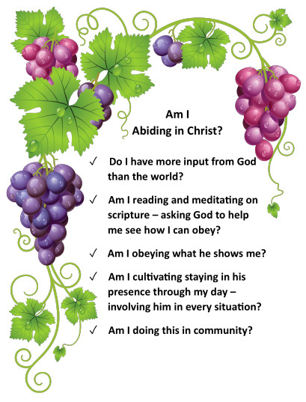
Abiding
Checklist!

Slide 28
So if we are remaining in Christ, what are the implications of that in everyday life?

Slide 29
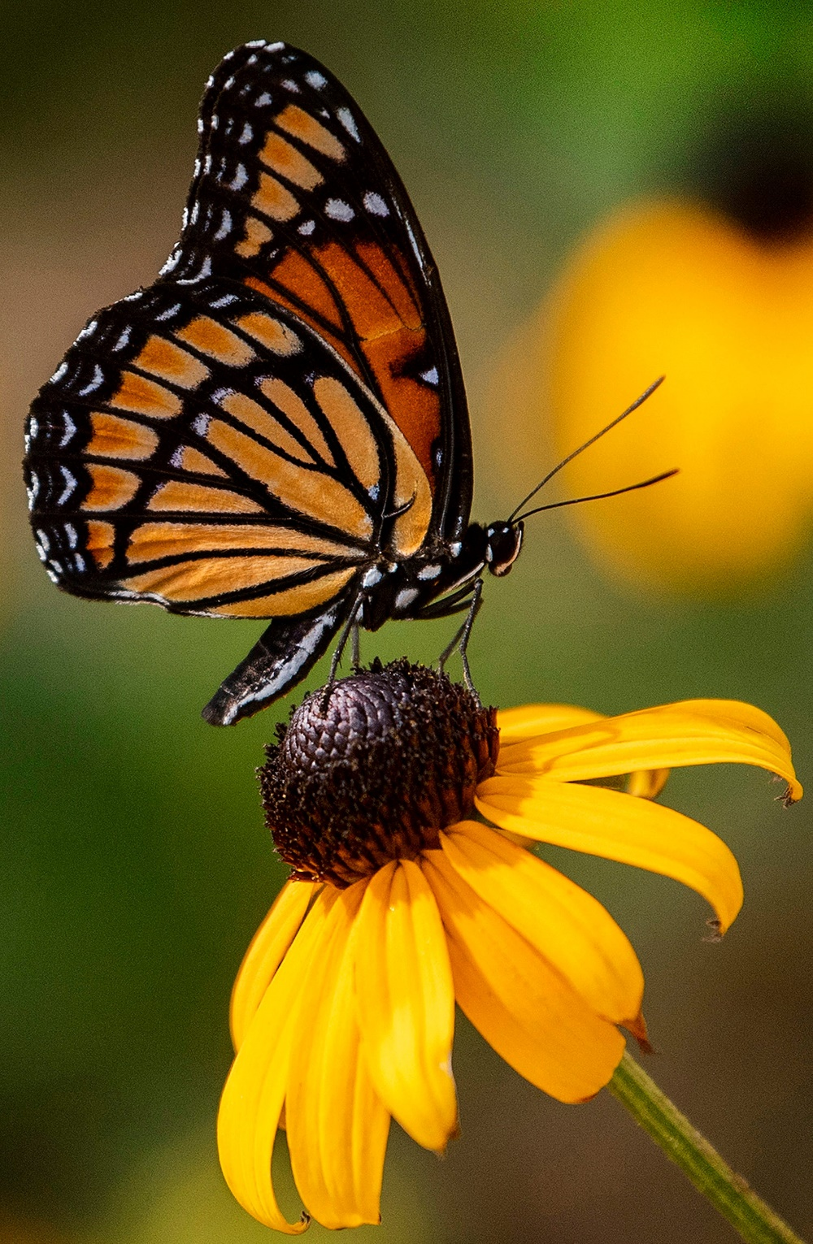
Abiding is the only path to Christ-likeness…
What sorts of things might need to change?
Anger
Controlling
Unforgiveness
Weak relationship with God
Gossip / Slander
Addictions

Slide 30
Anger
Controlling
Unforgiveness
Weak relationship with God
Gossip / Slander
Addictions
Mechanical Growth: How and why might people try to change these things apart from God?

Slide 31
2. How might organic growth look different than mechanical growth in a marriage conflict?

Slide 32
Abiding will produce Christ-likeness and enable us to spiritually impact others.
Have you ever lost hope about changing?

Slide 33
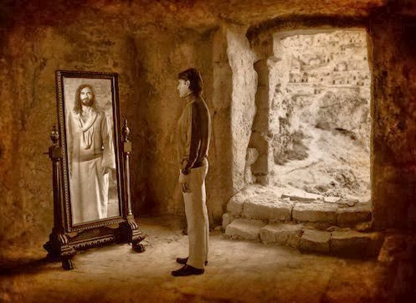
Abiding will produce Christ-likeness and enable us to spiritually impact others.
“… God has chosen to make known among the Gentiles the glorious riches of this mystery, which is Christ in you, the hope of glory.” Colossians 1:27

Slide 34
Abiding will produce Christ-likeness and enable us to spiritually impact others.
In our union with Christ, the very life of the god-head comes in to us. Is that not enough to change us?!

Slide 35
Abiding will produce Christ-likeness and enable us to spiritually impact others.
But it is in our remaining that we “activate” our union with Christ.
God does not force his way in.

Slide 36
Abiding will produce Christ-likeness and enable us to spiritually impact others.
Example: When we “remain”, God can give us joy in him without changing our circumstances.

Slide 37
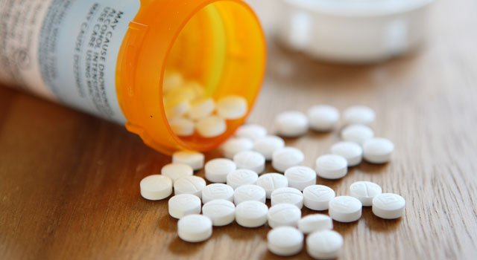
Abiding will produce Christ-likeness and enable us to spiritually impact others.
What about Addictions?

Slide 38
Abiding will produce Christ-likeness and enable us to spiritually impact others.
Why is Alcoholics Anonymous so effective?
Honesty about the problem
Honesty about our inability to change on our own
Daily (even multiple times daily) focus on truth
Power of the community & accountability
Importance of obedience – saying no every time
This is a great picture of what remaining in Christ looks like!

Slide 39
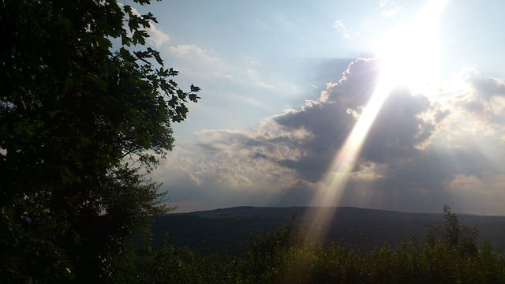
Abiding will produce Christ-likeness and enable us to spiritually impact others.
Example: God can speak to others through us.
A simple bedside prayer
A walk across campus
Follow the Holy Spirit’s prompting!

Slide 40
Main Idea for Today:
Learning to Remain in Christ is the most important factor in realizing God’s vision for our lives!

Slide 41
Your Gardener Has a Vision for Your Life!
God’s one goal: To make us completely like himself!
What sins have we been we willing to live with?
What have we given up on changing?
Are we expectant and ready to be used by God to spiritually impact others around us?
Are you ready to start or renew your pursuit
of God’s vision for your life?

Slide 42
Next Steps:
Tell God you are serious!
With God, identify a single…
Sin you’ve been living with or have given up changing or
Way you feel God wants you to impact others
With this focus, commit to going through the abiding checklist daily

Slide 43
Black

Slide 44
NT Preaching link at BibleStudyDownloads.org
Get this presentation for free!
Notes:
NT Preaching (np)

