Slide 1
The Witness of God’s Omniscient Love
John 13:18-38

Slide 3
Acceptance and Betrayal: The Beginning of the End (John 13:18-30)
Jesus calls His disciples to accept/believe in Him (18-20).
Jesus’ betrayal was predicted in the Old Testament.

Slide 4
Psalm 41:9
Even my close friend, whom I trusted, he who shared my bread, has lifted up his heel against me.

Slide 5
Acceptance and Betrayal: The Beginning of the End (John 13:18-30)
Jesus calls His disciples to accept/believe in Him (18-20).
Jesus knew He would be betrayed to death.
Jesus told His disciples in advance as an additional witness to believe in and accept Him as the Messiah and divine Son of God.

Slide 6
Acceptance and Betrayal: The Beginning of the End (John 13:18-30)
Jesus calls His disciples to accept/believe in Him (18-20).
Accepting Jesus as God’s Son is the same as accepting God the Father’s Lordship.

Slide 7
Acceptance and Betrayal: The Beginning of the End (John 13:18-30)
Although Jesus knows Judas will betray Him, He lovingly gives him the chance to repent (21-30).
No one knew who would betray Jesus.
The act of giving Judas the bread was one of kindness and honor.

Slide 8
Acceptance and Betrayal: The Beginning of the End (John 13:18-30)
Although Jesus knows Judas will betray Him, He lovingly gives him the chance to repent (21-30).
“And it was night.”

Slide 9
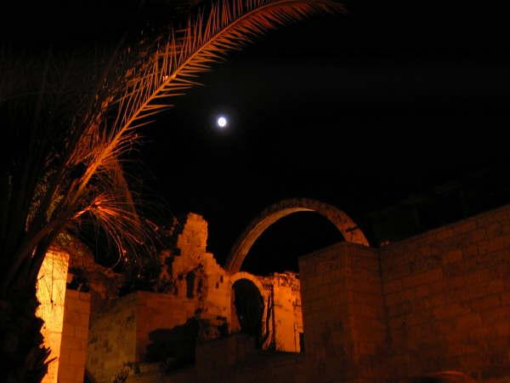

Slide 12
Glorification and Denial: The Witness of Love (John 13:31-38)
Jesus’ betrayal leads to God’s greater glory (31-32).

Slide 13
Glorification and Denial: The Witness of Love (John 13:31-38)
After Jesus’ departure, our love for one another will be our greatest witness that we truly follow Him (33-35).
The command to love is not new, but the way we are to love (like Jesus) certainly is.

Slide 14
John 15:12-13
My command is this: Love each other as I have loved you. Greater love has no one than this, that he lay down his life for his friends.

Slide 15
The Mark of a Christian:
LOVE

Slide 16
Ocean City, New Jersey

Slide 17
The Book Cafe

Slide 18
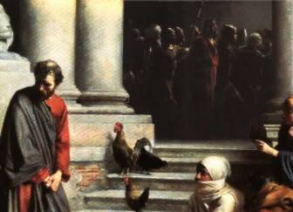
Glorification and Denial: The Witness of Love (John 13:31-38)
Despite Peter’s promise to love and follow Him to death, Jesus knows that Peter will first deny Him three times (36-38).

Slide 19
Judas’ Betrayal Versus Peter’s Denial
Judas
Peter
For Selfish Gain
Premeditated
Devotion to a Preconceived Idea
Remorse without Repentance
Suicide, the Ultimate Act of Self-centeredness
For Self Preservation
Rashly Emotional
Devotion to Jesus
Remorse Leading to Repentance
Sacrifice, the Ultimate Act of Other-centered Love

Slide 20
Psalm 51:17
The sacrifices of God are a broken spirit; a broken and contrite heart, O God, you will not despise.

Slide 21
Conclusion and Application
Is your heart more like Judas’ or more like Peter’s?
God can redeem and use anyone!
But you must surrender to Christ’s love, repent of your sin, and turn to Him in faith.

