Slide 1


Happy New Year!
Dr. Rick Griffith • Crossroads International Church Singapore
CICFamily.com & BibleStudyDownloads.org

Slide 2
CIC Priorities

Slide 3

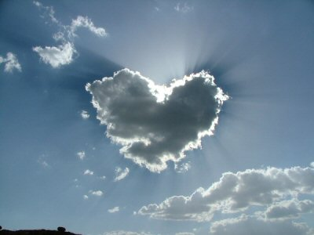


Our Vision is to…
Bible Reading
(Jeff)
Origins: Genesis (Alan)
Love God
Jesus: John (Rick)
Word
Prayer
(Jaz)
Love the Church
Love the Nations
Evangelism & Missions
(Nicole & Ming)
Home Groups
(Enriko)
Notes:
• Love God
Where it starts—and ends—is in our call to LOVE. As Paul noted, “The greatest of these is love” (1 Cor. 13:13).
What is the most important thing we do as a church? It begins with loving the God who loves us.
• Love Church
Do you genuinely love him? If you don’t, then nothing else you do counts, really.
The second thing He said right after this: to love your neighbor as yourself.
• Love Nations
But who is your neighbor? It starts right here in the body—to love the church—but then it extends from this “close neighbor” to those who are out of the reach of this fellowship where we love the nations. Our leadership is committed to make all that we do revolve around one of these three priorities.
3

Slide 4


Attacks Against Scripture
Since the early church false teaching has tried to undermine our faith
Presentation_ID
4
4
© 2003 Cisco Systems, Inc. All rights reserved.
4
Notes:
Yet still the deity of Christ has always been attacked but the unbelieving world.

Slide 5
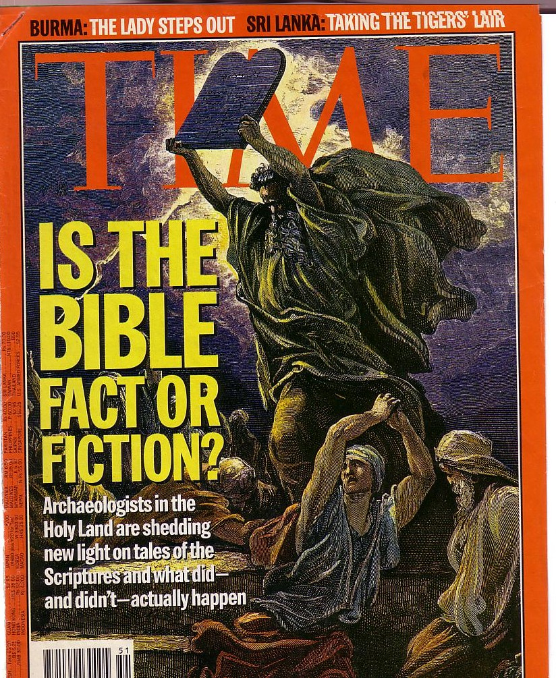
Attacks Continue
The Bible is continually attacked
However, discoveries continue to verify its accuracy
Notes:
The non-Christian world has always attacked Christianity, so today’s attacks should be expected.

Slide 6

Answer the Critics
But in your hearts set apart Christ as Lord. Always be prepared to give an answer to everyone who asks you to give the reason for the hope that you have. But do this with gentleness and respect.
1 Peter 3:15
Notes:
Peter tells us the foundation on which to respond (Christ’s Lordship of our lives), the “what” to do (answer based on hope), and the “how” to do this (gently and respectfully). This is our desire as we respond to The Da Vinci Code.

Slide 7


A New Heresy
Notes:
You’ll see in a minute why I don’t hesitate to call this a heresy…

Slide 8

The New Testament Literary Context
Primary Sources to Understand the
First Century

Slide 9
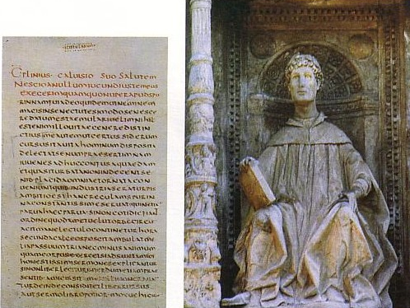
Pliny the Younger (AD 111-113)
Wrote letters to the Emperor Trajan
Said Christians gathered on a certain day (Sunday?) “to sing responsively a hymn to Christ as if to a god” (Epistle 10.96)—the earliest Latin reference to Jesus Christ

Slide 10
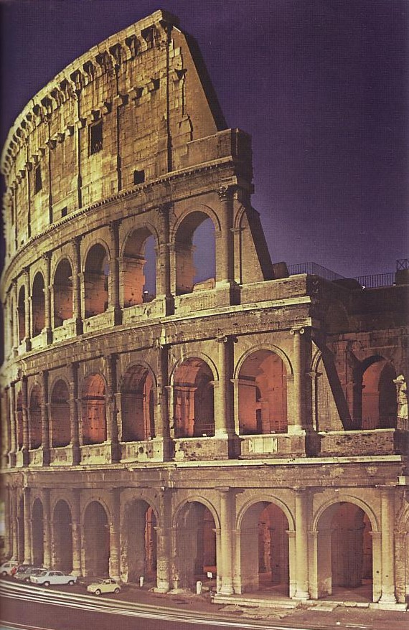
Roman Historians
(year of death)
Cicero (43 BC)
Livy (AD 17)
Pliny the Younger (AD 113)
Tacitus (AD 120)
About persecuted Christians under Nero:
“Their name comes from Christus, who, in the reign of Tiberius as emperor was condemned to death by the procurator Pontius Pilate”
(Tacitus, Annals 15.44 in AD 115)

Slide 11
Roman Historians
(year of death)
Cicero (43 BC)
Livy (AD 17)
Pliny the Younger (AD 113)
Tacitus (AD 120)
Suetonius (AD 121)
Claudius expulsed Jews from Rome “who had been continually stirring up trouble under the influence of Chrestus” (oops!)
(Suetonius, Lives of the Caesars, ch. 25,
in AD 120; cf. Acts 18:2)

Slide 12
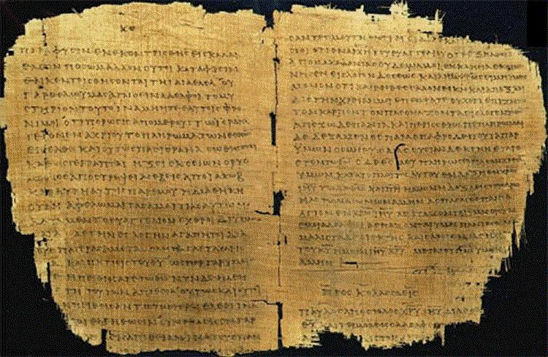
Other Unbelieving Early Historians Mention Jesus too…
Lucian
Mara bar Serapion

Slide 13

Extant Copies of Pagan vs. NT Writings
Author | When Written | Earliest Copy | Time Span | Number of Copies
Plato | 347 BC | AD 900 | 1200 yrs | 7
Catullus | 54 BC | AD 1550 | 1600 yrs | 3
Pliny | AD 113 | AD 850 | 750 yrs | 7
Paul, Luke, etc. | AD 95 | AD 200 | 100 yrs | 24,772

Slide 14
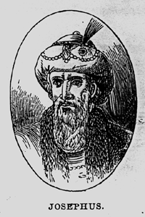
Significance of Josephus
Uninspired Jewish Writings
Earliest non-Christian witness to the historicity of Jesus Christ
(AD 93-94)

Slide 15
Short quote by Josephus
Uninspired Jewish Writings
“Convening the judges of the Sanhedrin, he [Ananus, son of Annas] brought before them a man named James, the brother of Jesus who was called the Christ, and certain others. He accused them of having transgressed the law, and condemned them to be stoned to death”
(Ant. 20.9.1 in Maier, 276; cf. Whiston, 4:140).
Josephus inaccurately refers to James as the brother of Jesus (cf. Acts 12:1-2; AD 44).

Slide 16

Long quote (two versions)
Uninspired Jewish Writings
Jewish | Christian
“At this time there was a wise man called Jesus, and his conduct was good, and he was known to be virtuous. Many people among the Jews and the other nations became his disciples. Pilate condemned him to be crucified and to die. But those who had become his disciples did not abandon his discipleship. They reported that he appeared to them three days after his crucifixion and that he was alive. Accordingly, he was perhaps the Messiah, concerning whom the prophets have reported wonders. And the tribe of the Christians, so named after him, has not disappeared to this day.” | “About this time lived Jesus, a wise man, if indeed one ought to call him a man. For he was the achiever of extraordinary deeds and was a teacher of those who accept the truth gladly. He won over many Jews and many of the Greeks. He was the Messiah. When he was indicted by the principal men among us and Pilate condemned him to be crucified, those who had come to love him originally did not cease to do so; for he appeared to them on the third day restored to life, as the prophets of the Deity had foretold these and countless other marvelous things about him. And the tribe of Christians, so named after him, has not disappeared to this day.”

Slide 17
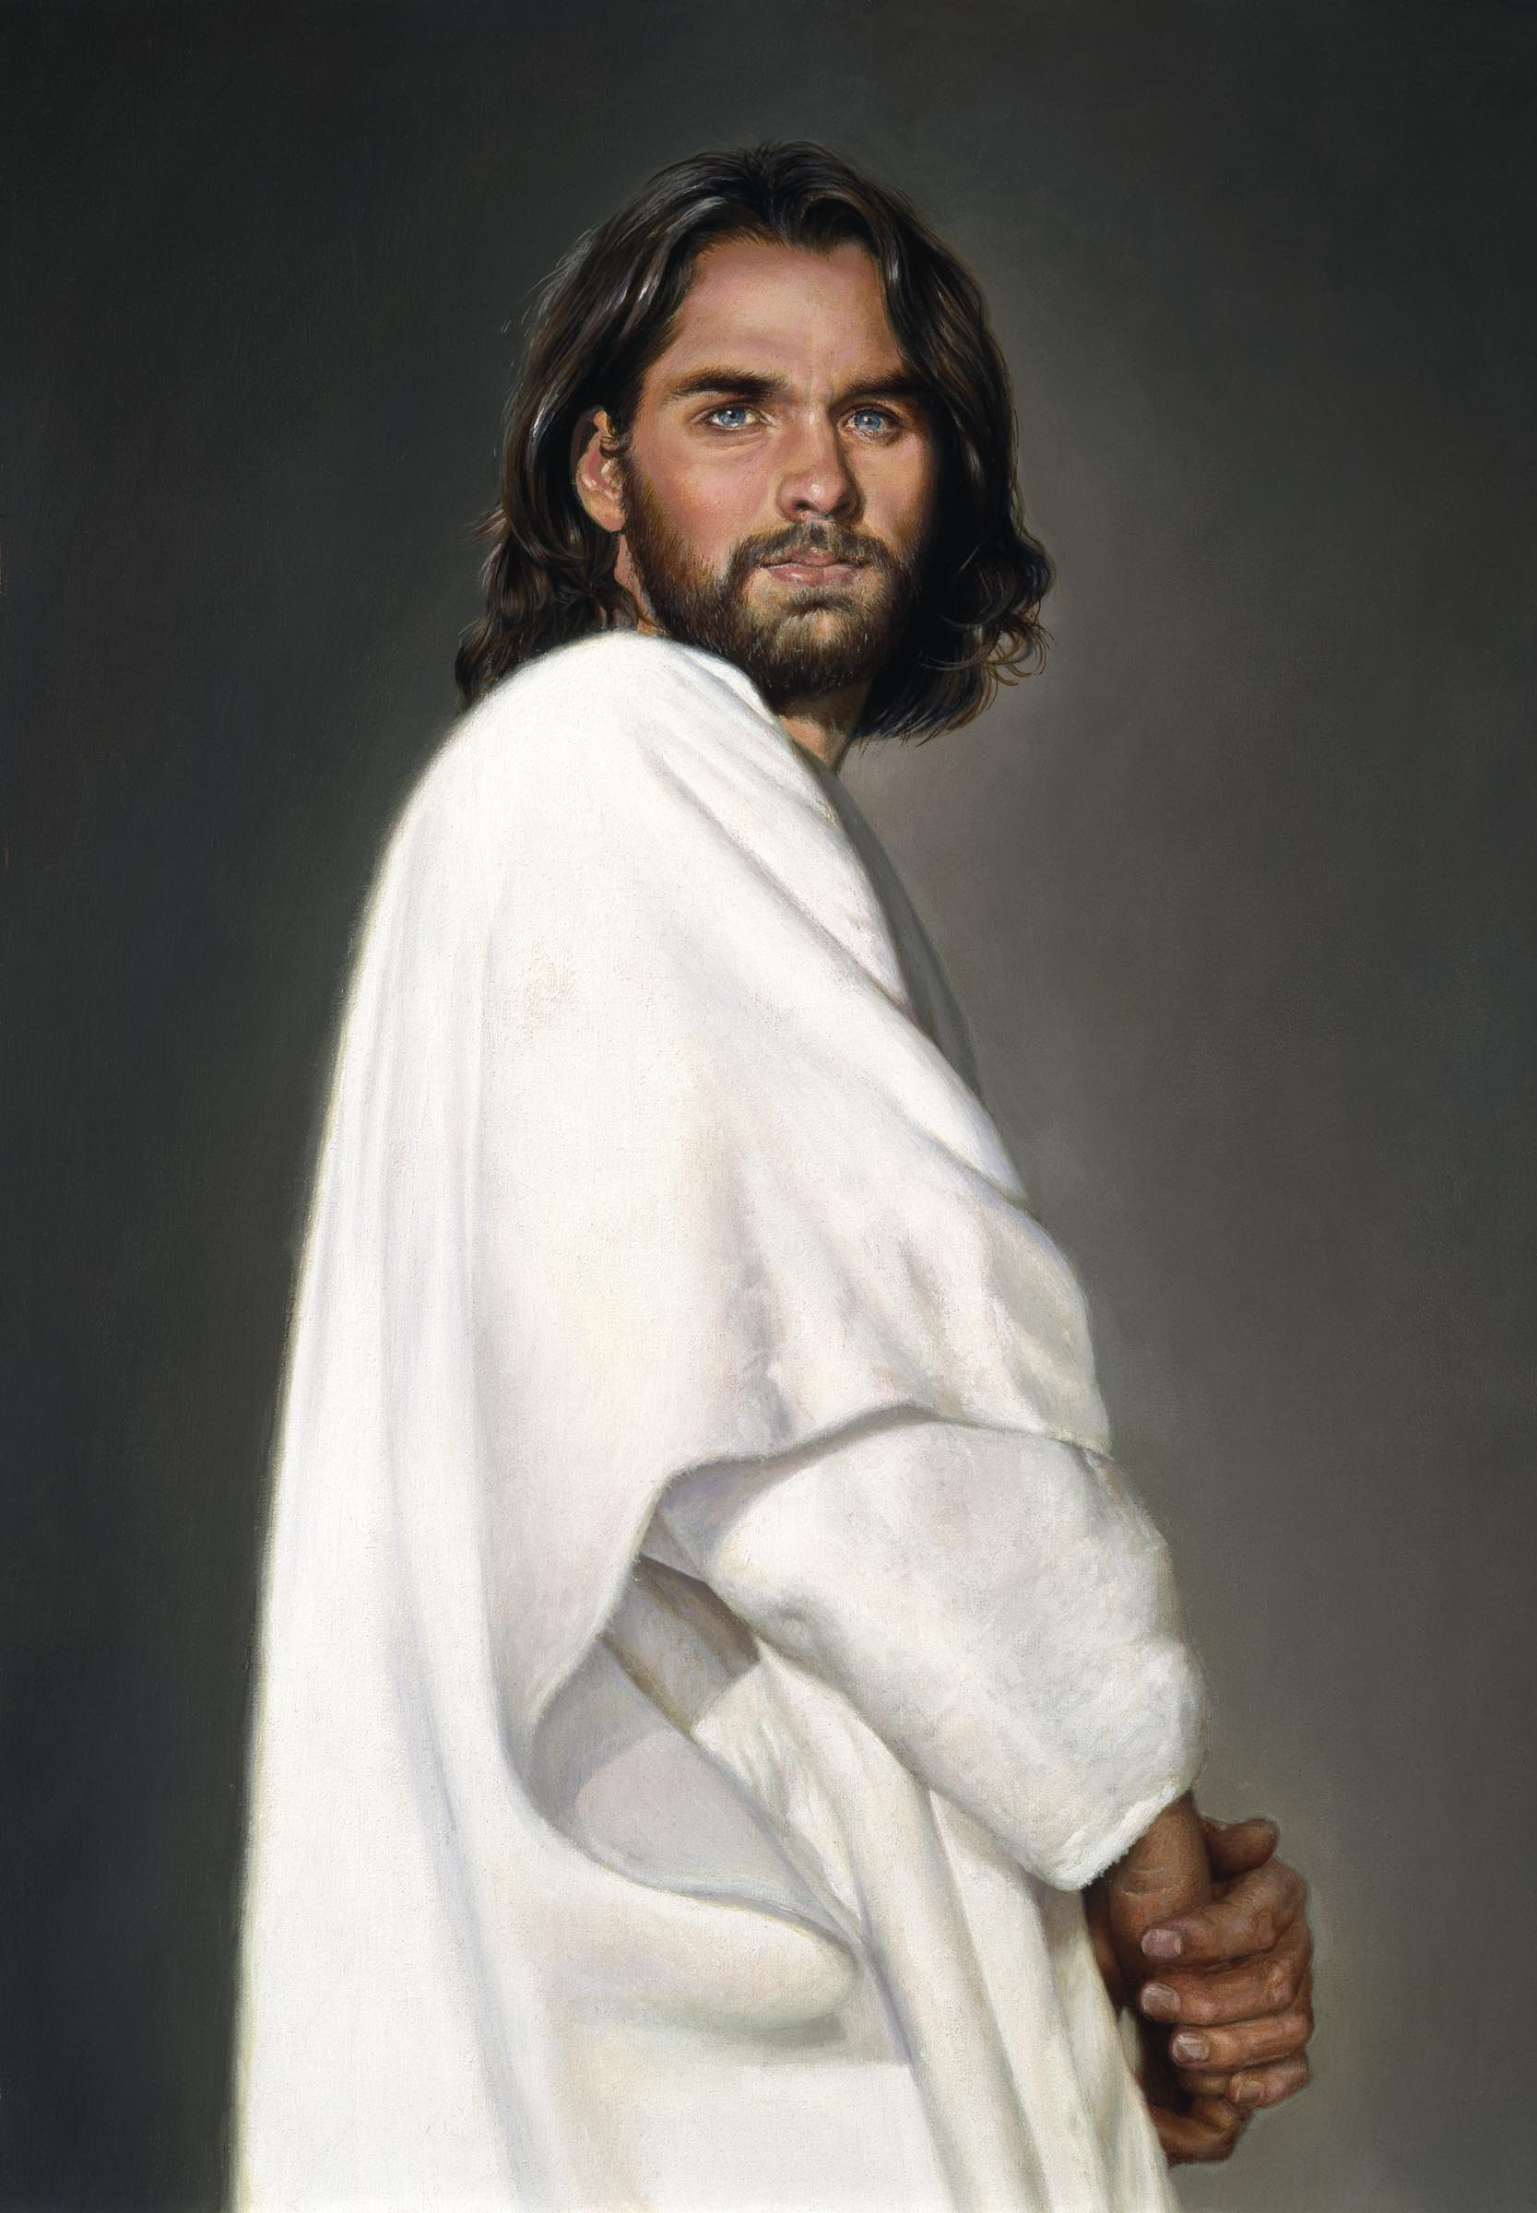
Who is Jesus Christ… really?
Brown:
Bible:
Only human
God-Man
Notes:
Now let’s turn our attention away from historical inaccuracies about the canon to the early view of Jesus himself.

Slide 18
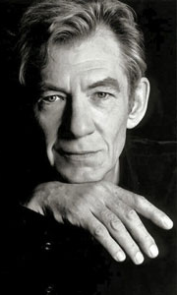
Brown’s view of Jesus through “historian” Leigh Teabing…
"My dear," Teabing declared, "until [AD 325], Jesus was viewed by His followers as a mortal prophet... a great and powerful man, but a man nonetheless. A mortal."
[Sophie:] "Not the Son of God?"
"Right," Teabing said. "Jesus' establishment as 'the Son of God' was officially proposed and voted on by the Council of Nicaea."
DVC, 197

Slide 19
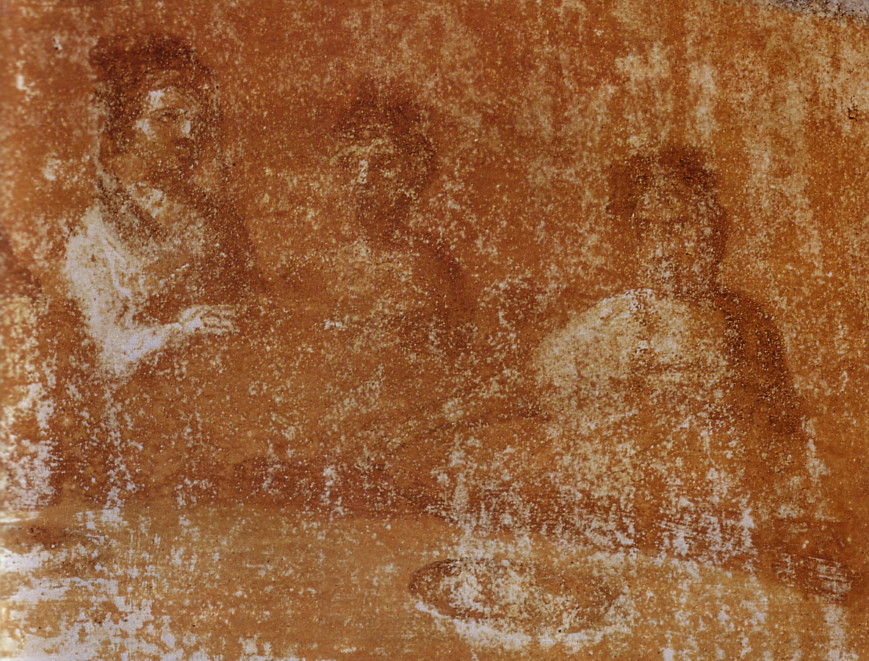
So what did the early Church really believe about Jesus?
Notes:
Here is where Brown rewrites not only the history of what unbelievers thought--he rewrites Christians’ view of Jesus.

Slide 20
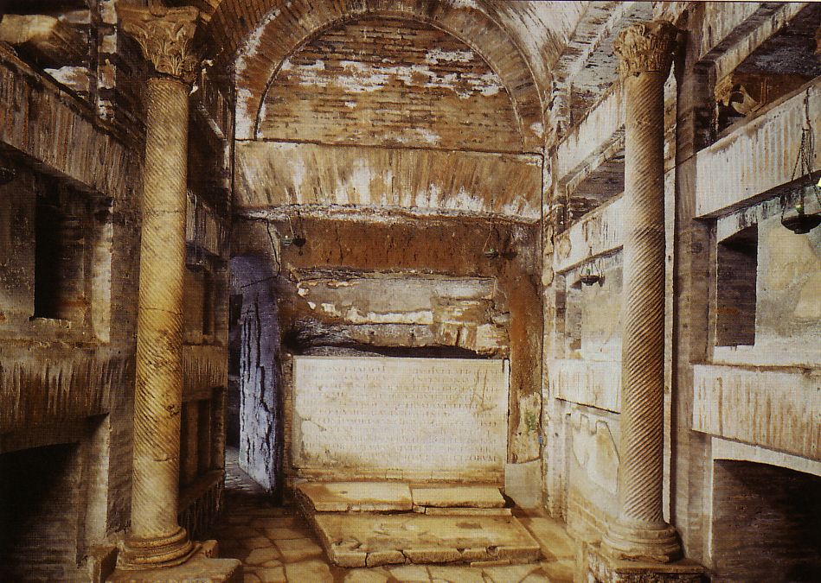
Would Christians who “believed that Jesus was only a man” really need to worship secretly in the catacombs? Nonsense!
Notes:
EVERYONE believed that Jesus was a man.

Slide 21
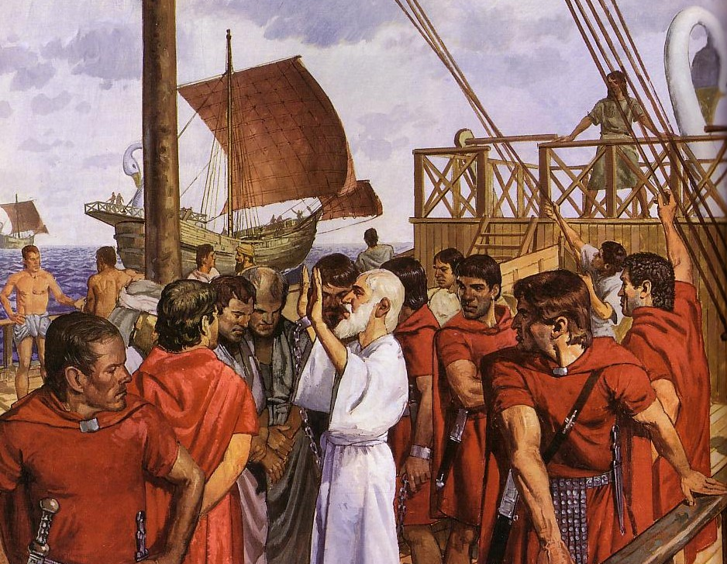
Would Christians who “believed that Jesus was only a man” die as martyrs? Hardly!
Ignatius, Bishop of Antioch, refused emperor worship and was brought to Rome to be fed to wild beasts.
Notes:
The Romans would have had no problem with Christians who only believed Jesus was a man. Their disagreement came with the Christian belief that Jesus was GOD.

Slide 22
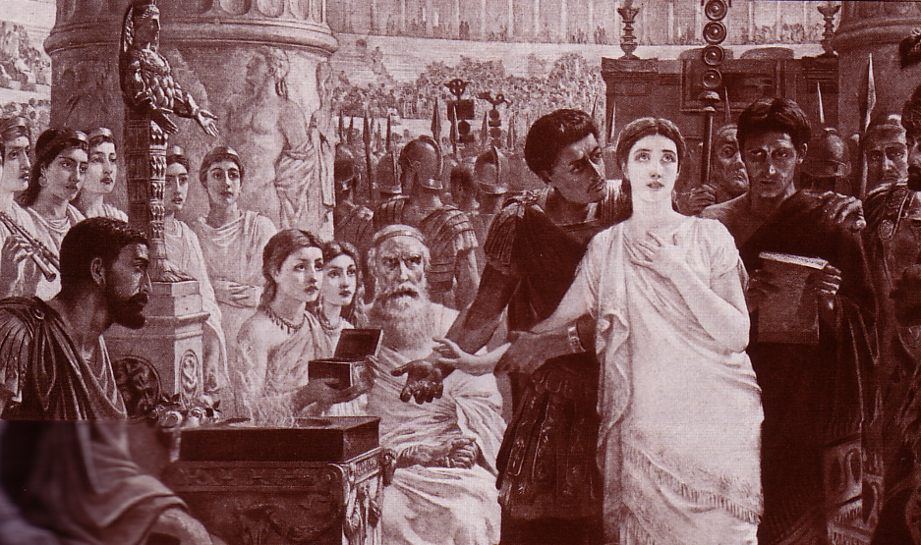
Perpetua’s Martyrdom (AD 203)
Notes:
Even women paid the ultimate price.

Slide 23

Irenaeus (AD 180)
“It is not possible that the Gospels can be either more or fewer in number than they are. For, since there are four zones of the world… and four principal winds… it is fitting that [the Church] should have four pillars….” (then he lists Matthew, Mark, Luke & John)
Against Heresies 3.11.8
Notes:
http://www.ccel.org/fathers2/ANF-01/anf01-60.htm#P7477_2003920

Slide 24
Irenaeus (AD 180)
“Matthew also issued a written Gospel among the Hebrews in their own dialect, while Peter and Paul were preaching at Rome, and laying the foundations of the Church. After their departure, Mark, the disciple and interpreter of Peter, did also hand down to us in writing what had been preached by Peter. Luke also, the companion of Paul, recorded in a book the Gospel preached by him. Afterwards, John, the disciple of the Lord, who also had leaned upon His breast, did himself publish a Gospel during his residence at Ephesus in Asia.”
Against Heresies 3.1
Notes:
http://www.ccel.org/fathers2/ANF-01/anf01-60.htm#P7477_2003920

Slide 25



“A FINISHED PORTRAIT OF THE
LORD JESUS CHRIST”
From “The Bible…Basically” Seminar…
AS SEEN THROUGH FOUR DIFFERENT LENSES
STUDY HELP #21
13
2
Notes:
Using Study Help #21, through this large picture frame…
we’re going to create a graphic representation called
//// A FINISHED PORTRAIT OF THE LORD JESUS CHRIST… but…
//// …we’re going to compose that portrait through four different literary lenses as the completed image develops.

Slide 26
Each Gospel Writer Had:
• His specific audience
• His unique presentation of the person of Jesus Christ
• His foundational purpose for writing his Gospel
• His own date of writing
14
4
Notes:
From each Gospel writer…
//// …we’ll discover the specific audience for his writings…
//// …with his unique presentation of the person of Jesus Christ…
//// …suggesting a foundational purpose communicated through the text of his Gospel…
//// …followed by the scholars’ estimate of the date of each writing.

Slide 27
FOUR INDIVIDUAL PORTRAITS…
1
2
3
4
15
Notes:
Now, please…in your imagination…insert four smaller picture frames into the larger one. In each frame install four lines. As we fill them in we’ll have some specific information about the purpose and function of each of the four Gospels. The individual “sub-frames” are designated 1 through 4.

Slide 28
FRAMING THE GOSPELS…
1
MATTHEW
2
MARK
3
LUKE
4
JOHN
16
3
Notes:
Each of the frames now gets its name... MATTHEW in the first...
//// MARK, second...
//// LUKE, third...and finally, the fourth…
//// JOHN, the names of the Gospels in the order of their appearance in the New Testament canon...the official collection of Biblical writings.

Slide 29
THE AUDIENCES FOR THE GOSPELS…
1
MATTHEW
2
MARK
TO:
JEWS
TO:
ROMANS
3
LUKE
4
JOHN
TO:
GREEKS
TO:
CHURCH
17
4
Notes:
Now comes an idea endorsed by Biblical scholars around the world…having to do with the audiences TO WHICH each Gospel was written.
For instance…
//// MATTHEW penned his work specifically toward his brothers and sisters in the Jewish audience. He makes repeated references to a regnant Jesus, seeing him as the Messiah and the King of the Chosen People.
//// For MARK, his work is widely regarded as directed toward the Romans, then occupying his native land and into the farther parts of the ancient world. MARK is brief, to the point. And, in fact, repeatedly he uses such term as "straightway" in early translations…all in a get-the-job-done mentality, which characterized the Roman way of thinking and doing things.
//// While LUKE, the physician, is the highly intellectual Greek who accompanied Paul on his tours. For LUKE, his Gospel audience was the Greeks, and in other words, to the Gentile world in general.
Also as the author of The Acts, Luke set down for all time a detailed account of the development of the early church and its wide-spread missionary ministries, to which he was a witness.
//// Finally, we come to the gospel of JOHN, whose audience differs markedly from the first three. John is written directly to UNBELIEVERS, AND REACHING THEM THROUGH THE COMMUNICATION CHANNEL OF THAT NEW ORGANISM, THE CHURCH. In fact, when you read John's gospel, you are struck with the fact that his work carries with it a somewhat mystical quality, certainly not the quick, even terse recounting of facts as we find in Mark’s Gospel. John's audience –– the Church itself, the members of the new Organism, bathed in the redemptive love of Christ –– receives his brilliant articulation of the impact of the coming of the Holy Spirit, now –after the Day of Pentecost -- having taken up permanent residence in the heart of each new believer.
So there are four individual audiences to which the Gospels were specifically directed at the time of their writing. That one insight, alone, gives a new way to categorize and individualize the Gospel writings.

Slide 30
…PORTRAYING JESUS AS…
2
1
2
1
MATTHEW
MARK
TO:
JEWS
TO:
ROMANS
AS:
KING
AS:
SERVANT
4
3
4
3
JOHN
LUKE
JOHN
GREEKS
CHURCH
TO:
TO:
CHURCH
TO:
TO:
AS:
GOD/MAN
AS:
GOD
18
4
Notes:
Another question: How does each Gospel portray The Lord as a Man and as Immanuel, “God With Us?”
//// For MATTHEW...Christ is seen as King of the Jews. Repeatedly Matthew describes how Jesus is the fulfillment of Old Testament Scripture. Matthew makes wide use of Jewish terminology of royalty.
//// For MARK...He is seen as the Servant of all...some say the Suffering Servant, and traditionally associated with an audience in Rome and among the widespread Roman world.
//// LUKE sees Christ as the God-Man -- truly God and truly Man. Luke shows the Gentiles that Christ is the perfect man to which they aspired.
//// Finally, John’s Gospel. Clearly and above all else...JOHN portrays Christ as God Himself. JOHN uses his pen to communicate the mystery and the power of the Messiah. Why? Because John experienced a particular closeness to the Master, one that was apparently unique among the disciples. Remember too that this was this same JOHN who was destined to see and write down the great End-Times vision we know as The Revelation.

Slide 31
THE MESSAGE IN A NUTSHELL…
1
MATTHEW
2
MARK
TO:
JEWS
TO:
ROMANS
AS:
KING
AS:
SERVANT
WHAT
HE:
WHAT
HE:
SAID
DID
3
LUKE
4
JOHN
TO:
GREEKS
TO:
CHURCH
AS:
GOD/MAN
AS:
GOD
WHAT
HE:
WHAT
HE:
FELT
MEANT
19
5
Notes:
Here is a last set of interesting ideas, with thanks to some anonymous believer who developed them years ago.
//// Call it “the message in a nutshell.” Question: what is the one single word that might characterize the message of each Gospel?
//// For MATTHEW...that book tells us what Jesus Christ SAID.
//// MARK tells us what He DID.
//// LUKE shows us clearly what the Messiah FELT.
//// And JOHN, with enormous clarity, tells us what Christ MEANT!
What he SAID...what He DID...what He FELT...and what He MEANT!
These single-word ideas help us to tightly focus on the remarkable differences that exist among the Gospel writings. For many Bible readers, such distinctives are unfamiliar territory.

Slide 32
THAT STRANGE SOUNDING WORD…
SYNOPTIC:
1
MATTHEW
2
MARK
TO:
JEWS
TO:
ROMANS
AS:
KING
AS:
SERVANT
WHAT
HE:
SAID
WHAT
HE:
DID
SYNOPTIC:
“TO SEE TOGETHER”
“TO
SEE TOGETHER”
3
LUKE
TO:
GREEKS
AS:
GOD/MAN
WHAT
HE:
FELT
20
3
Notes:
Now comes that word that’s a strange one to many...
//// SYNOPTIC…meaning…
//// … “TO SEE TOGETHER”…add these words to that triangle shape on your study help.
//// It is a term from Greek roots that means seeing a group of things together... from the same general perspective. One word that, again, helps organize and categorize the enormous factual base that makes up our Bible.

Slide 33
THE SYNOPTICS: “TO SEE TOGETHER”
1
MATTHEW
2
MARK
TO:
JEWS
TO:
ROMANS
AS:
KING
AS:
SERVANT
WHAT
HE:
SAID
WHAT
HE:
DID
∑
3
LUKE
4
JOHN
TO:
GREEKS
CHURCH
TO:
AS:
GOD/MAN
AS:
GOD
WHAT
HE:
FELT
WHAT
HE:
MEANT
21
1
Notes:
Follow the arrows as they link together the gospels of MATTHEW, MARK and LUKE. Again…you’ll notice that JOHN is not among them. Those three are the so-called SYNOPTIC Gospels...THEY ARE SEEN TOGETHER...in that these works take on that ground-level view of the human history of Jesus Christ just as he walked about Palestine in the days of his ministry. The Man…and his Mission among his People.
//// On the other hand…the Gospel of John –– seen here with the familiar mathematical SUMMA sign –– represents the summation of all that Jesus Christ MEANT –– the sum of all that he preached and demonstrated –– both publicly and privately. Seeing the Lord clearly as God Himself, John raises our spiritual horizon in ways that the first three gospels do not.

Slide 34
UNIQUE MATERIAL…
52
1
MATTHEW
2
MARK
7% unique!
Baptism
Lord’s Supper
Birth
Genealogy
5000 fed
Passion
3
LUKE
4
JOHN
92% unique!
16
Notes:
Each of the Gospels say things that the others don’t...
//// MATTHEW was believed by the early church to have written first...
//// MARK shares a lot of material with Matthew, such as Christ’s baptism and supper...
//// LUKE also has much overlap with Matthew and Mark, such as Christ’s baptism and supper—but only Matthew and Luke record Christ’s birth and genealogy. However, the fourth…
//// JOHN, stands alone in terms of its material. Only 8% of it repeats stories from the others—such as the feeding of the 5000, and, of course, His death and resurrection.
//// But the remaining 92% of JOHN you will find only in JOHN.

Slide 35
JOHN: SUMMING UP THE MESSAGE
1
MATTHEW
2
MARK
TO:
JEWS
TO:
ROMANS
AS:
KING
AS:
SERVANT
WHAT
HE:
SAID
∑
WHAT
HE:
DID
3
LUKE
4
JOHN
TO:
GREEKS
TO:
CHURCH
AS:
GOD/MAN
AS:
GOD
WHAT
HE:
FELT
WHAT
HE:
MEANT
22
Notes:
So, in summation, then…John wrote to UNBELIEVERS THROUGH THAT NEW ORGANISM, THE CHURCH, envisioning Christ as God Himself…
But what did John SAY that Jesus meant in his preaching?

Slide 36
6 GREAT TRUTHS
STUDY HELP #22
JOHN: SUMMING UP THE MESSAGE
CHAPTER 1: 6 GREAT TRUTHS OF
JESUS CHRIST!
VERSE 1: The Pre-existent One
A Distinct Person
He Was and IS God
“In the beginning was the Word, and the Word was with God, and the Word was God.”
23
3
Notes:
John’s first chapter sums up his message about Christ. Follow along with Study Help #22. John 1:1-9 has:
//// SIX GREAT TRUTHS of Jesus Christ. John lists them.
//// Verse One: He is portrayed as the Pre-existent One, a Distinct Person, but Who WAS and IS God.
//// Verse One reads: “In the beginning was the Word, and the Word was with God, and the Word was God.”

Slide 37
John 1:2
JOHN: SUMMING UP THE MESSAGE
CHAPTER 1: 6 GREAT TRUTHS OF
JESUS CHRIST!
VERSE 1:
The Pre-existent One
A Distinct Person
He Was and IS God
VERSE 2:
Eternally Co-existent
“He was with God in the beginning.”
24
1
Notes:
Verse 2: He is Eternally co-existent in that…
//// “He was with God in the Beginning.”

Slide 38
John 1:3
JOHN: SUMMING UP THE MESSAGE
CHAPTER 1: 6 GREAT TRUTHS OF
JESUS CHRIST!
VERSE 1:
The Pre-existent One
A Distinct Person
He Was and IS God
VERSE 2:
Eternally Co-existent
“Through him all things were made; without him nothing was made that has been made.”
VERSE 3:
Creator of the Universe
25
1
Notes:
Verse 3: He is the Creator of the Universe…
//// “Through him all things were made; without him nothing was made that has been made.”

Slide 39
John 1:4, 5, 9
JOHN: SUMMING UP THE MESSAGE
CHAPTER 1: 6 GREAT TRUTHS OF
JESUS CHRIST!
VERSE 1:
The Pre-existent One
A Distinct Person
He Was and IS God
VERSE 2:
Eternally Co-existent
“In him was life, and that life was the light of men. The light shines in the darkness, but the darkness has not understood it….The true light that gives light to every man was coming into the world.”
VERSE 3:
Creator of the Universe
VERSES 4, 5, 9:
Source of all Light and Life
26
1
Notes:
And finally…verses 4, 5, and 9…the Source of all Light and Life…
//// “In him was life, and that life was the light of men. The light shines in the darkness, but the darkness has not understood it…The true light that gives light to every man was coming into the world.”
THIS IS BASIC CHRISTIAN THEOLOGY. IT ALL STARTS HERE!

Slide 40
…AND THE DATES OF WRITING?
1
MATTHEW
2
MARK
TO:
JEWS
TO:
ROMANS
The A.D.40s
A.D. 64-68
AS:
KING
AS:
SERVANT
WHAT
HE:
WHAT
HE:
SAID
DID
3
LUKE
4
JOHN
GREEKS
CHURCH
A.D. 57-59
A.D. 69 AFTER THE SYNOPTICS
TO:
TO:
AS:
GOD/MAN
AS:
GOD
WHAT
HE:
WHAT
HE:
FELT
MEANT
27
4
Notes:
Now…what about the dates of the writing of these crucial documents? And here we are left to our best scholarly guesses. There will ALWAYS be argument here. But some of the best guesses, based on decades of academic research and study are these – in suggested order…
//// MATTHEW…composed sometime during the A.D. 40s…
//// LUKE is suggested as next, between the years A.D. 57 and 59 A.D…
//// Mark…in the next decade…between 64 and 68…
//// and finally…John’s Gospel…around A.D. 69….but certainly after the Synoptics were set down. Again, you will always find disagreement on these dates. However, these dates are from the research of well-known Christian scholars and teachers.

Slide 41
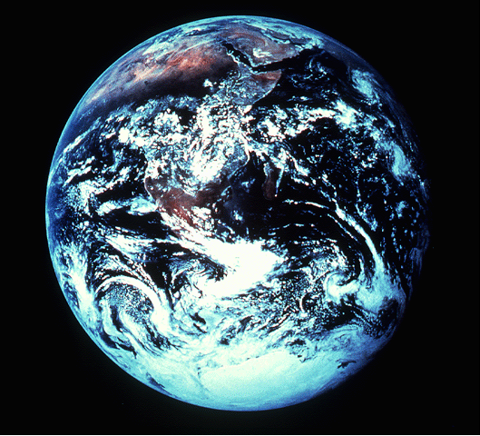
NOW…TO COMPLETE THE PORTRAIT…
Revelation 1:12-18 (NIV)
¹²I turned around to see the voice that was speaking to me. And when I turned I saw seven golden lamp stands,
THE REVELATION OF JESUS CHRIST
TO
JOHN THE APOSTLE
MATTHEW
MARK
¹³and among the lamp stands was someone "like a son of man,” dressed in a robe reaching down to his feet and with a golden sash around his chest.
¹⁴His head and hair were white like wool, as white as snow, and his eyes were like blazing fire.
¹⁵His feet were like bronze glowing in a furnace, and his voice was like the sound of rushing waters.
¹⁶In his right hand he held seven stars, and out of his mouth came a sharp double-edged sword. His face was like the sun shining in all its brilliance.
¹⁷When I saw him, I fell at his feet as though dead. Then he placed his right hand on me and said: "Do not be afraid. I am the First and the Last.
LUKE
JOHN
¹⁸I am the Living One; I was dead, and behold I am alive for ever and ever! And I hold the keys of death and Hades.”
28
9
Notes:
Now…to complete the portraits given to us by
MATTHEW…MARK…LUKE…and JOHN.
//// For this, we need to get out into space and look at this unfortunate planet. Man has made a mess of it, you will probably agree. This view of earth helps us more clearly understand the final view of Christ given to us in the New Testament.
//// Now travel to the last book of the New Testament…The Revelation of Jesus Christ to John the Apostle. There, we see Jesus Christ in His risen, ascended glory, as he will appear when He returns at the end of History to reclaim all that is His.
//// In his first chapter of The Revelation, John writes this:
I turned around to see the voice that was speaking to me. And when I turned I saw seven golden lamp stands…
//// and among the lamp stands was someone “like a son of man,” dressed in a robe reaching down to his feet and with a golden sash around his chest.
//// His head and hair were white like wool, as white as snow, and his eyes were like blazing fire.
//// His feet were like bronze glowing in a furnace, and his voice was like the sound of rushing waters.
//// In his right hand he held seven starts, and out of his mouth came a sharp double-edged sword. His face was like the sun shining in all its brilliance.
//// When I saw him, I fell at his feet as though dead. Then he placed his right hand on me and said: “Do not be afraid. I am the First and the Last.
//// I am the Living one; I was dead, and behold I am alive forever and ever! And I hold the keys the death and Hades.

Slide 42
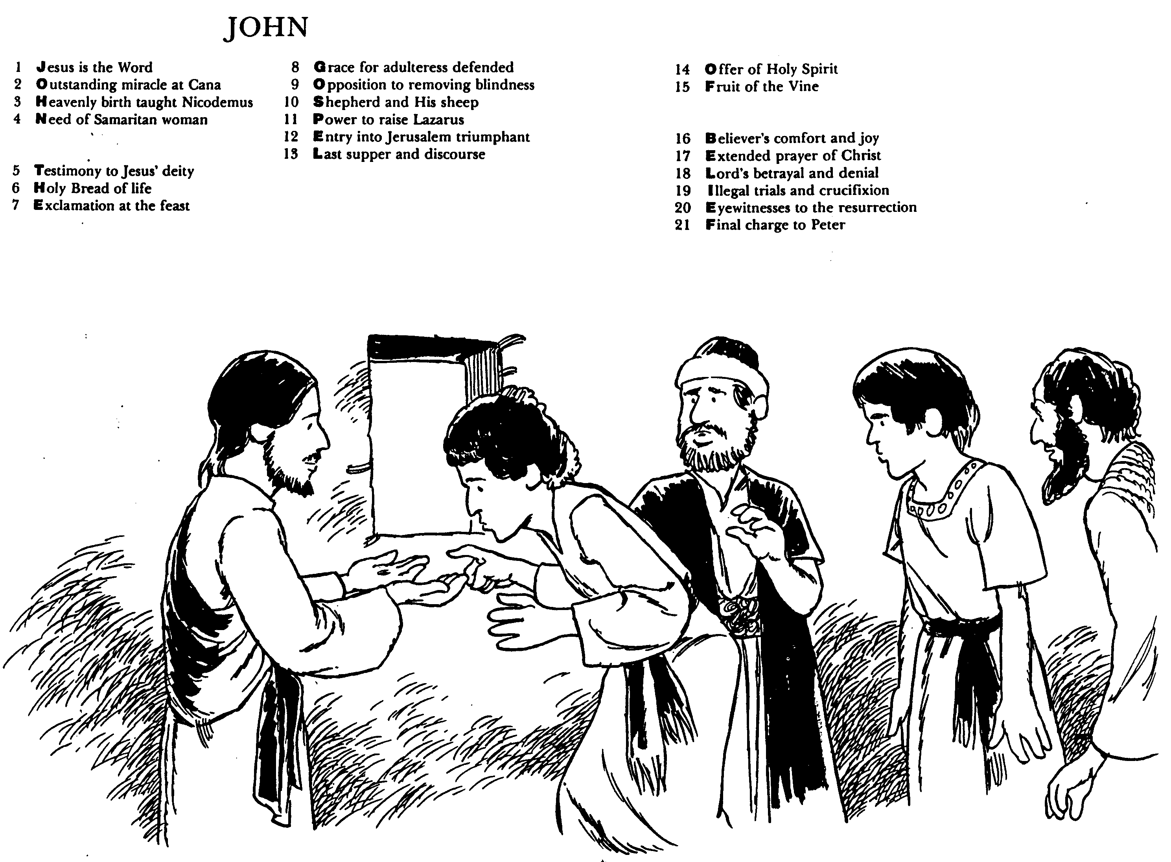
John (Huddleston)
Written by “the disciple whom Jesus loved”

Slide 43
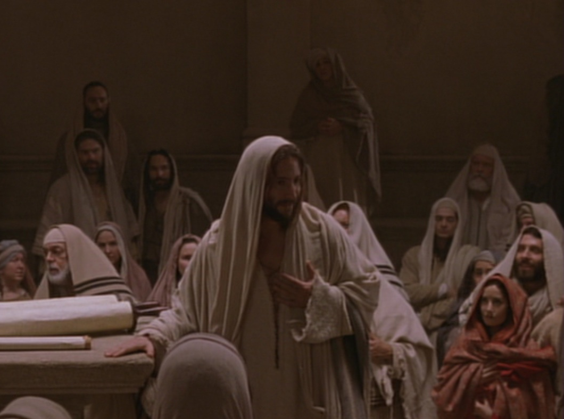
Key Word Believe
John
107
Key Verse
“Jesus did many other miraculous signs in the presence of his disciples, which are not recorded in this book. But these are written that you may believe that Jesus is the Christ, the Son of God, and that by believing
you may have life in his name” (20:30-31).

Slide 44
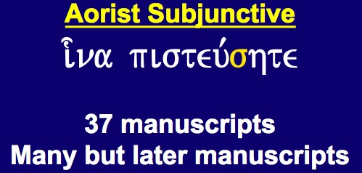
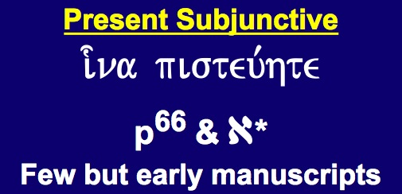
Textual Variants of John 20:31
110
Evangelistic
"…these are written that you may believe that
Jesus is the Christ, the Son
of God, and that by
believing you may have life
in his name"
Edification
"…these are written that you may go on believing that
Jesus is the Christ, the Son of God, and that by believing you may have life in his name"
Aorist Subjunctive
i-na pisteu,shte
37 manuscripts
Many but later manuscripts
Present Subjunctive
i-na pisteu,hte
p⁶⁶ & a*
Few but early manuscripts
Notes:
Most of the manuscripts have the little sigma (= English "s") that makes the verb for believe in an undefined sense. However, a few early MSS lack this sigma, which turns it into a present tense.

Slide 45
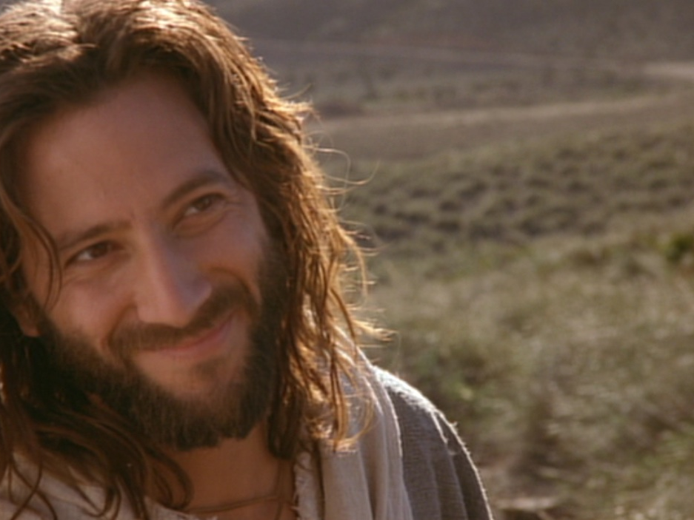
Summary Statement
Gospel of John
107
John proves Jesus to be the Son of God (deity) made man through selected signs and discourses of Christ to convince unbelieving Gentiles to believe in Him and receive eternal life.
Application
Are you 100% sure that you have eternal life by believing in Christ’s name?

Slide 46

Date Options
109
Authorship is easier to determine than when John wrote. Three periods have been proposed for the date of the Gospel:
Late First Century
Second Century
Before AD 70
33
Christ’s
Death
70
Temple
Destroyed
95
John’s
Death

Slide 47
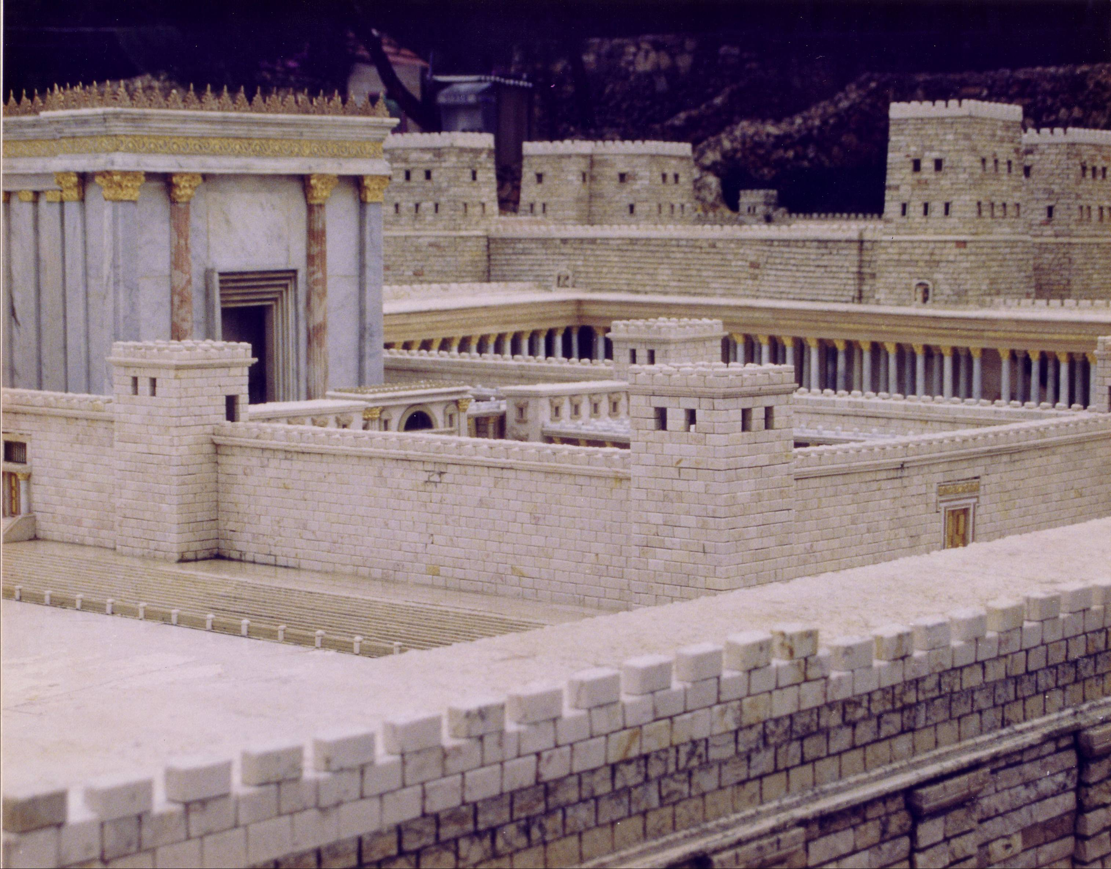
The Temple Stood Until AD 70

Slide 48
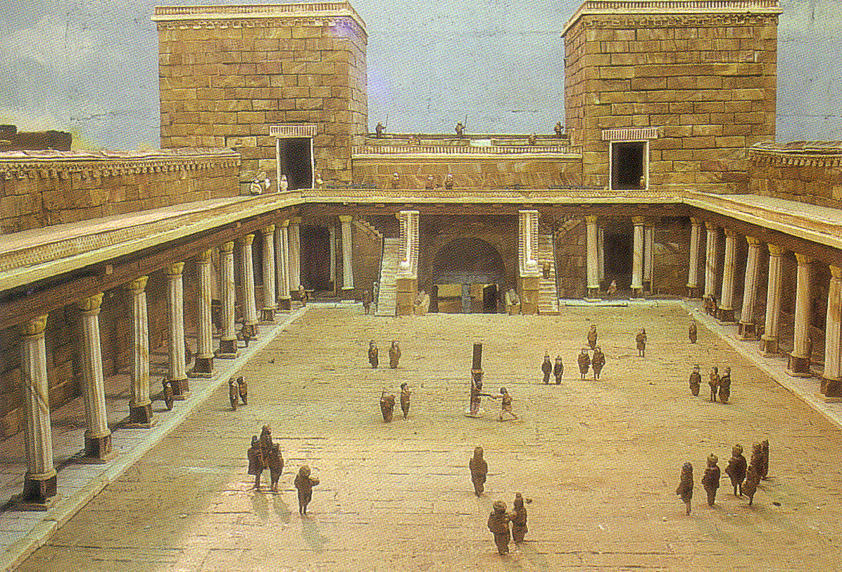
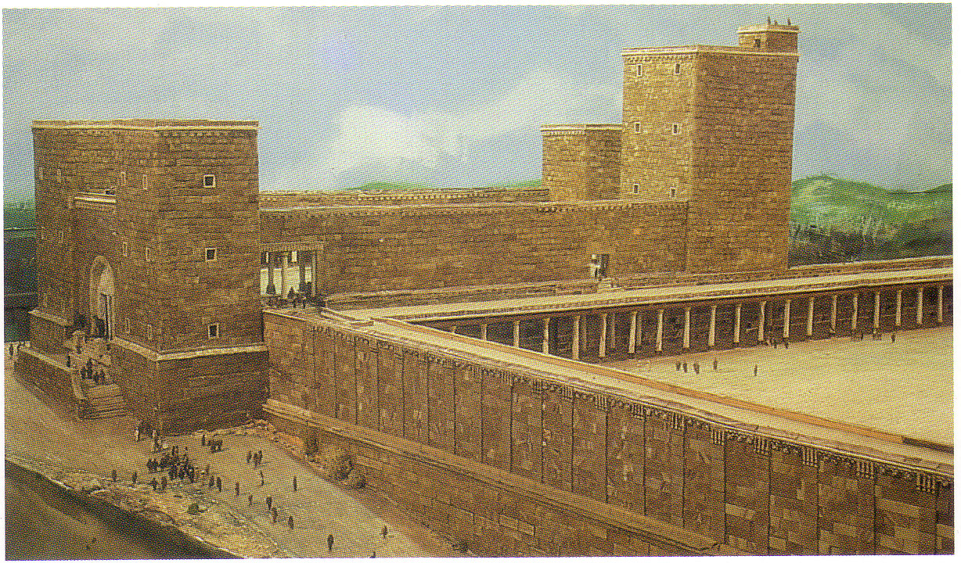
Antonia Fortress

Slide 49
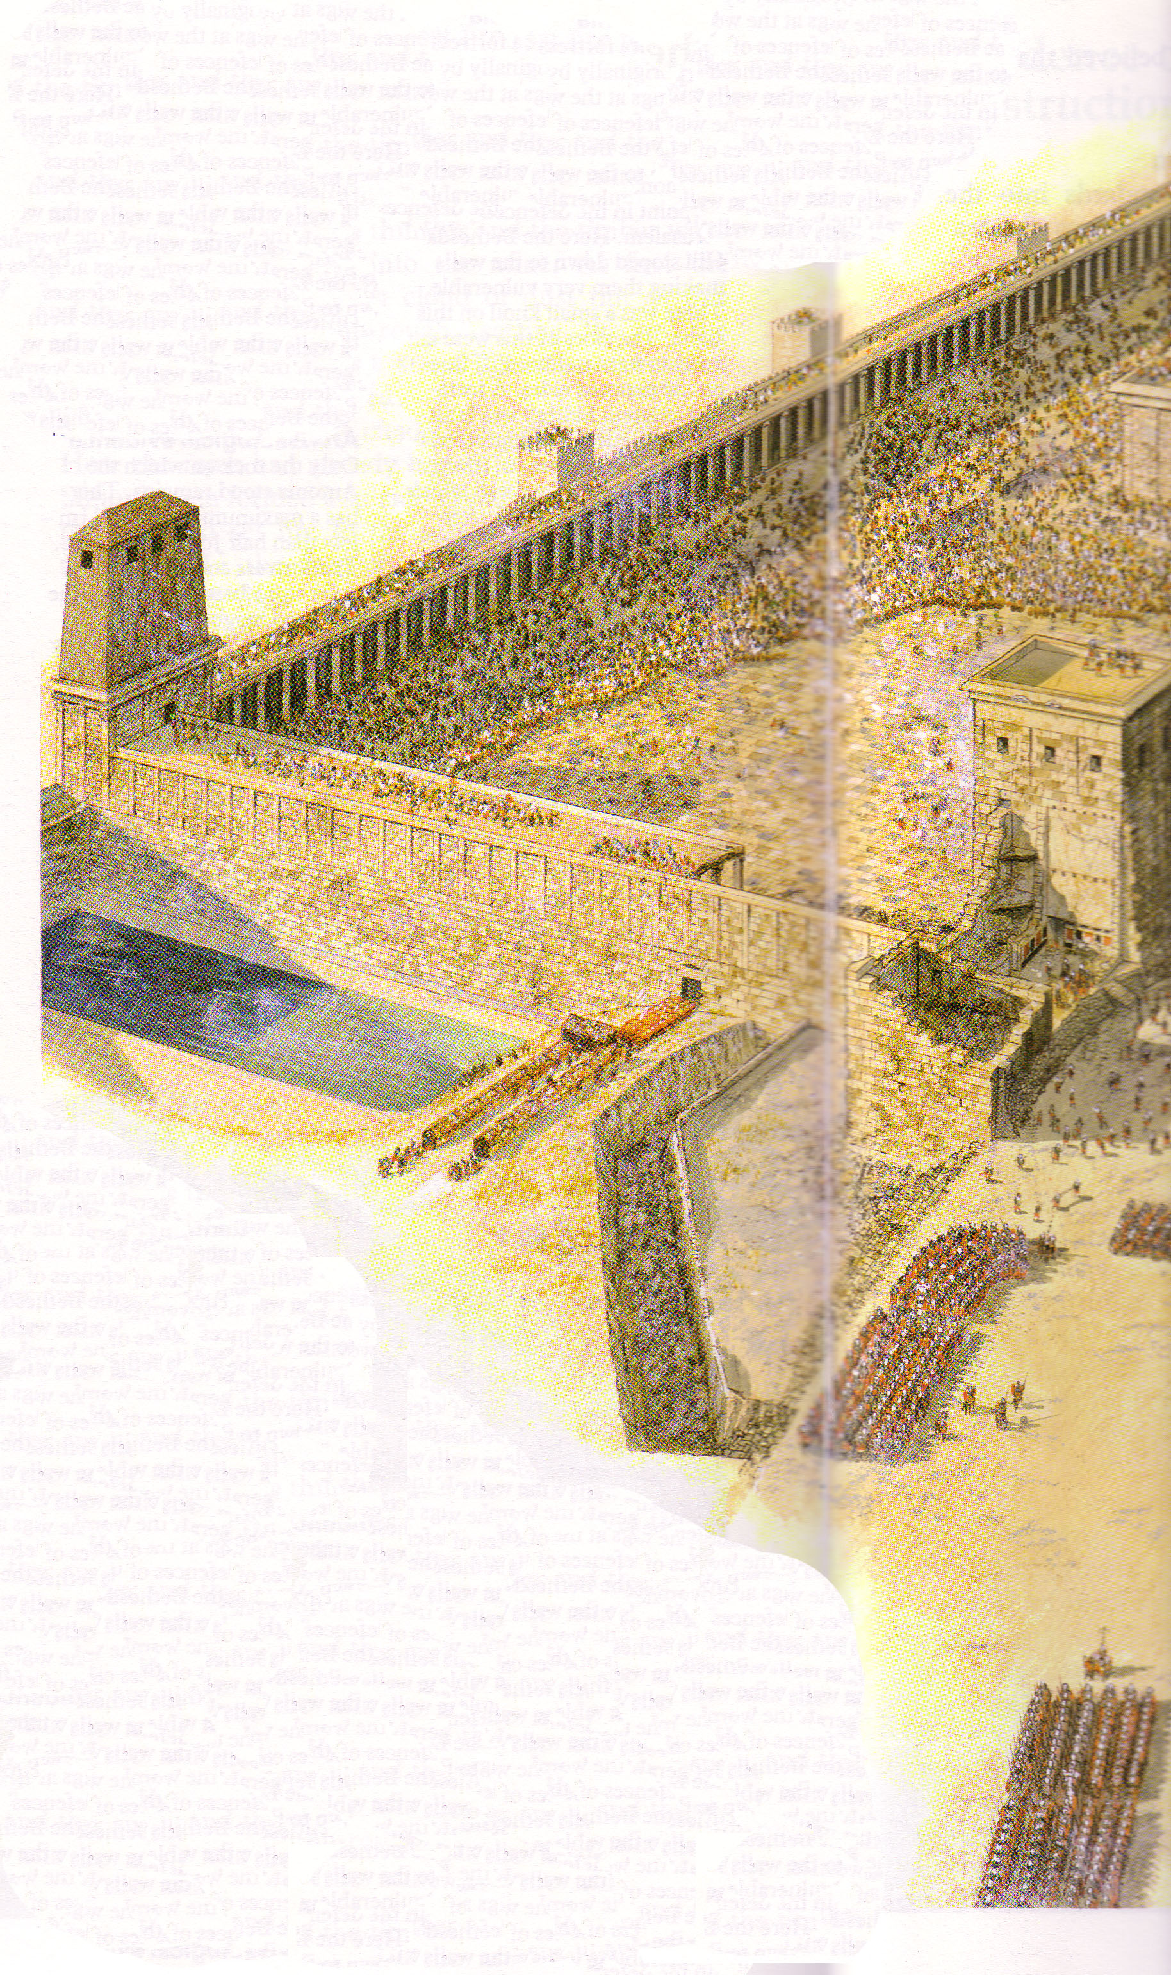
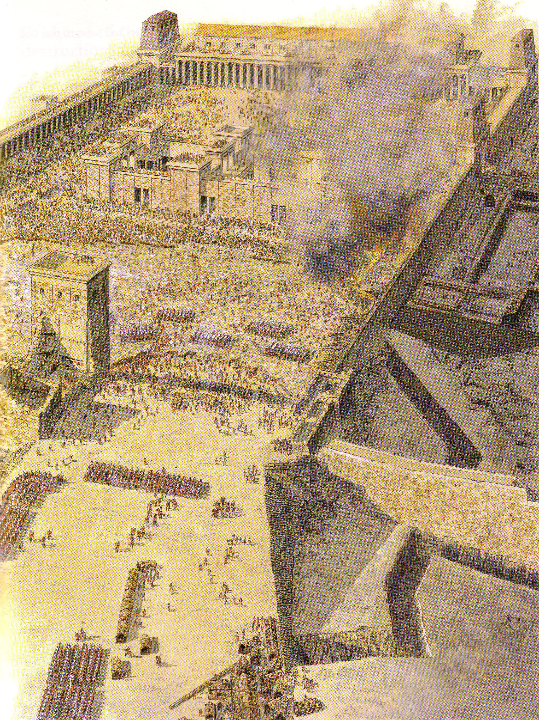
Temple Assault
Sept AD 70
Sheep Pool

Slide 50
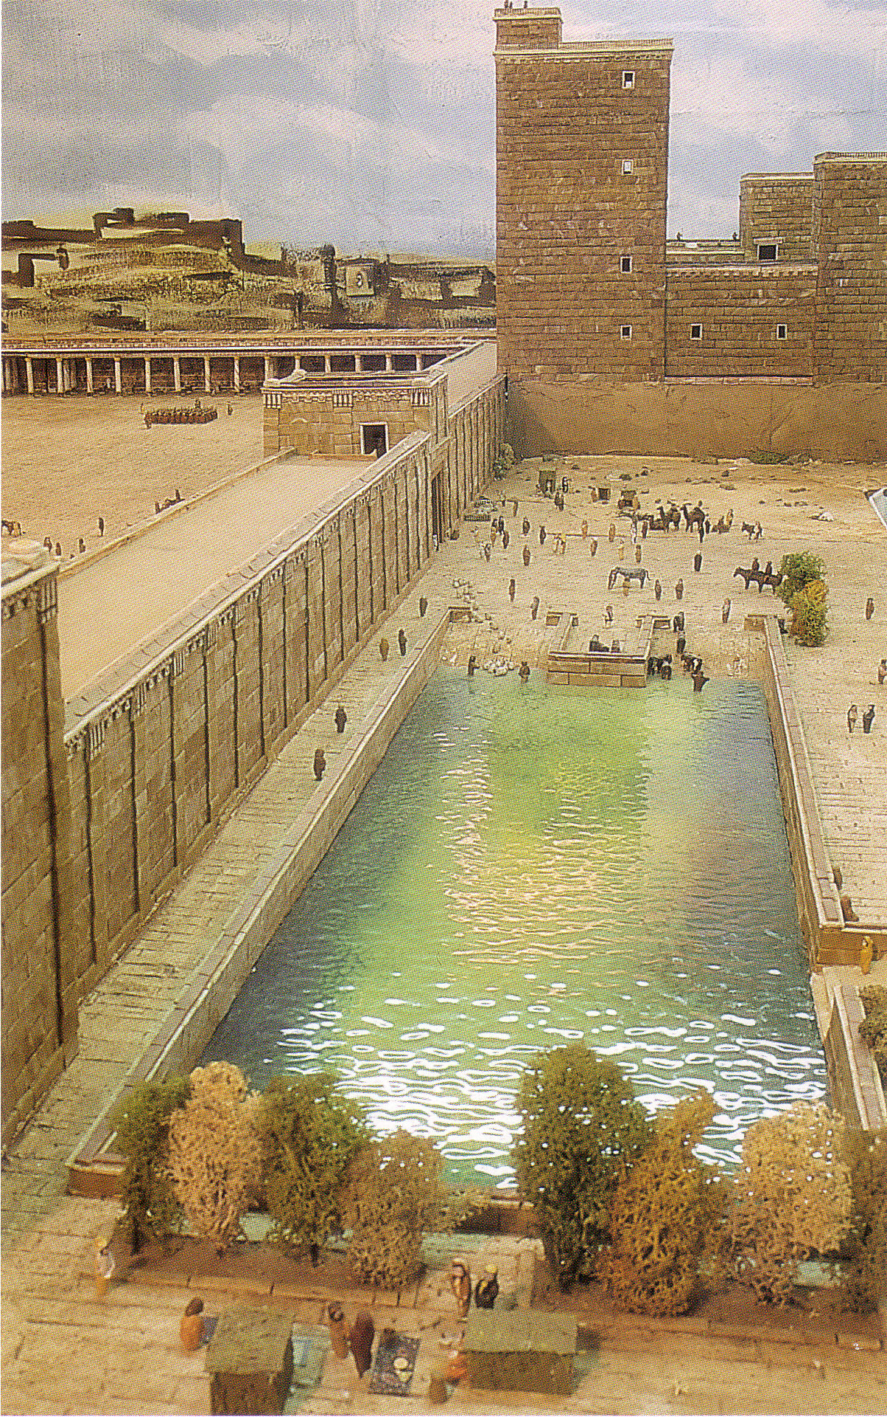
The Pool of Israel
(Sheep Pool south of Pool of Bethesda)

Slide 51
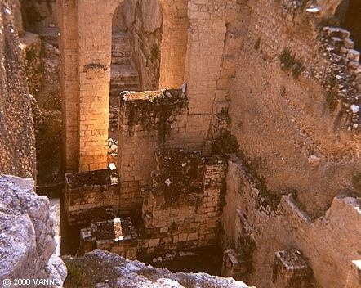
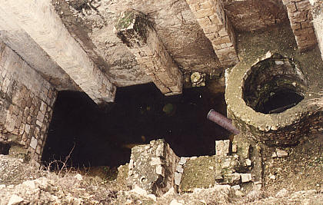
Pool of Bethesda
“Now there is in Jerusalem near the Sheep Gate a pool…”
John 5:2

Slide 52
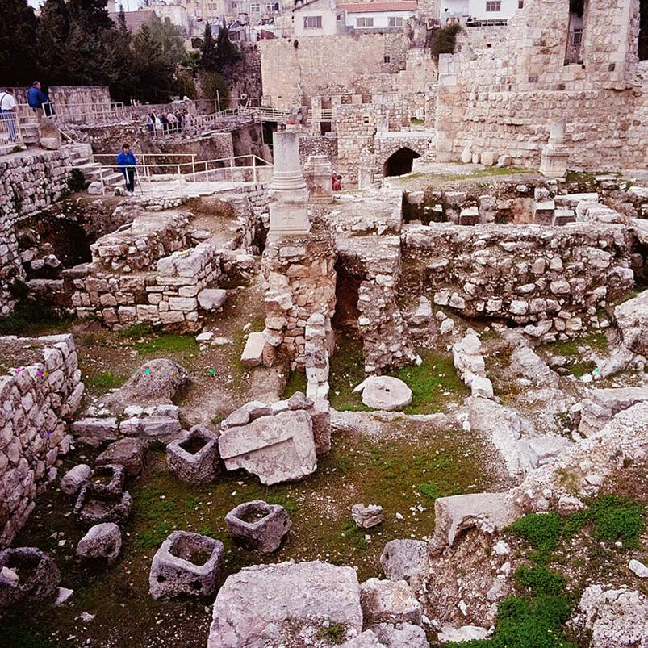
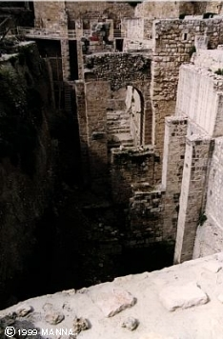
Pool of Bethesda Ruins

Slide 53
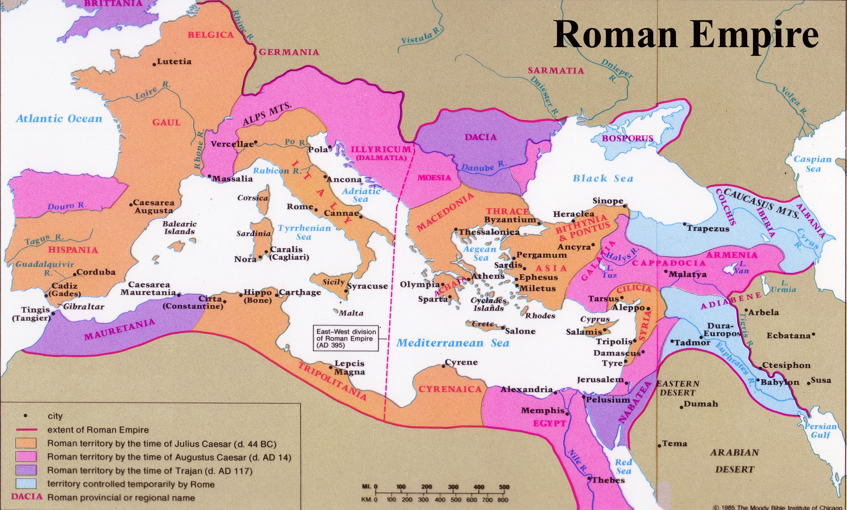
Origin
110
John wrote from Ephesus
Recipients
The first readers are likely to have been Gentiles in John's own location at Ephesus.

Slide 54
Occasion
110
John's stated purpose is for evangelism: to prove that Jesus was the Messiah and Son of God so that nonbelievers might be convinced of His deity through the signs recorded in the Gospel and believe in Him for salvation (John 20:31)

Slide 55

Signs are Vital to Life

Slide 56
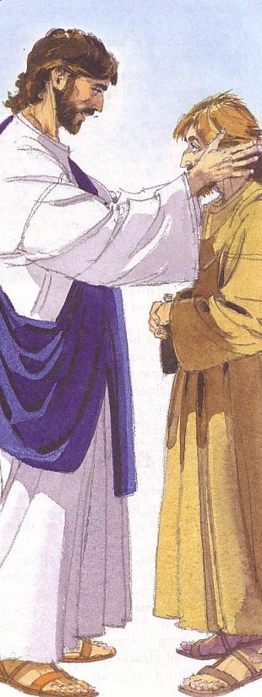
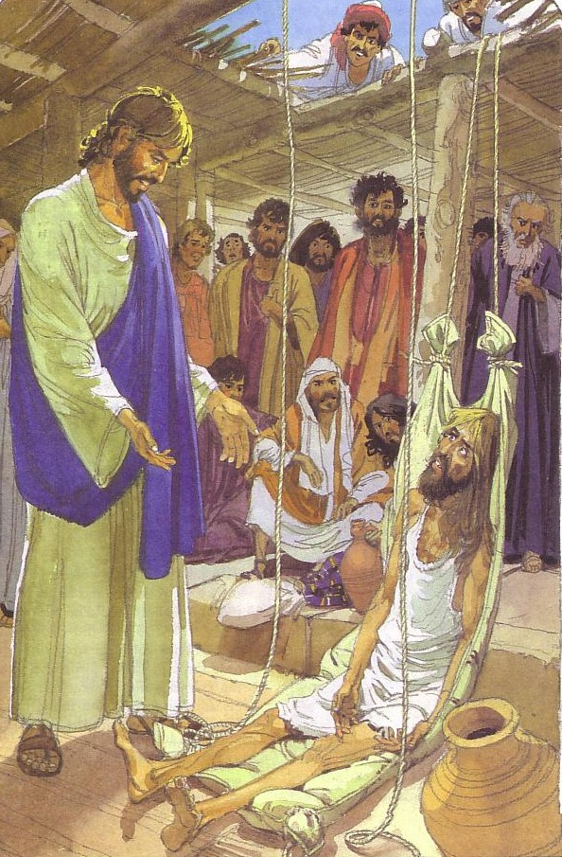
God’s Love
Shown in Signs

Slide 57

Signs in John’s Gospel
111
* Signs unique to John's Gospel (six of the nine miracles)
Seven pre-cross signs are recorded:
1. Changing water into wine at Cana (2:1-11)*
2. Healing the official's son in Capernaum (4:46-54)*
3. Healing the invalid at the Pool of Bethesda (5:1-18)*
4. Feeding the 5,000 near the Sea of Galilee (6:1-15)
5. Walking on water in the Sea of Galilee (6:16-24)
6. Healing the man born blind in Jerusalem (9:1-7)*
7. Raising Lazarus from the dead in Bethany (11:1-45)*
Two post-cross signs are also recorded:
1. Resurrection of Christ (ch. 20)
2. Miraculous catch of fish at Sea of Galilee (21:1-13)*
Therefore, the total miracles in John equal nine signs.

Slide 58
Overview of John’s Gospel
107
Deity Made Man for Eternal Life
Deity of the Son of God | Revelation of the Son of God |  | Preparation of the Son’s Disciples | Passion & Resurrection of the Son of God | Adequacy of the Son of God
1:1-18 | 1:19–12:50 |  | 13–17 | 18–20 | 21
Prologue | Public |  | Private | Public | Private
Incarnation | 2 Signs Received 1:19–4:54 | 5 Signs Rejected 5–12 | Upper Room Discourse (no signs) | Ultimate Sign | Last Sign
Eternity Past | Fall AD 29- Monday, 30 March 33 |  | Thursday, 2 April 33 | Friday, 3 April 33- Sunday, 5 April 33 | May, AD 33
Ephesus (AD 65-69)

Slide 59
Synthesis
113
1:1-18 Prologue: Deity
1:19–12:50 Public Revelation through
7 Signs and 8 Discourses
13–17 Private Preparation of Disciples
18–20 Public Passion/Resurrection
21 Private Epilogue: Adequacy

Slide 60
CIC Priorities

Slide 61
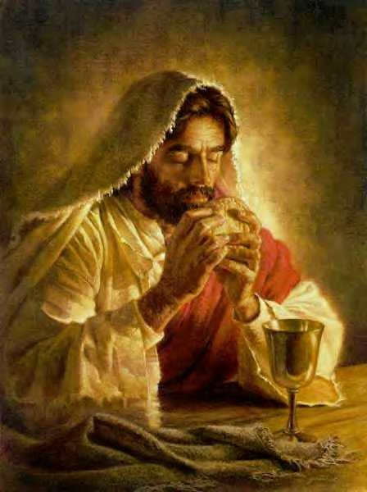
The Message of John
Do you believe in Jesus Christ?

Slide 62
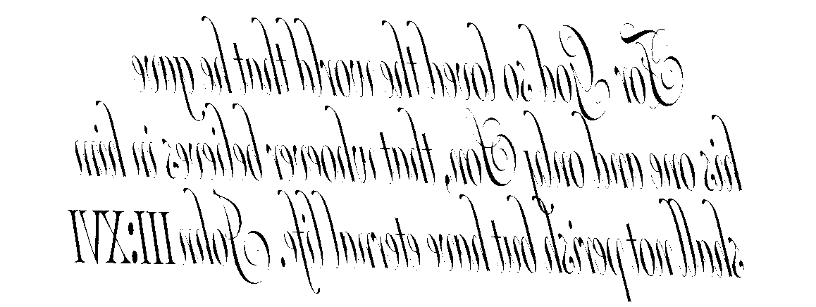
The Divine Code
For God so loved the world that he gave his one and only Son, that whoever believes in him shall not perish but have eternal life.
John 3:16
Notes:
This may look like a cryptic message but it’s actually the best known verse in the Bible. It tells us that God gives us life with him forever when we simply place our trust in Jesus Christ. This is no da Vinci Code. It’s the Divine Code!

Slide 63
2010 Priorities
Will you grow in prayer with us this year?
Will you grow in God’s Word by daily reading?

Slide 64
Black

Slide 65


NT Preaching link at BibleStudyDownloads.org
Get this presentation and script for free!
Notes:
NT Preaching (np)

