Slide 1
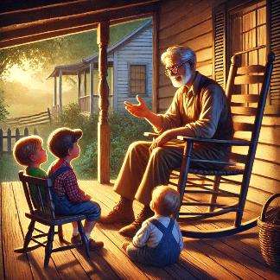
James
3:1-18
Speaks Wisely
Preached by Matthew Lyle at Crossroads International Church Singapore • CICFamily.com Uploaded by Dr. Rick Griffith • Jordan Evangelical Theological Seminary Thousands of files in 54 languages for free at BibleStudyDownloads.org
Notes:
Image created by ChatGPT with the prompt “create an image of a wise old grandpa sitting on porch rocking chair explaining something to his 3 young grandchildren who are sitting patiently at his feet“

Slide 3
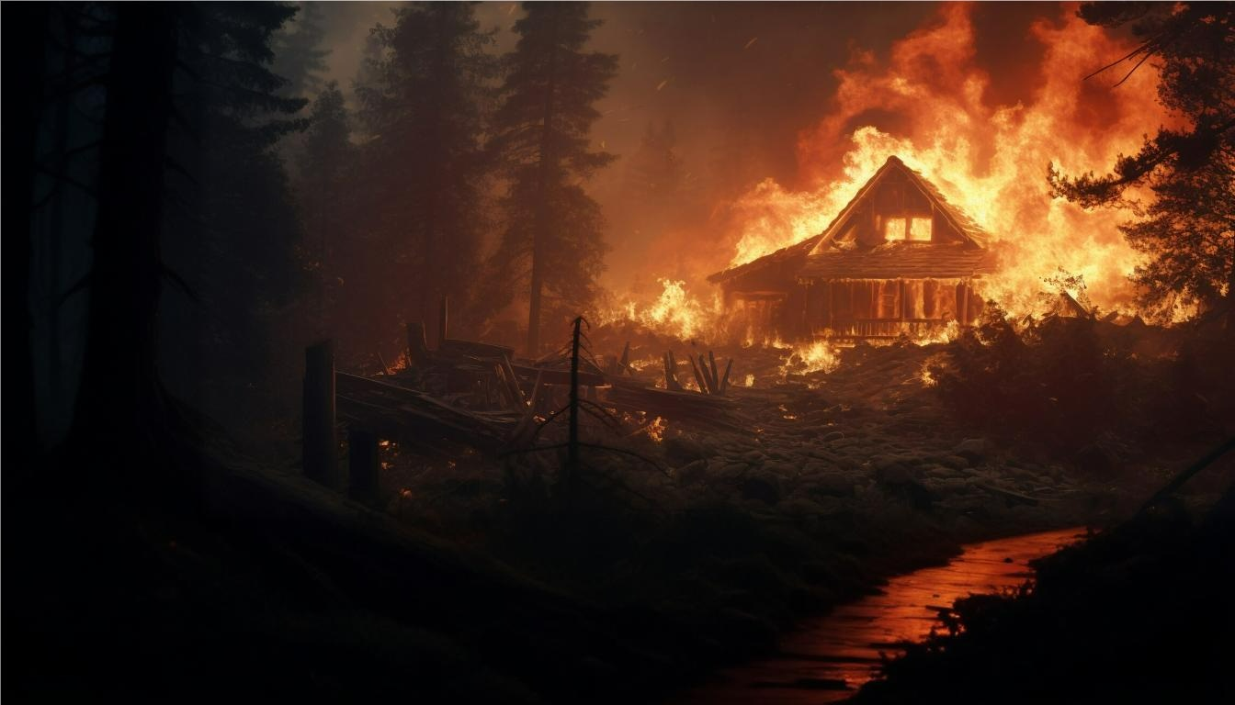
Notes:
https://www.freepik.com/search?format=search&last_filter=orientation&last_value=landscape&orientation=landscape&query=raging+wildfire&selection=1

Slide 5
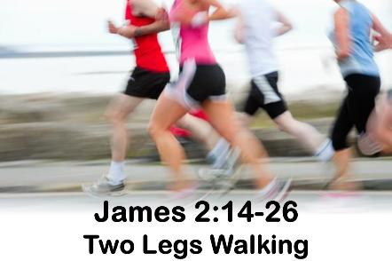
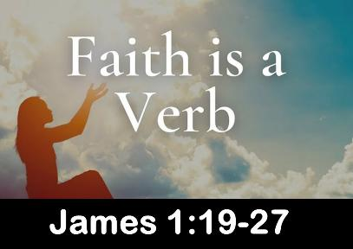
 | Obeys the Word | Avoids Favor-itism | Produces Works |  | Produces Humility | Triumphs
 | 1:19-27 | 2:1-13 | 2:14-26 |  | 4:1–5:6 | 5:7-20
Salutation Trials Temptations | Prepare Obey | Discrimination Materialism Egalitarianism | Meeting Needs Validation | Influence Untamable Be Wise | Conflict Judging Presumption | Suffering Prayer Confrontation
Faith in Action . . .
Rejoices in Difficulty
Speaks Wisely
1:1-18
3:1-18
A book summary chart of all the books of the New Testament can be found at
https://biblestudydownloads.org/resources/new-testament-survey/
Notes:
A book summary chart of all the books of the New Testament can be found at
https://biblestudydownloads.org/resources/new-testament-survey/
Download can be found under “An Overview of the Books of the New Testament”
https://biblestudydownloads.org/files/eng/ns/00-NT_Book_Overviews-542_27a-f_eng_ns_7609_v12.pptx

Slide 6
James
3:1-18
Speaks Wisely
How can we demonstrate faith with our words when we can’t control our tongue?
Notes:
Image created by ChatGPT with the prompt “create an image of a wise old grandpa sitting on porch rocking chair explaining something to his 3 young grandchildren who are sitting patiently at his feet“

Slide 7
James 3 -- Taming the Tongue: A Call to Wisdom

Slide 8
Taming the Tongue
James 3:1-12
Notes:
https://www.freepik.com/search?format=search&last_filter=orientation&last_value=landscape&orientation=landscape&query=raging+wildfire&selection=1

Slide 9
James 3:1-2

Slide 10
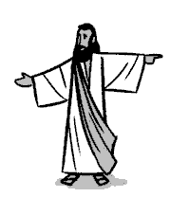
¹ Not many of you should become teachers,
¹⁹ Go therefore and make disciples of all nations, baptizing them in the name of the Father and of the Son and of the Holy Spirit, ²⁰ TEACHING them to observe all that I have commanded you.
Matt 28:19-20 ESV
¹⁹ Go therefore and make disciples of all nations, baptizing them in the name of the Father and of the Son and of the Holy Spirit, ²⁰ TEACHING them to observe all that I have commanded you.
Matt 28:19-20 ESV
James 3:1-2
Notes:
Image from The Bible Project

Slide 11
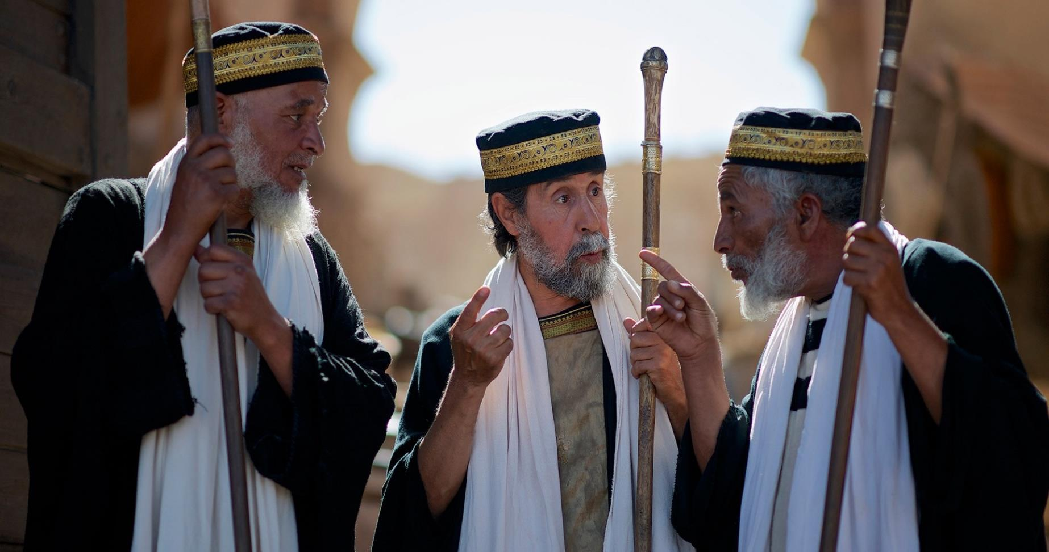
¹ Not many of you should become teachers,
The teachers of religious law
² “The scribes and the Pharisees sit on Moses' seat,
² “The scribes and the Pharisees sit on Moses' seat, ³ so do and observe whatever they tell you,
Matt 23:2-3
scribes
Scribes & Pharisees
image courtesy of www.freebibleimages.org

Slide 12
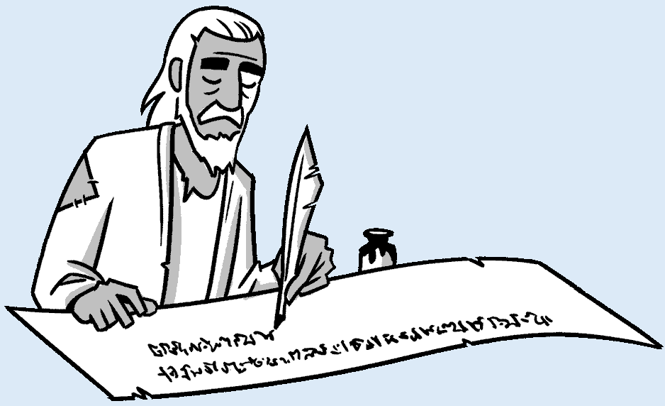
¹ Not many of you should become teachers,
James 2:20 Do you want to be shown, YOU FOOLISH PERSON, that faith apart from works is useless?
YOU FOOLISH PERSON
Notes:
Image from The Bible Project

Slide 13
¹ Not many of you should become teachers,
¹ Not many of you should become teachers, my brothers,
² Count it all joy, my BROTHERS,
when you meet trials of various kinds,
⁹ Let the lowly BROTHER boast in his exaltation,
BROTHER
James 2:20 Do you want to be shown, YOU FOOLISH PERSON, that faith apart from works is useless?
Notes:
https://www.patfindley.com/blog/only-one-life-ct-studd

Slide 14
¹ Not many of you should become teachers, my brothers, for you know that we who teach will be JUDGED with greater strictness.
³ so do and observe whatever they tell you,
³ so do and observe whatever they tell you, BUT NOT THE WORKS THEY DO.
Preach but don’t practice
Demand work from others
Steal the Spotlight
Demand places of honor
Scribes & Pharisees

Slide 15
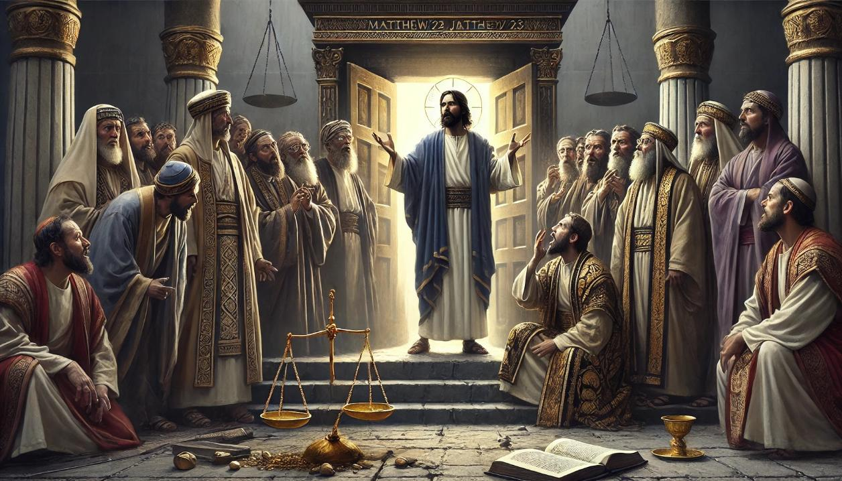
Matthew 23:16-31 – 7 Woes!
Notes:
Image created by ChatGPT with the prompt “Create an image that captures Matthew 23 and the 7 woes Jesus pronounces on the scribes and pharisees.”
Then added “make the image 16.9 format for a power point slide”
ChatGPT: Here is an image capturing the essence of Matthew 23, with Jesus pronouncing the seven woes on the scribes and Pharisees in a symbolic and dramatic setting.

Slide 16
If the Pharisees and Scribes
(both experts in the law)
stumbled,
Is there any hope for us?

Slide 17
¹ Not many of you should become teachers, my brothers, for you know that we who teach will be judged with greater strictness. ² For we all stumble in many ways.
stumble
in many ways.

Slide 18
sin
sin
sin
sin
sin
sin
sin
sin
sin
sin
stumble
sin
sin
in many ways.
sin
sin
sin
sin
sin
sin
sin
sin
sin
sin
sin
sin

Slide 19
sin
sin
sin
sin
sin
sin
One area to not stumble
sin
sin
sin
sin
sin
sin
sin
sin
sin
sin
sin
sin
sin
sin

Slide 20
¹ Not many of you should become teachers, my brothers, for you know that we who teach will be judged with greater strictness. ² For we all stumble in many ways. And if anyone does not stumble in what he says, he is a perfect man, able also to bridle his whole body.

Slide 21
stumble
not stumble
in MANY ways.
in ONE way
(in what he says)
He is a Perfect Man
Cheat Code to Perfection

Slide 22
sin
sin
sin
sin
sin
sin
sin
sin
sin
sin
does not stumble
in what he says,
sin
sin
Perfect Man
sin
sin
τέλειος
sin
sin
sin
sin
sin
sin
sin
sin
sin
sin

Slide 23
James 1:4 And let steadfastness have its full effect, that you may be PERFECT and complete, lacking in nothing.
Matt 5:48 You therefore must be PERFECT,
as your heavenly Father is PERFECT.
Col 1:28 Him we proclaim, warning everyone and teaching everyone with all wisdom, that we may present everyone MATURE in Christ.
Perfect Man
τέλειος (tel'-i-os)

Slide 24
¹ Not many of you should become teachers, my brothers, for you know that we who teach will be judged with greater strictness. ² For we all stumble in many ways. And if anyone does not stumble in what he says, he is a perfect man, able also to bridle his whole body.

Slide 25
¹ Not many of you should become teachers, my brothers, for you know that we who teach will be judged with greater strictness. ² For we all stumble in many ways. And if anyone does not stumble in what he says, he is a perfect man, able also to bridle his whole body.
James 1:26 If anyone thinks he is religious and does not bridle his tongue but deceives his heart, this person's religion is worthless.

Slide 26
The Wild Tongue
James 3:3-12

Slide 27
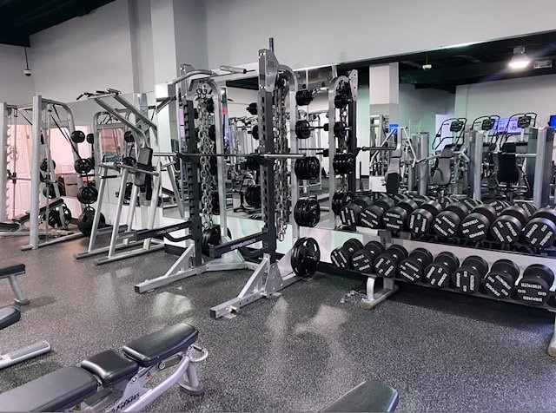
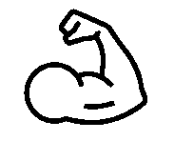
Powerful (3-6)
Notes:
https://roswellgym.com/24-hour-gym/free-weights/

Slide 28
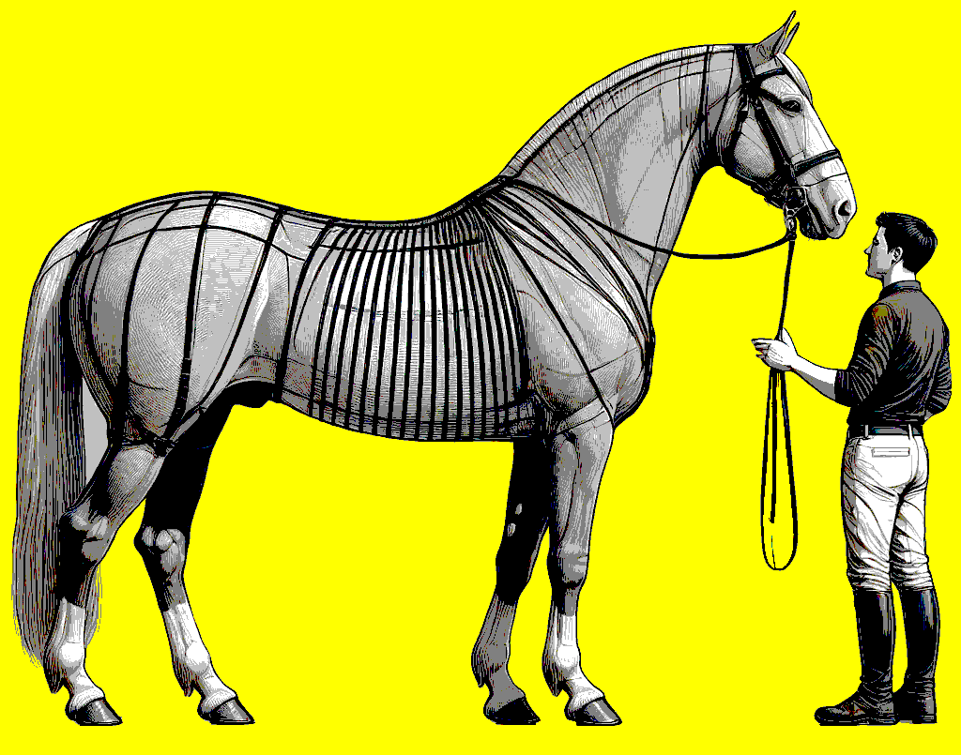
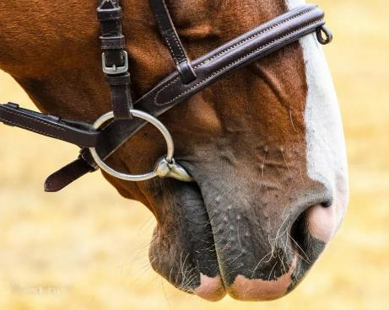
³ If we put bits into the mouths of horses so that they obey us, we guide their whole bodies as well.
James 3:3-6
Notes:
Image created by ChatGPT using the following series of prompts:
create an image of a side view of horse wearing a bridle with a man standing in front of the horse
show both the horse and man as full size
show the complete horse

Slide 29
³ If we put bits into the mouths of horses so that they obey us, we guide their whole bodies as well.
James 3:3-6
Notes:
https://madbarn.com/bits-for-horses/

Slide 30
³ If we put bits into the mouths of horses so that they obey us, we guide their whole bodies as well.
James 3:3-6
Notes:
https://www.trust-equestrian.com/bitsize/?lang=en

Slide 31
³ If we put bits into the mouths of horses so that they obey us, we guide their whole bodies as well.
⁴ Look at the ships also: though they are so large and are driven by strong winds, they are guided by a very small rudder wherever the will of the pilot directs.
James 3:3-6

Slide 32
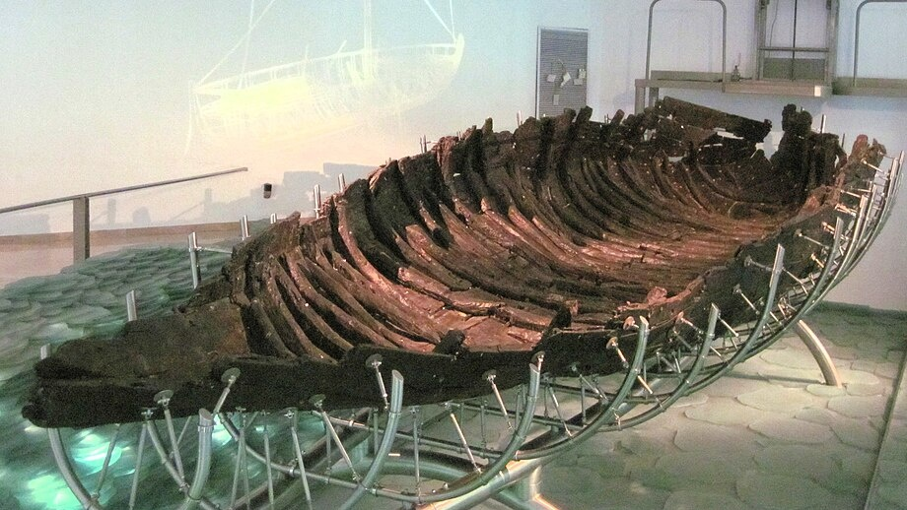
Notes:
By Travellers & Tinkers - Own work, CC BY-SA 4.0, https://commons.wikimedia.org/w/index.php?curid=47050075

Slide 33
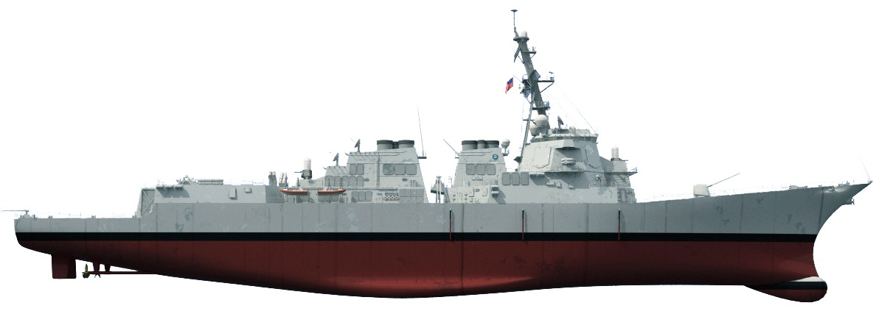
Notes:
https://www.surfpac.navy.mil/ships/by-class/US-Navy-Destroyer-Ship-class-DDG/

Slide 34
³ If we put bits into the mouths of horses so that they obey us, we guide their whole bodies as well.
⁴ Look at the ships also: though they are so large and are driven by strong winds, they are guided by a very small rudder wherever the will of the pilot directs.
⁵ So also the tongue is a small member, yet it boasts of great things.
How great a forest is set ablaze by such a small fire!
boast
boasting
James 3:3-6

Slide 35
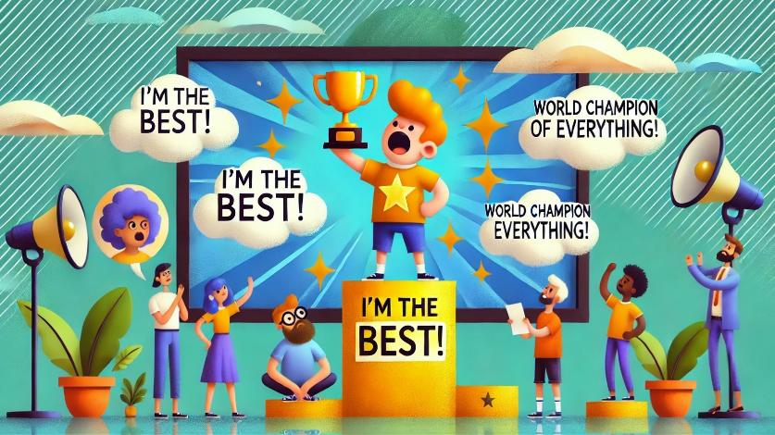
boast
boasting

Slide 36
How great a forest is set ablaze by such a small fire!
⁶ And the tongue is a fire, a world of unrighteousness. The tongue is set among our members, staining the whole body, setting on fire the entire course of life, and set on fire by hell.
James 3:3-6

Slide 37
The Cognitive Revolution refers to a transformative period in human history when early humans developed new ways of communicating
Enabled larger groups with stories that bonded people
Shortened timeline for scientific advancements
Allowed humans to become apex predator
“manipulated by the propagation of misleading ideas”
“The biblical description of this momentous event in Genesis is much more personal and emotional”
setting on fire the entire course of life,
James 3:3-6
Notes:
Lyle, Gen-X Redactor: DL. The Gen-X Bible: The Old Testament: Kingdoms, Catastrophes, and Covenants (p. 15). Outskirts Press. Kindle Edition.

Slide 38
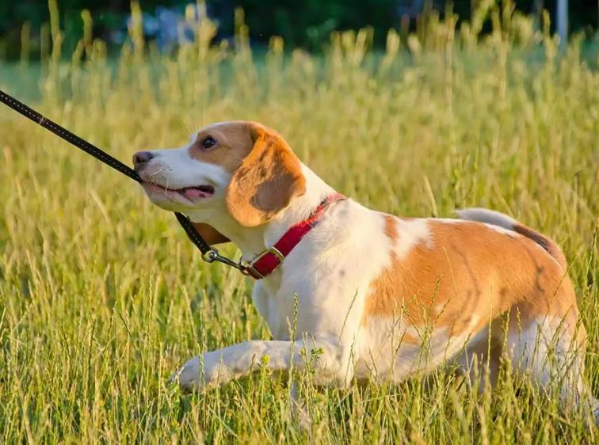
Uncontrollable (7-8)
Notes:
https://www.smalldoorvet.com/learning-center/behavior/stop-leash-pulling

Slide 39
⁷ For every kind of beast and bird, of reptile and sea creature, can be tamed and has been tamed by mankind, ⁸ but no human being can tame the tongue. It is a restless evil, full of deadly poison.
James 3:7-8

Slide 41
⁷ For every kind of beast and bird, of reptile and sea creature, can be tamed and has been tamed by mankind, ⁸ but no human being can tame the tongue. It is a restless evil, full of deadly poison.
It is a restless evil, full of deadly poison.
James 3:7-8

Slide 42
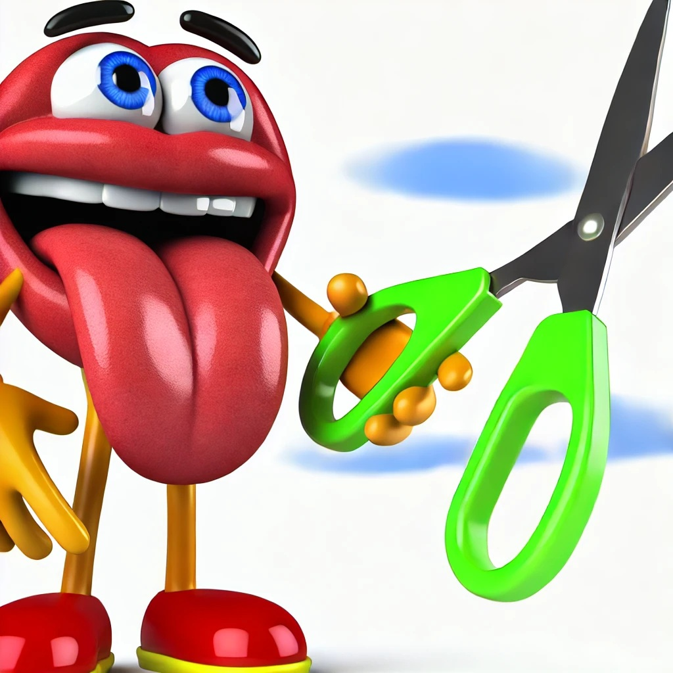
the tongue is a fire, a world of unrighteousness . . .
It is a restless evil, full of deadly poison.
²⁹ If your right eye causes you to sin . . . ³⁰ And if your right hand causes you to sin, cut it off
Matt 5:29-30
Notes:
Image created by ChatGPT using the prompt create a fun image suggesting to cut one's tongue out

Slide 43
Revealing (9-12)
Notes:
https://www.smalldoorvet.com/learning-center/behavior/stop-leash-pulling

Slide 44
⁹ With it we bless our Lord and Father, and with it we curse people who are made in the likeness of God. ¹⁰ From the same mouth come blessing and cursing. My brothers, these things ought not to be so.
James 3:9-12

Slide 45
⁹ With it we bless our Lord and Father, and with it we curse people who are made in the likeness of God. ¹⁰ From the same mouth come blessing and cursing. My brothers, these things ought not to be so.
¹¹ Does a spring pour forth from the same opening both fresh and salt water? ¹² Can a fig tree, my brothers, bear olives, or a grapevine produce figs? Neither can a salt pond yield fresh water.
James 3:9-12

Slide 46
³³ “Make a tree good and its fruit will be good, or make a tree bad and its fruit will be bad, for a tree is recognized by its fruit. ³⁴ You brood of vipers, how can you who are evil say anything good? For the mouth speaks what the heart is full of.
Matt 12:33-34
the heart
Revealing (9-12)
Notes:
https://roswellgym.com/24-hour-gym/free-weights/

Slide 47
inherently good or neutral, shaped by circumstances,
inherently sinful, needing transformation through God’s grace.
the heart

Slide 48
True Wisdom
James 3:13-18
Notes:
Image create with ChatGPT using the prompt “create a 16x9 aspect image of an old library or study, with shelves lined with books symbolizing accumulated wisdom. In the foreground, there’s an open book or a quill pen resting beside a cup of tea or coffee, hinting at quiet reflection. There is also a large warm fireplace with a blazing fire at the bottom right side of the picture”
ChatGPT: Here is the image depicting a warm, old library or study with bookshelves, a cozy fireplace, and thoughtful details like an open book, a quill, and a cup of tea. Let me know if you'd like any modifications!

Slide 49
¹³ Who is wise and understanding among you? By his good conduct let him show his works in the meekness of wisdom.
show
James 3:13-16

Slide 50
¹³ Who is wise and understanding among you? By his good conduct let him show his works in the meekness of wisdom.
Jas 2:18 But someone will say, “You have faith and I have works.” show me your faith apart from your works, and I will show you my faith by my works.
show
δεικνύω (dike-noo’-o)

Slide 51
¹³ Who is wise and understanding among you? By his good conduct let him show his works in the meekness of wisdom.
not boastful

Slide 52
¹³ Who is wise and understanding among you? By his good conduct let him show his works in the meekness of wisdom. ¹⁴ But if you have bitter jealousy and selfish ambition in your hearts, do not boast and be false to the truth.
James 3:13-16

Slide 53
¹³ Who is wise and understanding among you? By his good conduct let him show his works in the meekness of wisdom. ¹⁴ But if you have bitter jealousy and selfish ambition in your hearts, do not boast and be false to the truth. ¹⁵ This is not the wisdom that comes down from above, but is earthly, unspiritual, demonic. ¹⁶ For where jealousy and selfish ambition exist, there will be disorder and every vile practice.
James 3:13-16

Slide 54
bitter jealousy and selfish ambition . . . earthly, unspiritual, demonic
pure, peaceable, gentle, open to reason, full of mercy and good fruits, impartial and sincere.
wisdom

Slide 55
¹⁷ But the wisdom from above is first pure, then peaceable, gentle, open to reason, full of mercy and good fruits, impartial and sincere. ¹⁸ And a harvest of righteousness is sown in peace by those who make peace.
James 3:1-18

Slide 56
Where jealousy and selfish ambition exist, there will be disorder and every vile practice.
A harvest of righteousness is sown in peace by those who make peace

Slide 57
Black

Slide 58
NT Preaching link at BibleStudyDownloads.org
Get this presentation for free!
Notes:
NT Preaching (np)

