Slide 1
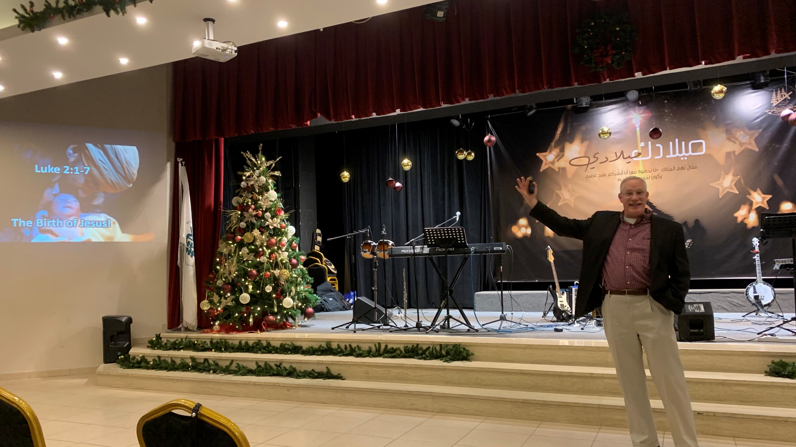
Let Suffering Mature You
James 1:5-12
Dan Bridges • Amman International Church AmmanChurch.org • BibleStudyDownloads.org

Slide 2
Last Week: James 1:2-4
The Purpose of Trials…
² Consider it all joy, my brothers and sisters, when you encounter various trials, ³ knowing that the testing of your faith produces endurance. ⁴ And let endurance have its perfect result, so that you may be perfect and complete, lacking in nothing.

Slide 3
Last Week: James 1:2-4
² Consider it all joy, my brothers and sisters, when you encounter various trials, ³ knowing that the testing of your faith produces endurance. ⁴ And let endurance have its perfect result, so that you may be perfect and complete, lacking in nothing.
The Choice…

Slide 4
Trials and Suffering can lead to
Maturity
Or…
Bitterness
Today’s Question: How can we “let trials mature us”?

Slide 5
James 1:5-12
⁵ But if any of you lacks wisdom, let him ask of God, who gives to all generously and without reproach, and it will be given to him. ⁶ But he must ask in faith without any doubting, for the one who doubts is like the surf of the sea, driven and tossed by the wind. ⁷ For that person ought not to expect that he will receive anything from the Lord, ⁸ being a double-minded man, unstable in all his ways.

Slide 6
James 1:5-12
⁹ Now the brother or sister of humble circumstances is to glory in his high position; ¹⁰ but the rich person is to glory in his humiliation, because like flowering grass he will pass away. ¹¹ For the sun rises with its scorching heat and withers the grass; and its flower falls off and the beauty of its appearance is destroyed; so also the rich person, in the midst of his pursuits, will die out.

Slide 7
James 1:5-12
¹² Blessed is a man who perseveres under trial; for once he has been approved, he will receive the crown of life which the Lord has promised to those who love Him.

Slide 8
James 1:2-12
Four Ideas…
Perseverance in
Trials
² Consider it all joy, my brothers and sisters, when you encounter various trials, ³ knowing that the testing of your faith produces endurance. ⁴ And let endurance have its perfect result, so that you may be perfect and complete, lacking in nothing.
⁵ But if any of you lacks wisdom, let him ask of God, who gives to all generously and without reproach, and it will be given to him. ⁶ But he must ask in faith without any doubting, for the one who doubts is like the surf of the sea, driven and tossed by the wind. ⁷ For that person ought not to expect that he will receive anything from the Lord, ⁸ being a double-minded man, unstable in all his ways.
⁹ Now the brother or sister of humble circumstances is to glory in his high position; ¹⁰ but the rich person is to glory in his humiliation, because like flowering grass he will pass away. ¹¹ For the sun rises with its scorching heat and withers the grass; and its flower falls off and the beauty of its appearance is destroyed; so also the rich person, in the midst of his pursuits, will die out.
¹² Blessed is a man who perseveres under trial; for once he has been approved, he will receive the crown of life which the Lord has promised to those who love Him.
Wisdom and Praying in Faith
One Subject or Four???
The Poor and the Rich
Reward for Persevering in Trial

Slide 9
James 1:2-12
Two Textual Clues…
Perseverance in
Trials
² Consider it all joy, my brothers and sisters, when you encounter various trials, ³ knowing that the testing of your faith produces endurance. ⁴ And let endurance have its perfect result, so that you may be perfect and complete, lacking in nothing.
⁵ But if any of you lacks wisdom, let him ask of God, who gives to all generously and without reproach, and it will be given to him. ⁶ But he must ask in faith without any doubting, for the one who doubts is like the surf of the sea, driven and tossed by the wind. ⁷ For that person ought not to expect that he will receive anything from the Lord, ⁸ being a double-minded man, unstable in all his ways.
⁹ Now the brother or sister of humble circumstances is to glory in his high position; ¹⁰ but the rich person is to glory in his humiliation, because like flowering grass he will pass away. ¹¹ For the sun rises with its scorching heat and withers the grass; and its flower falls off and the beauty of its appearance is destroyed; so also the rich person, in the midst of his pursuits, will die out.
¹² Blessed is a man who perseveres under trial; for once he has been approved, he will receive the crown of life which the Lord has promised to those who love Him.
Greek: De
A continuation of the thought
Wisdom and Praying in Faith
The Poor and the Rich
Reward for Persevering in Trial

Slide 10
James 1:4-5
⁴ And let endurance have its perfect result, so that you may be perfect and complete, lacking in nothing
⁵ But if any of you lacks wisdom, let him ask of God, who gives to all generously and without reproach, and it will be given to him.
WISDOM

Slide 11
James 1:5-12
Main Idea:
Suffering will mature us if we trust in God’s wisdom through it,
rather than our own!
⁴ And let endurance have its perfect result, so that you may be perfect and complete, lacking in nothing. ⁵ But if any of you lacks wisdom, let him ask of God, who gives to all generously and without reproach, and it will be given to him.

Slide 12
Wisdom in Trials
What is wisdom?
How do we get wisdom?
What does wisdom look like in action?

Slide 13
Meanings of Wisdom in the Bible
God’s infinite understanding – Rom 11:33
Skill as an artisan – 1 Kings 7:14
Skill in making good decisions – Solomon
Moral competence – Proverbs
Secular knowledge and understanding – 1 Cor 1
Spiritual truth revealed only by the Holy Spirit

Slide 14
For our context today…
God’s infinite understanding – Rom 11:33
Skill as an artisan – 1 Kings 7:14
Skill in making good decisions – Solomon
Moral competence – Proverbs
Secular knowledge and understanding – 1 Cor 1
Spiritual truth revealed only by the Holy Spirit (specifically what we should ask for in trials)

Slide 15
God’s Wisdom
“The Lord by wisdom founded the earth;
by understanding he established the heavens.”
Proverbs 3:19
“Oh, the depth of the riches and wisdom and knowledge of God! How unsearchable are his judgments and how inscrutable his ways!”
Romans 11:33

Slide 16
The Wisdom We Should Ask For
The wisdom we are to seek is not the “why” of suffering. That’s God’s wisdom!
The wisdom we are to ask for is the ability to know God and to see life from his perspective.

Slide 17
The Wisdom We Should Ask For
“⁷ …we impart a secret and hidden wisdom of God, which God decreed before the ages for our glory…
¹² Now we have received not the spirit of the world, but the Spirit who is from God, that we might understand the things freely given us by God. ¹³ And we impart this in words not taught by human wisdom but taught by the Spirit, interpreting spiritual truths to those who are spiritual.” 1 Corinthians 2:7,12-13

Slide 18
The Wisdom We Should Ask For
“[I pray] that the God of our Lord Jesus Christ, the Father of glory, may give you a spirit of wisdom and of revelation in the knowledge of Him. I pray that the eyes of your heart may be enlightened, so that you will know what is the hope of His calling, what are the riches of the glory of His inheritance in the saints…” Ephesians 1:17-18
The ability to experience God more deeply
The ability to see this life and eternity as God sees
Notes:
A child who is afraid of the dark doesn’t need to know why it’s dark. What they want is the comforting presence of the parent to be with them. And, as big as our trials are, they are very small in light of eternity.

Slide 19
Wisdom in Trials
What is wisdom?
How do we get wisdom?
What does wisdom look like in action?

Slide 20
How do we get Wisdom?
⁵ But if any of you lacks wisdom, let him ask of God, who gives to all generously and without reproach, and it will be given to him. ⁶ But he must ask in faith without any doubting, for the one who doubts is like the surf of the sea, driven and tossed by the wind. ⁷ For that person ought not to expect that he will receive anything from the Lord, ⁸ being a double-minded man, unstable in all his ways.
1. Acknowledge that you need wisdom…

Slide 21
Acknowledge that you need Wisdom
⁵ And if, as is the case, anyone of you is deficient in wisdom, let him keep on presenting his request in the presence of the giving God who gives to all with simplicity and without reserve, and who does not reproach, and it shall be given him.
Wuest Translation

Slide 22
Acknowledge that you need Wisdom
⁵ Trust in the Lord with all your heart
And do not lean on your own understanding.
⁶ In all your ways acknowledge Him,
And He will make your paths straight.
⁷ Do not be wise in your own eyes…
Proverbs 3:5-7
Notes:
I am foolish and don’t understand. God is wise and understands everything!

Slide 23
How do we get Wisdom?
⁵ And if, as is the case, anyone of you is deficient in wisdom, let him keep on presenting his request in the presence of the giving God who gives to all with simplicity and without reserve, and who does not reproach, and it shall be given him.
Wuest Translation
2. Ask (and keep asking) for wisdom…

Slide 24
How do we get Wisdom?
⁵ But if any of you lacks wisdom, let him ask of God, who gives to all generously and without reproach, and it will be given to him.

Slide 25
How do we get Wisdom?
“Ask, and it will be given to you; seek, and you will find; knock, and it will be opened to you… If you then, who are evil, know how to give good gifts to your children, how much more will your Father who is in heaven give good things to those who ask him!” Matthew 7:7,11

Slide 26
So how do we ask for this Wisdom?
⁵ But if any of you lacks wisdom, let him ask of God, who gives to all generously and without reproach, and it will be given to him. ⁶ But he must ask in faith without any doubting, for the one who doubts is like the surf of the sea, driven and tossed by the wind. ⁷ For that person ought not to expect that he will receive anything from the Lord, ⁸ being a double-minded man, unstable in all his ways.
3. Ask in faith…
Notes:
I am foolish and don’t understand. God is wise and understands everything!

Slide 27
Asking in Faith
Faith in the wisdom and character of God:
Faith in God’s willingness to give wisdom!
Faith in God’s way of dealing with my suffering – He knows what he’s doing!
Faith in God’s motives in dealing with my suffering – He cares deeply about me!
Notes:
I am foolish and don’t understand. God is wise and understands everything!

Slide 28
So how do we ask for this Wisdom?
⁵ But if any of you lacks wisdom, let him ask of God, who gives to all generously and without reproach, and it will be given to him. ⁶ But he must ask in faith without any doubting, for the one who doubts is like the surf of the sea, driven and tossed by the wind. ⁷ For that person ought not to expect that he will receive anything from the Lord, ⁸ being a double-minded man, unstable in all his ways.
4. Ask without doubting…
Notes:
I am foolish and don’t understand. God is wise and understands everything!

Slide 29
So how do we ask for this Wisdom?
⁵ But if any of you lacks wisdom, let him ask of God, who gives to all generously and without reproach, and it will be given to him. ⁶ But he must ask in faith without any doubting, for the one who doubts is like the surf of the sea, driven and tossed by the wind. ⁷ For that person ought not to expect that he will receive anything from the Lord, ⁸ being a double-minded man, unstable in all his ways.
Who is the doubter?

Slide 30
Who is the Doubter?
Double-Minded – This person…
Is “two-souled” – Has their mind or soul divided between God and the world
Is chasing happiness and fulfillment in this life
Doubts that God knows best
Faith and doubt are connected with loyalty!

Slide 31
Doubt vs. Faith
The doubter is someone of divided loyalty – not someone honestly struggling to believe in God’s goodness.
The person of faith remains loyal to God – continuing to believe in his goodness, wisdom and love no matter what!

Slide 32
A Sample “Wisdom Prayer”
God, I
Acknowledge my need for wisdom in this trial
Trust that you know what you’re doing
Ask for wisdom to know you in this trial and to see it as you see it
I will remain loyal to you – to believe in your goodness, infinite wisdom and love, no matter how dark things get!
Endurance: the ability to endure an unpleasant or difficult process or situation without giving way
Perseverance: persistence in doing something despite difficulty or delay in achieving success
Steadfast: resolutely or dutifully firm and unwavering

Slide 33
Wisdom in Trials
What is wisdom?
How do we get wisdom?
What does wisdom look like in action?

Slide 34
Wisdom in Action
When we have biblical wisdom, we see our circumstances, whether good or bad, as temporary. We see them wrapped up in the loving hands of our infinite God who knows everything, can do anything and is working all things for our good.
Notes:
I am foolish and don’t understand. God is wise and understands everything!

Slide 35
Wisdom in Action (Two Examples)
⁹ Now the brother or sister of humble circumstances is to glory in his high position; ¹⁰ but the rich person is to glory in his humiliation, because like flowering grass he will pass away. ¹¹ For the sun rises with its scorching heat and withers the grass; and its flower falls off and the beauty of its appearance is destroyed; so also the rich person, in the midst of his pursuits, will die out.

Slide 36
Wisdom’s Effect on the Poor
⁹ Now the brother or sister of humble circumstances is to glory in his high position; ¹⁰ but the rich person is to glory in his humiliation, because like flowering grass he will pass away. ¹¹ For the sun rises with its scorching heat and withers the grass; and its flower falls off and the beauty of its appearance is destroyed; so also the rich person, in the midst of his pursuits, will die out.

Slide 37
Wisdom’s Effect on the Rich
⁹ Now the brother or sister of humble circumstances is to glory in his high position; ¹⁰ but the rich person is to glory in his humiliation, because like flowering grass he will pass away. ¹¹ For the sun rises with its scorching heat and withers the grass; and its flower falls off and the beauty of its appearance is destroyed; so also the rich person, in the midst of his pursuits, will die out.

Slide 38
Wisdom in Trials
What is wisdom?
How do we get wisdom?
What does wisdom look like in action?

Slide 39
Applying this in Daily Life
⁴ And let endurance have its perfect result, so that you may be perfect and complete, lacking in nothing… ¹² Blessed is a man who perseveres under trial; for once he has been approved, he will receive the crown of life which the Lord has promised to those who love Him.

Slide 40
Daily Endurance
Endurance: the ability to endure an unpleasant or difficult process or situation without giving way
Perseverance: persistence in doing something despite difficulty or delay in achieving success
Steadfast: resolutely or dutifully firm and unwavering

Slide 41
Daily Endurance
Continue to do what we know:
Keep reading our Bibles
Keep praying
Get help with these things if it’s too hard
Stay in fellowship with believers who are understanding and willing to walk with us

Slide 42
Daily Endurance
Keep asking God for wisdom (daily +):
Acknowledge our own foolishness
Acknowledge who God is
Infinitely wise
Completely loving and faithful
Ask for wisdom to see the situation as God sees it

Slide 43
Daily Endurance
Pursue Jesus – the answer is the Person!
In Jesus are hidden all the treasures of wisdom and knowledge – Colossians 2:3
Jesus is the ultimate example of persevering through unjust suffering!

Slide 44
Wisdom in Action – Daily Endurance
Continue to do what we know
Keep asking God for wisdom
Pursue Jesus – the answer is the Person!

Slide 45
Result of Wisdom – A Changed Heart!
“I had heard of you by the hearing of the ear, but now my eye sees you; therefore I despise myself, and repent in dust and ashes.” Job 42:5-6
“Then you will understand… for wisdom will come into your heart…” Proverbs 2:10
Notes:
I am foolish and don’t understand. God is wise and understands everything!

Slide 46
Result of Wisdom – Heavenly Reward!
¹² Blessed is a man who perseveres under trial; for once he has been approved, he will receive the crown of life which the Lord has promised to those who love Him.

Slide 47
“In light of heaven, the worst suffering on earth will be seen to be no more serious than one night in an inconvenient hotel.”
Saint Teresa of Avila

Slide 48
Let suffering mature you!

Slide 50
NT Preaching link at BibleStudyDownloads.org
Get this presentation and script for free!
Notes:
NT Preaching (np)

