Slide 1
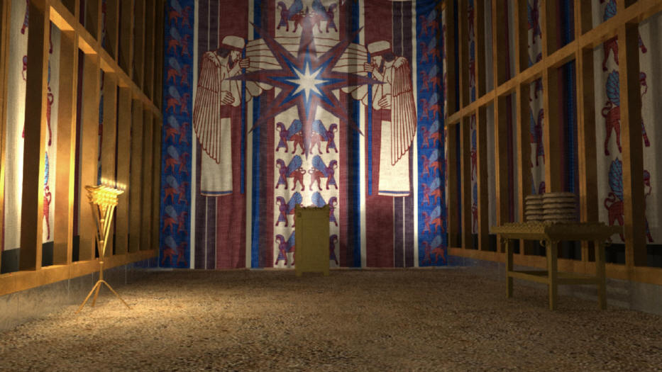
Better than the Old Covenant
Hebrews 8
Dr. Rick Griffith • Crossroads International Church Singapore
BibleStudyDownloads.org

Slide 2

Relationships Differ
Notes:
We understand the difference between various types of relationships

Slide 3

Relationships Differ
Notes:
Do you have the best possible relationship ever? Different relationships stem from different commitments we make to various people.

Slide 4


Relationships Change
Notes:
When we make a new agreement to a new boss, our agreement to our old employer no long holds any effect

Slide 5

Dating
Notes:
To some extent, dating is a commitment, though at a lower level

Slide 6
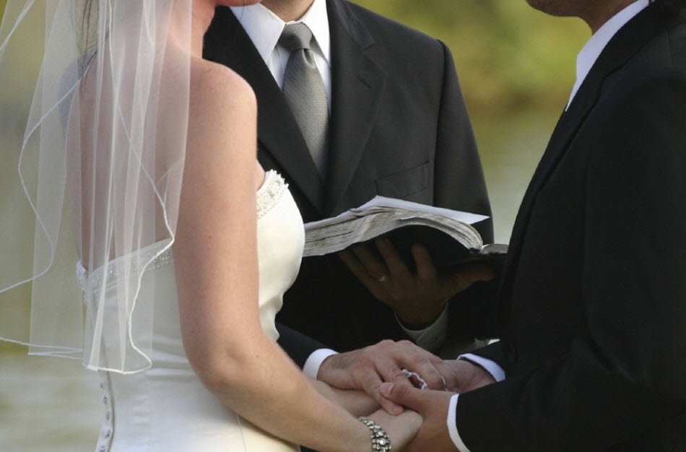
Marriage Covenant
Notes:
But when we get married, our spouse becomes our first priority in human relationships because we have made a covenant—a binding agreement—with our spouse

Slide 7

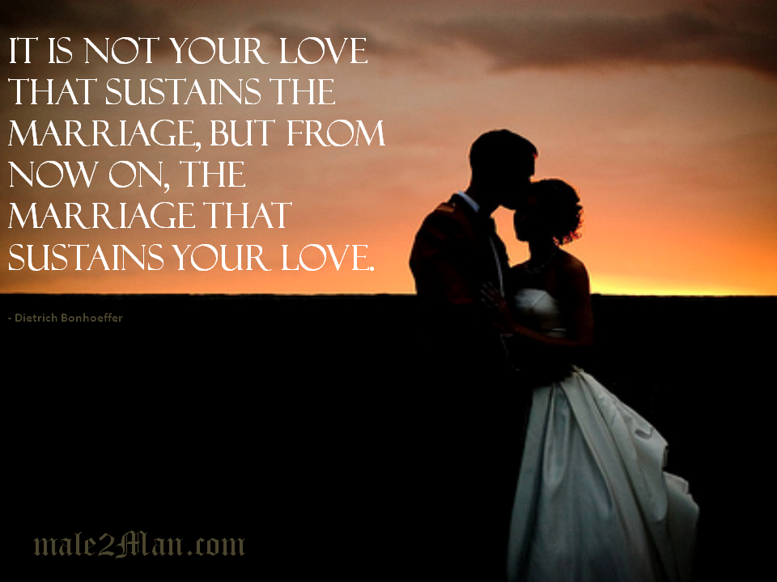
"It is not your love that sustains the marriage, but from now on, the marriage that sustains your love."
male2Man.com
Notes:
I read a quote this week: "It is not your love that sustains the marriage, but from now on, the marriage that sustains your love." Do you agree?

Slide 8

A Lifelong Covenant
Notes:
What will keep marriage vibrant for the long haul? Nothing more than knowing that you entered a covenant relationship for life. We often don’t feel love, but covenant commitment must continue.

Slide 9
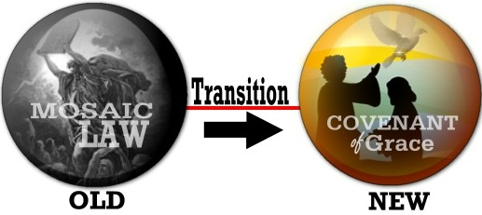
Two Covenants
Transition
OLD
NEW
Notes:
The same applies to God’s relationship to us now, as contrasted with his relationship to OT Israel

Slide 10
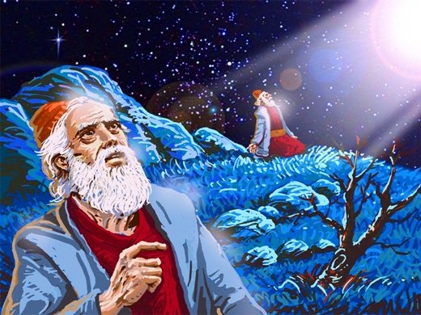
Did OT saints have a relationship with God?
Notes:
Did OT saints have a relationship with God? Yes, of course!

Slide 11
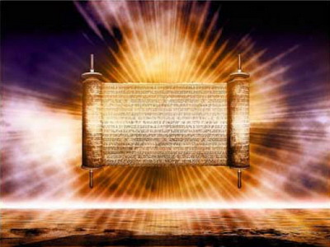
The Old Covenant
Notes:
Godly Jews under the old covenant certainly had a relationship with God, and Christians today do as well

Slide 12
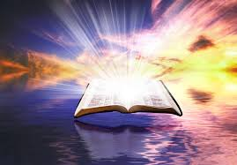
Old vs. New Covenants
Notes:
But the nature of these relationships is quite different. Our new covenant with him is much better than the agreement that Israel had with God. But how is it different?

Slide 13

How is knowing Jesus better than anything you've ever experienced (or ever will experience)?

Slide 14
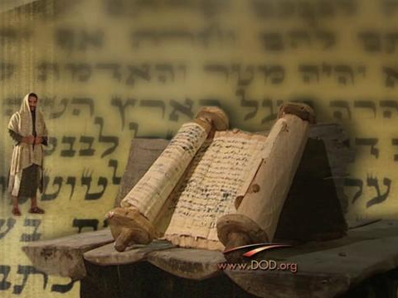
Background to the Letter
Notes:
Who were the first readers of this letter to the Hebrews that we’re studying?

Slide 15
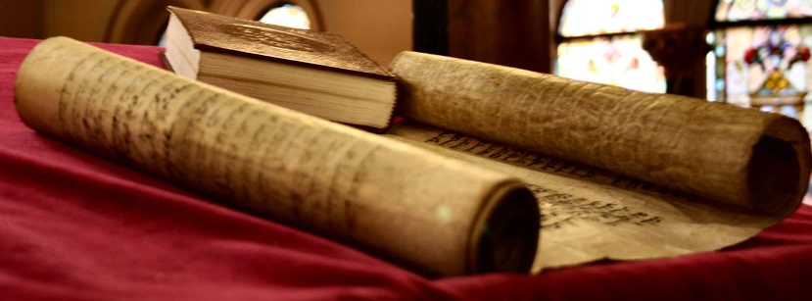
The readers had a great foundation in Judaism

Slide 16
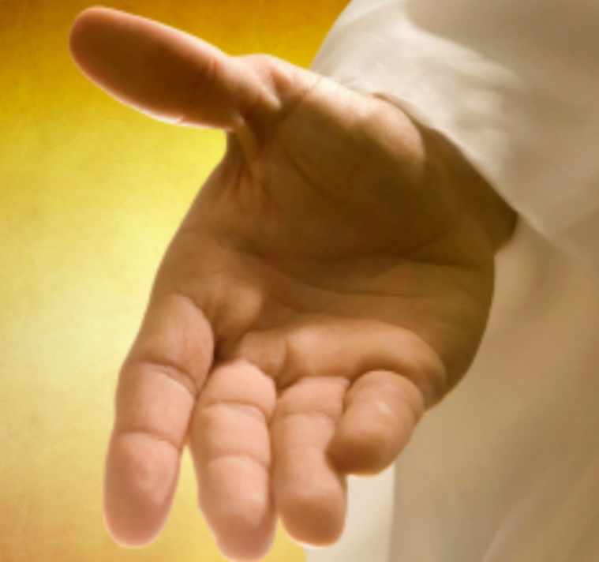
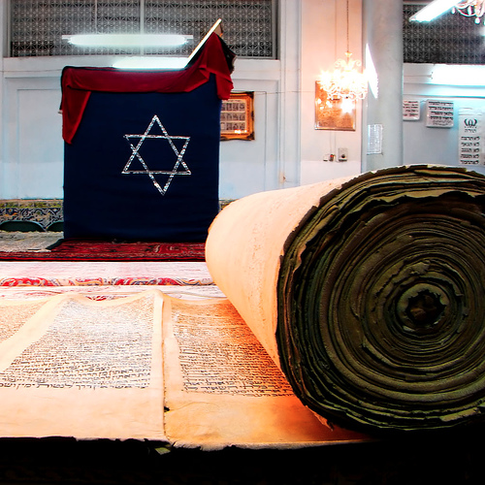
Old to New to Old?
?
Notes:
Then they embraced the new covenant—in other words, they were believers in Christ—but now were tempted to go back to the old covenant.

Slide 17
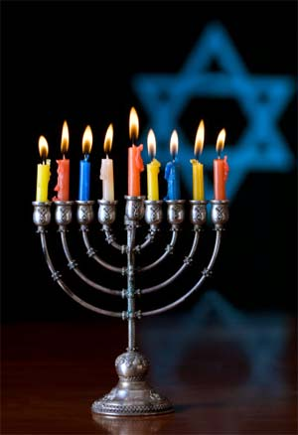
How is the new covenant better than the old?
Notes:
Yet they still needed to know how this new covenant was better than the old

Slide 18

Press On!
A Study of Hebrews
Notes:
The writer’s goal was for them to be able to press on in their faith with a sense of confidence in the message they had believed and the person whom they had trusted.
So the author exhorted them repeatedly in his letter to press on, I'm calling this new series on Hebrews "Press On!"

Slide 19
How is knowing Jesus better than anything you've ever experienced
(or ever will experience)?
Best
Representative
Best
Relationship
Notes:
Today we’ll see two ways that knowing Jesus is better than anything you’ve ever experienced (or ever will experience). We will see that, in Christ, we have the best representative before God, and the best possible relationship with God.

Slide 20
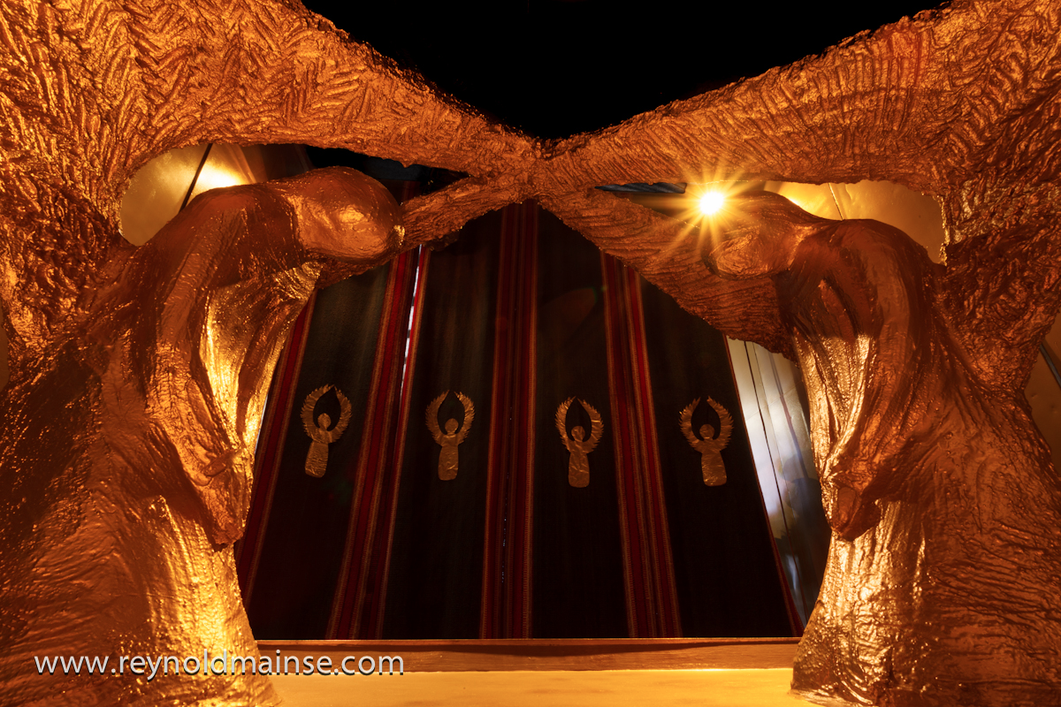
How is the New Covenant Better?
(Hebrews 8)
Notes:
Hebrews 8 gives these two ways that the new covenant is better than the old.
How is the new covenant better than the old?

Slide 21

I. Jesus is the best possible representative before God (8:1-6).

Slide 22
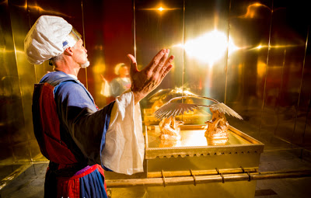
Jesus as High Priest is better than the old priesthood (8:1-5)

Slide 23
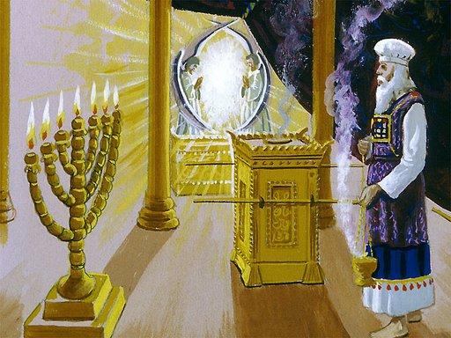
"Here is the main point: We have a High Priest who sat down in the place of honor beside the throne of the majestic God in heaven"
(8:1 NLT).
Notes:
How is it significant that Christ "sat down" as High Priest in heaven (8:1)?
Priests didn’t have a desk job like us. They always worked standing up, so there was no chair in the tabernacle. This lack of a seat indicated that their ministry was never finished.
In contrast, after providing redemption, Jesus could sit down—and not sit down just anywhere, but in heaven itself at God’s place of honor—God’s right hand!
This means that atonement for our sins is finished. We don’t have to pay the price of our sin since one payment is enough.

Slide 24
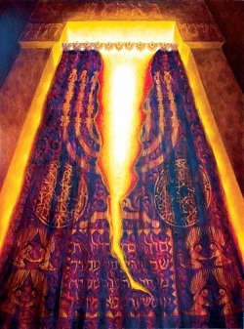
God honored him with ministry in heaven itself (8:2 NLT).
"There he ministers in the heavenly Tabernacle, the true place of worship that was built by the Lord and not by human hands."
Notes:
Is there a part of heaven that is like the earthly tabernacle—or does "heavenly Tabernacle" refer to all of heaven itself (8:2)? It is the latter.
The heavenly sanctuary and tabernacle are one and the same—heaven itself.
As Hodges notes, "The ‘true tabernacle’ is the heavenly sphere where that service takes place" (BKC).
Would you prefer a leader who serves here on earth or one who serves in heaven itself at the very right hand of God? Trust him!

Slide 25
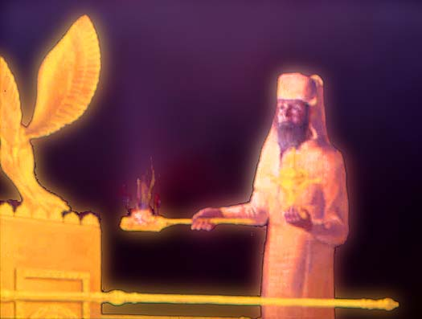
"And since every high priest is required to offer gifts and sacrifices, our High Priest must make an offering, too"
(8:3 NLT).
Notes:
Earthly high priests were only a shadow of Christ’s heavenly ministry (8:3-5).
What offering did Jesus make as High Priest (8:3)?
The text doesn’t say explicitly, but it certainly wasn’t the same as the earthly priests who continued to minister at that time when the temple service still continued.
Christ’s offering was no less than his own body as the Lamb of God.

Slide 26
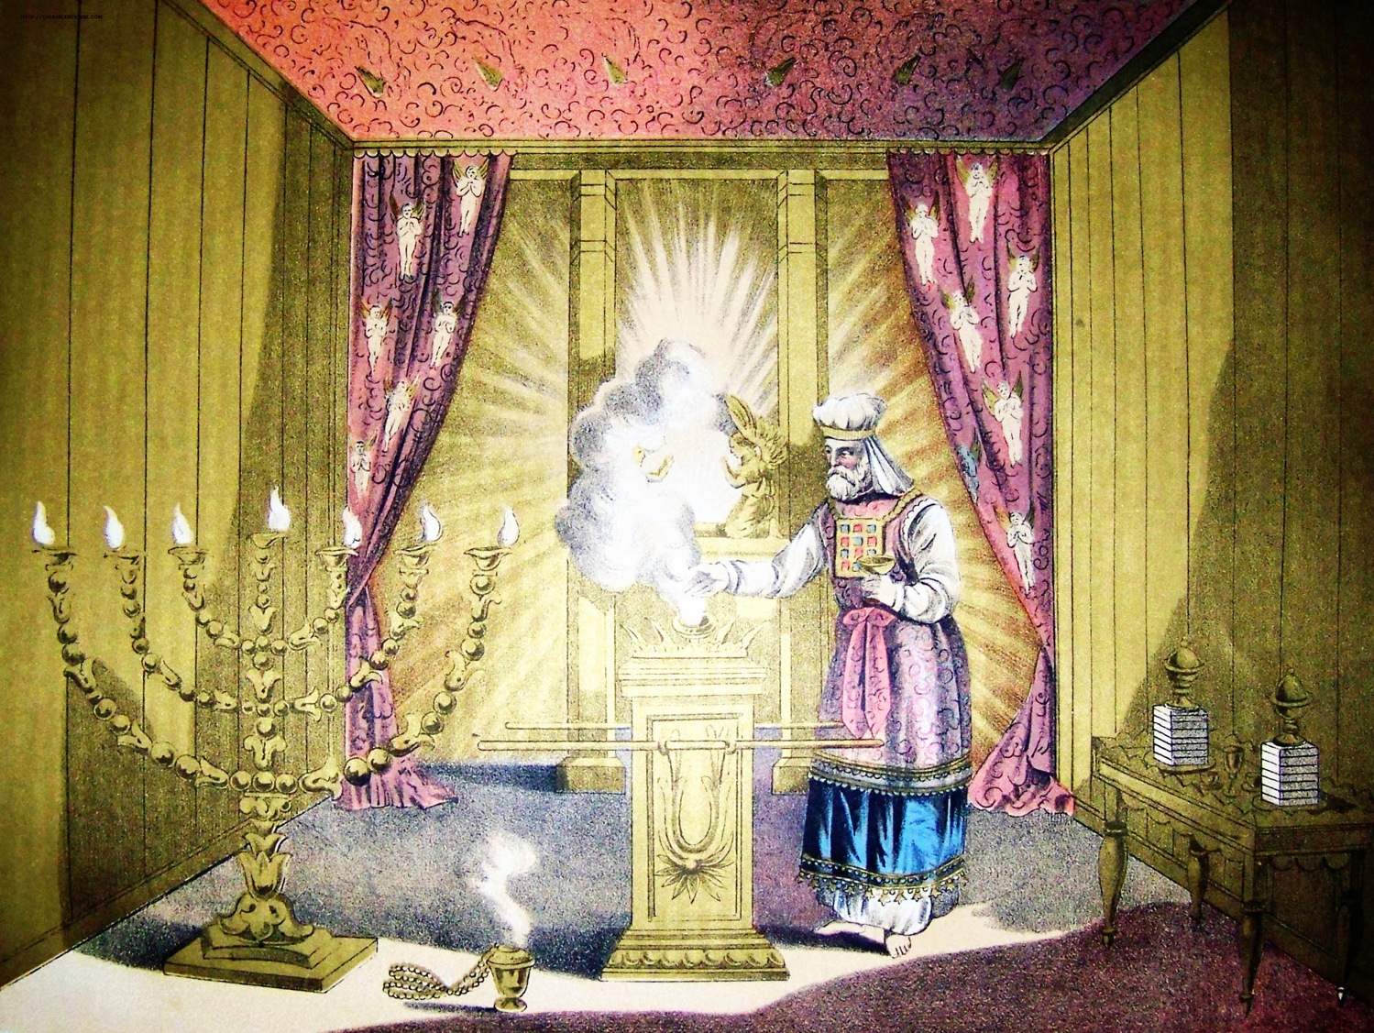
"If he were here on earth, he would not even be a priest, since there already are priests who offer the gifts required by the law" (8:4 NLT).
Notes:
Why wouldn’t Jesus be a priest if he were on earth (8:4)?
God follows the laws that he himself has made.
God says that no one can be a priest of the old covenant unless he descended from Aaron, while Jesus was in the kingly line of Judah instead.
Therefore, Jesus did not qualify as an earthly priest but he did qualify as a priest in the heavenly order of Melchizedek.

Slide 27
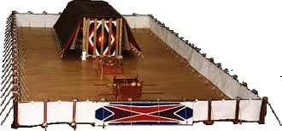
"They serve in a system of worship that is only a copy, a shadow of the real one in heaven.' For when Moses was getting ready to build the…" (8:5a NLT).
Notes:
How was the earthly tabernacle a copy of the heavenly one (8:5)?
The common idea is the place where God’s presence abides.
Even though God’s presence hovered over the ark, that still was a very local presence—a mere example of heaven, where God’s presence fills the place!

Slide 28
"…Tabernacle, God gave him this warning: 'Be sure that you make everything according to the pattern I have shown you here on the mountain'" (8:5b NLT).

Slide 29
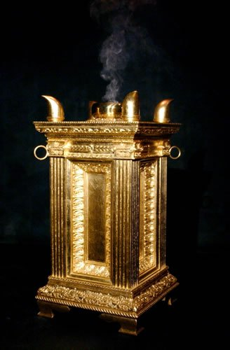
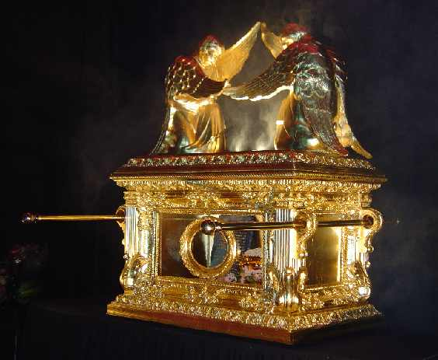
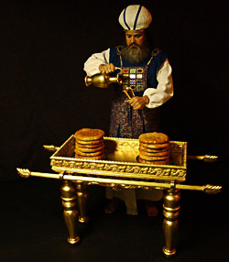
"But now Jesus, our High Priest, has been given a ministry that is far superior to the old priesthood, for he is the one who mediates for us a far better covenant with God, based on better promises" (8:6 NLT).
Notes:
Therefore, Jesus’ new covenant is better than the old covenant (8:6).
A better priesthood indicates a better covenant.
We often remember Jesus’ ministry at the cross for us—but we think too little of his ongoing, present ministry for us as our High Priest.
This, of course, means that he represents us before the Father. In fact, he prays for us constantly!

Slide 30


"Old" Replaced by "New"
266hh
Wayne Grudem, Systematic Theology, 521
"What then is the 'old covenant' in contrast with the 'new covenant' in Christ? It is not the whole of the Old Testament, because the covenants with Abraham and David are never called 'old' in the New Testament. Rather, only the covenant under Moses, the covenant made at Mount Sinai (Ex. 19-24) is called the 'old covenant' (2 Cor. 3:14; cf. Heb. 8:6, 13), to be replaced by the "new covenant" in Christ (Luke 22:20; 1 Cor. 11:25; 2 Cor. 3:6; Heb. 8:8, 13; 9:15; 12:24)."
Notes:
What covenant does Jesus mediate that is far better than the old (8:6)?

Slide 31
How is knowing Jesus better than anything you've ever experienced
(or ever will experience)?
Best
Representative
Best
Relationship
Notes:
How else is the new covenant better than the old? In the new covenant…

Slide 32
I. Jesus is the best possible representative before God (8:1-6).

Slide 33
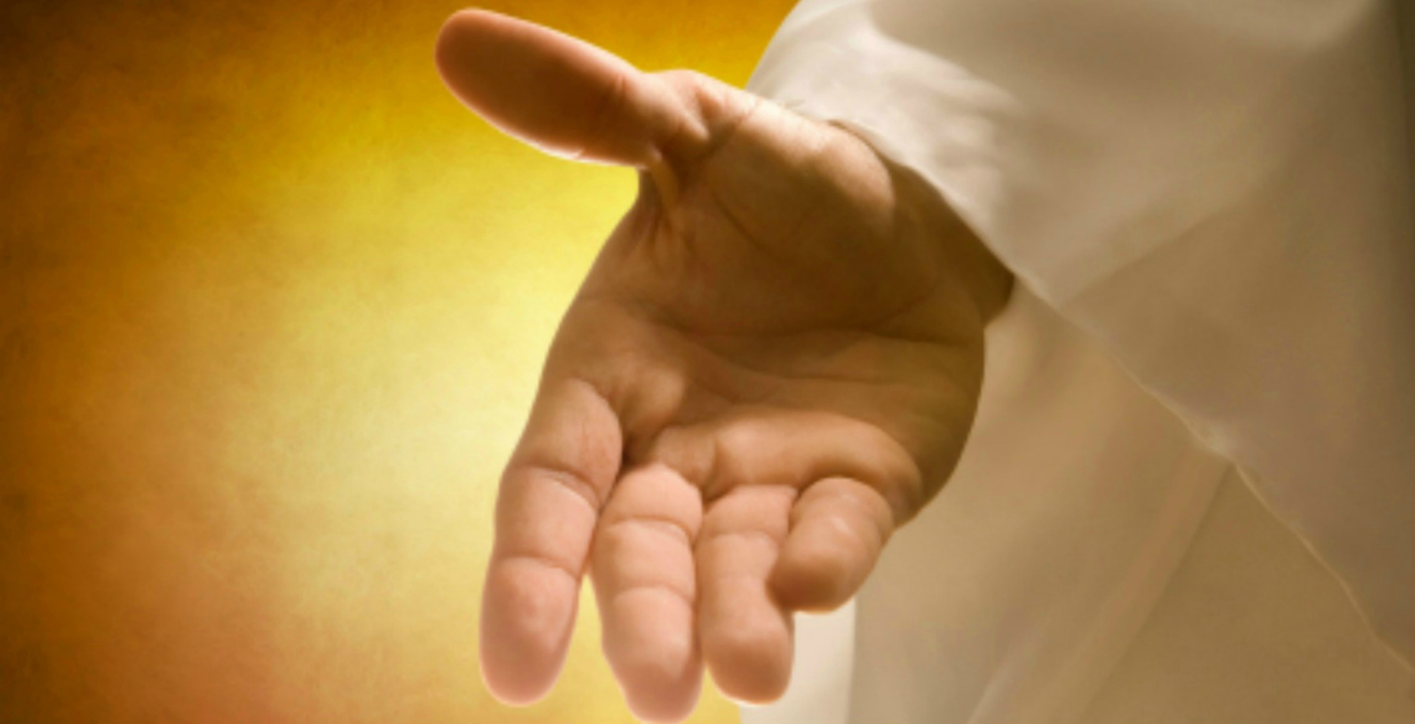
II. Jesus gives the best possible relationship (8:7-13)
Notes:
God made the most amazing agreement with us in Christ than he did with anyone else.

Slide 34
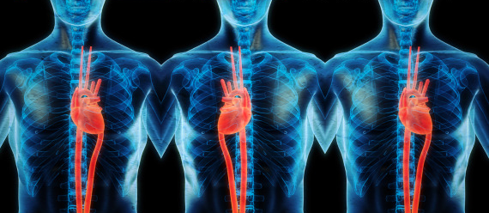
Jesus replaced a faulty covenant with a flawless one (8:7).
Notes:
The ways that the new covenant is better than the old makes the old obsolete (8:7-13; cf. Jeremiah 31:31-34).

Slide 35
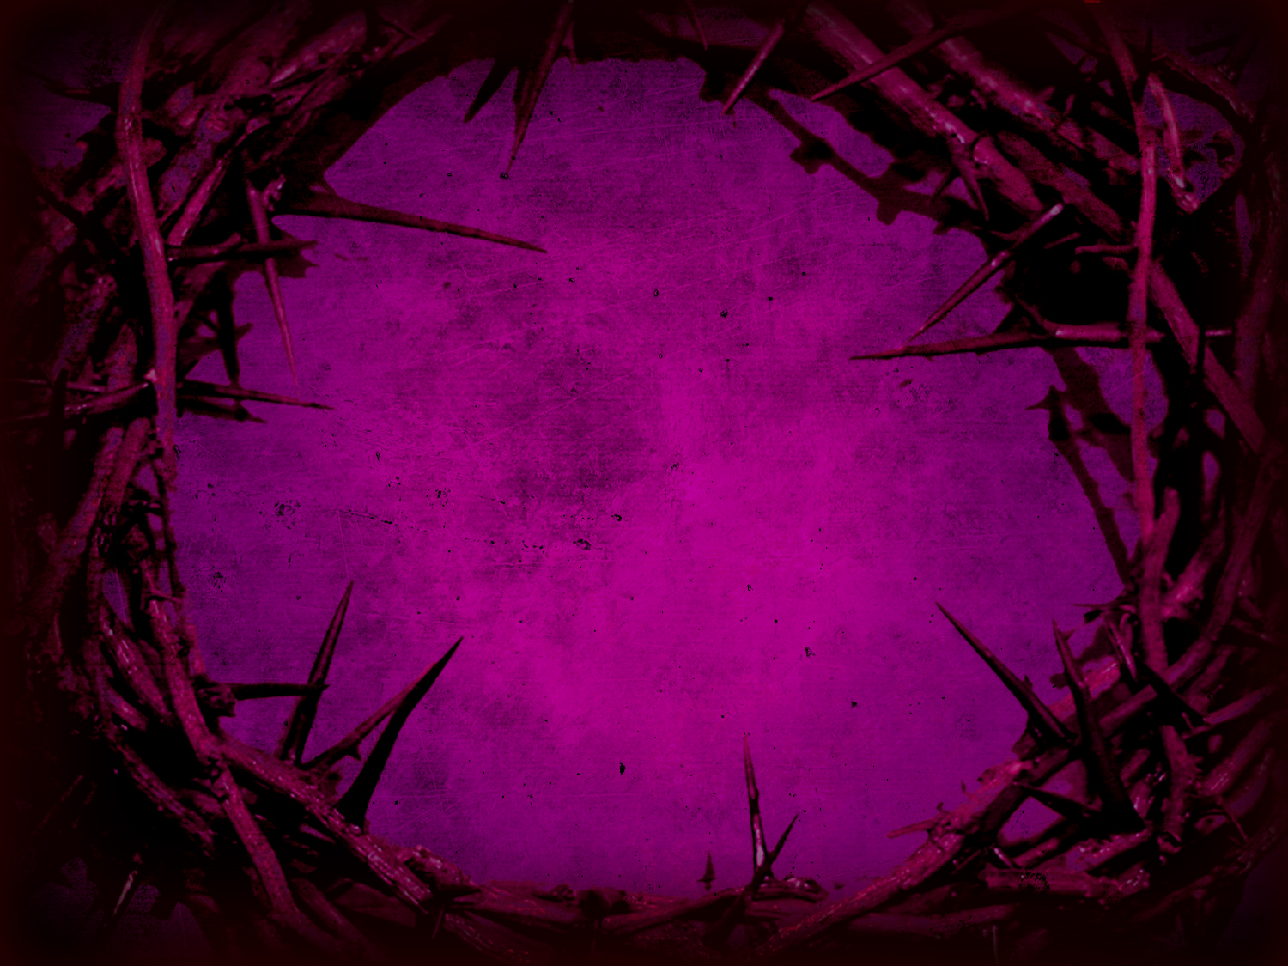
"If the first covenant had been faultless, there would have been no need for a second covenant to replace it.
⁸But when God found fault with the people, he said:
'The day is coming, says the LORD, when I will make a new covenant with the people of Israel and Judah'" (8:7-8).
Notes:
How was the first covenant flawed (8:7)?
God never intended for the old covenant to serve as a universal, perpetual system—it couldn’t, as it was impossible to expect Jews to offer a sacrifice in Jerusalem each time they sinned.
Rather, the new covenant is far better as it is not limited in space and time.
How could God make something flawed that needed to be replaced?
Actually, we do this all the time by making temporary things. We hardly expect anything to last forever—shoes, cars, computers, etc.
Being temporary and inferior, the old covenant effectively served its purpose until the arrival of the better covenant. It was like the scaffolding on a building that was designed only for a noble, yet temporary purpose.
An unbelieving people will be replaced with a believing Israel and Judah (8:8).
Was the new covenant needed due to fault with the old one or fault with the people—or both (8:8a)?
Both the old covenant and the people were to blame:
The system couldn’t really change people inside.
The people refused to follow it as well.
What Israel needed was a new agreement with God that was universal, internal and empowered by God for obedience.

Slide 36

If the new covenant were made with "Israel and Judah," then how would it apply to the church (8:8b)?
"Israel and Judah"
(Jer. 31:31)
"[We are] ministers of his new covenant"
(2 Cor. 3:6)

Slide 37

"This cup is the new covenant in my blood" (Luke 22:20)
Refers back to Jeremiah 31:31-34
The new covenant replaces the old
The church participates in the covenant promised to Israel
Never does Scripture say that the church replaces Israel since God has not rejected the nation (Rom. 11:1; cf. Jer. 31:35-37)

Slide 38
Views on New Covenant Fulfillment
View | Explanation | School & Scholars | Problems
Restated Mosaic | No New Covenant | Critical: –Couturier –Duhm –Schmidt –Potter | 1. OC/NC distinctions in text ignored 2. OC = conditional, NC = unconditional 3. OC = temporal, NC = eternal 4. OC = external, NC = internal 5. OC = no enablement, NC = enablement 6. NC = peace, prosperity, sanctuary, Spirit (parallel passages)
Church Alone | No Israel Participation | Amillennial/ Postmillennial: –Allis –Cox –Smick –Boettner | 1. Ignores OT data by equating Israel & the Church 2. NC introduced ≠ fulfilled to Israel 3. Present need to know YHWH (we still need to obey the Great Commission) 4. AD 70 Jerusalem vs. Jer. 31:40
166d

Slide 39
Views on New Covenant Fulfillment
View | Explanation | School & Scholars | Problems
Israel Alone | No Church Participation | Misc/Classical Dispensational: –Darby – Thompson –von Rad | 1. Ignores NT data –Christ's Last Supper words –Paul's statements –Hebrews application to Church 2. Ignores present work of Spirit
Two New Covenants | NC for Israel + NC for Church | Early 1900s Dispensational: –Chafer –Walvoord (old) –Ryrie (old) | 1. Same terminology for OT & NT NCs 2. Israel/Church distinction too sharp 3. Basis of forgiveness the same 4. If 2 NCs then no OC for Church 5. Church doesn't possess Israel's promises
166d

Slide 40
= My View on New Covenant Fulfillment
View | Explanation | School & Scholars | Problems
Church Participates | Primarily for Israel Secondarily for the Church | Misc/Present Dispensational: –Keil –Lemke –Bright –Scofield –Walvoord (DTS) –Ryrie (DTS) –Archer (TEDS) –Kaiser (TEDS) | Support: 1. Primary fulfillment is future— Rom 11 2. Deals with both OT & NT data 3. Forgiveness & the Spirit are blessings experienced now 4. NC has new law 5. Rebuttals to above views
166d

Slide 41

Sign of the Covenant with Noah

Slide 42
Signs of the Covenants
166e
Covenant | Definition | Promise | Fulfillment | Sign
Noahic | Unconditional promise not to flood earth again | Gen. 9:12-17 | No more sea (Rev. 21:1) | Rainbow (Gen. 9:12-17)
Abrahamic | Promise to provide Israel a land, rule, and spiritual blessing | Gen. 12:1-3; 15:13-18 | Continues at present (Gal. 3:17) but Israel still has a future (Rom. 11:25-27) | Circumcision (Gen. 17:11)
Mosaic | Conditional stipulations for blessing on Israel | Exod. 19-31; Deut. 28 | Death of Christ (Rom. 7:4-6) | Sabbath (Exod. 31:13)
Land | Promise of physical land from the Wadi of Egypt to the River Euphrates | Deut. 30:1-10 | Land blessed (Amos 9:13-15) | No sign (that I know of)
Davidic | Promise of eternal, political rule of a descendant of David | 2 Sam. 7:12-17 | Rule renewed (Amos 9:11-12) | Christ seated at the Father's right hand (Acts 2:34-36)
New | Promise of spiritual indwelling of the Spirit ("law written on hearts"), forgiveness, and total evangelization of Israel | Jer. 31:31-34 | Paul & the Apostles (2 Cor. 3–4) All Israel saved (Rom. 11:26-27) | Cup of the Lord's Supper (Luke 22:20; 1 Cor. 11:25)

Slide 43
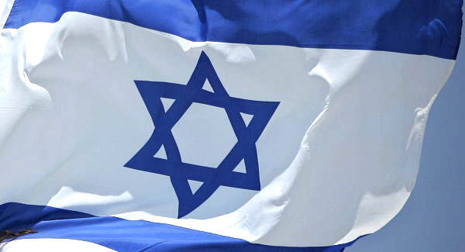
God says it has to be fulfilled with Israel, so He will do it!

Slide 44
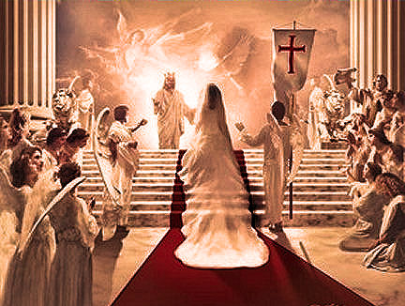
Marriage of the Bride

Slide 45

The Mosaic stone tablets will be replaced with a covenant of minds and hearts (8:9-10a)

Slide 46
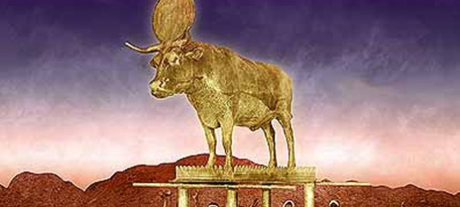
"This covenant will not be like the one I made with their ancestors when I took them by the hand and led them out of the land of Egypt. They did not remain faithful to my covenant, so I turned my back on them, says the LORD" (8:9 NLT).

Slide 47
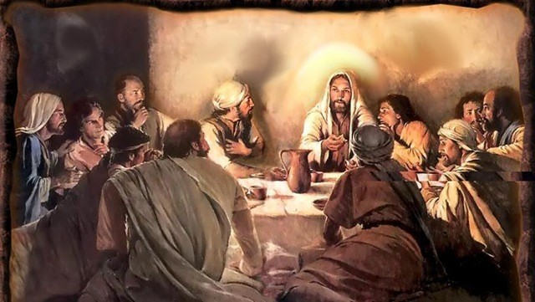
"But this is the new covenant I will make with the people of Israel on that day, says the LORD" (8:10a NLT).

Slide 48
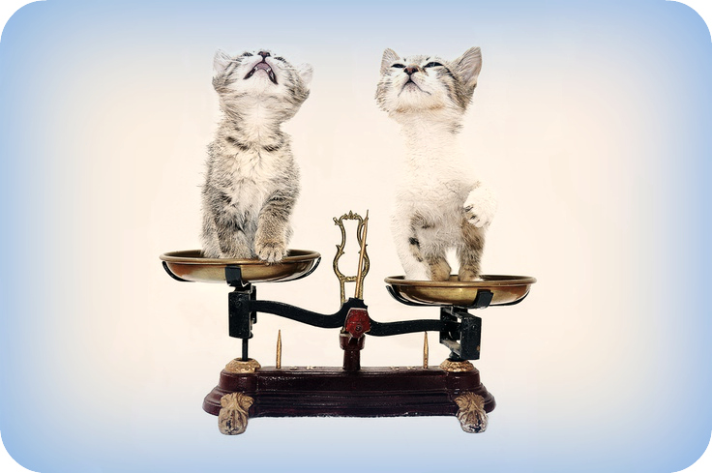
How can we contrast the Old and New Covenants?

Slide 49
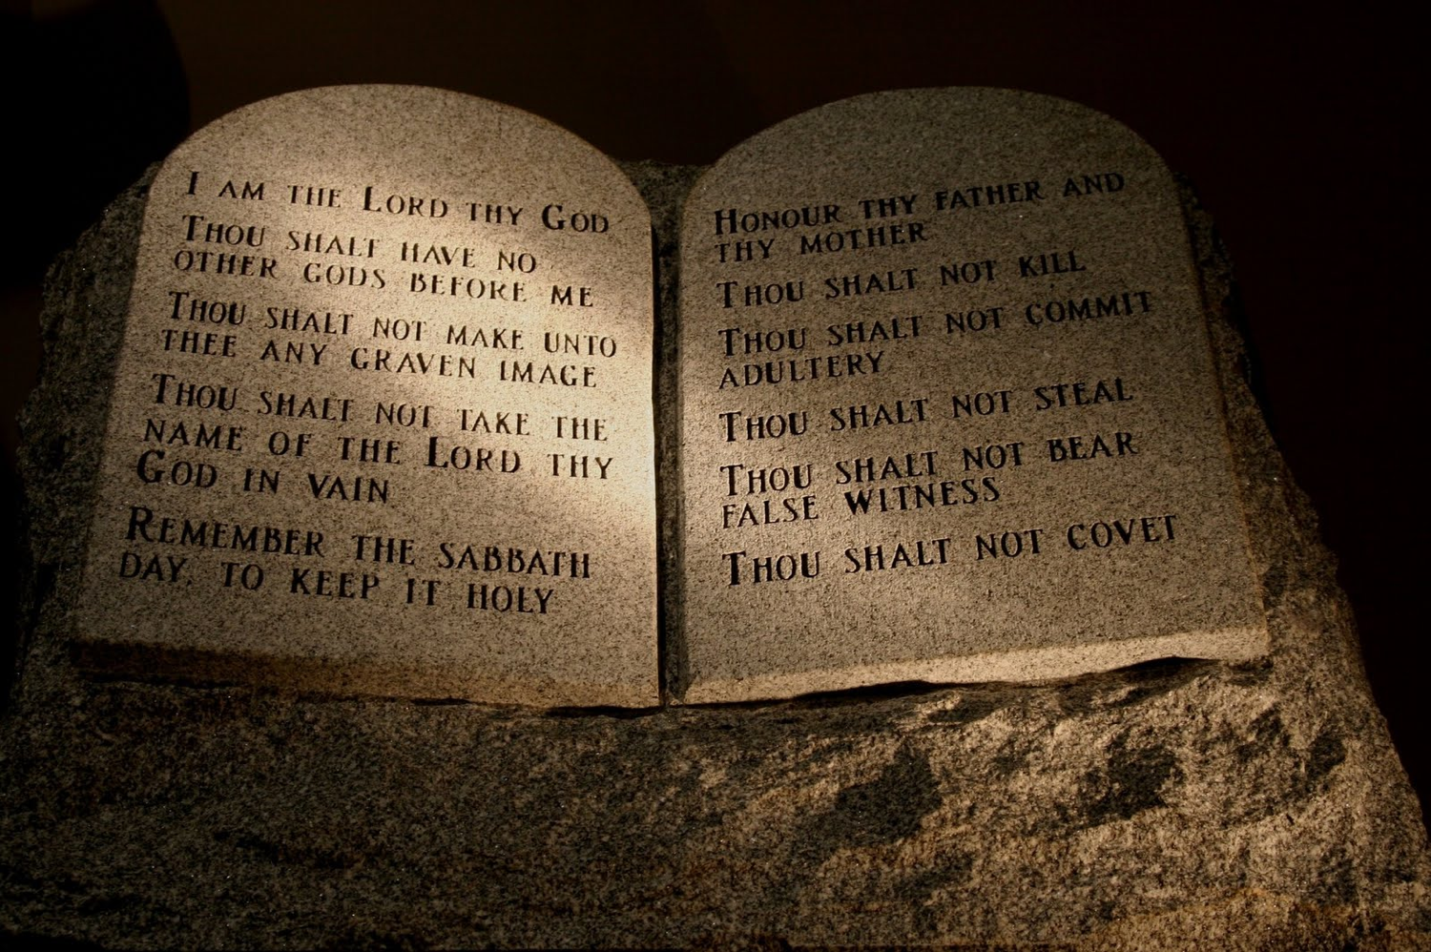
The Old Covenant for Israel

Slide 50

The New Covenant is for the Church now (Jew and Gentile), but many more Jews will believe in Christ during the Tribulation

Slide 51
Contrasting the Covenants (2 Cor. 3–4)
166c
Old Covenant | New Covenant
initiated by Moses (3:8) | initiated by Christ (3:4)
of the letter (3:6a) | of the Spirit (3:6a, 18b)
kills (3:6b, 7a) | gives life (3:6b)
engraved on stone (3:3b, 7a) | engraved on hearts (3:3b; Jer. 31:33)
glorious (3:7a) | more glorious (3:8, 10)
glory faded (3:7b, 11a, 13b) | glory ever-increases (3:11b, 18)
condemns men (3:9a) | brings righteousness (3:9b)
deception (3:13) | boldness (3:12)
veiled face of Moses (3:13b) | unveiled faces (3:13a, 18a)
veiled minds (3:14a) | unveiled minds (3:14b; 4:3-6)
veiled hearts (3:15) | unveiled hearts (3:16)
dullness (3:14a) | freedom (3:17)
Moses reflected God's glory | all believers reflect Son's glory (3:17)
non-transforming (3:7) | transforming (3:18)
lack of zeal (3:13) | confidence, steadfastness (3:4-5; 4:1)
deception (3:13) | sincerity (4:2)

Slide 52
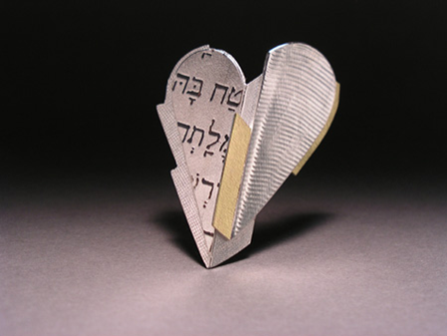
"I will put my laws in their minds, and I will write them on their hearts"
(8:10b NLT).
Notes:
How would God put his law on people’s minds and write it on their hearts (8:10)?
This passage doesn’t say how this will happen.
Other texts tell us that the Holy Spirit will change us within.

Slide 53

"I will be their God, and they will be my people"
(8:10c NLT).

Slide 54
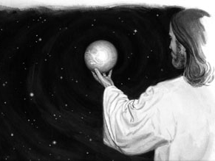
"And they will not need to teach their neighbors, nor will they need to teach their relatives, saying, 'You should know the LORD.' For everyone, from the least to the greatest, will know me already"
(8:11 NLT).

Slide 55
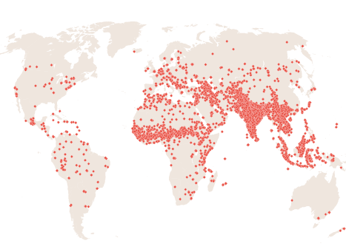
Unreached Peoples
joshuaproject.net
Notes:
When will everyone know the Lord and thus not need to be evangelized (8:11)? Right now the world's 7,000+ unreached people groups lack enough followers of Christ and resources to evangelize their own people, but that will totally change in the days to come.

Slide 56
A "Pre-Trib" Rapture explains how the Millennium will have both babies & death
435
Second Coming
Christians
Rapture
Those remaining
Tribulation
Millennium
Church Age
Eternal Kingdom
7 years
1000 years
At the Rapture, believers will go to heaven and unbelievers remain on earth—the Tribulation will start 0% Christian.
After the Tribulation, believers on earth will enter the Millennium in their mortal bodies—the Millennium will start 100% Christian.
Judgment

Slide 57
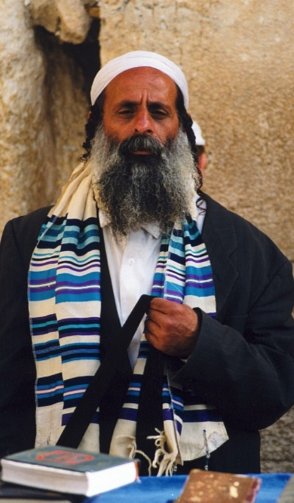
"All Israel will be saved" (Rom. 11:25-27)
155w
²⁵I do not want you to be ignorant of this mystery, brothers, so that you may not be conceited: Israel has experienced a hardening in part until the full number of the Gentiles has come in.
²⁶And so all Israel will be saved, as it is written:
"The deliverer will come from Zion; he will turn godlessness away from Jacob.
²⁷And this is my covenant with them when I take away their sins."

Slide 58

"From every tribe, nation, language and people" (5:9)
369

Slide 59

Worldwide Belief in God

Slide 60
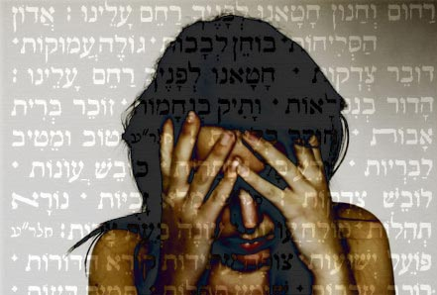
"And I will forgive their wickedness, and I will never again remember their sins"
(8:12 NLT).

Slide 61
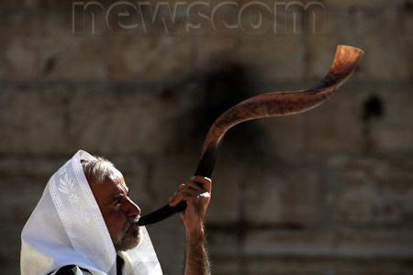
Yom Kippur (the Day of Atonement) looks each year to the forgiveness in the New Covenant

Slide 62

Yom Kippur
Wishing you a happy Yom Kippur
Notes:
One Messianic Jew wrote on 3 October 2014…
"Today, is Yom Kippur. A Jew will go to those he has wronged, and ask forgiveness. He will do so believing that God of Israel forgives those who forgive others… Yeshua the Messiah… is the perfect Yom Kippur for all Jews, and all people on the face on the Earth. Amen."
http://ivarfjeld.com/2014/10/03/greetings-on-yum-kippur/

Slide 63
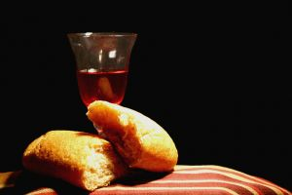
New Covenant Blessings
Motivation to obey God (8:10a)
Relationship with God (8:10b)
Knowledge of God (8:11)
Forgiveness of sin (8:12)
Notes:
Note that these will all apply to Israel and Judah, too.
As such these blessings await full, future fulfillment for Jews at the return of Christ.
When "all Israel will be saved" (Rom. 11:26), the knowledge of God will actually be true of the entire world in the millennium!

Slide 64
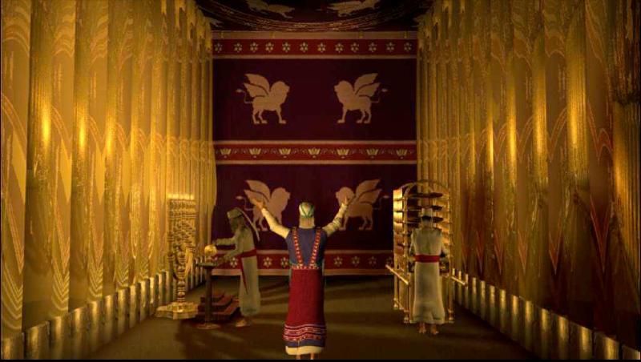
The obsolete old covenant would soon disappear (8:13).

Slide 65

"When God speaks of a 'new' covenant, it means he has made the first one obsolete. It is now out of date and will soon disappear"
(8:13 NLT).

Slide 66
Hebrews 8:13
"By calling this covenant 'new,'
he has made the first one obsolete; and what is obsolete and aging will soon disappear."
Obsolete
AD 33
Hebrews Written
AD 67-68
Disappeared
AD 70
Notes:
When was the old covenant rendered obsolete (8:13a)?
Christ’s death in AD 33 rendered the old sacrificial system unnecessary.
It thus became obsolete.
How was the old covenant rendered obsolete (8:13b)?
It was not designed to last forever, as it was but a shadow.
Now that the substance (Christ) has come, the shadow (OT law) is not needed.
When was the old covenant to disappear (8:13c)?
This letter was written about AD 66-68 during the Jewish Revolt against Rome.
The uprising would soon result in the destruction of the temple, putting an end to the sacrificial system in AD 70.

Slide 67
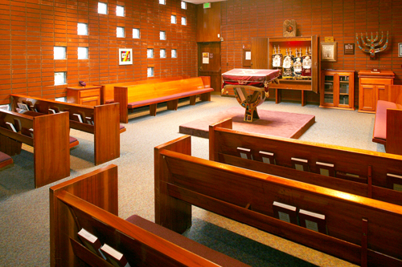
Don't emphasize rituals over your relationship with God!

Slide 68
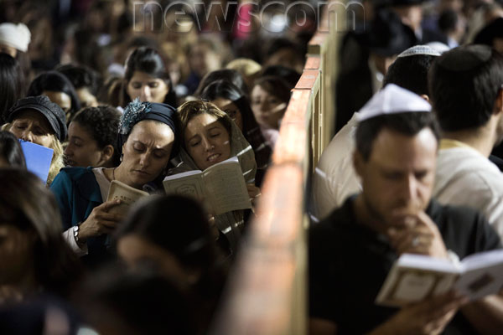
Jewish women pray along thousands of Jews for forgiveness (Selichot), at the Western Wall, the holiest site in Judaism, in Jerusalem's Old City, Israel

Slide 69
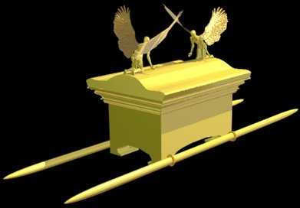
The Ark of the Covenant

Slide 70
How is the New Covenant Better?
(Hebrews 8)

Slide 71
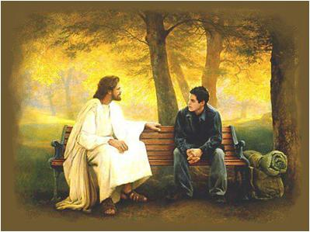
Main Idea of Hebrews 8
Our better priest gives us a better relationship with God.

Slide 72
I. Jesus is the best possible representative before God (8:1-6).

Slide 73
II. Jesus gives the best possible relationship (8:7-13)

Slide 74
Do you relate to Jesus as your compassionate, High Priest?
JESUS > RELIGION

Slide 75
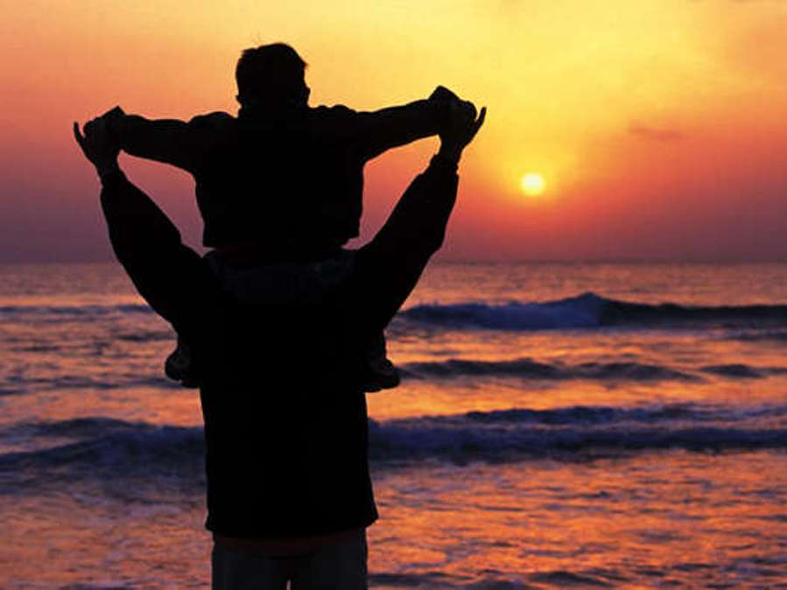
Relationship, not rituals

Slide 76

New Covenant Growth
Growing
in
Christ

Slide 77
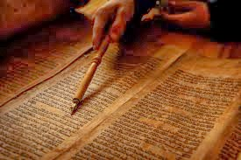
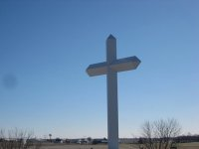
Which covenant is reflected in your life?

Slide 78
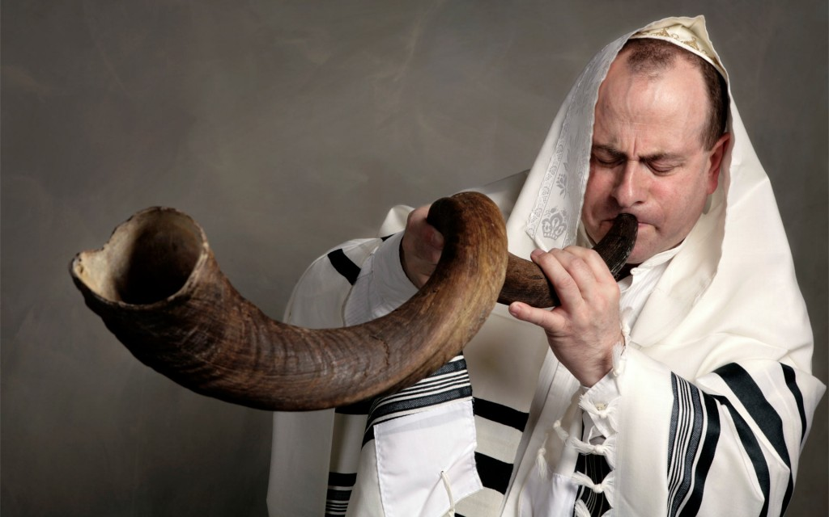
Yom Kippur (the Day of Atonement) looks each year to the forgiveness in the New Covenant

Slide 79
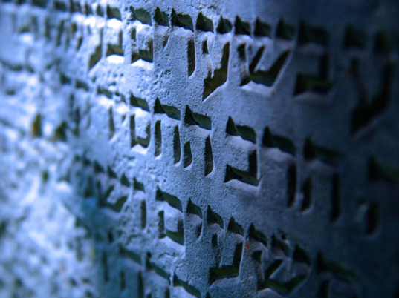
The "Better" Book
Hebrews uses the word "better" 13 times…
266f
8:4 Christ is "better than the angels"
6:9 We are confident of "better things in your case"
7:7 Melchizedek "better" ("greater") than Abraham
7:19 "We have confidence in a better hope"
7:22 Jesus is the "guarantee of a better covenant"
8:6 Christ is the "mediator of a better covenant"
8:6 New covenant "established on better promises"
9:23 Priestly garments need "better sacrifices"
10:34 Heaven a "better and lasting possession"
18:16 Heaven a "better country"
18:35 They obtain a "better resurrection" experience
18:40 God "provided something better for us"
12:24 Christ's blood is "better than the blood of Abel"
Note:
18:4 "Abel offered to God a better sacrifice" uses a different Greek word often translated "better"

Slide 80
Hebrews 8:6
"But the ministry Jesus has received is as superior to theirs as the covenant of which he is mediator is superior to the old one, and it is founded on better promises."

Slide 81
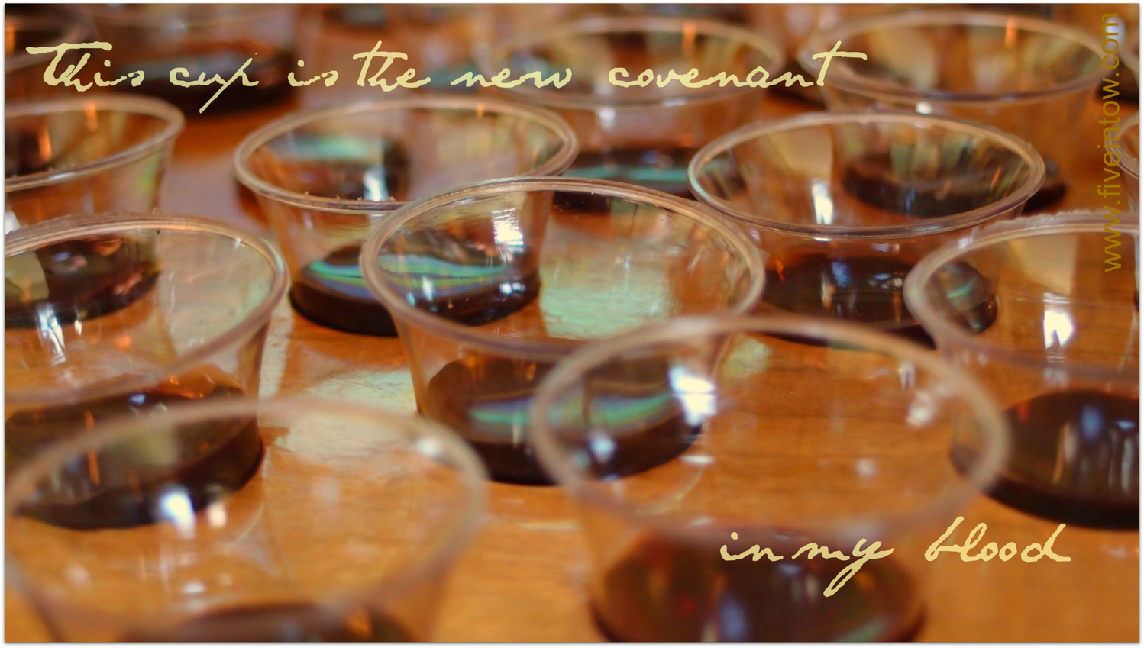
The Lord's Supper

Slide 82

The Cup of the New Covenant

Slide 83
Black

Slide 84


NT Preaching link at BibleStudyDownloads.org
Get this presentation and script for free!

