Slide 1
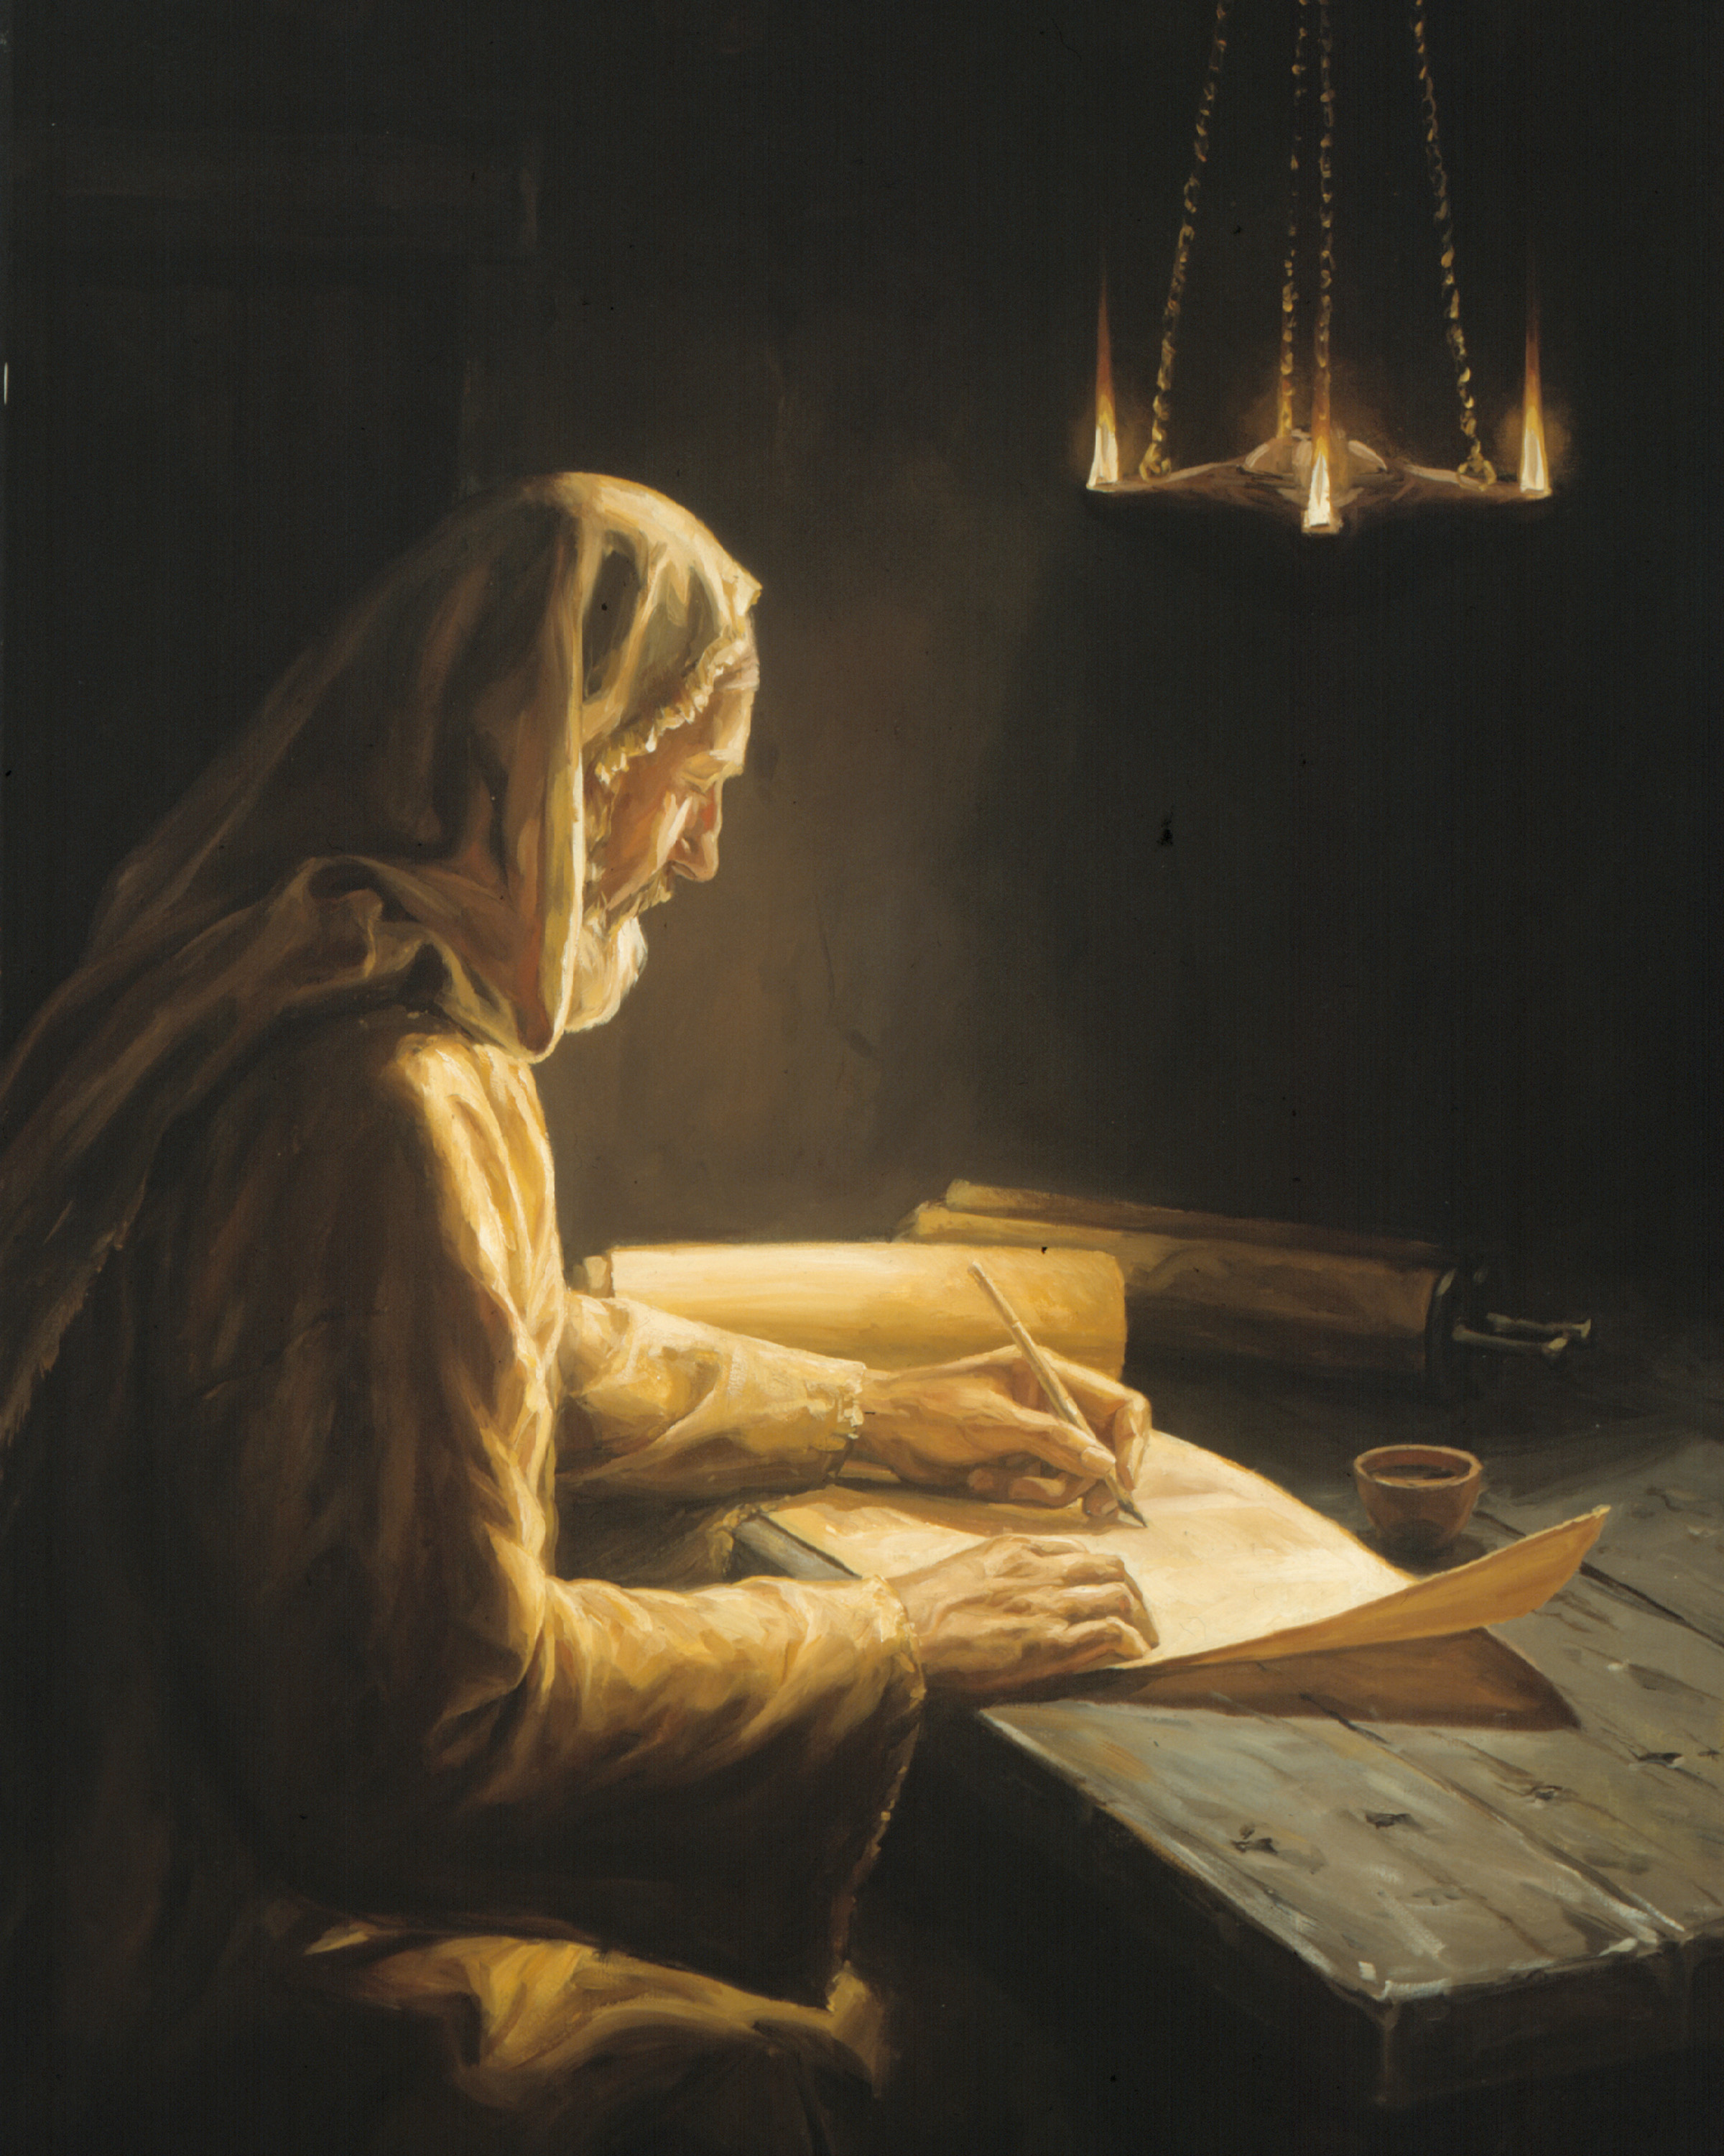
Better than Prophets
Hebrews 1:1-3
Dr. Rick Griffith • Crossroads International Church Singapore
BibleStudyDownloads.org

Slide 2

Some love running.
Notes:
Some people just love running.
One of my graduate school colleagues recently told me that he can't gain weight. He weighs only 123 pounds, or 55 kilos. I told him, "You want to gain weight? That's easy. Stop your running every day and enjoy more desserts!"

Slide 3
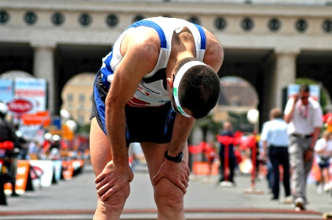
Some quit.
Notes:
He is among several colleagues who run every day, but I'm not much of a runner. I figure that running is silly because you exert all that energy and still end up tired and right where you started!

Slide 4

The Christian life is a race
Notes:
But, seriously speaking, the Christian life is a race where many drop out

Slide 5

Some are running well but…
Notes:
Some believers run well for a time…

Slide 6
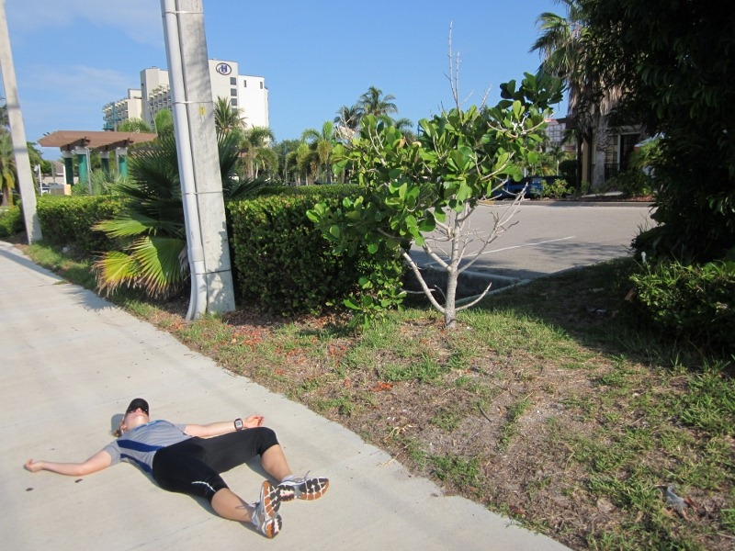
Some quit the Christian race
Notes:
…but then they quit.

Slide 7

Foster Letter 2002
"The 'American Family In Crises Research' by the Southern Baptist Council on Family Life uncovered some disturbing facts. Of the children raised in evangelical homes, 88% leave the church at age 18 and never return."
Pastor's Weekly Briefing, Focus on the Family, 26 July 2002, quoted in Gary Foster, The Foster Letter, 10 Aug. 2002, p. 1.
Notes:
In the USA, about 2 or every 3 teenagers quits the race and stops attending church in their 20s. It's as high as 88% who quit!
__________
From Carl Kerby
Following is the entire quote that was in my newsletter. My source was the 7/26/02 issue of Pastor's Weekly Briefing published by the Pastoral Ministries department of Focus on the Family.
American Family In Crises Research by the Southern Baptist Council on Family Life has uncovered some disturbing facts that are leading the group to emphasize the need to rebuild the American family.
§ 88% of the children raised in evangelical homes leave church at the age of 18, never to return.
§ The divorce ratio among members of evangelical churches is virtually the same as non-church members.
§ One million children in the U.S. see their parents divorce.
§ Personal bankruptcies are at an all-time high in America.
The majority of children in America have less than 10 minutes of significant and meaningful conversation with their parents each week. If you remove the mother, you can measure this statistic in seconds. The council recommends that families set aside one evening a week as a family night, on which no local church activities would be scheduled to interfere. It also urged an increased emphasis on biblically based premarital counseling. (PWB 7/26)
Gary D. Foster
Gary D. Foster Consulting
334 Sutherland Place
Manitou Springs, CO 80829
Phone: 719-685-1138 E-mail: GFosterCns@rmi.net Website: http://www.garydfoster.com/
"Helping Christian ministries & product companies discover new revenue streams and to better leverage existing ones."

Slide 8
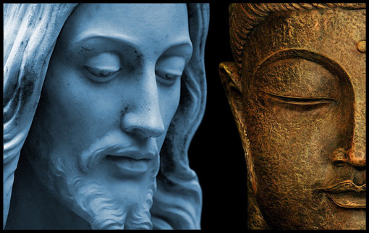
Singaporeans Return
Notes:
The last major study of new believers in Singapore in the 1980s shows that one third of Buddhists who become Christians then return to Buddhism (Keith Hinton, Growing Churches, Singapore-Style).

Slide 9

"They used to be here."
• Divorce
• College doubts
• Living together
• Living apart
Notes:
As I think about those who used to attend here, I think of one woman who divorced her husband, youth who abandoned the Lord in college, people living together apart from marriage, and others who found the race too difficult—so they quit.

Slide 10

How long will you run with Christ?

Slide 11
What about you?
266t
Atheist?
Ancestor Worship?
Buddhist?
Free thinker?
Hindu?
Muslim?
Taoism?
Christian?
Nominal Christian?
What was your previous religion?
What tempts you to go back?
Notes:
Some aspects of quitting seem nice. I often ask students what their previous religion was and what tempts them to go back.

Slide 12

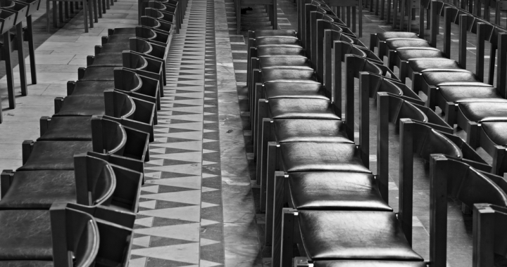
Some aspects of quitting seem nice.
Time
Money
Family
Notes:
Time: If you don't attend church on Sunday, the whole day can be an adventure.
Money: Giving 10% of your money to God is costly—most spend it on stuff.
Family: Many of my relatives want me to quit the race to be closer to them.

Slide 13

Will you cross the finish line in your Christian race?
Notes:
What makes you think that you will press on in the Christian race? Will you cross the finish line?

Slide 14

Keep running
Notes:
Why keep running after Jesus? I assume that you think this race is worth running…

Slide 15

Why keep running?
Notes:
…but why keep running after Jesus?

Slide 16

Hebrews
H

Slide 17

Press On!
A Study of Hebrews
Notes:
So the author exhorting them repeatedly in his letter to press on, so I'm calling this new series on Hebrews "Press On!"

Slide 18
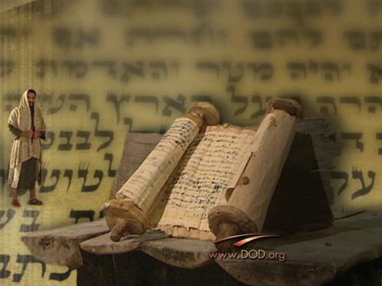
Background to the Letter

Slide 19
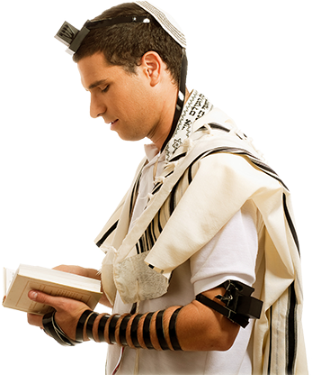
How do we know that the readers were Jews?

Slide 20
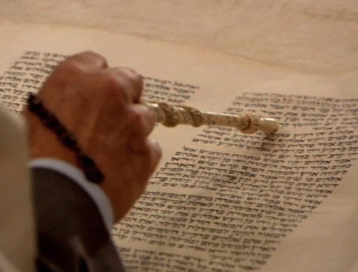
How do we know that the readers were Jews?
Many OT quotes
"To the Hebrews"
Notes:
The letter has many allusions to and quotes from the Old Testament that would have needed explanation if it was sent to Gentiles. This finds support in that "To the Hebrews" is the oldest and most reliable title.

Slide 21
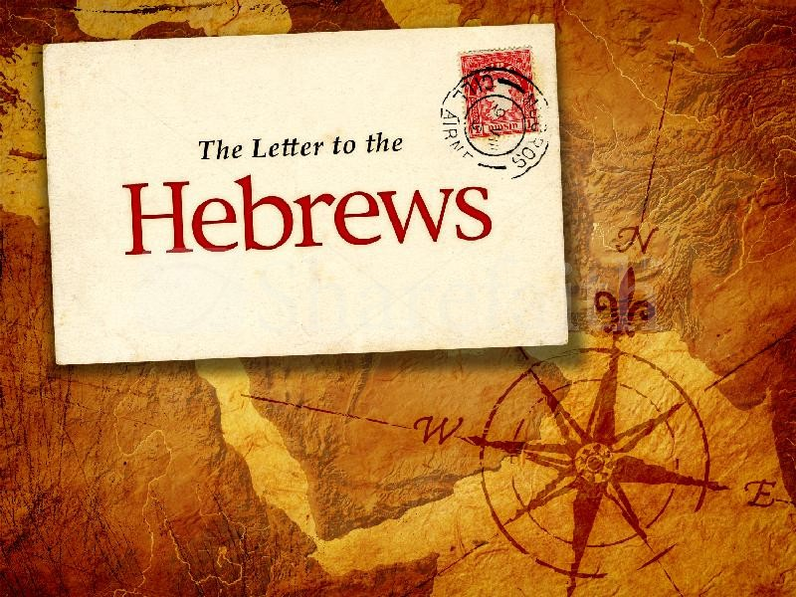
Hebrews
The Letter to the

Slide 22

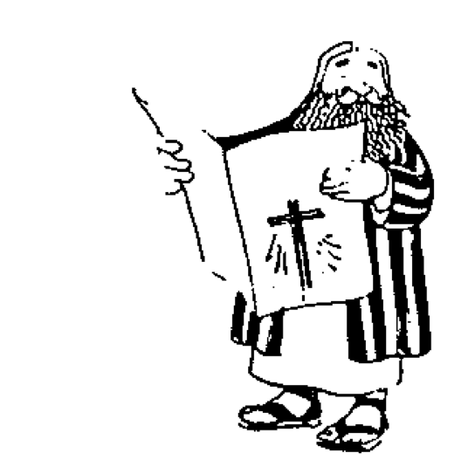




The New Testament "Building"
21
Paul's Letters to Pastors
 | 1 Timothy | 2 Timothy | Titus |  | Philemon
Paul's Letters to Churches | 2 Thessalonians |  |  |  | Revelation | General Letters
 | 1 Thessalonians |  |  |  | Jude
 | Colossians |  |  |  | 3 John
 | Philippians |  |  |  | 2 John
 | Ephesians |  |  |  | 1 John
 | Galatians |  |  |  | 2 Peter
 | 2 Corinthians |  |  |  | 1 Peter
 | 1 Corinthians |  |  |  | James
 | Romans |  |  |  | Hebrews
 | Acts
 | Matthew | Mark |  | Luke | John
Historical Books
Romans sets the foundation for Paul's Epistles
Hebrews sets the foundation for the General Epistles
Adapted from Walk Thru the Bible
Notes:
Contrary to the placement of Hebrews as first of the General Epistles in the NT (like Romans heads up the Pauline letters), many lines of evidence indicate that the letter is not a general address; instead, it appears that these Jewish Christians composed a specific community…

Slide 23
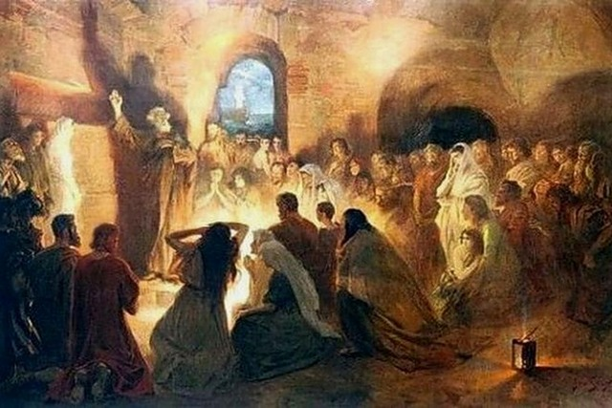
A Specific Jewish Community
"And especially pray that I will be able to come back to you soon" (13:19 NLT).
Notes:
The author already visited them once and wanted to revisit them (13:19, 23).
The readers apparently had a concern for Timothy as well (13:18).

Slide 24
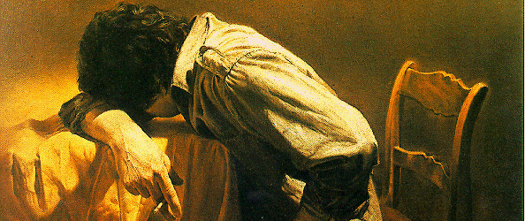
A Jewish Community Under Stress
"You suffered along with those who were thrown into jail, and when all you owned was taken from you, you accepted it with joy. You knew there were better things waiting for you that will last forever" (10:34 NLT).
Notes:
They have a definite history to which the author is acquainted, including their conversion (2:3), ministry to other Christians (6:10), sufferings for the gospel (10:32-34), and present state of spiritual maturity (5:11ff.).
The readers may have been the leaders of a larger community since it is unlikely that the writer would expect the entire church to be teachers (5:12).

Slide 25

Where did these Jews live?
256
Rome?
Asia Minor?
Cypress?
Israel?
Cyrene?
Notes:
Destination: The Jewish Christians who first read the letter lived in a specific geographical location that probably was away from Jerusalem (i.e., in a mission field) since they were not among those who personally saw the Lord (2:3).
Many destinations have been suggested: Asia Minor, Rome, Cyprus, Cyrene, and Israel.
No one really knows the origin or destination, but Jewish Christians in the Diaspora mixed with Gentile believers, as in Ephesus, Corinth, and Rome—but the recipients of this letter were all Jews, so a location in Israel is most likely.

Slide 26
Where did these Jews live?
256
Rome
"The believers from Italy send you their greetings" (13:24b NLT).
Israel
Notes:
Origin: The letter seems to be sent from Italy (13:24) to another locale. Italy itself may have been the destination since the Italians here may have been with the author sending their greetings to their countrymen in Italy, but Jewish believers there lived with Gentiles, so that's why Israel is more likely the destination.

Slide 27
HEBREWS
256-
257
Author
Recipients
Origin
Destination
UNKNOWN

Slide 28
Review of the Background…
The Recipients
  Most see it as written to Jewish Christians.
  No one knows where they were at the time of the writing.
  Many see the recipients in Israel and the author in Italy (13:24)
  The author knew the recipients personally (10:34; 13:19)

Slide 29
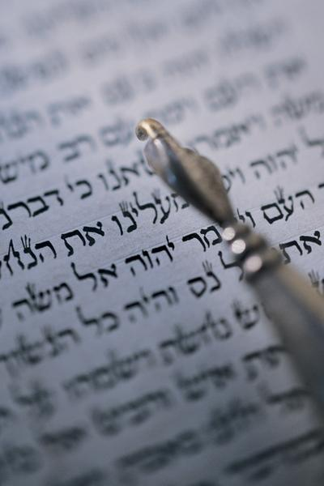
"Should I go back?"
"So we must listen very carefully to the truth we have heard, or we may drift away from it" (2:1 NLT).

Slide 30

Why keep running?
Notes:
Preview: Today we will see why the first readers should keep their faith in Jesus—and why we should too.

Slide 31

Hebrews 1:1-3
Notes:
The reason the original readers were exhorted to keep their faith in Jesus was because of the word "better"…

Slide 32
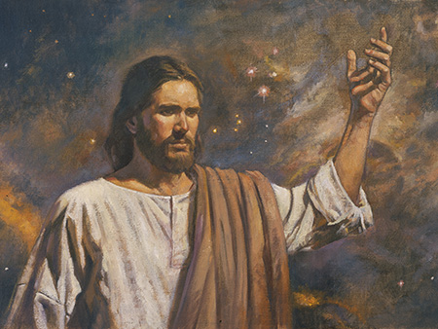
I. Christ is better than any prophet (1:1-3).
Notes:
Jesus best reveals God, so he's greater than any limited spokesman for God.

Slide 33

Hebrews: "Press On!"
254
Christ's Superiority Over Judaism as High Priest
Superior in His Person to... |  |  | Superior in His Priestly Work to... |  |  |  |  | Endurance Through Faith
1:1–4:13 |  |  | 4:14–10:18 |  |  |  |  | 10:19–13:25
Prophets | Angels | Moses | Aaron | Melch | Old Cov. | Taber-nacle | Sacri-fices | Will-ful Sin | Models | Endure as Sons | Ethics | Ignoring God | Exhort
1:1-3 | 1:4–2:18 | 3:1–4:13 | 4:14–6:20 | 7 | 8 | 9:1-10 | 9:11–10:18 | 10:19-39 | 11:1–12:3 | 12:4-13 | 12:14-17 | 12:18-29 | 13
Christ's Majesty |  |  | Christ's Ministry |  |  |  |  | Christian's Manifestation
Theology |  |  |  |  |  |  |  | Practice
Unknown Author, Recipients, Origin, and Destination!
AD 67-68

Slide 34

The Better Things
266f
Superior Person 1:1–4:13
Superior Work 4:14–10:18
Endure by Faith 10:19–13:25

Slide 35
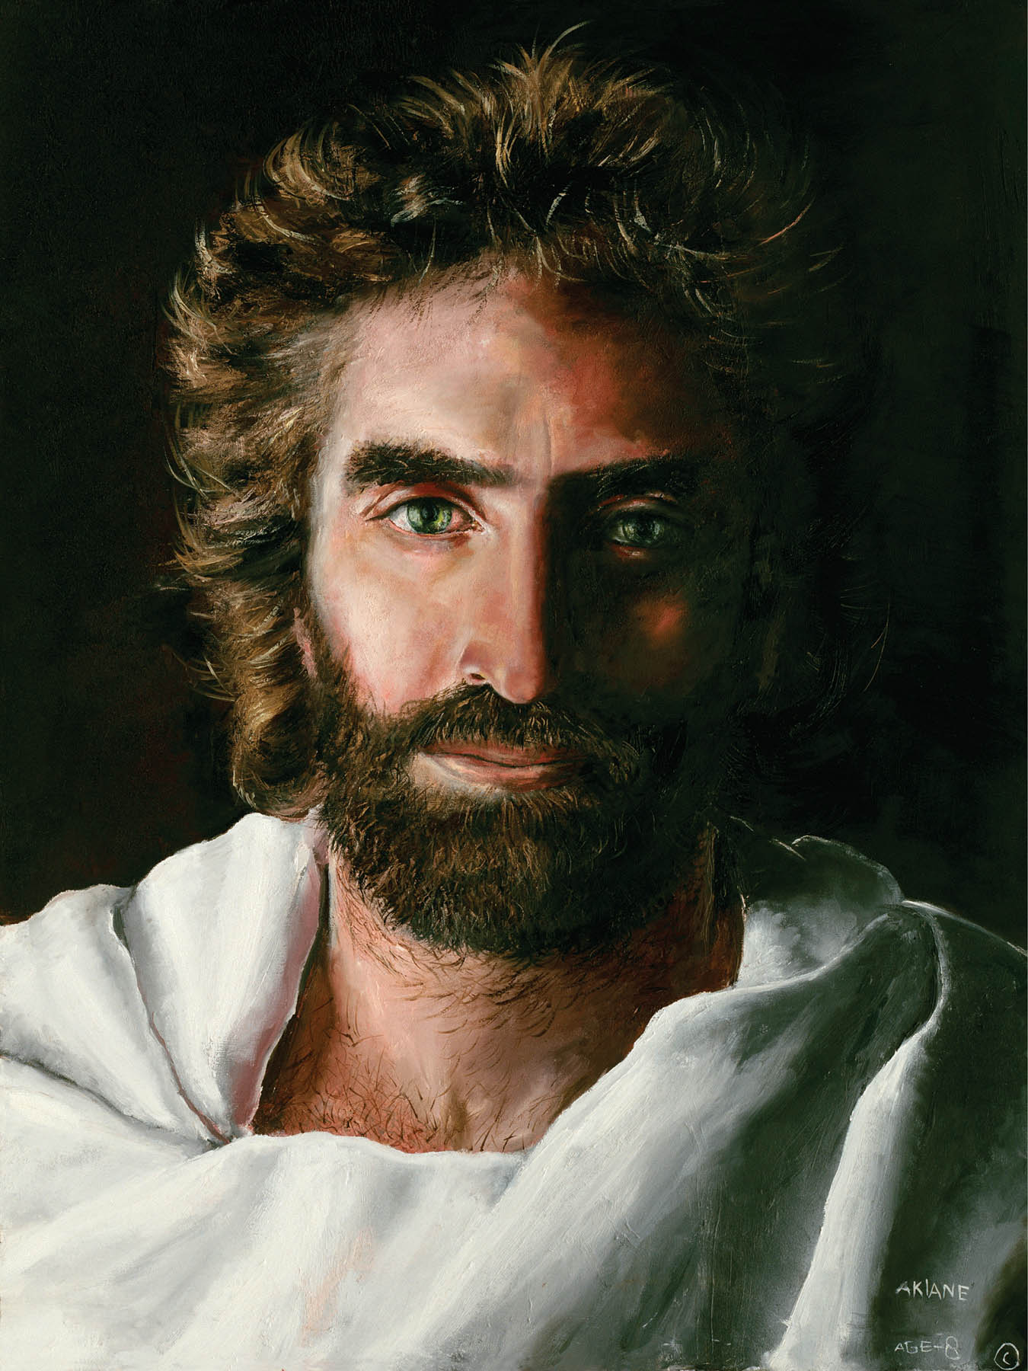
Christ as Superior in His Person (1:1–4:13)

Slide 36
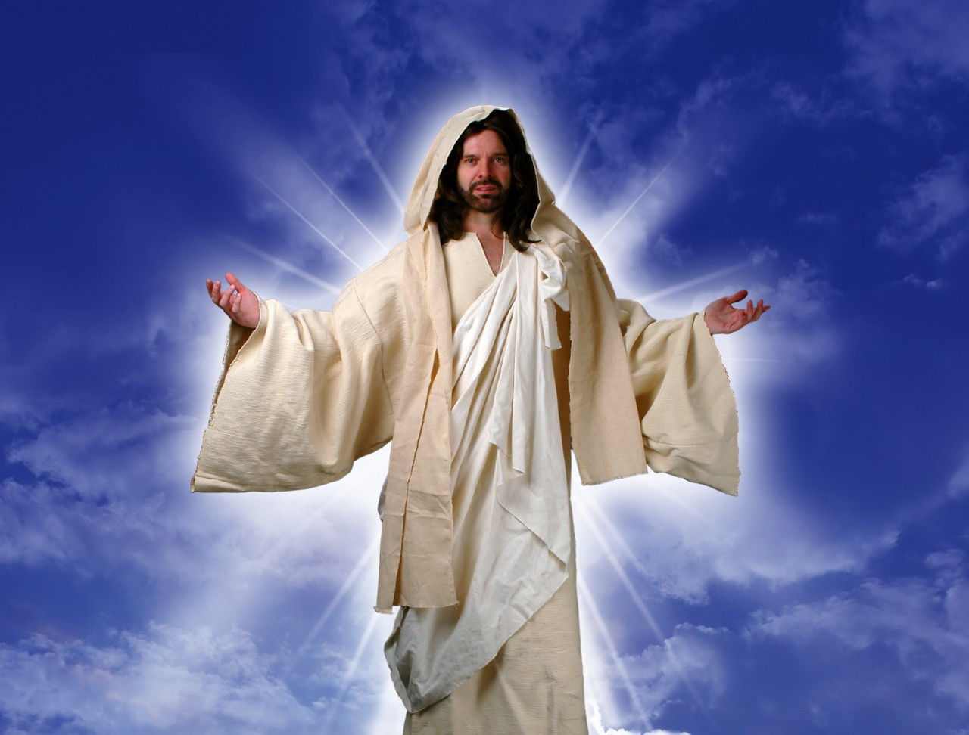
Christ is Superior in His Person
258-59
Superior to the Prophets 1:1-3

Slide 37
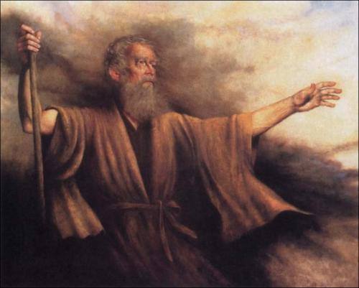
Hebrews 1:1
¹ In the past God spoke to our forefathers through the prophets at many times and in various ways.
Notes:
OT prophets gave only partial revelations of God (1:1)

Slide 38
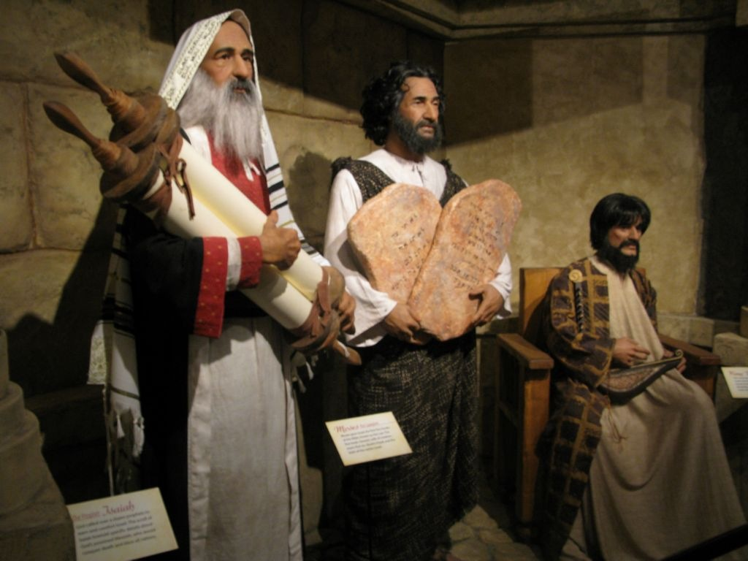
Jeremiah, Moses, David
Notes:
Imagine being Elijah standing up to the entire northern nation of Israel! He told king Ahab the truth that there would be no rain for 3.5 years!
Jeremiah stood up to Judah's last kings and preached the truth of Jerusalem's fall, even though it wasn't popular.
Jonah preached the unpopular truth that God would even spare wicked Nineveh.
However, they still only spoke part of God's truth.
Each was God's voice box only in his own time period.
Each gave only part of what God said.

Slide 39
Hebrews 1:1-2
¹ In the past God spoke to our forefathers through the prophets at many times and in various ways,
² but in these last days he has spoken to us by his Son, whom he appointed heir of all things, and through whom he made the universe.
Notes:
Jesus is God's Son speaking—while prophets were mere men (1:2a).
Jesus is heir of the universe—but no prophet was ever appointed to rule the world (1:2b).
Jesus is the Creator of the universe—while all prophets were created (1:2c).

Slide 40
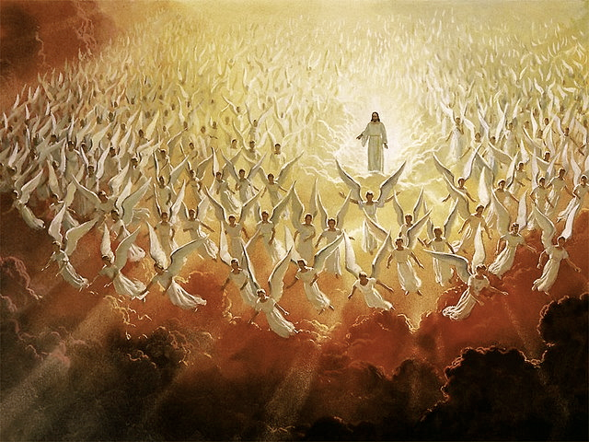
^{Hebrews 1:3}
"The Son is the radiance of God's glory and the exact representation of his being, sustaining all things by his powerful word. After he had provided purification for sins, he sat down at the right hand of the Majesty in heaven."
Notes:
Jesus is God since he exactly represents the Father—but no prophet was deity (1:3a).
Jesus is Sustainer of the universe by his word—but no prophet sustained creation (1:3b).
Jesus is Atonement for mankind's sins—while prophets need his atonement (1:3c).
Jesus completed his ministry in a manner pleasing to the Father—while prophets needed to supplement each other (1:3d).

Slide 41

Why keep running?

Slide 42
I. Christ is better than any prophet (1:1-3).
Notes:
Jesus best reveals God, so he's greater than any limited spokesman for God.

Slide 43

II. Christ is God's final revelation to you also.
Notes:
Truth isn't found anywhere better than Jesus!

Slide 44
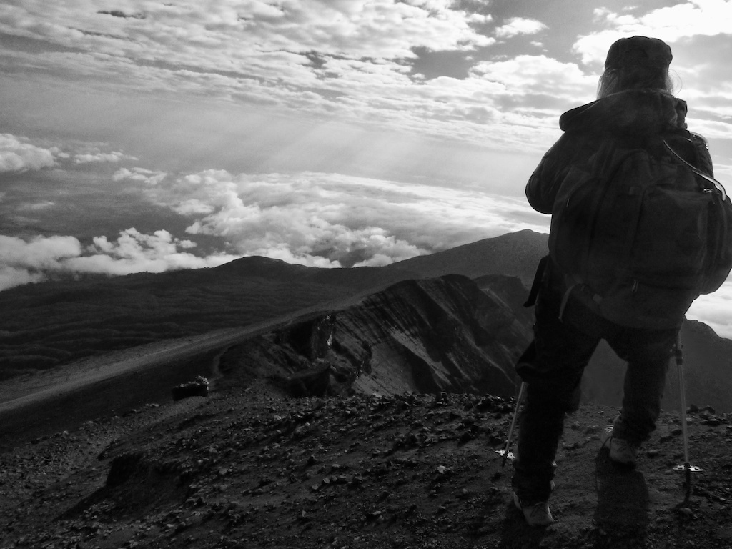
We look for truth in all the wrong places.
Notes:
Some think science has the final answers—but it is constantly being revised every day!
Others are addicted to the latest interesting teaching that tickles the ear—these YouTube clips or TED talks might be interesting, but they don't provide ultimate truth.

Slide 45

Christ is Better
Notes:
Jesus is the best source of truth.
Why wouldn't he be?

Slide 46

"I am the Way, the Truth, and the Life"
—Jesus

Slide 47

So why should we keep running after Jesus?

Slide 48
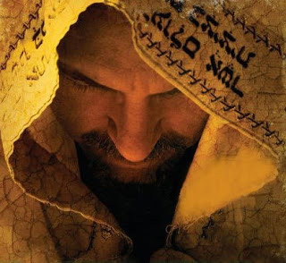
Main Idea of 1:1-3
Jesus is the ultimate truth.
Notes:
Christ is far better than any human messenger.

Slide 49
I. Christ is better than any prophet (1:1-3).
Notes:
Jesus best reveals God, so he's greater than any limited spokesman for God.

Slide 50
II. Christ is God's final revelation to you also.
Notes:
Truth isn't found anywhere better than Jesus!

Slide 51
Are you trusting Christ for truth?
Let's grow via the book of Hebrews
Trust Christ today as God's Truth
  Hear: Romans 10:17
  Believe: Mark 16:16
  Repent: Acts 2:38
  Confess: Romans 10:10
  Baptism: Romans 6:3-4

Slide 52
Black

Slide 53


NT Preaching link at BibleStudyDownloads.org
Get this presentation and script for free!

