Slide 1
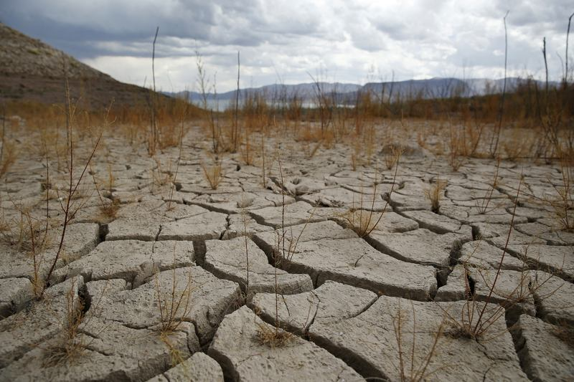
living a life of faith
Preached by Pastor Asung Pharung at Crossroads International Church Singapore • cicfamily.com Uploaded by Dr. Rick Griffith • Singapore Bible College Thousands of files in 49 languages for free at BibleStudyDownloads.org

Slide 2
Faith BELIEVES in God even when we don’t see it

Slide 3
Faith OBEYS God’s Word even when we don’t fully understand

Slide 4
Faith PERSEVERES the Test even if we don’t feel like it

Slide 5
Faith BELIEVES in God even when we don’t see it

Slide 6
Genesis 15:1-6
1“Some time later, the Lord spoke to Abram in a vision and said to him, “Do not be afraid, Abram, for I will protect you, and your reward will be great.”
2 But Abram replied, “O Sovereign Lord, what good are all your blessings when I don’t even have a son? Since you’ve given me no children, Eliezer of Damascus, a servant in my household, will inherit all my wealth.

Slide 7
Genesis 15:2-6
3 You have given me no descendants of my own, so one of my servants will be my heir.”
4 Then the Lord said to him, “No, your servant will not be your heir, for you will have a son of your own who will be your heir.”
5 Then the Lord took Abram outside and said to him, “Look up into the sky and count the stars if you can. That’s how many descendants you will have!”
6 And Abram BELIEVED the Lord, and the Lord counted him as righteous because of his faith.”

Slide 8
Mark 11:24
“I tell you, you can pray for anything, and if you believe that you’ve received it, it will be yours” (NLT)
Faith is Believing
Even When We Don’t See It

Slide 9
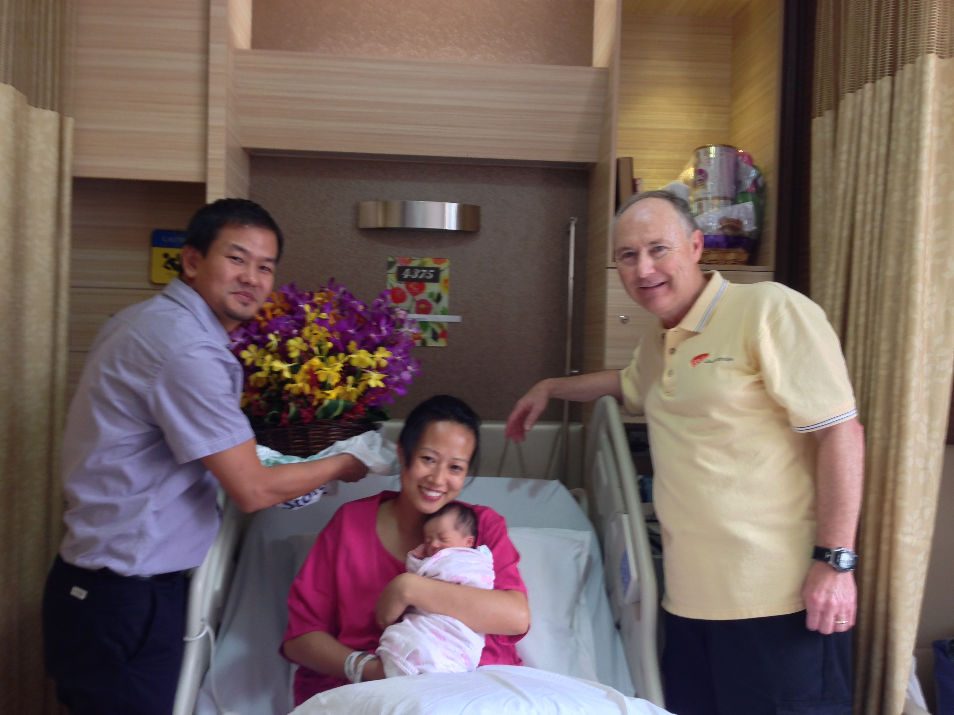
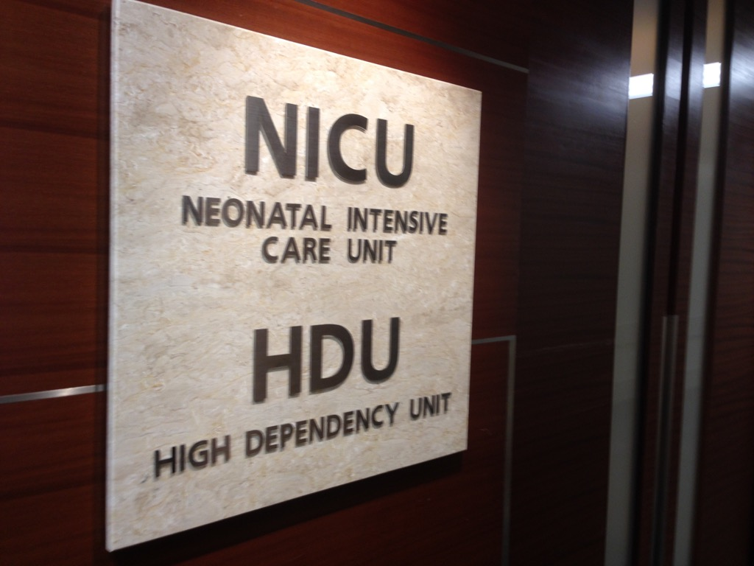
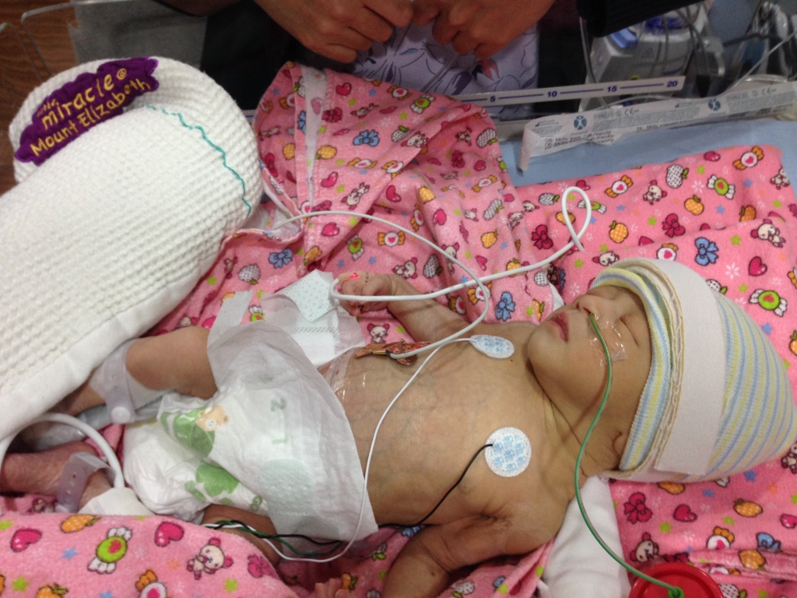
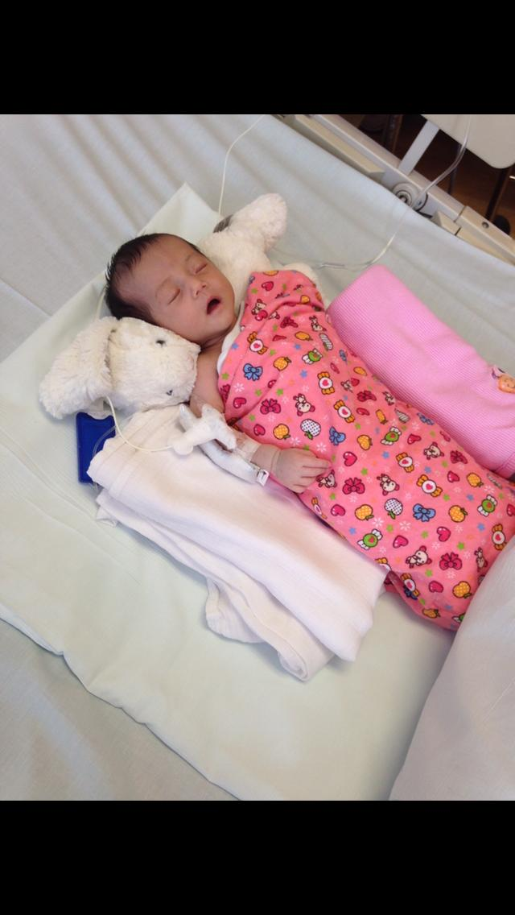

Slide 10
Faith OBEYS God’s Word even when we don’t fully understand

Slide 11
Hebrews 11:8
8 It was by faith that Abraham OBEYED when God called him to leave home and go to another land that God would give him as his inheritance. He went without knowing where he was going.” (NLT).

Slide 12
Faith is Obeying even when We Don’t Understand at All

Slide 13
Faith PERSEVERES the Test even if we don’t feel like it

Slide 14
Hebrews 11:17-18
17 It was by faith that Abraham offered Isaac as a sacrifice when God was TESTING him. Abraham, who had received God’s promises, was ready to sacrifice his only son, Isaac, 18 even though God had told him, “Isaac is the son through whom your descendants will be counted” (NLT).

Slide 15
Gen. 22:16-18
¹⁶“ Because you have obeyed me and have not withheld even your son, your only son, I swear by my own name that ¹⁷ I will certainly bless you. I will multiply your descendants beyond number, like the stars in the sky and the sand on the seashore. Your descendants will conquer the cities of their enemies.¹⁸ And through your descendants all the nations of the earth will be blessed—all because you have obeyed me”(NLT).

Slide 16
Faith is PERSEVERING even when we don’t feel like it

Slide 17
Faith BELIEVES in God
Faith OBEYS God’s Word
Faith PERSEVERES the Test
B – ELIEVES
O – BEYS
P – ERSEVERES

Slide 18
Without FAITH It is Impossible to Please God
[Heb 11:6]

Slide 19
Black

Slide 20
NT Preaching link at BibleStudyDownloads.org
Get this presentation for free!

