Slide 1
The Spirit-Led Church
Galatians 6:1-10
Dr. Jim Harmeling Crossroads International Church Singapore • CICFamily.com Uploaded by Dr. Rick Griffith • Jordan Evangelical Theological Seminary Files in many languages for free download at BibleStudyDownloads.org

Slide 2
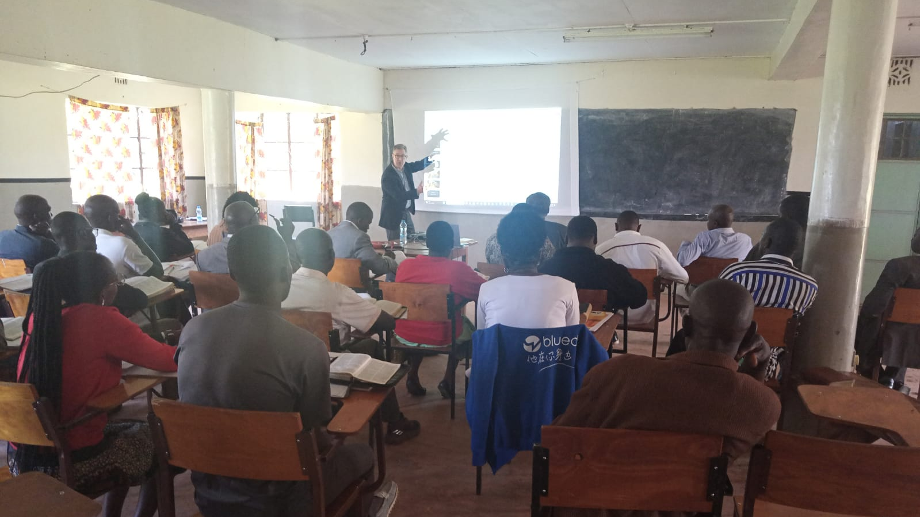

Slide 3
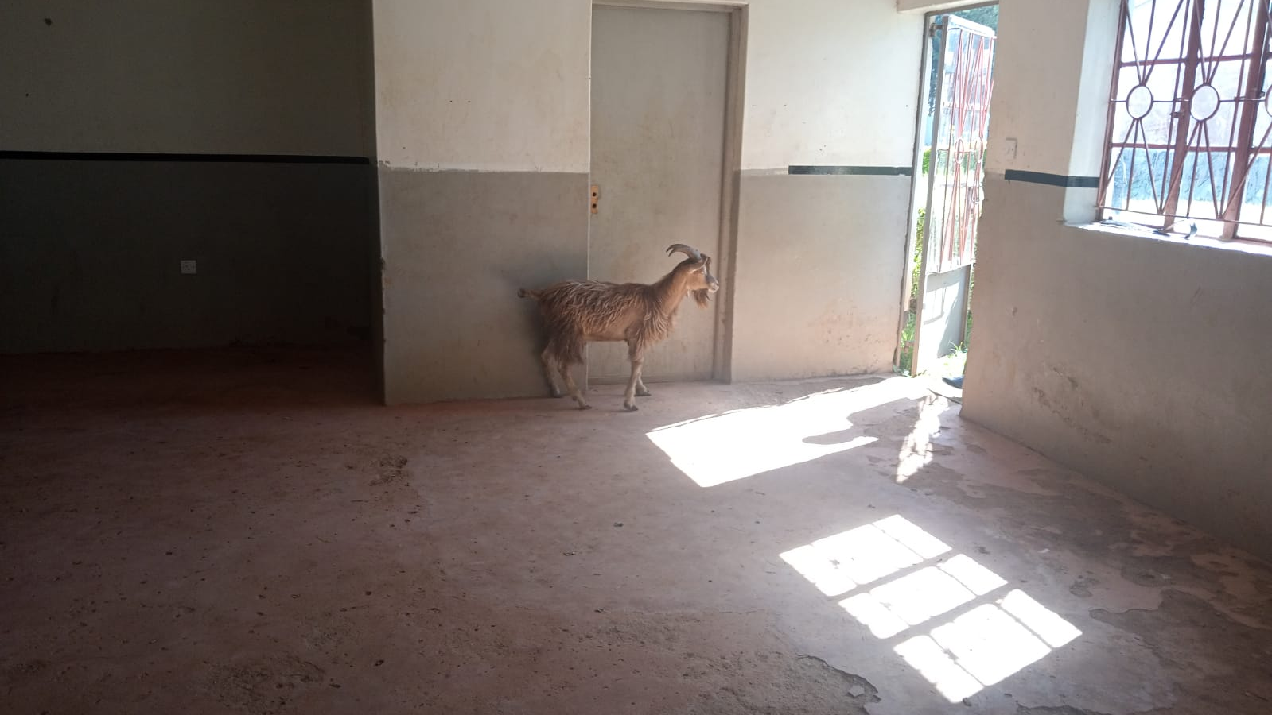

Slide 4
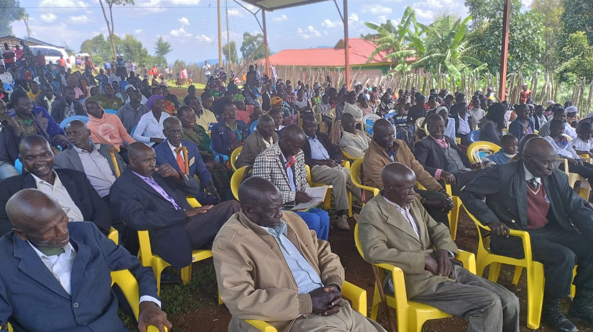

Slide 5
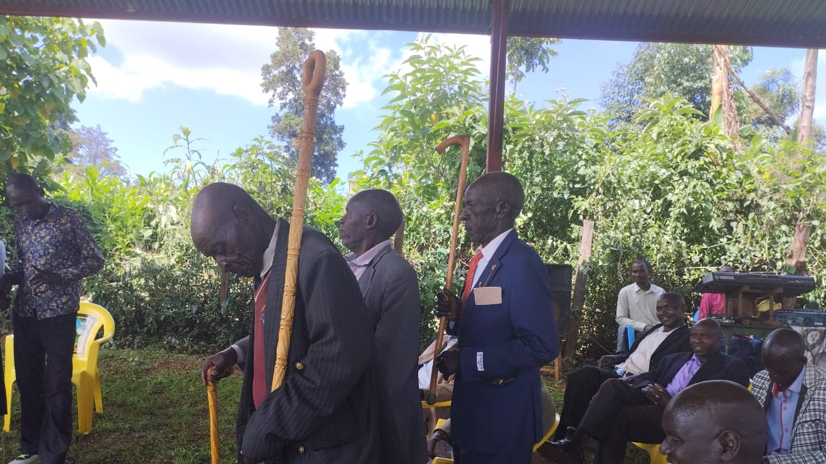

Slide 6
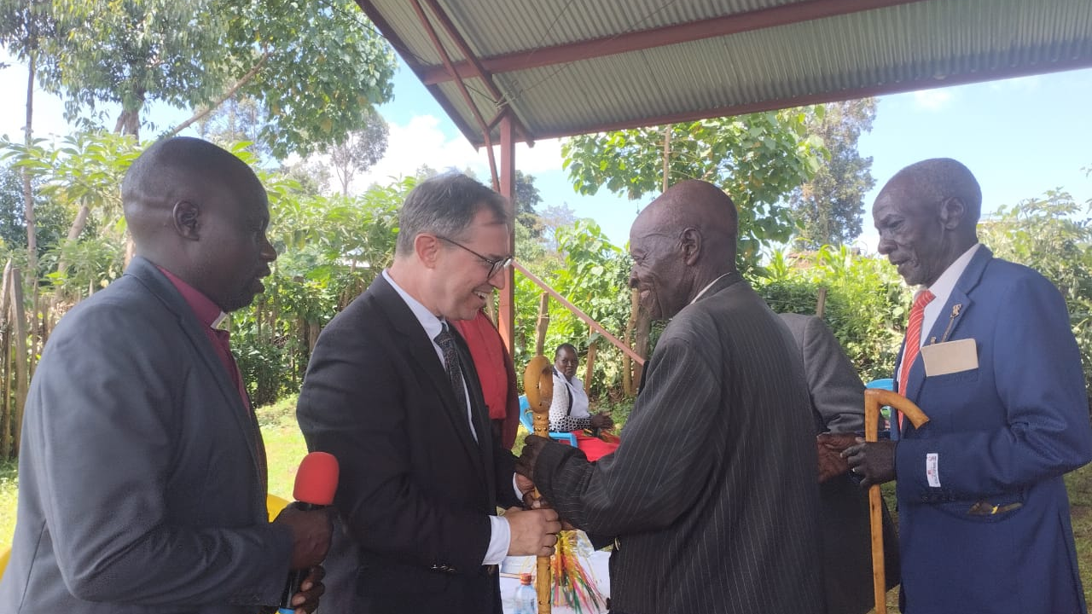

Slide 7
The Spirit-Led Church
Galatians 6:1-10

Slide 8
Old Covenant
Law of Moses
Conform without Holy Spirit
No Can
New Covenant
Law of Christ
Conform with Holy Spirit
Can

Slide 9
Spirit-led churches walk in the Spirit (5:16-26)
Spirit-led churches restore those who walk in the flesh (6:1-5)
“Now, when we are conceited, our relationships with other people are poisoned.”
John Stott

Slide 10
“To sum up, then, truly Christian relationships are governed not by rivalry but by service. The correct attitude to other people is not ‘I’m better than you and I’ll prove it’, nor ‘Your better than I and I resent it’, but ‘You are a person of importance in your own right (because God made you in His own image and Christ died for you) and it is my joy and privilege to serve you.’”
John Stott

Slide 11
Spirit-led churches walk in the Spirit (5:16-26)
Spirit-led churches restore those who walk in the flesh (6:1-5)
We restore gently (1a)
We restore carefully (1b)
We restore out of love (2)
We restore to protect (3-5)

Slide 12
Spirit-led churches walk in the Spirit (5:16-26)
Spirit-led churches restore those who walk in the flesh (6:1-5)
Spirit-led churches serve others in love (6:6-10)
We share good things with our spiritual teachers (6)
We consider the future outcome of present investments of life (7-10)

Slide 13
Black

Slide 14
NT Preaching link at BibleStudyDownloads.org
Get this presentation and handout for free!
Notes:
NT Preaching (np)

