Slide 1
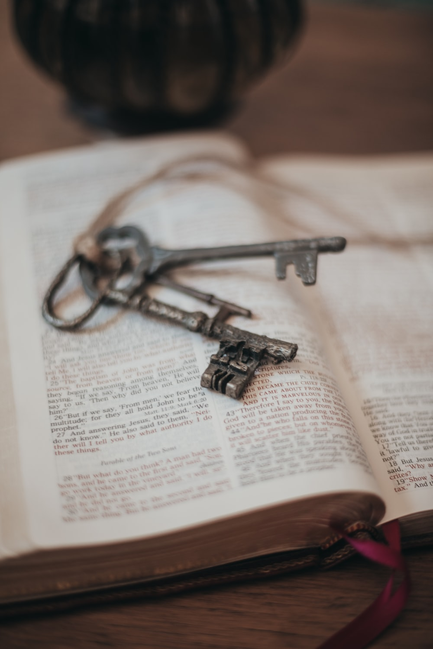
Freed to be free THE LETTER TO THE GALATIANS
True Freedom
Galatians 5:1-12
Manik Corea Crossroads International Church Singapore • CICFamily.com Uploaded by Dr. Rick Griffith • Jordan Evangelical Theological Seminary Files in many languages for free download at BibleStudyDownloads.org

Slide 2
Galatians Overview
A Unique Gospel Chapters 1–2 | Made Righteous by Faith Chapters 3–4 | Freed to be Free Chapters 5–6
Biographical | Doctrinal | Practical
The Message of the Apostle | The Redemption of Christ | The Walk of the Holy Spirit
The Gospel is true! | The Gospel is superior! | The Gospel is freedom!
Grace Defended | Grace Expounded | Grace Applied
Key Verse: "I have been crucified with Christ. It is no longer I who live, but Christ who lives in me." (Gal 2:20) | Key Verse: "And because you are sons, God has sent the Spirit of his Son into our hearts, crying, 'Abba! Father!'" (Gal 4:6) | Key Verse: "For freedom, Christ has set us free; stand firm therefore, and do not submit again to a yoke of slavery." (Gal 5:1)

Slide 4
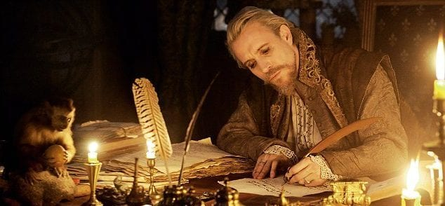

Slide 5
Galatians 5:1-12
Vs 1-6: Addressing the Galatians who were seeking to follow the Judaizers.
Vs 7-12 Addressing the false teachers and their activity.

Slide 7
Galatians 5:1-6
Circumcision was a physical mark with theological significance – setting Israel apart as God’s covenantal people.
“This is My covenant, which you shall keep, between Me and you and your descendants after you: every male among you shall be circumcised.” (Genesis 17:10)
“But some men came down from Judea and were teaching the brothers, 'Unless you are circumcised according to the custom of Moses, you cannot be saved.'”(Acts 15:1)
Vs 2-4 – To be circumcised is to be "severed from Christ…fallen away from grace."

Slide 8
Galatians 5:1-6
Vs 2-4 – To be circumcised is to be "severed from Christ…fallen away from grace."
Vs 5-6 – For through the Spirit by faith we are WAITING for the hope of righteousness.
What matters is faith WORKING through love.

Slide 9
Galatians 5:7-12
Vs 7 Paul likens the Christian life to a race. Who stopped you from running?
Vs 8 – Such teaching (persuasion) is not from God.
Vs 9 - A little leaven (false teaching) affects the whole lump (body).
Vs 10 – Paul is confident they will stay strong and judge the false teachers.
Vs 11 - If Paul taught circumcision, why would his preaching of the cross be so opposed by Jewish people? Paul wishes these false teacher that they "castrate" themselves.

Slide 10
Galatians 5:13-15
Vs 13: We were saved from sin, but not to sin. Live in love.
In Christ, we are actually to fulfil the true intent of the law – to love each other.
Vs 15: But if our actions show we are against one another, then we better watch out!

Slide 11
Galatians 5:16-26
If we are not careful, we can fall back from freedom in legalism (vs 1) or license (vs 13).
This part is full of the Holy Spirit – He is mentioned 7 times alone.
Vs 19-21 – the works of the flesh are clearly described.
Vs 21b – Paul warns us that those who do such things will lose the Kingdom of God.
πράσσω prássō Lit. "to practice", i.e., perform repeatedly or habitually

Slide 12
Galatians 5:16-26
Vs 22-23 – One fruit of the Spirit in 9 flavours:
"Love, joy and peace" have to do with a right relationship to God.
" ...patience, kindness and goodness" have to do with a right relationship with others.
" …faithfulness, gentleness and self-control” have to do with our personal attitudes and behaviour.
ARE WE DESTINED TO LIVES OF CONSTANT PRONENESS TO SIN?

Slide 13
Galatians 5:16-26
"Walk by the Spirit, and you will not gratify the desires of the flesh." (vs 16).
How can we walk in consistent victory?
1) We must daily crucify the flesh. (Luke 9:23 – see also Mark 8:34; Matthew 16:24; cf. Galatians 2:20; Romans 6:6)
SIN CANNOT BE IMPROVED – IT MUST BE KILLED!

Slide 14
Galatians 5:16-26
How to crucify our sinful nature?
1. Preach to yourself the true Gospel of Jesus every day.
2. When you face the inevitable temptations of your own sinful nature, the deceitful promise of the world or the luring lies of the devil, run to God. "Submit yourselves therefore to God. Resist the devil, and he will flee from you. Draw near to God, and he will draw near to you." (James 4:7-8).

Slide 15
Pray adapted from https://servantsofgrace.org/crucified-with-christ-how-the-cross-kills-sin
“Lord Jesus, you died to free me from sin, to put my sinful passions and desires to death, to change me and restore me in Your glorious image. Thank you for Your undying love! Now, cleanse me with Your blood. Strengthen me with Your power. Uphold me by Your grace. Endue me with your power. Help me, Lord!”

Slide 16
Galatians 5:16-26
How to crucify our sinful nature?
1. Preach to yourself the true Gospel of Jesus every day.
2. When you face the inevitable temptations of your own sinful nature, the deceitful promise of the world or the luring lies of the devil, run to God. "Submit yourselves therefore to God. Resist the devil, and he will flee from you. Draw near to God, and he will draw near to you." (James 4:7-8).
3. If you do fall, do not despair. Confess your sins (1 John 1:9). Seek help of other Christians (James 5:16). Don't struggle with besetting sins on your own.

Slide 17
Galatians 5:16-26
2) Positively, we need to be led and walk after the Spirit (vs 16, 18 and 25).

Slide 19
Galatians 5:16-26
2) Positively, we need to be led by and walk after the Spirit (vs 16, 18 and 25).
Contrast two words used for walking in verses 16 and 25.
Vs 16 is ordinary walking.
Vs 25 – Greek στοιχέω stoicheō Lit. “to proceed in a row as the march of a soldier, go in order.”

Slide 20
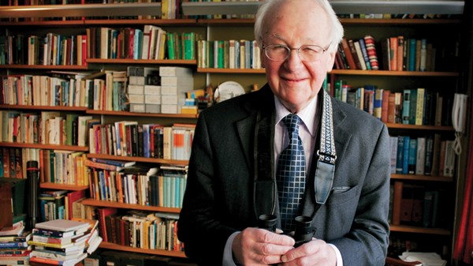
John Stott
"This will be seen in our whole way of life - in the leisure occupations we pursue, the books we read, and the friendships we make…. In all these ways, we occupy ourselves in spiritual things. It is not enough to yield passively to the Spirit's control; we must also walk actively in the Spirit's way."
John Stott, The Message of Galatians (Leicester: InterVarsity, 1984), page 134

Slide 21
A prayer as you go to your workplace
"My heavenly Father, as I enter this workplace I bring your presence with me. I seek and desire to speak and reflect Your peace, Your grace, Your mercy, and Your perfect order to all that I meet with today. I acknowledge and submit to your Lordship over all that will be spoken, thought, decided, and accomplished this day. Help me to be led by Your Spirit every minute of my life and work today. Be glorified today in me, in Jesus' name. Amen.”
—Adapted from David W. Gill, Workplace Discipleship 101 (Hendrickson, 2020), page 21

Slide 22
Black

Slide 23
NT Preaching link at BibleStudyDownloads.org
Get this presentation and notes for free!
Notes:
NT Preaching (np)

