Slide 1
Freed to be free THE LETTER TO THE GALATIANS
Galatians 1:1-12
Manik Corea Crossroads International Church Singapore • CICFamily.com Uploaded by Dr. Rick Griffith • Jordan Evangelical Theological Seminary Files in many languages for free download at BibleStudyDownloads.org

Slide 2
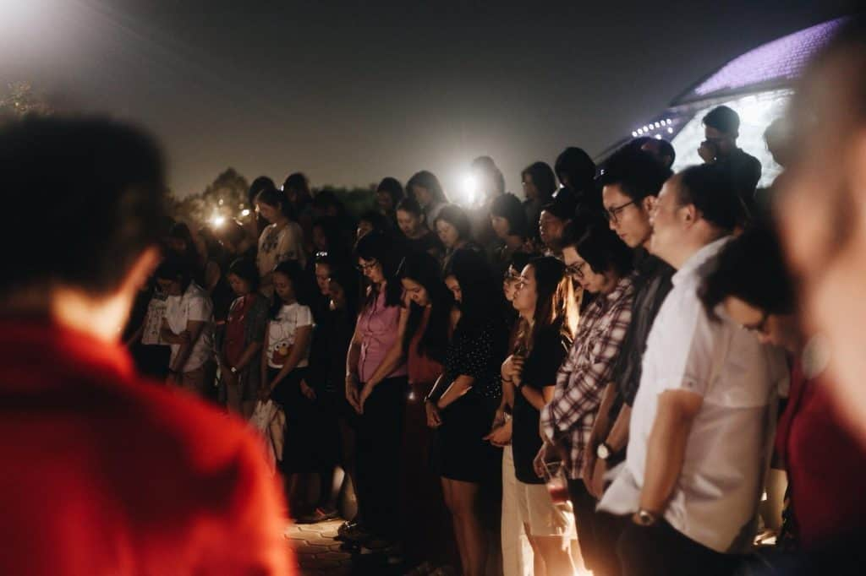
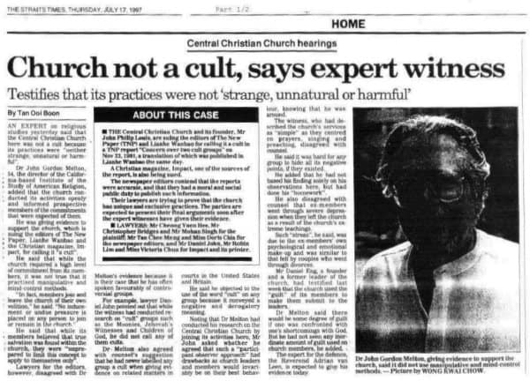
1997 – Impact magazine versus Central Christian Church

Slide 3
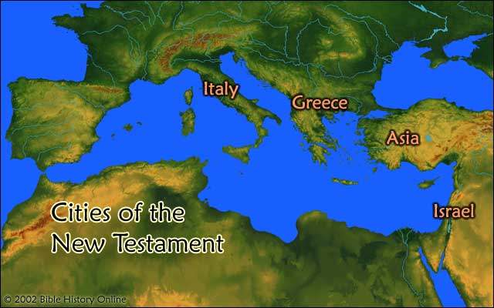
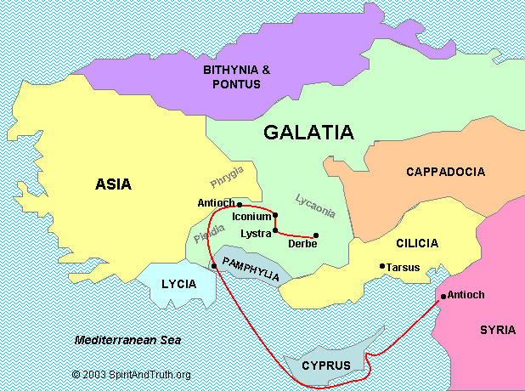
The Roman Province of Galatia

Slide 4
Why was Paul so angry?

Slide 5
_________________

Slide 6
Galatians Overview
A Unique Gospel Chapters 1–2 | Made Righteous by Faith Chapters 3–4 | Freed to be Free Chapters 5–6
Biographical | Doctrinal | Practical
The Message of the Apostle | The Redemption of Christ | The Walk of the Holy Spirit
The Gospel is true! | The Gospel is superior! | The Gospel is freedom!
Grace Defended | Grace Expounded | Grace Applied
Key Verse: "I have been crucified with Christ. It is no longer I who live, but Christ who lives in me." (Gal 2:20) | Key Verse: "And because you are sons, God has sent the Spirit of his Son into our hearts, crying, 'Abba! Father!'" (Gal 4:6) | Key Verse: "For freedom, Christ has set us free; stand firm therefore, and do not submit again to a yoke of slavery." (Gal 5:1)

Slide 7
GALATIANS 1:1-5
Vs 1 – Paul is an Apostle by divine appointment – “..not from men or through man, but through Jesus Christ and God the Father.”
He was personally met and appointed by the Lord Jesus (1 Cor 9:1; 15:8,9).
Vs 3-4 – “Grace to you and peace from God the Father and the Lord Jesus Christ.”

Slide 8
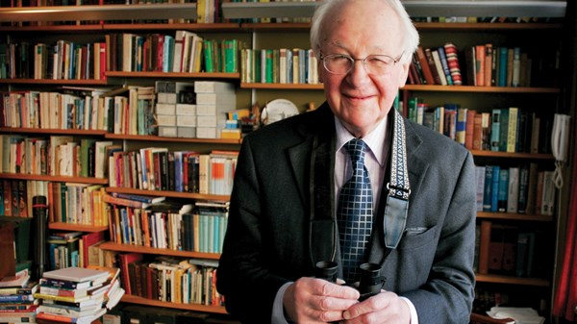
John Stott
“Although 'grace' and 'peace' are common monosyllables, they are pregnant with theological substance. In fact, they summarize Paul's Gospel of Salvation.”
John Stott, The Message of Galatians (Leicester: InterVarsity, 1984), 16

Slide 9
GALATIANS 1:1-5
Vs 1 – Paul is an Apostle by divine appointment – “..not from men or through man, but through Jesus Christ and God the Father.”
He was personally met by and appointed by the Lord Jesus (1 Cor 9:1; 15:8,9).
Vs 3 – “Grace to you and peace from God the Father and the Lord Jesus Christ.”
Vs 4 - "He gave himself for our sins to deliver us from the present evil age"

Slide 11
GALATIANS 1:6-10
Vs 6 – You have deserted Christ and turning to another gospel!
Jesus + the law = a gospel of works (see Acts 15:1).

Slide 12
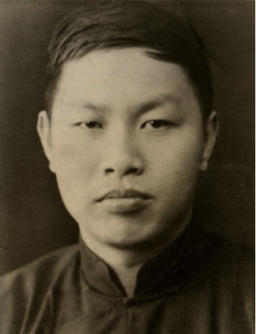

Slide 13
GALATIANS 1:6-9
Vs 6 – You have deserting Christ and turning to another gospel!
Jesus + the law = a gospel of works (see Acts 15:1).
Vs 7-9 – Don’t accept any distorted or additional Gospel from them, us or angels! There is only ONE Gospel.
Why is Paul so strong about this?
The glory and work of Christ is at stake.
The salvation of the Galatian Christians is also at stake.

Slide 14
GALATIANS 1:10-12
Vs 10 – Paul is a servant of Christ, not of men – neither seeking their approval or to please them.
Vs 11-12 – Paul emphasizes that he received the Gospel by revelation from Jesus Christ.

Slide 15
Where do you stand in relation to
our Lord Jesus Christ today?

Slide 16
Black

Slide 17
NT Preaching link at BibleStudyDownloads.org
Get this presentation and script for free!
Notes:
NT Preaching (np)

