Slide 1

Be United
Ephesians
Dr. Rick Griffith • Crossroads International Church Singapore
BibleStudyDownloads.org

Slide 2
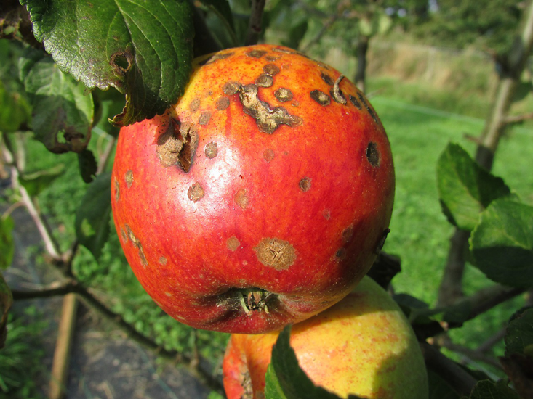
The Second Law of Thermodynamics
Notes:
The Second Law of Thermodynamics is a reality.
Everything runs down. Things get old. That's The Second Law of Thermodynamics.

Slide 3
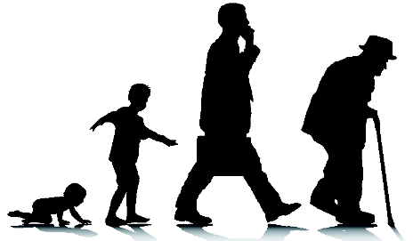
The Second Law of Thermodynamics
Notes:
Order naturally moves to disorder—unity to disunity.

Slide 4
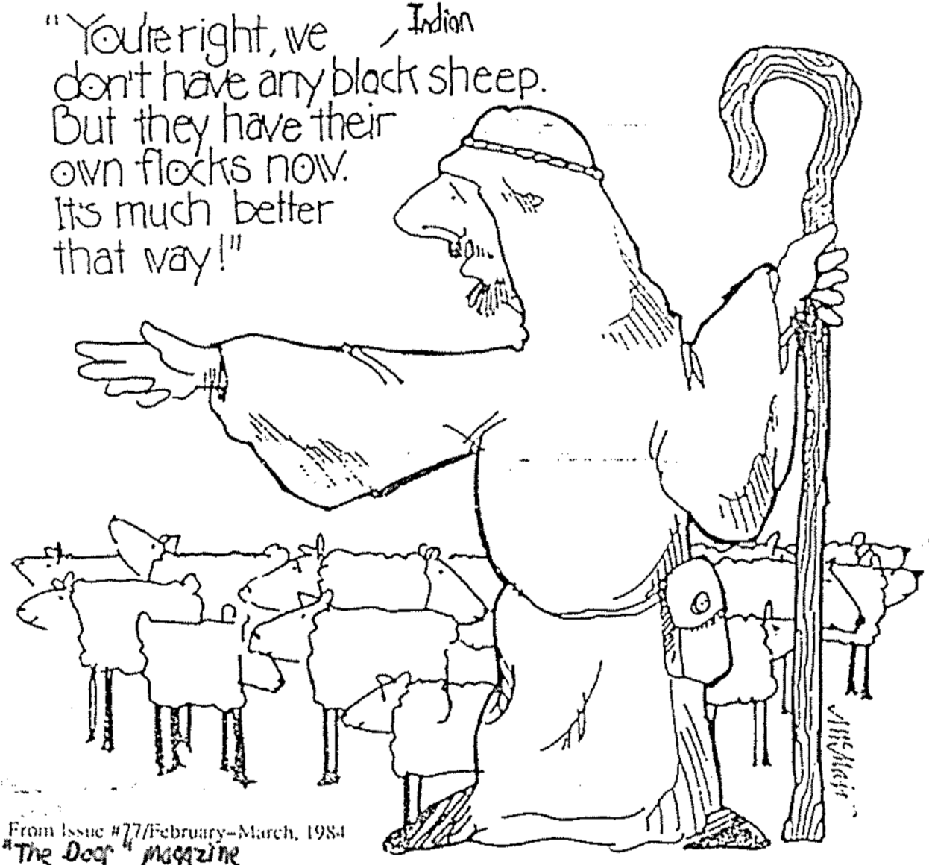
You’re right, we don’t have any dark sheep. But they have their own flocks. It’s much better that way!
Notes:
Diversity can divide since we try to be with others like us.
Birds of a feather flock together.
Friends look like each other.
Married couples look more alike the longer they are married.
We tend to do what we do because we think it is the best way to do it—this diversity can lead to disunity.

Slide 5
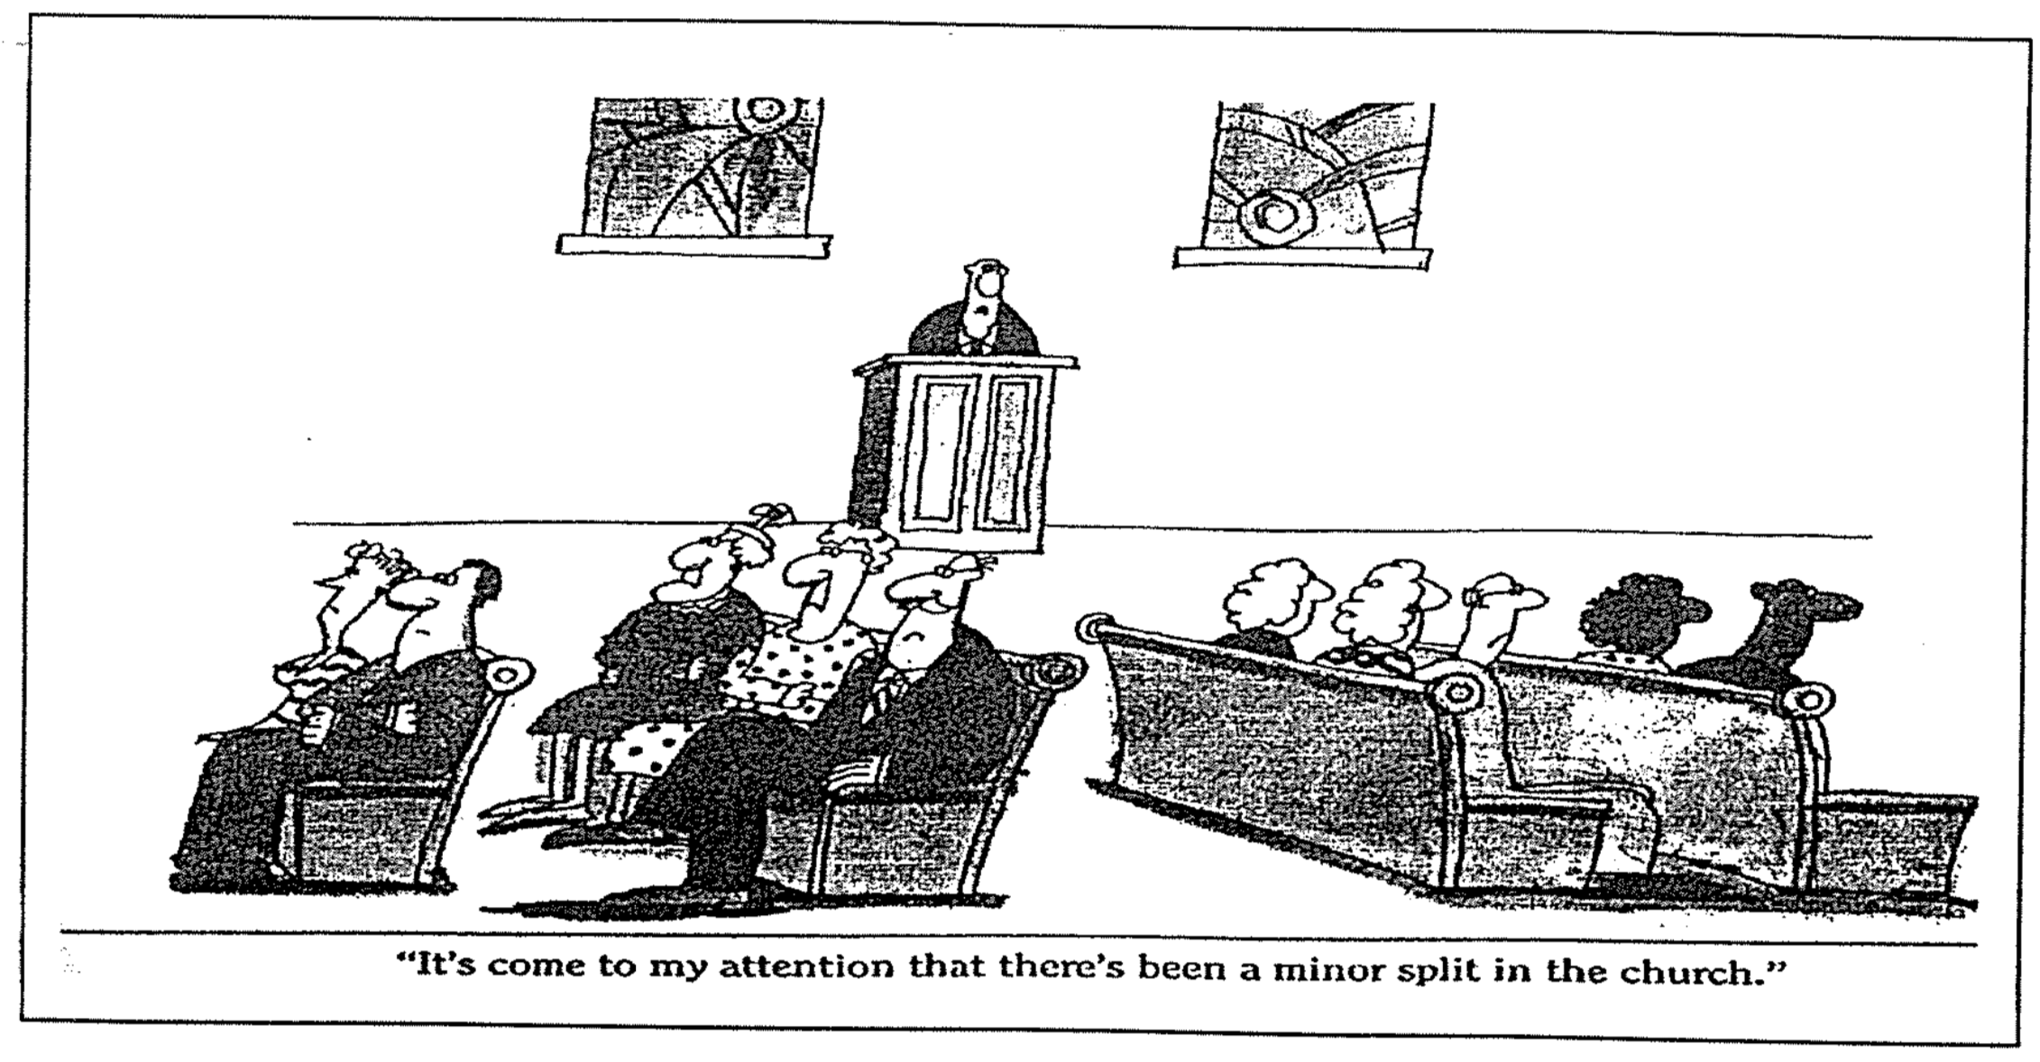
A Slight Division
“It’s come to my attention that there’s been a minor split in the church.”
Notes:
Have you ever been in a divided church?

Slide 6
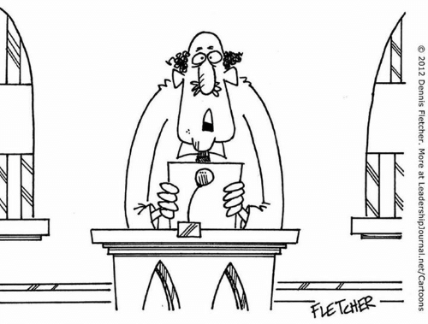
“…and the church unity workshop has been postponed until the deacons can agree on the date, time, and color of the participant name tags.”
Notes:
Christians sometimes see their differences as a liability instead of a strength.

Slide 7
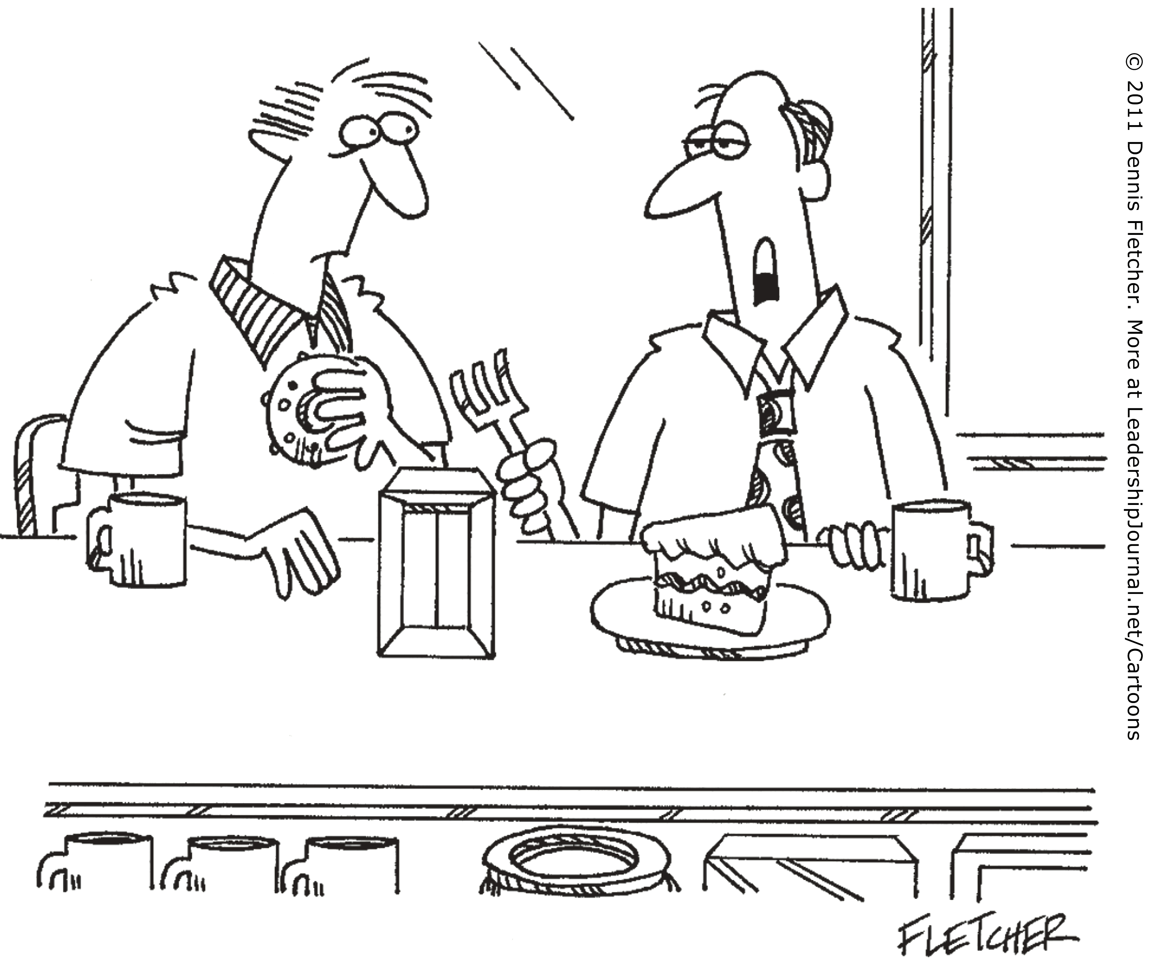
“I sense a new unity in my church… away from apathy, and moving steadily toward opposition.”
Notes:
Even people in church can fight for their own way.

Slide 8

How can our church be united despite our many different kinds of people?

Slide 9
NT Overview (Paul's Letters)
38
124
39-41
“To the remotest part of the earth” (Acts 1:8)
Acts 9 13 14 15 16 18 21 27 28
Apr 48-
Sep 49
1
Galatia
Apr 50-
Sep 52
2
Aegean
Spr 53-
May 57
3
Asia
Feb 60-
Mar 62
1
Rome
Spr 62-
Fall 67
4
Spain
Aut 67-
Spr 68
2
Rome
Summer 35-
37
Damascus
Antioch
May 57-
Aug 59
Trials
Fall 49
The
Council
Spring 68
Expansion of Church
35 48 49 50 52 53 57 60 62 67 68 95
Matt
Luke
Acts
Mark
John
Gal
1 Thess
1 Cor
Eph
2 Thess
2 Cor
Col
Missionary
Romans
Philem
Gospels & Acts
Phil
Pauline Epistles
1234
Journeys
Prison
Rome
Imprisonments
Pauline
Notes:
Observations about chronology:
Gospels not written first but throughout NT era
Evangelistic letters preceded pastoral
Rough letter (Galatians) preceded smoother ones

Slide 10


175
Rome
Ephesus
EPHESIANS

Slide 11
Key Word
175
Unity
Ephesians
Notes:
Our natural tendency is to move towards disunity. We want to be around people who look like us, talk like us, eat like us, smell like us, and act like us.
God is much broader and more flexible than this. How many races are there? He did not create various races. He made only one race called the human race. He wants us to learn more about him and his open arms by being united with those who are different from us in minor ways and yet are united in the major way—the way of Jesus.

Slide 12
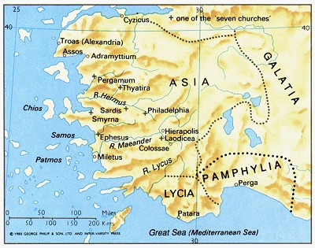
Ephesus was the capital of Asia
349

Slide 13
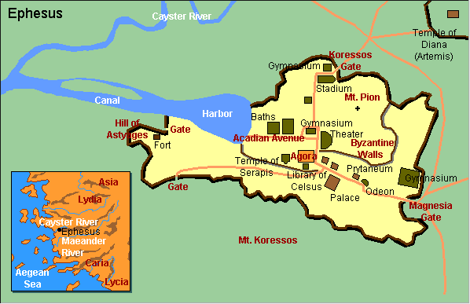
Ephesus City Layout
180

Slide 14
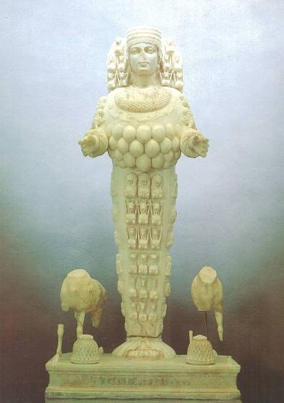
Artemis, Goddess of Fertility

Slide 15
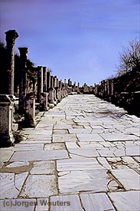
Marble Roads
Notes:
Marble city, chariot ruts, speed humps, after earthquake columns put back up again.

Slide 16
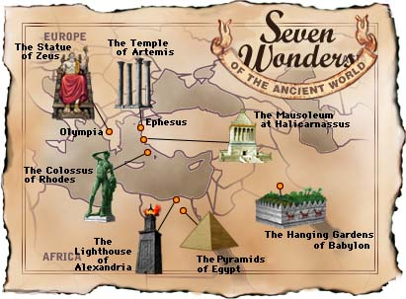
Seven Wonders of the Ancient World

Slide 17

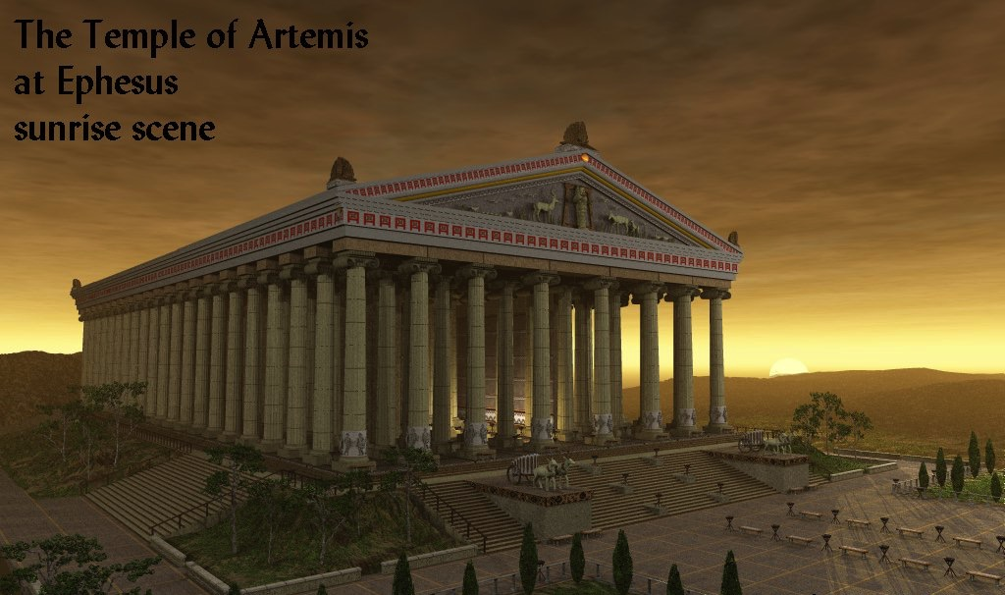
The Temple of Artemis at Ephesus
180c
Notes:
Diana—the goddess mother of Ephesus, 127 Marble pillars, Artemis (Gk), Diana (Latin)

Slide 18
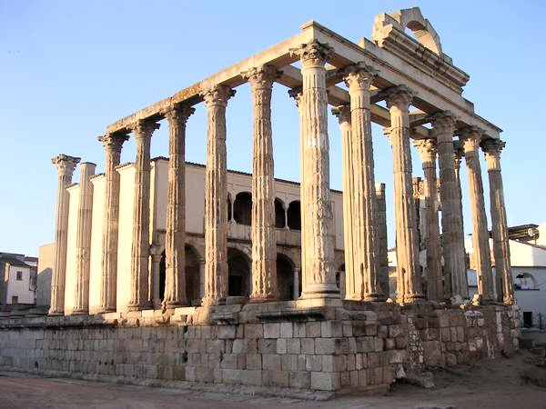
The Temple of Diana (Artemis) Today
180c
Notes:
"In Roman mythology, Diana (lt. "heavenly" or "divine") was the goddess of the hunt and moon and birthing, being associated with wild animals and woodland, and having the power to talk to and control animals. She was equated with the Greek goddess Artemis, though she had an independent origin in Italy." (http://en.wikipedia.org/wiki/Diana_%28mythology%29)
Temple had 127 Marble pillars, Artemis (Gk), Diana (Latin)

Slide 19
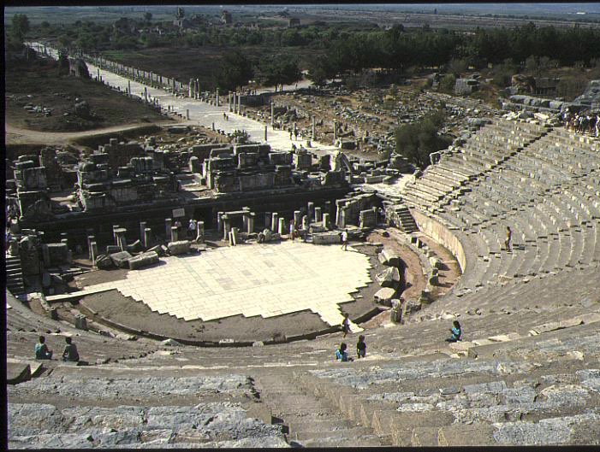
The Ephesian Theatre of Acts 19:29
180a

Slide 20
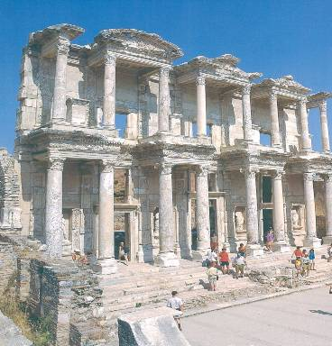
Library
349

Slide 21
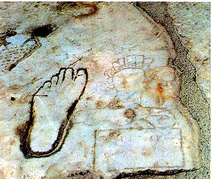
Directions for the Immoral & Illiterate
349

Slide 22
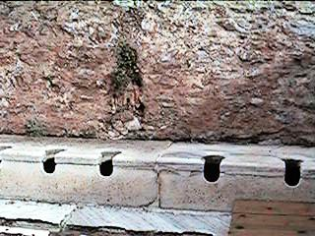
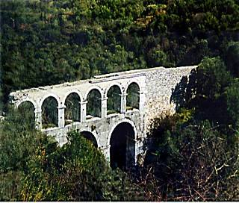
Toilets and aqueduct
349

Slide 23

Jew-Gentile Divisions

Slide 24
Theme
23
Jew-Gentile Unity
Shown in Love
Ephesians

Slide 25
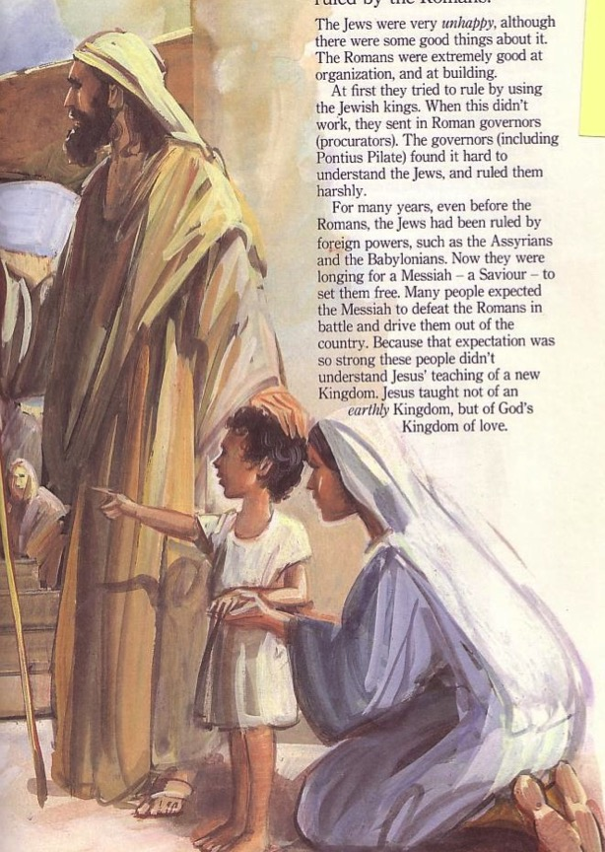
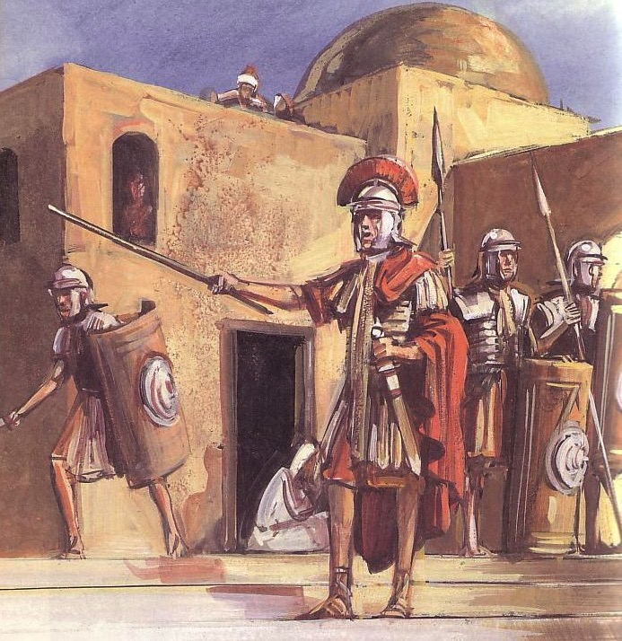
Sometimes Christians mistreat others of a different ethnic group
180b
Jews
Gentiles
One God
Many taboos
Many Gods
Few taboos

Slide 26


East Meets West
180b
Writing Style
Hebrew
Greek
Favors poetry, imagery & symbolism
Favors outlines, lists and bullet points
Adapted from Lynne M. Thompson, "Christmas: The Real Deal," interview with Ray Vander Laan, Breakaway magazine (Dec 2003): 7-9.
Notes:
Adapted from Lynne M. Thompson, "Christmas: The Real Deal," interview with Ray Vander Laan, Breakaway magazine (Dec 2003): 7-9.

Slide 27
East Meets West
180b
Numbers
Hebrew
Greek
Sees numbers as a quality or symbol
Sees numbers as a specific quantity
Adapted from Lynne M. Thompson, "Christmas: The Real Deal," interview with Ray Vander Laan, Breakaway magazine (Dec 2003): 7-9.
Notes:
Adapted from Lynne M. Thompson, "Christmas: The Real Deal," interview with Ray Vander Laan, Breakaway magazine (Dec 2003): 7-9.

Slide 28
East Meets West
180b
Relation to God
Hebrew
Greek
Focuses on the community in relationship with God
Focuses on the individual's relationship with God
Adapted from Lynne M. Thompson, "Christmas: The Real Deal," interview with Ray Vander Laan, Breakaway magazine (Dec 2003): 7-9.
Notes:
Adapted from Lynne M. Thompson, "Christmas: The Real Deal," interview with Ray Vander Laan, Breakaway magazine (Dec 2003): 7-9.

Slide 29
East Meets West
180b
Eternal Life
Hebrew
Greek
The kingdom of God begins in this life. Eternal life is lived in harmony with God.
The kingdom of God is outside this world. Eternal life will occur after this life ends.
Adapted from Lynne M. Thompson, "Christmas: The Real Deal," interview with Ray Vander Laan, Breakaway magazine (Dec 2003): 7-9.
Notes:
Adapted from Lynne M. Thompson, "Christmas: The Real Deal," interview with Ray Vander Laan, Breakaway magazine (Dec 2003): 7-9.

Slide 30
East Meets West
180b
Sin
Hebrew
Greek
Sin is wrong behavior alone.
They emphasize what one does in response to faith.
Sin is wrong actions & thinking.
They emphasize what a person knows about faith.
Adapted from Lynne M. Thompson, "Christmas: The Real Deal," interview with Ray Vander Laan, Breakaway magazine (Dec 2003): 7-9.
Notes:
Adapted from Lynne M. Thompson, "Christmas: The Real Deal," interview with Ray Vander Laan, Breakaway magazine (Dec 2003): 7-9.

Slide 31
East Meets West
Existence of God
180b
Hebrew
Greek
Assumes that God exists
Tries to prove God's existence
Adapted from Lynne M. Thompson, "Christmas: The Real Deal," interview with Ray Vander Laan, Breakaway magazine (Dec 2003): 7-9.
Notes:
Adapted from Lynne M. Thompson, "Christmas: The Real Deal," interview with Ray Vander Laan, Breakaway magazine (Dec 2003): 7-9.

Slide 32
East Meets West
180b
Faith
Hebrew
Greek
Relational and personal
Expressed in terms of relationship with God rather than rationalization
Intellectual and impersonal
Expressed in creeds and doctrine with support through proof texts
Adapted from Lynne M. Thompson, "Christmas: The Real Deal," interview with Ray Vander Laan, Breakaway magazine (Dec 2003): 7-9.
Notes:
Adapted from Lynne M. Thompson, "Christmas: The Real Deal," interview with Ray Vander Laan, Breakaway magazine (Dec 2003): 7-9.

Slide 33
East Meets West
180b
Truth
Hebrew
Greek
Experiential
What is done and who did it in Scripture
Believing comes through experience
Truth is unfolding and relative
Scientific & rational
How things are done in the Scripture
Believing comes through thinking
Truth is static and unchanging
Adapted from Lynne M. Thompson, "Christmas: The Real Deal," interview with Ray Vander Laan, Breakaway magazine (Dec 2003): 7-9.
Notes:
Adapted from Lynne M. Thompson, "Christmas: The Real Deal," interview with Ray Vander Laan, Breakaway magazine (Dec 2003): 7-9.

Slide 34
How can our church be united despite our many different kinds of people?
Notes:
What do we need to do so we don’t end up divided due to our diversity?

Slide 35
How to be united…
Love God
Eph 1–3
Notes:
Love God for our equality in Christ (Eph 1–3).
[Praise God that none of us is better than any other due to salvation or ethnic origin or class.]

Slide 36
Slides on
Ephesians 1

Slide 37
175
Rome
EPHESIANS
Ephesus
"This letter is from Paul, chosen by the will of God to be an apostle of Christ Jesus. I am writing to God’s holy people in Ephesus [“To the saints in Ephesus” NIV], who are faithful followers of Christ Jesus” (Eph. 1:1 NIV).
Notes:
God made each of us a “saint” in Christ (1:1-2).

Slide 38
Ephesians 1:3-14 (NAU)
178
Blessed be the God and Father of our Lord Jesus Christ, who has blessed us with every spiritual blessing in the heavenly places in Christ, ⁴just as He chose us in Him before the foundation of the world, that we would be holy and blameless before Him. In love ⁵He predestined us to adoption as sons through Jesus Christ to Himself, according to the kind intention of His will, ⁶to the praise of the glory of His grace, which He freely bestowed on us in the Beloved. ⁷In Him we have redemption through His blood, the forgiveness of our trespasses, according to the riches of His grace ⁸which He lavished on us. In all wisdom and insight ⁹He made known to us the mystery of His will, according to His kind intention which He purposed in Him ¹⁰with a view to an administration suitable to the fullness of the times, that is, the summing up of all things in Christ, things in the heavens and things on the earth. In Him ¹¹also we have obtained an inheritance, having been predestined according to His purpose who works all things after the counsel of His will, ¹²to the end that we who were the first to hope in Christ would be to the praise of His glory. ¹³In Him, you also, after listening to the message of truth, the gospel of your salvation — having also believed, you were sealed in Him with the Holy Spirit of promise, ¹⁴who is given as a pledge of our inheritance, with a view to the redemption of God’s own possession, to the praise of His glory.
Notes:
“In the Greek text, 1:3-14 is one sentence, which is considered by some scholars to be the most cumbersome sentence in the Greek language! In fact, Ephesians has eight lengthy sentences (1:3-14, 15-23; 2:1-7; 3:1-13, 14-19; 4:1-7, 11-16; 6:14-20). However, it is common even today for prayers and doxologies to be lengthy” (Hoehner, BKC, 2:616).

Slide 39

"Us/We/Our" & "You" in Ephesians 1:3-14 (NLT)
178
"All praise to God, the Father of our Lord Jesus Christ, who has blessed us with every spiritual blessing in the heavenly realms because we are united with Christ. ⁴Even before he made the world, God loved us and chose us in Christ to be holy and without fault in his eyes. ⁵God decided in advance to adopt us into his own family by bringing us to himself through Jesus Christ. This is what he wanted to do, and it gave him great pleasure. ⁶So we praise God for the glorious grace he has poured out on us who belong to his dear Son. ⁷He is so rich in kindness and grace that he purchased our freedom with the blood of his Son and forgave our sins."
Notes:
We all have every spiritual blessing in Christ (1:3-14).

Slide 40
"Us/We/Our" & "You" in Ephesians 1:3-14 (NLT)
178
^{"8}He has showered his kindness on us, along with all wisdom and understanding. ⁹God has now revealed to us his mysterious plan regarding Christ, a plan to fulfill his own good pleasure. ¹⁰And this is the plan: At the right time he will bring everything together under the authority of Christ—everything in heaven and on earth. ¹¹Furthermore, because we are united with Christ, we have received an inheritance from God, for he chose us in advance, and he makes everything work out according to his plan. ¹²God's purpose was that we Jews who were the first to trust in Christ would bring praise and glory to God."
^{"13}And now you Gentiles have also heard the truth, the Good News that God saves you. ¹⁴And when you believed in Christ, he identified you as his own by giving you the Holy Spirit, whom he promised long ago."
Gentiles
You
Us
v.
God gave us Gentiles equal status with predestined Jews (1:3-23)!
Jews

Slide 41
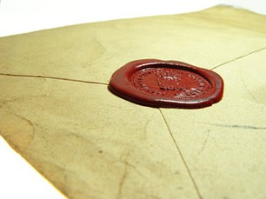
"Having believed, you were marked in him with a seal, the promised Holy Spirit, ¹⁴who is a deposit guaranteeing our inheritance until the redemption of those who are God's possession—to the praise of his glory"
(Eph. 1:13-14 NIV).
"And do not grieve the Holy Spirit of God, with whom you were sealed for the day of redemption"
(Eph. 4:30 NIV).

Slide 42

A Seal Guarantees Security and Provides Assurance
Notes:
In Paul's day, a wax seal on a letter conveyed: (1) ownership in that the seal of the sender was stamped on it, and (2) security by guarding the contents. The result was that the recipient could feel assurance that the contents were guaranteed and safe.

Slide 43

Assurance of
Salvation
Notes:
Paul used this background to assure his readers their salvation by noting that the Holy Spirit HIMSELF was the seal of their salvation (Eph. 1:13-14).
Please translate the text at the left and then drag everything over this slide so no English shows. Make sure the fonts remain.

Slide 44
What About Ethnic Differences Now?
Jews
Gentiles
One God
Many taboos
Many Gods
Few taboos

Slide 45
The Cross Makes Ethnicity Irrelevant
Jew-Gentile Unity
Gentiles
Make every effort to keep yourselves united in the Spirit, binding yourselves together with peace. ⁴For there is one body and one Spirit, just as you have been called to one glorious hope for the future.
Ephesians 4:3-4 NLT
One God
Love over Taboos
One God
Love over Taboos
There is neither Jew nor Greek, there is neither slave nor free, there is neither male nor female, for you are all one in Christ Jesus.
Galatians 3:28 ESV

Slide 46
The Two-Headed Snake
Notes:
ILLUSTRATION
A woman in Woodbridge, Virginia, saw a rarity in her front yard: a two-headed copperhead snake. The snake only has one heart and one set of lungs, but each head has its own brain. This leads to multiple problems.
Both heads want to eat, but since eating takes time, the snake is vulnerable to predators for twice as long. Further, each head wants to go its own way. That means they can't respond as quickly when under attack. Even getting water can be precarious, as one head can drag the other down when drinking.
An expert at the Wildlife Center of Virginia said, "Based on the anatomy, it would be better for the right head to eat, but it may be a challenge since the left head appears more dominant" (Dana Hedgpeth, The Washington Post, 9/24/18). Experts also say that these internal conflicts prevent these rare "dual-cephalic" creatures from living very long.
APPLICATION
James tells us that the double-minded man is unstable in all his ways (1:7), and implies that double-mindedness reflects impurity of heart (4:8).
Jesus taught, "No one can serve two masters; for either he will hate the one and love the other, or he will be devoted to one and despise the other. You cannot serve God and wealth" (Matthew 6:24). We must choose to whom we will listen if we are to avoid spiritual peril (Joshua 24:15).
Paul wrote, "They that are after the flesh do mind the things of the flesh; but they that are after the Spirit the things of the Spirit. For to be carnally minded is death; but to be spiritually minded is life and peace" (Romans 8:5-6).
We cannot live for the world and the Lord. It is an either/or proposition. Jesus says, "He who is not with Me is against Me; and he who does not gather with Me, scatters" (Luke 11:23).
Don't let double-mindedness leave you more vulnerable to spiritual attack, steer you the wrong way, or drag you down. Make the right choice to be single-minded in your dedication and devotion to the One true Head of the Church, Jesus Christ (Ephesians 1:22).
The Problems Of The Two-Headed Snake
Publication Information: preacherpollard.com
Publication Source: Click here to view source
Contributed By: Neal Pollard
Author: Neal Pollard
Date: 11 October 2018

Slide 47

The One-Headed Church
Christ as Head
Many parts,
One body
Notes:
The Church has only one head—Jesus Christ himself.
This leads to unity in the body amidst its diversity.

Slide 48
Slides on
Ephesians 2
Notes:
God’s love removed our depravity and separation from Israel (Eph 2).

Slide 49
Why did God save us?
Because we were so helpless
"Once you were dead because of your disobedience and your many sins. ²You used to live in sin, just like the rest of the world, obeying the devil—the commander of the powers in the unseen world. He is the spirit at work in the hearts of those who refuse to obey God. ³All of us used to live that way, following the passionate desires and inclinations of our sinful nature. By our very nature we were subject to God’s anger, just like everyone else" (Eph. 2:1-3 NLT).

Slide 50
How did God save us?
By his grace he gave us spiritual life
"But God is so rich in mercy, and he loved us so much, ⁵that even though we were dead because of our sins, he gave us life when he raised Christ from the dead. (It is only by God’s grace that you have been saved!) ⁶For he raised us from the dead along with Christ and seated us with him in the heavenly realms because we are united with Christ Jesus" (Eph. 2:4-6 NLT)

Slide 51
Why did God save us?
To show his grace through eternity!
"So God can point to us in all future ages as examples of the incredible wealth of his grace and kindness toward us, as shown in all he has done for us who are united with Christ Jesus" (Eph. 2:7 NLT)

Slide 52
How did God save us?
Through his grace—not our works
"God saved you by his grace when you believed. And you can't take credit for this; it is a gift from God. ⁹Salvation is not a reward for the good things we have done, so none of us can boast about it" (Eph. 2:8-9 NLT)

Slide 53
Why else did God save us?
To show his goodness through our good works!
"For we are God's masterpiece. He has created us anew in Christ Jesus, so we can do the good things he planned for us long ago" (Eph. 2:10 NLT)

Slide 54
Divisions in Herod's Temple
Most Holy Place
Holy Place
Main Temple
Temple Courtyard
Court of Priests
Court of Israel
Court of Gentiles
Court of Women

Slide 55
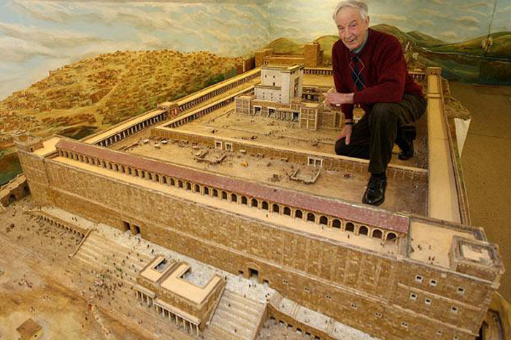
Divisions in Herod's Temple
Notes:
This model builder has his left foot in the Court of Gentiles

Slide 56
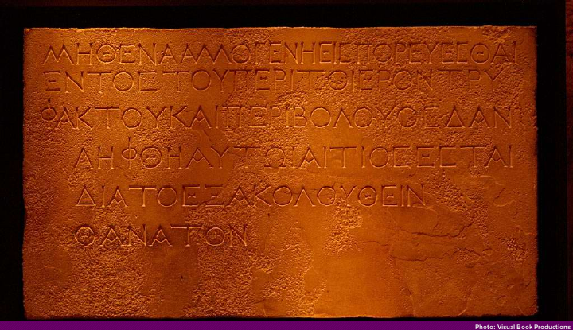
Warning of Dividing Wall for Gentiles
Ephesians 2:14
"For He Himself is our peace, who made both groups into one and broke down the barrier of the dividing wall."
"Let no foreigner enter within the partition and enclosure surrounding the temple. Whoever is arrested will be responsible for his death which will follow."
Notes:
https://sjoelupton.wordpress.com/2013/01/06/no-intruders-allowed/
"Just over a week ago I was standing in the Istanbul Museum of Archeology looking at something that can only be described as extraordinary. On the third floor, in a not too prominent location, there is a stone with an inscription in Greek. If I had not been with a friend who had pointed it out to me (let alone that got us into the exhibit even though it was technically closed) I would have probably missed its significance.
The stone is from the dividing wall between the Court of Gentiles and the Court of Israel in Herod's Temple. (1st century A.D.)
The stone is an unassuming piece of limestone that is very common in Israel and throughout the Middle East. This piece of limestone, however, served a very specific purpose. Inscribed on the face of the stone is a warning to any presumptuous Gentiles that might want to invade the sanctity of Jewish holy places. The stone reads:
"No intruder is allowed in the courtyard and within the wall surrounding the temple. Whoever enters will invite death for himself."
This stone sat in Herod's temple in Jerusalem from the time of the temple expansion by Herod in 20-19 B.C. until the Romans sacked Jerusalem and destroyed the temple in 70 A.D. This marker was to serve as a barrier beyond which the unclean Gentiles were simply not permitted. This stone made a distinction between who could worship in the temple and who couldn't.
It is a distinction that God never intended.
A quick comparison (which can be found in any halfway decent study Bible) between Solomon's Temple and Herod's Temple reveals that there was no such thing as a "Court of Gentiles" in the original design of God's temple. It was never God's original design that one group of people who fear and worship God should be separated from another group of people who fear and worship God. Regardless of the outward characteristics or inward inclinations toward sin, no man or woman should ever be separated from the flock when it comes time to worship Yahweh. As God said through the prophet Isaiah (Is. 56:7) and repeated by Jesus himself (Mt. 21:13) "My house shall be called a house of prayer for all peoples."
This attitude of making distinctions among equals and cutting people off from worshipping the King is part of what Jesus is addressing in Matthew 23 as he stands before the Pharisees and the Scribes and condemns them with some of the strongest words we have record of him saying. This chapter is a polemic in which Jesus pronounces seven woes to the religious leaders of the day. He calls out their hypocrisy and rightly accuses them of doing everything they do to be seen as holy by the people and not before Holy God. One of the most chilling statements is the first of the woes: "Woe to you, scribes and Pharisees, hypocrites! For you shut the kingdom of heaven in people's faces. For you neither enter yourselves nor allow those who would enter to go in." This condemnation strikes at the heart of conservative evangelicalism in America. The sad reality looming behind most of our churches glossy advertising and overbearing welcome committees is that the world perceives us welcoming only to those of our own ilk. Behind the "First Baptist Church of So and So Welcomes You" sign they see a church that welcomes those who dress like we do, talk like we do, work where we work, live where we live and sin like we sin. If we truly read the Bible the way it is written then we would see that our prejudiced attitudes (no matter how far we try to bury them) draw more wrath from the Son of God than the woman who has had five husbands and is shacking up with a man she isn't married to at the moment (see John 4). Unfortunately most of us read the Bible just deeply enough to reinforce our preconceived biases. The reason the world sees Christianity as the religion of xenophobes, homophobes, Islamophobes, misogynists, racists, pro-death penalty, warmongering Republicans is because many of us are those things. Reputation is because of repetition. We must let the Gospel of Jesus Christ shatter our prefabricated, cookie-cutter notions about sin and grace and forgiveness. We must abandon our bumper-sticker Christianity. Let me be clear: the Bible never calls the Church to tolerate sin in any form whatsoever. What the Bible calls for is the unconditional love of the Church for those that find themselves tempted to and caught in sin.
If we ever intend to love people without conditions then we can be assured of a few things: first, we're going to get some on us. You can't love someone without getting in their mess and you can't get in their mess without getting dirty. Loving alcoholics may mean going and getting them from a bar. Loving prostitutes may mean going to some of the less-prestigious parts of town and rescuing them from that life. Second, loving people demands sacrifice. Loving people is not easy, it is not clean and it will cost us tremendously. On the other hand, judging people is easy, judging people is clean but judging people will cost us our souls. God has not called his Church to be an instrument of judgement and wrath, instead he has called us to be gracious bearers of his holy image. If we make an error in this then let it be an error on the side of grace. Leave it to God to open and shut the kingdom of heaven, let us simply lay down our lives to proclaim his grace to all who will listen until the day he returns."
(cf. Elwell & Yarborough, Readings from the First-Century World, 83)

Slide 57
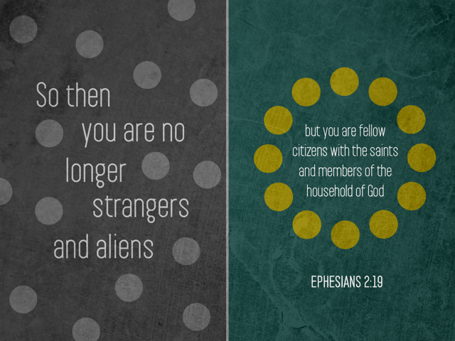
Ephesians 2:19

Slide 58
Slides on
Ephesians 3

Slide 59

Dispensations (Eph. 3:2)
"…you know God gave me the special responsibility
of extending his grace to you Gentiles"
(NLT)
"…you have heard of the stewardship of God's grace which was given to me for you"
(NAU)
"administration" (NIV)
"dispensation" (KJV)
oivkonomi,a (Greek)
oi;koj (house) + no,moj (law)
"responsibility of management, management of a household, direction, office" (BDAG)
Time before Paul's dispensation (Gentiles came through Israel under law)
Time of Paul's dispensation (Gentiles equal to Jews
under grace)

Slide 60
Dispensations in Ephesians
180f
SALVATION BY GRACE THROUGH FAITH
(6)
Church
(3:2, 9)
(1)
Pre-Fall
(2)
Conscience
(3)
Government
(4)
Patriarchal
(5)
Mosaic
(2:15)
(7)
Millennial
(1:9-10)
ISRAEL ≠ CHURCH
PROGRESSIVE REVELATION
Adapted from Paul Benware, Understanding End Times Prophecy, 2d ed. (Chicago: Moody, 2006), 88

Slide 61
"God’s purpose in all this was to use the church to display his wisdom in its rich variety to all the unseen rulers and authorities in the heavenly places" (Ephesians 3:10 NLT).
Why the Church?

Slide 62
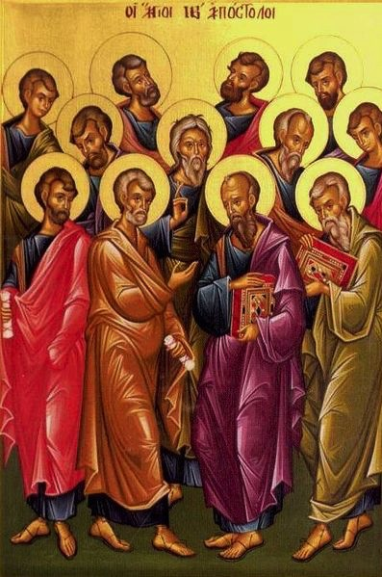
Are there apostles today?
20
God's household (the church) is:
"built on the foundation of the apostles and prophets, with Christ Jesus himself as the chief cornerstone"
(Eph. 2:20)

Slide 63

God's Household (Eph. 2:19-22)
19
Non-Equipping Gifts
(Eph. 4:12b)
Pastor-Teachers
Evangelists
Teachers
Equipping Gifts
(Eph. 4:11-12a)
Foundation: Apostles & Prophets (Eph. 2:20)
Foundation: The Lord Jesus Christ (1 Cor. 3:11)
Adapted from Charles R. Swindoll. "Spiritual Gifts Study Guide" (IFL, 1983), 7

Slide 64
How can our church be united despite our many different kinds of people?
Notes:
What do we need to do so we don’t end up divided due to our diversity?

Slide 65
How to be united…
Love God
Eph 1–3
Notes:
Love God for our equality in Christ (Eph 1–3).
[Praise God that none of us is better than any other due to salvation or ethnic origin or class.]

Slide 66
How to be united…
Love the Church
Love God
Eph 4–6
Notes:
Love the church to witness to the world (Eph 4–6).
[Unity leads to care for each other in a way that attracts unbelievers.]

Slide 67
Slides on
Ephesians 4
Notes:
Serve one another under God’s gifted servants to reach Christ-likeness (4:1-16).

Slide 68
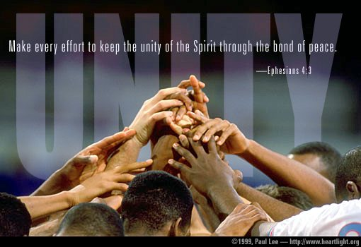
Ephesians 4:3
Make every effort to keep the unity of the Spirit through the bond of peace.

Slide 69

What unites us (Eph. 4:4-6)?
Body – fellowship of believers (Church)
Spirit – Holy Spirit activates fellowship
Hope – of the future
Lord – to whom we belong
Faith – singular commitment
Baptism – sign of entry into the Church
God – our Father keeps us for eternity

Slide 70
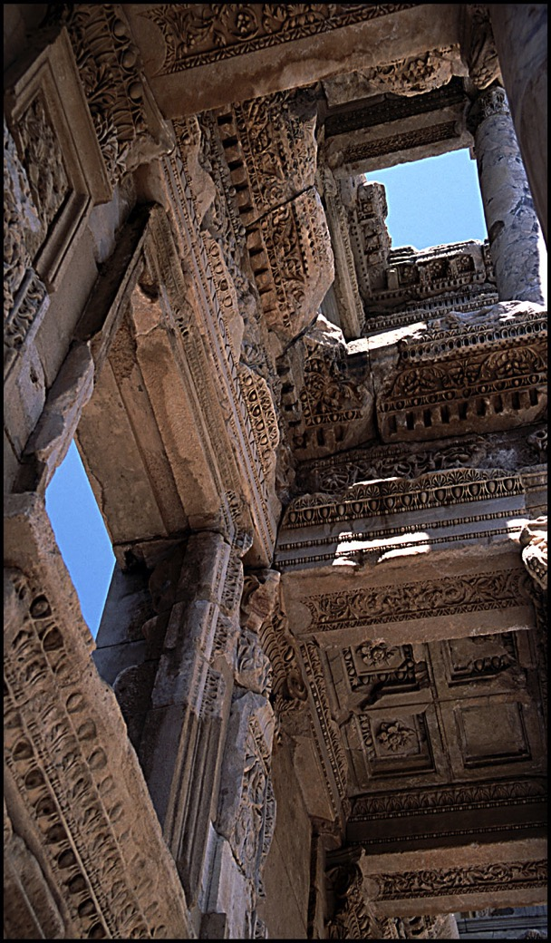
Ephesians 4:1-16
Call to Unity (1-6)
Way to Unity (7-16)
  Ascension (7-10)
  Roles (11-12a)
  Purpose (12b-13)
  Results (14-16)

Slide 71
The Do's (4:17–5:2)
Put on your new self (4:17-22)
Think anew (4:23)
Be holy (4:24)
Tell the truth (4:25)
Do not sin in anger (4:26-27)
Don't steal (4:28)
Speak graciously (4:29)
Be kind, compassionate & forgiving (4:31–32)
Imitate God's love (5:1-2)

Slide 72
Slides on
Ephesians 5

Slide 73
The Don'ts (5:3-18)
Sexual immorality (5:3)
Greed (5:3)
Impurity (5:3)
Obscenity (5:4)
Foolish talk, coarse joking (5:4-5)
Drunkenness (5:18)

Slide 74

"So be careful how you live. Don’t live like fools, but like those who are wise. ¹⁶Make the most of every opportunity in these evil days. ¹⁷Don’t act thoughtlessly, but understand what the Lord wants you to do"
(Eph 5:15-17 NLT).
"Therefore be careful how you walk, not as unwise men but as wise, ¹⁶making the most of your time, because the days are evil. ¹⁷So then do not be foolish, but understand what the will of the Lord is"
(Eph 5:15-17 NAU).
Notes:
The New American Standard Updated (1995) gives the more literal sense.
How do you “walk carefully” (cf. KJV)?
The two commands here are “be careful” and “do not be foolish.”
You show care and wisdom by making the most of your time.
And you use your time wisely because many live in sin! These truly are evil days.

Slide 75

How can you “redeem the time”?

Slide 76
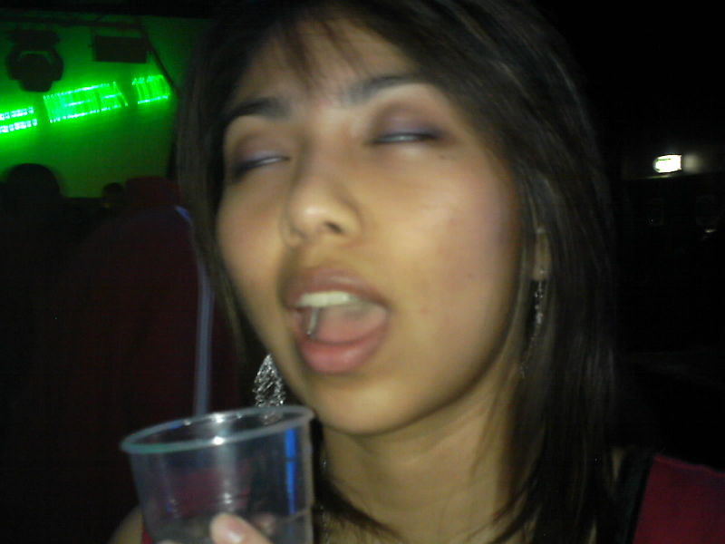
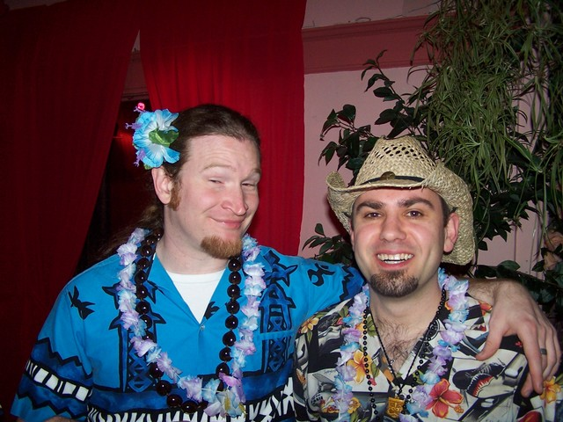
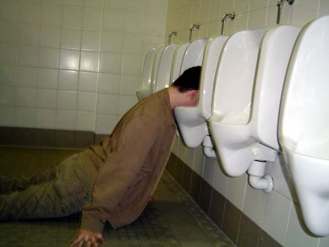
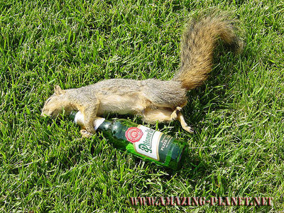
When someone is drunk…

Slide 77
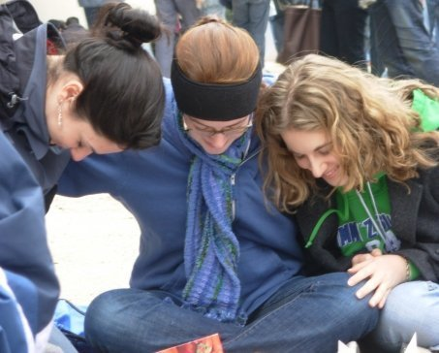

Ephesians 5:18-20 NLT
Don't be drunk with wine, because that will ruin your life.
Instead, be filled with the Holy Spirit,
¹⁹singing psalms and hymns and spiritual songs among yourselves, and making music to the Lord in your hearts. ²⁰And give thanks for everything to God the Father in the name of our Lord Jesus Christ.

Slide 78
Results of Spirit Filling (Eph 5:18-21)
Be filled with Spirit (5:18)
Sing psalms, hymns and spiritual songs (5:19a)
Make music to the Lord (5:19b)
Always be thankful (5:20)
Submit to one another out of reverence for Christ (5:21)

Slide 79
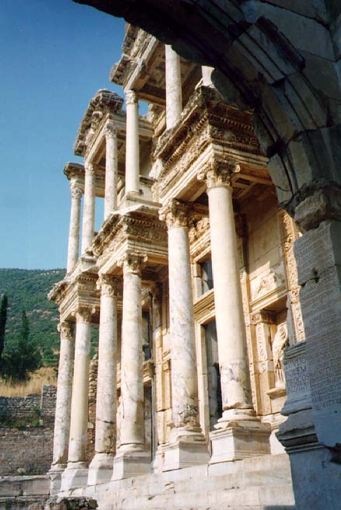

Ephesians 5:21–6:9
Submission in the family of God

Slide 80
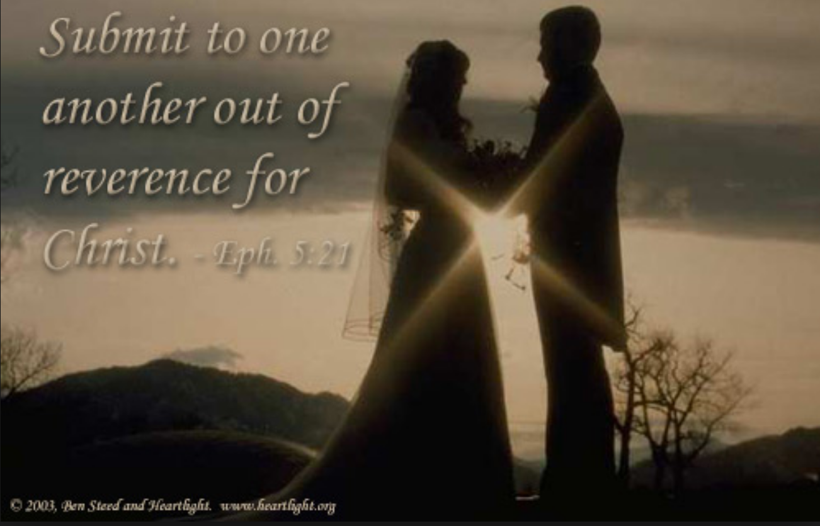
Mutual Submission (Ephesians 5:21).

Slide 81
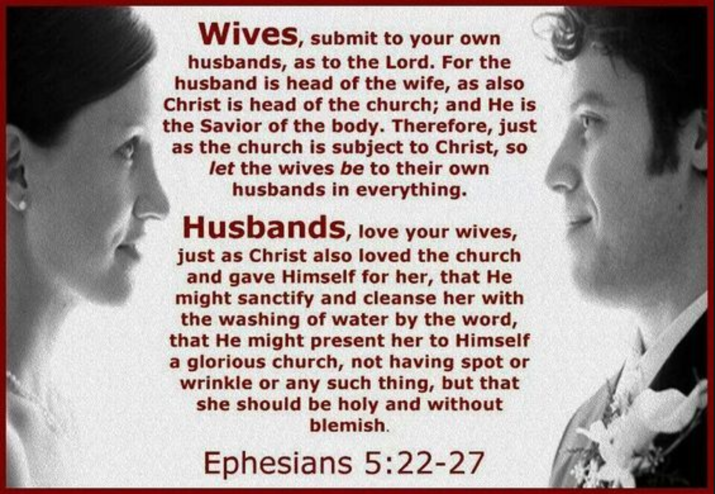
Submission & Love
(Ephesians 5)

Slide 82
Slides on
Ephesians 6

Slide 83

Parenting is the hardest job in the world

Slide 84

“Children, obey your parents in the Lord, for this is right”
(Ephesians 6:1 NLT).

Slide 85
"Slaves, obey your earthly masters with deep respect and fear. Serve them sincerely as you would serve Christ" (Ephesians 6:5 NLT).
Love the Nations

Slide 86
"Try to please them all the time, not just when they are watching you. As slaves of Christ, do the will of God with all your heart. ⁷Work with enthusiasm, as though you were working for the Lord rather than for people" (Ephesians 6:6-7 NLT).
Love the Nations

Slide 87
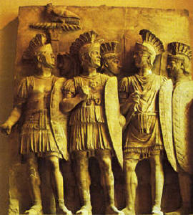
6:10-20 Armor of God
Ephesians 6:10-20
The Armor
of
God

Slide 88
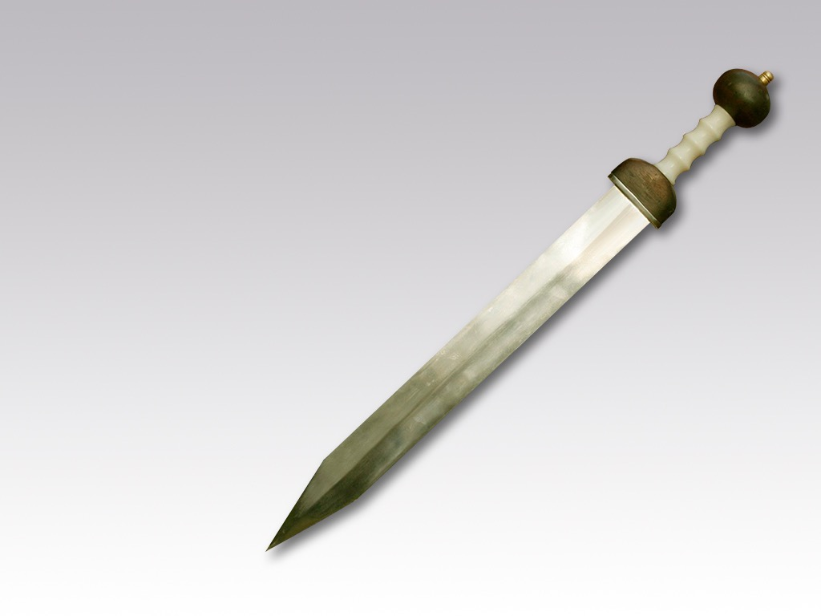
"A final word: Be strong in the Lord and in his mighty power. ¹¹Put on all of God’s armor so that you will be able to stand firm against all strategies of the devil. ¹²For we are not fighting against flesh-and-blood enemies, but against evil rulers and authorities of the unseen world, against mighty powers in this dark world, and against evil spirits in the heavenly places"
(Ephesians 6:10-12 NLT).

Slide 89
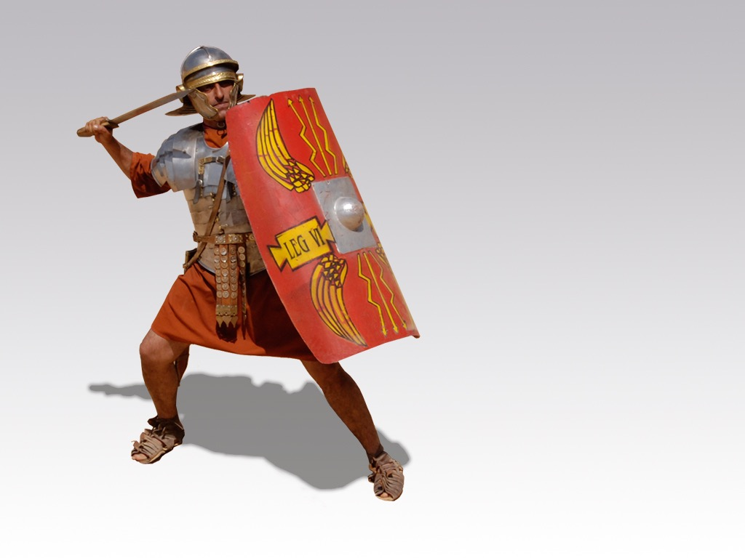

Free
Bible
images
CONTRIBUTION
Ephesians 6:10-20
THE CHRISTIAN'S ARMOUR

Slide 90
Paul compared us to a Roman soldier
Notes:
Paul wrote to the Ephesian church while in bondage in Rome, seen in two direct references (3:1; 4:1) and mention of his chains (6:20). While under house arrest when he penned this letter to the Ephesians (Act 28:30-31), he may have been chained to a soldier since he mentions his chains. Perhaps he simply looked at each part of the soldier’s armor and drew parallels to the more significant spiritual battles that we all fight.

Slide 91

Belt of truth
Notes:
Paul first mentions this belt that protected the private parts of the soldier.

Slide 92
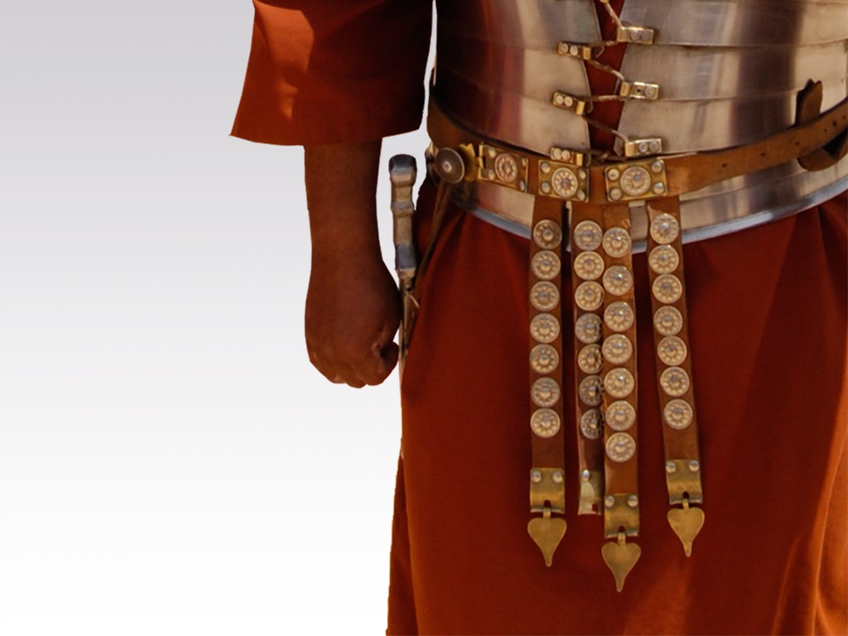
  Held up flowing robe and sword
  = integrity
Notes:
We must “put on” or apply the integrity of Jesus where our actions match our words to protect us from hypocrisy.

Slide 93
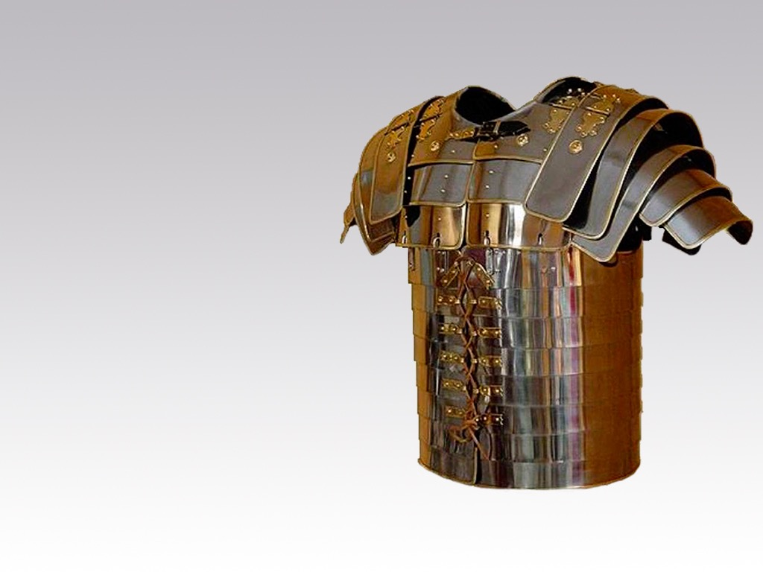
  Breastplate of righteousness

Slide 94
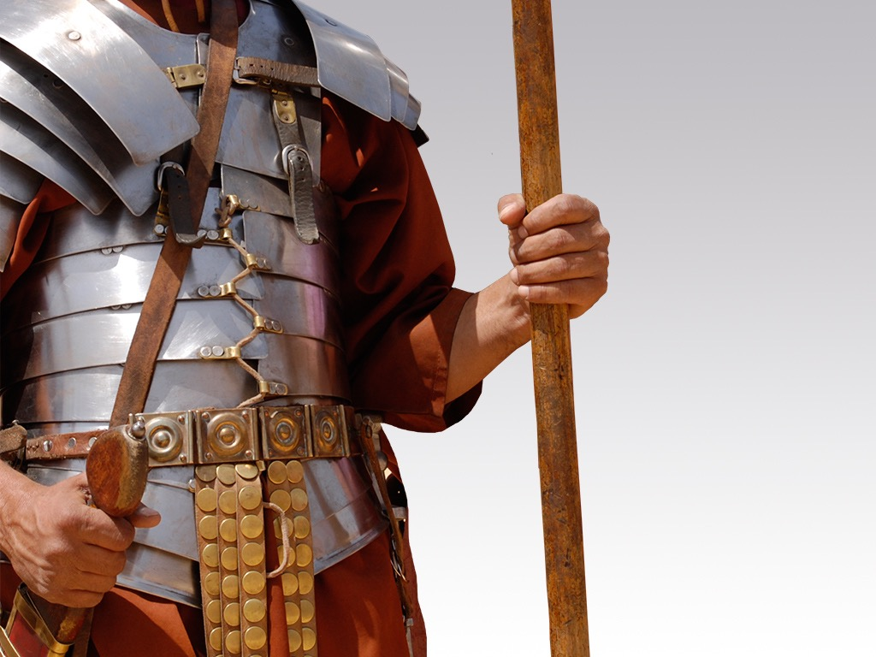
Protected vital organs
  = imputed righteousness
Notes:
We need to discover their position in Christ where the righteousness of Christ is applied to them. It is not our own righteousness that protects us but only the righteousness of Jesus that we receive since we cannot earn it.

Slide 95
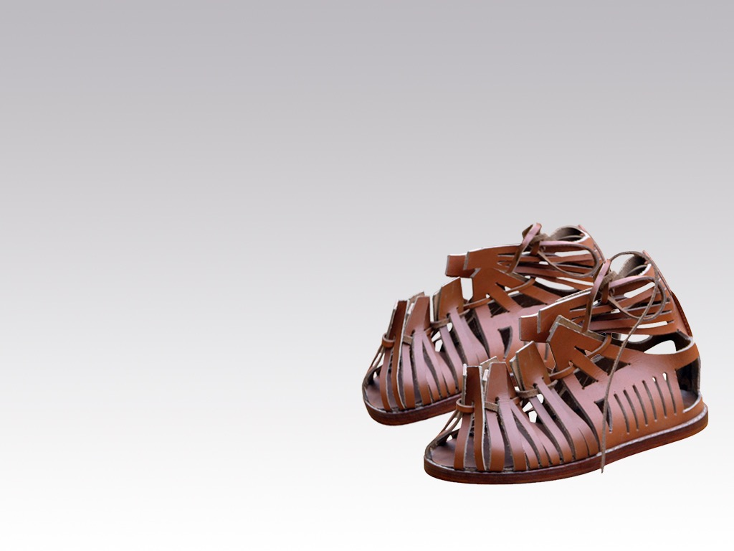
  Shoes that lead to peace

Slide 96
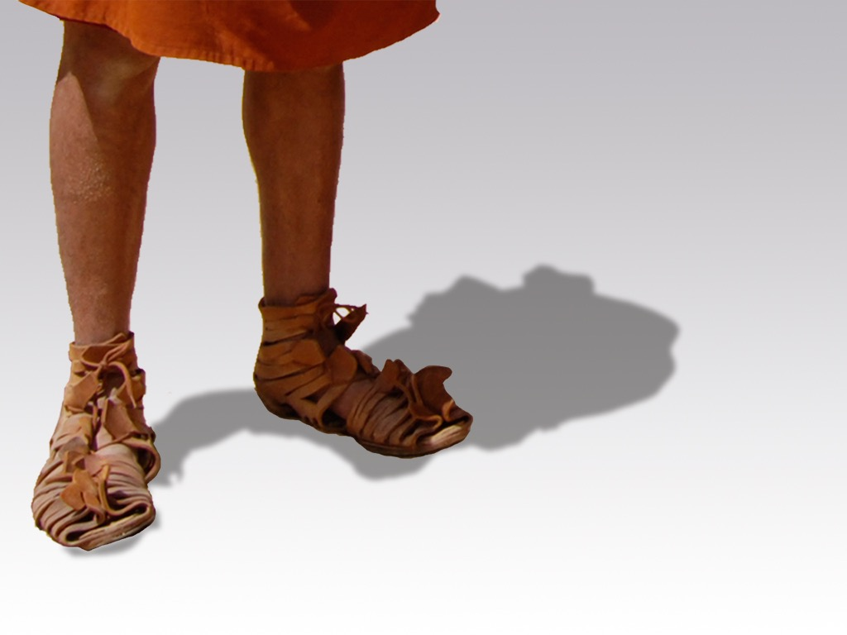
Sure footing and mobility to fight anywhere
  = availability in evangelism
Notes:
We must “put on” an availability in evangelism where we share the gospel anywhere.

Slide 97

Shield of faith

Slide 98
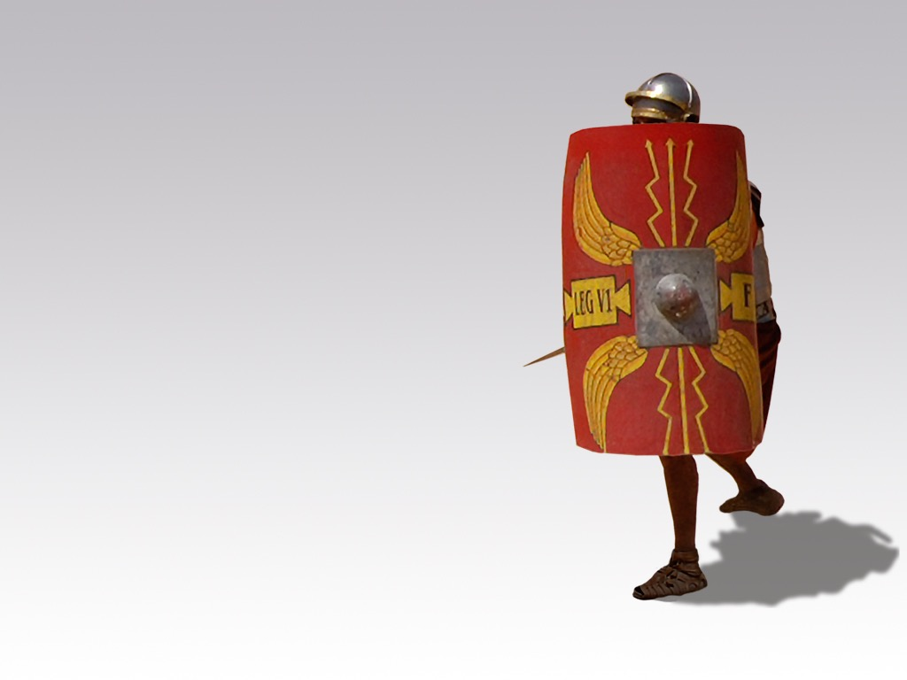
  Extinguished fiery arrows and fended off swords
  = faith to fight temptations
Notes:
Our faith in God enables us to fight temptations from Satan.

Slide 99
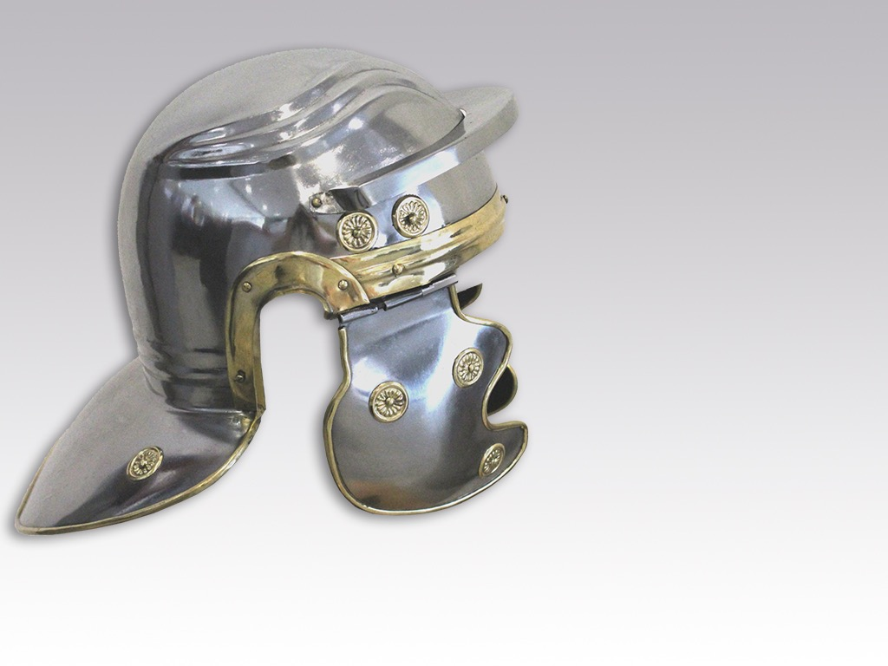
Helmet of salvation

Slide 100
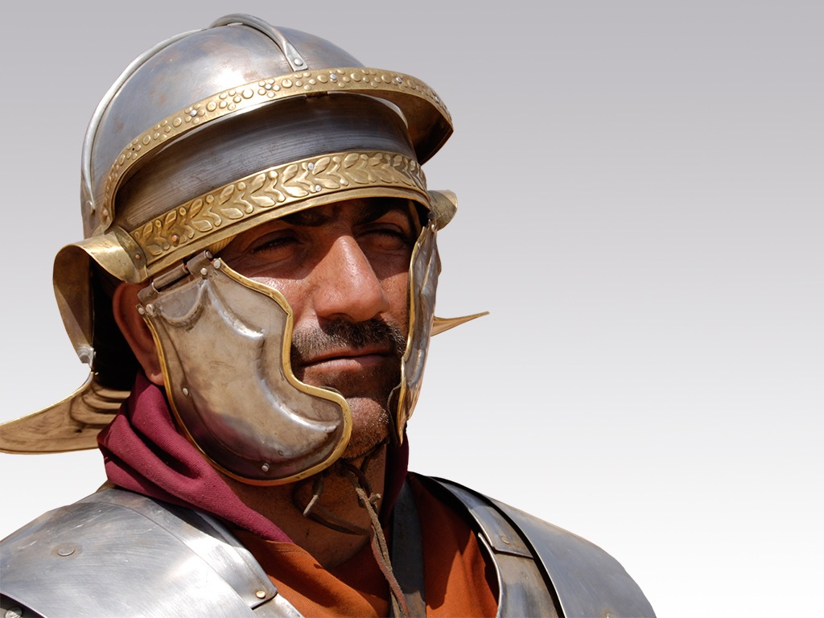
Protected from head injury
  = assurance of salvation

Slide 101
Sword of the Spirit

Slide 102
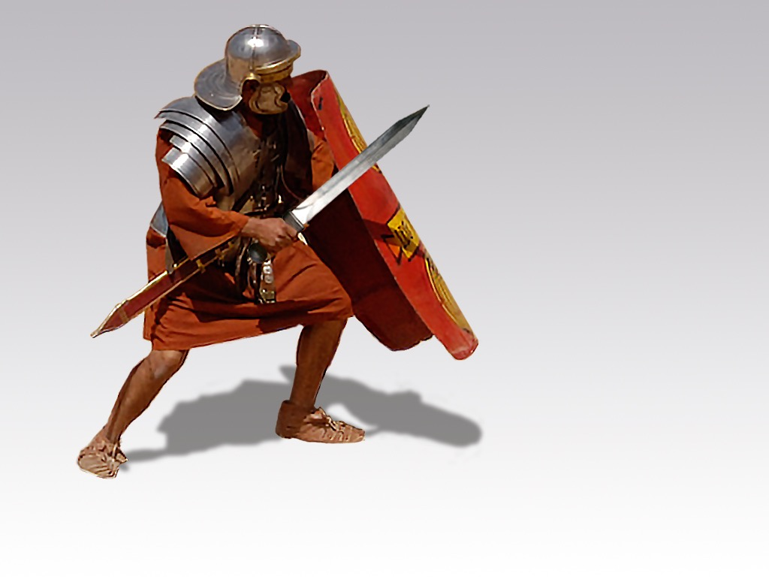
Attacked the foe or defended against attack

Slide 103
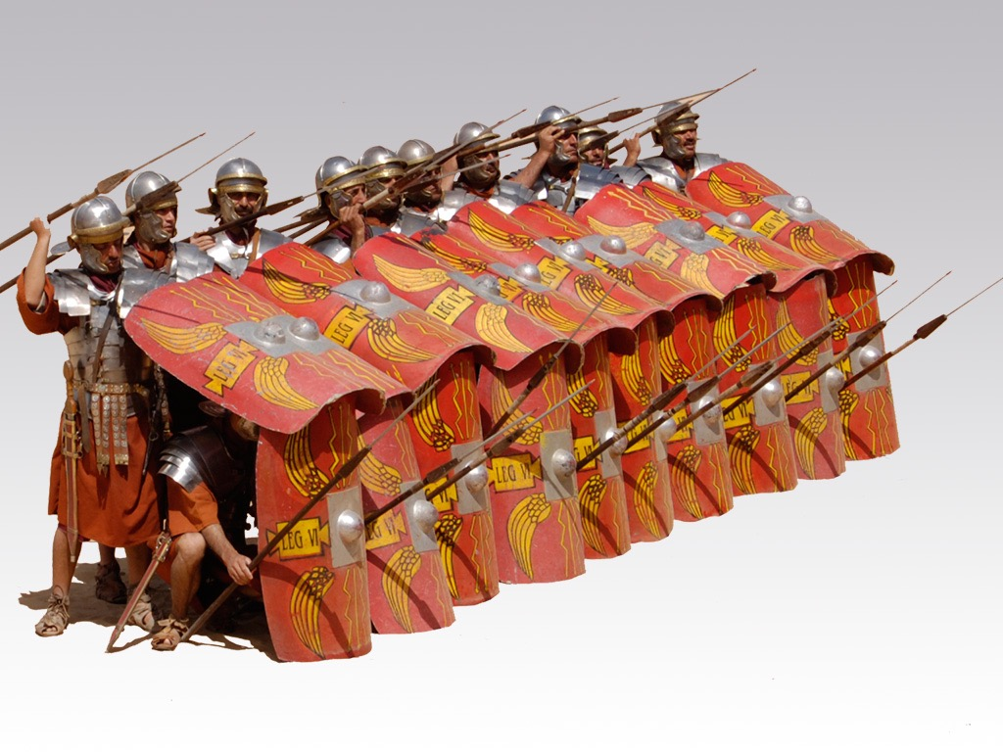
Unity in battle
Notes:
When we all wear the armor, we can both attack enemy strongholds and also defend from Satan’s attacks.

Slide 104
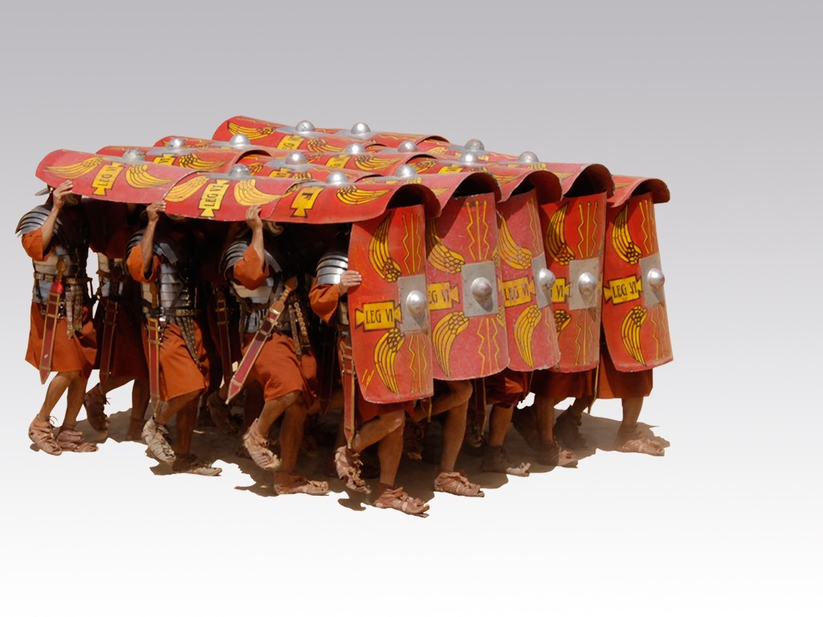
“The Turtle”
= advancing together
Notes:
Believers who are united in direction can advance the gospel where they otherwise would be unprotected.

Slide 105
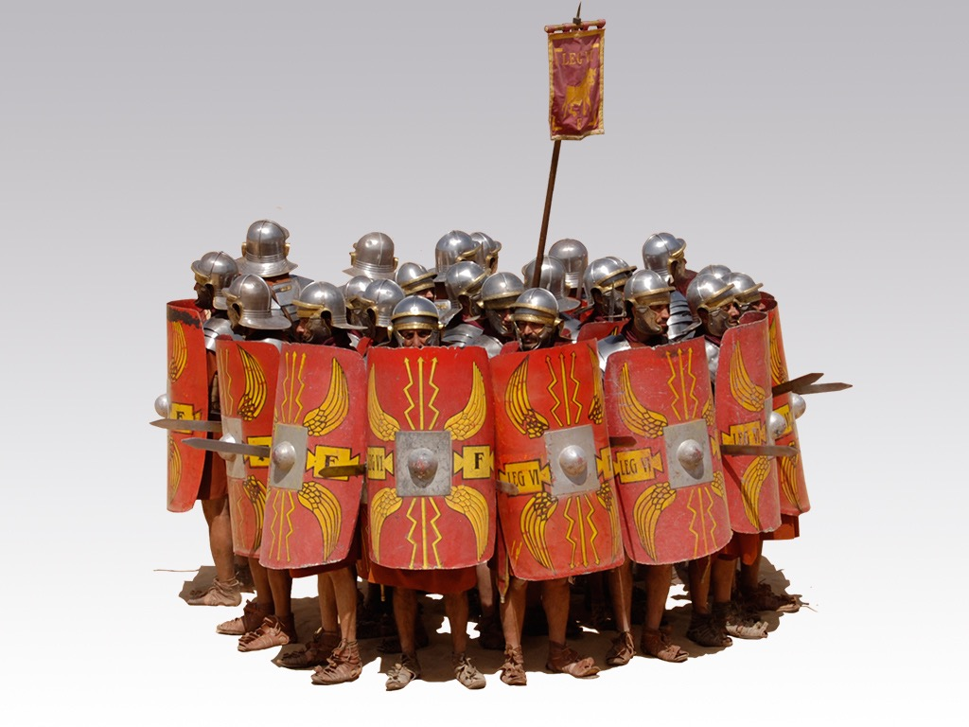
Protecting
one another
Notes:
When we all wear the armor, we defend not only ourselves from attack—we defend one another.

Slide 106


Slide 107



Use Your Weapons!
Notes:
It does little good to have weapons at our service but they lie somewhere in a corner! This is why Paul commanded that we “take up” or put to use these weapons.

Slide 108

Love one another
²³ Peace be with you, dear brothers and sisters, and may God the Father and the Lord Jesus Christ give you love with faithfulness.
²⁴ May God’s grace be eternally upon all who love our Lord Jesus Christ.
Ephesians 6: 23-24 (NLT)

Slide 109
How can our church be united despite our many different kinds of people?
Notes:
What do we need to do so we don’t end up divided due to our diversity?

Slide 110

Love God, love the church as equals, and love the nations
Main Idea of Ephesians

Slide 111
How to be united…
Love God
Eph 1–3
Notes:
Love God for our equality in Christ (Eph 1–3).
[Praise God that none of us is better than any other due to salvation or ethnic origin or class.]

Slide 112
How to be united…
Love the Church
Love God
Eph 4–6
Notes:
Love the church to witness to the world (Eph 4–6).
[Unity leads to care for each other in a way that attracts unbelievers.]

Slide 113
How to be united…
Love the Nations
Love the Church
Love God
Ephesians
Notes:
Love God, love the church as equals, and love the nations (Main Idea).
The way to unity for believing Jews and Gentiles is to see their equality and love one another as a witness to the world.

Slide 114

Think about it.
Do you really act like you are equal with other members of the body of Christ?
• Maids?
• Former Muslims (Malays)?
• Believers in Prison?
• Poor churches of India, Myanmar, Bangladesh, etc.?
How do you show your unity with believers different from you?

Slide 115
Black

Slide 116


NT Preaching link • BibleStudyDownloads.org
Get this presentation for free!
Notes:
NT Survey (ns)

