Slide 1
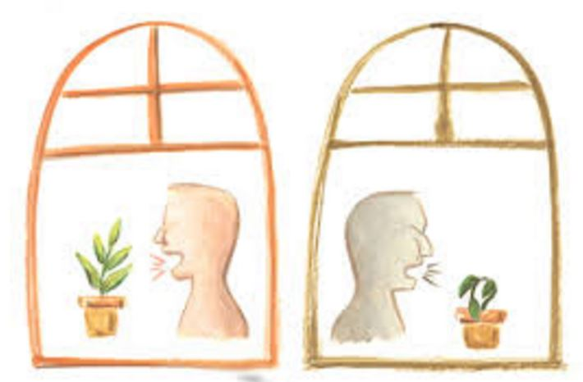
To Harm or To Help?
(Ephesians 4:29)
Harrison (2017. 03. 28)
Harrison Park • Homiletics 1 Class Sermon Uploaded by Dr. Rick Griffith • Singapore Bible College All files in many languages for free download at BibleStudyDownloads.org

Slide 2
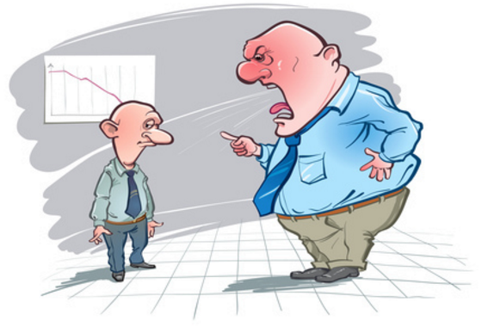

Slide 3
• Speaking is one of the most common and important ways of communication
• You can save people or kill them with words.
—"The tongue can bring death or life" (Prov. 18:21)

Slide 4
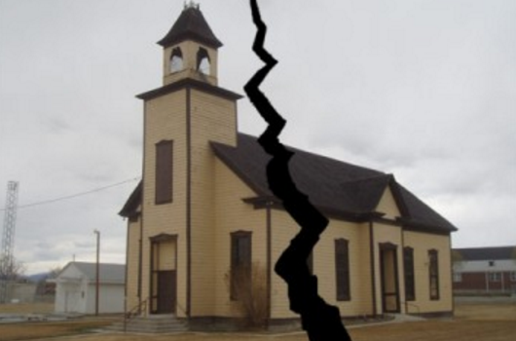
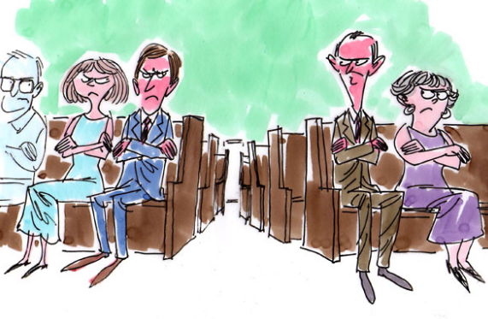
Notes:
.

Slide 5
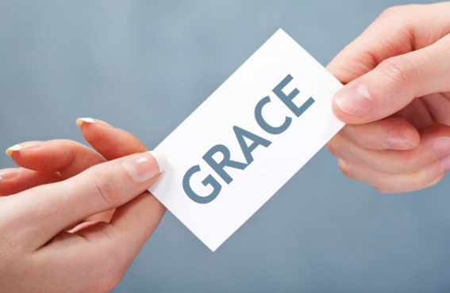

Slide 6
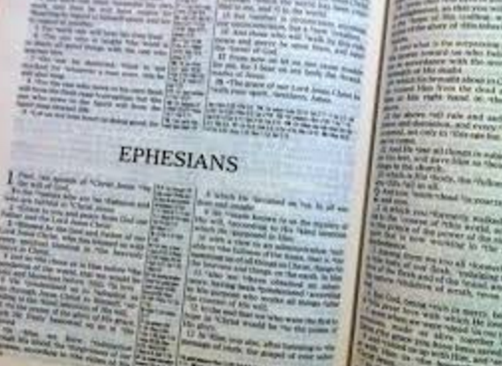
• Throw off your old sinful nature and your former way of life [4:22]
• Put on your new nature, created to be like God – truly righteous and holy [4:24]

Slide 7
Ephesians 4:25-30
The new lifestyle as believers
• Not to do: lie (25), steal (28), use foul language (29),
angrily abuse people (31)
• To do: tell the truth (25), work hard (28),
use edifying speech (29), and forgive (32)

Slide 8
Ephesians 4:29
"Let no unwholesome word proceed from your mouth, but only such a word as is good for edification according to the need of the moment, so that it will give grace to those who hear" [NASB]

Slide 9
I. Speak to other believers harmlessly
• Speak no unwholesome talk out of your mouths
(v. 29a)
• “Unwholesome” means literal sense of rotten or decay and figuratively of bad, evil, foul, unwholesome.

Slide 10
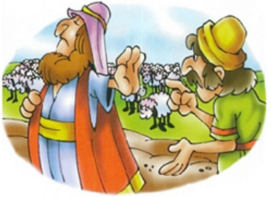
"Who is this fellow David?" Nabal sneered to the young men. "Who does this son of Jesse think he is? There are lots of servants these days who run away from their masters. Should I take my bread and my water and my meat …give it to a band of outlaws who come from who knows where?" (1 Sam. 25:10-11)

Slide 11
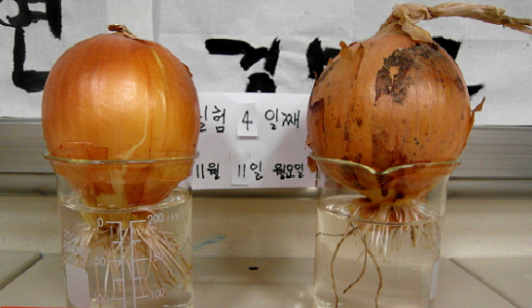
"I hate you!"
"You're annoying!"
"You are ugly!"

Slide 12
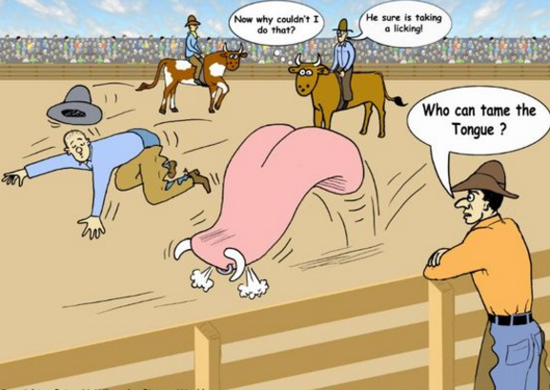
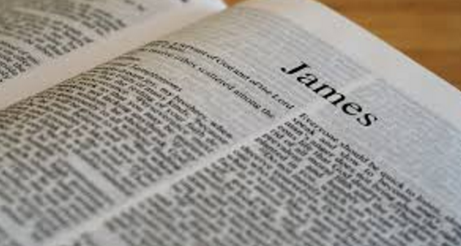
"For if we could control our tongues, we would be perfect and could also control ourselves in every other way…No one can tame the tongue" (James 3:2, 8).

Slide 13
"If you need wisdom, ask our generous God, and he will give it to you" (James. 1:5).

Slide 14
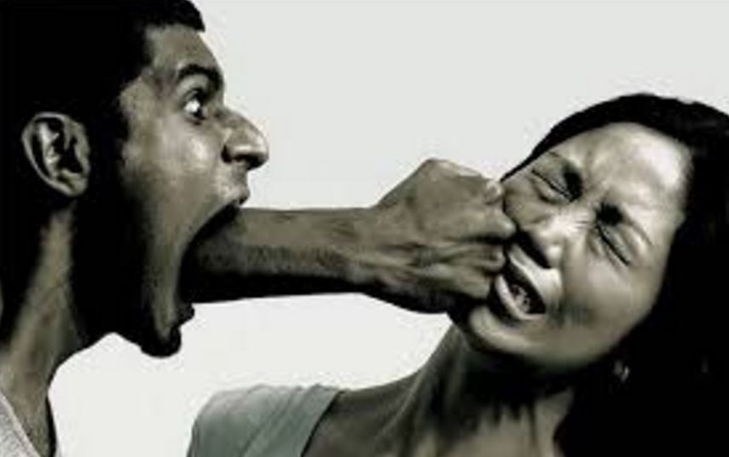
Vulgar words
Angry words
Annoying words
Insulting words
are like hitting or spewing poison to your opponent.

Slide 15
II. Speak to other believers helpfully
• "Only such a word as is good for edification according to the need of the moment" (v. 29b)
• “Good for edification” means morally good, building the confidence, encouraging, creating goodwill, genuine.

Slide 16
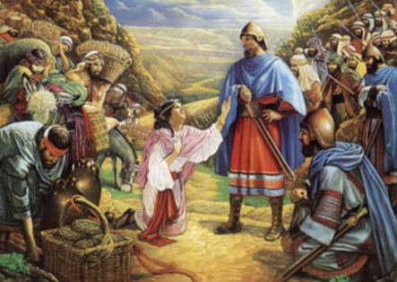
"I know Nabal is a wicked and ill-tempered man; please don't pay any attention to him. He is a fool, just as his name suggests. …the LORD has kept you from murdering and taking vengeance into your own hands, let all your enemies and those who try to harm you be as cursed as Nabal is."
1 Sam. 25:25-26

Slide 17
"I love you" "Thank you"
"You're pretty!"
"I hate you!"
"You're annoying!"
"You are ugly!"

Slide 18
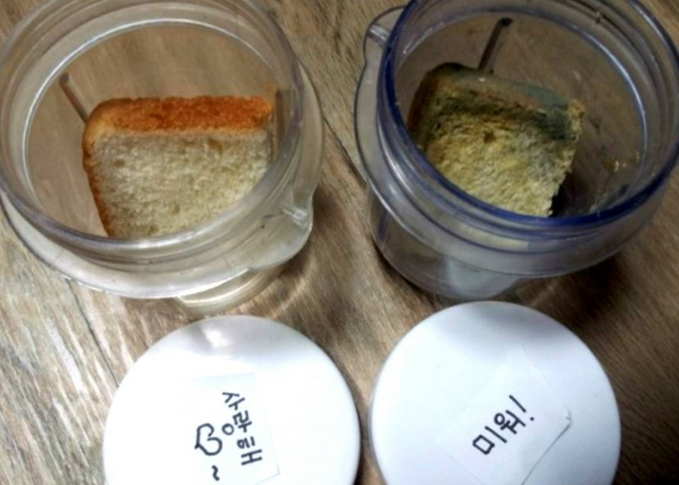
Love you Thank you
Pretty
Hate you
Annoying
Ugly

Slide 19
What kind of words can you use to help others?
True praise
Encouragement
Comfort
Effective Advice

Slide 20
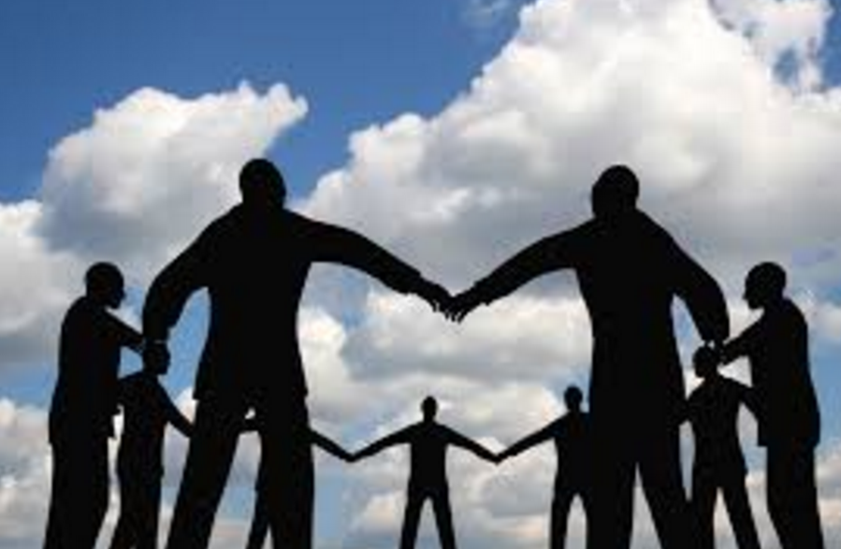
III. Harmless and helpful speaking give benefits to listeners
"…so that it will give grace to those who hear" (v. 29c)
“Grace” means “give grace and do a favor for someone.”
Grace is a gift given by God to enable the recipient to accomplish the task of God.

Slide 21
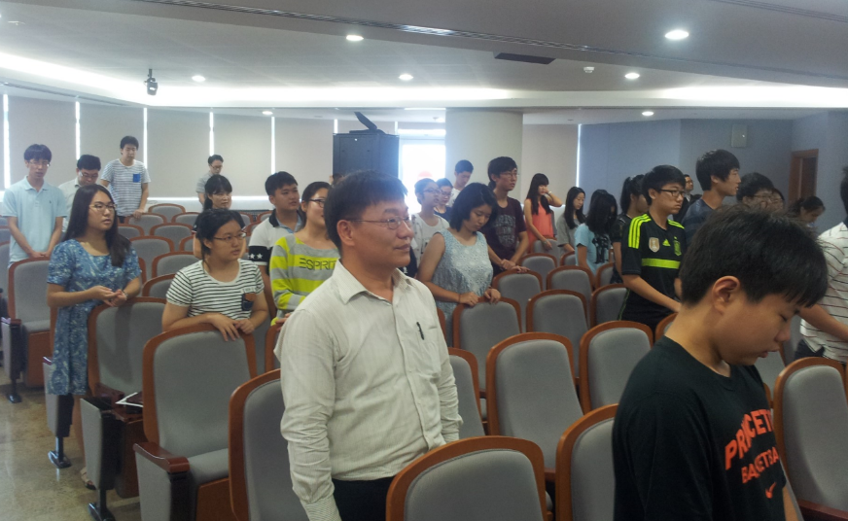
Notes:
I served the church as a voluntary teacher quite long time but I found it difficult to build good relationship with young generation. One day, senior pastor invited me to dinner and thanked me for my effort and encouraged me to continue the work. Additionally, he gave me one advice that I should try to praise young people for every little they do correctly. His advice changed my behavior toward young people. After that, I felt more comfortable working with young generation. My senior pastor told me my weakness in a way that I will not feel hurt but be encouraged to change.

Slide 22
Conclusion
Speak harmlessly and helpfully.
It is the best way to respond to others.
You can build community or destroy it by the way you speak.
Use words wisely by power of Spirit.

Slide 23
Don’t Say Anything That Doesn’t Help

Slide 25
NT Preaching link at BibleStudyDownloads.org
Get this presentation and script for free!
Notes:
NT Preaching (np)

