Slide 1
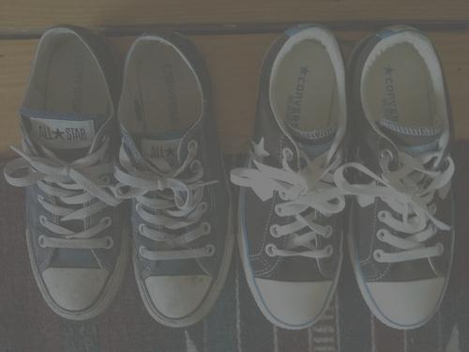
out with the old, in with the new
Ephesians 4:17-32

Slide 2
The Old and the New: Our Life Before and After Christ (17-24)
The Old Self: Your Life Before Christ (17-19)
The New Self: Your Life in Christ (20-24)

Slide 3
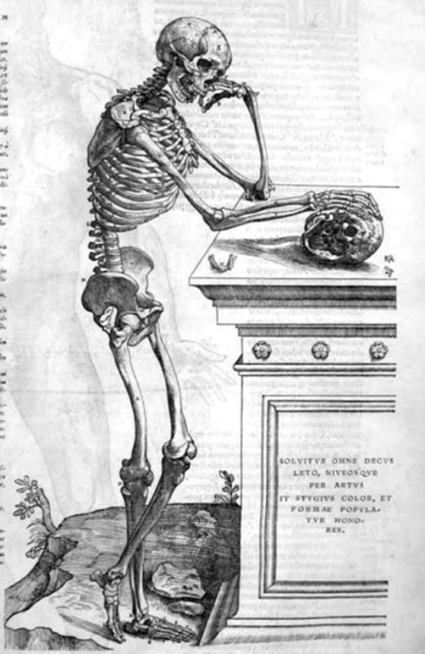
The Old Self: Your Life Before Christ (17-19)
Futile Thinking (17)

Slide 4
The Old Self: Your Life Before Christ (17-19)
Darkened Understanding (18)

Slide 5
The Old Self: Your Life Before Christ (17-19)
Separated from God’s Life (18)

Slide 6
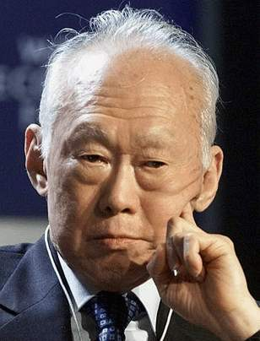
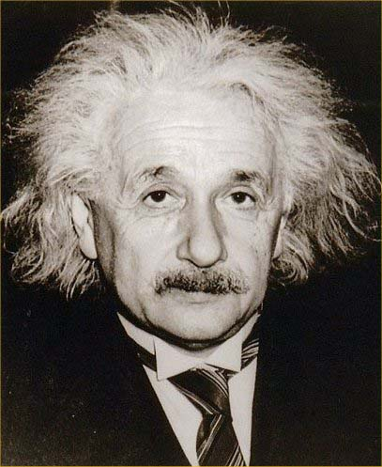
The Old Self: Your Life Before Christ (17-19)
Ignorant (18)

Slide 7
The Old Self: Your Life Before Christ (17-19)
Insensitive (19)

Slide 8
The Old Self: Your Life Before Christ (17-19)
Impure (19)

Slide 9
The Old Self: Your Life Before Christ (17-19)
Futile Thinking
Darkened Understanding
Separated from God’s Life
Ignorant
Insensitive
Impure
Why would you ever want to go back to this way of living and thinking?

Slide 10
The New Self: Your Life in Christ (20-24)
Knowledge of the Truth in Jesus (21)

Slide 11
The New Self: Your Life in Christ (20-24)
Put off the corrupt old self ruled by deceitful desires (22)

Slide 12
The New Self: Your Life in Christ (20-24)
Made New in the Attitude of Our Minds (23)

Slide 13
The New Self: Your Life in Christ (20-24)
Put on the new self who is righteous and holy like God (24)

Slide 14
The Average American Every Day:
Watches Four Hours of Television
Sees 5,000 Advertisements
Spends 8 ½ Hours Before a Digital Screen

Slide 15
Some Food for Thought
How do you spend your time and money?
With whom do you spend it?
What and who do you talk about the most?
How much time do you devote to filling your mind with God’s perspective and spending time with His people?

Slide 16
Living Out Your New Life in Christ (25-32)

Slide 17
Contrasting the Old and New Self
Old Self: | New Self:
Speaking Falsehood | Speak Truthfully
Unrighteous Anger | Righteous Anger
Dishonest Gain | Hard-working & Generous
Unwholesome Talk | Edifying Talk
Bitterness, Rage, Anger, Brawling, Slander, Malice | Kind, Compassionate, Forgiving

Slide 18
Living Your New Life in Christ
Speak Truthfully (25)

Slide 19
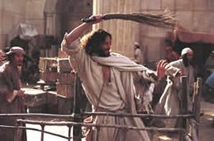
Living Your New Life in Christ
Righteous Anger (26-27)

Slide 20
Living Your New Life in Christ
Righteous Anger (26-27)
Keep short accounts
Seek first to understand
Practice drive-through communication
Work toward a win-win solution
“Kiss and make up”

Slide 21
Living Your New Life in Christ
Hard-working Generosity (28)

Slide 22
Living Your New Life in Christ
Edifying Talk (29-30)

Slide 23
Living Your New Life in Christ
Kind, Compassionate, and Forgiving (31-32)

Slide 24
Summary & Conclusion
Speak Truthfully (25)
Righteous Anger (26-27)
Hard-working Generosity (28)
Edifying Talk (29-30)
Kind, Compassionate, & Forgiving (31-32)
This is the just the kind of person we long and were created to be!

Slide 25
Main Idea:
As Christians, we are called to leave behind our old way of life and pursue a new way of living with one another in righteousness, holiness, and loving forgiveness.

Slide 26
Application
Spend ten minutes a day reading God’s word.
Listen to Christian worship.
Join CIC home group.

Slide 27
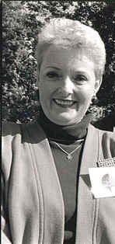
Sue Norton’s Story of Forgiveness
Sue Norton

