Slide 1

Our Task, Your Task
Ephesians 4:11-13
26 November 2006
Preached by Dr. Rick Griffith
at Crossroads International Church Singapore • CICFamily.com
Uploaded by Dr. Rick Griffith • Jordan Evangelical Theological Seminary
Files in many languages for free download at BibleStudyDownloads.org

Slide 2
The Plane Truth
The Plane Truth

Slide 3

EDS Clip

Slide 4

What's the Point?
What's the Point?
Be careful when you pour your coffee?
Crossroads is a fly-by-the-seat-of-our-pants church?
We all have a part to play here--even while the jet is moving!

Slide 5

Why did God bring you here to CIC?
Notes:
(1) You didn't come because you see this church as a finished product!
(2) You didn't come due to us offering the variety of programs of a large church.
(3) Maybe you came because someone twisted your arm!
(4) Each of us actually came due to a perceived need—a need to meet with God, a need to connect with people, or another need—which raises the question…

Slide 6



What do you really need in a church?
What do you really need in a church?

Slide 7


Biblical Roles
Dr. Rick Griffith
International Baptist Church of Singapore
22 May 2005
Are now fuzzy

Slide 8
Ephesians 4
Dr. Rick Griffith
International Baptist Church of Singapore
22 May 2005

Slide 9
Ephesians at a Glance

Slide 10

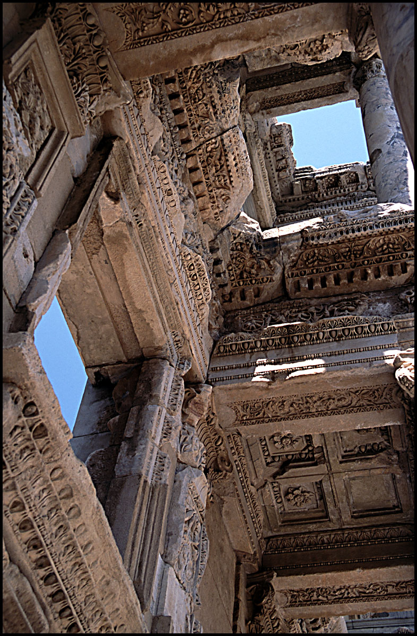
Ephesians 4:1-16
Call to Unity (1-6)
Way to Unity (7-16)
  Ascension (7-10)
  Roles (11-12a)
  Purpose (12b-13)
  Results (14-16)

Slide 11
Where we're headed in 4:11-13
Roles
  The What
Purpose
  The Why

Slide 12
What are our roles?
What is the pastor-teacher supposed to do?
What are the people supposed to do?
The issue in Eph. 4:11-13

Slide 13
Main Point #1
The What
Christ called pastor-teachers to equip you for your ministries
(11-12a)
Notes:
The Lord Jesus designed Tom and me to be shepherds who will train the sheep to use their gifts.
Read 11-12a.

Slide 14
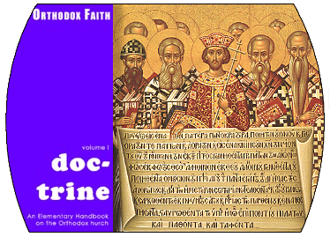

“The Professionals”
Evangelists
Prophets
Teachers
Apostles
Pastor-
Notes:
Christ gave four types of equippers to the church. I know it looks like five, but hold on. I'll explain in a minute.

Slide 15
The Gift of Apostle
What is it?
Is it here today?
Notes:
Some equippers were apostles.

Slide 16
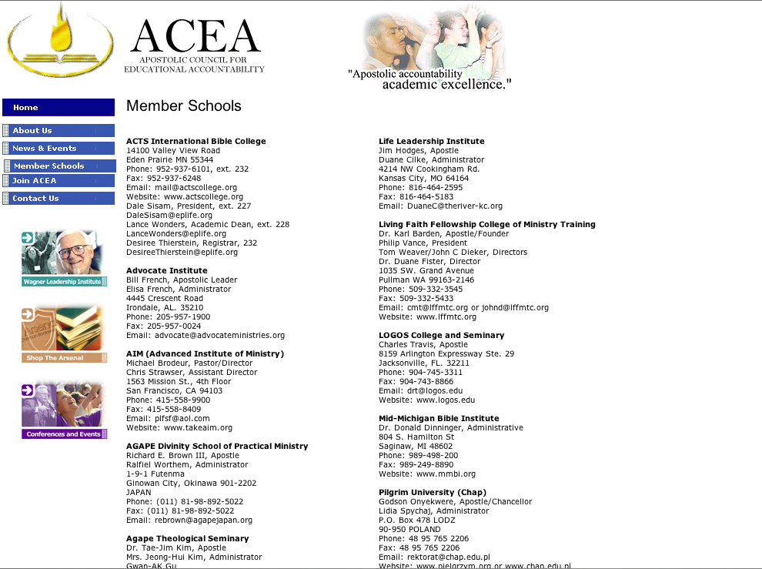
Apostolic Council for Educational Accountability
TOUCH Equipping Stations System (TESS) Lawrence Khong, Apostle
Rev. Yong Tai Tong, Director
Blk 750A Chai Chee Road #04-01
Technopark @ Chai Chee
SINGAPORE 469001
Phone: 011-65-64249400
Fax: 011-65-64249500
Email: taitong.yong@touch.org.sg
Website: www.FCBC.org.sg
Notes:
Some believe this gift to be here today and Singapore has even appointed its own apostles.

Slide 17
So what is the gift of apostle?
“The divinely ordained gift to establish the Church on earth by divine revelation, unquestioned authority, and authentication by miracles.”

Slide 18
Are there apostles today?
God's household (the church) is:
“built on the foundation of the apostles and prophets, with Christ Jesus himself as the chief cornerstone”
(Eph. 2:20)
Notes:
Since they needed to see Christ (Acts 1) and do miracles (2 Cor. 12:12), we don't have apostles today.
Ephesians 2:20 says, they were for the foundation of the Church.
So we'll not focus on them today.

Slide 19
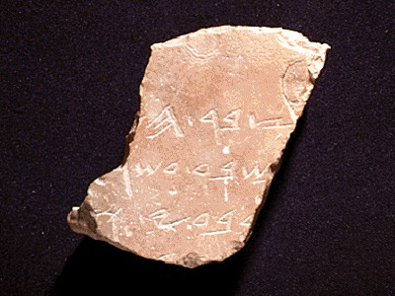
Prophets
Hebrew: nabi
a mouthpiece for God
“spokesman, speaker, prophet”
Greek:
prophetes
“one who speaks for God, proclaiming what God wants to make known”
Notes:
Some equippers were prophets.

Slide 20

What is Prophecy?
“knowing this first of all, that no prophecy of Scripture comes from someone's own interpretation. For no prophecy was ever produced by the will of man, but men spoke from God as they were carried along by the Holy Spirit”
2 Peter 1:20-21 (ESV)

Slide 21

Tests of a True Prophet (Deut. 18:18-20)
Predictions 100% true
Worships the LORD

Slide 22

God's Household
Pastor-Teachers
Evangelists
Teachers
Foundation: Apostles & Prophets (Eph 2:20)
Foundation: The Lord Jesus Christ (1 Cor. 3:11)
Notes:
On top of this are the other gifts of verse 11.

Slide 23

A Stern Warning
(Rev. 22:18-19)
“I warn everyone who hears the prophecy of this book:
If anyone adds anything to them, God will add to him the plagues described in this book.
If anyone takes words away from this book of prophecy, God will take away from him his share in the tree of life and the holy city, which are described in this book”
Notes:
Since prophets ended with the last prophecy of John in Revelation 22:18-19, any prophecy today would be adding to Scripture, so we need not concern ourselves with this gift either.

Slide 24
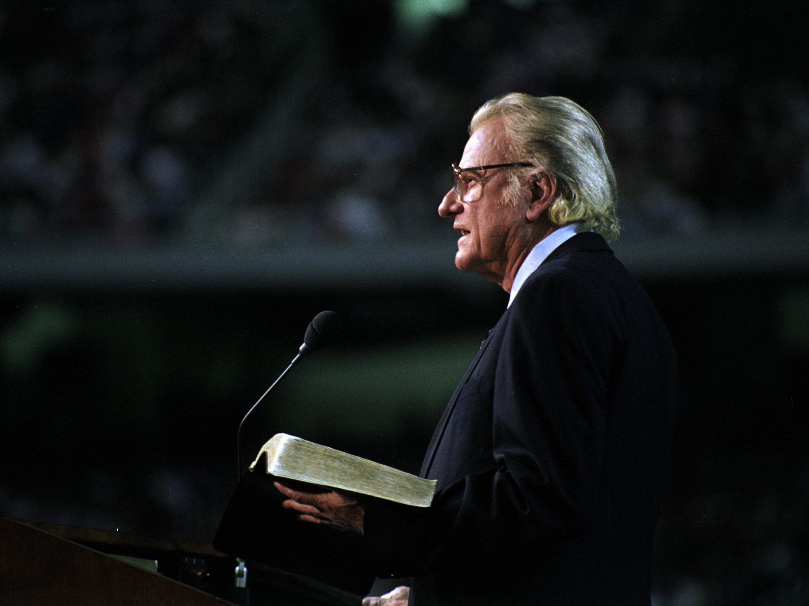
Evangelists
Is Billy Graham the standard?
Notes:
Some equippers are evangelists.
We often think of evangelists only as those who share Christ like Billy Graham…

Slide 25

The Harley Pastor
Notes:
But then there's guys like Tom Chandler too!
Verse 12 will tell us that they are also supposed to train other believers for evangelism.

Slide 26
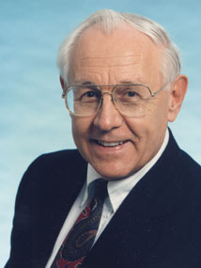
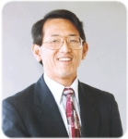
Pastor-Teacher
Too often we think only of those with the position of pastor-teacher
Notes:
Some equippers are pastor-teachers.

Slide 27
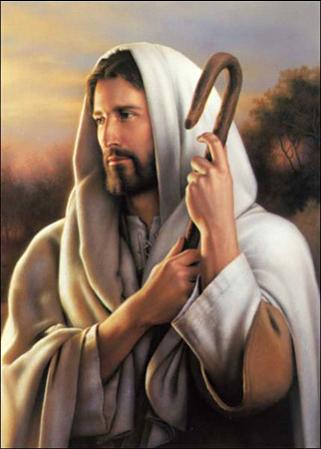
Christ is the Good Shepherd
Notes:
Of course, Christ is the Good Shepherd, but here we're talking about guys like Tom and me—as well as others in our body who shepherd others.

Slide 28

The Dual Gift
And He gave
some, apostles;
and (de) some, prophets;
and (de) some, evangelists;
and (de) some, pastors and (kai,) teachers
[
[

Slide 29

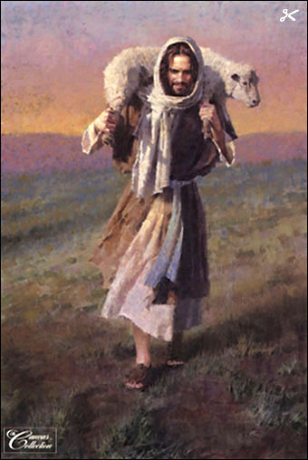
The Only “Dual” Gift
Pastor
Teacher
Protection
Study
Discipline
Instruction
Leading
Applying
Caring
Warning
Notes:
While not every teacher will be a pastor, every pastor must be a teacher.

Slide 30
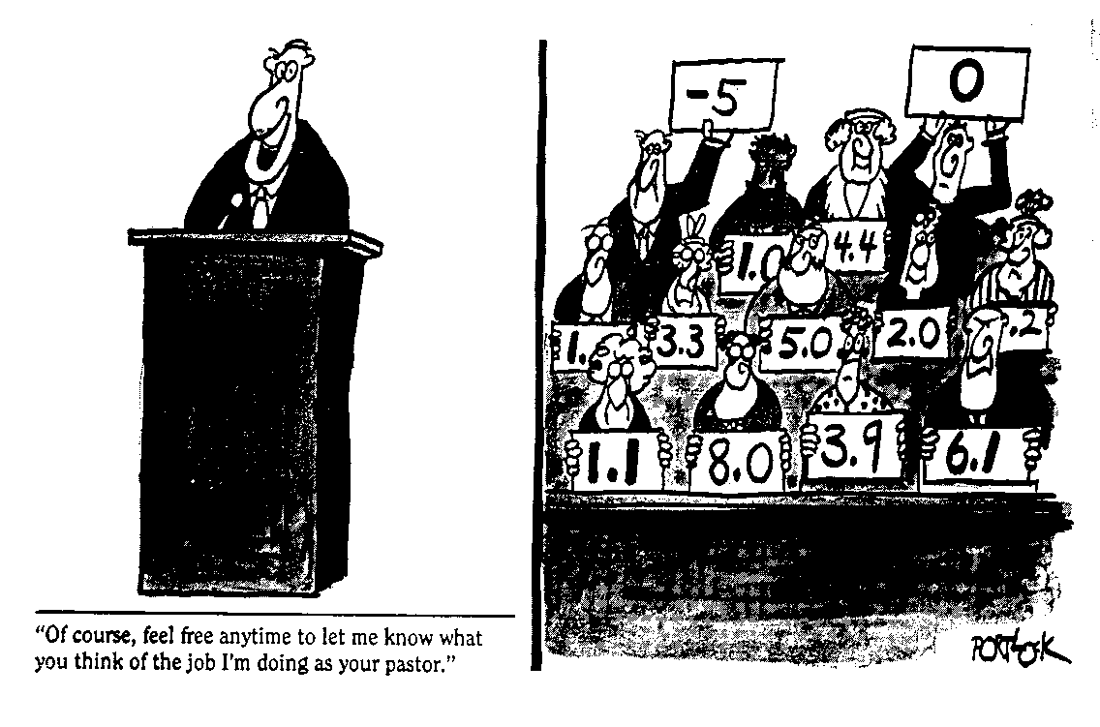
Toughest Job in the World
The Forum
“Of course, feel free anytime to let me know what you think of the job I'm doing as your pastor.”

Slide 31

Ephesians 4:11-12 (KJV)
The Comma
v. 11
KJV
And He gave
some, apostles;
and (de) some, prophets;
and (de) some, evangelists;
and (de) some, pastors and (kai,) teachers
v. 12
KJV
for (pro,j) the perfecting of the saints,
for (ei,j) the work of the ministry,
for (ei,j) the edifying of the body of Christ.
This implies the gifted men do all three ministries!
Notes:
The KJV translation here is unfortunate as it puts the ministry solely into the hands of the pastors!
Here's where a comma after “the perfecting of the saints” gives pastors a three-fold job!

Slide 32
The Advertisement Read…
“Wanted: Pastor for a growing church—a real challenge for the right man. Must know about all problems of birth, life, sickness and death. Must know how to operate and fix copier. Able to sound learned at times but most of the time sounds like good-ole-Joe. Must pretend he likes hearing women talk. Applicant's wife must be both stunning and plain, never discouraged. Applicants will undergo evaluation by a committee of 100 to determine sanity.”
Notes:
This advertisement actually appeared in a local newspaper:

Slide 33

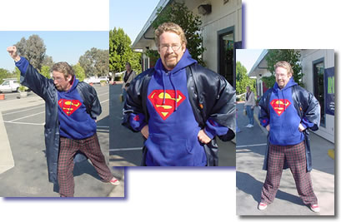
What's inside the church?
Women
Worship
Men
Finances
Super
Pastor!
Helps
Visitation
Marketing
Grass Cutting
Notes:
I actually found “Super Pastor” on a website for “Crossroads Christian School” in Corona, CA! He does it all…

Slide 34
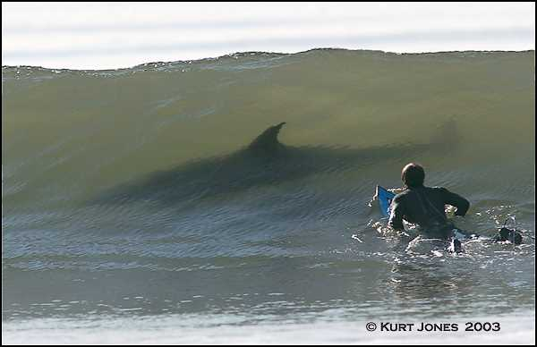
Cutting it Close
Notes:
Speaking of cutting, is a pastor doing everything best for the pastor—or for the people? I think that's about as smart as surfing with sharks!

Slide 35
“Equipping” (NAU, 4:12)
“to prepare” (NIV)
“Equipping” (NAU, 4:12)
“to prepare” (NIV)
katartismo,j (katartismos = noun)
equipping, training
katarti,zw (katartizo = verb)
mend, restore, set right,
make complete

Slide 36
katarti,zw (katartizo = verb) mend, restore, set right, make complete
katarti,zw (katartizo = verb)
mend, restore, set right,
make complete
NAU 1 Thessalonians 3:10
complete what is lacking in your faith
NIV Hebrews 13:21
equip you with everything good for doing his will
Notes:
1. Equipping the saints is best for both the pastor and for the people.
a) Equipping others is best for me as a pastor-teacher.

Slide 37

Don't Expect Leadership to Hold the Sun!
Notes:
(1) The pastor who does all the work of ministry himself will soon burn out—like trying to hold the sun!
(2) Pastor John was the chief carpenter at his new church building, so he couldn't preach well and ended up leaving the church.

Slide 38

Ephesians 4:11-12 (NASB)
v. 11
NASB
And He gave
some as apostles,
and (de) some as prophets,
and (de) some as evangelists,
and (de) some as pastors and (kai,) teachers.
v. 12
NASB
for (pro,j) the equipping of the saints
for (ei,j) the work of service
to (ei,j) the building up of the body of Christ.
God gave gifted men to train others to do ministry!

Slide 39
Ephesians 4:11-12 (NIV)
v. 11
NIV
It was he who gave
some to be apostles,
and some to be prophets,
and some to be evangelists,
and some to be pastors and teachers.
v. 12
NIV
to prepare God's people
for works of service
so that the body of Christ may be built up.
God gave gifted men to train others to do ministry!

Slide 40

Why No Comma?
v. 12
NIV
to prepare God's people
for works of service
so that the body of Christ may be built up.
All have the same “grace” (4:7)
The church is one body with parts that need each other (1 Cor. 12)
All are called and have the same armor (6:10-17)
God gave gifted men to train others to do ministry!
Notes:
Most of the ministry is God's grace through the MEMBERS—not the leaders!
You all need to belong; so each of you should have a ministry here
If I don't train you to do the ministry yourself then I will rob you of the blessing of battling for Christ.
The pastor who refuses to equip makes his people lazy.

Slide 41
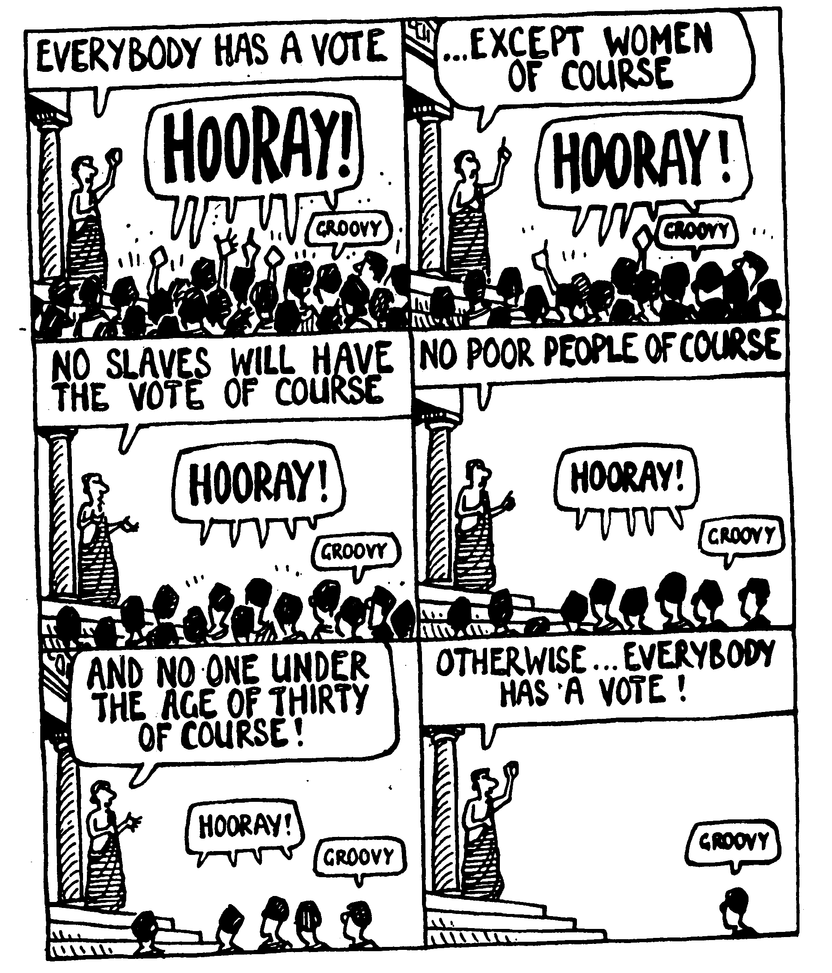
We want to share the joy of ministry together!
Notes:
Greeks had to learn how to get everyone involved. We will too!

Slide 42
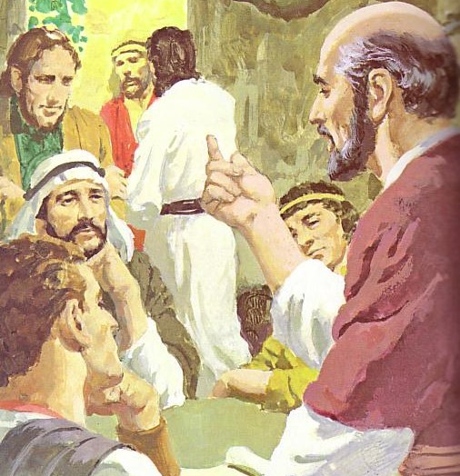
B. As pastor-teachers our role is to train you for your own ministry (12a)
Pastor-
Teachers
EQUIP
DO
Works of
Service

Slide 43
How are we equipping?
Women
Worship
Clare
Karen
Becky
Men
Susan
Ansel
Budmaa
Pastor-
Teachers
Finances
Vong
Bill
Maya
Andrew
Rick C.
Helps
Joe
Cynthia
Soul Care
Kurt
Marketing
?
Grass Cutting
Notes:
a) We are willing to do servant roles, but this should not be our chief focus.
(1) The apostles refused to neglect God's Word to serve food in Acts 6.
(2) While Christ washed his disciples' feet, He did this only once—doing it all the time would have detracted from his equipping ministry (John 13).
b) We must equip you in the Word of God.
c) We must equip you how to pray.
d) We plan to show you many tasks and then get out of the way so you can do them alone.
KAREN: mid January, which is by Kay Arthur: Lord, Heal My Hurts

Slide 44
Cat Lies
Cat Lies

Slide 45

EDS Clip

Slide 46
What's the Point?
What's the Point?
Don't let the cat rip you to shreds?
Crossroads people are like cats that can't be herded?
Divergent people like us can still move together towards Christ-likeness!

Slide 47
Flow of Eph. 4:11-13
Roles
  The What
Purpose
  The Why

Slide 48
Your being equipped will make the church like Christ
(12b-13)
The What
The Why
Main Point #1
Main Point #2
Christ called pastor-teachers to equip you for your ministries
(11-12a)
Notes:
Our training you will result in us becoming like Jesus!

Slide 49
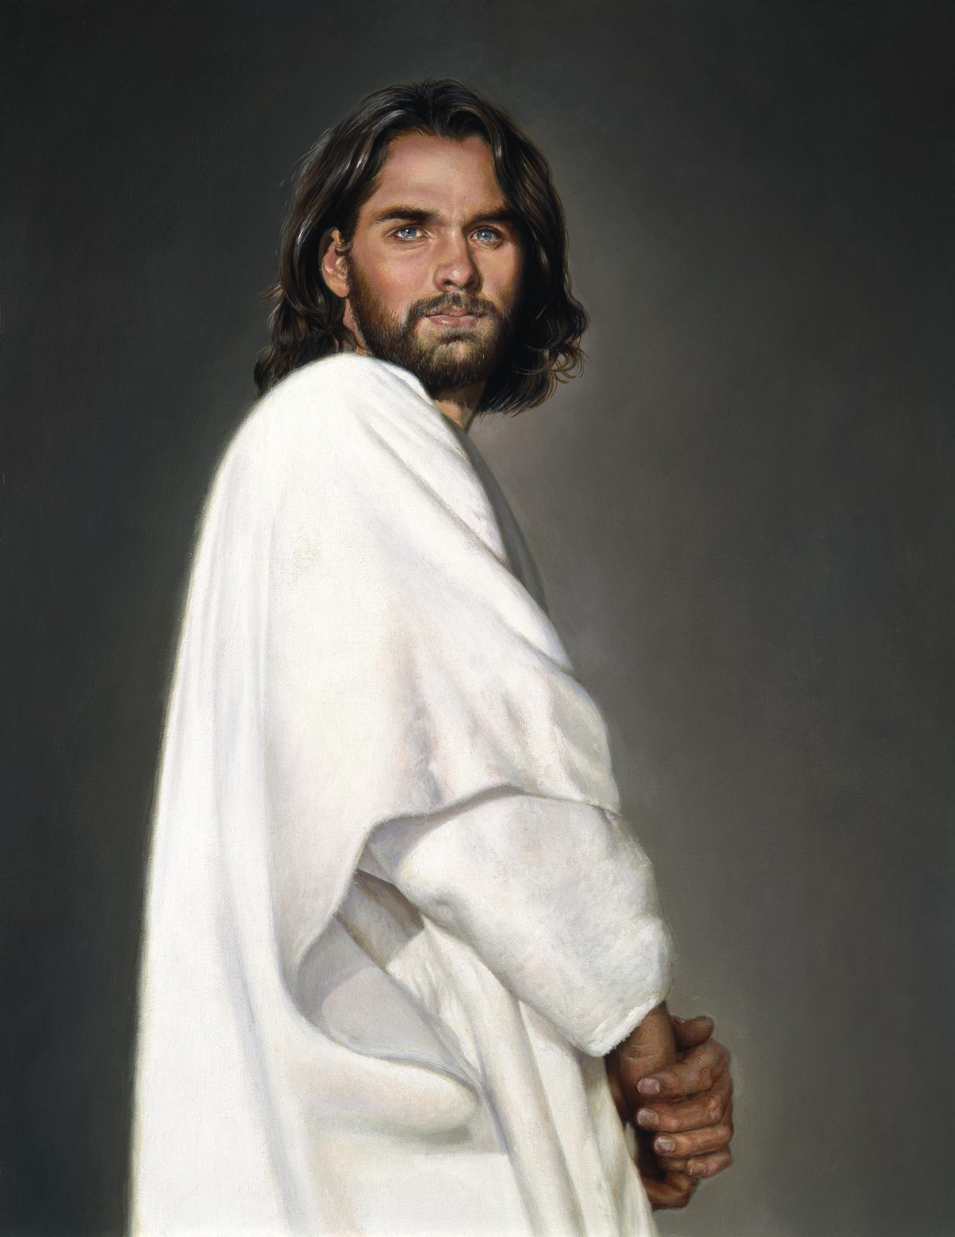
Encourages us (12b)
Results of Equipping
Christ-likeness
(13c)
Notes:
Our training you will make us like Jesus in three ways:
(1) Equipping builds us in the faith

Slide 50
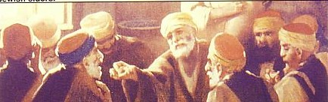

The Meaning of “Build Up”
oivkodomh.n
Upbuilding
Strengthening
Encouragement
Building
Structure

Slide 51

The Same Word for “Build Up”
NIV Ephesians 4:16
From him the whole body, joined and held together by every supporting ligament, grows and builds itself up in love, as each part does its work.

Slide 52
The Same Word for “Build Up”
NAU Ephesians 4:29
Let no unwholesome word proceed from your mouth, but only such a word as is good for edification according to the need of the moment, so that it will give grace to those who hear.

Slide 53
Encourages us (12b)
Results of Equipping
Christ-likeness
(13c)
Unites us (13a)
Teaches us (13b)
Matures us (13c)
Notes:
ENCOURAGES: Basically, it means that one result of the pastor-teacher's equipping is that the people will be encouraged as they do the work of ministry.
B. Equipping unites us in the faith (13a).
1. A church that expects its pastor to serve them ends up selfish and divided.
2. When each member feels needed because of his or her ministry contribution, the body unites together in mutual dependency
C. Equipping teaches us about Christ (13b).
1. A true knowledge of Christ includes his character—giving, etc.
2. We ought to be continually growing in understanding the many wonders about Christ—and this comes through the pastor's equipping ministry.
D. Equipping matures us to be like Christ (13c).
[The goal of this equipping is Christ-likeness.]
1. God desires the body to become as mature and perfect as Christ Himself.
2. Maturity cannot happen when believers push their entire ministry onto the pastor's shoulders—the “fullness of Christ” comes only through the hard knocks of ministry.

Slide 54
Why did God bring you here?
Notes:
(1) You didn't come because you see this church as a finished product!
(2) You didn't come due to us offering the variety of programs of a large church.
(3) Maybe you came because someone twisted your arm!
(4) Each of us actually came due to a perceived need—a need to meet with God, a need to connect with people, or another need—which raises the question…

Slide 55
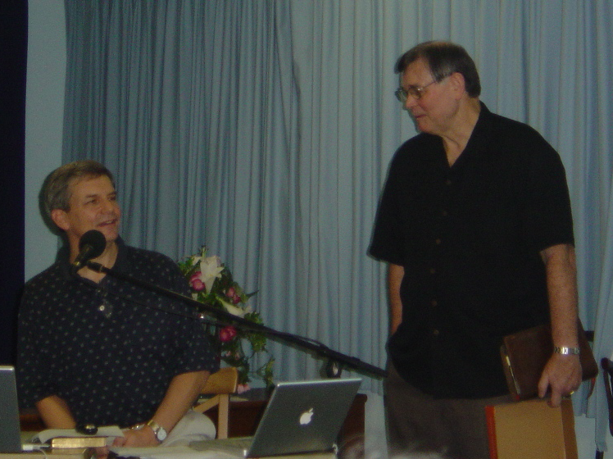

God's Design for CIC
Pastor-
Teachers
EQUIP
DO
Works of
Service

Slide 56

—Main Idea—
Christ called Tom and me to equip you to be like Christ!
—Main Idea—
Christ called pastor-teachers to equip you to be like Christ !

Slide 57
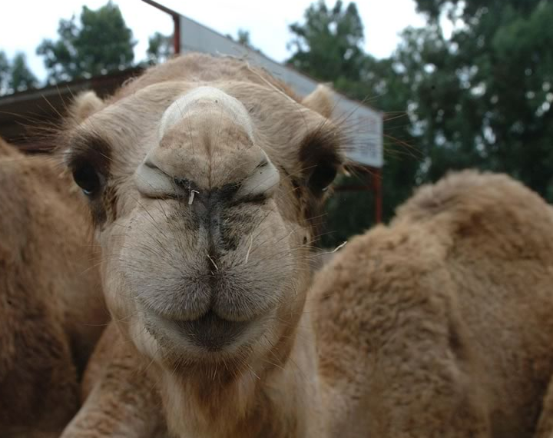
So What?
So what?

Slide 58
Action Points
Your Role
  How can your pastor-teacher(s) better equip you for your unique role to better minister together?
  What role are you being equipped for?
Notes:
(1) How can the pastor-teachers better equip you?
(a) We seek to prioritize our ministry responsibilities around the Word and prayer (Acts 6:1-7).
(b) This means that some minor things may have to go undone.
(c) Who wants equipping in evangelism? Budmaa can help.
(2) What role are you being equipped for?
(a) Let us know your areas of passion—and we'll set you loose!
(b) Do you know your spiritual gift(s)?

Slide 59

Response Form
Ministry/Servant Response Form
Please list your area of interest to serve.
Name: ________________________________________ Date:________________
E-mail:________________________________________
Phone: home _______________ hp______________________ office_______________
Usher
Set Up & Take Down
Administration
Deacon
Women's Ministry
Worship leader/Song leader
Musician: what instrument___________________________
Vocalist
A/V Tech
Evangelism/Outreach
Missions
Small group leader
Nursery worker
Children SS teacher
Food service
Prayer Ministry
Pastoral Care
Other____________________________________________
Comments:_________________________________
__________________________________________
Notes:
Can tick/check more than one
Pastoral Care

Slide 60
Action Points
Your Role
  How can the pastor-teachers better equip you for your unique role here?
  What role are you being equipped for?
Your Goal
  What character trait of Christ are you trusting God to equip in you this next year?
  How can Crossroads help you develop here?
Notes:
(1) How can the pastor-teachers better equip you?
(a) We seek to prioritize our ministry responsibilities around the Word and prayer (Acts 6:1-7).
(b) This means that some minor things may have to go undone.
(c) Who wants equipping in evangelism? Budmaa can help.
(2) What role are you being equipped for?
(a) Let us know your areas of passion—and we'll set you loose!
(b) Do you know your spiritual gift(s)?

Slide 61
Black

Slide 62

May the Mind 1/6
May the mind of Christ my Savior
Live in me from day to day,
By His love and pow'r controlling
All I do and say.

Slide 63
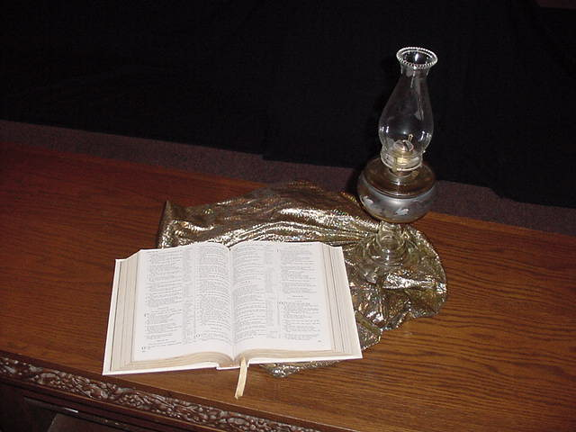
May the Mind 2/6
May the Word of God dwell richly
In my heart from hour to hour,
So that all may see I triumph
Only thru His pow'r.

Slide 64

May the Mind 3/6
May the peace of God my Father
rule my life in everything,
that I may be calm
to comfort
sick and sorrowing.

Slide 65

May the Mind 4/6
May the love of Jesus fill me
As the waters fill the sea;
Him exalting, self abasing-
This is victory.

Slide 66
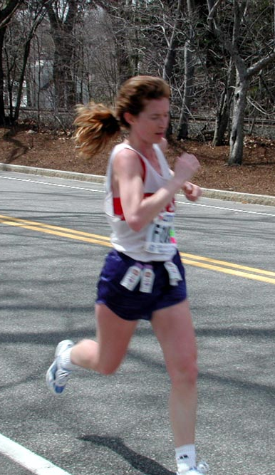
May the Mind 5/6
May I run the race before me,
strong and brave to face the foe,
looking only unto Jesus
as I onward go.

Slide 67

May the Mind 6/6
May His beauty rest upon me
As I seek the lost to win,
And may they forget the channel,
Seeing only Him.

Slide 68
Black

Slide 69

Come Next Door for Refreshments & Fellowship

Slide 70
Action Points
Your Role
  How can the pastor-teachers better equip you for your unique role here?
  What role are you being equipped for?
Your Goal
  What character trait of Christ are you trusting God to equip in you in 2007?
  How can Crossroads help you develop here?
Notes:
(1) How can the pastor-teachers better equip you?
(a) We seek to prioritize our ministry responsibilities around the Word and prayer (Acts 6:1-7).
(b) This means that some minor things may have to go undone.
(c) Who wants equipping in evangelism? Budmaa can help.
(2) What role are you being equipped for?
(a) Let us know your areas of passion—and we'll set you loose!
(b) Do you know your spiritual gift(s)?

Slide 71
Black

Slide 72


NT Preaching link at BibleStudyDownloads.org
Get this presentation for free!
Notes:
The Bible…Basically (bb)

