Slide 1
Sarah Lim • Homiletics 1 Class Sermon Uploaded by Dr. Rick Griffith • Singapore Bible College All files in many languages for free download at BibleStudyDownloads.org
1
For an
AUDIENCE OF
Colossians 3:22

Slide 2
Why should we work/study??
How should we relate to our superiors?
Who is the worst boss you ever had?
What motivates you to study/work?
Notes:
Interest: Who is the worst boss/teacher you ever had? What was it like working/studying under such a superior? Did you get the work done? Why?
Need: What about now? What motivates you to study or work hard? Is it your scary boss or our scary lecturers?
Subject: As followers of Christ, we ask ourselves – “How should we relate to our superiors? Why or for what should we work/study?”

Slide 3
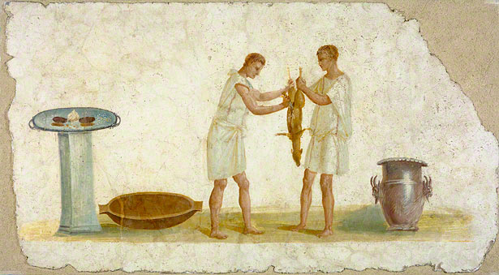
Why should we work/study??
How should we relate to our superiors?
Bondservants, obey in everything
those who are your earthly masters,
Not by way of eye service, as people pleasers,
but with sincerity of heart, fearing the Lord.
(ESV)
Colossians 3:22
Notes:
Background: Like us today, the Colossae servants in Paul’s time were subordinates who often lived under harsh treatment by their masters. Paul saw a need to instruct them concerning what it means to walk in Christ like love within their specific context as subordinates working under earthly masters.
Preview: In today’s text of Col 3:22, Paul tells the Colossae servants how they are to relate to their masters and why/how they should work.

Slide 4
?
GP: GENERAL PRINCIPLE
How should we relate to our superiors?
(22a)
Bondservants, obey in everything
those who are your earthly masters,
(22b)
Not by way of eye service,
as people pleasers,
(22c)
but with sincerity of heart, fearing the Lord.
NEGATIVE way of applying GP
POSITIve way of applying GP
How should we work/study??
Colossians 3:22
Notes:
Restatement: In terms of structure, Col 3:22 gives us a general principle for how we should relate to our superiors, followed by a negative and then positive way to apply this principle, which also sheds light on why/how we should work/study.
[So what is the general principle given as to how we should relate to our superiors?]
Text: Verse 22a tells us…

Slide 5
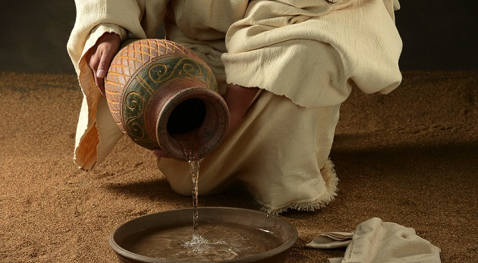
?
GP: GENERAL PRINCIPLE
How should we relate to our superiors?
(22a)
Bondservants, obey in everything
those who are your earthly masters,
ALWAYS OBEY
YOUR
EARTHLY SUPERIORS
Notes:
Always obey our earthly superiors. (22a)
[When your nasty boss tells you to do something, do it!]

Slide 6
1. Obedience to our
earthly superiors
is an expression
of Christ-like love
which stems from our union with Christ.
ALWAYS OBEY
YOUR
EARTHLY SUPERIORS
Context of Colossians
Main Thesis: Col 2:6-8
Therefore, as you received Christ Jesus the Lord,
so walk in him, rooted and built up in him
and established in the faith,
just as you were taught, abounding in thanksgiving.
See to it that no one takes you captive by philosophy and empty deceit, according to human tradition, according to the elemental spirits of the world, and not according to Christ.
WALK IN CHRIST,
BE BUILT UP UNTO MATURITY!
Notes:
Obedience to our earthly superiors is an expression of Christ-like love which stems from our union with Christ.
[When we hear the word “obey” – the immediate reaction of most young people today is repulsion. “obey” brings with it today the connotations of not having a mind of your own, it is thoroughly out of fashion. Why should we obey?]
Let us consider the context of the epistle. Col 2:6-8 represents Paul’s main concern in the epistle. In the midst of a pluralistic, syncretistic society, his desire is for the believers to walk in Christ Jesus, and be built up in Christ unto maturity. Not wanting them to be deceived, he tells them that in union with Christ, they have been filled, circumcised, buried and raised to life.

Slide 7
1. Obedience to our
earthly superiors
is an expression
of Christ-like love
which stems from our union with Christ.
ALWAYS OBEY
YOUR
EARTHLY SUPERIORS
Context of Colossians
Main Thesis: Col 2:6-8
Walk IN CHRIST,
BE BUILT UP UNTO MATURITY!
3:1 Seek what is above,
not what is earthly!
PUT OFF OLD SELF
PUT ON NEW SELF!!
Renewed in image of CHRIST
“above all these put on love,
which binds everything together
in perfect harmony” (3:14)
* SERIES OF INSTRUCTIONS*
- xxx
- xxx
- 3:22-4:1 (Servants & Masters)!!
Notes:
As a result, they are to seek what is above, not what is earthly. This is done by putting off the old self and putting on the new self – which implies being renewed in the image of Christ. Under this call to put on the new self, Paul gives a series of varied instructions, but he tells them in 3:14 that the overarching quality that binds these commandments together – is love.
It is within this overarching instruction for the believers to put on the new self, renewed in the image of Christ, that Paul makes the specific applications to servants and masters in 3:22-4:1. This has tremendous implications for how we perceive Col 3:22.

Slide 8
ALWAYS OBEY
YOUR
EARTHLY SUPERIORS
1. Obedience to our
earthly superiors
is an expression
of Christ-like love
which stems from our union with Christ.
WALK IN CHRIST,
BE BUILT UP UNTO MATURITY!
3:1 Seek what is above,
not what is earthly!
Obedience is the appropriate expression of their union with Christ
Overarching quality & goal that characterizes this instruction = love
PUT ON NEW SELF!!
Renewed in image of CHRIST
** Love as overarching quality that binds all commandments TOGETHER
…
…
COL 3:22 OBEY YR …
CONTEXT
Notes:
Firstly, in the specific context of the Colossae servants, we note that obedience is the appropriate expression of their being in union with Christ and walking in Christ. (2:6) If they were to relate to their masters in a Christ like manner, it would look like – obedience.
Secondly, we note that the primary overarching quality over this instruction for servants to obey their masters – is love. The reason why the Colossae servants are to obey their masters is ultimately not submission for submission’s sake, nor is it to show the superiority of the master! Rather, the ultimate aim of obedience is love.
In other words what is Paul calling upon the Colossae Christians to do? He is asking them to obey their earthly masters in all things – as an expression of their union with Christ for the sake of living out Christ like love. It is not a call for mindless obedience, but a call for intentional, willing submission in the path of sacrificial love, as they are renewed in the image of Christ.
Likewise we who are in the position of being subordinate today as employees and students should seek to obey our earthly superiors as an expression of our union with Christ and our walking in His ways. We do not mindlessly obey, but intentionally and willingly submit to our superiors in the path of sacrificial love as we are renewed in the image of Christ.
Illustration: Say your boss asks you to work on a certain proposal, and you know that its not going to work out, but he insists on doing this in-spite of your reasonable objections. What will you do? Just ignore him anyway and do things your way? Or do as he says even if it’s just to help him see that he’s in the wrong? The second path is in one sense a waste of time, but sometimes, round-a-bouts are necessary to intentionally show love through submission.
Let us obey our superiors, because this is an expression of Christ-like love which stems from our union with Christ, our walking in His ways.

Slide 9
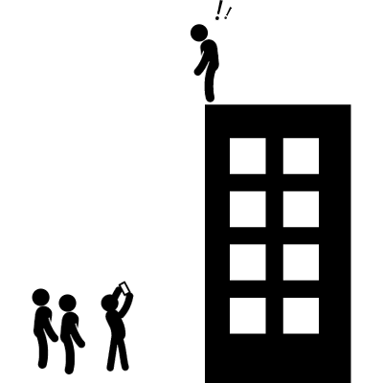
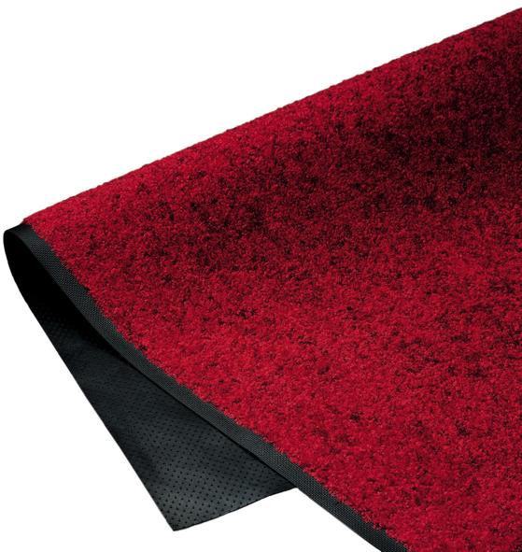
ALWAYS OBEY
YOUR
EARTHLY SUPERIORS
2. The instruction to obey must be read in tandem with all other portions of Scripture
E.g.
“ Therefore let no one pass judgment on you in questions of food and drink… Let no one disqualify you, insisting on asceticism and worship of angels, going on in detail about visions” Col 2:16-18 (ESV)
Within the constraints of all portions of Scripture
I will obey you in “everything”
“But now you must put them all away: anger, wrath, malice, slander, and obscene talk…Do not lie to one another…” Col 3:8-9
They are not unthinking floor mats to be trampled upon, blindly obeying!
I instruct you to jump now!
Notes:
[But some will surely say ‘so how if my boss asks me to jump off the building? So I jump lah? Obedient what.’]
The instruction to obey must be read in tandem with all other instructions in scripture.
The believing slave is not simply told to obey their masters in everything, they have also been instructed to seek the things above, to put to death what is earthly in them – whether sexual immorality, covetousness, malice, obscene talk, etc. (even lying) They have even been instructed to let no one pass judgment on them in questions of food or drink.
In other words, they are not un-thinking floor mats to be trampled upon – blindly doing whatever they are told even if it is immoral or wrong or plainly suicidal. Rather - within the constrains of all portions of scripture, they are to obey their earthly masters in “everything.”
Illustration: So say your boss asks you to work 24/7, will you do that to the blatant neglect of your family? No, for God also instructs us to love our family. Or say your boss asks you to go entertain the guests by taking them to some sleazy location – do you say yes? No, for God also says to flee sexual immorality.
We are to always obey our superiors as an expression of love, but this obedience must be one practiced through the holistic wisdom of scripture.

Slide 10
ALWAYS OBEY
YOUR
EARTHLY SUPERIORS
(22a)
Bondservants, obey in everything
those who are your earthly masters,
GP: GENERAL PRINCIPLE
How should we relate to our superiors?
?
1. Obedience to our earthly superiors
is an expression of Christ-like love
which stems from our union with Christ.
2. The instruction to obey must be read in tandem with all other portions of Scripture
Notes:
We are to always obey our superiors as an expression of love, but this obedience must be one practiced through the holistic wisdom of scripture.

Slide 11
GP: GENERAL PRINCIPLE
How should we relate to our superiors?
?
(22a) ALWAYS OBEY
OUR
EARTHLY SUPERIORS
(22a)
Bondservants, obey in everything
those who are your earthly masters,
(22b)
Not by way of eye service,
as people pleasers,
(22c)
but with sincerity of heart, fearing the Lord.
NEGATIVE way of applying GP
POSITIve way of applying GP
How should we work/study??
Colossians 3:22
Notes:
(We have thus far established that the general principle with which we are to relate to our superiors is obedience. But is it simply the outward action of obedience that is important? What about our inward attitude? Ultimately what motivates us to obey?
Lets Read 22b,c. Verse 22b, c tells us this…)

Slide 12
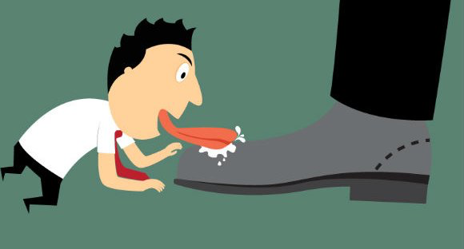
(22b)
Not by way of eye service,
as people pleasers,
Do not obey hypocritically
out of
a fear of man
Notes:
Do not obey hypocritically out of a fear of man. (22b,c)
[We are always to obey our superiors, but never for the purpose of being seen and pleasing man]

Slide 13
Do not obey
hypocritically out of
a fear of man
(22b)
Not by way of eye service,
as people pleasers,
ὀφθαλμοδουλίᾳ ως ἀνθρωπάρεσκοι
“eye service” consistently followed by “people pleasing”
Hypocritical, skin-deep “willingness” or obedience
Focus on External action
& its Visibility
Goal of being seen is to Please the Superior
Obeying with the intention that others see it
Root motivation = People pleasing, or a fear of man
Notes:
Taken together as a whole, the Greek phrase for “not by way of eye service, as people pleasers” is “ὀφθαλμοδουλίᾳ ως ἀνθρωπάρεσκοι.” Both Eph 6:6 and Col 3:22 have the same phrase. And notably, “eye-service” is consistently followed by “people pleasing.”
“By way of eye-service” (ὀφθαλμοδουλίᾳ) implies a hypocritical, skin-deep “willingness” or obedience with the intention of having people see what is done. (22b)
The focus is on the external action and the visibility of the action.
In other words, the servant obeys with the intention that others see this, and the goal of being seen is to please the superior.
This implies, that the root motivation is really people pleasing, or the fear of men.

Slide 14
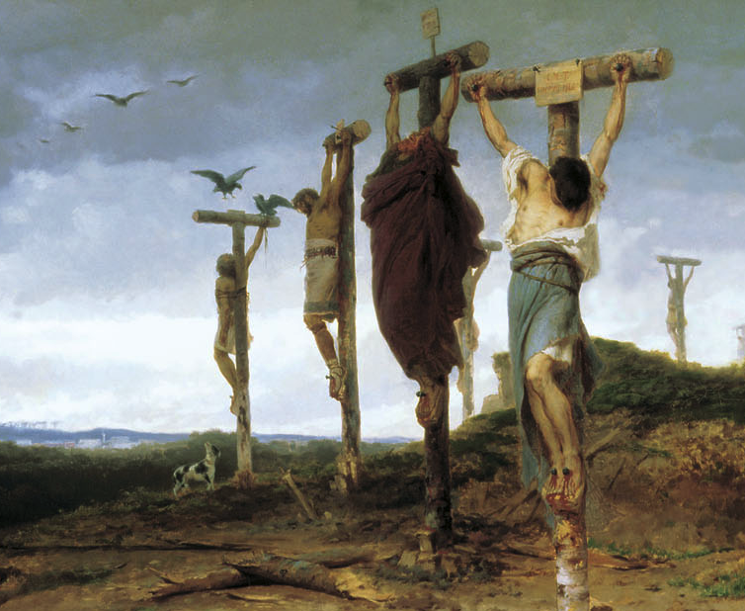
Do not obey
hypocritically out of
a fear of man
(22b)
Not by way of eye service,
as people pleasers,
ὀφθαλμοδουλίᾳ ως ἀνθρωπάρεσκοι
“eye service” consistently followed by “people pleasing”
“Beatings were frequent and could be severe, including flogging and mutilation.
If a slave was required to give testimony in court, torture preceded testimony…
Sexual abuse of slaves was common.
If a slave killed, the penalty was burning at the stake or crucifixion.”
Gary M. Burge, Lynn H. Cohick, and Gene L. Green, The New Testament in Antiquity, 359
Hypocritical, skin-deep “willingness” or obedience
Focus on External action
& its Visibility
Goal of being seen is to Please the Superior
Obeying with the intention that others see it
Root motivation = People pleasing, or a fear of man
Notes:
In those days, it was not uncommon for slaves to be cruelly controlled. “Beatings were frequent and could be severe, including flogging and mutilation. If a slave was required to give testimony in court, torture preceded testimony… Sexual abuse of slaves was common. If a slave killed, the penalty was burning at the stake or crucifixion.” Its not difficult to understand why the slaves would obey their masters for the purpose of pleasing them, being motivated out of fear.
(But Paul instructs the slaves and likewise us today that…)
Gary M. Burge, Lynn H. Cohick, and Gene L. Green, The New Testament in Antiquity, 359.

Slide 15
Do not obey
hypocritically out of
a fear of man
(22b)
Not by way of eye service,
as people pleasers,
The root motivation for obedience should not be
a fear of man or a desire to please man.
What’s wrong working to please our boss?
Rom 15:2 ?? “Please one another?”
Pleasing of man that stems from:
- Concern for self benefit
- Fear of what man can do to us
Purpose:
Building one another up
Ascribes glory and power to men! To those with earthly authority over us.
Notes:
(But Paul instructs the slaves and likewise us today that…)
The root motivation for us to obey should not be a fear of man and a desire to please man. (22c)
But we might ask: what is wrong with doing work to please our superiors? After all, in Romans 15:2, believers are told to please one another! We see that in the context of Romans the believers are to please one another for the purpose of building one another up. What Paul is opposing here in Col 3:22 however, is referring not to a pleasing for the up-building of another, but a pleasing of man that stems from a concern for self benefit, and a fear of what man can do to us. It is a people-pleasing that ascribes glory and power to men, to those who have earthly authority over us.
Illustration: So lets say its Monday night and you have not completed both your homiletics and Greek assignments. What do you do? Should you do them because you’re scared of what Dr Rick and Dr Jerry would say? Do you do them because you’re worried about what they can do to you? And how that will affect others perspective of you when they see your grades? Even if you do the homework well with all diligence and no short cuts – if the root motivation behind your doing the assignments is because you are scared of what the Drs can do to you and how others will perceive you, that is not God’s will.

Slide 16
?
GP: GENERAL PRINCIPLE
How should we relate to our superiors?
(22a) ALWAYS OBEY
OUR
EARTHLY SUPERIORS
(22a)
Bondservants, obey in everything
those who are your earthly masters,
(22b)
Not by way of eye service,
as people pleasers,
(22b) Do not obey hypocritically
out of a fear of man
(22c)
but with sincerity of heart, fearing the Lord.
NEGATIVE way of applying GP
POSITIve way of applying GP
How should we work/study??
Colossians 3:22
Notes:
So let us obey our superiors always, but not hypocritically, to be seen by others, because we are scared of men and what they can do to us.
(Granted that we should not obey out of an inward fear of man, how then should we obey? Lets Read 22d,e. Col 3:22d,e tells us this…)

Slide 17
(22c)
but with sincerity of heart, fearing the Lord.
OBEY in
genuine willingness
out of a
fear of the Lord
Notes:
Obey in genuine willingness out of a fear of the Lord. (22d,e)
[Let a desire to please the Lord be the only motivation that drives your obedience]

Slide 18
Obey in GENIUNE
WILLINGNESS out of a
fear of THE LORD
(22c)
but with sincerity of heart, fearing the Lord.
a`plo,thti kardi,aj
= a simple & pure
heart/ intention
Emphasis: singularity
of one’s intention
Integrity/Unity between internal being and external actions
= working in genuine willingness
Notes:
To obey in “sincerity of heart” implies that we work in genuine willingness.
“Sincerity of heart” comes from the phrase “a`plo,thti kardi,aj” The phrase refers to a simple, unmixed, or pure heart/intention.
The emphasis is on the singularity of one’s internal intention. It implies integrity and unity between one’s internal being and one’s external actions.
(So servants and workers are to obey their earthly masters/superiors with a heart and intention that is unmixed and pure. But what could this pure motivation be? v22e tells us to…)

Slide 19
Obey in GENIUNE
WILLINGNESS out of a
fear of THE LORD
(22c)
but with sincerity of heart, fearing the Lord.
obou,menoi
Verb participle from Fobe,w
Servants are to obey their superiors in genuine willingness –
with a heart/intention
that is pure…
Being afraid of God, having a deep reverence and awe for Him.
Acknowledgement & knowing
of His power, ability and character,
a fear of going against Him.
But what is this pure motivation?
But this knowing is not held in disgust or found to be repulsive and stifling. Rather, it inspires respect, attraction & adoration.
Notes:
(So servants and workers are to obey their earthly masters/superiors with a heart and intention that is unmixed and pure. But what could this pure motivation be? v22e tells us this singular motivation is…)
A fear of the Lord…
[The root motivation for our wholehearted and sincere obedience is a fear of the Lord.
But what does it mean to fear the Lord?]
The greek for “fearing the Lord” is οβούμενοι, a verb participle from φοβέω.
The phrase literally and simply refers to being afraid of God, having a deep reverence and awe for Him. There is an acknowledgement and knowing of His power and ability and character, a fear of going against Him.
But this knowing is not one that is held in disgust or which one finds repulsive and stifling. Rather it inspires respect, attraction and adoration.

Slide 20
Obey in GENIUNE
WILLINGNESS out of a
fear of THE LORD
(22c)
but with sincerity of heart, fearing the Lord.
Col 3:24-25
Paul gives specific truths about who the Lord is…
That motivates servants to fear him, not man
It is from the Lord that servants will receive an inheritance as reward (v 24a).
PAUL ASCRIBES TRUE/REAL POWER TO BOTH REWARD AND PUNISH UNTO THE LORD, NOT MAN!
It is the Lord Christ that they are serving. (v24b)
And it is the Lord who will pay back unto the master
the wrong done to the servants. (v25)
Hence servants are to fear the Lord alone
(the only appropriate response)
Notes:
In Col 3:24-25, Paul gives specific truths about who the Lord is that motivates the servants to fear Him instead of men.
It is from the Lord that they will receive an inheritance as reward. (v24a)
It is the Lord Christ that they are serving. (v24b)
And it is the Lord who will pay back unto the master the wrong done to the servants. (v25)
In other words, Paul ascribes true/real power to both reward and punish unto the Lord and not to men. Hence, the servants are to fear the Lord as is appropriate and work for Him alone.
At the end of the day the crux of the matter is this: do we know who the Lord is and do we thus love Him and fear Him more than we fear man? When we work out of fear of men, it reveals a deficiency in our knowing of who the Lord is. On the contrary, if we know the Lord and trust Him to be who He says He is, our provider and protector, then let us work and study with fearless obedience to our superiors as an expression of Christ love because of our union with Christ.

Slide 21
Obey in GENIUNE
WILLINGNESS out of a
fear of THE LORD
(22c)
but with sincerity of heart, fearing the Lord.
At the end of the day…
do we know who the Lord is &
do we thus love Him and fear Him
MORE THAN we fear man?
Then let us work
with fearless obedience,
knowing who is truly worthy
and truly in control
Notes:
At the end of the day the crux of the matter is this: do we know who the Lord is and do we thus love Him and fear Him more than we fear man? When we work out of fear of men, it reveals a deficiency in our knowing of who the Lord is. On the contrary, if we know the Lord and trust Him to be who He says He is, our provider and protector, then let us work and study with fearless obedience to our superiors as an expression of Christ love because of our union with Christ.
Illustration: Its Monday night again and you have not completed both your homiletics and Greek assignments. What do you do? Remember; don’t do your work in fear as you think of how Dr Rick and Jerry will slash your grades. Instead, lets do whatever we can in diligence – in fear of our Lord alone - remembering that it is He alone who ultimately educates and disciplines His leaders.
Illustration: Or say in 2 years time when you graduate, you start working in a church and your really scary head pastor tasks you with preaching. Don’t prepare like mad for the sermon because it will win you the applause of the congregation and help you avoid verbal abuse from the head pastor and members. You can win all the applause possible and yet if you did it in fear of man, all you did is but futility and a sham that doesn’t please God. In the end, it is before the Lord whom we have to give a record of our lives, and it is Him who will judge and reward. His opinion, His approval, His pleasure is all that matters because He alone is worthy – so let Him be the motivation for all that you do, let Him be the reason you obey your superiors.
Let us recognize that there is but one person whose opinion really matters in the end and let us fear Him alone.
Whether in study or work, let us obey our superiors – to please an audience of one.

Slide 22
Obey in GENIUNE
WILLINGNESS out of a
fear of THE LORD
Let us recognize that there is but ONE person
whose opinion really matters in the end
. let us fear Him alone .
Whether in study or work,
let us obey our superiors to please an audience of ONE
Notes:
Let us recognize that there is but one person whose opinion really matters in the end and let us fear Him alone.
Whether in study or work, let us obey our superiors – to please an audience of one.

Slide 23
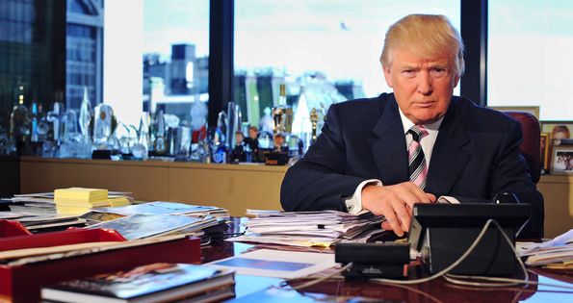
Why should we work/study??
How should we relate to our superiors?
Always obey your superiors only because you fear the Lord
(Main Idea)
What drives you at work and school?
Pray that God would grant you a greater understanding of who He is, that you may work/study out of fear of Him and not man.
Notes:
(So what are Paul’s instructions for how to work/study in relation to our superiors? This verse basically says…)
Conclusion
Always obey our superiors only because we fear the Lord (MI).
Don’t obey hypocritically to be seen by others because you fear man. (Restated MI)
(Application): Reflect upon what drives you at work and school. Pray that God would grant you a greater understanding of who He is, that you may work/study out of fear of Him and not man.

Slide 24
1
OBEY for an
AUDIENCE OF

Slide 25
NT Preaching link at BibleStudyDownloads.org
Get this presentation and script for free!
Notes:
NT Preaching (np)

Slide 26
Black

