Slide 1
Problem Solved— BY YOU!
Acts 6:1-7
Dr. Rick Griffith • Crossroads International Church Singapore CICFamily.com • BibleStudyDownloads.org

Slide 2
Internal issues can hinder bodily growth.

Slide 3
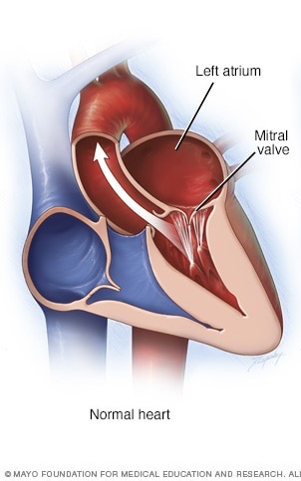
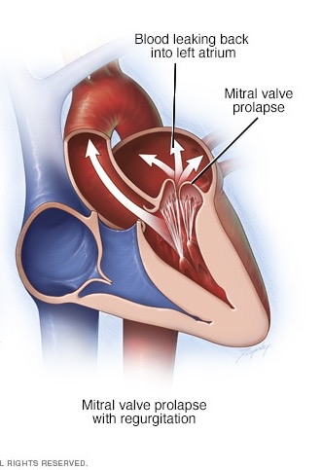
Mitral Valve Prolapse
Blood Leaks Back into Left Atrium
Left Atrium
Mitral Valve Prolapse
Mitral Valve
Normal Heart
Heart Needing a Valve Job

Slide 4
Internal issues can hinder church growth.

Slide 5
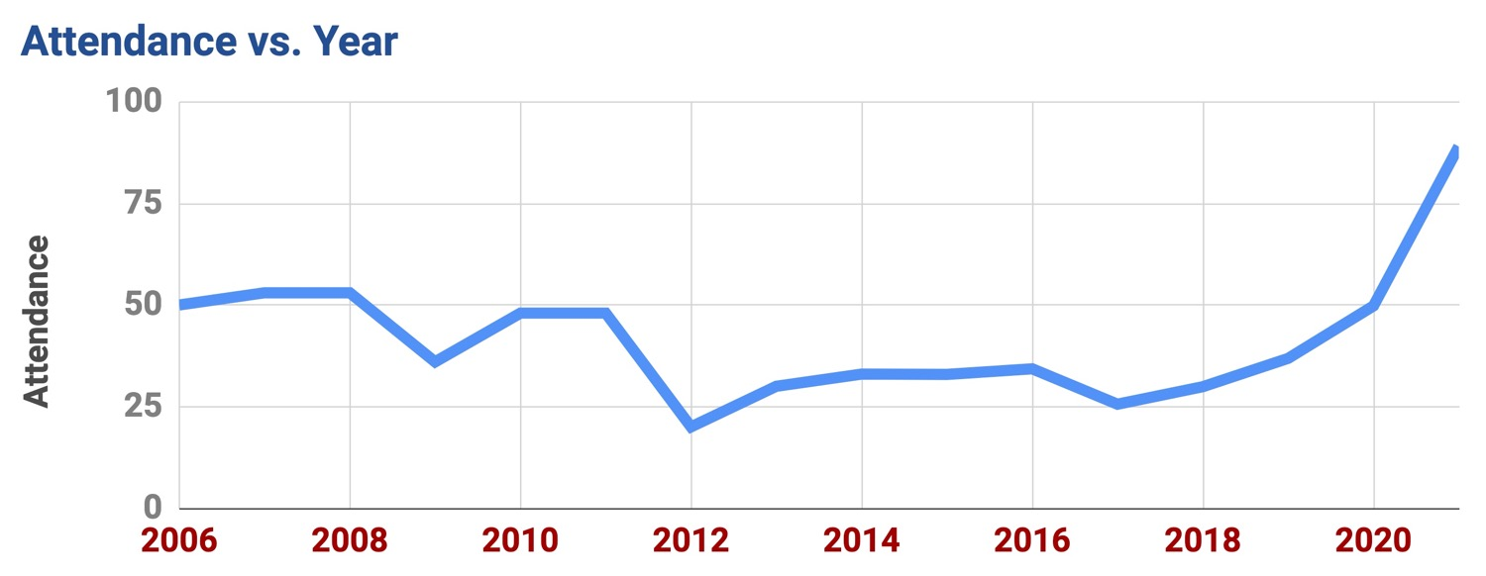
Crossroads Growth

Slide 6
Our Problems
Kids
Youth
Ladies
Men
Home Groups
Worship

Slide 7
How should we solve the growth issues we face?

Slide 8
GOOD NE WS
ON THE MO VE
God’s work through the early church in
Acts

Slide 9
Opposition & Response
External
Internal

Slide 10
Opposition & Response
External

Slide 11
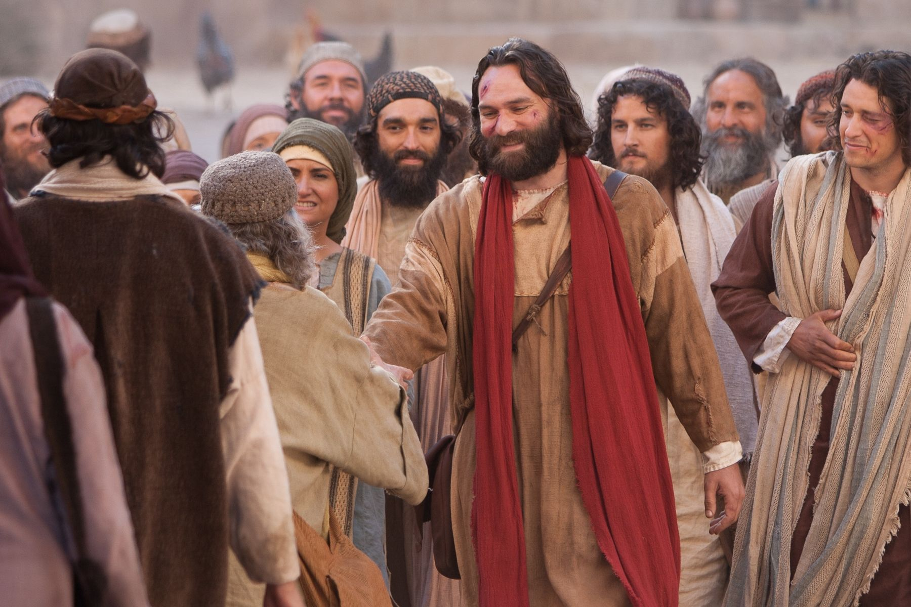
Suffering for the Name…

Slide 12
Internal issues can hinder church growth.
Acts 6:1-7

Slide 13
The blessing of God on the Jerusalem church caused it to grow (Acts 6:1a).

Slide 14
Forget Church Growth— Aim for Church Health
—Rick Warren
Notes:
May 20, 2016 Forget Church Growth, Aim for Church Health
By Rick Warren
https://pastors.com/health-not-growth/
When I wrote The Purpose Driven Church, I predicted that church health – not church growth – would be the primary concern of the 21st Century church. I believe that prediction is proving itself true.
The New Testament says a lot about the health of the church. Consider just a few verses:
“As each part does its own special work, it helps the other parts grow, so that the whole body is healthy and growing. …” (Ephesians 4:16b, NLT)
“The focus of my letter wasn’t on punishing the offender but on getting you to take responsibility for the health of the church.” (2 Corinthians 2:9, Msg)
“You can develop a healthy, robust community that lives right with God and enjoy its results only if you do the hard work of getting along with each other. …” (James 3:18, Msg)
Church health is the key to church growth. All living things grow if they’re healthy. You don’t have to make them grow – it’s just natural for living organisms. As a parent, I didn’t have to force my three children to grow. They naturally grew up. As long as I removed the hindrances, such as poor nutrition or an unsafe environment, their growth was automatic.
If my children had not grown up, something would have been terribly wrong. I would have done whatever it took to discover the disease and correct it. I wouldn’t have remained passive, spouting clichés about faithfulness, or wanting “quality not quantity” in my children.
The same principle is true for the church. Since the church is a living organism, it’s natural for it to grow if it’s healthy. The church is a Body, not a business – an organism, not an organization. It’s alive. If a church is not growing, it is dying.
What then is the secret of church health?
In a word, it’s balance!
Your body has nine different systems (circulatory, respiratory, digestive, skeletal, etc.). When these systems are all in balance, it produces health. But when your body gets out of balance, we call that “disease.” Likewise when the Body of Christ becomes unbalanced, disease occurs. Health and growth can only occur when everything is brought into balance.
Our entire world is based on this principle of balance. Our planet was perfectly balanced by God, at just the right angle on its axis to support life. It rotates at a speed that minimizes vibration. If this planet were just a little closer to the sun, we’d burn up and, if it were just a few miles further away from the sun, we’d freeze to death.
Nature is a collection of ecosystems that live in balance with each other. We now know that even the tiniest variation in the ecosystem creates a chain reaction. God has set up a food chain with plants and animals in balance.
In architecture, structures must be balanced. If the stress isn’t balanced, a building will collapse or a bridge will fall. There must be equilibrium. If your life is not balanced, you might collapse, and if your congregation is not balanced, it might collapse.
As pastors and counselors we must realize that healing is the recovery of balance to the body, soul, and congregation.
Healthy, lasting church growth is multi-dimensional. I’ve written extensively on the fact that church health has five facets: every church needs to grow warmer through fellowship, deeper through discipleship, stronger through worship, broader through ministry, and larger through evangelism.
These five purposes of the church are commanded by Jesus in the Great Commandment and Great Commission, explained by Paul in Ephesians 4, described in Jesus’ prayer for the church in John 17, and modeled by the first church in Jerusalem.
In Acts 2:42-47 these five facets of health are mentioned: They fellowshipped, edified each other, worshipped, ministered, and evangelized. As a result, verse 47 (NIV) says, “And the Lord added to their number daily those who were being saved.”
The Five Dimensions of a Healthy Church:
Churches grow warmer through fellowship.
Churches grow deeper through discipleship.
Churches grow stronger through worship.
Churches grow broader through ministry.
Churches grow larger through evangelism.
Church growth is the natural result of church health. But church health can only occur when our message is biblical and our mission is balanced. Each of the five New Testament purposes of the church must be in equilibrium with the others for health to occur.
Now this is important: Because we are imperfect beings, balance in a church does not occur naturally. In fact, we must continually correct imbalance! It’s human nature to overemphasize the aspect or purpose of the church we feel most passionate about.
Most evangelical churches already do the five purposes of the church – sort of.
But they don’t do them all equally well. One church may be strong in fellowship, yet weak in evangelism. Another may be strong in worship, yet weak in discipleship. Still another may be strong in evangelism, yet weak in ministry.
Why is this? It’s the natural tendency of leaders to emphasize what they feel strongly about and neglect whatever they feel less passionate about. Around the world you can find churches that have become the extension of their pastor’s giftedness. They focus only on what he cares about most.
Unless you set up a system and structure to intentionally balance the five purposes, your church will tend to overemphasize the purpose that best expresses the gifts and passion of its pastor.
Healthy churches are built on purpose! By focusing equally on all five of the New Testament purposes of the church, your church will develop the healthy balance that makes lasting growth possible.

Slide 15
Jerusalem Church Growth
Disciples
Increasing
Acts 6:1
Persecution
5000
Acts 4:4
Pentecost
3000
Acts 2

Slide 16
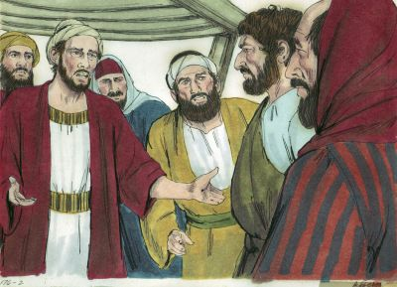
But the growing church had a food distribution problem (Acts 6:1b).

Slide 17
The believers shared all they had (Acts 4:32-37)

Slide 18
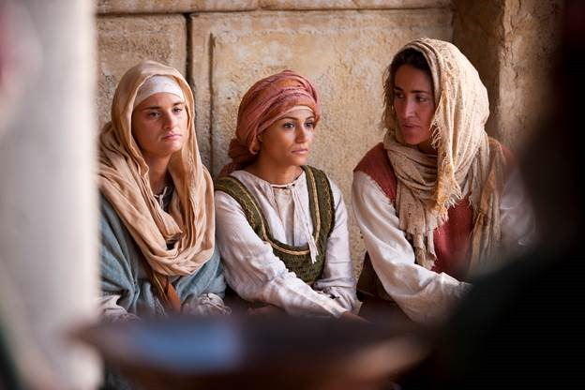
The Widows
Greek-speaking
Hebrew-speaking

Slide 19
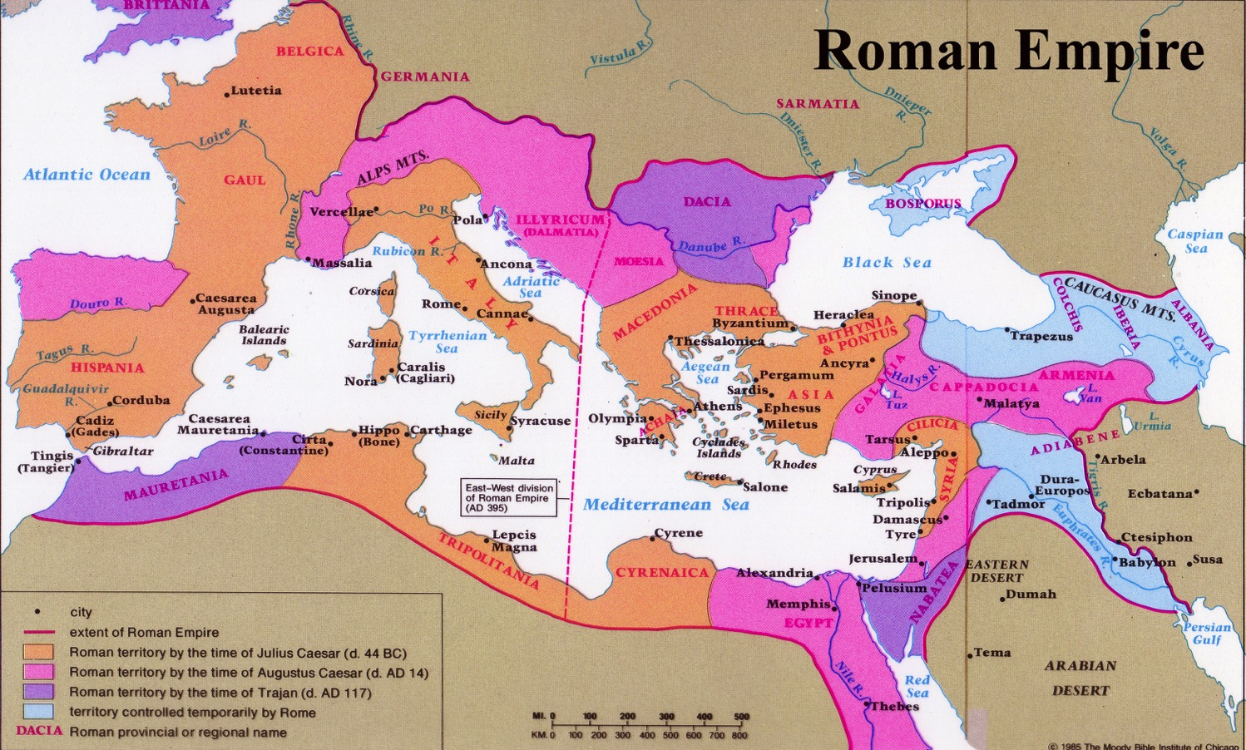
Languages of the Empire
97
Languages of the Empire
Roman Empire
Greek
Latin
Aramaic
Hebrew

Slide 20
An idea…

Slide 21
Black on White

Slide 22
The apostles solved the growth problem by appointing lay leaders (Acts 6:2-7).

Slide 23
The Word

Slide 24
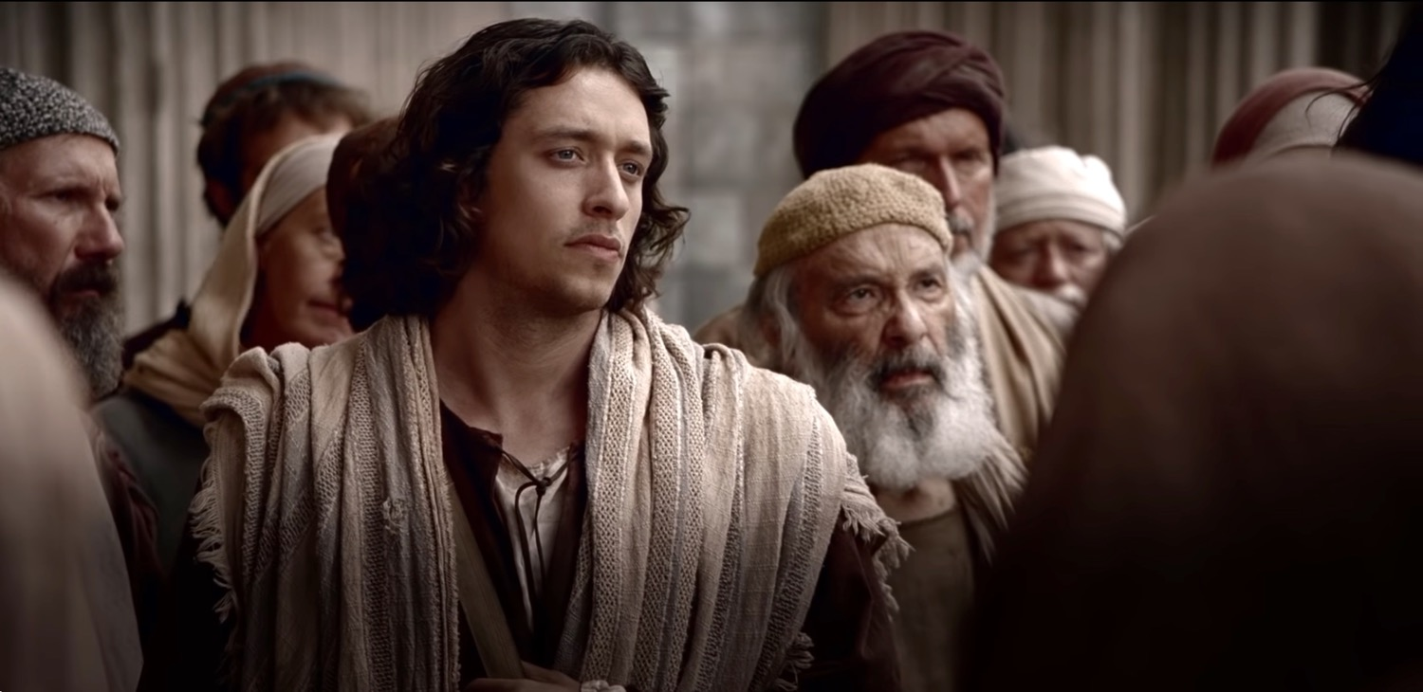
Why men for a food program?

Slide 25
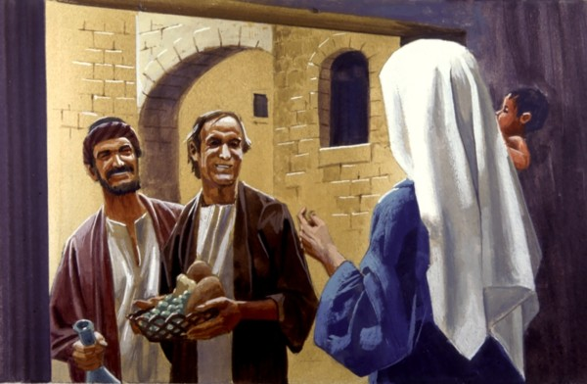
“The Seven” administered the food.

Slide 26
"full of the Spirit" (Acts 6:3).

Slide 27
The Word and Prayer
Stephen
Philip
Procorus
Nicanor
Timon
Parmenas
Nicolas from Antioch, a convert to Judaism

Slide 28
The Result

Slide 29
Jerusalem Church Growth
Priests
Rapidly
Acts 6:7
Disciples
Increasing
Acts 6:1
Persecution
5000
Acts 4:4
Pentecost
3000
Acts 2

Slide 30
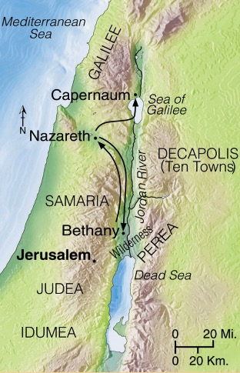
Progress Reports
125
End of the Earth
Key Verse: 1:8
2:47b
6:7
8:40
9:31
12:24
16:5
19:20
28:30-31
1:1–6:7
6:8–8:40
Acts 9–28
Adapted from Stanley D. Toussaint, BKC; Jeremy Chew, EAST

Slide 31
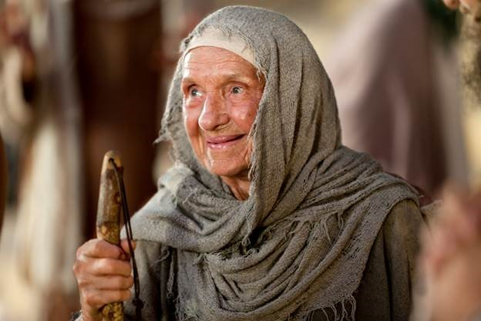
Happy widows

Slide 32
How should we solve the growth issues we face?

Slide 33
Main Idea of Acts 6:1-7
The solution to church growth problems is more lay leaders.

Slide 34
The worldly solution is to put more work on less people.

Slide 35
So what do we do about our growth problems?

Slide 36
Applying Acts 6:1-7
We must appoint more leaders to handle our growth.

Slide 37
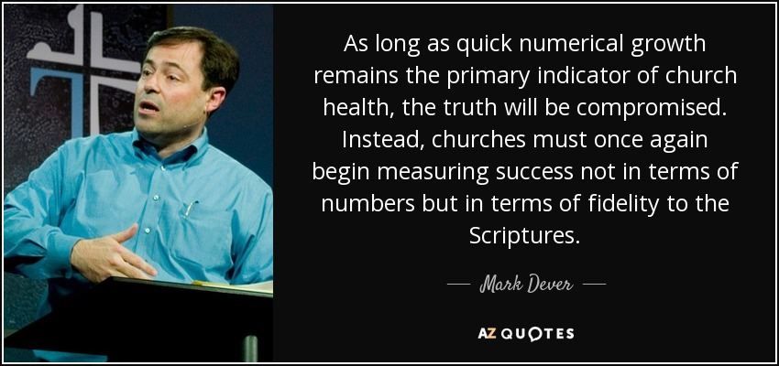
Seek truth—not growth

Slide 38
Crossroads Growth

Slide 39
Our Problems
God’s Solutions
Kids
Youth
Ladies
Men
Home Groups
Worship
Leaders
Leaders
Leaders
Leaders
Leaders
Leaders

Slide 40
How should we solve the growth issues we face?

Slide 41
Main Idea of Acts 6:1-7
The solution to church growth problems is more lay leaders.

Slide 42
Leadership Lessons
Choose leaders closest to the issues and trust them.
Have the people choose leaders they already respect.
Character is more important than experience or ability.
Church leaders must prioritize teaching and prayer.

Slide 43
What to do?
Consider how God allows problems in your life for your growth.
Ask God what role he wants you to play in this church.
Prioritize the word and prayer in your own life.
Attend our Loving Christ’s Church class by Pastor Jim.

Slide 44
Black

Slide 45
NT Preaching link at BibleStudyDownloads.org
Get this presentation and script for free!

