Slide 1
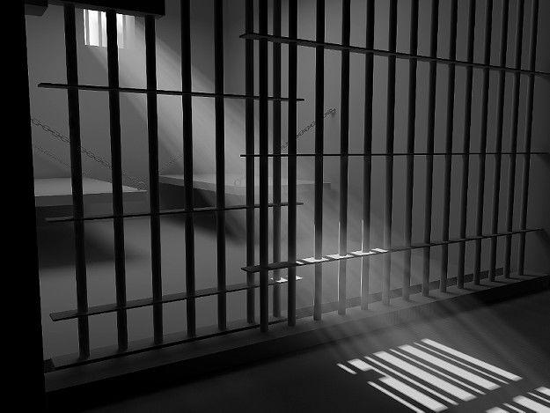
Black
Signs, Sealed, and Delivered:
God’s Power in Spreading the Gospel Message
Acts 5:12-42
Preached by Dr. Jim Harmeling at Crossroads International Church Singapore • CICFamily.com Uploaded by Dr. Rick Griffith • Singapore Bible College Files in many languages for free download at BibleStudyDownloads.org

Slide 2
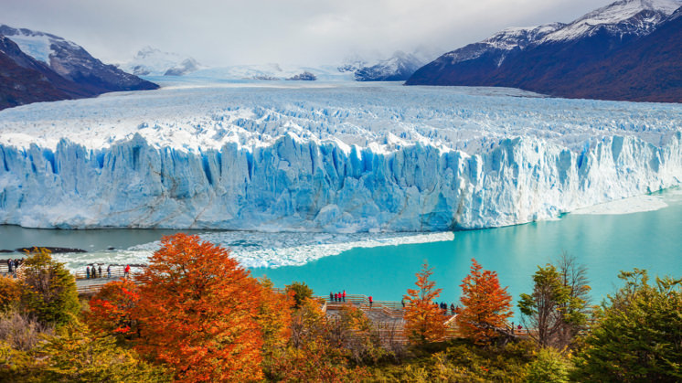
Try to stop this

Slide 3
GOOD NE WS
ON THE MO VE
God’s work through the early church in
Acts

Slide 4
Black
Signs, Sealed, and Delivered:
God’s Power in Spreading the Gospel Message
Acts 5:12-42

Slide 5
Opposition & Response
External
Internal

Slide 6
God’s power transforms lives (Acts 5:12-16)

Slide 7
Signs & Wonders
Acts = narrative but not normative handbook
Signs = miracles that point to truth

Slide 8
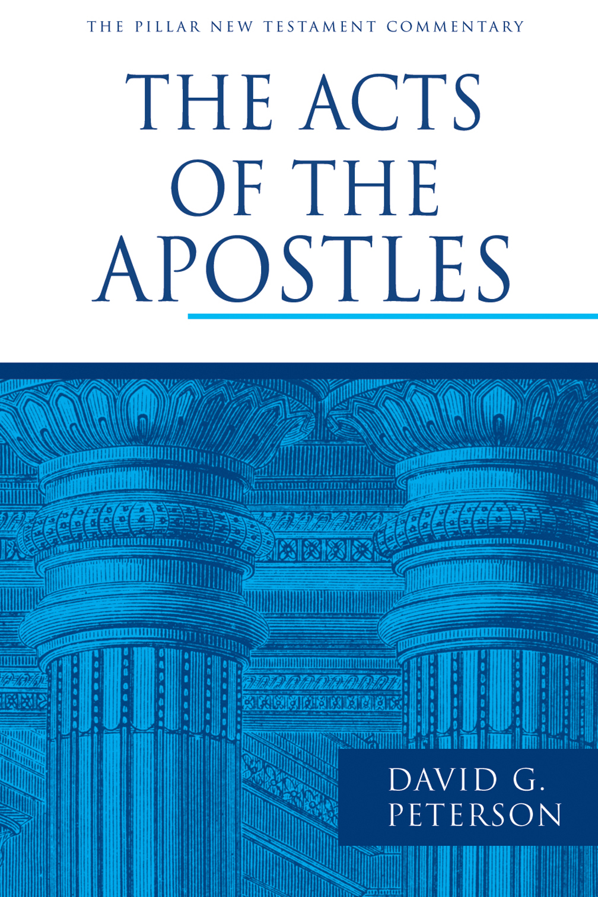
“Throughout Acts, signs and wonders ‘authenticate the word of missionary preaching as the word of God.’ It is the word that saves, as people come to believe and put their trust in God as its source and Christ as its content.”

Slide 9
2 Corinthians 12:12
“The signs of a true apostle were performed among you with utmost patience, with signs and wonders and mighty works.”
Romans 1:1
“Paul, a servant of Christ Jesus, called to be an apostle, set apart for the gospel of God.”

Slide 10
1 Corinthians 9:1
“Am I not free? Am I not an apostle? Have I not seen Jesus our Lord? Are not you my workmanship in the Lord?”
1 John 1:1-2
¹ That which was from the beginning, which we have heard, which we have seen with our eyes, which we looked upon and have touched with our hands, concerning the word of life— ² the life was made manifest, and we have seen it, and testify to it and proclaim to you the eternal life, which was with the Father and was made manifest to us.

Slide 11
God’s power overrides suffering (Acts 5:17-42)
Arrest & release: God overcomes human resistance to the gospel (vs. 17-26)

Slide 12
Acts 2 – Holy Spirit arrives; Peter confronts unbelief; no opposition; church is unified.
Acts 3 – Poor lame man walks; Peter confronts unbelief; no opposition.
Acts 4 – External opposition; Peter confronts unbelief; church is unified.
Acts 5 – Internal & external opposition; church is not unified; miraculous signs; Peter confronts unbelief.

Slide 13
Opposition to gospel increases
God’s display of power increases
Boldness to witness increases

Slide 14
Luke 4:17-21
¹⁷ And the scroll of the prophet Isaiah was given to him. He unrolled the scroll and found the place where it was written,
¹⁸ “The Spirit of the Lord is upon me, because he has anointed me to proclaim good news to the poor. He has sent me to proclaim liberty to the captives and recovering of sight to the blind, to set at liberty those who are oppressed, ¹⁹ to proclaim the year of the Lord's favor.”

Slide 15
²⁰ And he rolled up the scroll and gave it back to the attendant and sat down. And the eyes of all in the synagogue were fixed on him. ²¹ And he began to say to them, “Today this Scripture has been fulfilled in your hearing.”

Slide 16
Isaiah 61:1
“The Spirit of the Lord God is upon me, because the Lord has anointed me to bring good news to the poor; he has sent me to bind up the brokenhearted, to proclaim liberty to the captives, and the opening of the prison to those who are bound.”

Slide 17
Luke 7:22-23
²² And he answered them, “Go and tell John what you have seen and heard: the blind receive their sight, the lame walk, lepers are cleansed, and the deaf hear, the dead are raised up, the poor have good news preached to them. ²³ And blessed is the one who is not offended by me.”

Slide 18
God’s power overrides suffering (Acts 5:17-42)
Arrest & release: God overcomes human resistance to the gospel (vs. 17-26)
The rearrest and Peter’s message: God is sovereign & Jesus will be exalted (vs. 27-32)

Slide 19
Deuteronomy 21:22-23
²² And if a man has committed a crime punishable by death and he is put to death, and you hang him on a tree, ²³ his body shall not remain all night on the tree, but you shall bury him the same day, for a hanged man is cursed by God. You shall not defile your land that the Lord your God is giving you for an inheritance.

Slide 20
“Christianity, then, is a religion of postponed honor.”

Slide 21
Jesus
Raised & exalted
Disciples of Jesus
Receive repentance, forgiveness, & Holy Spirit

Slide 22
God’s power overrides suffering (Acts 5:17-42)
Arrest & release: God overcomes human resistance to the gospel (vs. 17-26)
Rearrest and Peter’s message: God is sovereign & Jesus will be exalted (vs. 27-32)
Response: confusion versus confidence (vs. 33-42)

Slide 23
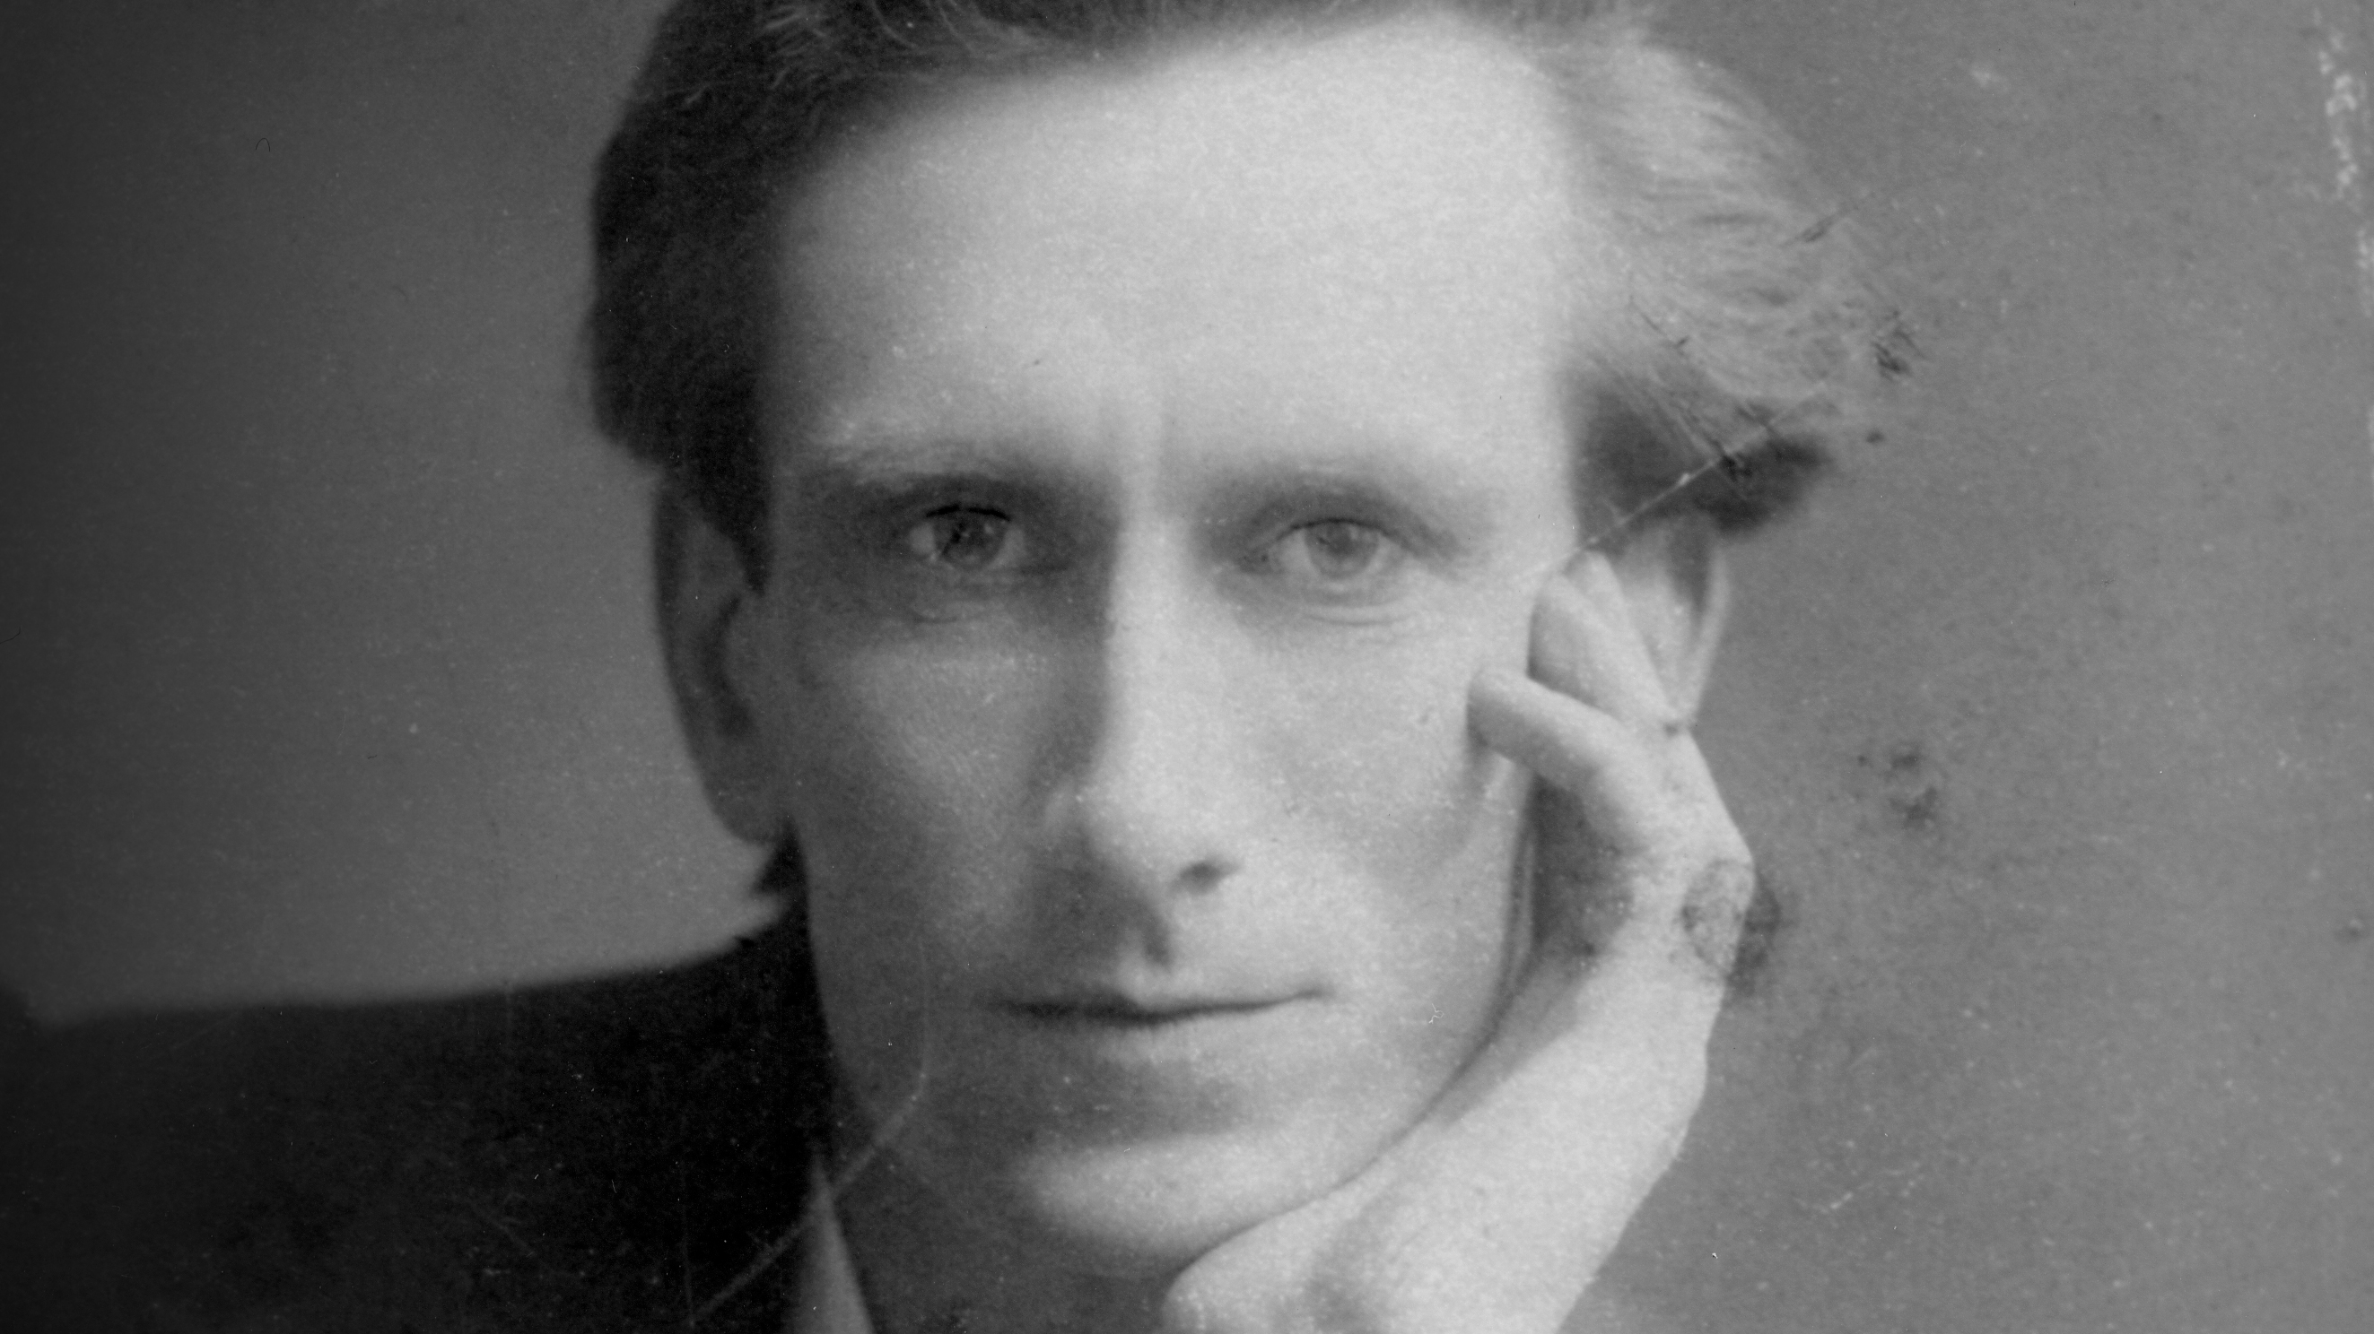
Oswald Chambers

Slide 24
Black

Slide 25
NT Preaching link at BibleStudyDownloads.org
Get this presentation for free!
Notes:
The Bible…Basically (bb)

