Slide 1
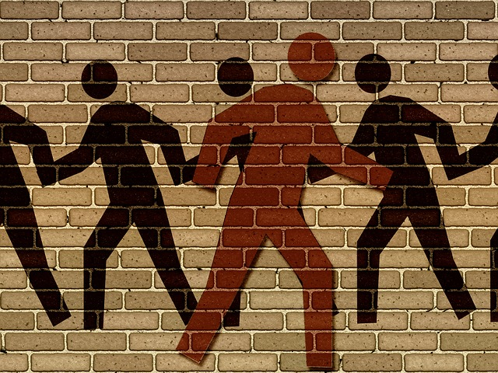
Obey God—Not Man
Acts 4:1–5:11
Dr. Rick Griffith • Crossroads International Church Singapore CICFamily.com • BibleStudyDownloads.org

Slide 2
It’s not getting easier to be a Christian

Slide 3
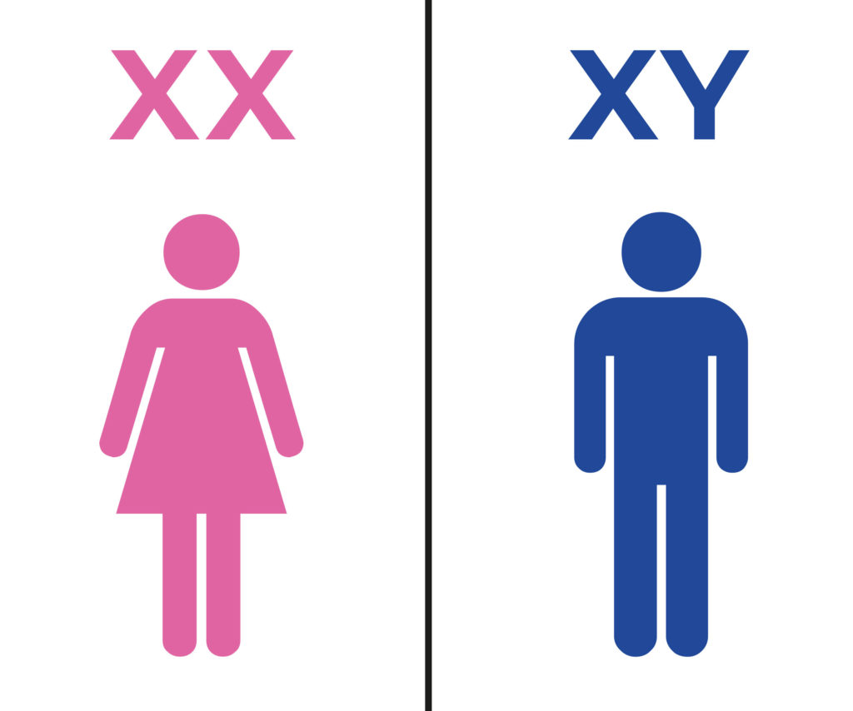
How many sexes?

Slide 4
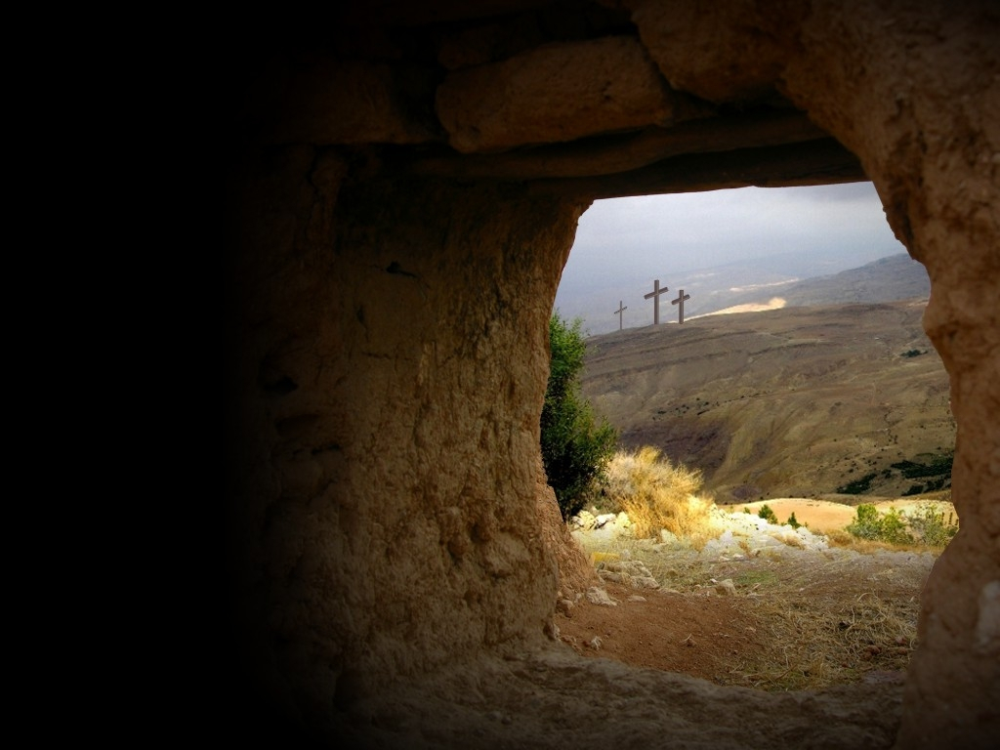
Empty Tomb

Slide 5
How should you respond to the challenges that your faith in Christ brings?
Notes:
How do you respond when there is a price to pay for your faith?
How are you challenged at work because you are a Christian?
How’s your response to unbelieving family members when it may cost you?
Do you cave in? Get angry and demand your rights? Allow your voice to be cancelled due to fear?
• Subject: How should you respond to the challenges that your faith in Christ brings? What should we do when the truth of the gospel is opposed?

Slide 6
GOOD NE WS
ON THE MO VE
God’s work through the early church in
Acts

Slide 7
Herod’s Temple
Holy Place
Priest Courtyard
Women's Courtyard
Gentile Courtyard
Gentile Courtyard
Notes:
Copyright 2017 Faithlife / Logos Bible Software
Logos User

Slide 8
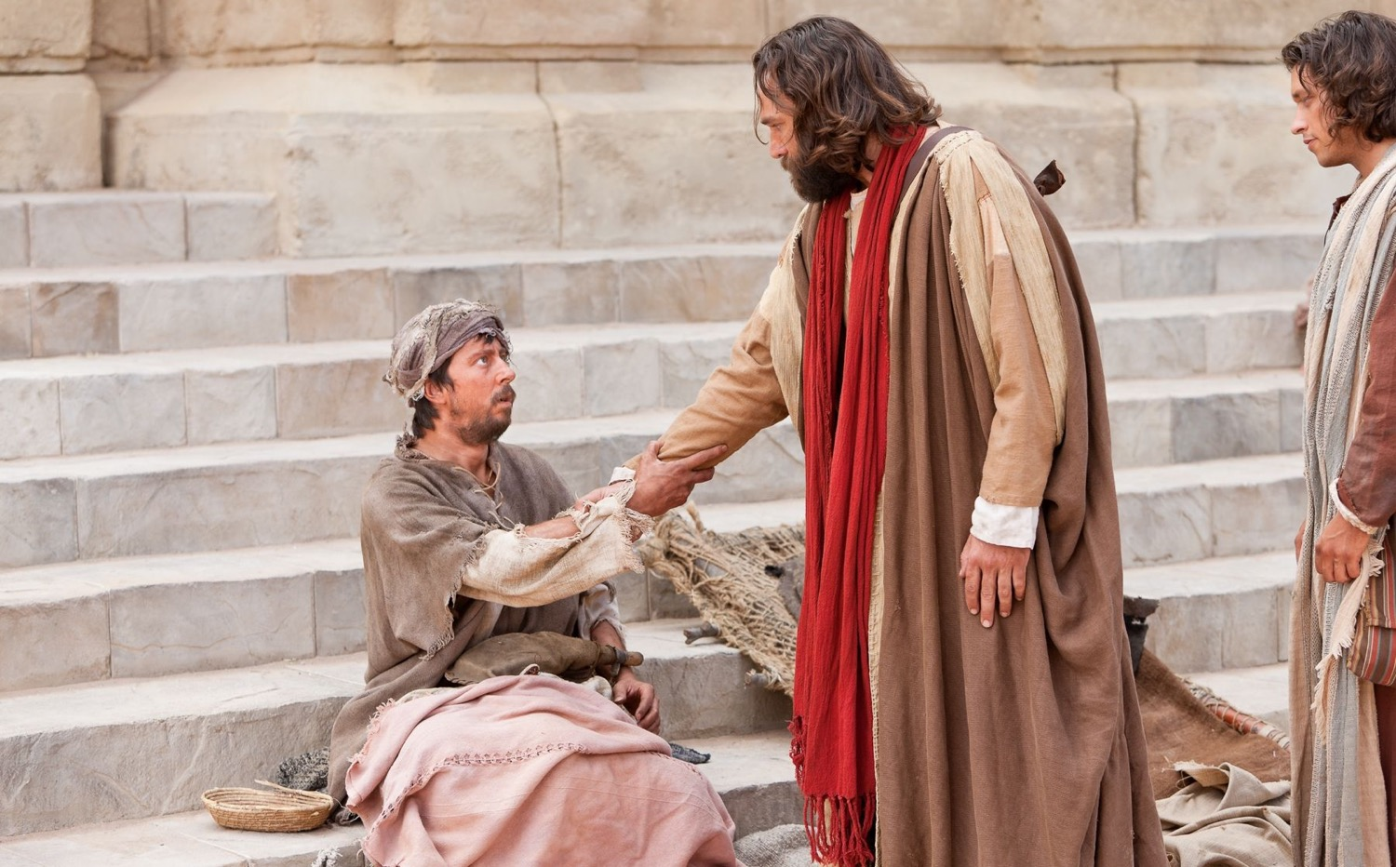
"Then Peter took the lame man by the right hand and helped him up" (Acts 3:7a NLT).

Slide 9
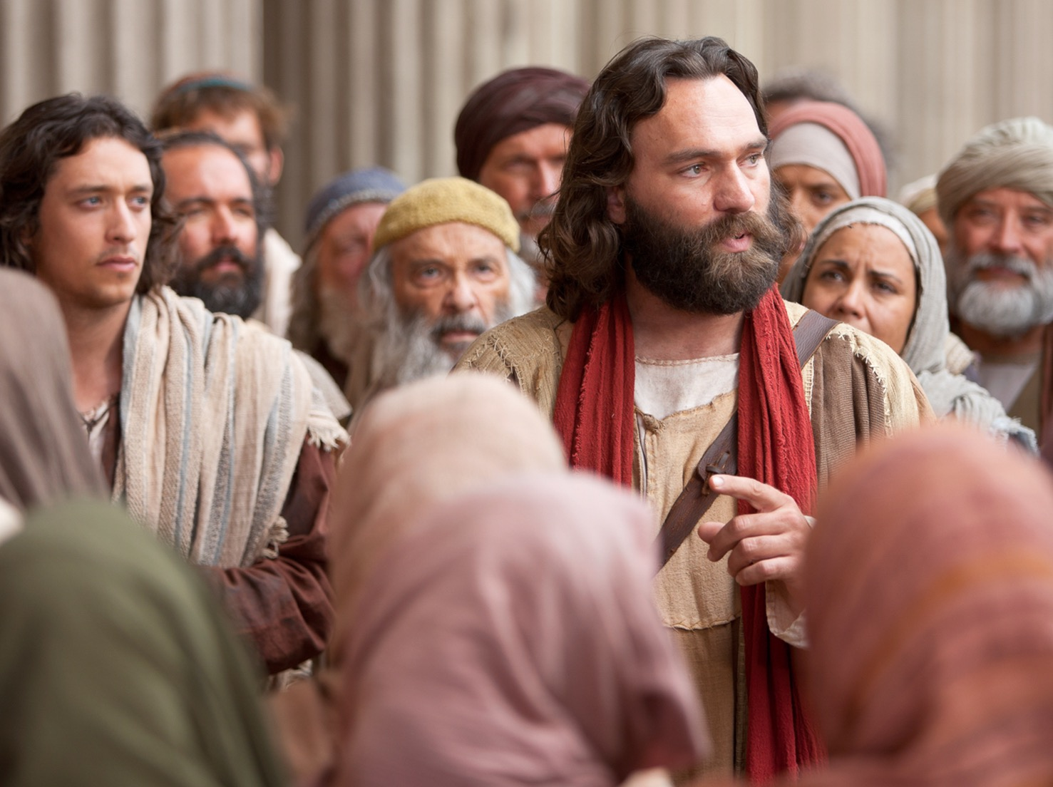
"Peter saw his opportunity and addressed the crowd. ‘People of Israel,’ he said, ‘what is so surprising about this? And why stare at us as though we had made this man walk by our own power or godliness?’" (Acts 3:12 NLT).

Slide 10
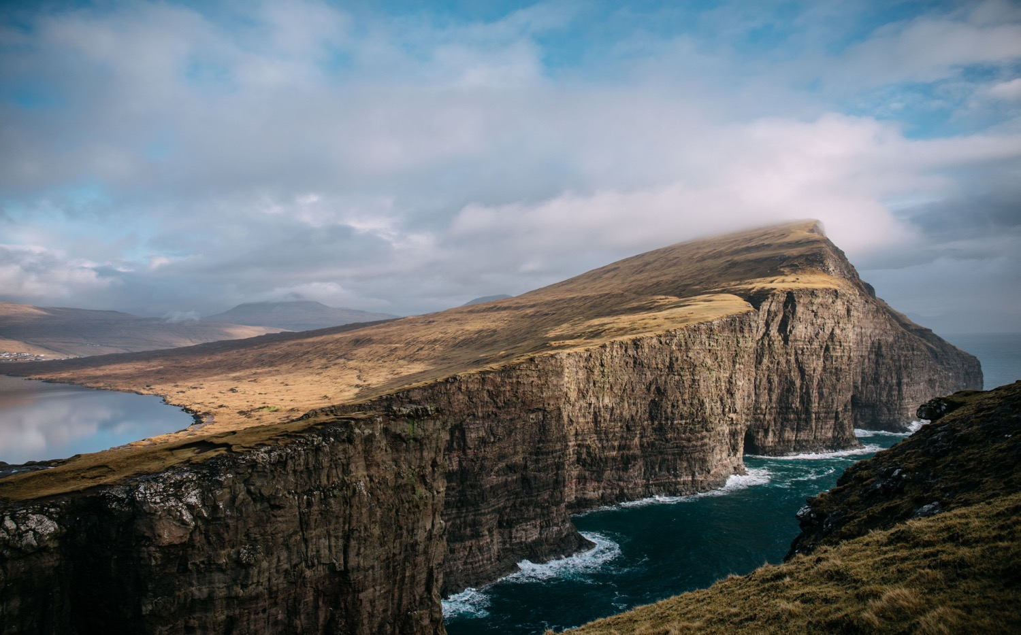
Main Idea of Acts 3
Seeing God work gives us open doors for witness!

Slide 11
Opposition & Response
External
Internal

Slide 12
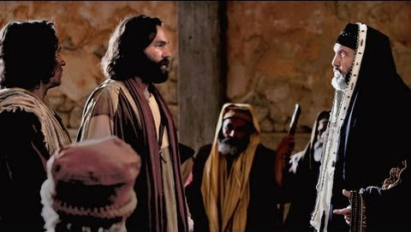
When unbelievers oppose you, obey God—not man (Acts 4:1-31).

Slide 13
Opposition & Response
External
Obey God
Notes:
[When non-Christians challenge your faith, don’t give in and deny your Lord.]

Slide 14
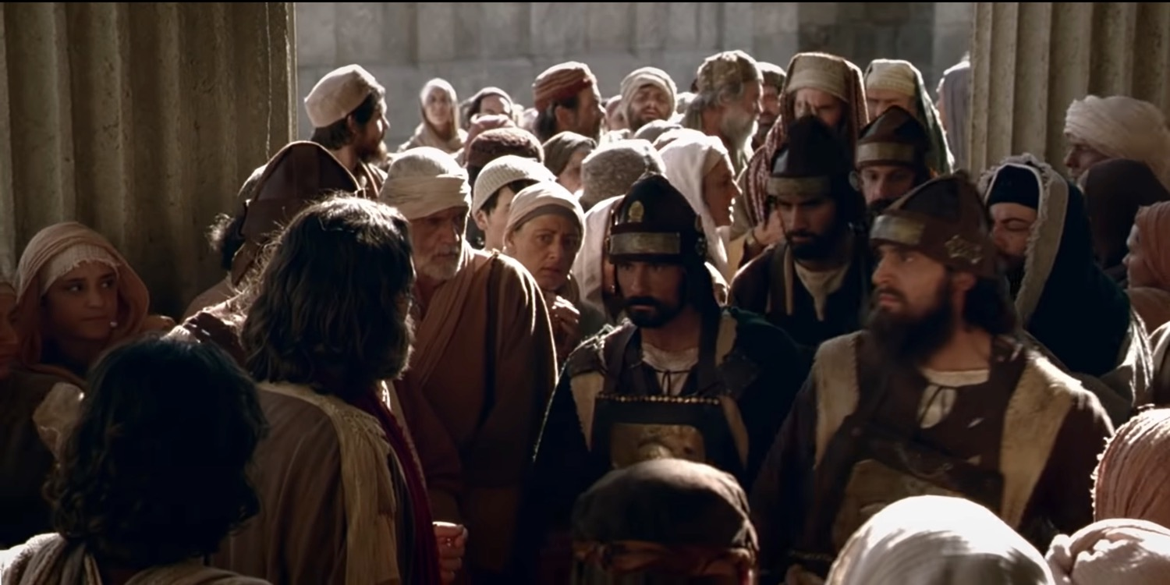
The Sadducees opposed Peter and John preaching Christ’s resurrection after the church grew to 5000 (4:1-7).

Slide 15
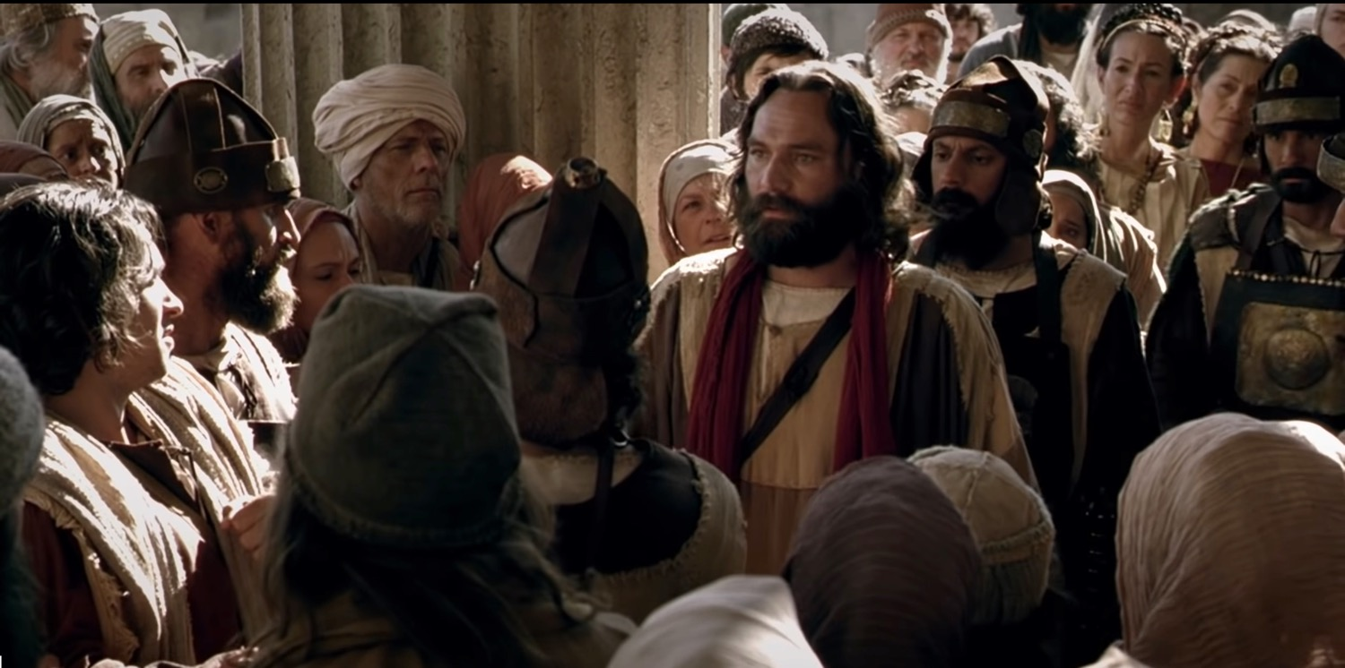
"They seized Peter and John and, because it was evening, they put them in jail until the next day. ⁴ But many who heard the message believed; so the number of men who believed grew to about 5000" (Acts 4:3-4 NIV).

Slide 16
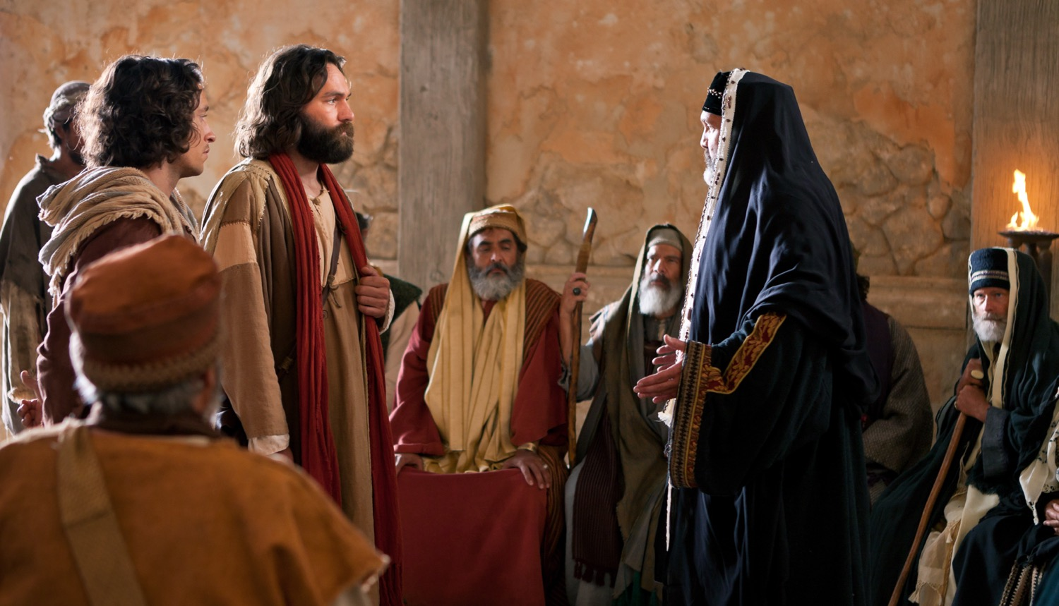
"The next day the rulers, the elders and the teachers of the law met in Jerusalem" (Acts 4:5 NIV).

Slide 17
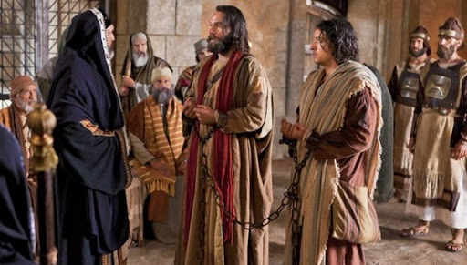
"They had Peter and John brought before them and began to question them: ‘By what power or what name did you do this?’" (Acts 4:7 NIV).

Slide 18
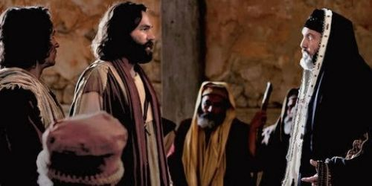
"Then Peter, filled with the Holy Spirit, said to them: ‘Rulers and elders of the people! If we are being called to account today for an act of kindness shown to a man who was lame and are being asked how he was healed, then know this, you and all the people of Israel: It is by the name of Jesus Christ of Nazareth, whom you crucified but whom God raised from the dead, that this man stands before you healed’" (Acts 4:8-10 NIV).

Slide 19
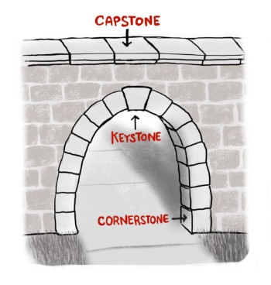
The stone you builders rejected… has become the capstone.
Literally simply “stone”
Acts 4:11 NIV

Slide 20
The stone you builders rejected… has become…
Acts 4:11 NLT, ESV

Slide 21
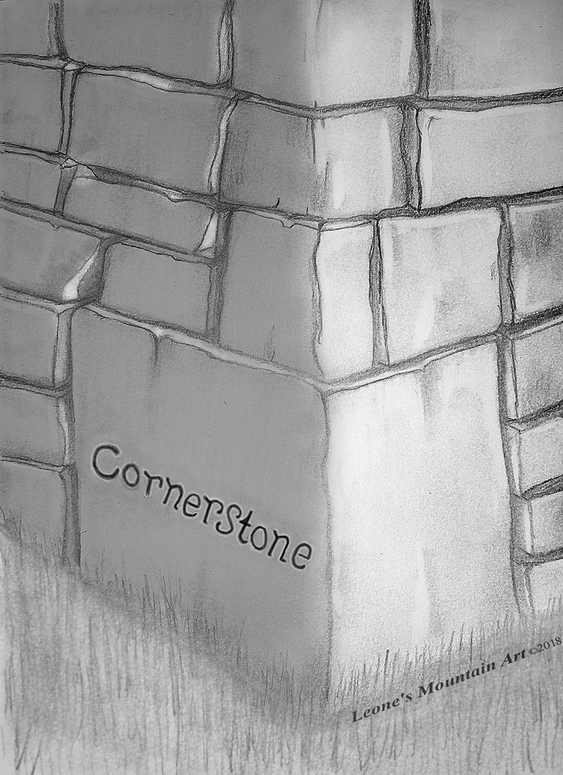
Jesus is that stone on which the entire OT rests—the law, the sacrifices, the priesthood, the temple—everything!
Acts 4:11

Slide 22
Really?

Slide 23
Who else has paid the price for our sin?

Slide 24
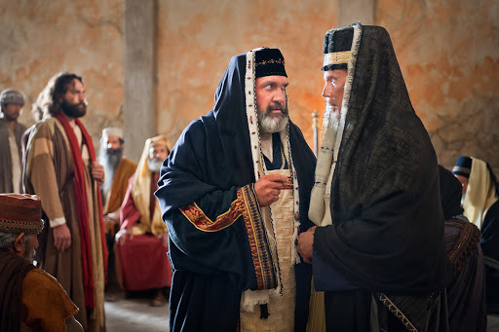
Unsuccessful Threats (Acts 4:13-22)

Slide 25
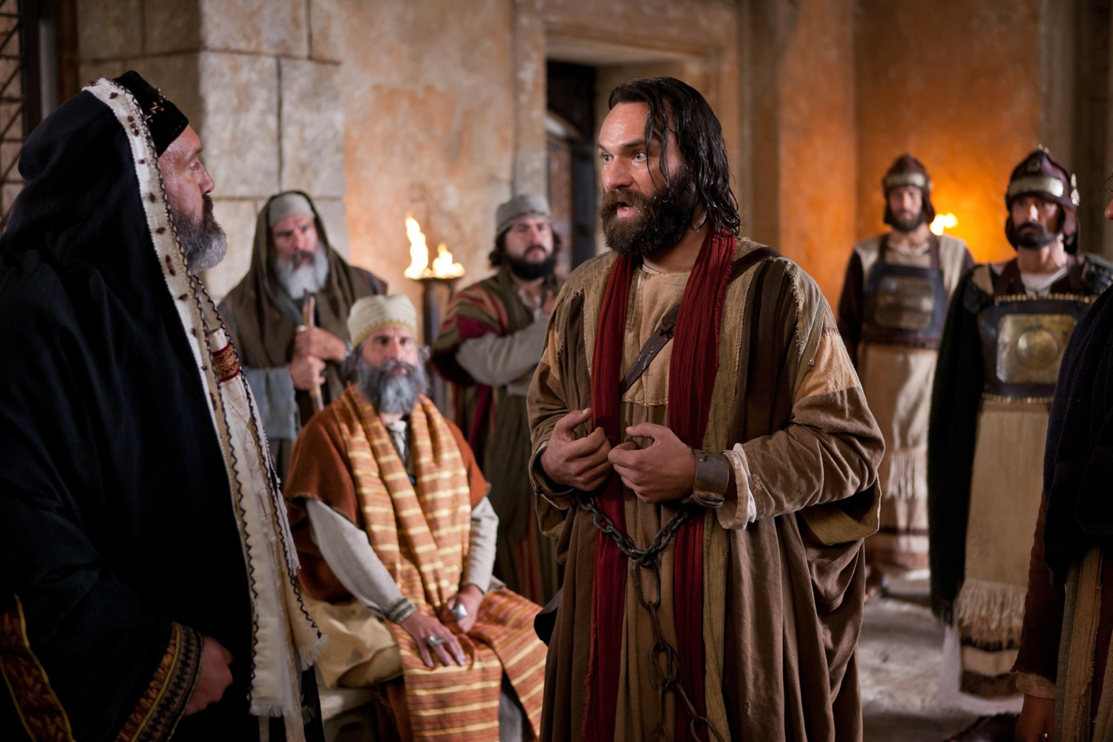
"…Judge for yourselves whether it is right in God’s sight to obey you rather than God" (Acts 4:19 NIV).
Notes:
The NT commands us four times to obey authority.
Yet we are also to obey God.

Slide 26
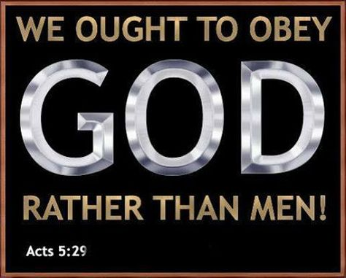
It happens later too…
Notes:
But sometimes these two authorities clash—as they will do in the next chapter also. So we must choose to obey the lower authority of humans or the higher authority of God.

Slide 27
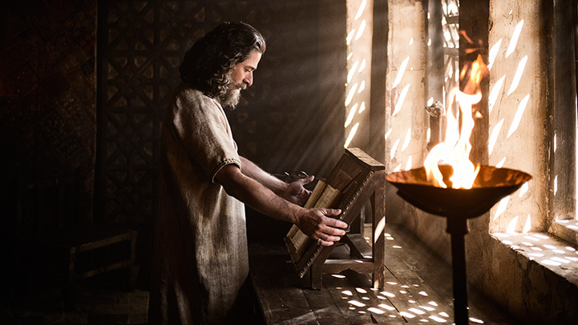
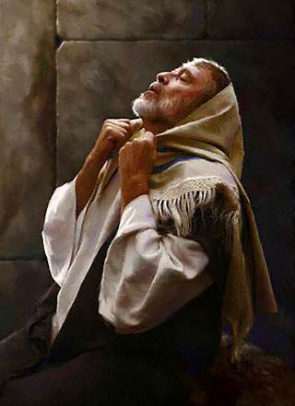
Daniel prayed with windows open to Jerusalem (Daniel 6)
Notes:
The apostles acted like Daniel, who was told to pray to no “other god” except King Darius, who couldn’t hear his prayers anyway, so Daniel also obeyed the higher authority (Dan 6).
But we must be prepared to suffer for doing what is right—so God gave us the letter of 1 Peter, since Peter, after all, is the one of those who refused to obey the Sanhedrin.
______________
When you act in accord with God’s will, you need not fear the results. This doesn’t mean that you parade your righteousness or you always spout off your beliefs. Daniel was known for his integrity and commitment to keep the Jewish food laws—but he also did not want to be known as one who prayed to pagan deities to save his head.

Slide 28
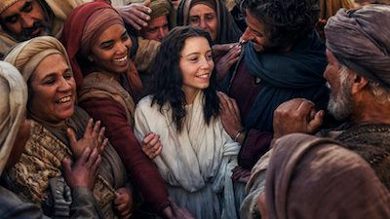
Church rejoicing (Acts 4:23-31)

Slide 29
Commit now to obey God before temptations by unbelievers to obey man become too strong.
Notes:
When I graduated from business school, my unbelieving parents wanted me to become a businessman—which is fine for most graduates—but God called me overseas, I resolved to obey God by becoming a missionary. Obey God—not man.

Slide 30
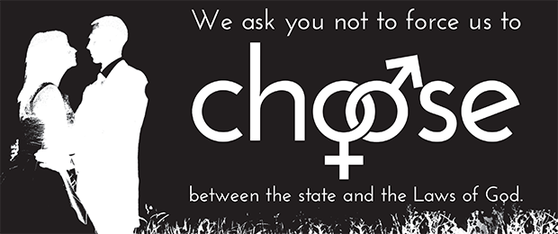
Choices
Pastors Tell Supreme Court: We Must “Obey God Rather than Men”
(18 June 2015)
Notes:
A broad coalition of Protestant, Catholic, Orthodox Christian, and Jewish leaders joined by civic and business leaders from around the nation have signed an open letter to the U.S. Supreme Court vowing they will not honor any decision by the Supreme Court that would force them to violate the biblical understanding of marriage as the union of one man and one woman.
The letter was published in an ad in the Washington Post and was signed by many prominent pastors and Christian leaders, many from Texas, including: Pastor Robert Jeffress at First Baptist Church Dallas, Pastor Robert Morris at Gateway Church in Southlake, Pastor Charles Hagee at Cornerstone Church in San Antonio, Pastor Gregg Matte at Houston’s First Baptist Church, and Pastor Steve Riggle at Grace Church in Houston. Here is a portion of the letter:
We are Protestant, Catholic, and Orthodox Christian pastors, clergy, lay leaders and Jewish leaders, who collectively represent millions of people in our specific churches, parishes, denominations, synagogues and media ministry outreaches. Marriage transcends our various theological differences and unites us together in one voice.
We affirm that any judicial opinion which purports to redefine marriage will constitute an unjust law, as Martin Luther King Jr. described such laws in his letter from the Birmingham Jail.
We are Christians who love America and who respect the legitimate rule of law.
However, we will not honor any decision by the Supreme Court which will force us to violate a clear biblical understanding of marriage as solely the union of one man and one woman.
This week also saw the Southern Baptist Convention, the nation’s largest evangelical denomination, release a statement on biblical marriage and the implications of the Supreme Court redefining marriage at their annual meeting. The statement, signed by the current and 16 former Southern Baptist Convention presidents, states in part:
As Southern Baptist Christians, we are committed to Biblical faith and ethics. As a result, this body of Believers stands on the authority of Scripture and God’s Truth as central to our lives.
What the Bible says about marriage is clear, definitive and unchanging. We affirm biblical, traditional, natural marriage as the uniting of one man and one woman in covenant commitment for a lifetime. The Scriptures’ teaching on marriage is not negotiable. We stake our lives upon the Word of God and the testimony of Jesus.
Consequently, we will not accept, nor adhere to, any legal redefinition of marriage issued by any political or judicial body including the United States Supreme Court. We will not recognize same-sex “marriages”, our churches will not host same-sex ceremonies, and we will not perform such ceremonies.
The concern among Pastors about the consequences of the Supreme Court redefining marriage is one of the main reasons that Texas passed the Pastor Protection Bill, an effort led by Texas Values Action. The bill, already signed into law, specifically protects Texas pastor and churches from being forced to perform a same-sex ‘marriage’ that violates their religious beliefs.
_____
Pastors Tell Supreme Court: We Must ‘Obey God Rather than Men’
by David Walls
Jun 18, 2015
https://txvalues.org/2015/06/18/pastors-tell-supreme-court-we-must-obey-god-rather-than-men/

Slide 31
Opposition & Response
External
Internal
Obey God
Fear God

Slide 32
The believers shared all they had (Acts 4:32-37)

Slide 33
Joseph Called Barnabas Acts 4:36-37

Slide 34
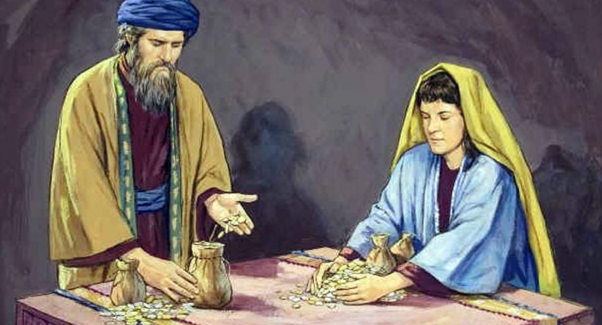
“But there was a certain man named Ananias who, with his wife, Sapphira, sold some property” (Acts 5:1 NLT).

Slide 35
Choosing the dark path (Acts 5:1-11)
“lied to the Holy Spirit” (v. 3)
“lied to God” (v. 4)

Slide 36
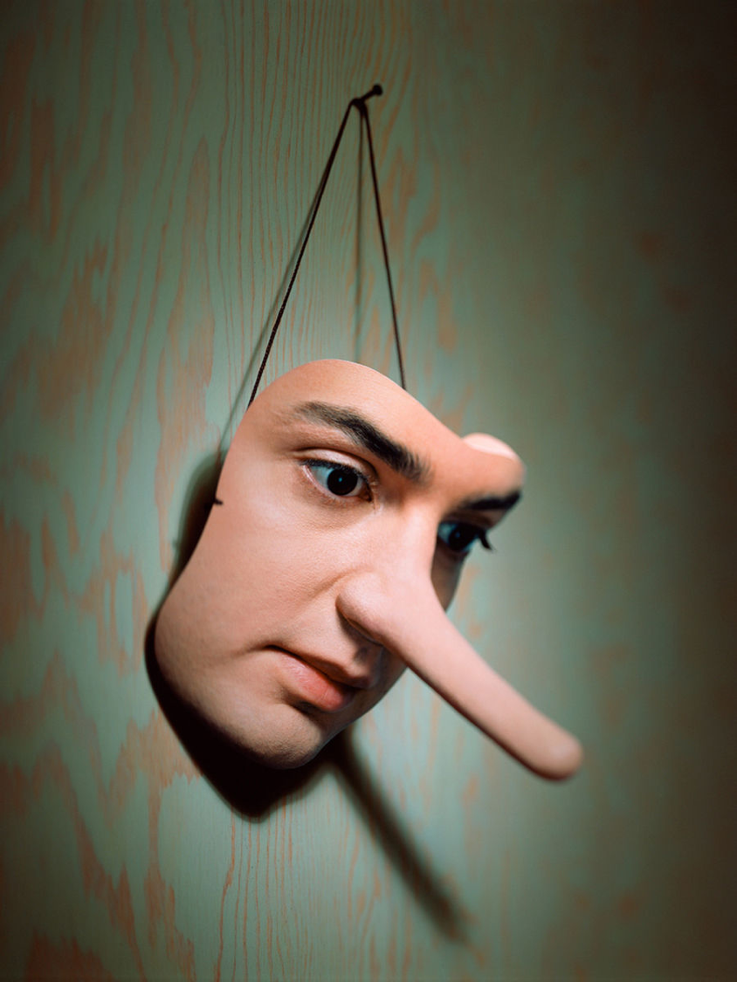
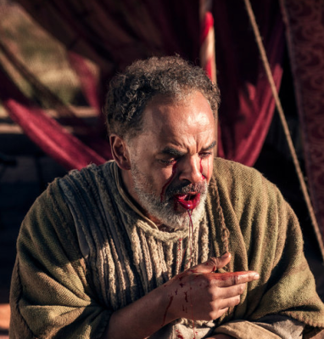
Ananias & Sapphira
Acts 5

Slide 37
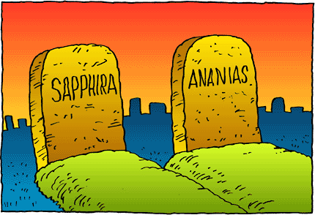
Grace, yes, but there is still divine discipline…

Slide 38
"And a great fear seized all who heard…" (5:5)
"Great fear seized the whole church…" (5:11)
Notes:
What does it mean that fear seized the church (5:5, 11)?
That this happened both with the death of Ananias and his wife Sapphira underscores that the believers genuinely were afraid of what God might do to them—aren’t you?
One of my middle-aged students shared the story a few years back how her husband was a key leader in the church but abandoned his faith to sleep with a woman from China. Within a year he was dead as God took his life.

Slide 39
Let resistance by believers lead you to fear God.

Slide 40
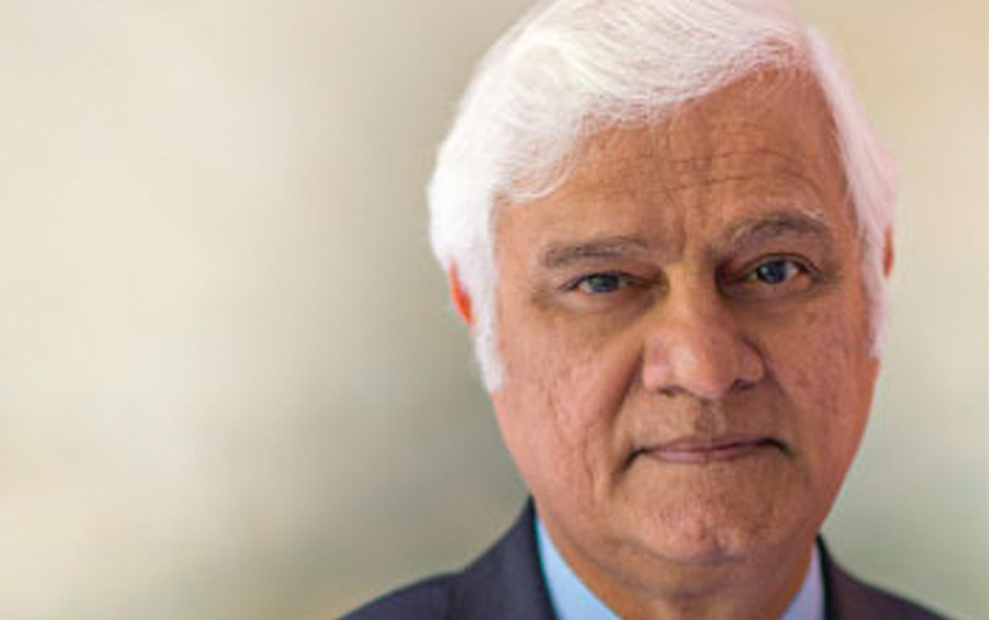
Ravi Zacharias 1946-2020
Notes:
Ravi Zacharias has proven to be a sexual predator—so fear God.
Ask hard questions and welcome hard questions from other believers.

Slide 41
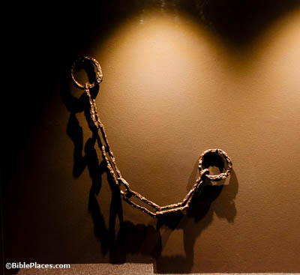
Going into missions…
Notes:
When I graduated from business school, I told you that my parents opposed my mission direction to Asia. But the fuller story is that my church also opposed my missions goal! That was even harder as these were believers out of step with God. So I drew near to God—and here we are 41 years later!

Slide 42
How should you respond to the challenges that your faith in Christ brings?
Notes:
How do you respond when there is a price to pay for your faith?
How are you challenged at work because you are a Christian?
How’s your response to unbelieving family members when it may cost you?
Do you cave in? Get angry and demand your rights? Allow your voice to be cancelled due to fear?
• Subject: How should you respond to the challenges that your faith in Christ brings? What should we do when the truth of the gospel is opposed?

Slide 43
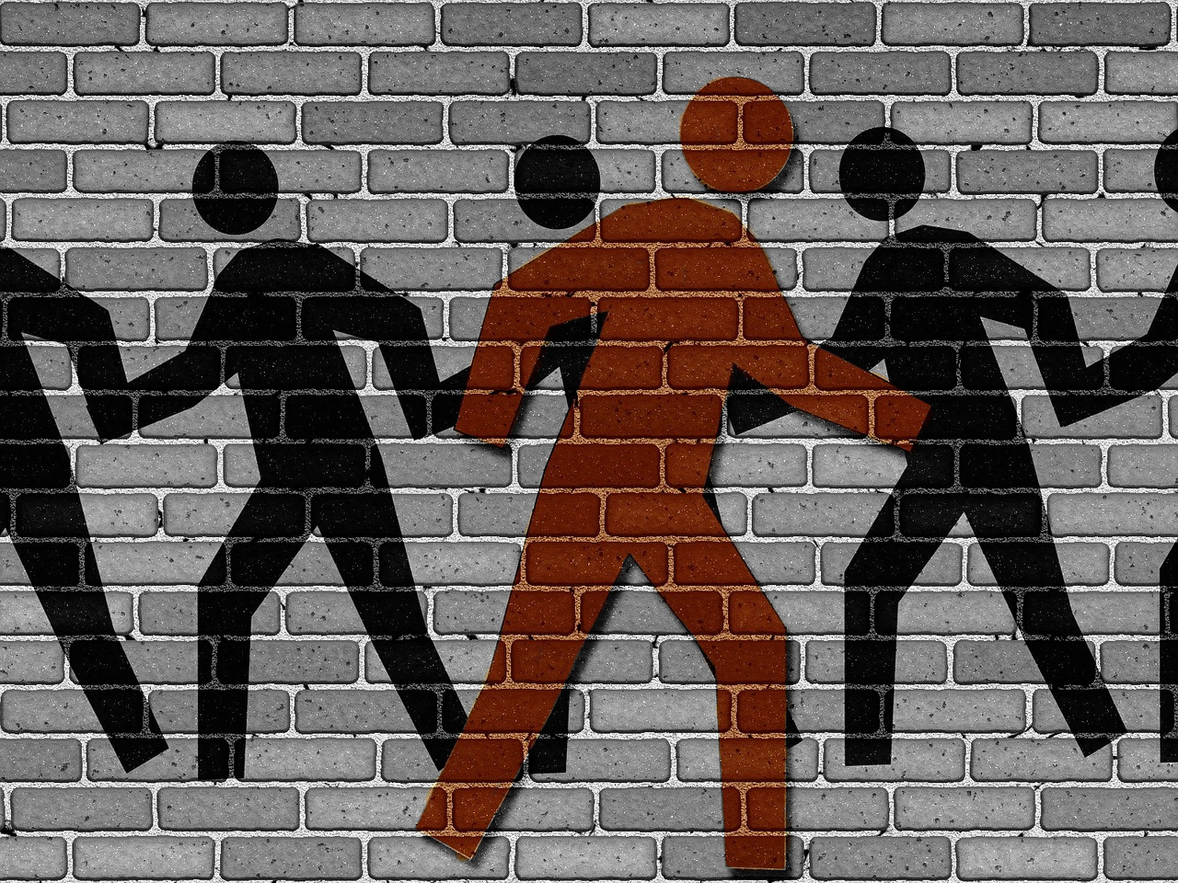
Main Idea
Obey God—Not Men

Slide 44
Opposition & Response
External
Internal
Obey God
Fear God

Slide 45
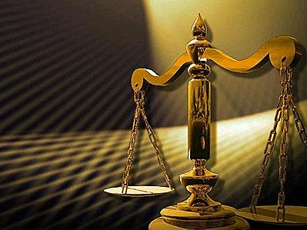
Say aloud, “I will ultimately account to Jesus himself for my life—not to people.”
Notes:
Say aloud, “I will ultimately account to Jesus himself for my life—not to people.”
This realization moves me to make hard decisions.
Susan and I have had to make some difficult choices in recent years. So here’s the deal…

Slide 46
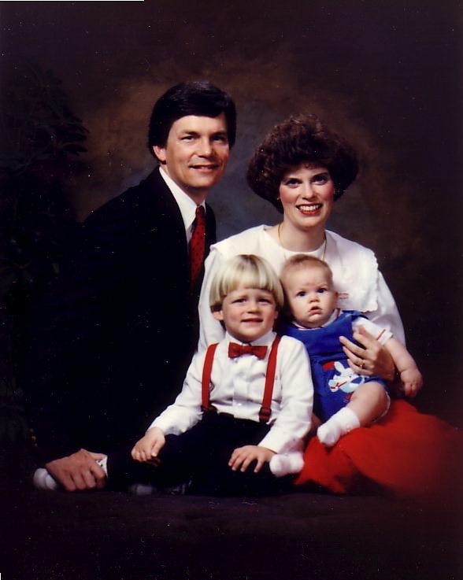
20 Feb 1991: Move to Singapore
Rick, 33
Susan, 30 something
Kurt, 4
Stephen, 1
Notes:
As of yesterday, I have been a professor at Singapore Bible for 30 years—yes, we arrived in Singapore 30 years ago yesterday on 20 Feb 1991.

Slide 47
We planned to stay until age 70 teaching Bible and theology…
Notes:
My goal has been to teach Bible and theology until age 70—which is 7 more years as I am now 63 years old.
But the College recently decided to shift me to teach only preaching rather than my master degree specialty of theology and my PhD area in Bible Exposition.
So we have been praying whether to try to stay 7 more years in Singapore without teaching Bible and theology.
Singapore law also seeks to retire expatriates in their 60s so more Singaporeans can take these positions.

Slide 48
Jordan Evangelical Theological Seminary (JETS)
Notes:
At the same time, Jordan Evangelical Theological Seminary (JETS) has invited us to move to Amman, Jordan

Slide 49
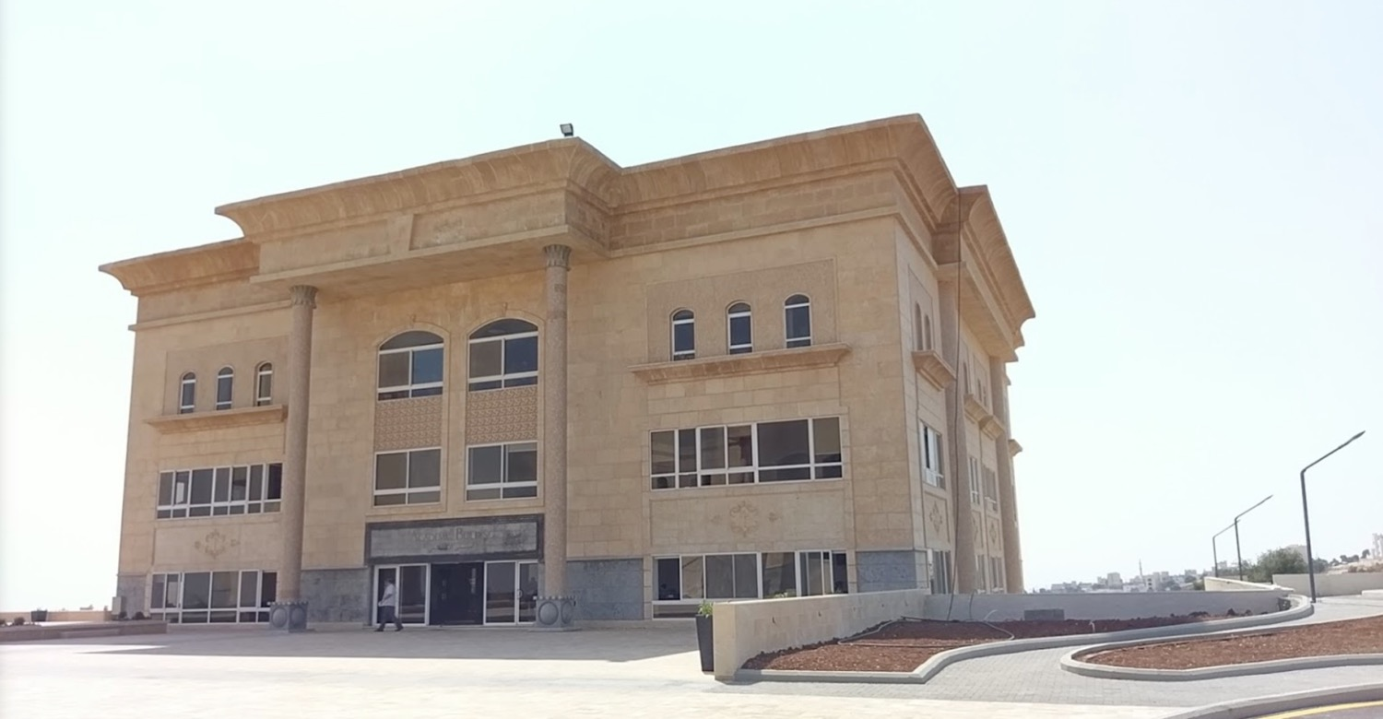
Jordan Evangelical Theological Seminary (JETS)
Notes:
to teach Bible and theology through translation into Arabic.

Slide 50
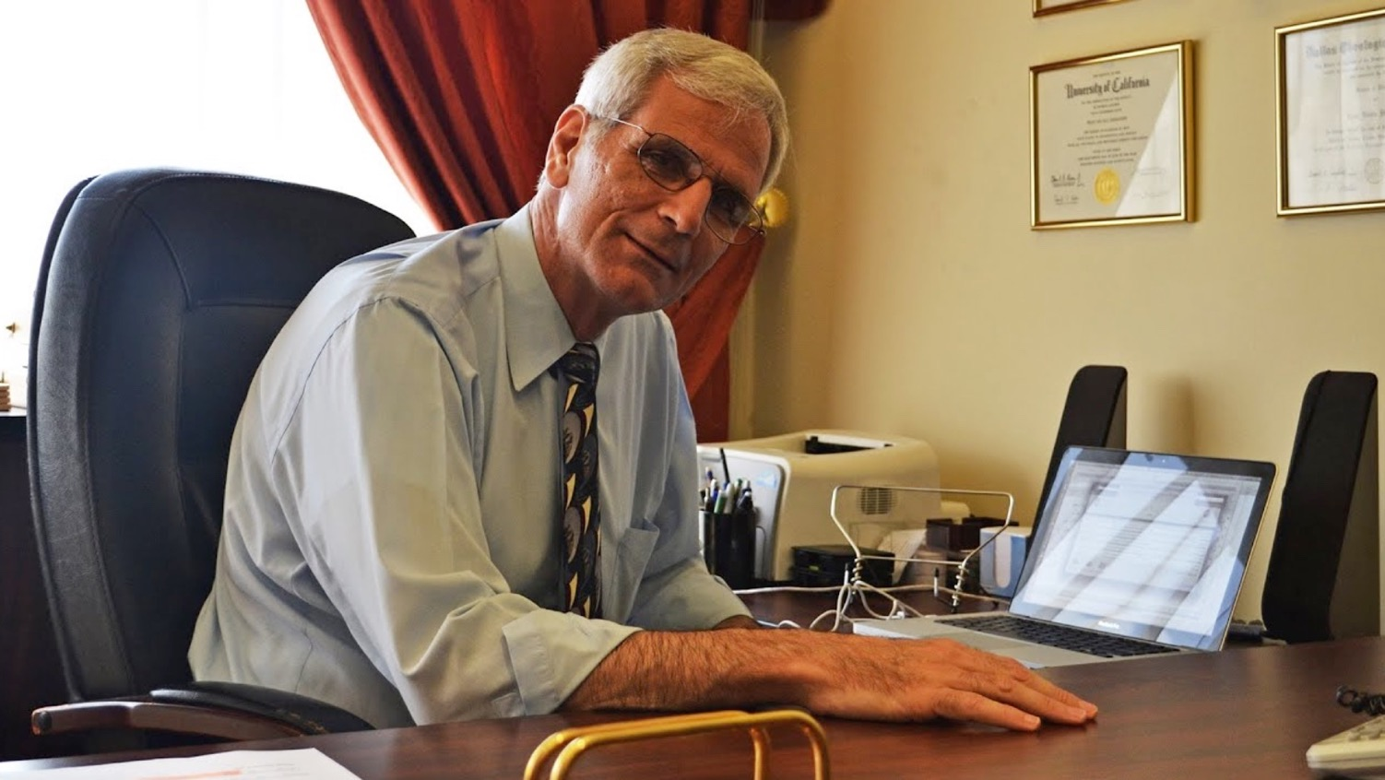
Dr. Imad Shehadeh Founder and President of JETS
Notes:
In 1990, I graduated with the president and founder, Dr Imad Shehadeh

Slide 51
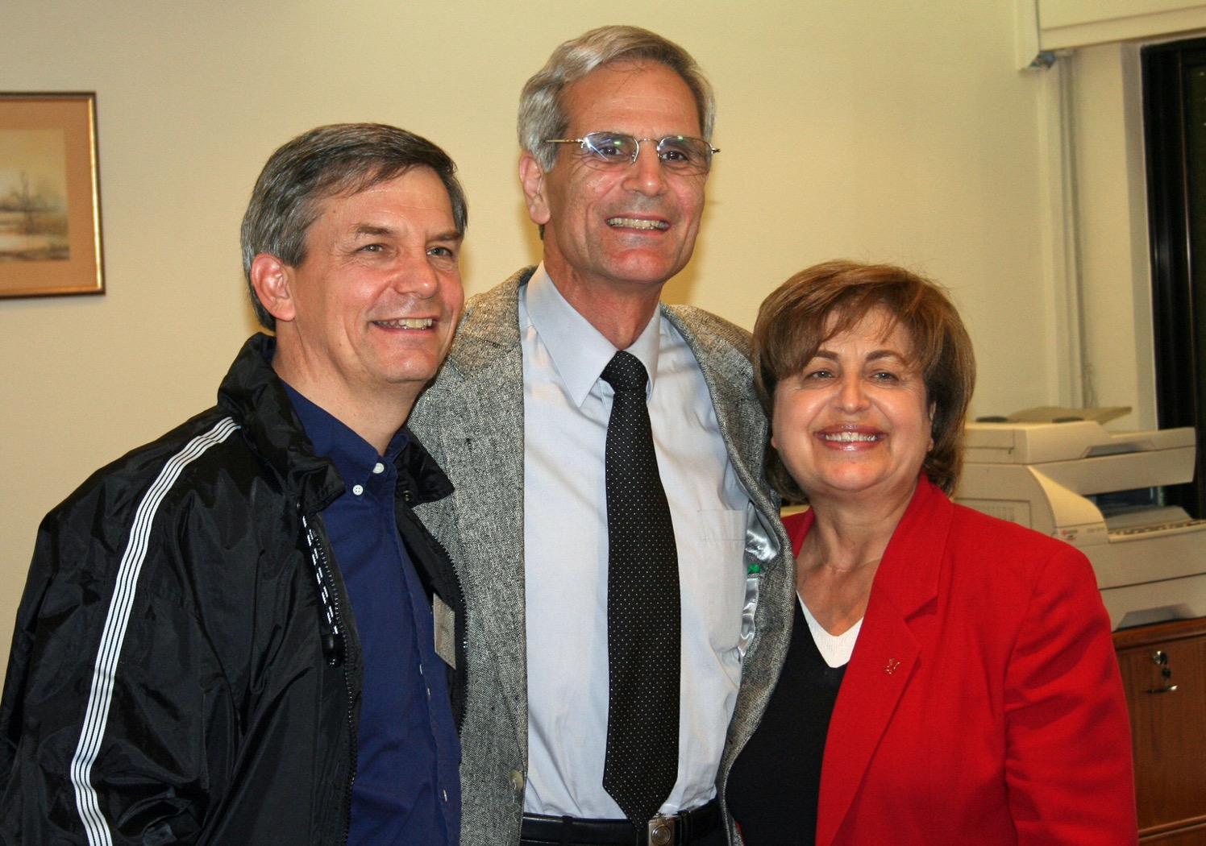
Dr. Imad Shehadeh, his wife Julia & Rick (2001)
Notes:
—and over the years he has asked four times if we would join with him there but the timing has never been right.

Slide 52
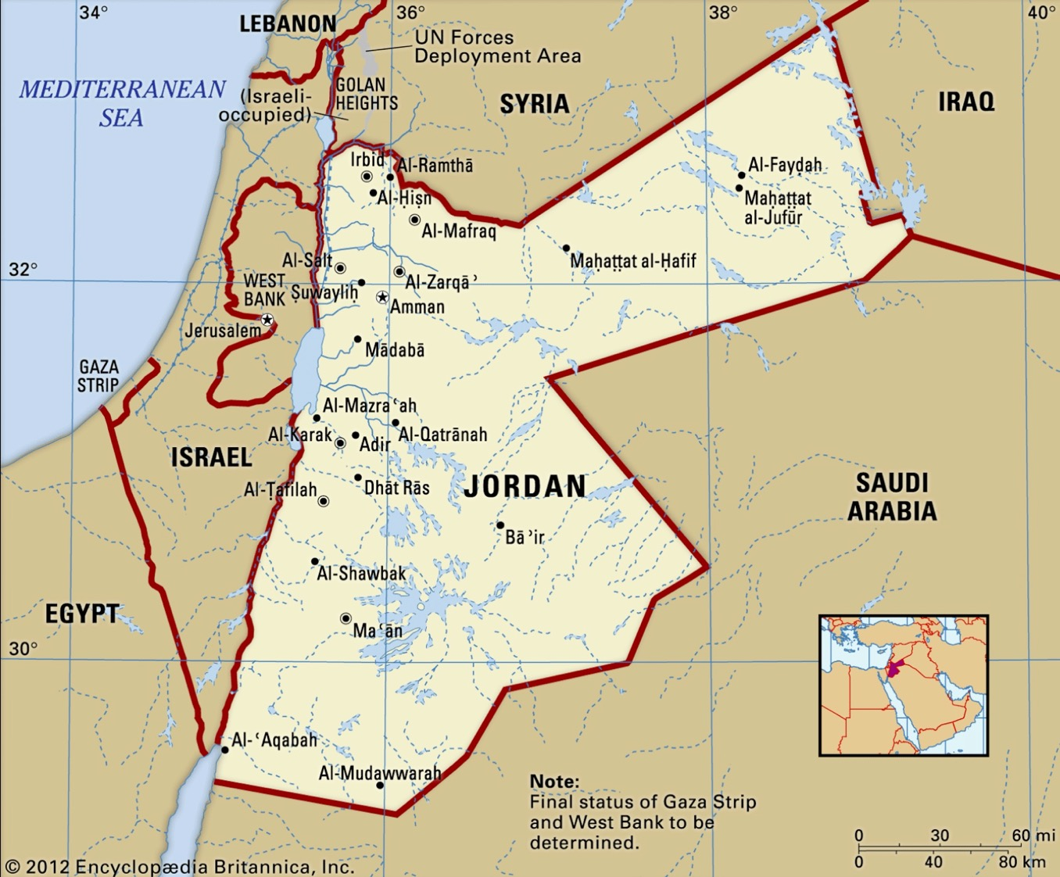
Jordan Evangelical Theological Seminary (JETS)
Notes:
But now we believe that is timing is right to make this shift before we get too old to shift to another culture. Jordan also gives us the potential to serve as long as we wish!

Slide 53
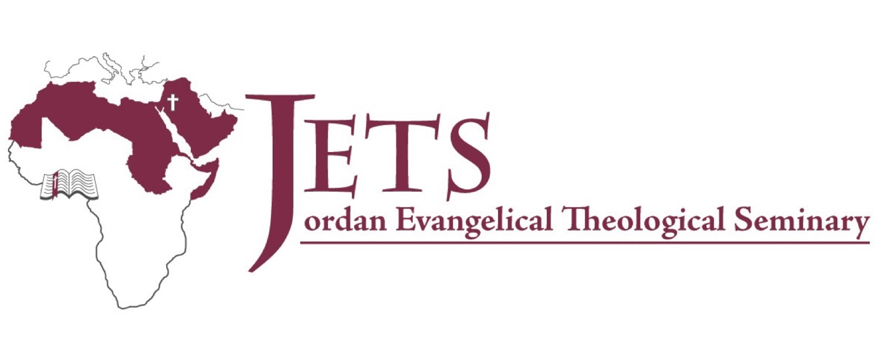
June 8 depart Singapore June 8-July USA family and church visits August begin at JETS
Notes:
So we will be leaving Singapore on June 8, have a few weeks in the USA with churches and family, and join JETS in August

Slide 54
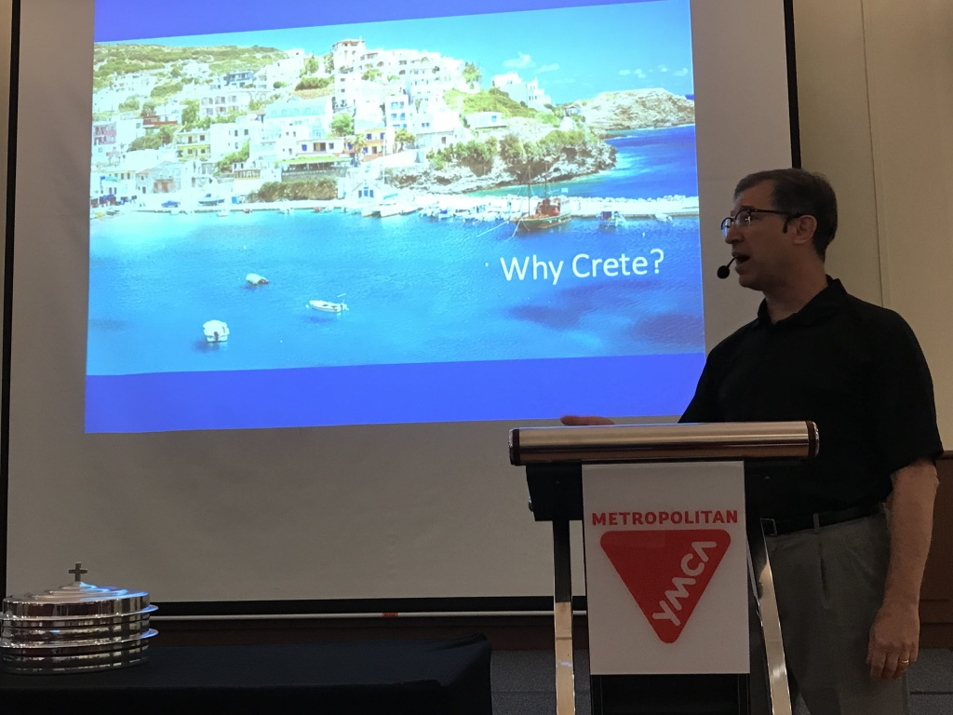
What about Crossroads?
Notes:
I have never been more confident in the future of Crossroads International Church! Most of the past year, CIC has been in the able hands of Pastor Jim and Jacqui, along with our other elder Matt and his wife Karla. The Lord is raising up others of you also so that the church has never been in a stronger position—nor has it ever had this many people in the past 15 years.

Slide 55
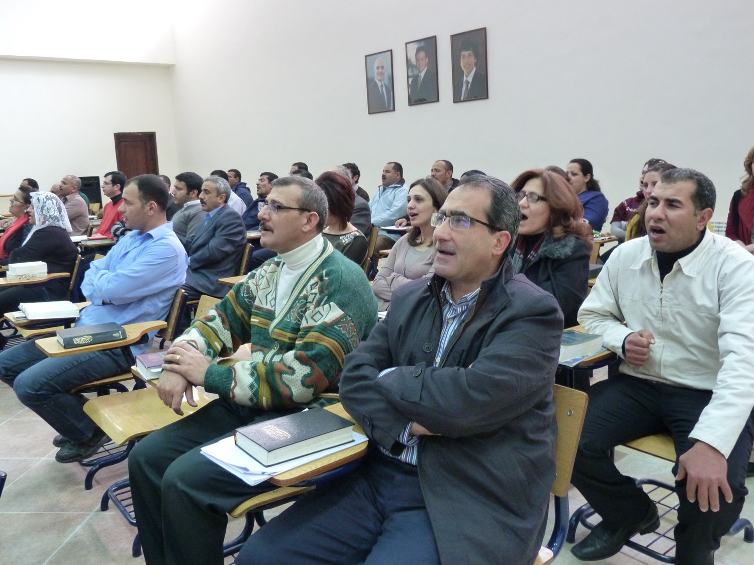
Jordan Evangelical Theological Seminary (JETS)
Notes:
The church leaders have known about our decision for 1-2 months and have given their blessing for us to be an extension of CIC into the Middle East. The past three decades I have been privileged to train students from 21 Asian nations

Slide 56
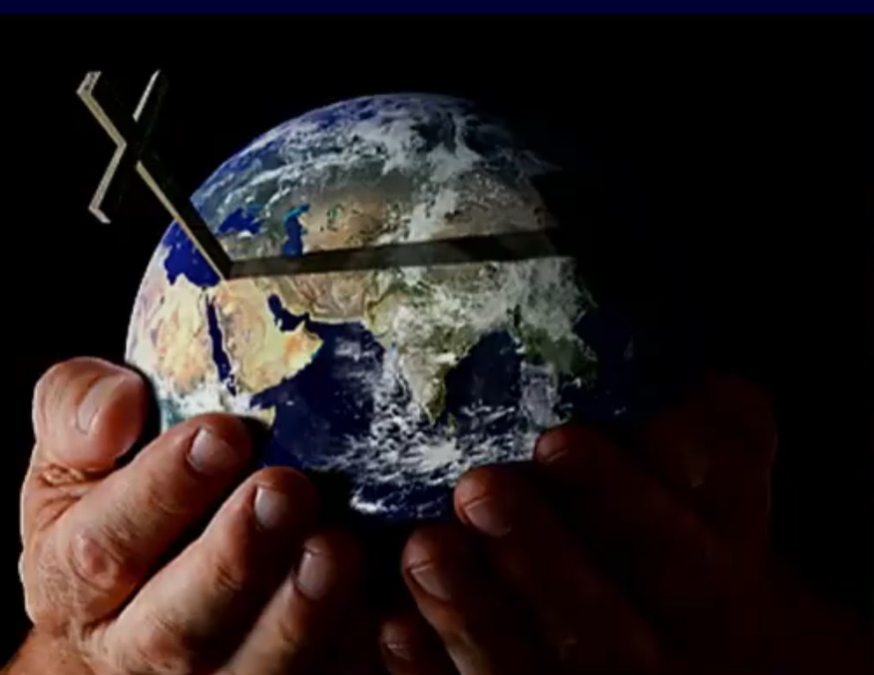
Jordan Evangelical Theological Seminary (JETS)
Notes:
—but now God has opened the door to serve at JETS that has students from 21 MENA nations (Middle East & North Africa). I am convinced that the best years for CIC are ahead!

Slide 57
Where do you need to do this?
Notes:
How is he challenging you also to make changes for his glory—even if this was not part of your original plan?
Are you ready to say, “Here I am, Lord”?

Slide 58
Black

Slide 59
NT Preaching link at BibleStudyDownloads.org
Get this presentation and script for free!

