Slide 1
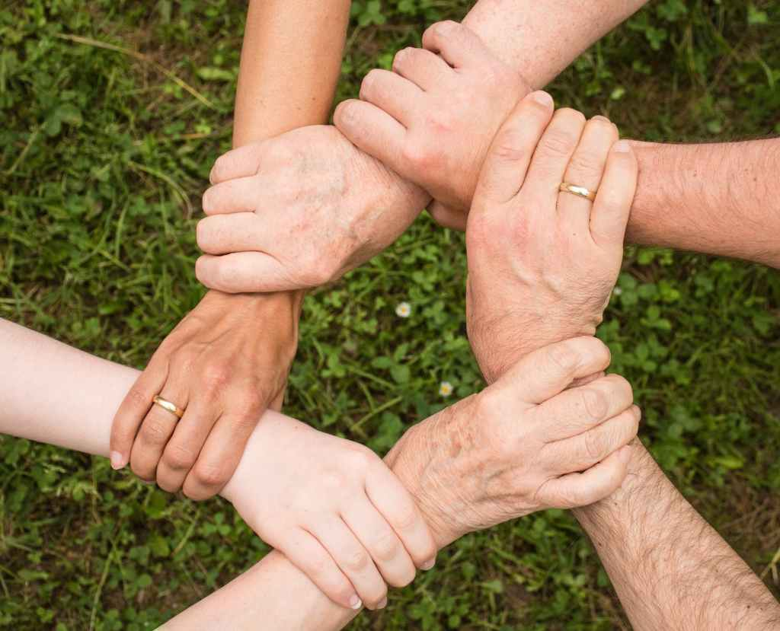
Acts 2:42
Devoted to the the Fellowship
Preached by Dan Bridges Amman International Church, Jordan (AmmanChurch.org) Uploaded by Dr. Rick Griffith • Jordan Evangelical Theological Seminary Files in many languages for free download at BibleStudyDownloads.org

Slide 2
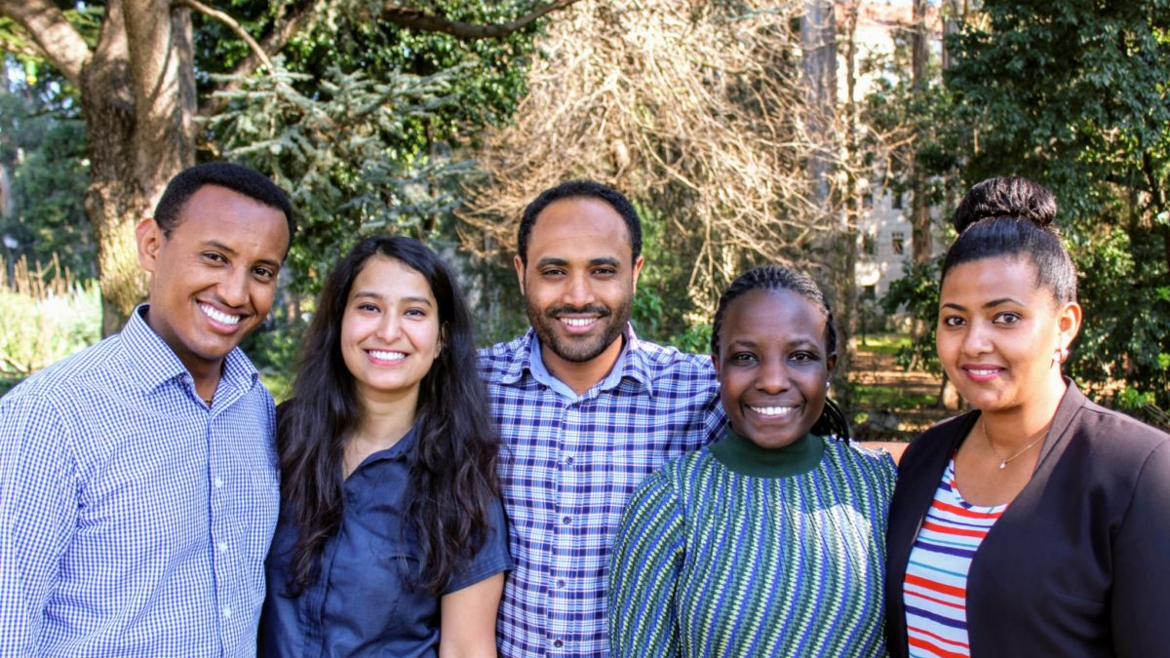
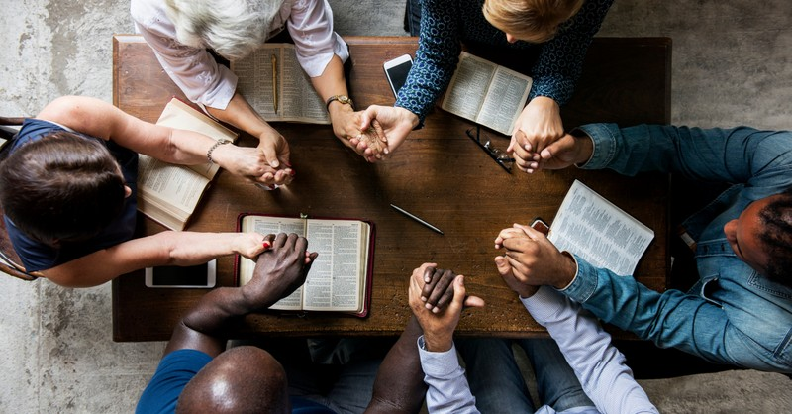
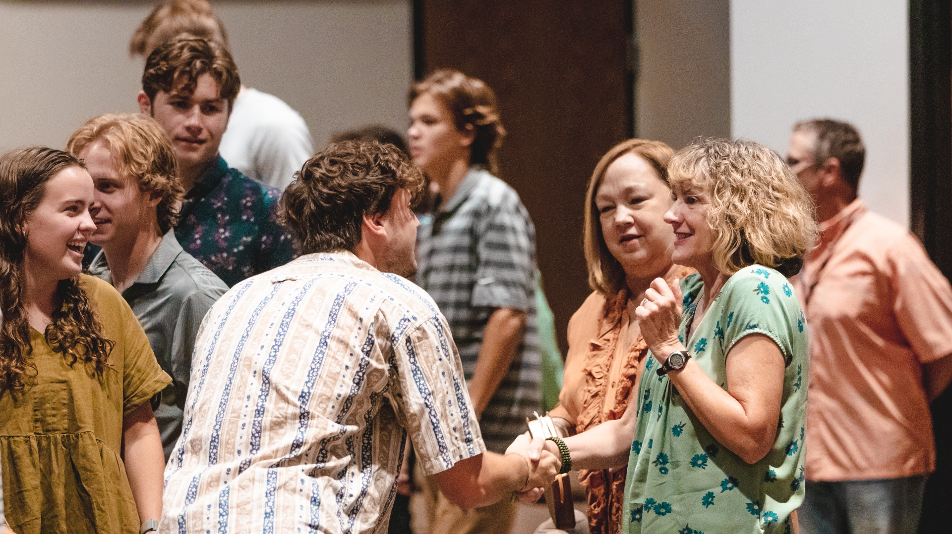
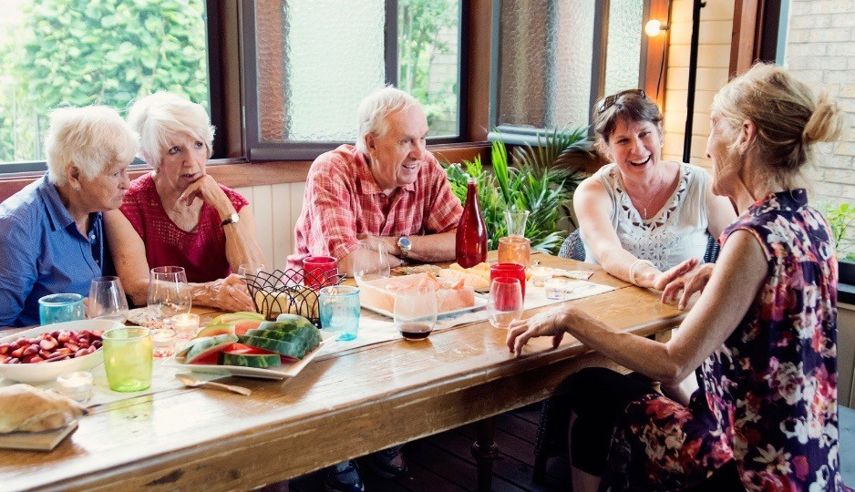
What do you picture when you think of Fellowship?

Slide 3
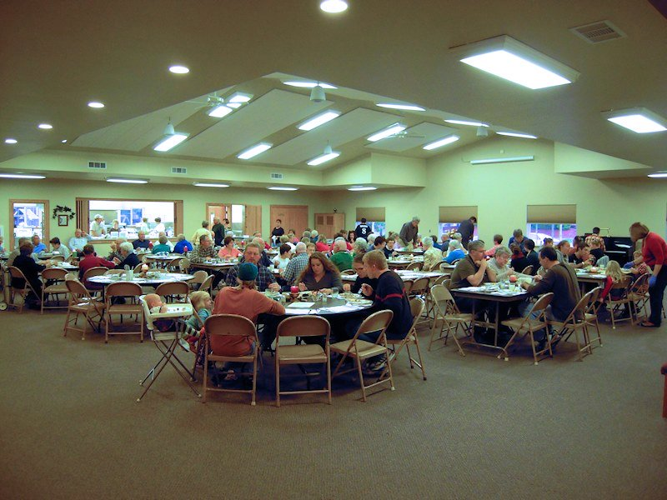
Fellowship Hall!

Slide 4
Used 80+ times in New Testament
Never used to refer to eating together! (except Lord’s supper – 1 Corinthians 10)

Slide 5
What Makes a Church Healthy?
“And they devoted themselves to the apostles' teaching and the fellowship, to the breaking of bread and the prayers.”
Acts 2:42

Slide 6
What Makes a Church Healthy?
A healthy church is a community of believers where the ordinary people are devoted in everyday life to Christ and his body.

Slide 7
And they devoted themselves to
the apostles' teaching
the breaking of bread
the fellowship
the prayers
Acts 2:42

Slide 8
And they devoted themselves to
the apostles' teaching
the breaking of bread
the fellowship
the prayers
Acts 2:42

Slide 9
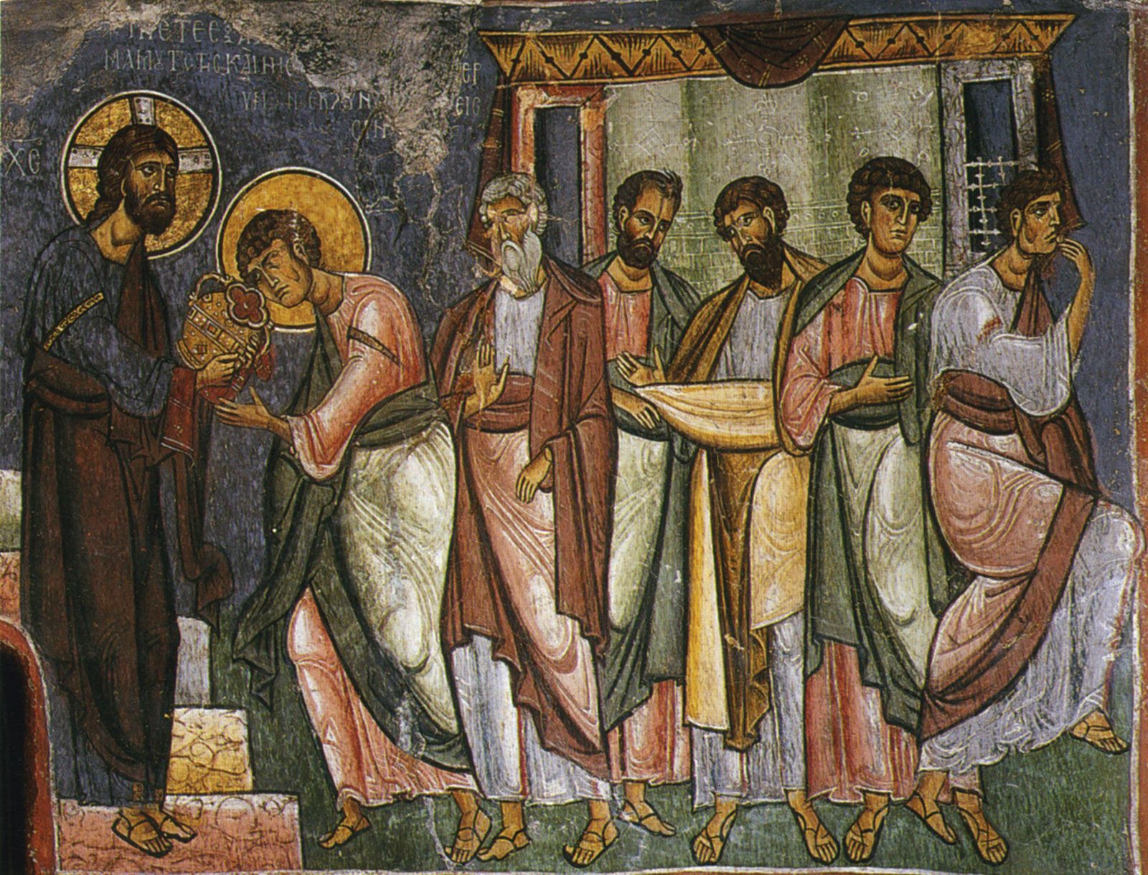
The Fellowship…
What Exactly Were They Devoted To?
Koinonia – From root “koinos”,
meaning “common, ordinary”
Primarily refers to having things in common; to sharing

Slide 10
The Fellowship…
What Exactly Were They Devoted To?
⁴⁴ And all who believed were together and had all things in common. ⁴⁵ And they were selling their possessions and belongings and distributing the proceeds to all, as any had need. ⁴⁶ And day by day, attending the temple together and breaking bread in their homes, they received their food with glad and generous hearts… Acts 2:44-46
They were devoted to living life together! Why?

Slide 11
The Fellowship…
What Exactly Were They Devoted To?
The early believers realized that salvation was not just an individual thing – it is an entrance into God’s family – becoming Christ’s body!

Slide 12
Three Questions
What is biblical fellowship?
What challenges biblical fellowship?
How can we experience it more?

Slide 13
What is Biblical Fellowship?
Fellowship is four types of sharing:
Our common life
Our spiritual truth / insights
Our possessions
Our ministry

Slide 14
Sharing Our Common Life
⁴ For as in one body we have many members, and the members do not all have the same function, ⁵ so we, though many, are one body in Christ, and individually members one of another.
Romans 12:4-5

Slide 15
Sharing Our Common Life
Fellowship with God →
Fellowship with one another
We are in fellowship with other believers whether or not we like it or even recognize the fact!

Slide 16
Sharing Our Common Life
[God is] making known to us the mystery of his will, according to his purpose, which he set forth in Christ as a plan for the fullness of time, to unite all things in him, things in heaven and things on earth.
Ephesians 1:9-10

Slide 17
Sharing Our Common Life
“We must grasp the idea that fellowship means belonging to one another in the body of Christ, along with all the privileges and responsibilities that such a relationship entails.” Jerry Bridges

Slide 18
Sharing Our Common Life
⁴ For as in one body we have many members, and the members do not all have the same function, ⁵ so we, though many, are one body in Christ, and individually members one of another.
Romans 12:4-5

Slide 19
Our Family Responsibilities!
¹⁰ Love one another with brotherly affection. Outdo one another in showing honor… ¹³ Contribute to the needs of the saints and seek to show hospitality. ¹⁵ Rejoice with those who rejoice, weep with those who weep.”
Romans 12:10,13,15

Slide 20
Sharing Our Common Life
Western Idea: Individual salvation
Biblical Truth: We are saved in order to be brought into a family!
Devotion to the fellowship is the natural devotion to the family we are a part of!

Slide 21
Sharing Our Common Life
“Those who share in God inevitably share in God’s nature, which includes loving as God loves, sharing as God shares, pursuing one another and the lost as God pursues.”
Barry Kercheville

Slide 22
What is Biblical Fellowship?
Fellowship is four types of sharing:
Our common life
Our spiritual truth / insights
Our possessions
Our ministry

Slide 23
Sharing Spiritual Truth
Let the word of Christ dwell in you richly, teaching and admonishing one another in all wisdom, singing psalms and hymns and spiritual songs, with thankfulness in your hearts to God.
Colossians 3:16

Slide 24
Sharing Spiritual Truth
But exhort one another every day, as long as it is called “today,” that none of you may be hardened by the deceitfulness of sin. Hebrews 3:13

Slide 25
Sharing Spiritual Truth
And let us consider how to stir up one another to love and good works, not neglecting to meet together, as is the habit of some, but encouraging one another, and all the more as you see the Day drawing near.
Hebrews 10:24-25

Slide 26
Sharing Spiritual Truth
Are you someone who “doesn’t really need people”?
Have you considered that people need you!
We may need to attend activities not for what we get out of them, but for what we give to them!

Slide 27
What is Biblical Fellowship?
Fellowship is four types of sharing:
Our common life
Our spiritual truth / insights
Our possessions
Our ministry

Slide 28
Sharing Our Possessions
Sharing possessions is the #1 usage of “Koinonia” in the New Testament!

Slide 29
Sharing Our Possessions
⁴⁴ And all who believed were together and had all things in common. ⁴⁵ And they were selling their possessions and belongings and distributing the proceeds to all, as any had need. ⁴⁶ And day by day, attending the temple together and breaking bread in their homes, they received their food with glad and generous hearts… Acts 2:44-46

Slide 30
Sharing Our Possessions
Contribute to the needs of the saints and seek to show hospitality. Romans 12:13
By their approval of this service, the saints will glorify God because of … the generosity of your contribution for them… 2 Corinthians 9:13
Do not neglect to do good and to share what you have, for such sacrifices are pleasing to God.
Hebrews 13:16

Slide 31
Sharing Our Possessions
Why do we share in this way?
Because we are family!
Family members meeting needs is not benevolence – it is their privilege and their duty!

Slide 32
Sharing Our Possessions
¹ We want you to know, brothers, about the grace of God that has been given among the churches of Macedonia, ² for in a severe test of affliction, their abundance of joy and their extreme poverty have overflowed in a wealth of generosity on their part. ³ For they gave according to their means, as I can testify, and beyond their means, of their own accord, ⁴ begging us earnestly for the favor of taking part in the relief of the saints. 2 Corinthians 8:1-4

Slide 33
Sharing Our Possessions
Do you have needs? Let us know!
Ask God to show you opportunities to share and be generous!

Slide 34
What is Biblical Fellowship?
Fellowship is four types of sharing:
Our common life
Our spiritual truth / insights
Our possessions
Our ministry

Slide 35
Sharing in Ministry
³ I thank my God in all my remembrance of you, ⁴ always in every prayer of mine for you all making my prayer with joy, ⁵ because of your partnership in the gospel from the first day until now.
Philippians 1:3-4

Slide 36
Sharing in Ministry
How did the Philippians partner with Paul?
They ministered with him in Philippi (Lydia)
They supported him financially
They prayed for him
They sent people to help him

Slide 37
Sharing in Ministry
How are we doing in supporting each other in ministry?

Slide 38
What is Biblical Fellowship?
Fellowship is four types of sharing:
Our common life
Our spiritual truth / insights
Our possessions
Our ministry

Slide 39
Three Questions
What is biblical fellowship?
What challenges biblical fellowship?
How can we experience it more?

Slide 40
The Big Challenges
Inadequate definition of fellowship!
Being together is the means to fellowship – not the end in itself!

Slide 41
The Big Challenges
Modern Lifestyles…
New/Short-term in this location
Our busy schedules
Our geographical distance
Our technology
Our desire to be “private”

Slide 42
The Big Challenges
Sin!
Sin in our lives that separates us from God and therefore from each other
Sin in our relationships

Slide 43
The Big Challenges
Individualism and Independence
Success/failure are individual things
Taught not to “need” people

Slide 44
What does it mean to be “devoted” to something?
Devotion implies priorities!!!
To be devoted to something means it holds the primary purpose in your life!

Slide 45
What does it mean to be “devoted” to something?
Devotion implies priorities!!!
Do things need to change in our lives to make biblical fellowship happen?

Slide 46
Three Questions
What is biblical fellowship?
What challenges biblical fellowship?
How can we experience it more?

Slide 47
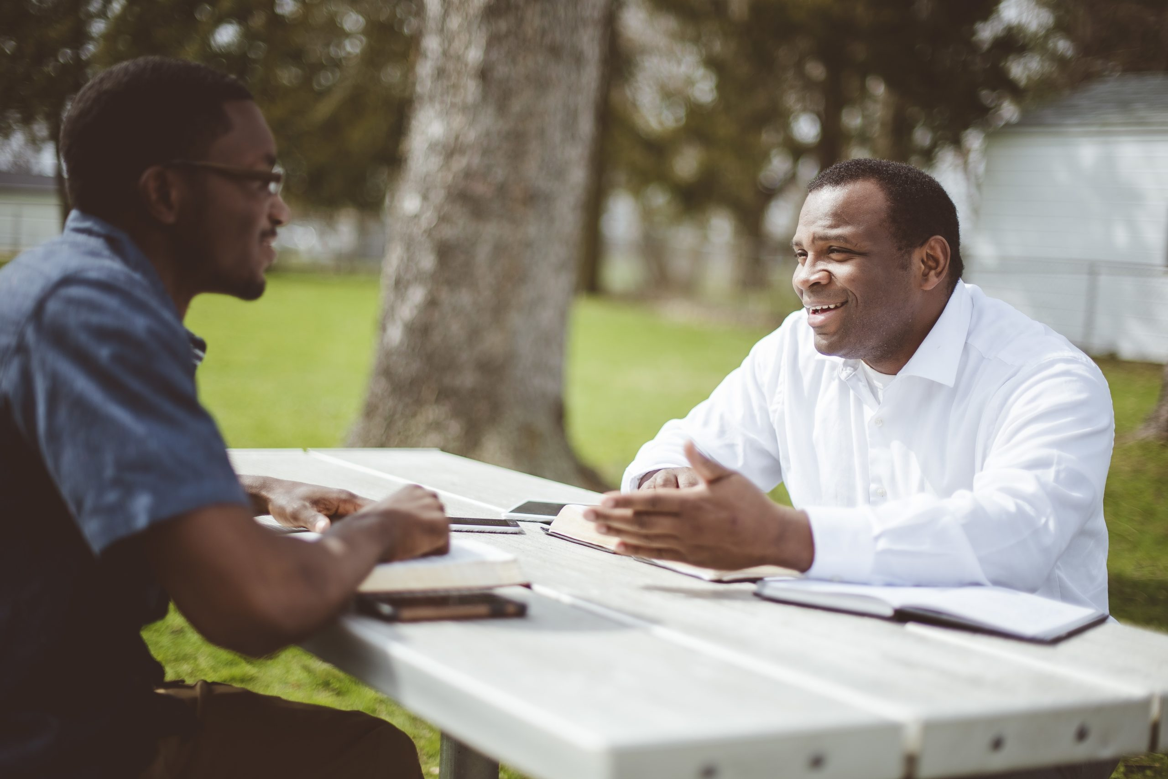
Sharing Our Common Life
Would you describe your relationships with other believers as “family-like”?
If not, how can this change?

Slide 48
Sharing Spiritual Truth
Do you have someone outside of your immediate family with whom you share deeply?

Slide 49
Sharing Our Possessions
With what believers are you sharing your possessions? Are you willing to ask God for opportunities to do this?

Slide 50
Sharing in Ministry
With whom do you partner in ministry – through activities, finances, prayer or other ways?

Slide 51
The Fellowship…
What Exactly Were They Devoted To?
The early believers realized that salvation was not just an individual thing – it is an entrance into God’s family – becoming Christ’s body!

Slide 53
NT Preaching link at BibleStudyDownloads.org
Get this presentation for free!
Notes:
NT Preaching (np)

