Slide 1
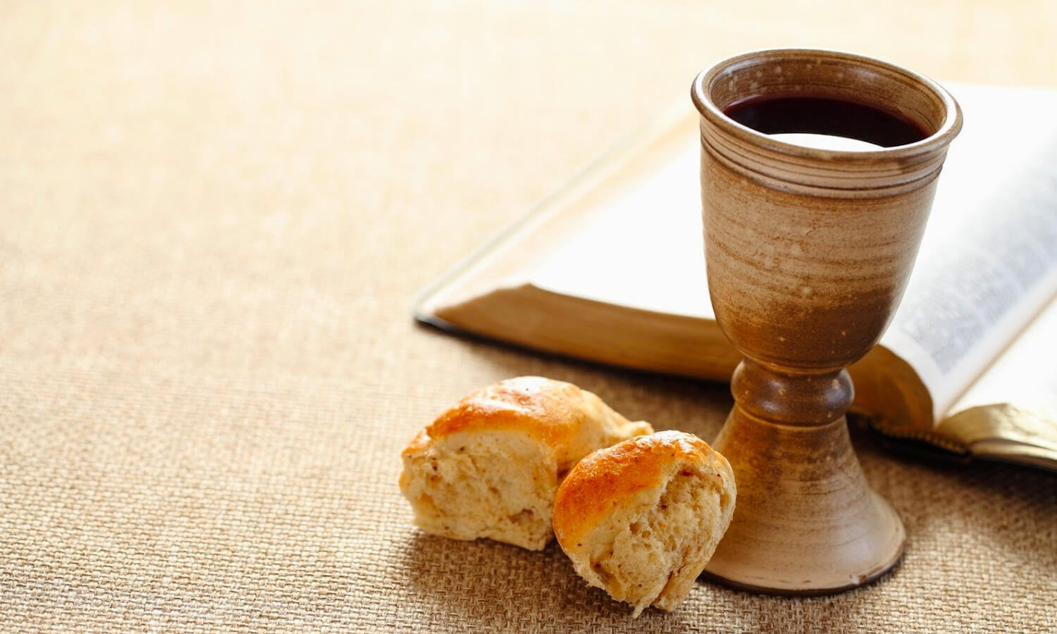
Acts 2:42
Devoted to the Breaking of Bread
Preached by Dan Bridges Amman International Church, Jordan (AmmanChurch.org) Uploaded by Dr. Rick Griffith • Jordan Evangelical Theological Seminary Files in many languages for free download at BibleStudyDownloads.org

Slide 2
What do you think?
Why do you celebrate the Lord’s Supper?

Slide 3
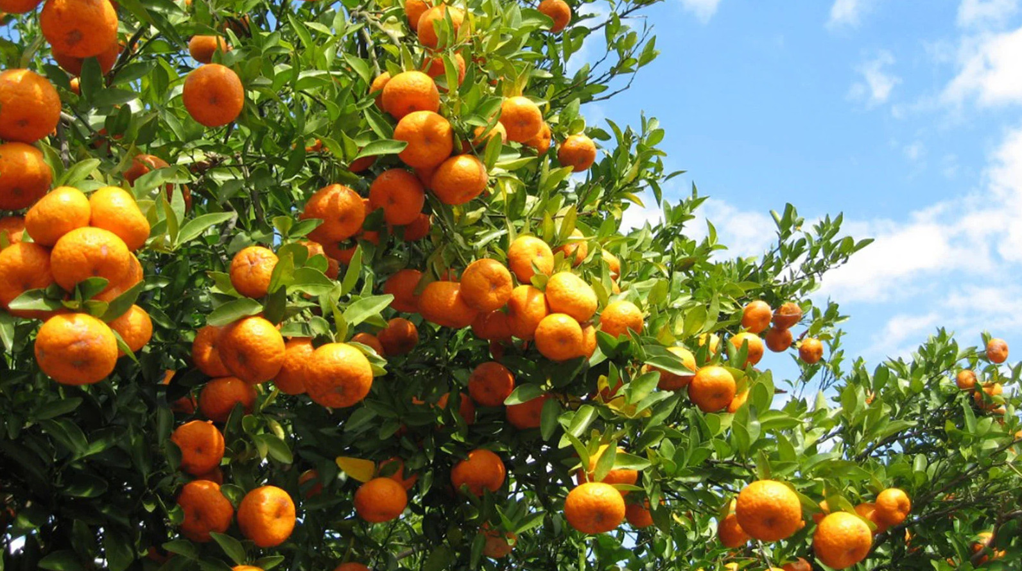
What Makes a Church Healthy?
“And they devoted themselves to the apostles' teaching and the fellowship, to the breaking of bread and the prayers.”
Acts 2:42

Slide 4
What Makes a Church Healthy?
A healthy church is a community of believers where the ordinary people are devoted in everyday life to Christ and his body.

Slide 5
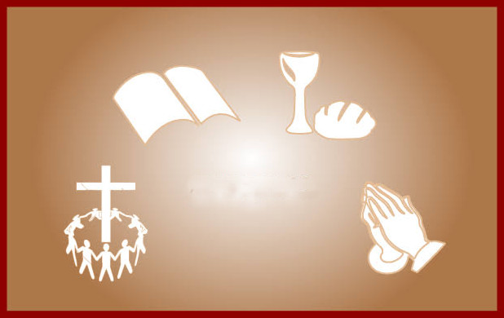
And they devoted themselves to
the apostles' teaching
the breaking of bread
the fellowship
the prayers
Acts 2:42

Slide 6
And they devoted themselves to
the apostles' teaching
the breaking of bread
the fellowship
the prayers
Acts 2:42

Slide 7
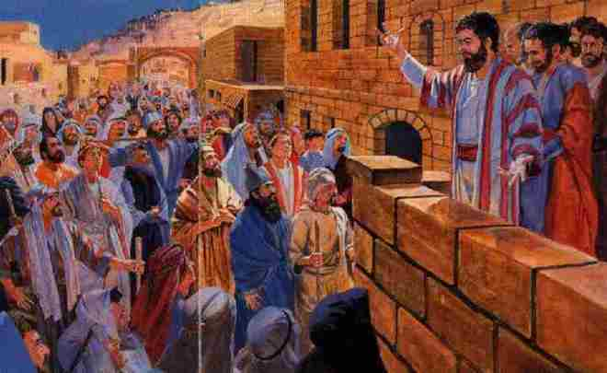
What is meant by “the breaking of bread”?
“⁴² And they devoted themselves to the apostles' teaching and the fellowship, to the breaking of bread and the prayers… ⁴⁶ And day by day, attending the temple together and breaking bread in their homes, they received their food with glad and generous hearts, ⁴⁷ praising God and having favor with all the people. ” Acts 2:42-47
The Lord’s Supper?
A regular meal?

Slide 8
What is meant by “the breaking of bread”?
“⁷ On the first day of the week, when we were gathered together to break bread, Paul talked with them, intending to depart on the next day, and he prolonged his speech until midnight. ” Acts 20:7

Slide 9
What is meant by “the breaking of bread”?
“⁴² And they devoted themselves to the apostles' teaching and the fellowship, to the breaking of bread and the prayers… ⁴⁶ And day by day, attending the temple together and breaking bread in their homes, they received their food with glad and generous hearts, ⁴⁷ praising God and having favor with all the people. ” Acts 2:42-47
The Lord’s Supper
A regular meal

Slide 10
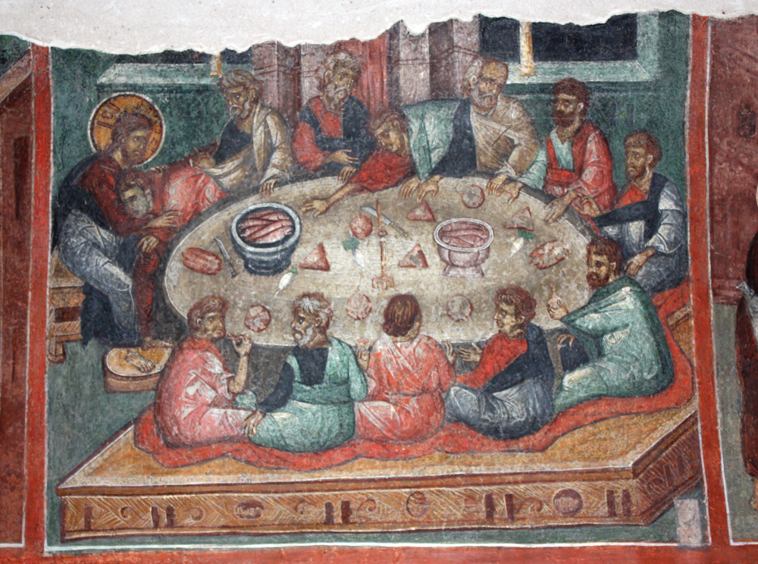
Why was the Lord’s Supper so important to them?
These were religious people…
What One Thing had changed about their worship?
JESUS!

Slide 11
Three Ways to Worship Jesus in Communion…
Passover Lamb
Manna and Water from the Rock
Blood of the Covenant

Slide 12
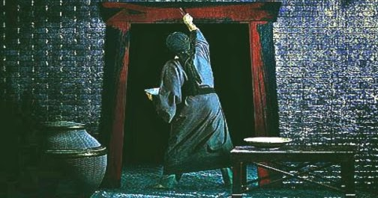
1. Passover
What did the Passover represent?
Salvation from death (blood of the lamb around the doorway)
Deliverance from slavery

Slide 13
1. Passover
Salvation from Death:
²⁶ And when your children say to you, “What do you mean by this service?” ²⁷ you shall say, “It is the sacrifice of the Lord's Passover, for he passed over the houses of the people of Israel in Egypt, when he struck the Egyptians but spared our houses.”
Exodus 12:26-27

Slide 14
1. Passover
Deliverance from slavery:
⁸ You shall tell your son on that day, ‘It is because of what the Lord did for me when I came out of Egypt.’ ⁹ And it shall be to you as a sign on your hand and as a memorial between your eyes, that the law of the Lord may be in your mouth. For with a strong hand the Lord has brought you out of Egypt. ¹⁰ You shall therefore keep this statute at its appointed time from year to year. Exodus 13:8-10

Slide 15
1. Passover
Jesus introduced the Lord’s supper by re-interpreting the Passover

Slide 16
1. Passover
²⁶ Now as they were eating, Jesus took bread, and after blessing it broke it and gave it to the disciples, and said, “Take, eat; this is my body.” ²⁷ And he took a cup, and when he had given thanks he gave it to them, saying, “Drink of it, all of you, ²⁸ for this is my blood of the covenant, which is poured out for many for the forgiveness of sins.
Matthew 26:26-28
Forgiveness - Salvation from Death

Slide 17
1. Passover
⁷ Cleanse out the old leaven that you may be a new lump, as you really are unleavened. For Christ, our Passover lamb, has been sacrificed. ⁸ Let us therefore celebrate the festival, not with the old leaven, the leaven of malice and evil, but with the unleavened bread of sincerity and truth. 1 Corinthians 5:7-8
Deliverance from slavery to sin

Slide 18
1. Passover
This Picture of Jesus reminds us of
Salvation from spiritual death
Deliverance from slavery to sin

Slide 19
1. Passover
Communion Prayer – Passover / Salvation:
“Jesus, thank you that you are my Passover lamb. Thank you that your blood has saved me from spiritual death and that you have delivered me from the power of sin and enabled me to live a new life in your power!”

Slide 20
Three Ways to Worship Jesus in Communion…
Passover Lamb
Manna and Water from the Rock
Blood of the Covenant

Slide 21
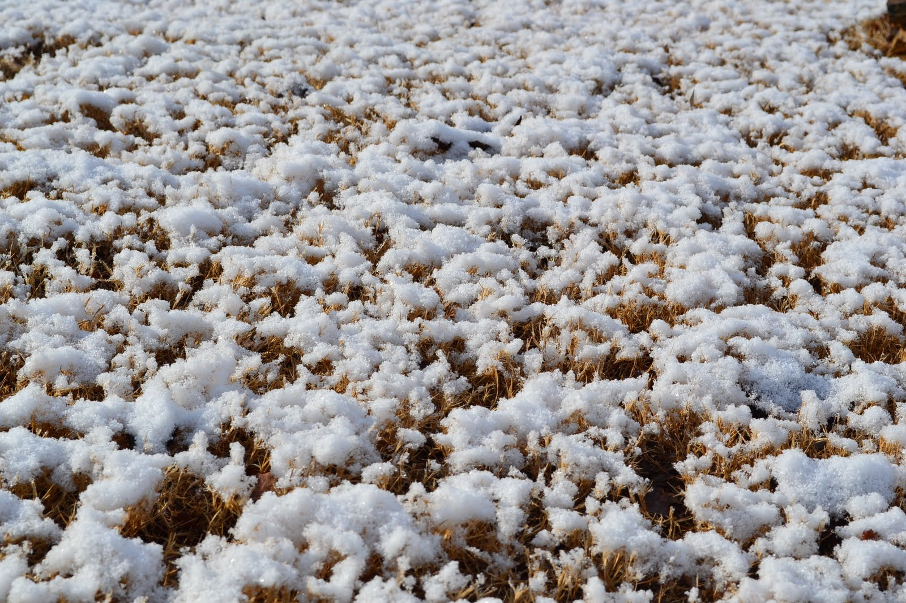
2. Manna and Water from the Rock
Premier OT Example of Provision:
Manna/Water in the Wilderness

Slide 22
2. Manna and Water from the Rock
NT Reinterpretation of manna / water:
¹ For I do not want you to be unaware, brothers, that our fathers were all under the cloud, and all passed through the sea, ² and all were baptized into Moses in the cloud and in the sea, ³ and all ate the same spiritual food, ⁴ and all drank the same spiritual drink. For they drank from the spiritual Rock that followed them, and the Rock was Christ. 1 Corinthians 10:1-4

Slide 23
2. Manna and Water from the Rock
⁴⁸ I am the bread of life. ⁴⁹ Your fathers ate the manna in the wilderness, and they died… ⁵¹ I am the living bread that came down from heaven. If anyone eats of this bread, he will live forever. And the bread that I will give for the life of the world is my flesh.
John 6:48-51

Slide 24
2. Manna and Water from the Rock
⁵³ So Jesus said to them, “Truly, truly, I say to you, unless you eat the flesh of the Son of Man and drink his blood, you have no life in you. ⁵⁴ Whoever feeds on my flesh and drinks my blood has eternal life, and I will raise him up on the last day. John 6:53-54
Figuratively eating of Jesus’ flesh and drinking his blood gives us eternal life!

Slide 25
2. Manna and Water from the Rock
⁵⁶ Whoever feeds on my flesh and drinks my blood abides in me, and I in him. ⁵⁷ As the living Father sent me, and I live because of the Father, so whoever feeds on me, he also will live because of me.
John 6:56-57
Figuratively eating of Jesus’ flesh and drinking his blood gives us an ongoing relationship with him!

Slide 26
2. Manna and Water from the Rock
The Picture of Manna and Water from the Rock
Jesus is our source of eternal life
Jesus enables an ongoing relationship with God

Slide 27
2. Manna and Water from the Rock
Communion Prayer - Provision:
“Jesus, thank you that you are my spiritual manna and water from the rock. In eating and drinking of you I have eternal life and an ongoing relationship with you that deeply satisfies!”

Slide 28
Three Ways to Worship Jesus in Communion…
Passover Lamb
Manna and Water from the Rock
Blood of the Covenant

Slide 29
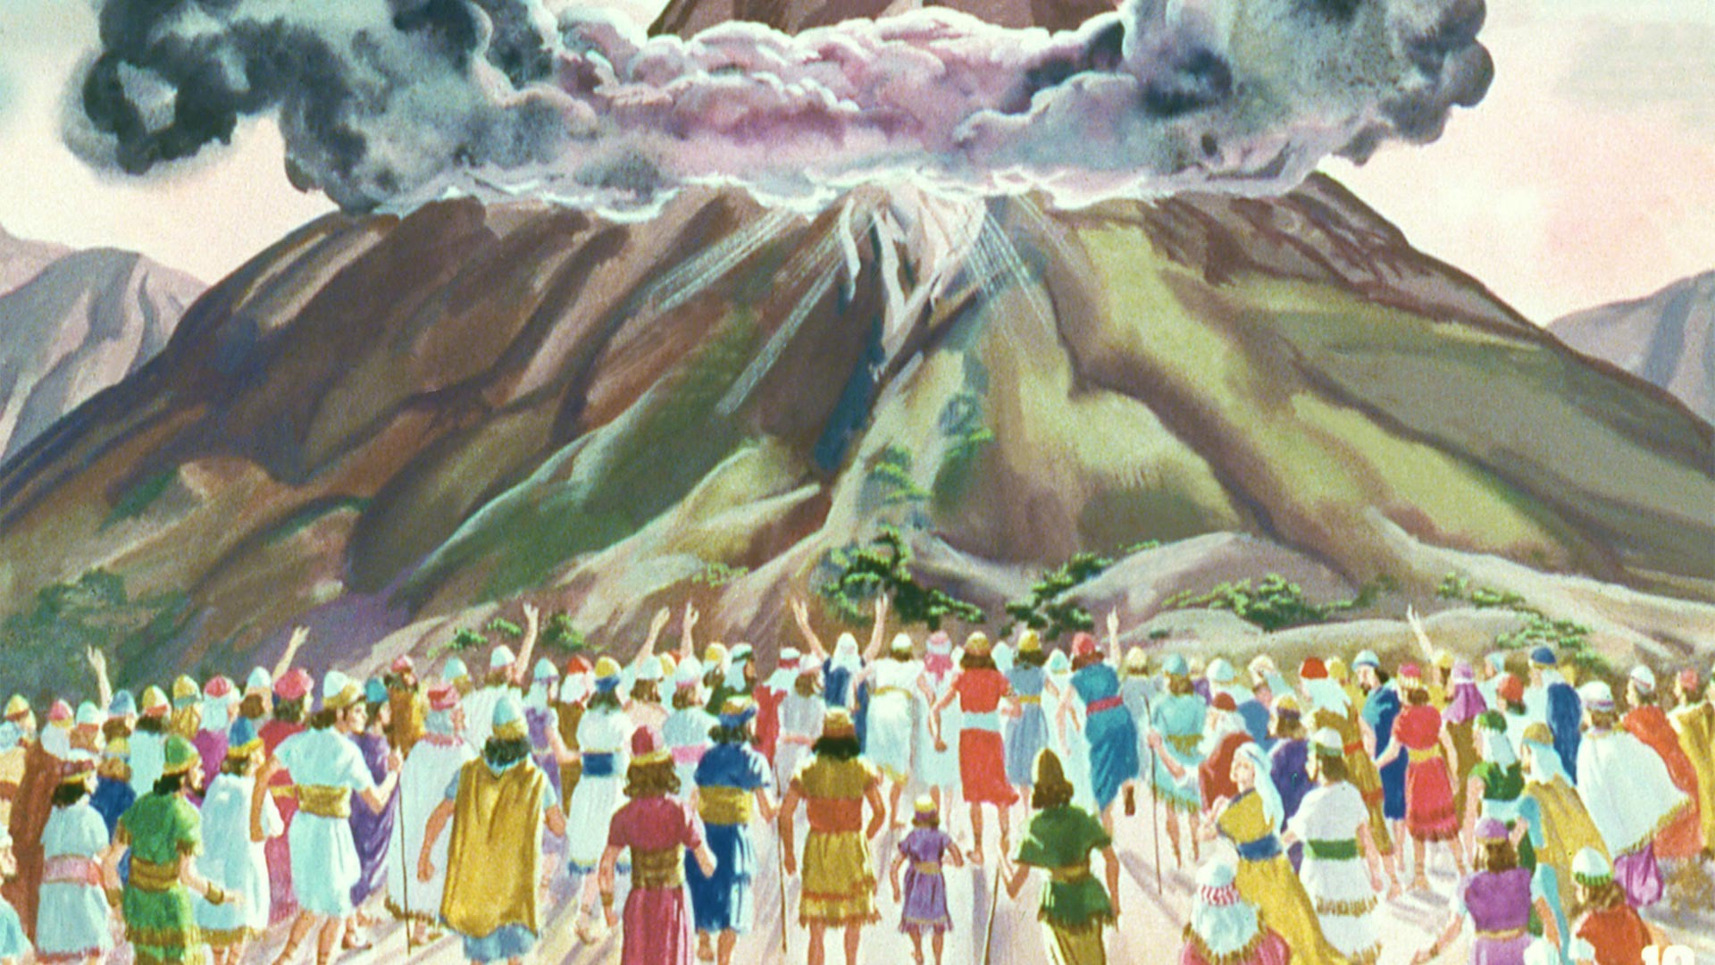
3. Blood of the Covenant
Exodus 19-24 – The Old (Mosaic) Covenant
Exodus 19 – God’s Chosen People
Exodus 20 – 10 Commandments
Exodus 24 – The Confirmation of the Covenant

Slide 30
The People of the Covenant
⁴ You yourselves have seen what I did to the Egyptians, and how I bore you on eagles' wings and brought you to myself. ⁵ Now therefore, if you will indeed obey my voice and keep my covenant, you shall be my treasured possession among all peoples, for all the earth is mine; ⁶ and you shall be to me a kingdom of priests and a holy nation.’ These are the words that you shall speak to the people of Israel.
Exodus 19:4-6

Slide 31
Confirmation of the Covenant – Blood
⁷ Then he took the Book of the Covenant and read it in the hearing of the people. And they said, “All that the Lord has spoken we will do, and we will be obedient.” ⁸ And Moses took the blood and threw it on the people and said, “Behold the blood of the covenant that the Lord has made with you in accordance with all these words.”
Exodus 24:7-8

Slide 32
Confirmation of the Covenant – The Meal
⁹ Then Moses and Aaron, Nadab, and Abihu, and seventy of the elders of Israel went up, ¹⁰ and they saw the God of Israel. There was under his feet as it were a pavement of sapphire stone, like the very heaven for clearness. ¹¹ And he did not lay his hand on the chief men of the people of Israel; they beheld God, and ate and drank.
Exodus 24:9-11

Slide 33
The New Covenant
³¹ “Behold, the days are coming, declares the Lord, when I will make a new covenant with the house of Israel and the house of Judah, ³² not like the covenant that I made with their fathers on the day when I took them by the hand to bring them out of the land of Egypt, my covenant that they broke, though I was their husband, declares the Lord.
Jeremiah 31:31-32

Slide 34
The New Covenant
³³ For this is the covenant that I will make with the house of Israel after those days, declares the Lord: I will put my law within them, and I will write it on their hearts. And I will be their God, and they shall be my people.
Jeremiah 31:33

Slide 35
3. Blood of the Covenant
¹⁹ And he took bread, and when he had given thanks, he broke it and gave it to them, saying, “This is my body, which is given for you. Do this in remembrance of me.” ²⁰ And likewise the cup after they had eaten, saying, “This cup that is poured out for you is the new covenant in my blood.” Luke 22:19-20

Slide 36
In taking the Lord’s Supper together, we are participating in a “Covenant Meal”

Slide 37
Participating in this “Covenant Meal”
¹⁶ The cup of blessing that we bless, is it not a participation in the blood of Christ? The bread that we break, is it not a participation in the body of Christ? ¹⁷ Because there is one bread, we who are many are one body, for we all partake of the one bread.
1 Corinthians 10:16-17
How do we participate?

Slide 38
Participating in this “Covenant Meal”
We participate by:
Blood of Christ: Holiness
Reaffirming our loyalty to God –
reconsecrating ourselves to him
Body of Christ: Fellowship
Reaffirming our commitment to
each other as the body of Christ

Slide 39
3. The Blood of the Covenant
Communion Prayer - Covenant:
“Jesus, thank you for making a new covenant based on your death on the cross. I choose to participate in this by reconsecrating myself to you – giving myself to you for holiness and your purposes. And I recommit myself to relationships with these other people as members of your body.”

Slide 40
Three Ways to Worship Jesus in Communion…
Passover Lamb
Manna and Water from the Rock
Blood of the Covenant

Slide 41
What does it look like to be devoted to this?
It is a priority for us!
Taking ownership in your participation
Done as a body – not individually
What happens when you miss it?

Slide 42
Taking the Lord’s Supper Together…

Slide 43
Before We Start…
Communion Prayer - Covenant:
“Jesus, thank you for making a new covenant based on your death on the cross. I choose to participate in this by reconsecrating myself to you – giving myself to you for holiness and your purposes. And I recommit myself to relationships with these other people as members of your body.”

Slide 44
Sharing the Bread
Communion Prayer - Provision:
“Jesus, thank you that you are my spiritual manna and water from the rock. In eating and drinking of you I have eternal life and an ongoing relationship with you that deeply satisfies!”

Slide 45
Drinking the Cup
Communion Prayer - Salvation:
“Jesus, thank you that you are my Passover lamb. Thank you that your blood has saved me from spiritual death and that you have delivered me from the power of sin and enabled me to live a new life in your power!”

Slide 47
NT Preaching link at BibleStudyDownloads.org
Get this presentation for free!
Notes:
NT Preaching (np)

