Slide 1
Acts 2:42
Devoted to the Apostles’ Teaching
Preached by Dan Bridges Amman International Church, Jordan (AmmanChurch.org) Uploaded by Dr. Rick Griffith • Jordan Evangelical Theological Seminary Files in many languages for free download at BibleStudyDownloads.org

Slide 2
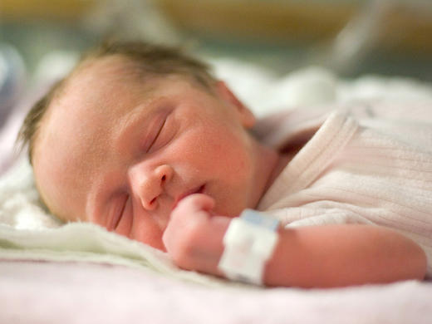
How does a baby become an adult?

Slide 3
Physical Growth
What makes physical growth happen?
Do we have to do anything?
Who is responsible to make it happen?
Primary Factor: Nutrition!

Slide 4
Physical Growth
What basic instincts has God given to us to ensure that we grow?
Hunger and Thirst!

Slide 5
Spiritual Growth
So what about spiritual growth?
How does it happen?

Slide 6
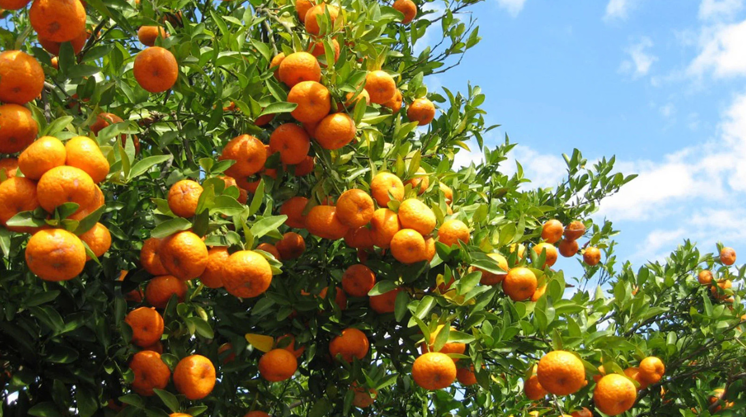
What Makes a Church Healthy?
“And they devoted themselves to the apostles' teaching and the fellowship, to the breaking of bread and the prayers.”
Acts 2:42

Slide 7
What Makes a Church Healthy?
A healthy church is a community of believers where the ordinary people are devoted in everyday life to Christ and his body.

Slide 8
And they devoted themselves to
the apostles' teaching
the breaking of bread
the fellowship
the prayers
Acts 2:42

Slide 9
And they devoted themselves to
the apostles' teaching
the breaking of bread
the fellowship
the prayers
Acts 2:42

Slide 10
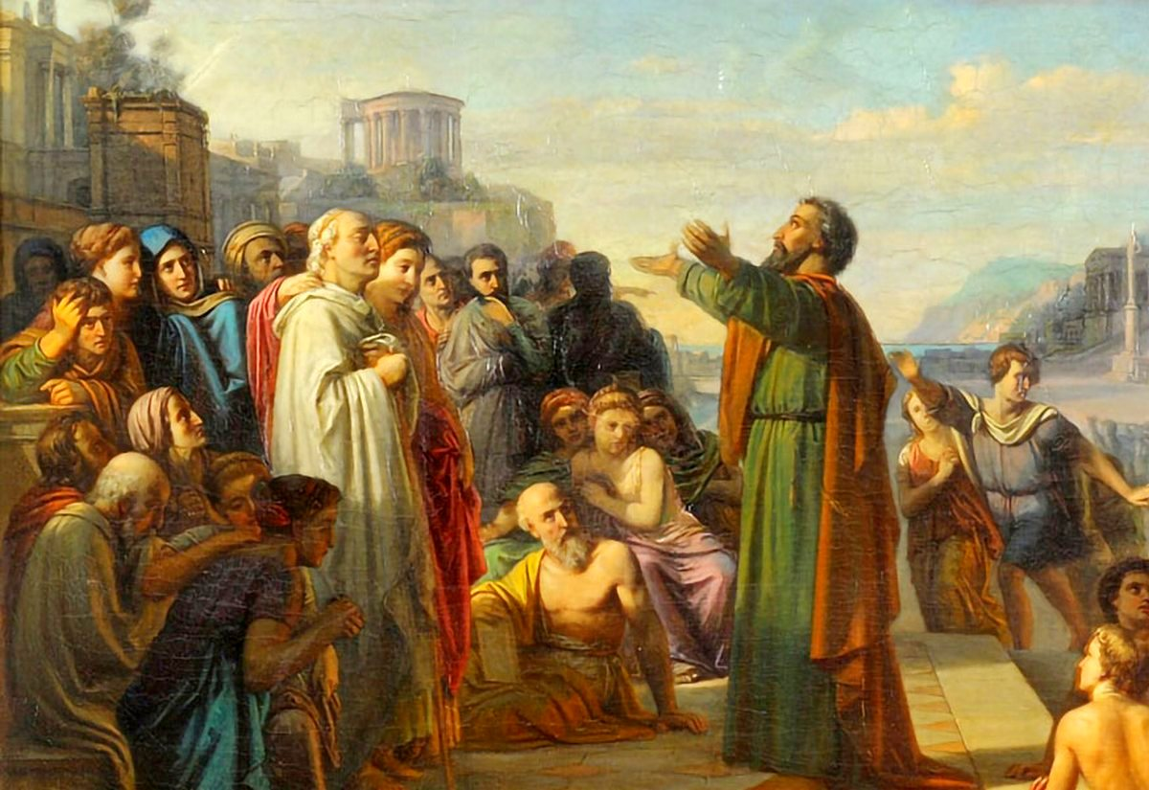
The Apostles’ Teaching…
What Exactly Were They Devoted To?
What did they have or not have?
Old Testament writings (synagogues only)
No gospels
No epistles or any New Testament writings

Slide 11
The Apostles’ Teaching…
What Exactly Were They Devoted To?
What would the apostles have taught?
Teachings of Jesus
Jesus’ earthly ministry, death and resurrection
How Jesus fulfilled the Old Testament
Salvation in the name of Jesus
Our Modern Day Bible!

Slide 12
In a healthy church, the ordinary person is
devoted to the Bible!

Slide 13
Three Questions:
What does devotion to the Word look like?
What are the results of devotion to the Word?
What will it do to our church?

Slide 14
What does Devotion to the Word Look Like?
Spiritual Growth
So what about spiritual growth?
How does it happen?
Primary Factor: Nutrition!

Slide 15
What does Devotion to the Word Look Like?
Spiritual Growth
“Like newborn infants, long for the pure spiritual milk, that by it you may grow up into salvation.” 1 Peter 2:2

Slide 16
What does Devotion to the Word Look Like?
Spiritual Growth
What instincts has God given us as believers to ensure that we are nourished?
Spiritual hunger and thirst!!!

Slide 17
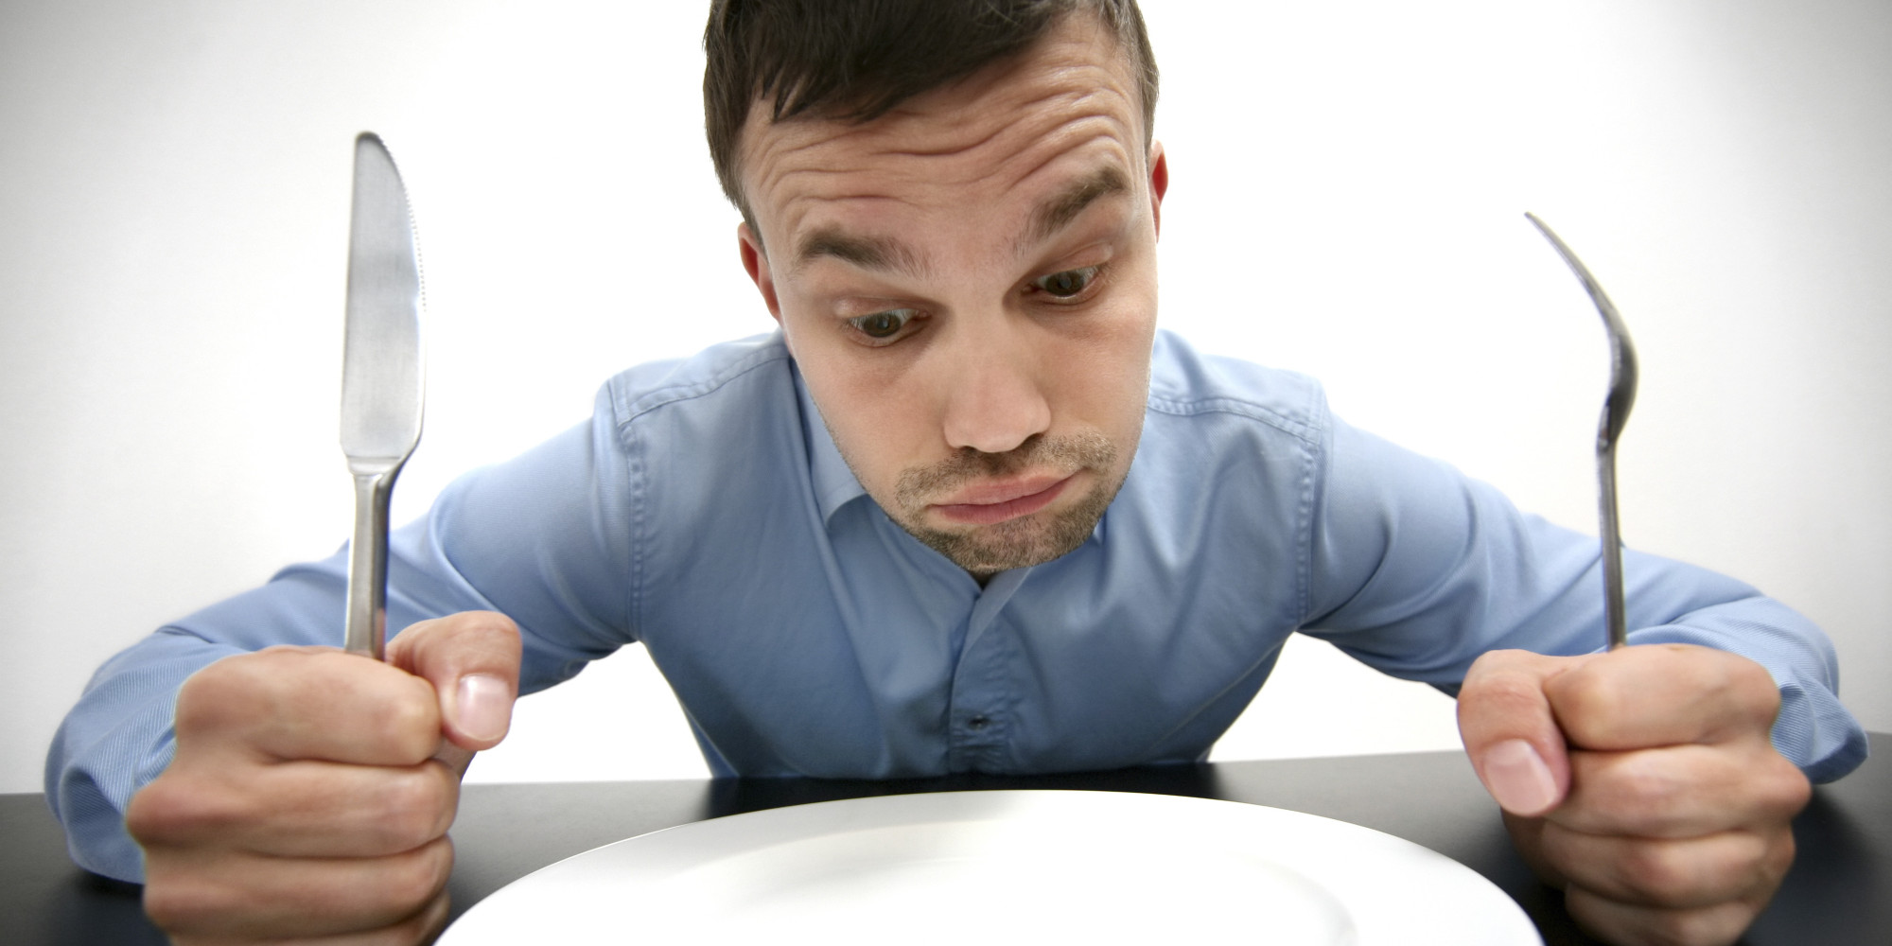
Are you hungry for God’s Word?
“O how I love your law! It is my meditation all the day.” Psalm 119:97

Slide 18
Are you hungry for God’s Word?
“Your words were found, and I ate them, and your words became to me a joy and the delight of my heart, for I am called by your name, O Lord, God of hosts.”
Jeremiah 15:16

Slide 19
Do you want to spend time with God?
“We have spent far too much time preaching and commanding Christians to study their Bibles. This should be a natural outcome of loving God for what God has done and what God has planned. Put another way, if we have to talk a married couple into spending more time together to grow their relationship, there is a deeper problem than just spending time together!”
Berry Kercheville

Slide 20
It’s All About Relationship!
What is the most common biblical picture of God’s relationship with his people?

Slide 21
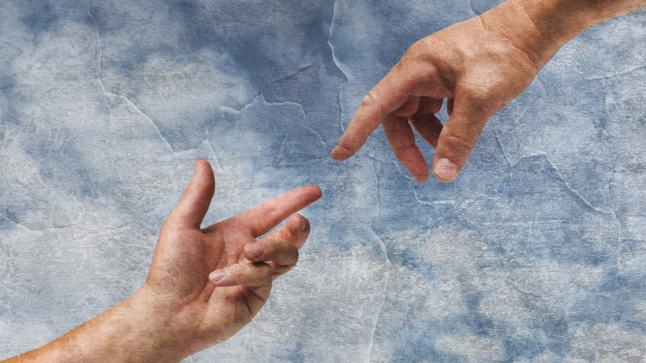
Do you want to spend time with God?
Think about your time in God’s Word relative to
Time on social media
Time on phone / internet
Time watching shows / movies
Time on hobbies / relaxation activities

Slide 22
What if you don’t have this hunger?
Do you have spiritual life?
Has someone shown you how to read, study and enjoy your Bible?
Is there spiritual sickness or disease (sin)?

Slide 23
How can we get this hunger?
Repent!
Ask God for this hunger
You may want to fast from food or something else while praying for this

Slide 24
What does devotion to the Word look like?
Love and hunger for the Word
Day-to-day commitment to getting the Word into your life

Slide 25
The Word Hand
Meditating
Memorizing
Studying
Reading
Hearing

Slide 26
¹ My son, if you receive my words and treasure up my commandments with you, ² making your ear attentive to wisdom and inclining your heart to understanding; ³ yes, if you call out for insight and raise your voice for understanding, ⁴ if you seek it like silver and search for it as for hidden treasures, ⁵ then you will understand the fear of the Lord and find the knowledge of God.
Proverbs 2:1-5

Slide 27
¹ My son, if you receive my words and treasure up my commandments with you, ² making your ear attentive to wisdom and inclining your heart to understanding; ³ yes, if you call out for insight and raise your voice for understanding, ⁴ if you seek it like silver and search for it as for hidden treasures, ⁵ then you will understand the fear of the Lord and find the knowledge of God.
Proverbs 2:1-5

Slide 28
What does devotion to the Word look like?
Love and hunger for the Word
Day-to-day commitment to getting the Word into your life

Slide 29
Three Questions:
What does devotion to the Word look like?
What are the results of devotion to the Word?
What will it do to our church?

Slide 30
What are the results of devotion to the Word?
Obedience
“This Book of the Law shall not depart from your mouth, but you shall meditate on it day and night, so that you may be careful to do according to all that is written in it. For then you will make your way prosperous, and then you will have good success.”
Joshua 1:8

Slide 31
¹⁸ “And when he sits on the throne of his kingdom, he shall write for himself in a book a copy of this law... ¹⁹ And it shall be with him, and he shall read in it all the days of his life, that he may learn to fear the Lord his God by keeping all the words of this law and these statutes, and doing them, ²⁰ that his heart may not be lifted up above his brothers, and that he may not turn aside from the commandment, either to the right hand or to the left, so that he may continue long in his kingdom, he and his children, in Israel. Deut. 17:18-20
Humility before God and People

Slide 32
A spiritually renewed mind
“Do not be conformed to this world, but be transformed by the renewal of your mind, that by testing you may discern what is the will of God, what is good and acceptable and perfect.”
Romans 12:2

Slide 33
Relationship with Jesus!
²¹ “Whoever has my commandments and keeps them, he it is who loves me. And he who loves me will be loved by my Father, and I will love him and manifest myself to him... ²³ If anyone loves me, he will keep my word, and my Father will love him, and we will come to him and make our home with him.”
John 14:21,23

Slide 34
What are the results of devotion to the Word?
A Changed Heart and Life!
Obedience
Humility before God and others
Spiritually renewed mind
Relationship with Jesus

Slide 35
Three Questions:
What does devotion to the Word look like?
What are the results of devotion to the Word?
What will it do to our church?

Slide 36
What will it do to our church?
¹⁶ Let the word of Christ dwell in you richly, teaching and admonishing one another in all wisdom, singing psalms and hymns and spiritual songs, with thankfulness in your hearts to God. ¹⁷ And whatever you do, in word or deed, do everything in the name of the Lord Jesus, giving thanks to God the Father through him.
Colossians 3:16-17

Slide 37
What will it do to our church?
¹⁶ Let the word of Christ dwell in you richly, teaching and admonishing one another in all wisdom, singing psalms and hymns and spiritual songs, with thankfulness in your hearts to God. ¹⁷ And whatever you do, in word or deed, do everything in the name of the Lord Jesus, giving thanks to God the Father through him.
Colossians 3:16-17
Logos

Slide 38
What will it do to our church?
¹⁶ Let the word of Christ dwell in you richly, teaching and admonishing one another in all wisdom, singing psalms and hymns and spiritual songs, with thankfulness in your hearts to God. ¹⁷ And whatever you do, in word or deed, do everything in the name of the Lord Jesus, giving thanks to God the Father through him.
Colossians 3:16-17
Not visit – live!

Slide 39
What will it do to our church?
¹⁶ Let the word of Christ dwell in you richly, teaching and admonishing one another in all wisdom, singing psalms and hymns and spiritual songs, with thankfulness in your hearts to God. ¹⁷ And whatever you do, in word or deed, do everything in the name of the Lord Jesus, giving thanks to God the Father through him.
Colossians 3:16-17
Plural!

Slide 40
What will it do to our church?
¹⁶ Let the word of Christ dwell in you richly, teaching and admonishing one another in all wisdom, singing psalms and hymns and spiritual songs, with thankfulness in your hearts to God. ¹⁷ And whatever you do, in word or deed, do everything in the name of the Lord Jesus, giving thanks to God the Father through him.
Colossians 3:16-17
Lavishly / Extravagantly!

Slide 41
What will it do to our church?
¹⁶ Let the word of Christ dwell in you richly, teaching and admonishing one another in all wisdom, singing psalms and hymns and spiritual songs, with thankfulness in your hearts to God. ¹⁷ And whatever you do, in word or deed, do everything in the name of the Lord Jesus, giving thanks to God the Father through him.
Colossians 3:16-17

Slide 42
What will it do to our church?
¹⁶ Let the word of Christ dwell in you richly, teaching and admonishing one another in all wisdom, singing psalms and hymns and spiritual songs, with thankfulness in your hearts to God. ¹⁷ And whatever you do, in word or deed, do everything in the name of the Lord Jesus, giving thanks to God the Father through him.
Colossians 3:16-17

Slide 43
What will it do to our church?
¹⁶ Let the word of Christ dwell in you richly, teaching and admonishing one another in all wisdom, singing psalms and hymns and spiritual songs, with thankfulness in your hearts to God. ¹⁷ And whatever you do, in word or deed, do everything in the name of the Lord Jesus, giving thanks to God the Father through him.
Colossians 3:16-17
It impacts our world!

Slide 44
In a healthy church, the ordinary person is
devoted to the Bible!

Slide 45
A Goal:
Each week (or more often!), ask God to give you something from his Word that you can share with someone!
Be expectant!

Slide 47
NT Preaching link at BibleStudyDownloads.org
Get this presentation for free!
Notes:
NT Preaching (np)

