Slide 1
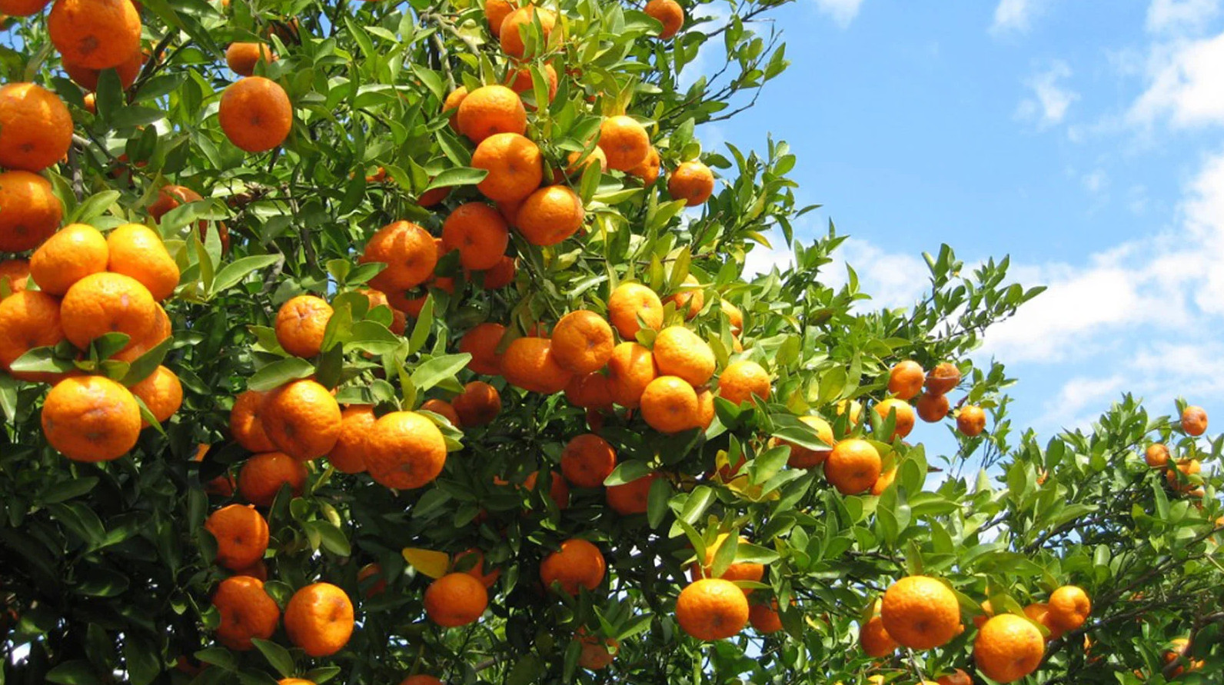
Acts 2:42
The Marks of a Healthy Church!
Preached by Dan Bridges Amman International Church, Jordan (AmmanChurch.org) Uploaded by Dr. Rick Griffith • Jordan Evangelical Theological Seminary Files in many languages for free download at BibleStudyDownloads.org

Slide 2
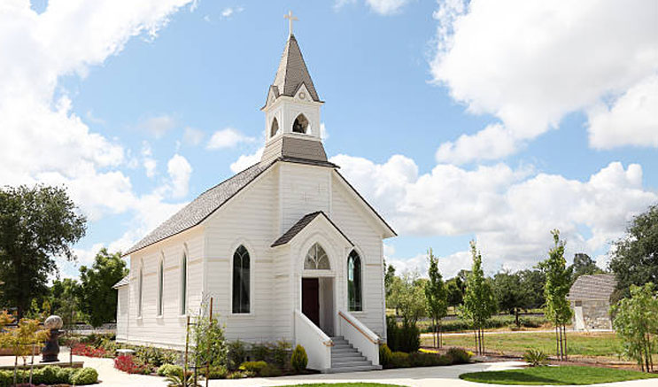
Did you grow up in church?
When you hear the word “church”, what do you picture?

Slide 3
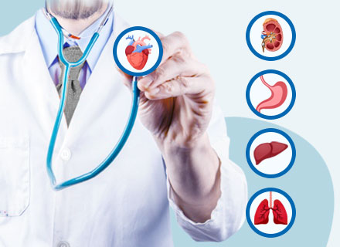
How would you measure the health of a church?

Slide 4
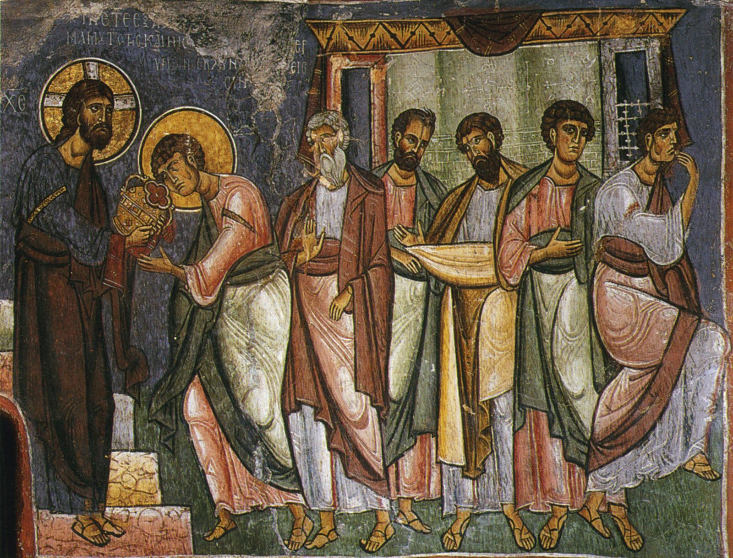
What can we learn from the early church?

Slide 5
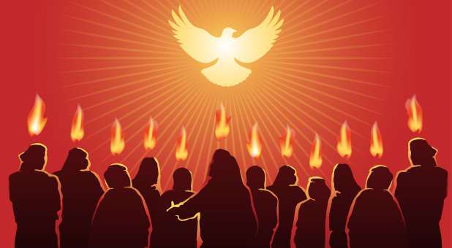
Day of Pentecost
Passover
(Crucifixion /
Resurrection)
Ascension
Pentecost
40 Days
50 Days

Slide 6
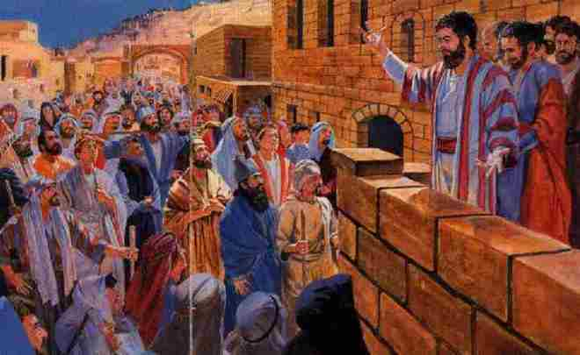
End of Peter’s Pentecost Sermon
“Let all the house of Israel therefore know for certain that God has made him both Lord and Christ, this Jesus whom you crucified.”
Acts 2:36

Slide 7
The Conviction of the Holy Spirit
“Now when they heard this they were cut to the heart, and said to Peter and the rest of the apostles, “Brothers, what shall we do?”
Acts 2:37

Slide 8
Invitation Given
“And Peter said to them, ‘Repent and be baptized every one of you in the name of Jesus Christ for the forgiveness of your sins, and you will receive the gift of the Holy Spirit.’”
Acts 2:38

Slide 9
The People Respond
“So those who received his word were baptized, and there were added that day about three thousand souls.”
Acts 2:41

Slide 10
The Devotion of the New Believers
“And they devoted themselves to the apostles' teaching and the fellowship, to the breaking of bread and the prayers.”
Acts 2:42

Slide 11
The Devotion of the New Believers
“⁴⁴ And all who believed were together and had all things in common. ⁴⁵ And they were selling their possessions and belongings and distributing the proceeds to all, as any had need. ⁴⁶ And day by day, attending the temple together and breaking bread in their homes, they received their food with glad and generous hearts, ⁴⁷ praising God and having favor with all the people.”
Acts 2:44-47a

Slide 12
The Growth of the Early Church
“And the Lord added to their number day by day those who were being saved.”
Acts 2:47b

Slide 13
What Makes a Church Healthy?
“And they devoted themselves to the apostles' teaching and the fellowship, to the breaking of bread and the prayers.”
“And the Lord added to their number day by day those who were being saved.”
?

Slide 14
What Makes a Church Healthy?
Acts 2 does not measure church health by…
Attendance at a meeting
Quality of the preaching or worship
The size of its childrens or youth programs
Number of small groups or outreach programs
But rather by the day-to-day actions and commitments of the ordinary people!

Slide 15
What Makes a Church Healthy?
A healthy church is a community of believers where the ordinary people are devoted in everyday life to Christ and his body.

Slide 16
What Makes a Church Healthy?
A healthy church is a community of believers where the ordinary people are devoted in everyday life to Christ and his body.

Slide 17
Who is the “they”?
“And they devoted themselves to the apostles' teaching and the fellowship, to the breaking of bread and the prayers.”
Acts 2:42

Slide 18
Who is the “they”?
Now when they heard this they were cut to the heart, and said to Peter and the rest of the apostles, “Brothers, what shall we do?”
And Peter said to them, “Repent and be baptized every one of you in the name of Jesus Christ for the forgiveness of your sins, and you will receive the gift of the Holy Spirit.”
They were Repentant - People who had become deeply aware of their sin and realized that something needed to be done!

Slide 19
Who is the “they”?
They were Forgiven – Their belief in Jesus (as shown by baptism) produced forgiveness of their sins!
Now when they heard this they were cut to the heart, and said to Peter and the rest of the apostles, “Brothers, what shall we do?”
And Peter said to them, “Repent and be baptized every one of you in the name of Jesus Christ for the forgiveness of your sins, and you will receive the gift of the Holy Spirit.”

Slide 20
Who is the “they”?
They were Internally Transformed – Their belief in Jesus caused them to receive a new spirit – the Holy Spirit of God.
Now when they heard this they were cut to the heart, and said to Peter and the rest of the apostles, “Brothers, what shall we do?”
And Peter said to them, “Repent and be baptized every one of you in the name of Jesus Christ for the forgiveness of your sins, and you will receive the gift of the Holy Spirit.”

Slide 21
A healthy church is a community of believers where the ordinary people are devoted to Christ and his body.
People who are repentant
People who are forgiven
People who have been internally transformed

Slide 22
What Makes a Church Healthy?
A healthy church is a community of believers where the ordinary people are devoted in everyday life to Christ and his body.

Slide 23
What Makes a Church Healthy?
A healthy church is a community of believers where the ordinary people are devoted in everyday life to Christ and his body.

Slide 24
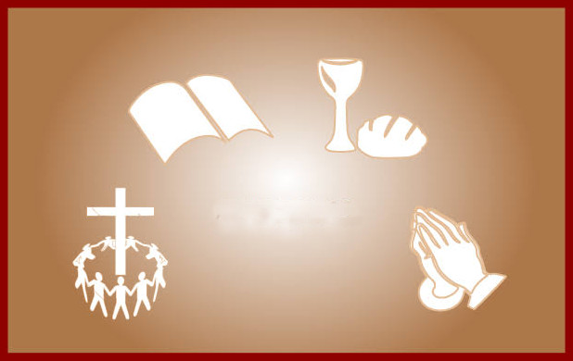
And they devoted themselves to
Acts 2:42

Slide 25
What does it mean to be “devoted” to something?
Devotion implies priorities!!!
To be devoted to something means it holds the primary purpose in your life!

Slide 26
And they devoted themselves to
the apostles' teaching
the breaking of bread
the fellowship
the prayers
Acts 2:42

Slide 27
They devoted themselves to
the apostles' teaching
the fellowship
the breaking of bread
the prayers
Why these four things?

Slide 28
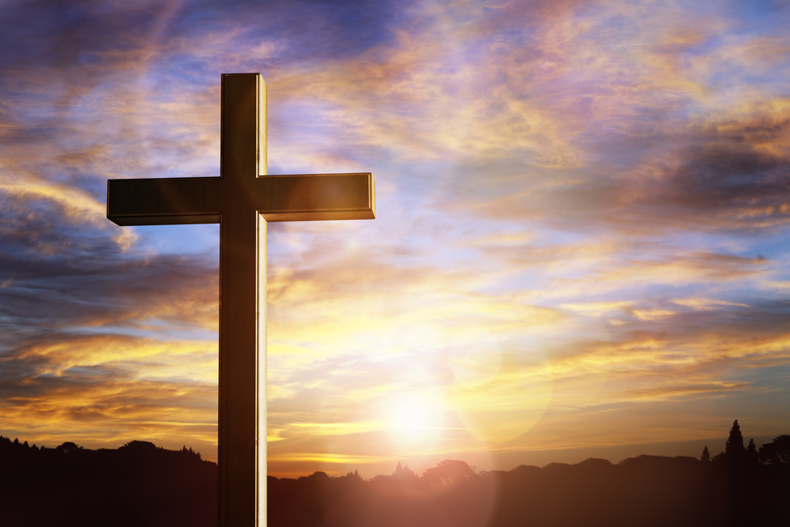
Why These Four Things?
In general, what are the keys of our faith?
The primacy of the gospel – We trust in Christ and his death alone for our salvation.
The supremacy of Christ – We live in complete dependence on Christ to give us spiritual life, to guide us and to provide everything that we need.
The priority of the Body of Christ – God has designed us to live in unity and dependence on each other.

Slide 29
Why These Four Things?
In general, what are the keys of our faith?
The primacy of the gospel
Devotion to the Breaking of Bread
The supremacy of Christ
Devotion to God’s word (apostles’ teaching)
Devotion to Prayer
The priority of the Body of Christ
Devotion to the Fellowship

Slide 30
The Health of AIC Depends on You!
As people look at your life – or at us as a church – what do they see?
The primacy of the gospel
Devotion to the Breaking of Bread
The supremacy of Christ
Devotion to God’s word (apostles’ teaching)
Devotion to Prayer
The priority of the Body of Christ
Devotion to the Fellowship

Slide 32
NT Preaching link at BibleStudyDownloads.org
Get this presentation for free!
Notes:
NT Preaching (np)

