Slide 1
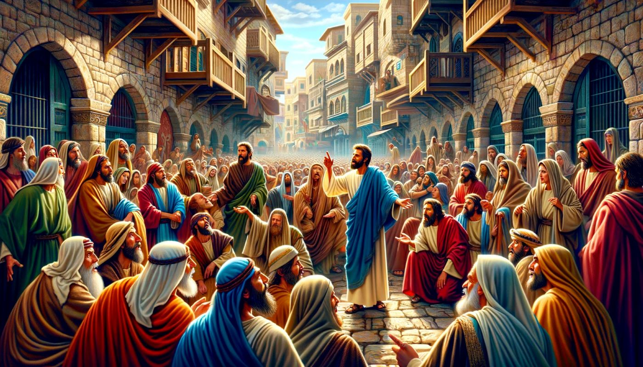
Don’t Miss It!
Acts 2:22-40
Preached by Dr. Jim Harmeling at Crossroads International Church Singapore • CICFamily.com Uploaded by Dr. Rick Griffith • Jordan Evangelical Theological Seminary Files in many languages for free download at BibleStudyDownloads.org

Slide 2
Don’t Miss It!
Acts 2:22-40
Jesus was validated (vs. 22)

Slide 3
John 5:36
But the testimony that I have is greater than that of John. For the works that the Father has given me to accomplish, the very works that I am doing, bear witness about me that the Father has sent me.
John 3:2
This man came to Jesus by night and said to him, “Rabbi, we know that you are a teacher come from God, for no one can do these signs that you do unless God is with him.”

Slide 4
Don’t Miss It!
Acts 2:22-40
Jesus was validated (vs. 22)
Jesus was crucified (v. 23)
Jesus was resurrected (v. 24)

Slide 5
Romans 1:1-4
¹ Paul, a servant of Christ Jesus, called to be an apostle, set apart for the gospel of God, ² which he promised beforehand through his prophets in the holy Scriptures, ³ concerning his Son, who was descended from David according to the flesh ⁴ and was declared to be the Son of God in power according to the Spirit of holiness by his resurrection from the dead, Jesus Christ our Lord,

Slide 6
Don’t Miss It!
Acts 2:22-40
Jesus was validated (vs. 22)
Jesus was crucified (v. 23)
Jesus was resurrected (v. 24)
Jesus was predicted (vs. 25-31)
Jesus was eye witnessed (v. 32)
Jesus is exalted (vs. 33-36)
We must respond (vs. 37-41)

Slide 7
Black

Slide 8
NT Preaching link at BibleStudyDownloads.org
Get this presentation and script for free!
Notes:
NT Preaching (np)

