Slide 1
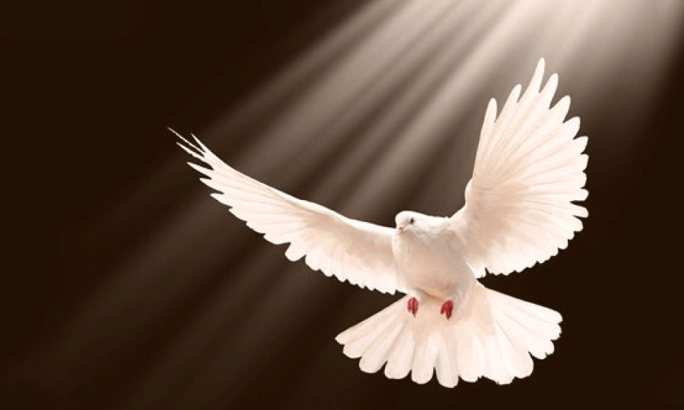
The Power of the Spirit
Acts 2
Dr. Rick Griffith • Crossroads International Church Singapore
CICFamily.com • BibleStudyDownloads.org

Slide 2
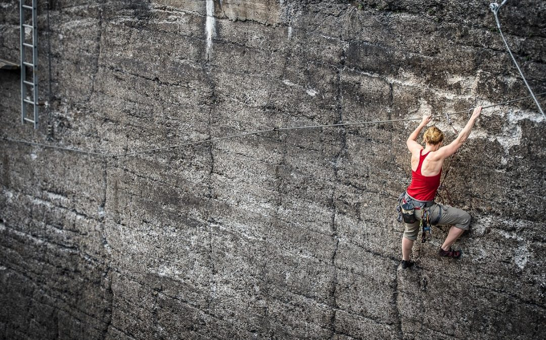
Do you agree?
Most of us go through life trusting in our own strength.
Most of us go through life without ever trusting God to do something big.
Most need a breakthrough past our monotony, but don’t trust God for it.
Notes:
BIG: (Someone said that if you tell others your dream for your life and they don’t laugh, then it isn’t big enough!)

Slide 3
Our Vision
Love the Nations
Love the Church
Love God

Slide 4
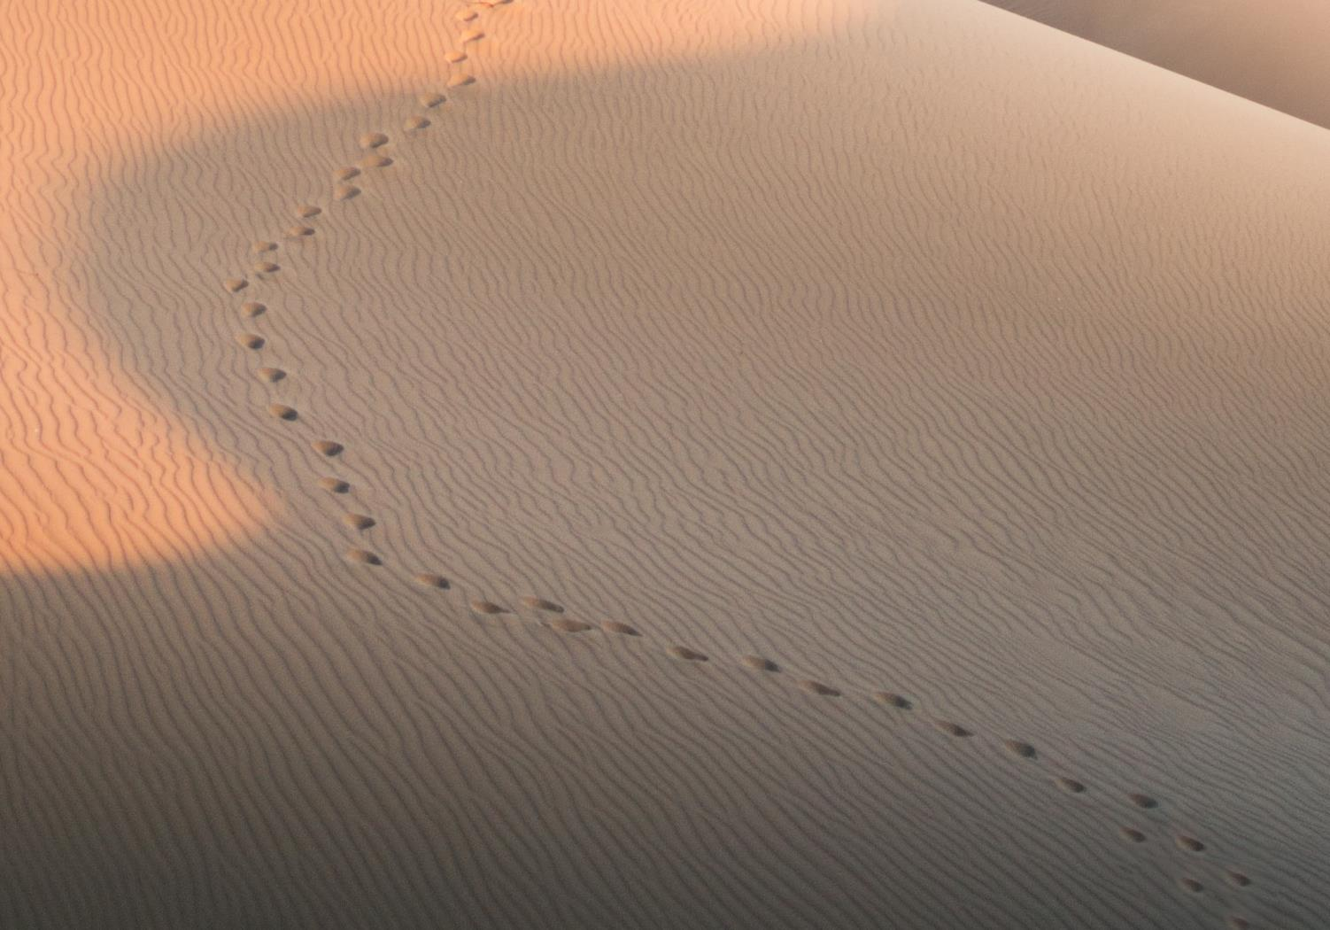
GOOD NE WS
ON THE MO VE
God’s work through the early church in
Acts

Slide 5
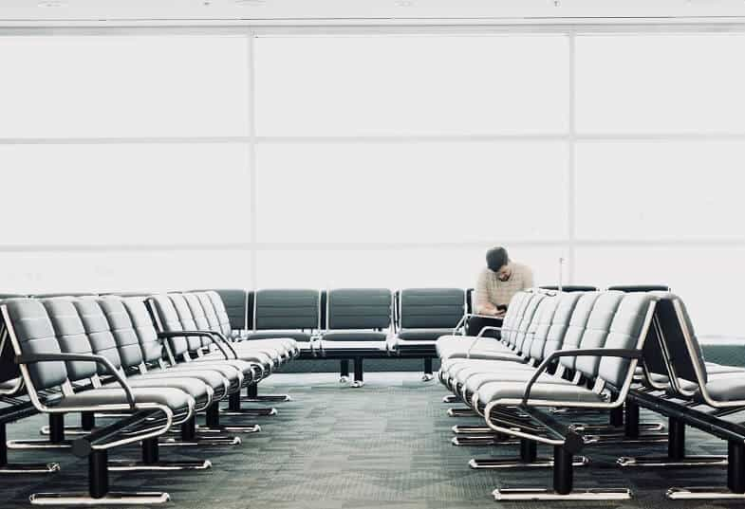
Waiting for a breakthrough…

Slide 6
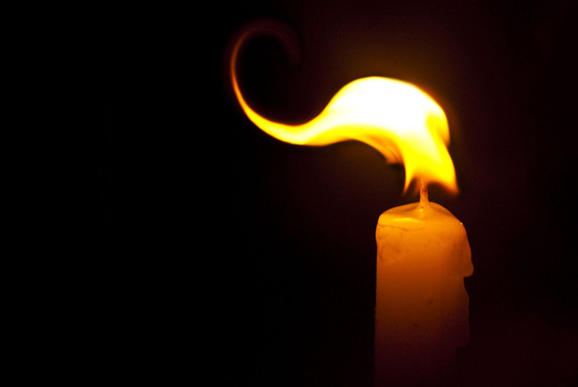
Acts 2 Background

Slide 7
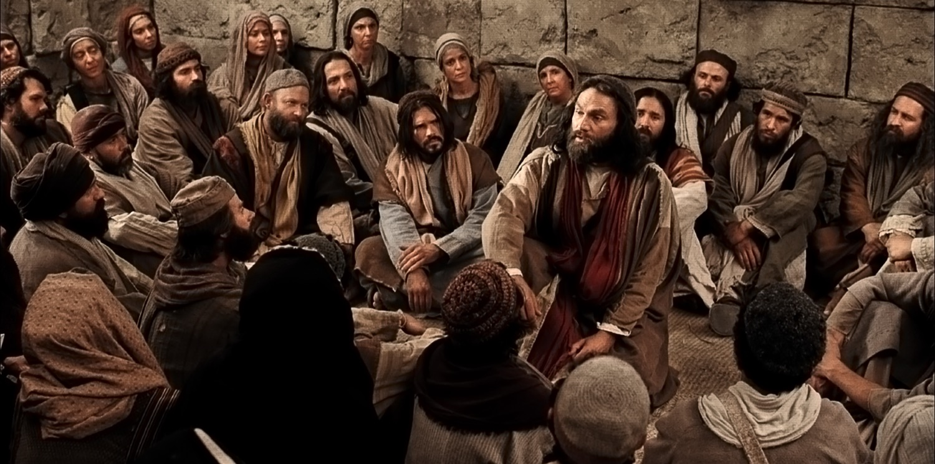
Upper Room Gathering

Slide 8
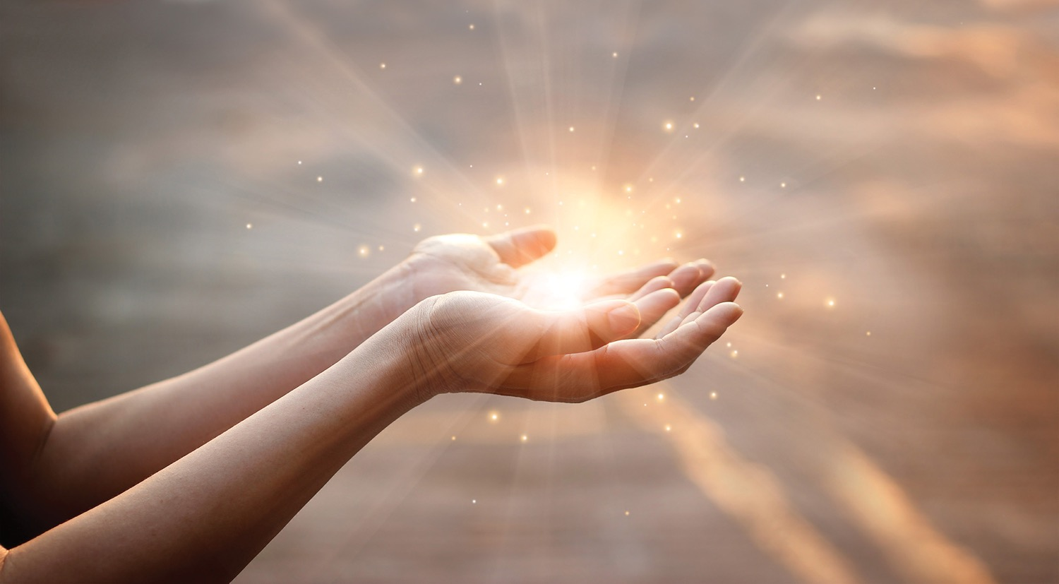
Why submit to the Spirit?
3 reasons

Slide 9
The Spirit reverses Babel (1-13)
Why submit to the Spirit?

Slide 10
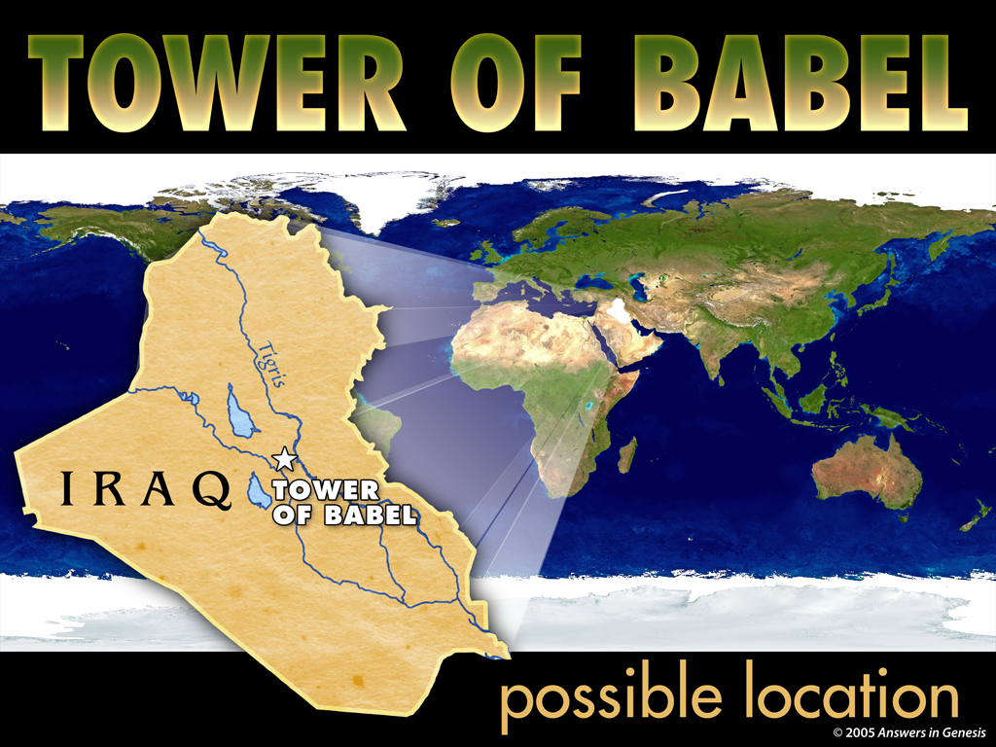
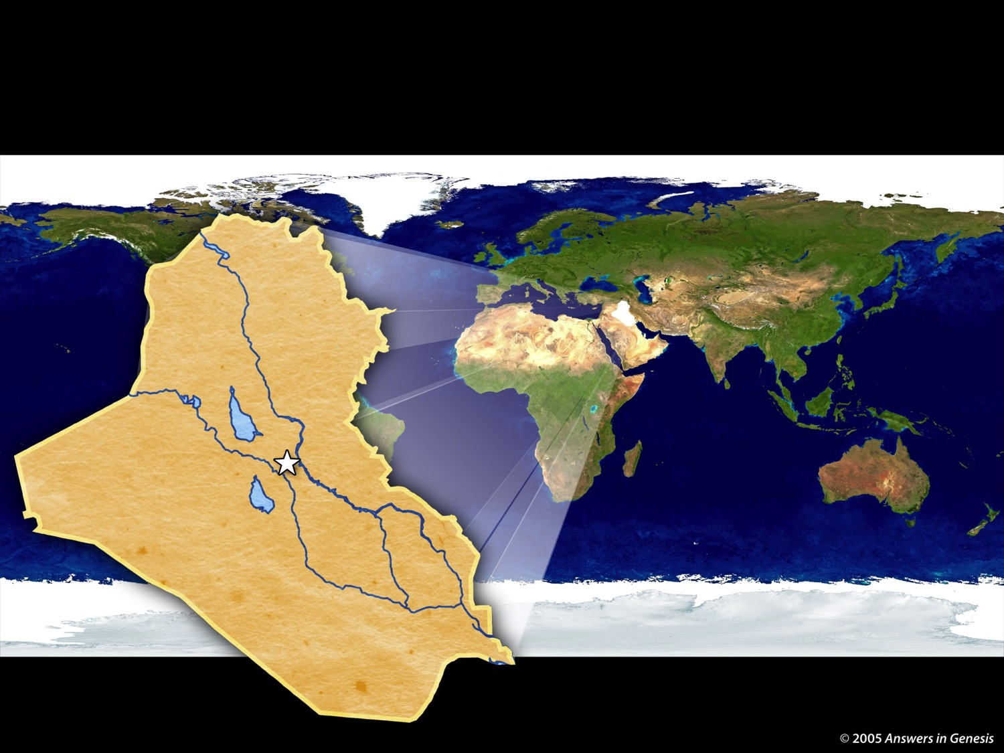
4-07 Tower of Babel Map 02277
TOWER OF BABEL
IRAQ
Tower
of Babel
Genesis 11
possible location
Notes:
10
10

Slide 11
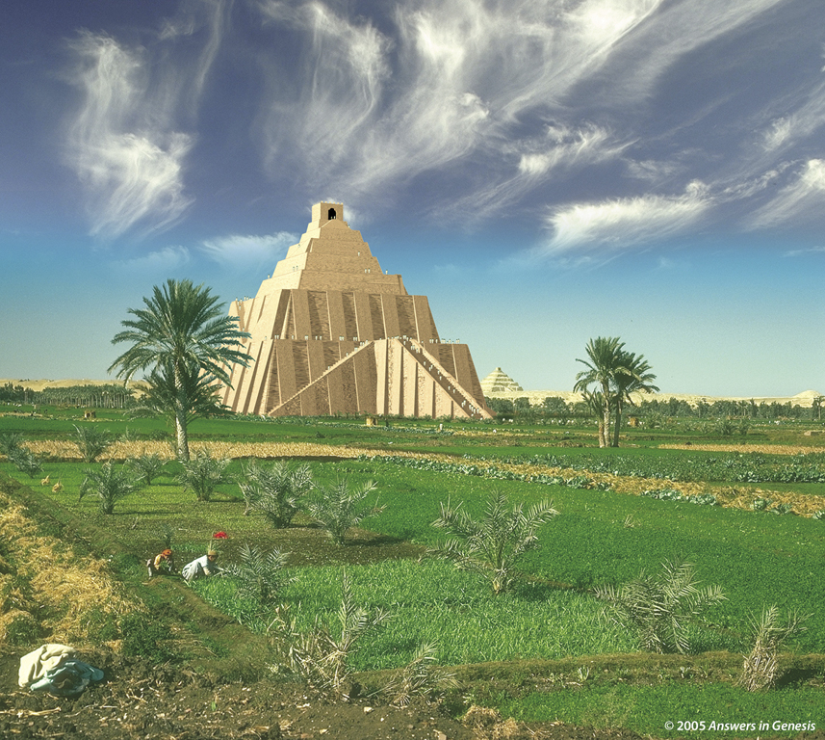
Tower of Babel 02275
Genesis 11:2-6
Notes:
Created: September 2005.

Slide 12
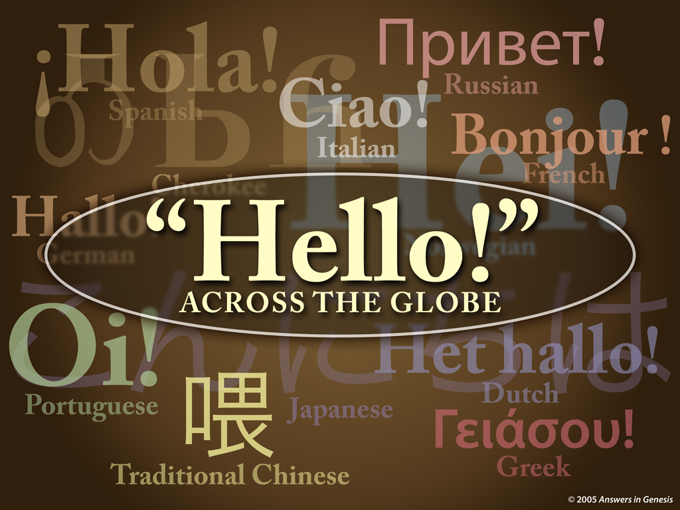
4-11 Hello World 02280
Genesis 11:7
Notes:
12

Slide 13
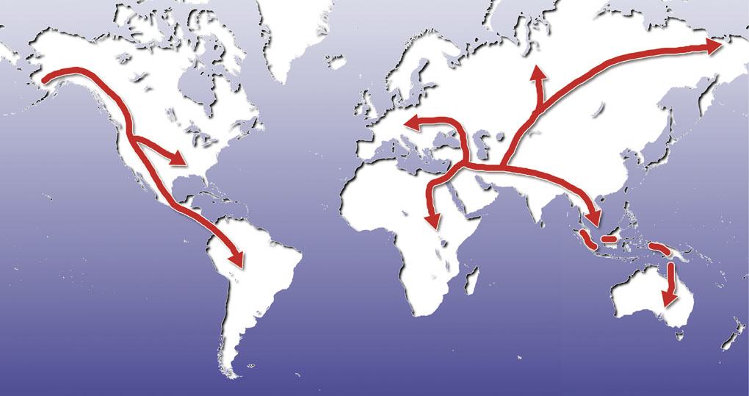
Map—post-flood dispersion
Babel Dispersion
Genesis 11:8

Slide 14

Gen. 11:9 NAS
Genesis 11:9
"Therefore its name was called Babel, because there the LORD confused the language of the whole earth; and from there the LORD scattered them abroad over the face of the whole earth."

Slide 15
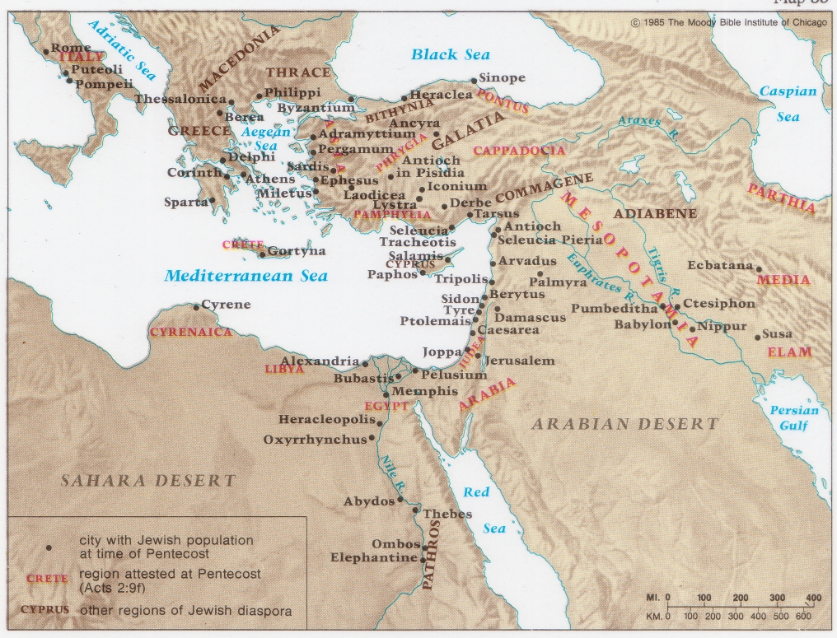
The Jewish Diaspora at Pentecost
132
Acts 2

Slide 16
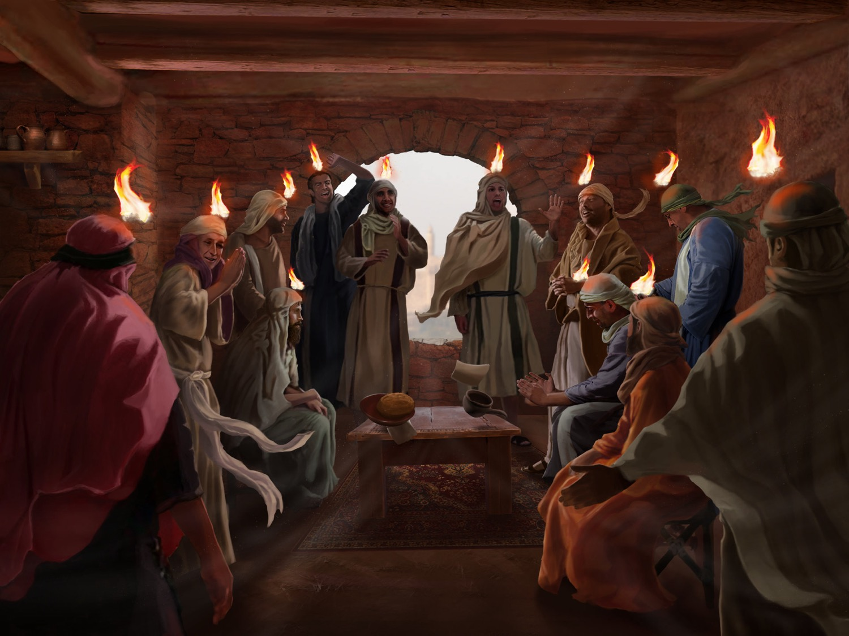
The Spirit Came at Pentecost
(Acts 2:1-13)

Slide 17
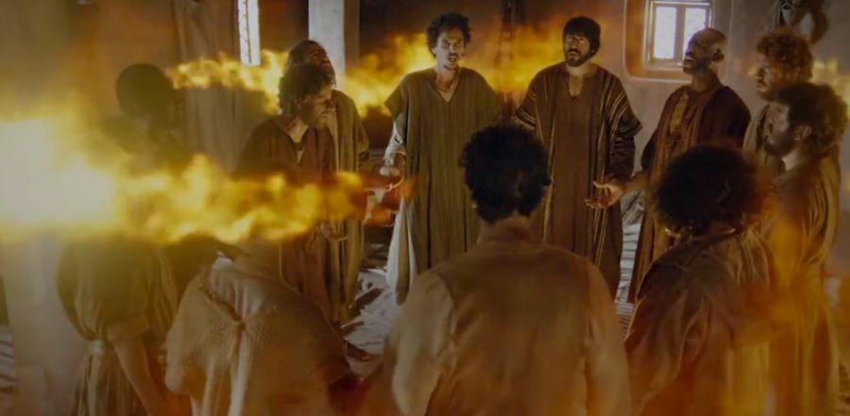
Wind filled the place (Acts 2:2)

Slide 18
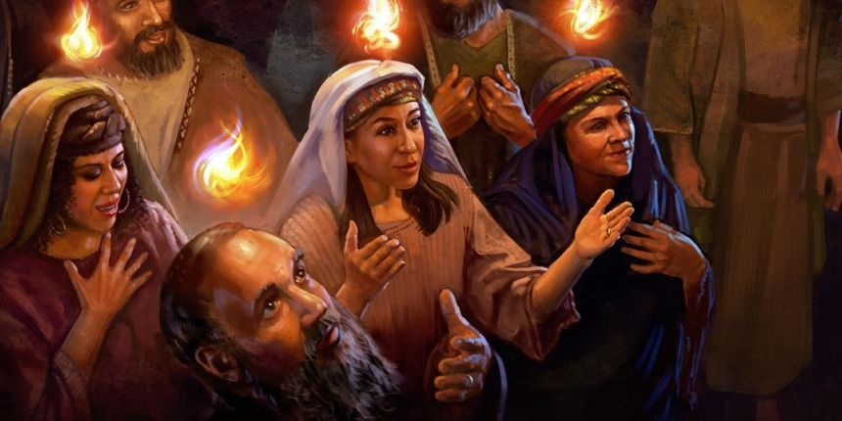
Tongues of Fire (Acts 2:3)

Slide 19
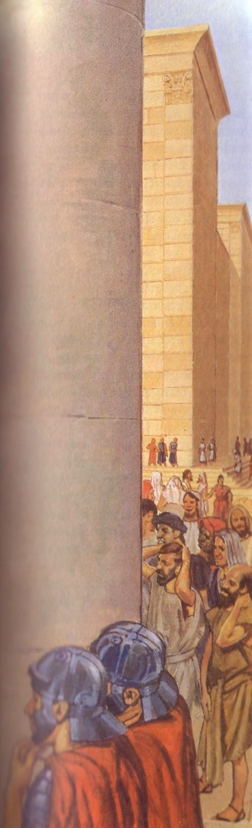
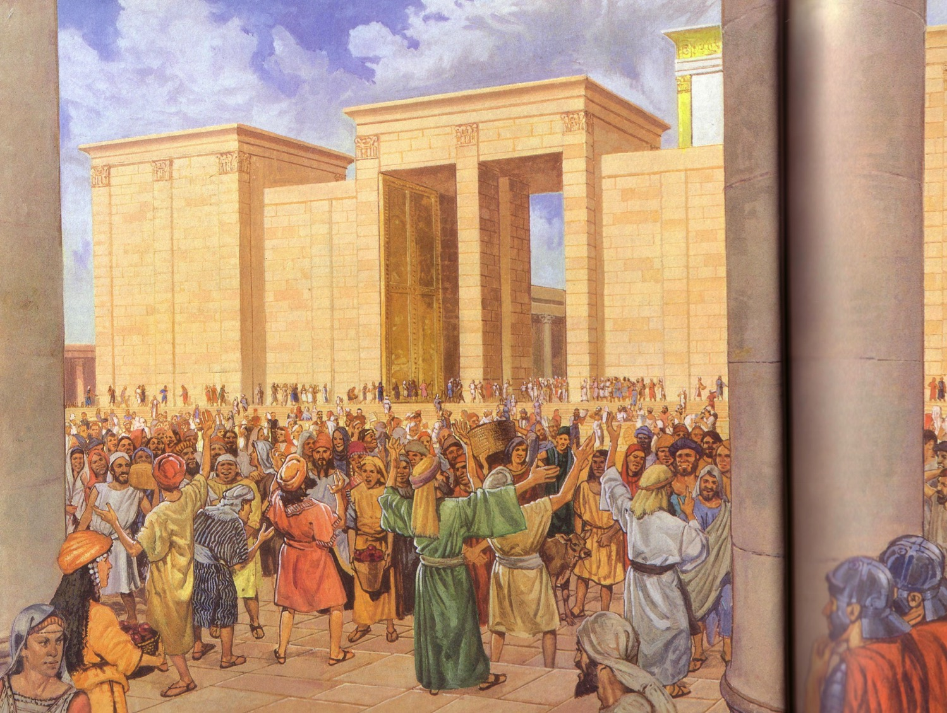
Apostles praised God in languages they had never learned (Acts 2:4)

Slide 20
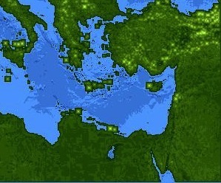
Jews at Pentecost––Acts 2:9-11
132
Rome (13)
PONTUS (7)
CAPPADOCIA (6)
ASIA (8)
PHRYGIA (9)
Parthia (1)
PAMPHILIA (10)
Mesopotamia (4)
CRETE (14)
Media (2)
Elam (3)
Jerusalem
CYRENE (12)
JUDEA (5)
ASIA––Roman Empire Provinces
Media––Parthian Empire Provinces
EGYPT (11)
Rome––Cities
CRETE––Islands
ARABIA (15)
Miles
0
200
400
600
800
1000
(1) (2) (3) etc. indicate sequence in Acts 2:9-11
Kms
0
300
600
900
1200
1500
Notes:
Jews numbered 40,000 in Rome during the reign of Augustus (30 BC to AD 14), so this was a sizable minority. We do not know for sure who actually started the church at Rome, but it likely was some of these Jews who returned to Rome after receiving the Spirit at Pentecost in Jeruslem. They, in turn, led Gentiles in Rome to faith as well.

Slide 21
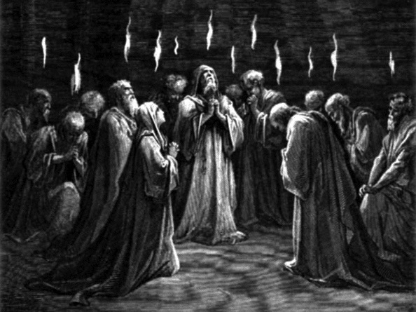
Pentecost Reversed Babel
Scattered
United
Confused
Understand
Praised Men
Praised God
Rebellion
Submission
Warren Wiersbe, Bible Exposition Commentary
Notes:
Warren Wiersbe notes, “Why did God do this? For one thing, Pentecost was a reversal of the judgment at the Tower of Babel when God confused man’s language (Gen. 11:1–9).
• United
God’s judgment at Babel scattered the people, but God’s blessing at Pentecost united the believers in the Spirit.
• Understood
At Babel, the people were unable to understand each other; but at Pentecost, men heard God’s praises and understood what was said.
• Praise God
The Tower of Babel was a scheme designed to praise men and make a name for men, but Pentecost brought praise to God.
• Submission
The building of Babel was an act of rebellion, but Pentecost was a ministry of humble submission to God. What a contrast!

Slide 22

The Gospel is for the
Whole World
“The Spirit of Christ is the spirit of missions, and the nearer we get to Him, the more intensely missionary we must become.”
—Henry Martyn—
Notes:
“Another reason for this gift of tongues was to let the people know that the Gospel was for the whole world. God wants to speak to every person in his or her own language and give the saving message of salvation in Jesus Christ. The emphasis in the Book of Acts is on worldwide evangelization, ‘unto the uttermost part of the earth’ (Acts 1:8). ‘The Spirit of Christ is the spirit of missions,’ said Henry Martyn, ‘and the nearer we get to Him, the more intensely missionary we must become’” (Wiersbe, BEC).

Slide 23
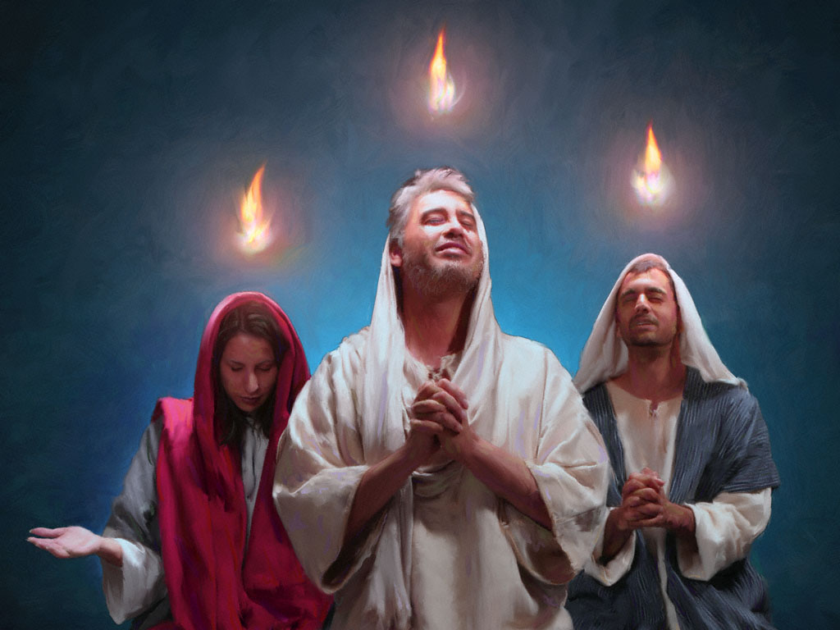
Amazing!

Slide 24



Population of Empire = 55 Million
97
Roman Empire
Gentiles - 51 million
Jews - 4 million

Slide 25
Languages of the Empire
97
Languages of the Empire
Roman Empire
Greek
Latin
Aramaic
Hebrew

Slide 26


Slide 27
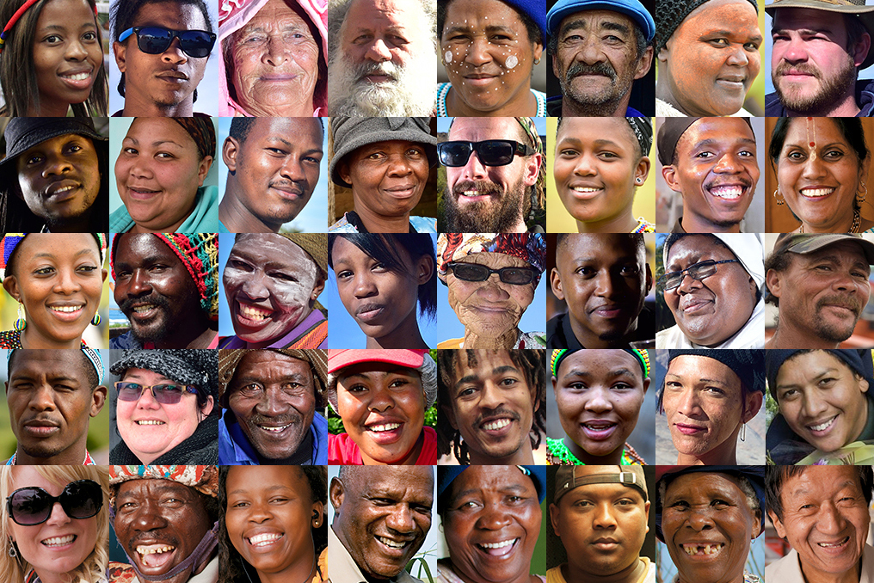
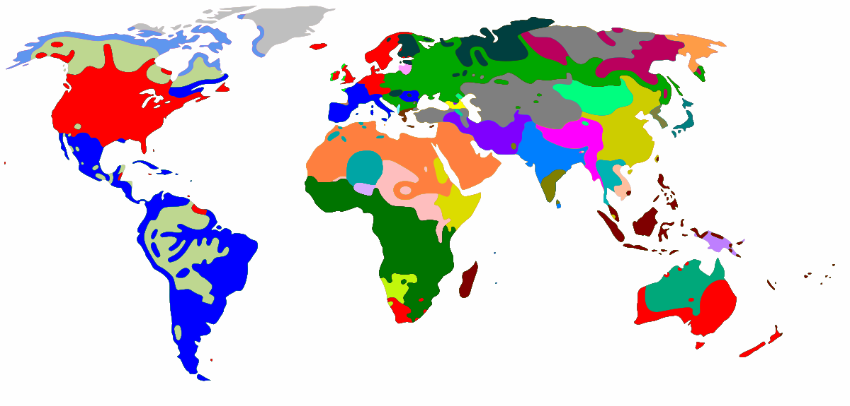
This Photo by Unknown Author is licensed under CC BY-SA
This Photo by Unknown Author is licensed under CC BY

Slide 28


Singapore Bible College Students
USA
MONGOLIA
JAPAN
KOREA
CHINA
HONG KONG
MYANMAR
INDIA
THAILAND
VIETNAM
PHILIPPINES
MALAYSIA
SINGAPORE
SBC
INDONESIA
Notes:
These faithful leaders are from about 25 countries who come to us in Singapore for masters and doctoral-level training. We train them to build into others back in their home countries.

Slide 29
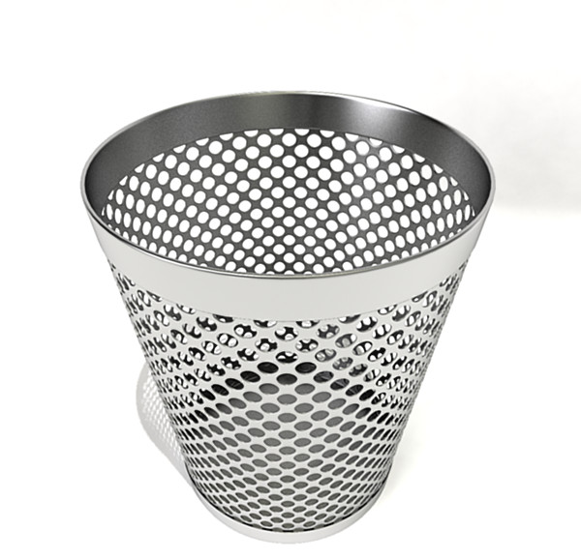
Assignment File System

Slide 30

BibleStudyDownloads.org
7
Notes:
My SBC teaching has resulted in Bible teaching and study materials—mostly PowerPoint—in 49 languages! All a teacher needs to do is to click on a file and it downloads for free to teach any book of the Bible and many other subjects.

Slide 31
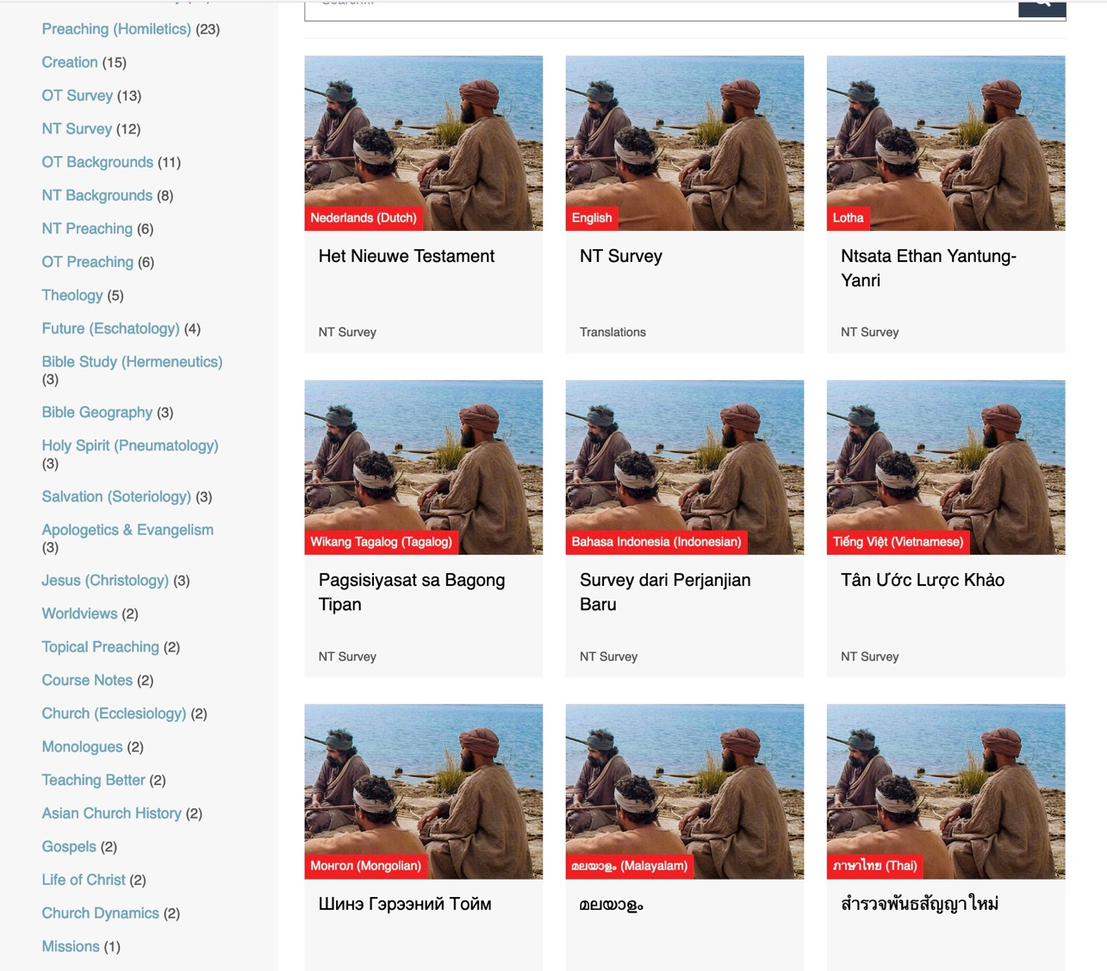
BibleStudyDownloads.org
7
Translations in 52 Languages
Notes:
Here are 9 languages featured.

Slide 32
The Spirit reverses Babel (1-13)
Why submit to the Spirit?
The Spirit proves Jesus (14-41).

Slide 33
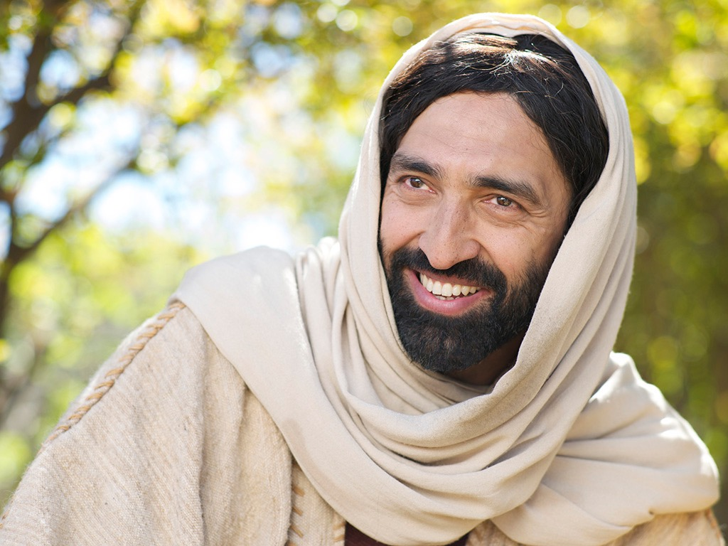

Slide 34
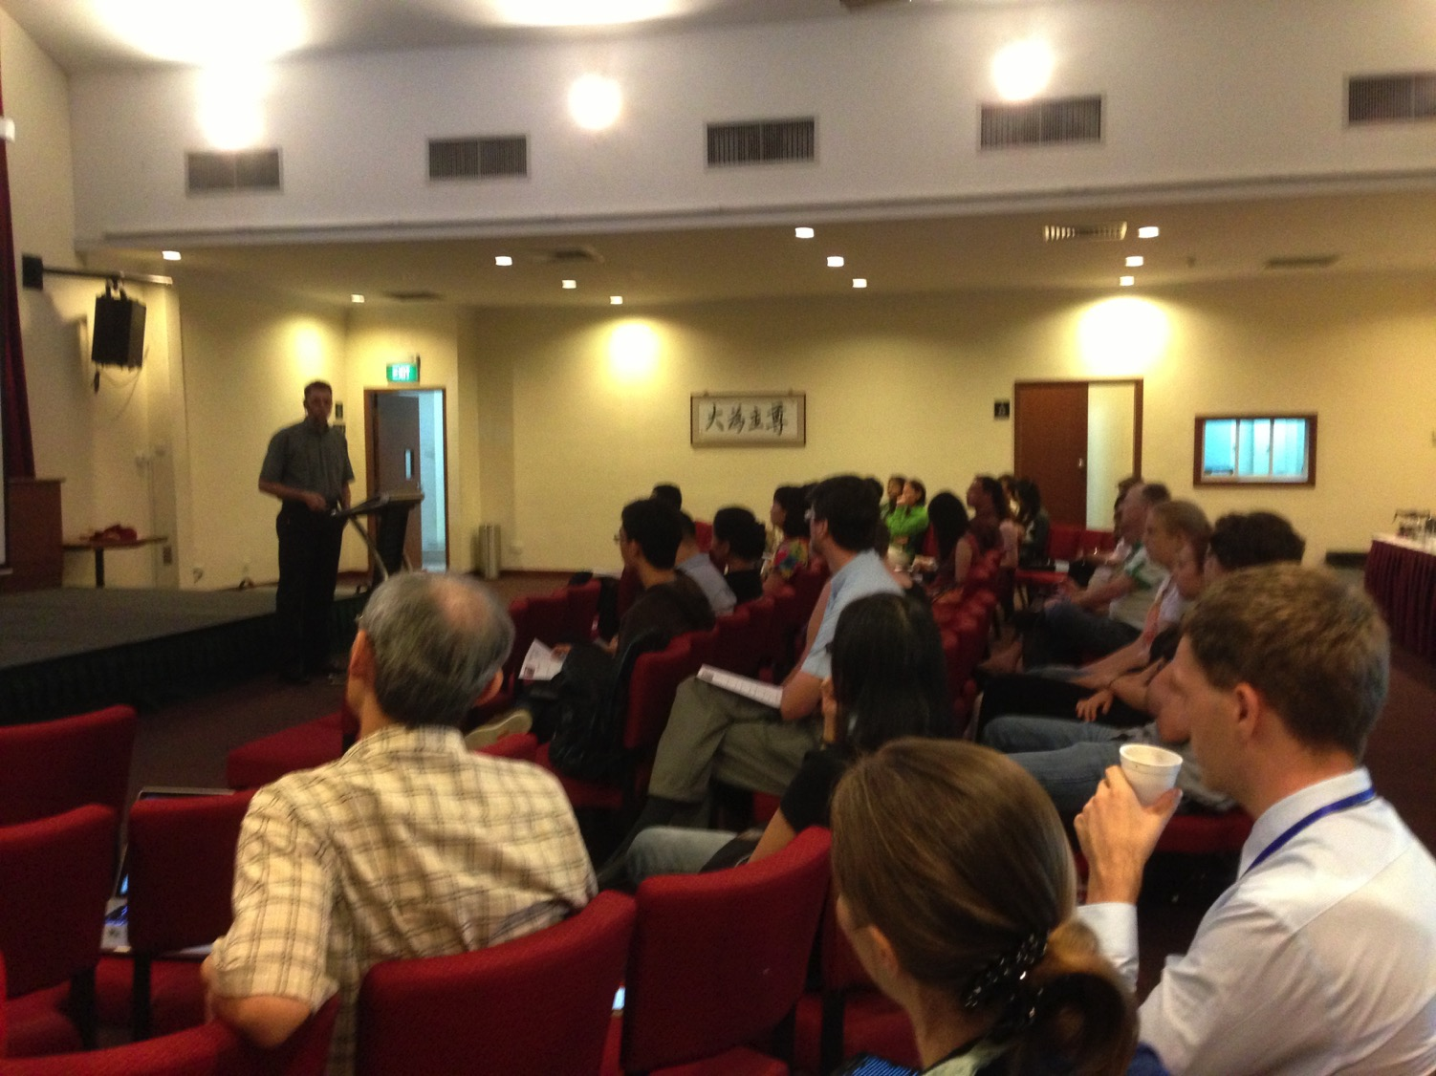

Our People
9
100 people from 16 nations
The Spirit’s indwelling shows that God accepts anyone—not a select few (14-21).
February 2021

Slide 35

Crossroads People • Feb 2021
GERMANY
MALAYSIA
JAPAN
UNITED KINGDOM
RUSSIA
FRANCE
NETHERLANDS
MONGOLIA
ITALY
FRANCE
KOREA
HONG KONG
LEBANON
CHINA
TAIWAN
GERMANY
NEPAL
TAIWAN
MYANMAR
CANADA
EGYPT
INDIA
USA
THAILAND
ETHIOPIA
MALAYSIA
KENYA
ZIMBABWE
SOUTH AFRICA
PHILIPPINES
SINGAPORE
INDONESIA
SOUTH AFRICA
CIC
AUSTRALIA
NEW ZEALAND
Notes:
We actually have about 20% Indian at CIC, thanks to St. Thomas, who overcame his initial reluctance to witness for Jesus in India.
Our Feb 2021 church of 100 people stem from 16 different countries around the world: Australia (David & Fiona), China (Jianji), France (Valentin), Korea (Grace Kim), India (Cynthia), Indonesia (Rena), Kenya (Jacqueline), Myanmar (Jewel), Nepal (Joshua), Netherlands (Toes), Singapore (Albina), South Africa (Coetsee), Taiwan (Cherry), Thailand (Mae), UK (James & Gabi), USA (Miriam).
This does not include people who have recently attended only once:
Nor does it include missionaries living back in their countries but still are members of CIC: Maple (Taiwan), Budmaa (Mongolia)
Previous: Canada (Gloria Lee), Ethiopia (Lele), Malaysia (Aston, Naomi), Netherlands (Dies & Desiree), Philippines (Micah), South Africa (Melody),

Slide 36
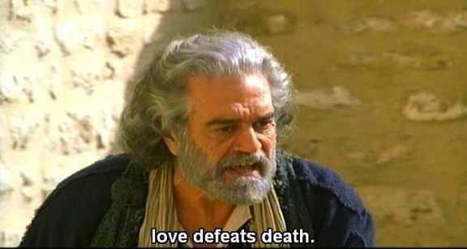
Joel 2:28-29 in Acts 2:16-21
579
"This is that which was spoken by the prophet Joel…"
(Acts 2:16)
Notes:
In the day of the LORD, God will send the indwelling of the Spirit upon all Jews and celestial signs [when the Jewish nation repents at the return of Christ] (2:28-32).

Slide 37
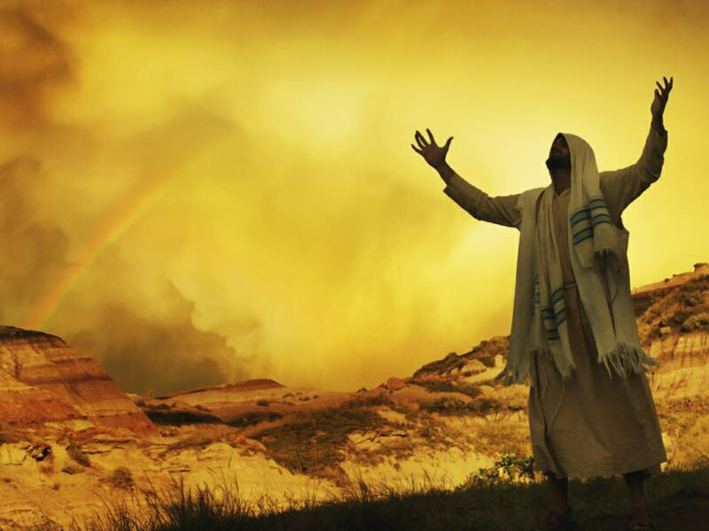
Joel 2:28-29; Acts 2:17-18 NLT
579
"Then, after doing all those things, I will pour out my Spirit upon all people. Your sons and daughters will prophesy. Your old men will dream dreams, and your young men will see visions.
²⁹In those days I will pour out my Spirit even on servants—men and women alike."

Slide 38
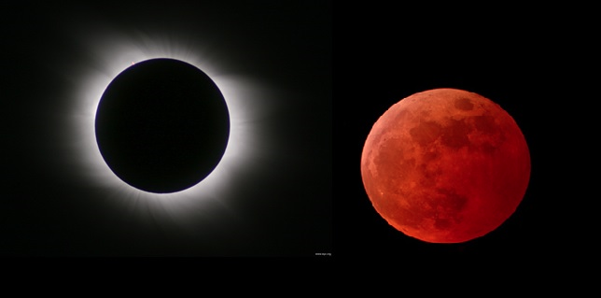
Joel 2:30-31; Acts 2:19-20 NLT
"And I will cause wonders in the heavens and on the earth—blood and fire and columns of smoke.
³¹The sun will become dark, and the moon will turn blood red before that great and terrible day of the LORD arrives."
579
Notes:
God notes these phenomena in the skies which were NOT at Pentecost in Acts 2. This clues us in that only the first part of the prophecy was fulfilled then in the outpouring of the Spirit. The rest will be fulfilled when Christ returns and the “terrible day of the LORD arrives.”

Slide 39
Joel 2:32; Acts 2:21 NLT
"But everyone who calls on the name of the LORD will be saved, [Joel: for some on Mount Zion in Jerusalem will escape, just as the LORD has said. These will be among the survivors whom the LORD has called.]"
579

Slide 40
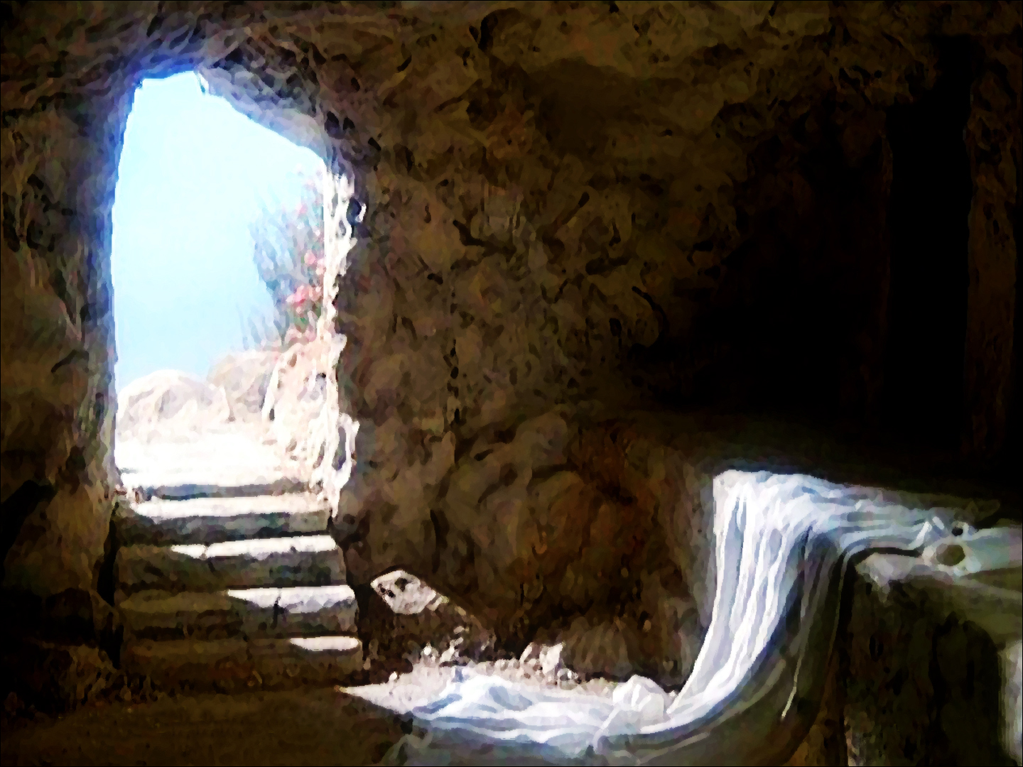
Resurrection Focus
(Acts 2:22-36)
The Spirit’s indwelling proved that Jesus as Messiah was raised to life (22-36).

Slide 41
³⁶ “So let everyone in Israel know for certain that God has made this Jesus, whom you crucified, to be both Lord and Messiah!”
³⁷ Peter’s words pierced their hearts, and they said to him and to the other apostles, “Brothers, what should we do?”
Acts 2:36-37 (NLT)

Slide 42
³⁸ Peter replied, “Each of you must repent of your sins and turn to God, and be baptized in the name of Jesus Christ for the forgiveness of your sins. Then you will receive the gift of the Holy Spirit. ³⁹ This promise is to you, to your children, and to those far away—all who have been called by the Lord our God.”
Acts 2:38-39 (NLT)

Slide 43
⁴⁰ Then Peter continued preaching for a long time, strongly urging all his listeners, “Save yourselves from this crooked generation!”
⁴¹ Those who believed what Peter said were baptized and added to the church that day—about 3,000 in all.
Acts 2:40-41 (NLT)

Slide 44
The Spirit proving Christ as Messiah has implications for all of us
Unbelievers: Has he saved you?

Slide 45
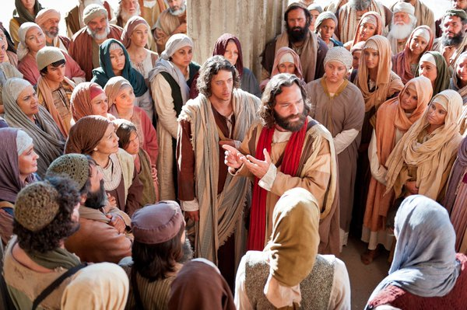
Peter Led 3000 to Christ at Pentecost
"Those who accepted his message were baptized, and about three thousand were added to their number that day."
Acts 2:41 NIV

Slide 46
The Spirit proving Christ as Messiah has implications for all of us
Unbelievers: Has he saved you?
Believers: Has he changed you?

Slide 47
Believers are different but still part of one body (12:13)
"For we were all baptized with one Spirit into one body—whether Jews or Greeks, slave or free—and we were all given one Spirit to drink" (1 Cor. 12:13)
Notes:
47

Slide 48

"Do you not know that your body is a temple of the Holy Spirit, who is in you, whom you have received from God? You are not your own; ²⁰you were bought at a price. Therefore honor God with your body"
(1 Cor 6:19-20 NIV).
Notes:
One of the greatest ways we witness for Jesus is how we treat our bodies.

Slide 49
The Spirit reverses Babel (1-13)
Why submit to the Spirit?
The Spirit proves Jesus (14-41).
The Spirit unites us (42-47).

Slide 50
⁴² All the believers devoted themselves to the apostles’ teaching, and to fellowship, and to sharing in meals (including the Lord’s Supper), and to prayer.
⁴³ A deep sense of awe came over them all, and the apostles performed many miraculous signs and wonders.
Acts 2:42-43 (NLT)

Slide 51
⁴⁴ And all the believers met together in one place and shared everything they had. ⁴⁵ They sold their property and possessions and shared the money with those in need.
Acts 2:44-45 (NLT)

Slide 52
⁴⁶ They worshiped together at the Temple each day, met in homes for the Lord’s Supper, and shared their meals with great joy and generosity— ⁴⁷ all the while praising God and enjoying the goodwill of all the people. And each day the Lord added to their fellowship those who were being saved.
Acts 2:46-47 (NLT)

Slide 53
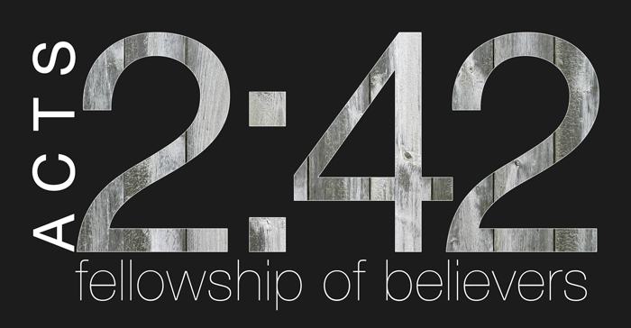
Acts 2:42
A Key Verse

Slide 54
Life Together (Acts 2:42-47)
Teaching
Fellowship
Meals
Prayer
Awe
Miracles
Generosity
Growth
Notes:
Their sense of awe and the miracles performed by the apostles can find a parallel today in our amazement of God’s answered prayer.
The generosity encompassed sharing, community, worship, joy, and a good reputation.
This all led to growth.

Slide 55
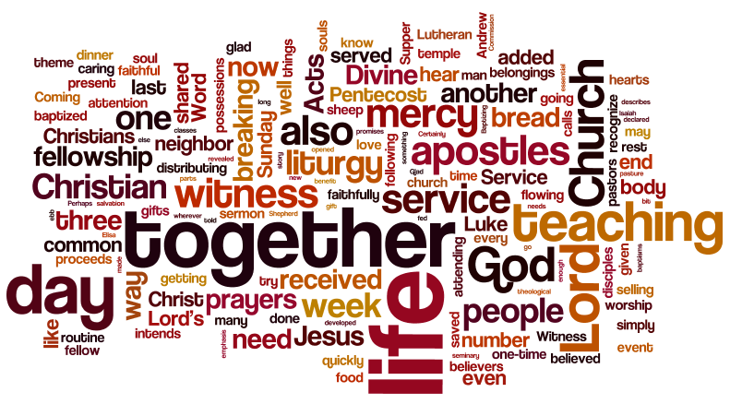
Acts 2:43-47
Text

Slide 56

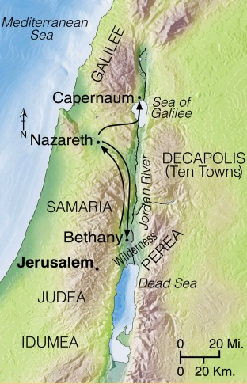
Progress Reports
125
End of the Earth
Key Verse: 1:8
2:47b
6:7
8:40
9:31
12:24
16:5
19:20
28:30-31
1:1–6:7
6:8–8:40
Acts 9–28
Why end this way?
Adapted from Stanley D. Toussaint, BKC; Jeremy Chew, EAST

Slide 57
Passage Idea
The purpose for the baptism with the Spirit was to show Jesus as the risen Messiah can save people from all nations into Christ’s church.

Slide 58
The Spirit reverses Babel (1-13)
Why submit to the Spirit?
The Spirit proves Jesus (14-41).
The Spirit unites us (42-47).

Slide 59
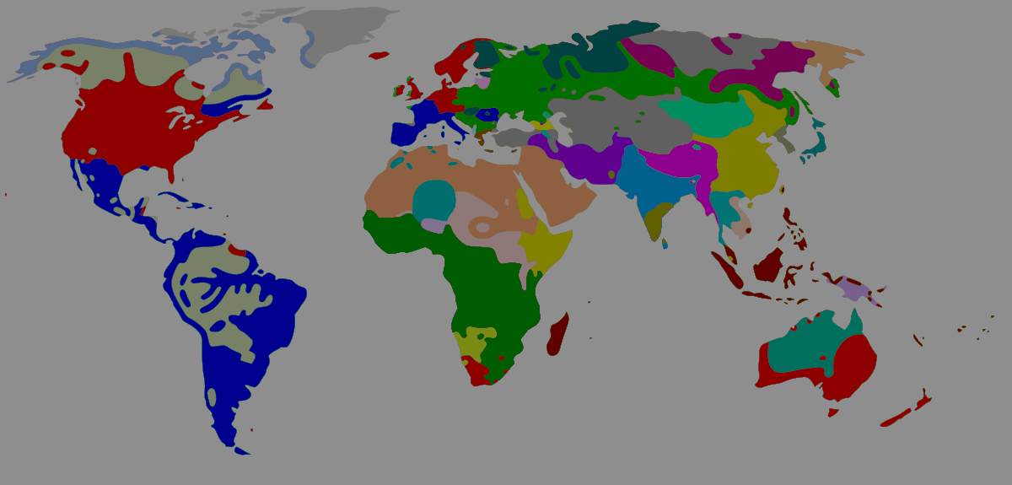
Main Idea of Acts 2
The Spirit put you into Christ’s body to reach the nations

Slide 60

Music Ministry
Children’s Ministry
Online Ministry
Small Groups
Hospitality

Slide 61
Black

Slide 62


NT Preaching link at BibleStudyDownloads.org
Get this presentation and script for free!

