Slide 1
Following GOD Sets us FREE
Acts 25–26
Matt Lyle • Crossroads International Church Singapore
CICFamily.com
Notes:
Today we are going to look at Acts, chapters 25 and 26. We will see that following God sets us free.
Paul has been waiting patiently in Caesarea for two years. But Paul also knows that it is God’s plan for him to go to Rome.
And although Paul is being held prisoner, he is actually free because he is following God’s will, not man’s plan.
Paul knows that because he is following God’s will, he can be thankful in all circumstances.
Even though he is a prisoner, he is free because of his hope in Jesus.
Go ahead and turn to Acts 25 and let us read about how God, working through Paul, sets in motion the chain of events that results in Paul eventually going to Rome.
Photo by Zhu Liang on Unsplash
https://unsplash.com/photos/eoy0fuzH5ss

Slide 2
Waiting
Notes:
Life seems to be filled with waiting.
As a school-age child in Singapore, you must wait for your PSLE results and your GCE O or N level results.
As a young Singaporean male, you must wait until you complete your 2-year national service obligation.
As a single adult Singaporean, you must wait until you are 35 before you are eligible to purchase an HDB flat.
Many of you have been waiting for the past 2 months just to be able to go to a restaurant with your family.
Photo by Zhu Liang on Unsplash
https://unsplash.com/photos/eoy0fuzH5ss

Slide 3
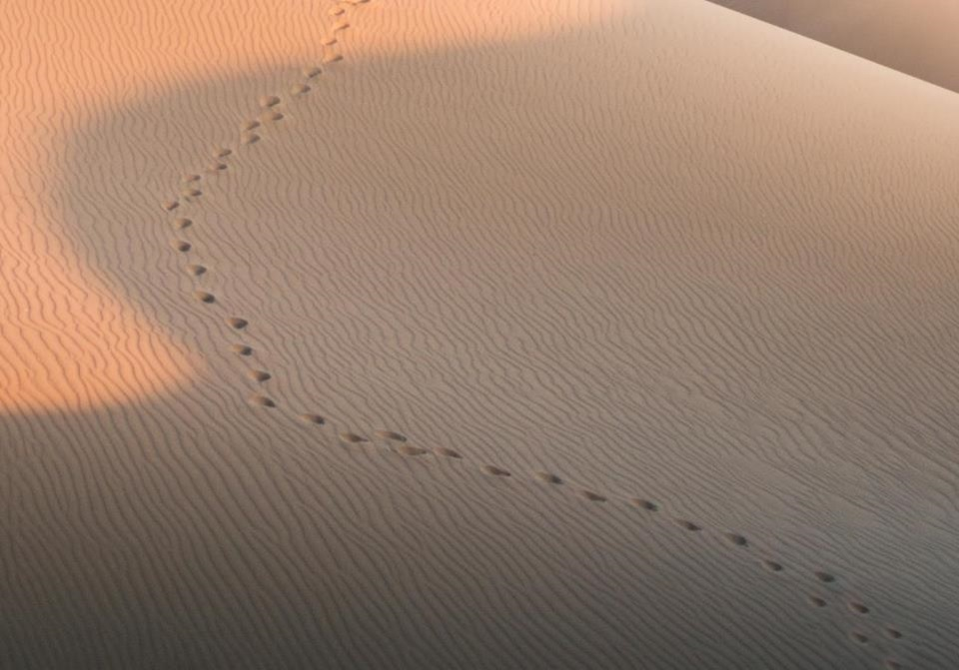
GOOD NE WS
ON THE MO VE
God’s work through the early church in
Acts
Notes:
When you read the book of Acts, you usually don’t see much waiting.
That’s because the Book of Acts is about
the Good News, ---on the Move.
It is about God’s work ---through the early church
With all this movement, you can easily miss the periods of waiting.
But, the end of chapter 24 (which we covered last week) has one such period of waiting.

Slide 4
Caesarea
Jerusalem
Notes:
To recap, the Apostle Paul has completed his third missionary journey. He has felt a calling to go to Rome but first had to return to Jerusalem.
He was warned (through prophecy) that when he returned to Jerusalem, he would be bound by the Jewish leaders and turned over to the Gentiles.
That is precisely what happened. Paul was at the temple, the Jews started a riot and were beating Paul, so the Roman guards arrested Paul.
After his arrest, Paul had a chance to speak first to the crowd, then to the Jewish high council.
Then, after hearing of a plot to take his life, the Roman guards were informed, and Paul was taken to Caesarea under heavy guard.
Brisco, T. V. (1998). Holman Bible atlas (p. 251). Nashville, TN: Broadman & Holman Publishers.

Slide 5
Paul Speaks:
to the crowd
to the High Council
to Governor Felix
Acts 24:27 After two years went by in this way, Felix was succeeded by Porcius Festus. And because Felix wanted to gain favor with the Jewish people, he left Paul in prison.
Notes:
Once Paul reached Caesarea, a trial was held, and he had a chance to defend himself before Governor Felix.
Governor Felix, however, stopped the trial. Felix would occasionally call for Paul but would become frightened when Paul talked about righteousness and the coming day of Judgment. It was also noted that Governor Felix hoped Paul would give him a bribe.
THE LAST VERSE of Acts 24 tells us that “After two years went by in this way, Felix was succeeded by Porcius Festus. And because Felix wanted to gain favor with the Jewish people, he left Paul in prison” (Acts 24:27 NLT).
Photo by Bill Oxford on Unsplash
https://unsplash.com/photos/OXGhu60NwxU

Slide 6
Following GOD Sets us FREE
Acts 25–26
Matt Lyle • Crossroads International Church Singapore
CICFamily.com
Notes:
Today we are going to look at Acts, chapters 25 and 26. We will see that following God sets us free.
Paul has been waiting patiently in Caesarea for two years. But Paul also knows that it is God’s plan for him to go to Rome.
And although Paul is being held prisoner, he is actually free because he is following God’s will, not man’s plan.
Paul knows that because he is following God’s will, he can be thankful in all circumstances.
Even though he is a prisoner, he is free because of his hope in Jesus.
Go ahead and turn to Acts 25 and let us read about how God, working through Paul, sets in motion the chain of events that results in Paul eventually going to Rome.
Photo by Zhu Liang on Unsplash
https://unsplash.com/photos/eoy0fuzH5ss

Slide 7
Changing of the Guard
Felix => Festus
Notes:
Starting at Acts 25:1, we read that “Three days after Festus arrived in Caesarea to take over his new responsibilities, he left for Jerusalem, ² where the leading priests and other Jewish leaders met with him and made their accusations against Paul” (Acts 25:1-2 NLT).
We have a changing of the guard. Governor Festus has now replaced Governor Felix.
A quick review on Felix—he was governor or procurator over the Roman province of Judea for 8 years. When Paul was on trial before Felix, Paul noted that Felix had been a judge of Jewish affairs for many years. Although Felix was knowledgeable of Jewish affairs, he kept Paul in prison (as we already said) because he wanted a bribe, and he wanted to gain favor with the Jewish people.
Festus is the new guy. He needs to start his tenure as governor on the right foot. He needs to learn about the territory he has been assigned. So he goes to Jerusalem.
Photo by Toa Heftiba on Unsplash
https://unsplash.com/photos/PxM8hw4j3ZY

Slide 8
Caesarea
Jerusalem
Notes:
So Festus, the new governor, arrives in Jerusalem and meets with the Jewish leaders.
Starting with vs. 3, we see that “They asked Festus as a favor to transfer Paul to Jerusalem (planning to ambush and kill him on the way)” (Acts 25:3).
The Jewish leaders knew that a trial would not convict Paul, so they needed to ambush him. They have been waiting to deal with their Paul problem for 2 years. If you recall from the last chapter, a group of more than 40 Jews made an oath not to eat or drink until they had killed Paul. However, since it has been 2 years, they were either really hungry, or they broke their oath.
Continuing with vs. 4: “But Festus replied that Paul was at Caesarea and he himself would be returning there soon. ⁵ So he said, ‘Those of you in authority can return with me. If Paul has done anything wrong, you can make your accusations.’” (Acts 25:4-5 NLT).
By our standards, it seems Governor Festus is off to a good start. He wants to do what is right by Roman law If you’ve done something wrong, you deserve a fair trial.
Image from Brisco, T. V. (1998). Holman Bible atlas (p. 251). Nashville, TN: Broadman & Holman Publishers.

Slide 9
Not Guilty:
Jewish Laws
Temple
Roman Government
Notes:
So once again, Paul is on trial. Continuing with vs. 6: “About eight or ten days later Festus returned to Caesarea, and on the following day he took his seat in court and ordered that Paul be brought in. ⁷ When Paul arrived, the Jewish leaders from Jerusalem gathered around and made many serious accusations they couldn’t prove” (Acts 25:6-7 NLT).
Of course, they couldn’t prove the charges. The charges were baseless, to begin with. And now 2 years have passed.
Continuing in vs 8: ⁸ Paul denied the charges. “I am NOT GUILTY of any crime against the Jewish laws or the Temple or the Roman government,” he said.
Photo by Bill Oxford on Unsplash
https://unsplash.com/photos/OXGhu60NwxU

Slide 10
Baseless
Charges
Acts 24:5-6
Cause Riots
Leader of Nazarenes
Desecrating Temple
Notes:
Luke doesn’t bother to record the charges in this trial before Festus. But if you go back to chapter 24, the Jewish Lawyer Tertullus charged Paul with being:
“a troublemaker who is constantly stirring up riots among the Jews all over the world
. . . a ringleader of the cult known as the Nazarenes
. . . (and) trying to desecrate the Temple” (Acts 24:5-6 NLT).
These are the charges Paul addresses when he states is not guilty of crimes against Jewish Law, the Temple or the Roman Government.
The Jewish teachers think Paul’s teachings were contrary to Jewish law, which caused riots. In reality, Paul’s teachings were the culmination of Jewish law, as many Jews who became Christian would attest to.
Regarding the temple, Paul was participating in a purification ritual, when the Jews caused the riot. If anyone was desecrating the temple it was the Jews.
And finally, the leader of the Nazarenes was Jesus, not Paul. Paul was merely a follower. And being a follower of Jesus was not contrary to the Roman Government.
Photo by Bill Oxford on Unsplash
https://unsplash.com/photos/OXGhu60NwxU

Slide 11
Changing of the Guard
Grade Repot Festus
Notes:
So now what?
• The charges are baseless.
• They cannot be proven.
• They are 2 years old.
How does the new governor respond? “⁹ Then Festus, wanting to please the Jews, asked him, ‘Are you willing to go to Jerusalem and stand trial before me there?’”
Governor Festus, you were doing so good. You were trying to do what is right. But now you are just trying to gain political favor with the Jews. That’s just sad. Festus was doing so well but has thrown away doing the right thing because he wanted to be liked by the Jews.
Paul recognized this. So he replied in vs 10: “No! This is the official Roman court, so I ought to be tried right here. You know very well I am not guilty of harming the Jews. ¹¹ If I have done something worthy of death, I don’t refuse to die. But if I am innocent, no one has a right to turn me over to these men to kill me. I appeal to Caesar!”
Photo by Toa Heftiba on Unsplash
https://unsplash.com/photos/PxM8hw4j3ZY

Slide 12
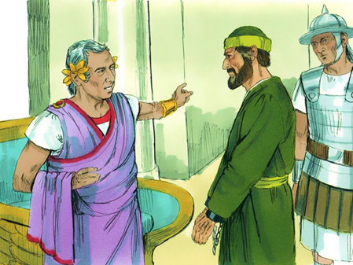
Appeal to Caesar
Notes:
Being a Roman Citizen is very beneficial. So is being Singaporean. The Singaporean passport will grant you access to 192 countries, ranking second in the world, only behind Japan, which has access to 193 countries.
Although Paul doesn’t have a powerful passport, he has the right to not be beaten before a trial, which he already used. And he had the right to have his trial heard in Rome. Pretty powerful stuff.
Not much Festus could do, so in vs ¹²: “Festus conferred with his advisers and then replied, ‘Very well! You have appealed to Caesar, and to Caesar you will go!’”
Image by Sweet Publishing at https://www.freebibleimages.org/illustrations/paul-festus-agrippa/ (CC BY-SA 3.0)

Slide 13
The Wait is Over
Acts 23:11
That night the Lord appeared to Paul and said, “Be encouraged, Paul. Just as you have been a witness to me here in Jerusalem, you must preach the Good News in Rome as well.”
Notes:
There is a lot of waiting in the Bible
• Abraham had to wait 25 years after he received the promise of a son before Isaac was born.
• The nation of Israel had to wait 40 years wandering the desert before entering the promised land (of course, that was their fault).
• Nehemiah waited for 3 to 4 months after receiving the distressing news about Jerusalem before God planted it on the Persian King’s heart to let Nehemiah go back to rebuild the city walls.
• Paul had been waiting for 2 years for Governor Felix to make a decision in his case. Knowing that in Acts 23:11, the Lord appeared to Paul, encouraged him, letting him know he must preach the Good News in Rome. Finally, we can see how this will happen.
Photo by Zhu Liang on Unsplash
https://unsplash.com/photos/eoy0fuzH5ss

Slide 14
The Wait is Over
Notes:
We can learn a lesson about following God’s will from Paul. We may know what the end result should look like, but we don’t how to get there. Paul probably did not know how he was going to get to Rome. But he didn’t mope and complain. Instead, he waited patiently and used every opportunity to tell the previous governor (Felix) about faith in Christ Jesus.
I’ve known for probably the past 9 or 10 years, I would be a missionary at some point in my life. But it wasn’t until last year I felt the calling to step forward and quit my job and attend seminary. So my changing of the guard was not a new Roman governor. Instead, it was my children moving out of the house.
We all have changes going on all the time.
We are also all called by God for something.
So take each changing of the guard in your life to examine:
• where your life is now
• where God is calling you to be
• and then how to get there.
Photo by Zhu Liang on Unsplash
https://unsplash.com/photos/eoy0fuzH5ss

Slide 15
The World will not Understand
=
King Agrippa
King Herod Agrippa II
Notes:
Once you figure out where you are going, the journey is not easy.
When you choose to follow God’s calling in your life, some people will not understand.
In the next section, Felix, the new Governor, does not understand Paul’s actions. So he confers with King Agrippa.
Starting in vs. 13, we see that “¹³ A few days later KING AGRIPPA arrived with his sister, Bernice, to pay their respects to Festus.
There are a lot of repeated names in the Bible when it comes to the various Kings. This King Agrippa is actually King Herod Agrippa the second.

Slide 16
Herods of the Bible
Herod (the Great)
Met wise men
Killed babies in Jerusalem
Notes:
Lets go back and look at all the Herods in the New Testament. Here is a quick overview. Since these slides are available on our website so I will go through them quickly.
The first Herod, is known as Herod the Great. He was King when Jesus was born, he met the wise men and killed the babies in Jerusalem.

Slide 17
Herods of the Bible
Herod (the Great)
Herod Antipas
Herod Archelaus
Herod Philip
Caused Joseph to return to Nazareth (when returning from Egypt)
Notes:
When he died, Rome decided that his Kingdom would be split between 3 of his sons.
Herod Archelaus was not a good ruler, he was so bad that Joseph was warned to return to Nazareth after Herod the Great’s death and the family was returning from Egypt. He was eventually fired by the Roman senate. His territory was then ruled by Roman governors.

Slide 18
Herods of the Bible
Herod (the Great)
Herod Antipas
Herod Archelaus
Herod Philip
Wife, Herodias, left him for his brother Antipas
Notes:
Herod Philip was actually a pretty good guy. Unfortunately for him, his wife left him for his brother, Herod Antipas.

Slide 19
Herods of the Bible
Herod (the Great)
Herod Antipas
Herod Archelaus
Herod Philip
Married his brothers wife, Herodias
Executed John the Baptist
Presided over Jesus’ trial
Notes:
Herod Antipas is the Herod that executed John the Baptist and presided of Jesus’ trial, conferring with Pontus Pilate.

Slide 20
Herods of the Bible
Herod (the Great)
Herod Antipas
Aristobulus IV
Herod Philip
Herod Archelaus
Herod Agrippa
Persecuted Christians (in Acts 12)
Notes:
Herod the Great had many other children. One of them, Aristobulus, was the father of Herod Agrippa.
Agrippa was sent to Rome to hobnob with Roman royalty. He became king by befriending the future emperor Caligula. His death is recorded in Acts 12 because he did not rebuke the people when they stated he has the voice of a God.

Slide 21
Herods of the Bible
Herod (the Great)
Herod Antipas
Aristobulus IV
Herod Philip
Herod Archelaus
Herod Agrippa
Listened to Paul’s defense (Acts 25-26)
Sisters Bernice and Drusilla (married to Felix)
Herod Agrippa II
Notes:
We finally get to Herod Agrippa II. We already met his sister, Drusilla, who was married to the former governor Roman Felix.

Slide 22
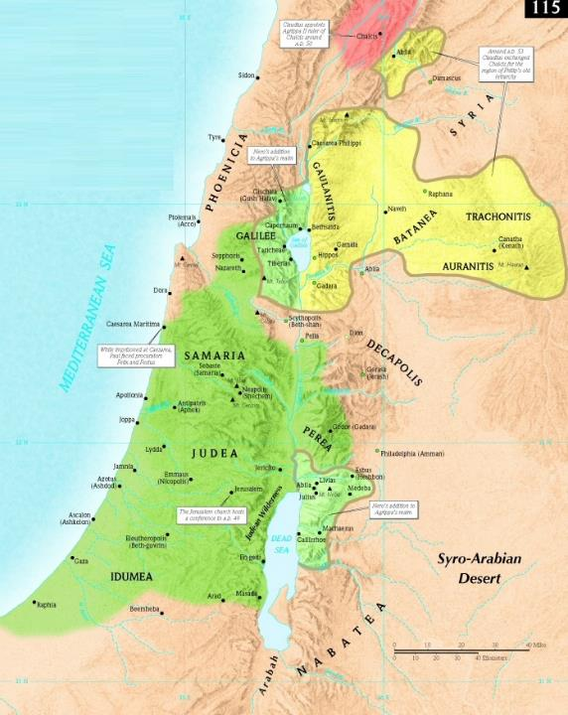
Agrippa II
AD 48-53: Agrippa II 1st kingdom
AD 53
AD 61
Roman governor (Felix / Festus)
Notes:
Although Agrippa II was the firstborn son, he was too young for Rome to give him any territory after his father’s death.
Eventually Rome gave him a small kingdom, and because he did well, ended up giving him more and more land. However, the largest portion of Herod the Great’s previous territory remained under control of the Roman Governors.
This is the King Agrippa in whom Governor Festus confided in.
Brisco, T. V. (1998). Holman Bible atlas (p. 239). Nashville, TN: Broadman & Holman Publishers.

Slide 23
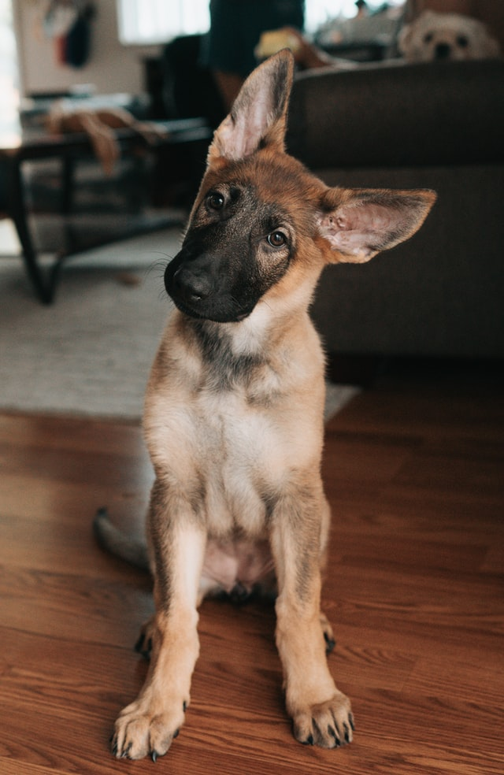
The World will not Understand
Notes:
In the next section we will see that Governor Festus does not understand the arguments being made against Paul. But he also does not understand Paul’s response.
Continuing in vs. 14: “During their stay of several days, Festus discussed Paul’s case with the king. ‘There is a prisoner here,’ he told him, ‘whose case was left for me by Felix. ¹⁵ When I was in Jerusalem, the leading priests and Jewish elders pressed charges against him and asked me to condemn him. ¹⁶ I pointed out to them that Roman law does not convict people without a trial. They must be given an opportunity to confront their accusers and defend themselves.
¹⁷ “When his accusers came here for the trial, I didn’t delay. I called the case the very next day and ordered Paul brought in. ¹⁸ But the accusations made against him weren’t any of the crimes I expected. ¹⁹ Instead, it was something about their religion and . . .
Photo by Dex Ezekiel on Unsplash
https://unsplash.com/photos/fg8tdcxrkrA

Slide 24
Key Truth
a dead man named Jesus, who Paul insists is alive.
Acts 25:19b
Notes:
. . . a dead man named Jesus, who Paul insists is alive.
A dead man named Jesus, who Paul insists is alive. Governor Festus, who is a pagan Roman governor, new to the area, just captured the heart of Christianity. A Deadman named Jesus who IS alive.
And Paul is not the only one who insists Jesus is alive.
When Thomas saw Jesus, he said, “My Lord and My God.”

Slide 25
Key Truth
⁵ He was seen by Peter and then by the Twelve. ⁶ After that, he was seen by more than 500 of his followers at one time, most of whom are still alive, though some have died. ⁷ Then he was seen by James and later by all the apostles.
1 Cor 15:5-7 NLT
Notes:
Paul writes:
⁵ He was seen by Peter and then by the Twelve. ⁶ After that, he was seen by more than 500 of his followers at one time, most of whom are still alive, though some have died. ⁷ Then he was seen by James and later by all the apostles.
Jesus rose from the dead. Our God is alive.

Slide 26
The World will not Understand
Notes:
Even though Governor Festus’ statement captured the heart of Christianity, he really does not know what is going on. Continuing in vs. 20, he states: “²⁰ I was at a loss to know how to investigate these things, so I asked him whether he would be willing to stand trial on these charges in Jerusalem. ²¹ But Paul appealed to have his case decided by the emperor. So I ordered that he be held in custody until I could arrange to send him to Caesar.”
Festus has a problem. Paul is going to Rome. Festus has to give a reason why. All he has are baseless charges that can’t be proved. Paul should have been declared innocent and set free. But that was not God’s plan.
This intrigued Agrippa, who responded ²² “I’d like to hear the man myself,” Agrippa said. And Festus replied, “You will—tomorrow!”
Photo by Dex Ezekiel on Unsplash
https://unsplash.com/photos/fg8tdcxrkrA

Slide 27
Paul Speaks:
to the crowd
to the High Council
to Governor Felix
to King Agrippa
Notes:
Paul now gets to speak one more time. He already spoke to the crowd, to the Jewish High Council, actual trials before Governors Felix and then 2 years later to Governor Festus. His fate has already been determined. He is going to Rome.
But Governor Festus does not know why. Governor Festus does not understand that Paul knows Jesus is alive. Paul knows Jesus has risen from the dead. Paul knows that he has been called by God to go to Rome. It doesn’t matter how he gets there.
Festus may think Paul’s way is foolish, but in reality it is the world’s way that is foolish.
Photo by Dex Ezekiel on Unsplash
https://unsplash.com/photos/fg8tdcxrkrA

Slide 28
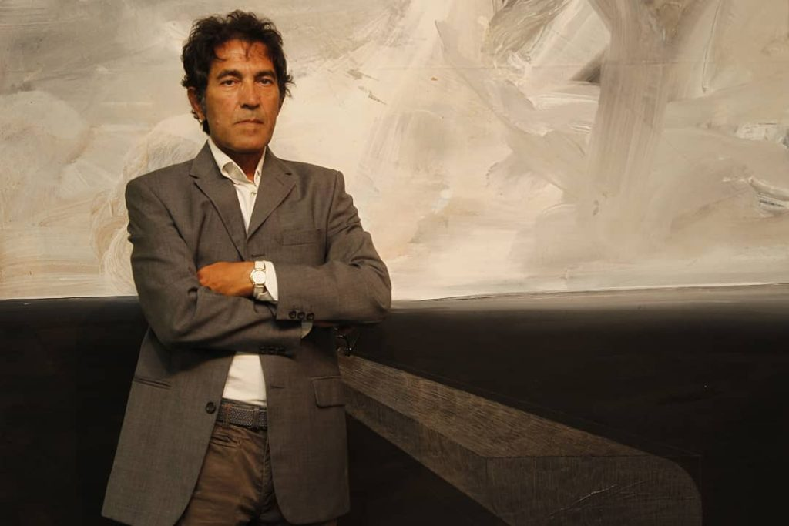
Invisible sculpture sold for SGD24K
Notes:
How foolish is the world. Have you heard of Salvatore Garau. I don’t think he is not foolish.
Back in May, he sold an “immaterial sculpture”—which is to say that it doesn’t exist, or its invisible for SGD 24,000.
Someone paid SGD 24,000 for an invisible sculpture? That tells me the world is foolish.
But Paul is not foolish. Neither are Christians . . .
whose hope is built on nothing less than Jesus’ blood and righteousness.
Christians who dare not trust the sweetest frame (or invisible painting)
But wholly lean on Jesus’ name.
On Christ the Solid Rock I stand, all other ground is sinking sand, or an invisible sculpture,
The world is foolish because they put their faith in “gods that are not God at all” as the prophet Jeremiah would say.
The world is foolish because they put their faith in invisible sculptures.
https://news.artnet.com/art-world/italian-artist-auctioned-off-invisible-sculpture-18300-literally-made-nothing-1976181

Slide 29
Acts 26
Paul before King Agrippa
Personal Testimony
Notes:
Moving on to ch 26, we finally get to hear Paul’s testimony in its entirety.
When Paul spoke to the crowd, he was interrupted when he said his mission was to the gentiles.
When he spoke to the high council, he was interrupted when he said his hope was in the resurrection.
When he spoke to Governor Felix, he was interrupted again after saying he was on trial for hope in the resurrection.
In his last trial with Governor Festus, he gave a simple summary not guilty against Jewish Law, the Temple, or the Roman government.
This is not just testimony in a criminal trial. This is Paul’s PERSONAL TESTIMONY on how he became a Christian.
All Christians have a personal testimony. We just don’t spend much time sharing it. A personal testimony is good because people can argue with your theology, but they can’t deny your experience. And almost everyone loves a story. A good personal testimony shares how Christianity is first a relationship (knowing Christ) and secondly a theology.
At Singapore Bible College, they taught us how to develop a simple 5 step testimony. I’ve included it on the notes page. You can even use it to grade Paul’s testimony here in ch 26.
Photo by Dex Ezekiel on Unsplash
https://unsplash.com/photos/fg8tdcxrkrA

Slide 30
Acts 26
Paul before King Agrippa
Introduction
vv. 1-3: acknowledges Agrippa as expert
vv. 4-5: mentions background as Pharisee
vv. 6-8: hope in fulfillment of God’s promise
Notes:
The SBC Grade sheet shows that a personal testimony starts with an introduction where you get the audience’s attention, you raise curiosity or a need.
Paul starts his testimony by mentioning that King Agrippa, unlike the new governor Festus, knows about Jewish customs and controversies.
In vs. 4 to 5, Paul mentions his background as a Pharisee.
In vs. 6 to 8, Paul presents the central question for his debate.
⁶ Now I am on trial because of my hope in the fulfillment of God’s promise made to our ancestors. ⁷ In fact, that is why the twelve tribes of Israel zealously worship God night and day, and they share the same hope I have. Yet, Your Majesty, they accuse me for having this hope! ⁸ Why does it seem incredible to any of you that God can raise the dead?
Paul is saying I am a Jew. I am an expert in Jewish Laws and customs. I have the same hope as all Jews. Why is that hope in resurrection? Paul now continues and will eventually answer that question.
I would call that an effective introduction.
Photo by Dex Ezekiel on Unsplash
https://unsplash.com/photos/fg8tdcxrkrA

Slide 31
Acts 26
Paul before King Agrippa
Pre-Conversion Life
vv. 9-11: persecuted Christians
Notes:
The next part of a personal testimony tells of your pre-conversion life. You are to explain your struggles. They need to be realistic and specific.
Paul’s struggles dealt with a bunch of religious heretics who claimed that a certain “Jesus” was, in fact, the Messiah, the fulfillment of all Jewish scriptures. He was given the task to hunt down these people who would later be called Christians.
Photo by Dex Ezekiel on Unsplash
https://unsplash.com/photos/fg8tdcxrkrA

Slide 32
Acts 26
Paul before King Agrippa
Conversion
vv. 9-11: persecuted Christians
vv. 12-18: meeting Jesus
Notes:
In fact, it was while Paul was chasing Christians down in foreign cities, he came to know Jesus. Paul states:
¹² “One day I was on such a mission to Damascus, armed with the authority and commission of the leading priests. ¹³ About noon, Your Majesty, as I was on the road, a light from heaven brighter than the sun shone down on me and my companions. ¹⁴ We all fell down, and I heard a voice saying to me in Aramaic, ‘Saul, Saul, why are you persecuting me? It is useless for you to fight against my will.’
¹⁵ “‘Who are you, lord?’ I asked.
“And the Lord replied, ‘I am Jesus, the one you are persecuting. ¹⁶ Now get to your feet! For I have appeared to you to appoint you as my servant and witness. Tell people that you have seen me, and tell them what I will show you in the future. ¹⁷ And I will rescue you from both your own people and the Gentiles. Yes, I am sending you to the Gentiles ¹⁸ to open their eyes, so they may turn from darkness to light and from the power of Satan to God. Then they will receive forgiveness for their sins and be given a place among God’s people, who are set apart by faith in me.’
That is a very dramatic conversion. For your own testimony, when did you recognize that Christ was the answer?
Photo by Dex Ezekiel on Unsplash
https://unsplash.com/photos/fg8tdcxrkrA

Slide 33
Acts 26
Paul before King Agrippa
Post-Conversion Life
vv. 9-11: persecuted Christians
vv. 12-18: meeting Jesus
vv. 19-23: positive results
Notes:
The next part of a personal testimony shows the positive results of your conversion. In Paul’s case, he tells King Agrippa that:
¹⁹ . . . I obeyed that vision from heaven. ²⁰ I preached first to those in Damascus, then in Jerusalem and throughout all Judea, and also to the Gentiles, that all must repent of their sins and turn to God—and prove they have changed by the good things they do. ²¹ Some Jews arrested me in the Temple for preaching this, and they tried to kill me. ²² But God has protected me right up to this present time so I can testify to everyone, from the least to the greatest. I teach nothing except what the prophets and Moses said would happen— ²³ that the Messiah would suffer and be the first to rise from the dead, and in this way announce God’s light to Jews and Gentiles alike.”
Photo by Dex Ezekiel on Unsplash
https://unsplash.com/photos/fg8tdcxrkrA

Slide 34
Key Truth
I preached first to those in Damascus, then in Jerusalem and throughout all Judea, and also to
the Gentiles,
Acts 26:20
Notes:
The entire theme of Acts is captures with Acts 1:8 when Jesus tells the apostles “you will be my witnesses, telling people about me everywhere—in Jerusalem, throughout Judea, in Samaria, and to the ends of the earth.”
Luke captures that same though when he mentions that Paul preached first to those in Damascus, then in Jerusalem and throughout all Judea, and also to the Gentiles
The key truth I want to point out is what Paul preached.

Slide 35
Key Truth
I preached first to those in Damascus, then in Jerusalem and throughout all Judea, and also to
the Gentiles, that all must repent of
their sins and turn to God—and prove they have changed by the good things they do.
Acts 26:20
Notes:
Paul preached that that all must repent of their sins and turn to God—and prove they have changed by the good things they do.
This message should look very familiar.

Slide 36
Key Truth
Matt 3:2: “Repent of your sins and turn to God, for the Kingdom of Heaven is near.”
Matt 4:17: From then on Jesus began to preach, “Repent of your sins and turn to God, for the Kingdom of Heaven is near.”
Acts 2:8: Peter replied, “Each of you must repent of your sins and turn to God, and be baptized in the name of Jesus Christ for the forgiveness of your sins.”
Notes:
John the Baptist preached Repent of your sins and turn to God, for the Kingdom of Heaven is near.
JESUS also began to preach, “Repent of your sins and turn to God, for the Kingdom of Heaven is near.
EVEN PETER, in his sermon on the day of Pentecost, when asked by the people what should we do answered by saying Each of you must repent of your sins and turn to God, and be baptized in the name of Jesus Christ for the forgiveness of your sins.

Slide 37
Key Truth
I preached first to those in Damascus, then in Jerusalem and throughout all Judea, and also to
the Gentiles, that all must repent of
their sins and turn to God—and prove they have changed by the good things they do.
Acts 26:20
Notes:
One final thing to point out on this key truth. How do you prove you have changed? How do you prove you have repented of your sins and turned to God?
Is it through baptism, is it though speaking in tongues, is it through handling snakes?
NO, the answer is right in the text. And prove they have changed by the good things they do.
Look at the sermon on the mount. Matthew records in Matthew 4 that “From then on Jesus began to preach, “Repent of your sins and turn to God, for the Kingdom of Heaven is near.”
What is Jesus’ first recorded sermon after this statement? The sermon on the mount Matthew 5-7. Let your good deeds shine out for all to see, so that everyone will praise your heavenly Father.

Slide 38
Acts 26
Paul before King Agrippa
Conclusion
vv. 9-11: persecuted Christians
vv. 12-18: meeting Jesus
vv. 19-23: positive results
v. 29: that everyone might believe
Notes:
The final part of a personal testimony is the conclusion. It answers the so what. If looking at Paul’s speech as a personal testimony the conclusion would be his response to King Agrippa: I am telling you this so that you might believe, that you might be the same as me, except for these chains.
What a powerful personal testimony. I think Paul would get a good grade using the SBC grade sheet.
Photo by Dex Ezekiel on Unsplash
https://unsplash.com/photos/fg8tdcxrkrA

Slide 39
Acts 26
Paul before King Agrippa
Thesis
Hope in the resurrection is fulfilled in Jesus
Notes:
But this speech is not just a personal testimony. It is also a trial (well sort of). Paul set up his defense by stating he was on trial because of his hope in the resurrection, which is the same hope all his people had.
Paul’s thesis is that
If I am on trial because of my hope in the resurrection, I am vindicated because my hope is found in Jesus, who is resurrected.
Paul is boldly proclaiming his innocence. But he is also trying to reach Agrippa, he is trying to reach Festus, with the message of the gospel. Jesus is the Messiah. We have a hope because of the resurrection.
Did Festus and Agrippa understand?
Photo by Dex Ezekiel on Unsplash
https://unsplash.com/photos/fg8tdcxrkrA

Slide 40
The World will not Understand
Notes:
They understood Paul was innocent. Verse 31 tells us, “As they went out, they talked it over and agreed, ‘This man hasn’t done anything to deserve death or imprisonment.’”
They didn’t understand that Paul was free because he was following God’ will even though we was going to Rome in chains. That’s in vs 32, “And Agrippa said to Festus, ‘He could have been set free if he hadn’t appealed to Caesar.’”
Did they understand the gospel? Did they repent of their sins and turn to God? I don’t think so. In verse 24, Festus shouted, “Paul, you are insane. Too much study has made you crazy!”
In vs 28 Agrippa interrupted him. “Do you think you can persuade me to become a Christian so quickly?”
Photo by Dex Ezekiel on Unsplash
https://unsplash.com/photos/fg8tdcxrkrA

Slide 41
“Do you think you can persuade me to be a Christian?”
“If someone asks about your hope as a believer, always be ready to explain it. But do this in a gentle and respectful way”
(1 Peter 3:15-16 NLT).
Notes:
Do you think you can persuade me to be a Christian? King Agrippa brings up an interesting question. But it is the wrong question. I believe that this question is a roadblock for most Christian, it keeps us from sharing our testimony.
It is not my job to persuade you to be a Christian. I like what Peter wrote: “If someone asks about your hope as a believer, always be ready to explain it. But do this in a gentle and respectful way” (1 Peter 3:15-16, NLT).
I don’t have to persuade anyone. But I do want to share my hope. That is why Paul was on trial. He was sharing his hope.

Slide 42
Be ready to explain . . .
Download “02-How to Share Your Testimony” at BibleStudyDownloads.org
Notes:
You don’t have to persuade, but you do need to be ready to explain, this means you need to be prepared.
Paul was prepared. Paul was ready to explain his hope when asked or given an opportunity. We can be to.
If you look at the handout, there are links to a CRU Singapore webpage that gives helpful tips on writing your personal testimony.
If you go to Dr Rick’s website, BibleStudyDownloads.org, you can download his entire homiletics course guide which has tips, his personal testimony, and the grade sheet I was mentioning earlier. But just download 02-How to Share Your Testimony-pp16-19_eng_pr_v4.docx. I also created an excerpt that was just 3 pages, then I added my personal testimony so now it’s 4 pages. That will be posted on our WhatsApp group shortly.
So prepare a personal testimony. Share it with your spouse, your family. If you want, Pastor Jim or I can take a look.
People are often afraid of sharing their testimony. They are bound by chains of uncertainty and doubt. But, when we know Christ, risen from the grave, and then follow his will, we will be free, even if in chains.
Let us pray:

Slide 43
Black

Slide 44
NT Preaching link at BibleStudyDownloads.org
Get this presentation for free!
Notes:
The Bible…Basically (bb)

