Slide 1
Elder Roles
Acts 20
Dr. Rick Griffith • Singapore Bible College • BibleStudyDownloads.org Crossroads International Church Singapore • CICFamily.com

Slide 2
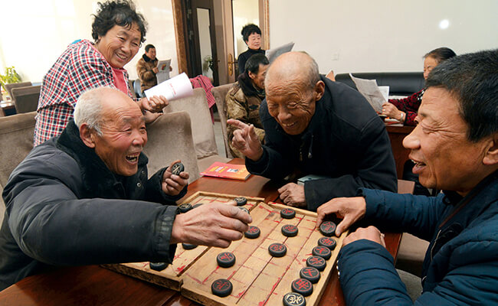
—Elders—
Notes:
Today we address elders. No—not the old folks who play games—

Slide 3
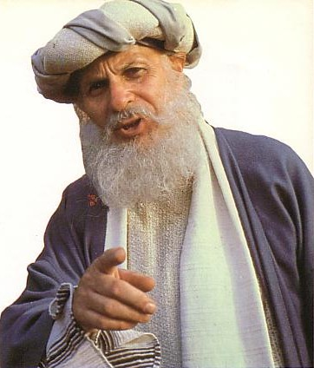
—Elders—
Notes:
—but the main leaders of the local church.

Slide 4
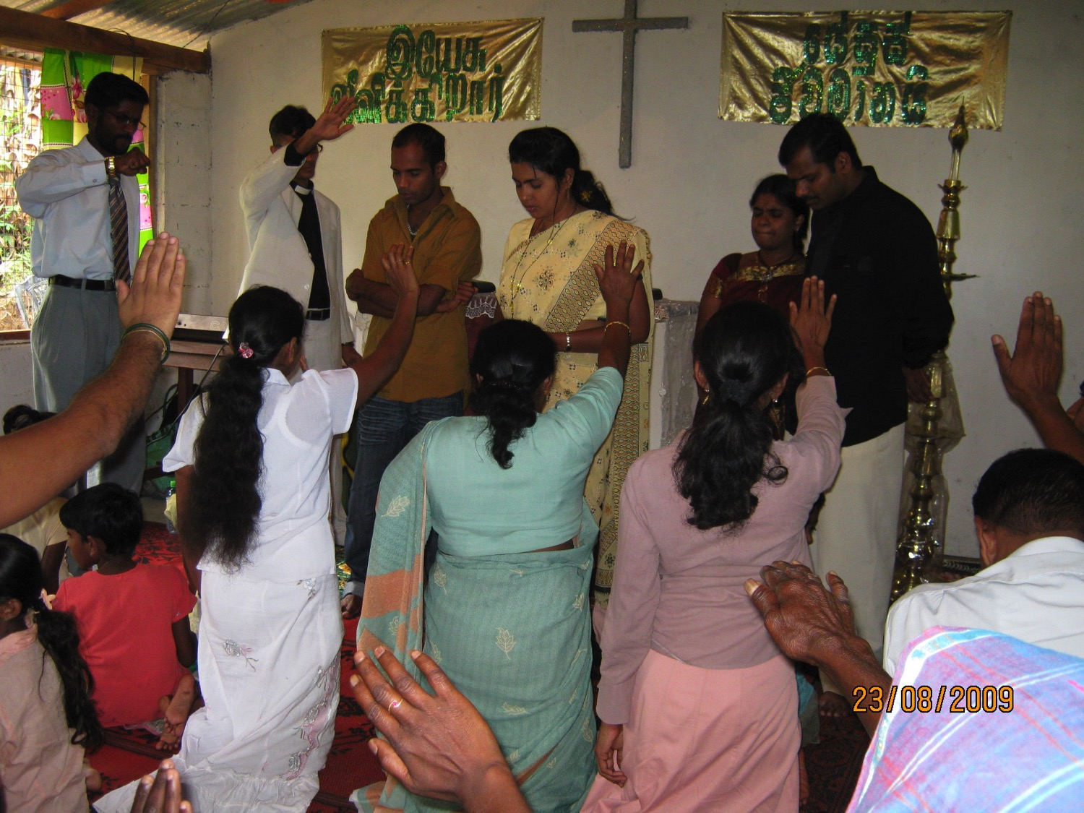
What are elders supposed to do?
Notes:
But Christians differ on what elders should do.
Some believe that all the elders do is serve communion.
Others think elders only carry on church traditions.
Elders sign papers and checks in the minds of others.
Some believe that elders function to give the impression to the congregation that the church isn't a "one-man show."

Slide 5
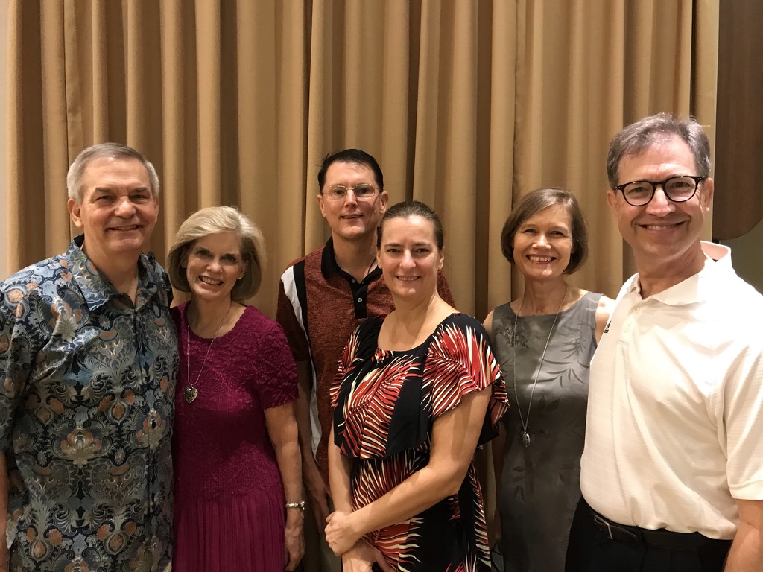
Our Church
2021 elders & wives
Notes:
Need: Here is the latest picture of our elders and their wives. Do you know what elders are supposed to do?
Can you name one Scripture on elder duties?
We have no excuse to be ignorant of elder roles since the NT addresses the issue many times.

Slide 6
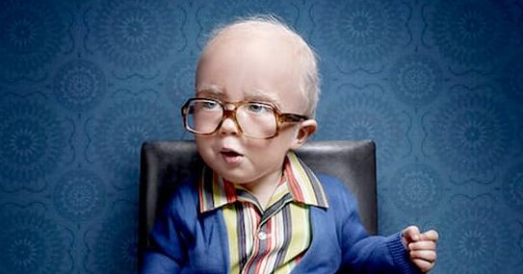
Who are you older than?
Notes:
But you say, “Nice that this message doesn’t apply to me! I can catch up on my sleep!” No, what we will see today does not only apply to elders. Each of us is older than someone else who looks up to us—so think of those who look to you, no matter how old you are. Let’s shepherd the flock we each have under our care—whether the whole church as elders, or our families, or friends.

Slide 7
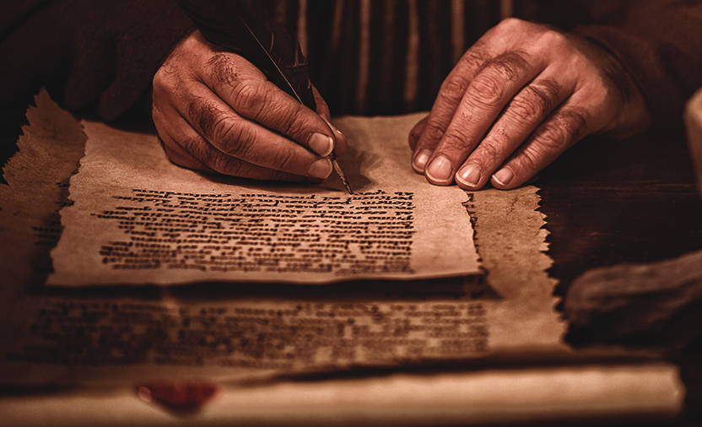
Background
What are elders supposed to do?
Notes:
Subject: So what are elders supposed to do?

Slide 8
The biblical pattern is church leadership by elders.
236a
Notes:
Elders Background: Elders have been around for millennia.

Slide 9
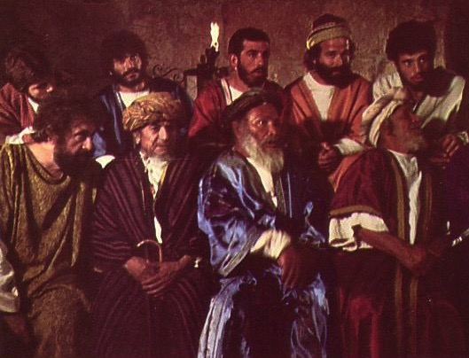
Elders led from the time of Moses
48
Elders led with Moses
1400 BC
“Go, assemble the elders of Israel and say to them…” (Exod. 3:16)
Notes:
Moses had elders in 1400 BC (Exodus 3:16).

Slide 10
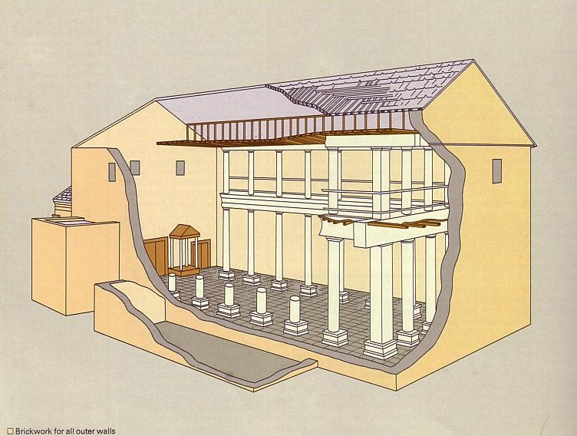
Who Led the Synagogue?
51
Elders led with Moses
1400 BC
Elders led Synagogues 600 BC
Notes:
Synagogues were led by elders from 600 BC to Jesus.

Slide 11
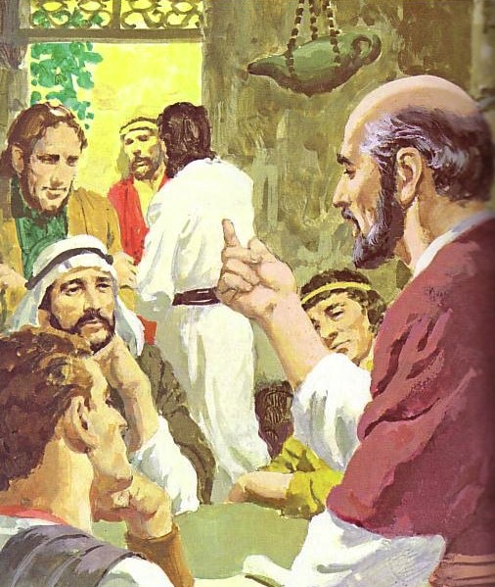
God has advocated group leadership through the ages
55
Elders led with Moses
1400 BC
Elders led Synagogues 600 BC
NT Elders
Notes:
Each NT church was led by elders.

Slide 12
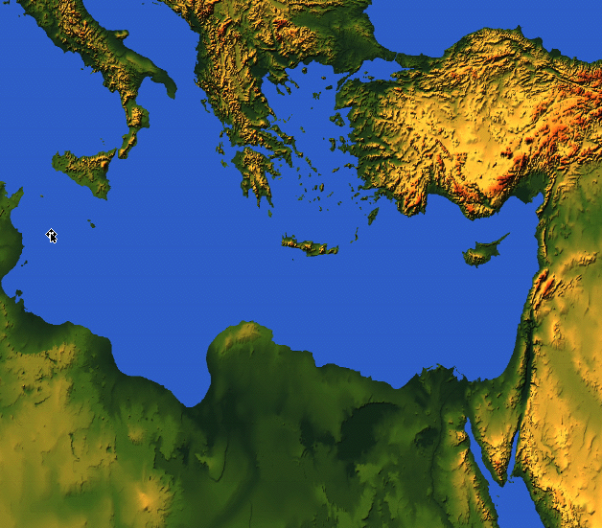
Places Mentioning Elders
elders = overseers = bishops = pastors
55
Jerusalem (AD 47):
NIV Acts 11:30 This they did, sending their gift to the elders by Barnabas and Saul.
Ephesus (AD 57):
NIV Acts 20:17 From Miletus, Paul sent to Ephesus for the elders of the church.
Galatia (AD 48):
NIV Acts 14:23 Paul and Barnabas appointed elders {or Barnabas ordained elders; or Barnabas had elders elected} for them in each church
Crete (AD 66):
NIV Titus 1:5 The reason I left you in Crete was that you might straighten out what was left unfinished and appoint {or ordain} elders in every town, as I directed you.
Philippi (AD 62):
NIV Philippians 1:1 Paul and Timothy, servants of Christ Jesus, To all the saints in Christ Jesus at Philippi, together with the overseers and deacons:
Pontus, Galatia, Cappadocia, Asia & Bithynia (AD 64)
NIV 1 Peter 5:1 To the elders among you, I appeal as a fellow elder… (cf. 1:1)
Notes:
Every NT church had elder leadership—whether Jewish, Gentile, or mixed—whether in Israel or modern-day Turkey or Greece or the Mediterranean Island of Crete.

Slide 13
Acts Series
GOOD NE WS
ON THE MO VE
God’s work through the early church in
Acts
Notes:
Acts Background: Paul modeled the elder lifestyle before he preached it to others in Acts where the Good News was on the Move.

Slide 14
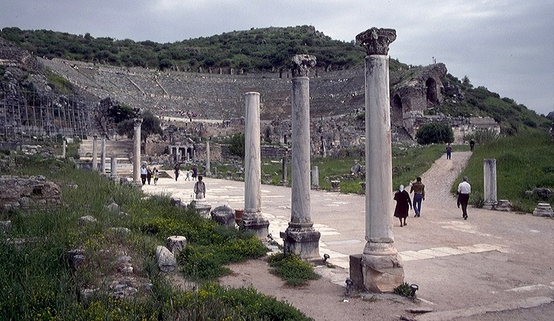
3."The Asian Thrust"
A.D. 53-57
ATLANTIC OCEAN
EUROPE
ANCIENT EPHESUS
ROME•
•Macedonia
ASIA
•Pisidian Antioch
•
•Ephesus
AFRICA
Athens
Acts 18-21
•Syrian Antioch
MEDITERRANEAN SEA
3.The Asian Thrust
•Jerusalem
Significance: extended time at the church in Ephesus; young man raised from the dead; important letters written; riot with Ephesian artisans at amphitheatre.
ARABIA
9.65.08.
45
4
© 2006 TBBMI
9.65.08.
Notes:
Paul had previously ministered in the Ephesian church for nearly three years (Acts 19; 20:31).
Then came Paul's ASIAN THRUST…recorded in Acts 18-21.
//// Again, this trip began overland from Syrian Antioch…revisited many of the earlier churches…made a horseshoe-shaped route around the Aegean, back down into Greece, retraced that route back around the horseshoe, remaining at Troas, then returning by sea to Syrian Antioch.
//// Paul spent a very long time living and ministering to the church in EPHESUS. Luke reports that Paul raised a young man from the dead in Ephesus. Many important letters –– our Epistles –– were written from Ephesus.
//// One of the most dramatic events recorded for us took place at the Ephesian AMPHITHEATRE where he confronted the souvenir makers of the city…those who manufactured small idols of the Goddess Diana, whose temple in Ephesus was one of the seven wonders of the ancient world.
//// LENGTH OF THIS TRIP: ALMOST FIVE YEARS BETWEEN A.D. 53 AND 57.

Slide 15
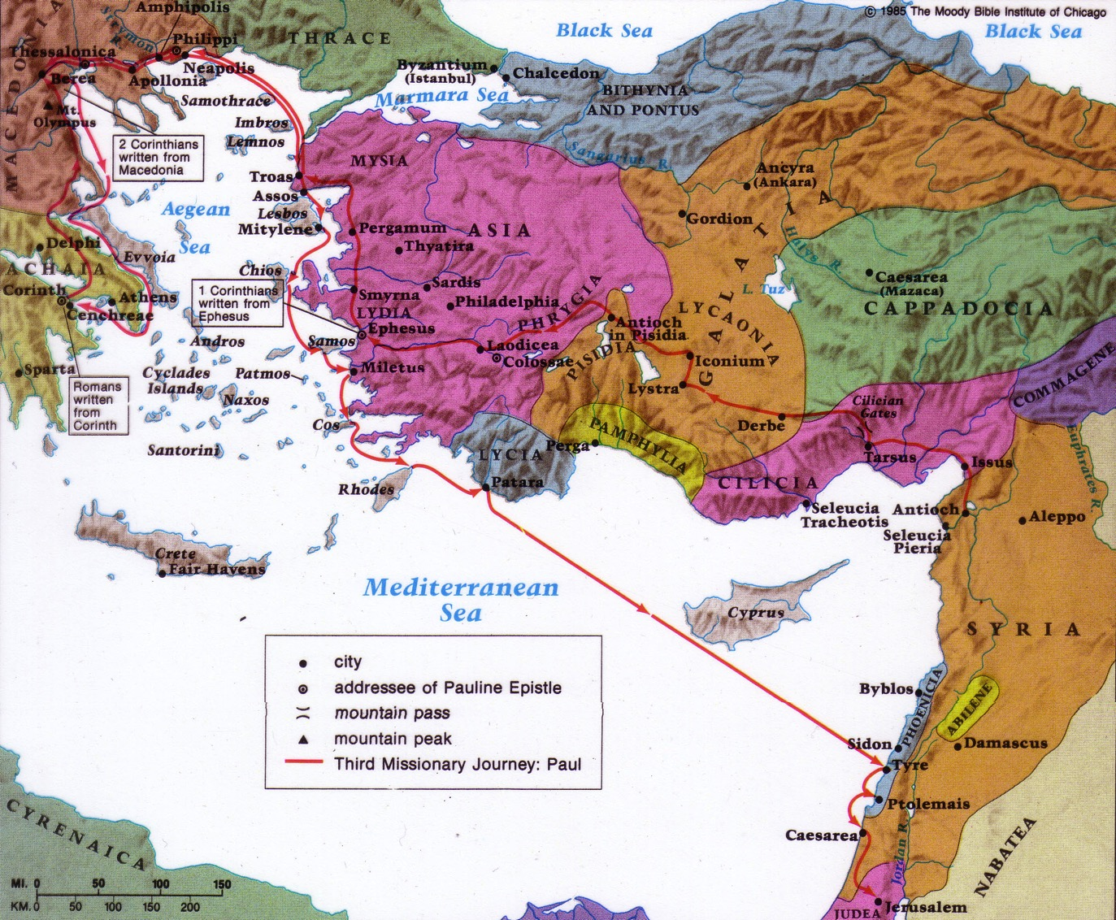
Paul's Third Missionary Journey
140
EPHESUS
Paul taught in Ephesus "for two years, so that all of Asia heard the word of the Lord" (Acts 19:10)
Notes:
He then ministered in Macedonia and Greece and Troas and coastal towns near Ephesus (20:1-15).
Paul stopped by the coastal town of Miletus while traveling to Jerusalem at the end of his third missionary journey (Acts 20:16,17a).
Knowing that he would soon die (20:25), Paul requested the Ephesian elders to come to him to hear his parting words (17b-18a).

Slide 16
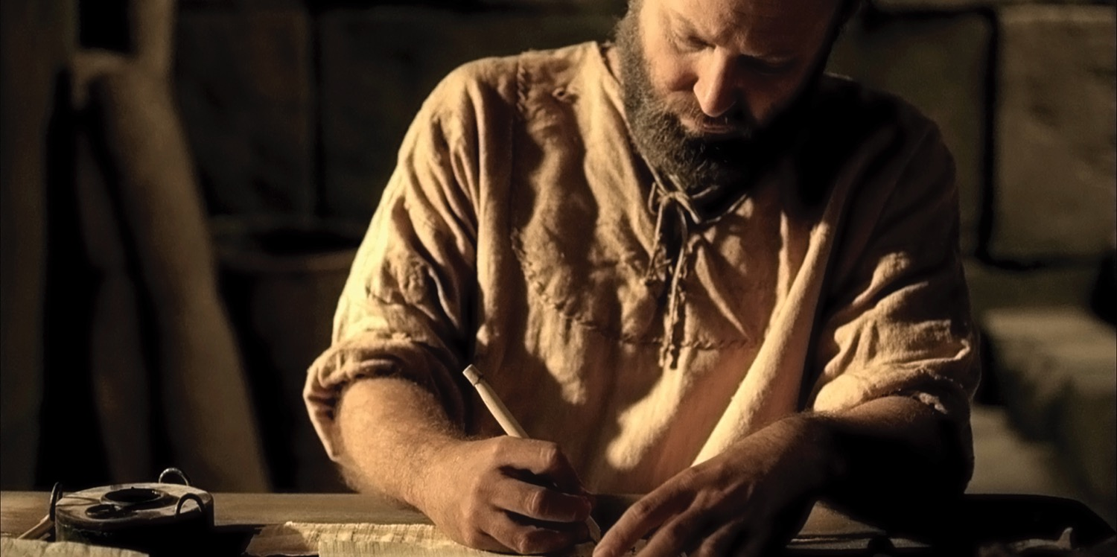
The Apostle Paul (Acts 20:18b-35)
Notes:
Preview: In our text today from Acts 20:18b-35, Paul shows first how he modeled being an elder and then what the elders were specifically supposed to do.
Text: Today we will observe Paul's example and instructions to elders concerning their job description found in Acts 20:18b-35.
(Paul knew that the success of the church at Ephesus would rest upon the faithfulness of the men who led the flock. But before charging the men with their responsibilities, Paul elaborated on his own life as an example.)

Slide 17
Paul modeled shepherding for the elders (Acts 20:18b-27).
Presence —where he was (18b)
Passion —what he felt (19)
Proclamation —what he preached (20-21)
Persecution —where he was going (22-23)
Priorities —what he valued (24-27)
Notes:
[He knew that more is caught than taught—so he set an example of care for them.]
A. Paul cared like an elder in his past ministry at Ephesus (18b-21).
1. Paul cared by his presence—where he was (18).
a) I once knew an elder who resigned due to the increased traveling responsibilities of his job. Through this he actually showed his commitment to the men.
b)As elders we must be available men.
2. Paul cared in his passion—what he felt (19).
a) He lived in brokenness.
b) He endured many trials that came with caring for people.
3. Paul cared in his proclamation—what he preached (20-21).
a) We must teach the basics: repentance towards God and faith in Christ.
b) Elders must not neglect evangelism.
B. Paul cared like an elder in his present situation (22-27).
1. Paul cared despite persecution—where he was going (22-23).
2. Paul cared by his priorities—what he valued (24-27).
(In light of Paul’s example, what specifically should elders do? He gives the Ephesian elders [and us] his charge in the following verses.)

Slide 18
My Only Aim
“But my life is worth nothing to me unless I use it for finishing the work assigned me by the Lord Jesus—the work of telling others the Good News about the wonderful grace of God”
(Acts 20:24 NLT).
Notes:
My only aim is within these verses!

Slide 19
Elders should follow Paul’s shepherding example (Acts 20:28-35).
236c1
Administration (Serve, care for & testify)
Teaching
1 Tim. 3:2; 5:17; Acts 20:28d
1 Tim. 3:1, 4-5; 5:17; Acts 20:28c
Pastor-Teacher
Episkopos =
Epi “over” +
skopos “look” =
“watch over”
Eph. 4:11
Pastoring (Protect & Lead)
1 Pet. 5:1-4
Acts 20:28a-b, 29, 35
1 Thess. 5:12
Notes:
They must lead the sheep like Paul cared for people.

Slide 20
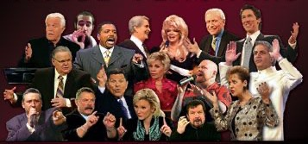
External False Teachers
Acts 20:29
Notes:
God hates false teaching, and we must hate what God hates.

Slide 21
Opposition
External
Notes:
God is truth—so whatever is not true cannot be allowed into the church.

Slide 22
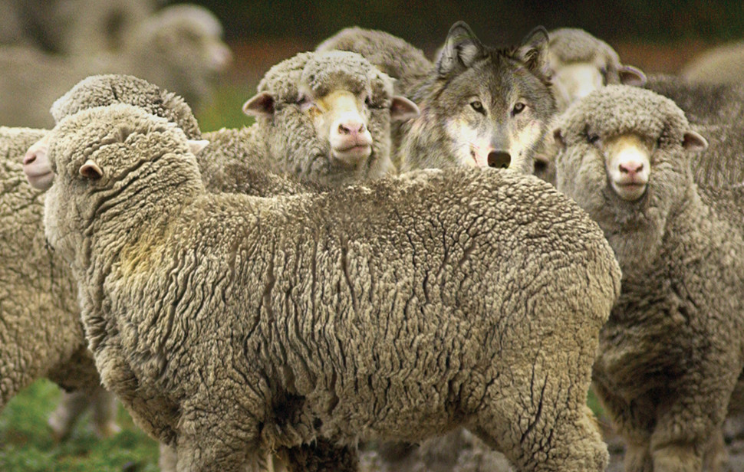
Internal False Teachers
Acts 20:30
Notes:
Sadly, too many churches have wolves right there among the sheep.

Slide 23
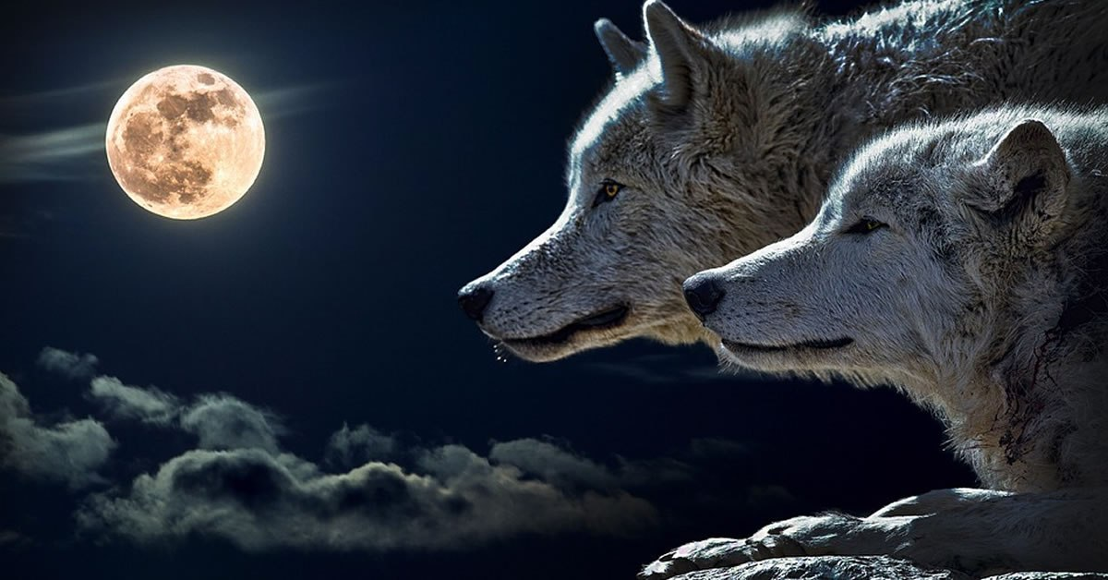
Black

Slide 24
Opposition
External
Internal
Notes:
Sadly, too many churches have wolves right there among the sheep.
Let's warn a factious (heretical) man only twice before we expel him from the body (Tit 3:10-11).

Slide 25
Elders must serve selflessly (Acts 20:32-35).
Founded on God’s grace and Word (32).
Based on hard work instead of greed (33-35).
Notes:
Be careful how others interpret the way we spend our money to avoid showing covetousness or greed (33-34a).
Set an example for the church in selfless giving (34b-38).

Slide 26
What are elders supposed to do?

Slide 27
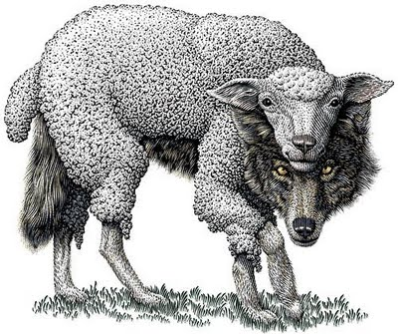
Main Idea of Acts 20
Elders should be selfless shepherds against false teachers

Slide 28
Watch Paul
Mimic Paul

Slide 29
What About You?
How can you better shepherd the flock under your care—whether the whole church as elders, or your family or friends?
Notes:
Acts 20 actually applies to us all.

Slide 30
Paul modeled shepherding for the elders (Acts 20:18b-27).
Presence —where he was (18b)
Passion —what he felt (19)
Proclamation —what he preached (20-21)
Persecution —where he was going (22-23)
Priorities —what he valued (24-27)
Notes:
[He knew that more is caught than taught—so he set an example of care for them.]
A. Paul cared like an elder in his past ministry at Ephesus (18b-21).
1. Paul cared by his presence—where he was (18).
a) I once knew an elder who resigned due to the increased traveling responsibilities of his job. Through this he actually showed his commitment to the men.
b)As elders we must be available men.
2. Paul cared in his passion—what he felt (19).
a) He lived in brokenness.
b) He endured many trials that came with caring for people.
3. Paul cared in his proclamation—what he preached (20-21).
a) We must teach the basics: repentance towards God and faith in Christ.
b) Elders must not neglect evangelism.
B. Paul cared like an elder in his present situation (22-27).
1. Paul cared despite persecution—where he was going (22-23).
2. Paul cared by his priorities—what he valued (24-27).
(In light of Paul’s example, what specifically should elders do? He gives the Ephesian elders [and us] his charge in the following verses.)

Slide 31
Elders should follow Paul’s shepherding example (Acts 20:28-35).
236c1
Administration (Serve, care for & testify)
Teaching
1 Tim. 3:2; 5:17; Acts 20:28d
1 Tim. 3:1, 4-5; 5:17; Acts 20;28c
Pastor-Teacher
Episkopos =
Epi “over” +
skopos “look” =
“watch over”
Eph. 4:11
Pastoring (Protect & Lead)
1 Pet. 5:1-4
Acts 20:28a-b, 29, 35
1 Thess. 5:12

Slide 32
Black

Slide 33
NT Preaching link at BibleStudyDownloads.org
Get this presentation and script for free!

