Slide 1
A Church on the Go!
Preached by Dr. Ron Sheveland at Crossroads International Church Singapore • cicfamily.com Uploaded by Dr. Rick Griffith • Singapore Bible College Files in many languages for free download at BibleStudyDownloads.org

Slide 3
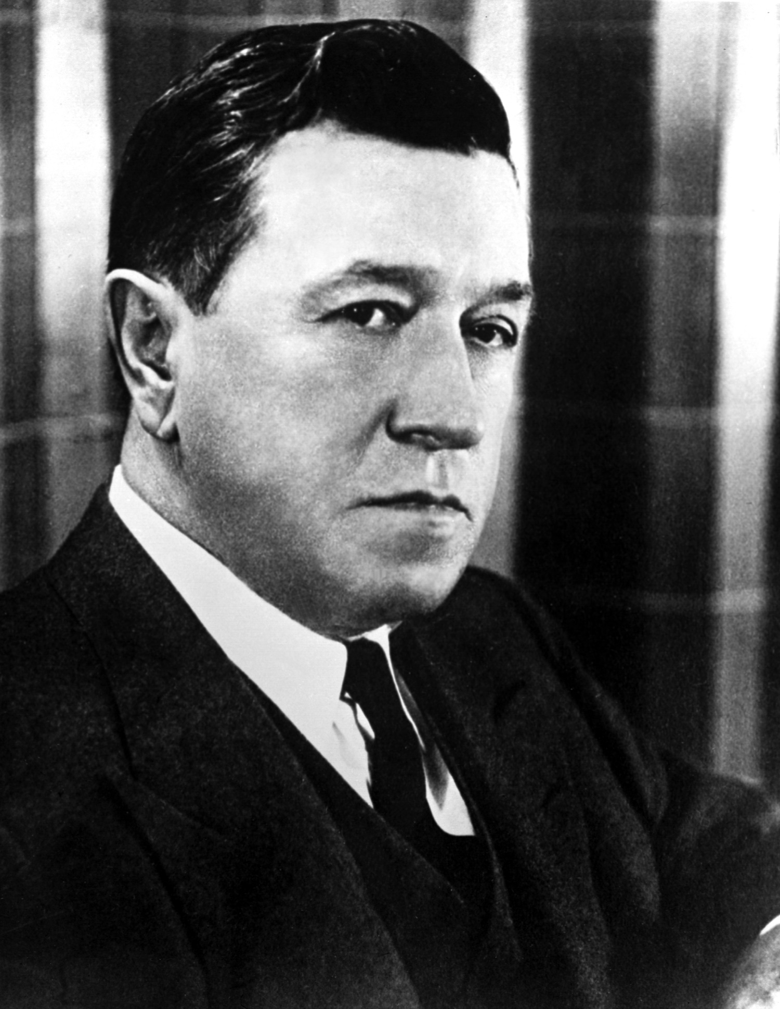
Robert Woodruff

Slide 4
Vision
Mission
Cooperation

Slide 5
OUR MISSION:
Making Disciples
Matt. 28:18-20 "Then Jesus came to them and said, `All authority in heaven and earth has been given to me. (19) Therefore go and make disciples of all nations, baptizing them in the name of the Father and of the Son and of the Holy Spirit, (20) and teaching them to obey everything I have commanded you. And surely I am with you always, to the very end of the age."

Slide 6
OUR MISSION:
Making Disciples
Matt. 28:18-20 "Then Jesus came to them and said, `All authority in heaven and earth has been given to me. (19) Therefore go and make disciples of all nations, baptizing them in the name of the Father and of the Son and of the Holy Spirit, (20) and teaching them to obey everything I have commanded you. And surely I am with you always, to the very end of the age."

Slide 7
What are the 3 parts of the Great Commission?
1. Reach
2. Baptize
3. Teach

Slide 8
OUR VISION:
Making Disciples
locally, regionally and globally
The Prophecy: Acts 1:8
"But you will receive power when the Holy Spirit comes on you; and you will be my witnesses in Jerusalem, and in all Judea and Samaria, and to the ends of the earth."

Slide 9
OUR VISION:
Making Disciples
locally, regionally and globally
The Prophecy: Acts 1:8
"But you will receive power when the Holy Spirit comes on you; and you will be my witnesses in Jerusalem, and in all Judea and Samaria, and to the ends of the earth."

Slide 10
The
"Acts 1:8"
Target
LOCAL
(Jerusalem)
REGIONAL
(Judea & Samaria)
GLOBAL
(Uttermost)

Slide 11
The Fulfillment:
Book of Acts
1. LOCALLY, The church began existence in Jerusalem (1-7)
2. REGIONALLY, The church expanded into Judea & Samaria (8-12)
3. GLOBALLY, The church extended to the ends of the earth (13-23)

Slide 12
OUR COOPERATION
Christians & churches
teaming together
to make disciples.

Slide 13
LOCALLY,
the church began existence in Jerusalem (1-7)
1:15 "In those days Peter stood up among the believers (a group numbering about a hundred and twenty)."

Slide 14
2:40-42 "With many other words he warned them; and he pleaded with them, 'Save yourselves from this corrupt generation.' Those who accepted his message were baptized, and about three thousand were added to their number that day. They devoted themselves to the apostles' teaching and to the fellowship, to the breaking of bread and to prayer."

Slide 15
2:46-47 "Every day they continued to meet together in the temple courts. They broke bread in their homes and ate together with glad and sincere hearts, praising God and enjoying the favor of all the people. And the Lord added to their number daily those who were being saved."

Slide 16
4:4 "But many who heard the message believed, and the number of men grew to about five thousand."

Slide 17
4:31 "After they prayed, the place where they were meeting was shaken. And they were all filled with the Holy Spirit and spoke the word of God boldly."

Slide 18
5:14 "Nevertheless, more and more men and women believed in the Lord and were added to their number."

Slide 19
6:1,7 "In those days when the number of disciples was increasing (KJV: "multiplied"), the Grecian Jews among them complained against the Hebraic Jews because their widows were being overlooked in the daily distribution of food... So the word of God spread. The number of disciples in Jerusalem increased rapidly, and a large number of priests became obedient to the faith."

Slide 20
REGIONALLY, the church expanded into Judea & Samaria (8-12)
8:4,5,12 "Those who had been scattered preached the word wherever they went. Philip went down to a city in Samaria and proclaimed the Christ there... But when they believed Philip as he preached the good news of the kingdom of God and the name of Jesus Christ, they were baptized, both men and women."

Slide 21
9:31 "Then the church throughout Judea, Galilee and Samaria enjoyed a time of peace. It was strengthened; and encouraged by the Holy Spirit, it grew in numbers, living in the fear of the Lord."

Slide 22
“The church needs to equip a generation of Christians with a deep passion to plant significant, biblically based Great Commission churches. These, in turn, will commit themselves to the task of sowing churches to reach various people groups at home and abroad. This is by no means a new vision; it is already present in the pages of the Book of Acts!” -- Aubrey Malphurs

Slide 23
11:19-21 "Now those who had been scattered by the persecution in connection with Stephen traveled as far as Phonecia, Cyprus and Antioch, telling the message only to the Jews. Some of them, however, men from Cyprus and Cyrene went to Antioch and began to speak to Greeks also, telling them the good news about the Lord Jesus. The Lord's hand was with them, and a great number of people believed and turned to the Lord."

Slide 24
Acts 11:26, 29, 30 for a whole year Barnabas and Saul met with the church and taught great numbers of people. The disciples were called Christians first at Antioch…
29 The disciples, each according to his ability, decided to provide help for the brothers living in Judea. 30 This they did, sending their gift to the elders by Barnabas and Saul.
Big Hearted Generosity!

Slide 25
GLOBALLY, The church extended to the ends of the earth (13-23)
13:1-5 In the church at Antioch there were prophets and teachers: Barnabas, Simeon called Niger, Lucius of Cyrene, Manaen… and Saul. While they were worshiping the Lord and fasting, the Holy Spirit said, "Set apart for me Barnabas and Saul for the work to which I have called them." So after they had fasted and prayed, they placed their hands on them and sent them off... When they arrived at Salamis, they proclaimed the word of God in the Jewish synagogues.

Slide 26
GLOBALLY, The church extended to the ends of the earth (13-23)
13:38-39 "Therefore, my brothers, I want you to know that through Jesus the forgiveness of sins is proclaimed to you. Through him everyone who believes is justified from everything you could not be justified from by the law of Moses…
13:49 The word of the Lord spread through the whole region.
13:52 And the disciples were filled with joy and with the Holy Spirit.

Slide 27
GLOBALLY, The church extended to the ends of the earth (13-23)
14:1 "At Iconium Paul and Barnabus went as usual into the Jewish synagogue. There they spoke so effectively that a great number of Jews and Gentiles believed."

Slide 28
14:21-22 They preached the good news in that city and won a large number of disciples. Then they returned to Lystra, Iconium and Antioch, 22 strengthening the disciples and encouraging them to remain true to the faith.
15:40-41 40 but Paul chose Silas and left, commended by the brothers to the grace of the Lord. 41 He went through Syria and Cilicia, strengthening the churches.

Slide 29
Missions consists of making more and better
churches that are
making more and better disciples.

Slide 30
16:5 "So the churches were strengthened in the faith and grew daily in numbers."

Slide 31
17:4 "Some of the Jews were persuaded and joined Paul and Silas, as did a large number of God-fearing Greeks and not a few prominent women."

Slide 32
19:8-10 "Paul entered the synagogue and spoke boldly there for three months, arguing persuasively about the kingdom of God. But some of them were obstinate; they refused to believe and publicly maligned the Way. So Paul left them. He took the disciples with him and had discussions daily in the lecture hall of Tyrannus. This went on for two years, so that all the Jews and Greeks who lived in the province of Asia heard the word of the Lord."

Slide 33
21:19-21 "Paul greeted them (Jerusalem elders) and reported in detail what God had done among the Gentiles through his ministry. When they heard this, they praised God. Then they said to Paul: `You see, brother, how many thousands of Jews have believed, and all of them are zealous for the law.'"

Slide 34
28:30-31 "For two whole years Paul stayed there in his own rented house and welcomed all who came to see him. Boldly and without hindrance he preached the kingdom of God and taught about the Lord Jesus Christ."
The mission continues…
Will you be part of ACTS 29?

Slide 35
What are we to do?
Reach
Baptize
Teach
That’s mission!

Slide 36
Where are we to do it?
Locally
Regionally
Globally
That’s vision!

Slide 37
Who should do it?
Christians
Churches
Church Partnerships
That’s Cooperation!

Slide 38
A Spirit of Cooperation
We know that no one Christian or church can effectively carry out the Great Commission, but the book of Acts demonstrates that together we can!

Slide 39
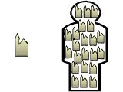
Your Church Body Partners
With A Body of Churches

Slide 40
Dear Ministry Partners,
“I thank my God every time I remember you. In all my prayers for all of you, I always pray with joy because of your partnership in the gospel” (Phil 1:3-4).
It is plain to see why Paul treasured their “partnership in the gospel.” The world was radically changed because Christians partnered with other Christians and churches partnered with other churches.
Let’s do it again!

Slide 41
We Have A World To Reach!

Slide 42
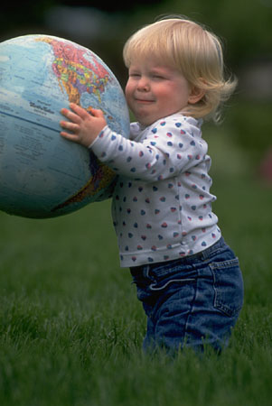
You don’t have to do it alone!

Slide 43
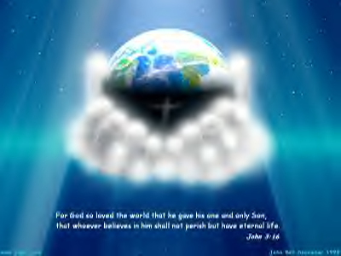
Together we can reach our world
through the power of God!

Slide 45
He’s the real thing. Christ!

Slide 48
Training church leaders around the world through: international teaching & internet resourcing

Slide 49
Questions?
Contact Ron Sheveland at
www.i-training.info

Slide 50
Black

Slide 51
NT Preaching link at BibleStudyDownloads.org
Get this presentation and script for free!
Notes:
NT Preaching (np)

