Slide 1
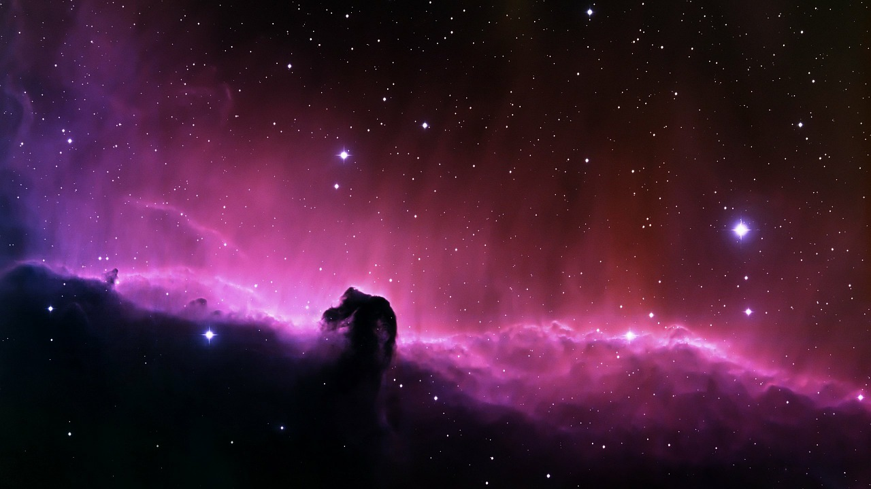
An Incomplete Gospel, an Incomparable God
Acts 18:23–19:20
Preached by Manik Corea
at Crossroads International Church Singapore • CICFamily.com
Uploaded by Dr. Rick Griffith • Singapore Bible College
Files in many languages for free download at BibleStudyDownloads.org

Slide 2
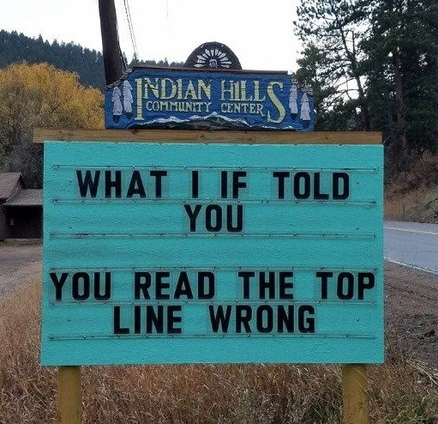

Slide 3

What is the
GOSPEL?

Slide 4
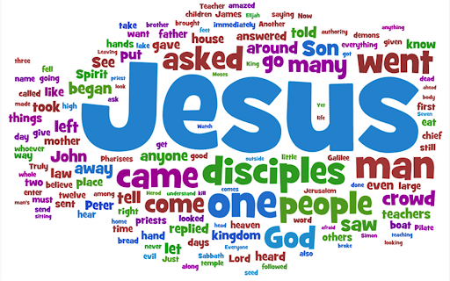

Slide 5

GOOD NE WS
ON THE MO VE
God’s work through the early church in
Acts

Slide 6
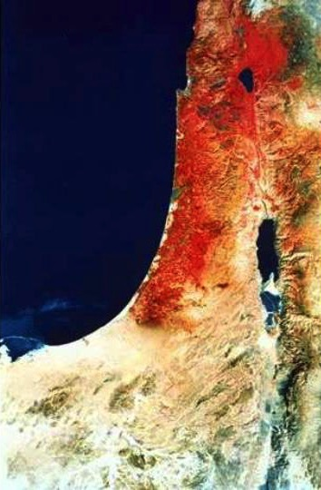
The end of the earth
Acts 1:8 ESV
But you will receive power when the Holy Spirit has come upon you, and you will be my witnesses in Jerusalem and in all Judea and Samaria, and to the end of the earth.”
Samaria
Jerusalem
Judea

Slide 7
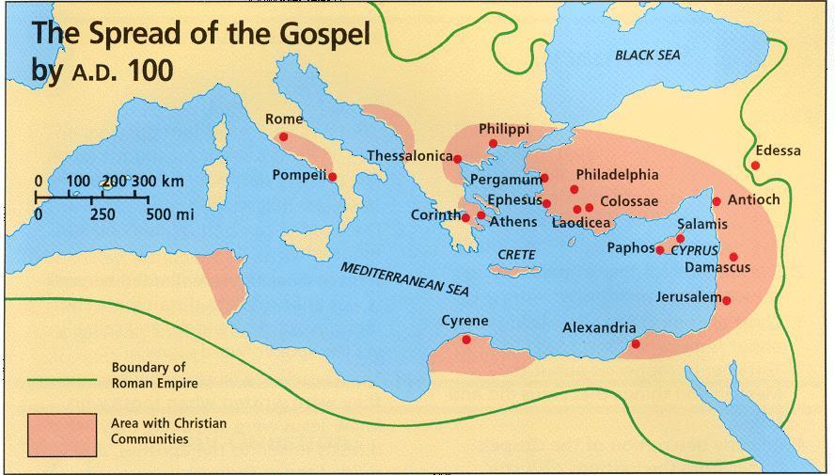

Slide 8
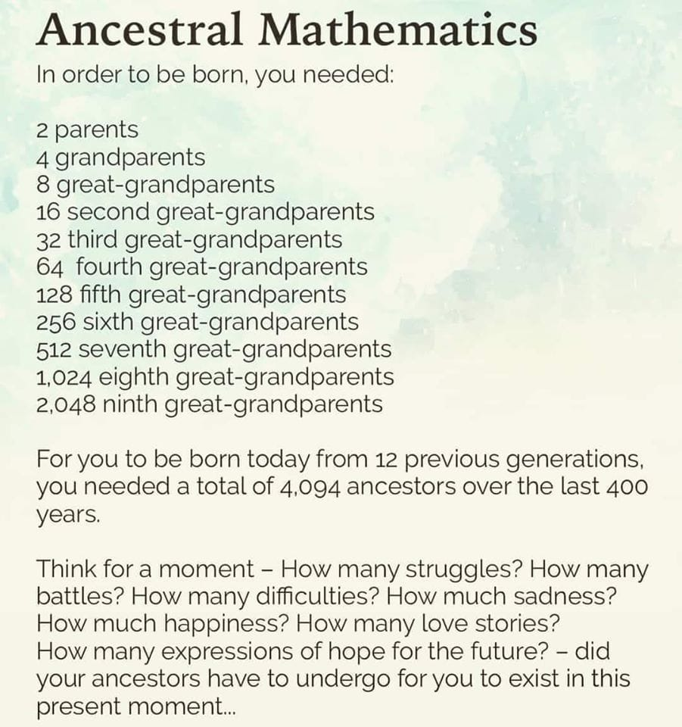

Slide 9

THE COMMUNION OF SAINTS

Slide 10


Slide 11
The Holy Spirit in Luke/Acts
Gospel of Luke
Jesus anointed by Holy Spirit at his baptism (Luke 3:22)
Proclaimed at start of his ministry – “The Spirit of the Lord is upon me…. to proclaim good news to the poor” (Luke 4:17-21)
Post-Resurrection – “I am sending you the promise of my Father” (Luke 24:49)
Acts
Disciples will receive the Holy Spirt (Acts 1:8; 2:38-39) to proclaim the good news to all the earth
In the Synoptic Gospels, the Holy Spirit is mentioned 34 times in 68 chapters. In John’s Gospel and his 3 letters, He is mentioned 21 times in 28 chapters.
But in 28 chapters of Acts, Holy Spirit is mentioned 56 times.

Slide 12
God reveals himself
to those who seek
and worship him
through Paul and others called to minister
not through testimony of demons
through actions of his disciples
through his word
even to Gentiles

Slide 13
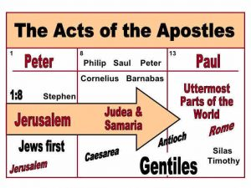
The Book of ACTS

Slide 14
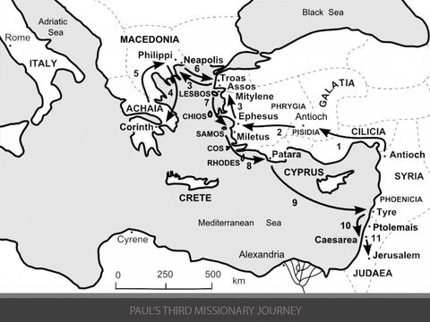

Slide 15
Acts 18:23-28
²³ After spending some time there, he departed and went from one place to the next through the region of Galatia and Phrygia, strengthening all the disciples.
²⁴ Now a Jew named Apollos, a native of Alexandria, came to Ephesus. He was an eloquent man, competent in the Scriptures. ²⁵ He had been instructed in the way of the Lord. And being fervent in spirit, he spoke and taught accurately the things concerning Jesus, though he knew only the baptism of John. ²⁶ He began to speak boldly in the synagogue, but when Priscilla and Aquila heard him, they took him aside and explained to him the way of God more accurately. ²⁷ And when he wished to cross to Achaia, the brothers encouraged him and wrote to the disciples to welcome him. When he arrived, he greatly helped those who through grace had believed, ²⁸ for he powerfully refuted the Jews in public, showing by the Scriptures that the Christ was Jesus.

Slide 16
An Incomplete Gospel
Acts 18:24-28
Apollos has knowledge of Scriptures but no faith in Jesus as Messiah.

Slide 17
An Incomplete Gospel
“He knew the water baptism of repentance, but not the Spirit baptism of regeneration.”
—Lloyd John Ogilvie, The Preacher's Commentary: Acts, 2010

Slide 18

Acts Series
GOOD NE WS
ON THE MO VE
God’s work through the early church in
Acts
Notes:
Our series on Acts has emphasized that the Good News on the Move was God’s work.

Slide 19
Acts 19:1-10
And it happened that while Apollos was at Corinth, Paul passed through the inland country and came to Ephesus. There he found some disciples. ² And he said to them, “Did you receive the Holy Spirit when you believed?” And they said, “No, we have not even heard that there is a Holy Spirit.” ³ And he said, “Into what then were you baptized?” They said, “Into John's baptism.” ⁴ And Paul said, “John baptized with the baptism of repentance, telling the people to believe in the one who was to come after him, that is, Jesus.” ⁵ On hearing this, they were baptized in the name of the Lord Jesus. ⁶ And when Paul had laid his hands on them, the Holy Spirit came on them, and they began speaking in tongues and prophesying. ⁷ There were about twelve men in all.
⁸ And he entered the synagogue and for three months spoke boldly, reasoning and persuading them about the kingdom of God. ⁹ But when some became stubborn and continued in unbelief, speaking evil of the Way before the congregation, he withdrew from them and took the disciples with him, reasoning daily in the hall of Tyrannus. ¹⁰ This continued for two years, so that all the residents of Asia heard the word of the Lord, both Jews and Greeks.

Slide 20
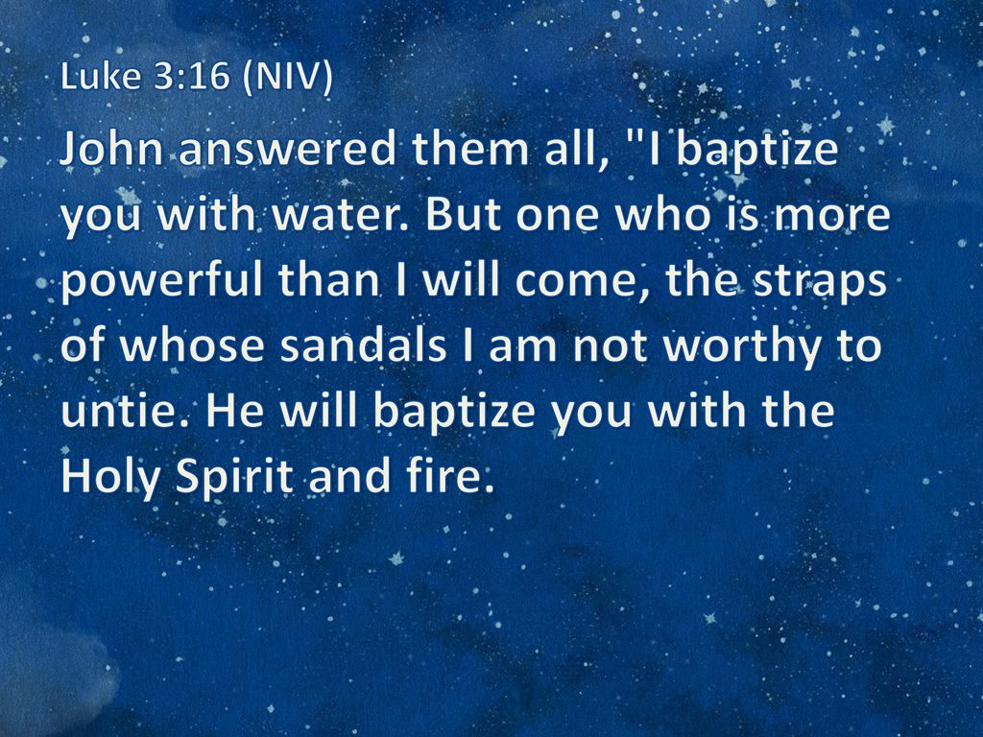

Slide 21
An Incomplete Gospel
1) Acts 18:24-28
Apollos has knowledge of Scriptures but no faith in Jesus as Messiah.
2) Acts 19:1-10
Disciples of John did not know Jesus as Saviour and Giver of the Holy Spirit.

Slide 22


Slide 23
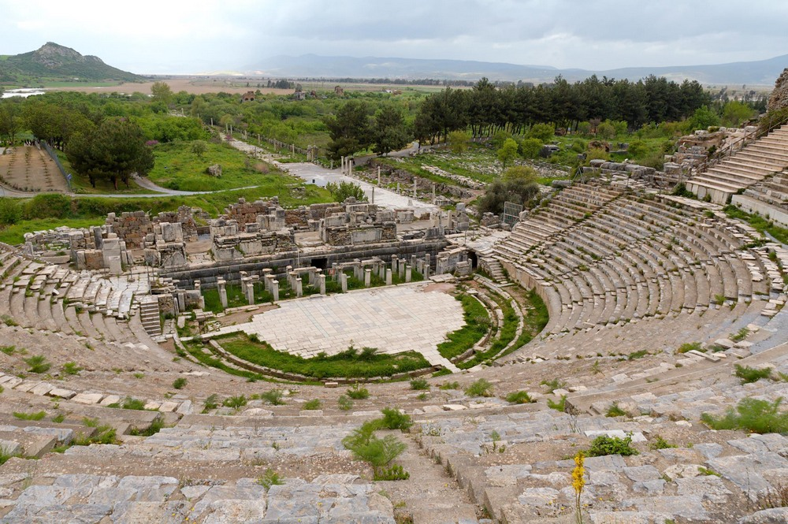
Great Theater of Ephesus, with a view to the sea and the ancient harbor
19:1
Notes:
During the period of the Roman Empire, Ephesus vied for political, economic, and religious supremacy among all the cities of Asia Minor. It was the capital of the Roman province of Asia and an important seaport for travel and trade through Asia Minor along the Cayster (Kaystros) River Valley. Ephesus moved around as the Cayster River silted the harbor. As the city decayed, the harbor was neglected, and today Ephesus sits 7 miles (11.2 km) from the coast. However, when Paul came to Ephesus, he would have landed at what is now a field in the distance and walked up Harbor Street toward the theater.
tb041405354

Slide 24
Acts 19:11-20
¹¹ And God was doing extraordinary miracles by the hands of Paul, ¹² so that even handkerchiefs or aprons that had touched his skin were carried away to the sick, and their diseases left them and the evil spirits came out of them. ¹³ Then some of the itinerant Jewish exorcists undertook to invoke the name of the Lord Jesus over those who had evil spirits, saying, “I adjure you by the Jesus whom Paul proclaims.” ¹⁴ Seven sons of a Jewish high priest named Sceva were doing this. ¹⁵ But the evil spirit answered them, “Jesus I know, and Paul I recognize, but who are you?” ¹⁶ And the man in whom was the evil spirit leaped on them, mastered all^{[a]} of them and overpowered them, so that they fled out of that house naked and wounded. ¹⁷ And this became known to all the residents of Ephesus, both Jews and Greeks. And fear fell upon them all, and the name of the Lord Jesus was extolled. ¹⁸ Also many of those who were now believers came, confessing and divulging their practices. ¹⁹ And a number of those who had practiced magic arts brought their books together and burned them in the sight of all. And they counted the value of them and found it came to fifty thousand pieces of silver. ²⁰ So the word of the Lord continued to increase and prevail mightily.

Slide 25
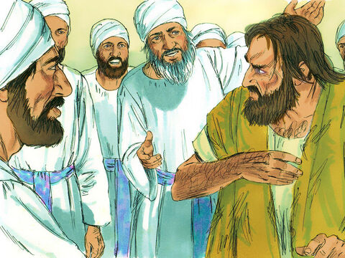

Slide 26
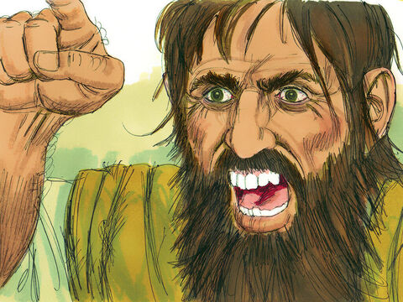

Slide 27
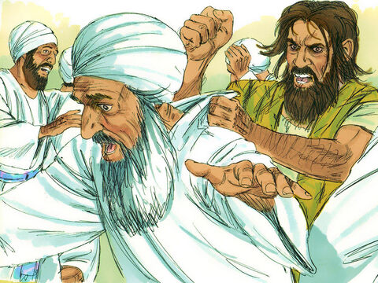

Slide 28
An Incomplete Gospel
1) Acts 18:24-28
Apollos has knowledge of Scriptures but no faith in Jesus as Messiah.
2) Acts 19:1-10
Disciples of John did not know Jesus as Saviour and Giver of the Holy Spirit.
3) Acts 19:11-20
The sons of Sceva did not know Jesus as Lord of their lives.

Slide 29
A Complete Gospel
Will reveal, proclaim, and result in people knowing Jesus as:
1) God’s messiah – the fulfilment of Scripture
2) Saviour and Baptiser with the Holy Spirit
3) Lord of heaven and earth, and our Lord.
It proclaims our incomparable God –
His love, grace, mercy, power & truth!

Slide 30
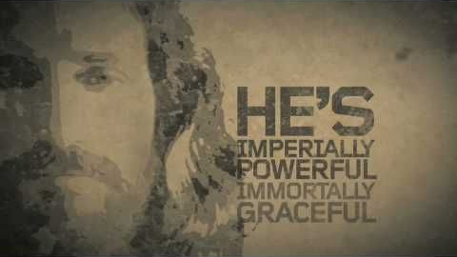

Slide 31
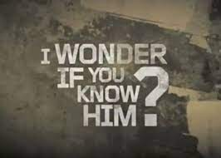

Slide 32
Black

Slide 33


NT Preaching link at BibleStudyDownloads.org
Get this presentation for free!
Notes:
The Bible…Basically (bb)

